Slide 1
Just Ask
Mollie Hand’s Lesson adapted from FYE 2021 Conference session by Kyle Heys and Jericha Scharphorn, Calvin University, February 2021

Slide 2
Pre-Party Survey (done before class)
As honestly as possible, rate each question based on the following scale: 0-never; 1-rarely; 2-sometimes; 3-often; 4-almost always
How often do you …
Ask questions in class?
Ask questions of a professor outside of class?
Ask questions with a peer?
Write questions to engage a reading?
Write questions to engage notes?
Use questions to quiz myself?

Slide 3
Road Map
You can tell whether a [person] is clever by [their] answers. You can tell whether a [person] is wise by [their] questions. - Naguib Mahfouz
Value of Asking Questions
Question Formulation Technique: Produce; Question Focus; Categorize; Prioritize; Next Step; Reflect
Ways to Use Questions
Assessment of Questions

Slide 4
2 Minute Quick Write
Write as many questions as you can about today’s topic: asking questions (FOCUS). You have two minutes to write your questions (PRODUCE).
Rules:
Write as many questions as you can possibly think of.
Don’t stop to discuss, ponder, or judge your questions – just keep writing.
Write down exactly how you came up with it in first formulation. No need to rewrite or worry about spelling, etc.
If a statement comes to mind, turn it into a question.

Slide 5
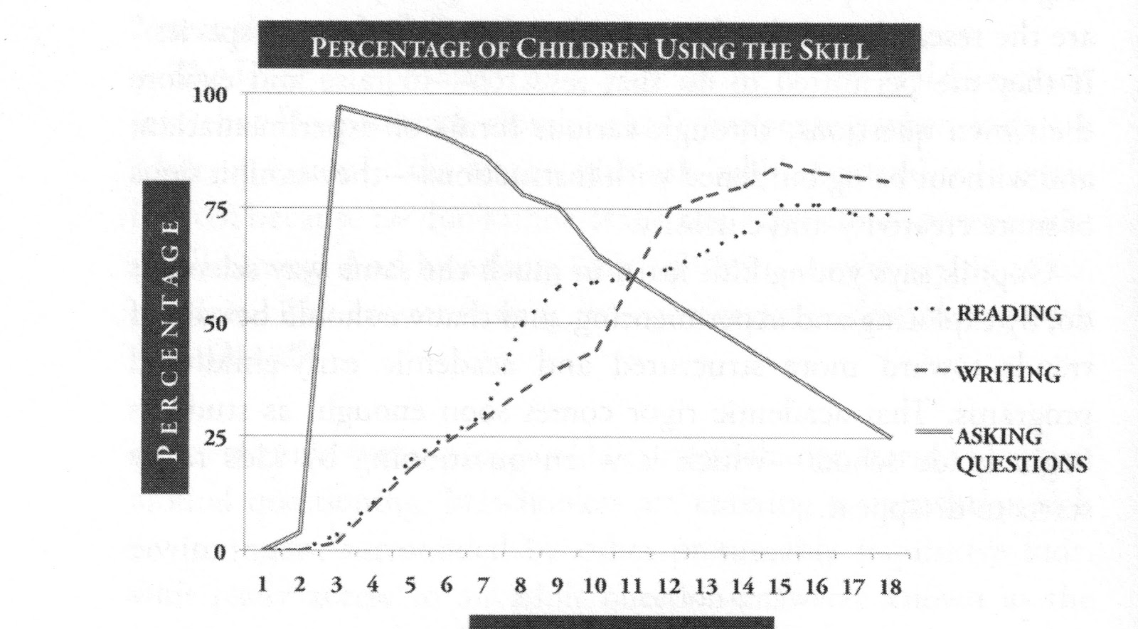

Slide 6
Why don’t we ask questions?
This Photo by Unknown Author is licensed under CC BY-SA

Slide 7
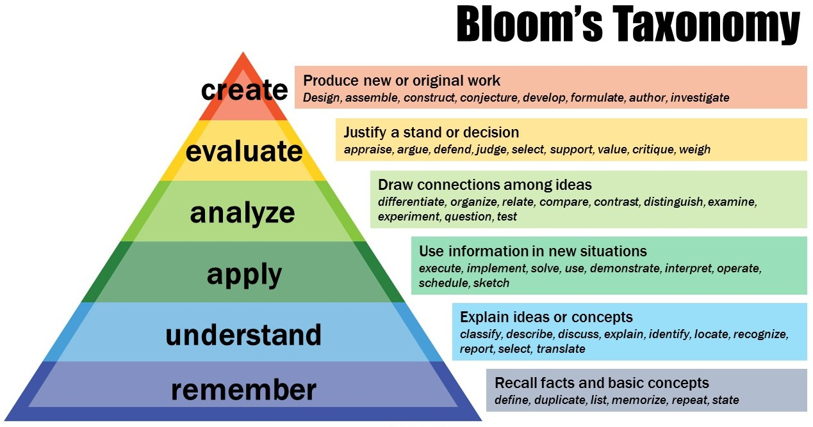
Categorize and Analyze your Questions
Open questions
(many words, divergent answers)
vs.
Closed questions
(one word, convergent answers)
This Photo by Unknown Author is licensed under CC BY-NC

Slide 8
Prioritize
What are the three questions you want to ask to better understand the FOCUS (asking questions)?

Slide 9
Ways to Use Questions
Clarify ideas
Build connections
Seek resources
Understand assignments or readings (transparent assignments)
Strengthen notetaking
Retrieval practice
Discuss concepts
Research Further

Slide 10
Reflect
What did you learn?
How did it feel to ask questions?
Why is asking questions important?
How can you use this skill in other classes?

