Slide 1
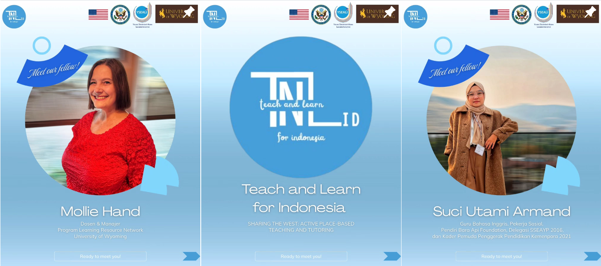
YSEALI Reciprocal Project

Slide 2
Slide Contents
Kedai Dupa Youth | Islamic State University of Jambi Administrators
Information about the University of Wyoming: Slides 3-21
SNP N21 Public Jr. High | Guang Ming Private School Kingergym | Education Quality Assurance Center
Focus Group & Workshop on Active Writing Activities: Slides 22- 45
Islamic State University of Jambi Students and Faculty
Writing Center Approaches in and out of the Classroom: 46-66
Language Institution of Jambi Province Ambassador Students
Writing the West: Active Writing Through Culture & Place: 67-82

Slide 3
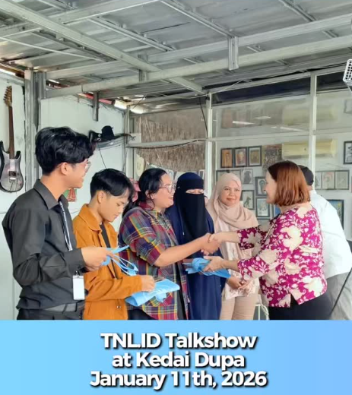
Location:
Kedai Dupa
Audience:
social education volunteers, youth activists in Jambi (20)
Goals:
Understand YSEALI Opportunities
Share experiences and ask questions about academic, social, and cultural aspects of university life in Wyoming (& U.S)

Slide 4
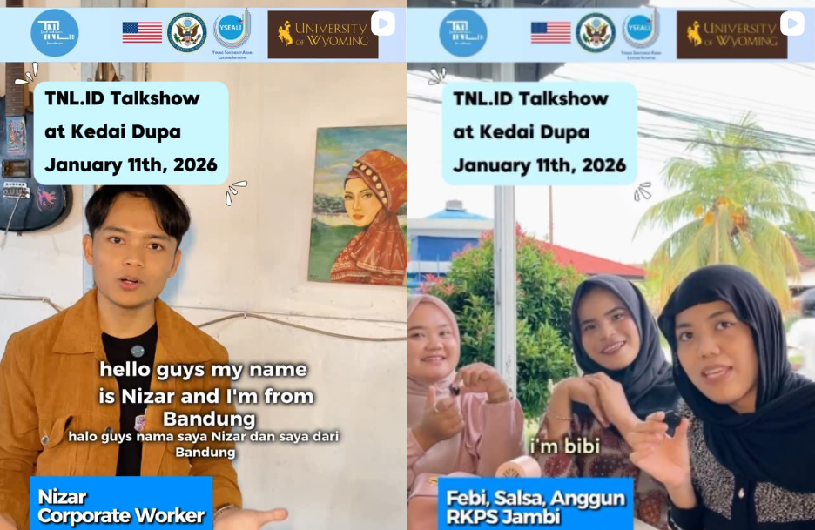

Slide 5

Resources to understand the University of Wyoming
Making College Count booklet: First Year Student Guidebook
Stories from the classroom: Karma's Kitchen

Slide 6
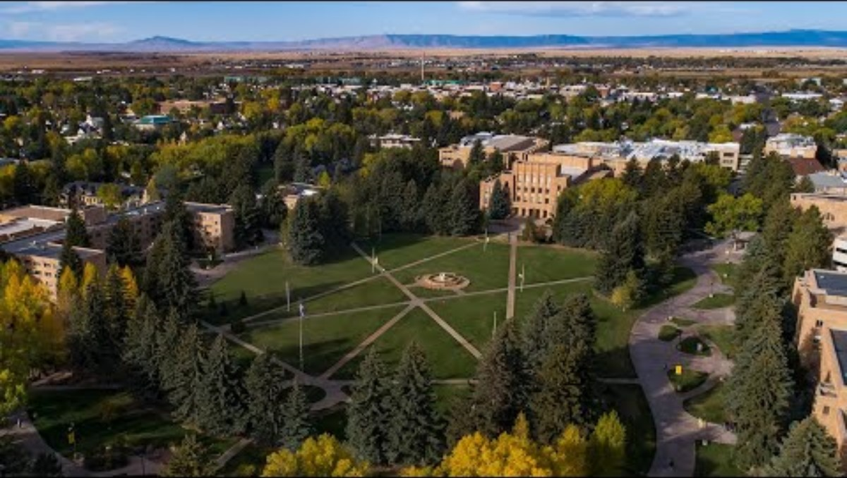

Slide 7
Students at the University of Wyoming
Approximately 11,000 students attend the University of Wyoming
8,300 undergraduates and 2,700 graduate students
45% male, 55% female
2,081 students enrolled in online programs
Numerous Support Programs to Help Students
Mental Health & Wellness (4 resources)
Physical Health & Safety (4 resources)
Food & Nutrition (2 resources)
Major and Career Services (7 resources)
LeaRN Programs

Slide 8
Indonesian Students at UW
https://www.instagram.com/reel/DRh9F3gEqaj/?utm_source=ig_web_copy_link&igsh=MzRlODBiNWFlZA==

Slide 9

Sports, Clubs, Student Government
University of Wyoming experience extends far beyond the classroom. UW boasts over 250 diverse student organizations, 30 club sports, and opportunities for leadership in Associated Students of the University of Wyoming.
UW Athletics

Slide 10
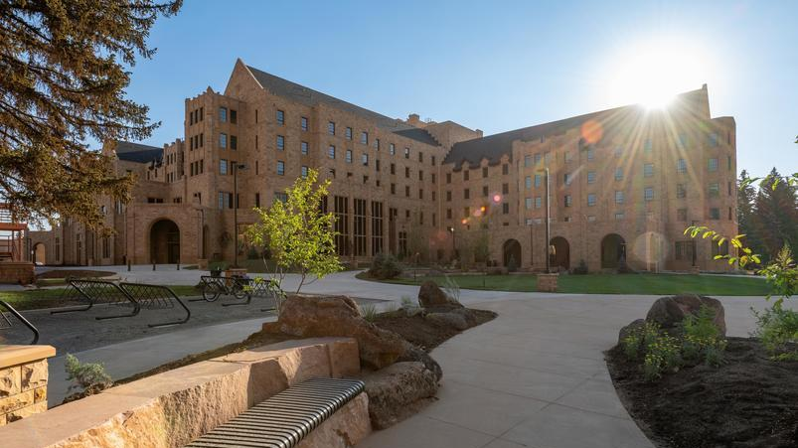
UW Housing
All first-year students are required to live in residence halls.
Floors are not separated by gender, but rooms are gendered.

Slide 11
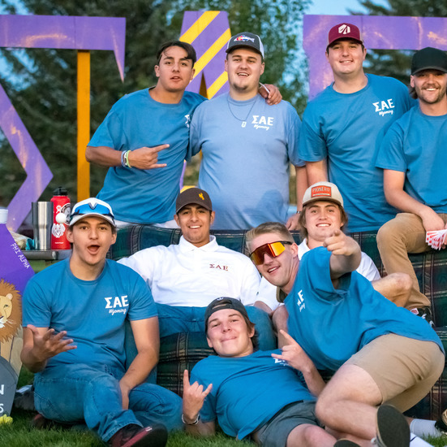
Fraternity and Sorority Life (FSL)
Students might opt to join a fraternity or sorority.
This provides a stronger support network, enhances academic performances, and opens doors to valuable professional and networking opportunities.
About 500 students join FSL and practice service, leadership and involvement.

Slide 12
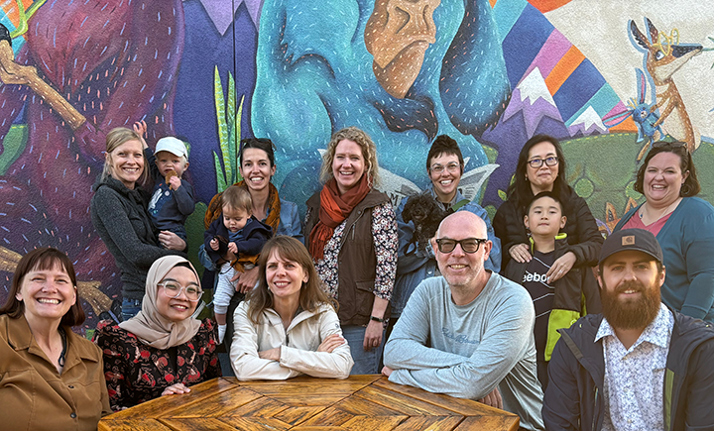
Learning Resource Network (LeaRN)
Living Learning Communities
First Year Experience Course
First Gen Scholars
Alert & Academic Recovery
Tutoring & Supplemental Instruction
Writing & Literacy-Focused

Slide 13
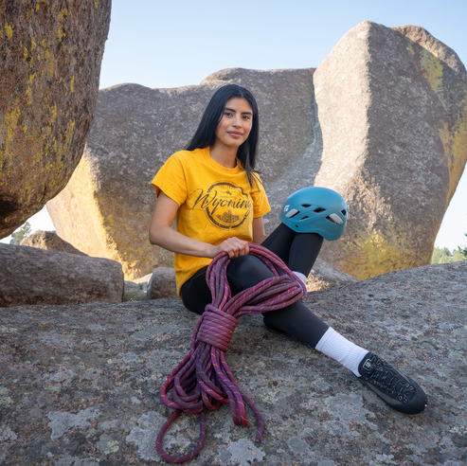
Summer Bridge
Students can improve in math and acclimate to the University of Wyoming and Laramie by participating in a four-week summer program before the fall semester of their first year.
“I found Summer Bridge extremely helpful! I was able to work with great professors and true leaders. I also gained confidence in math and I made great friends. The start of school was awesome because I was much more prepared.”

Slide 14
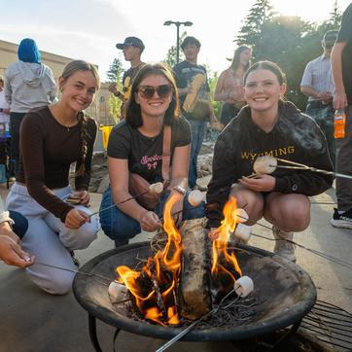
First-Year Interest Groups
FIGs) are designed to help first-year students build community and ease their transition to college life. FIGs connect students through shared interests and group activities, while also promoting academic success. Since many students in a FIG are enrolled in common courses, it’s like having a built-in study group! These living-learning communities provide support, engagement and a strong foundation for students to thrive both academically and socially during their first year at UW.

Slide 15
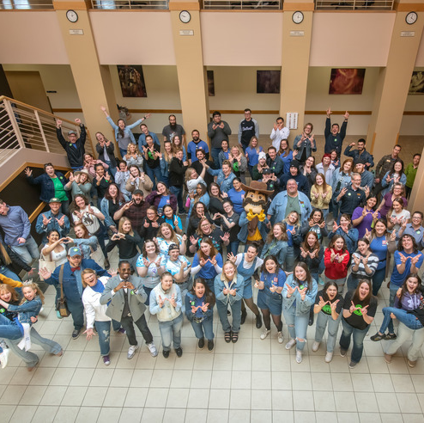
Fall Bridge for Students Admitted with Support
Course-based learning community that helps students in starting their college career
Teach students how to actively engage as a college student.
Students can choose one or two courses as part of the program.

Slide 16
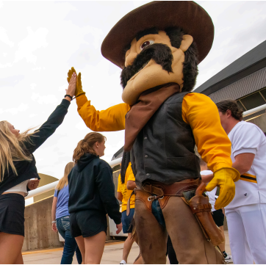
Create Your UW: First Year Experience Class
One credit 12-week biweekly class for self-exploration, campus resources, and tools for academic & wellness support.

Slide 17
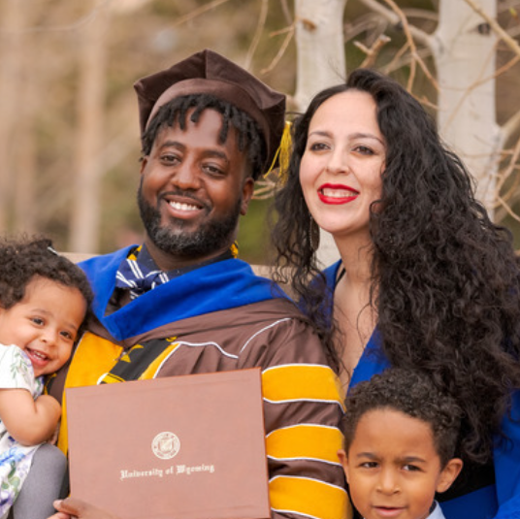
First Gen Scholars
A “first-generation college student” is any student whose parents did not complete a four-year college degree.
Nearly 30-40% of UW students are first-gen. Having this significant portion of our student body falling into this category strengthens our dedication to providing the tools, resources and support to help ALL of our UW students reach their full potential and thrive both academically and personally.

Slide 18

Early Alert & Academic Recovery
In weeks 4-5, if students have a D or F grade, they will receive an alert from their advisors, and Resident Assistants. This provides an opportunity to seek academic/personal help and discuss options with instructors and advisors.
Students who fall under 2.0 GPA are on academic recovery and can opt to take a class or receive an academic coach.

Slide 19
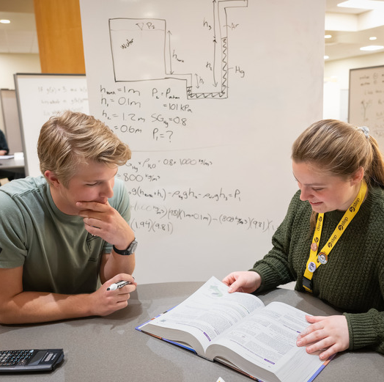
STEP Tutoring & Supplemental Instruction (SI)
Free one-on-one tutoring in 100+ classes
SI is a series of out-of-class study sessions led by a student who has successfully taken the class before.

Slide 20

Writing Center
free resource dedicated to helping students become more effective and confident writers
trained writing consultants are students and professional staff
Help with any stage of the writing process: brainstorming, drafting or revising

Slide 21
Did you know?
Jakarta International College has easy transfer credit to the University of Wyoming
Easy way to save money before transferring to the United States and earn your US Bachelor’s Degree!

Slide 22
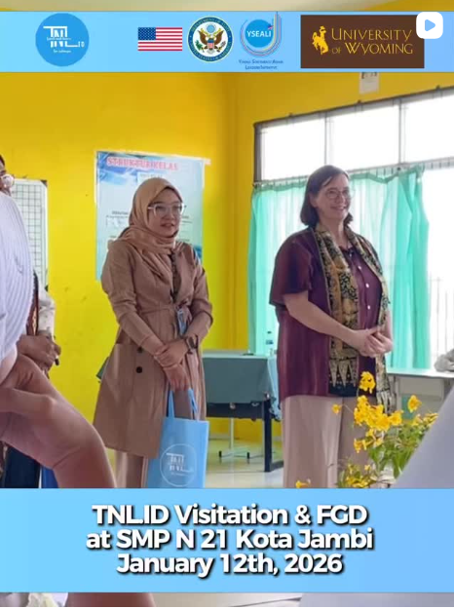
Location:
Public Junior High School
Audience:
US Fellow
English Teachers
Goals:
US Fellow to observe classroom
Teachers to gain understanding of differences in writing and speaking pedagogy between teachers in Jambi and in Wyoming, United States.
Slides 25-44

Slide 23

Location:
Private K-12 School, Guang Ming School
Audience:
Teachers
Goals:
Gain understanding of differences in writing and speaking pedagogy between English teachers in Jambi and English teachers in Wyoming, United States.

Slide 24
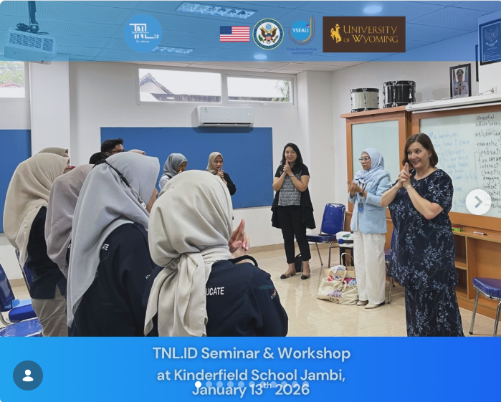
Location:
Jambi Kindergym
Audience:
Teachers of PreK to Grade 3
Goals:
Gain understanding of differences in pedagogy between teachers in Jambi and teachers in Wyoming, United States.

Slide 25

Teaching Writing and Speaking: Approaches, Practices, & Cultural Contexts
Location: Education Quality Assurance Center
Audience:
English language teachers (junior/senior/vocational, basic level) (50)
Goals:
Implement core principle of writing pedagogy in the classroom for genre-based approaches, include examples, & role-play approaches
Gain understanding of differences in pedagogy between teachers in Jambi and teachers in Wyoming, United States.

Slide 26
Welcome & Introductions (5 minutes)
Goals
Understand how teachers in Jambi experience teaching English
Explore classroom approaches, daily practices, and cultural contexts
Introductions
Name
Level you teach
One challenge and one joy in teaching
Describe your English classroom in 3 words!
Today is discussion-based, no right/wrong answers!

Slide 27
Jambi Classroom Snapshot (5 minutes)
Draw or write something representing your English class
Ideas:
seating layout
typical activity
student behavior
After 1 minute, share out!

Slide 28
Toolkit of High-Engagement Activities (1 of 6) (10 minutes)
Let’s try it! Find someone who…
has a student who gave them fruit from a family tree.
has taught for more than 10 years.
can make a vocabulary game in under 5 minutes.
can get a noisy classroom to calm down in under 60 seconds.
has taught class during a sudden rainstorm.
has used a K-pop song to teach vocabulary or grammar.
can pronounce “thought,” “though,” and “through” without hesitation.
has created a lesson that connects English to local Jambi culture.
1. Information Gap (“Find Someone Who…”)
Give simple prompts:
can cook fried rice
has a cat
likes durian
can ride a bicycle
Students walk around asking: “Do you…?” or “Can you… ?” Goal: Communicative practice using very simple language.

Slide 29
Poem to Get Young Children’s Attention
My hands upon my head, I place.
On my shoulders, and on my face.
And then I raise them way up high.
And I let my fingers fly, fly, fly.
And then I clap them, one, two, three.
And I fold them, SHHHH … silently.

Slide 30
Teaching Approaches Find Your Corner Activity (20 minutes)
Move to the corner with teaching methods you rely on most:
Grammar instruction
Communicative activities
Drills & Textbook
Project or task-based learning
Discuss in your group: What are benefits and drawbacks of your approach? Where did you learn to use it?
University?
Mentors?
Observing others?
Other?

Slide 31
Group Discussion Questions (10 minutes)
How do you help students practice speaking?
What is your balance between English and Bahasa Indonesia/Malay in class?
How does the Kurikulum Merdeka guide your approach?

Slide 32

Break Time (10 minutes) Think about a specific lesson for our next activity.

Slide 33
Classroom Practices & Routines (10 minutes)
Walk us through a typical lesson you teach. What happens first? Next?
What routines help students stay engaged?
How do you handle large classes?
How do you handle differing language levels?
How do you handle behavior or discipline issues?
What technology (if any) do you use?

Slide 34
Toolkit of High-Engagement Activities (2 of 6)
2. Mini Whiteboards (Paper Version)
Give each student a reusable “whiteboard” (laminated paper) and dry erase markers. Use for:
Quick checks
Spelling practice
Sentence writing races (see next slide)
Why: Saves paper; improves participation.
Let’s practice using them with the activity that comes next!

Slide 35
Toolkit of High-Engagement Activities (3 of 6) (5 minutes)
3. Running Dictation
Post 3–4 short sentences on the wall. One student runs to read, returns to partner, says the sentence, partner writes. Switch roles. Good for: Energy, teamwork, listening, pronunciation.

Slide 36
Sentences Used
Sentences for Running Dictation:
Wyoming is the least populated state in the United States.
Yellowstone National Park is partly located in Wyoming.
Cowboys and rodeos are important parts of Wyoming’s culture.
Wyoming is the Equality State because it is where the first U.S. woman voted.
What teaching practices are you proud of?
What challenges do you face as a teacher?

Slide 37
Discussion (5 minutes)
The final two sentences were discussion questions.
What teaching practices are you proud of?
What challenges do you face as a teacher?

Slide 38

Solving Common Teaching Challenges (10 minutes)
In pairs or groups of 3, select one real teaching problem (examples: lack of confidence, limited materials, mixed abilities, etc.).
Brainstorm 2-3 possible solutions based on experiences.
Share out.

Slide 39
Toolkit of High-Engagement Activities (4 of 6)
Let’s try this example for listening/pronunciation. (5 minutes)
Swat the Word
Two teams form lines. The front person is given a fly swatter. These words are on the wall for both teams. Facilitator says word and first person runs and swats the word then runs to the back. First person to slap correct word earns team one point.
Thought Through Though
Ship Sheep Sip
Bat Bad Bet
Pull Pool Pill
Bag Back Bad
Cap Cop Cup
Then Den Thin
4. Flashcard Games
Use hand-made cards (no printer needed).
Memory Matching (vocab)
Guess the Word (student holds card on forehead)
Slap or Swat the Word (teams compete in relay race to tap the correct card taped to wall after hearing prompts)

Slide 40
Cultural & Community Contexts: Write about any of these prompts (5 minutes).
How does Jambi’s local culture influence the way students learn English?
What cultural norms affect student participation (examples: speaking out loud, group work, confidence)?
How do parents view English learning?
Are there community expectations that help or hinder student engagement?
How do local languages interact with English learning in class?

Slide 41
Toolkit of High-Engagement Activities (5 of 6)
5. “Three Stars and a Wish” Peer Feedback
After any short writing task, a partner provides:
3 positive things
1 suggestion
Helps build supportive classroom culture.
Now let’s try it with the writing you just completed! (10 minutes)

Slide 42
Toolkit of High-Engagement Activities (6 of 6)
5. Whisper Lines (10 minutes)
Form two lines facing each other to make pairs.
The teacher gives a prompt. Line A speaks, quietly, as Line B listens.
The teacher calls a few students from Line B to summarize their partner’s answer.
Now Line B rotates one step to the right to form new pairs, last person on right goes to the other side (Line A stays still).
New prompt: Line B speaks, Line A listens.
A few students from Line A summarize their partner’s answer.
Then repeat for several rounds with new prompts.

Slide 43
Questions for Line Up Speaking Exchange
Do you use local stories, traditions, or examples in your lessons? If so, give examples. If not, why?
Are there topics you avoid because they might conflict with cultural or religious expectations? Examples?
What unique strengths do Jambi students bring to English learning?

Slide 44

Reflection: Group Brainstorm (5 minutes)
What materials or professional development do you wish you had?
What are your hopes for your future as English teachers in Jambi?
What recommendations do you have for improving English teaching in the region?

Slide 45
Closing and Summary
Summary of discussion
Thank you!

Slide 46
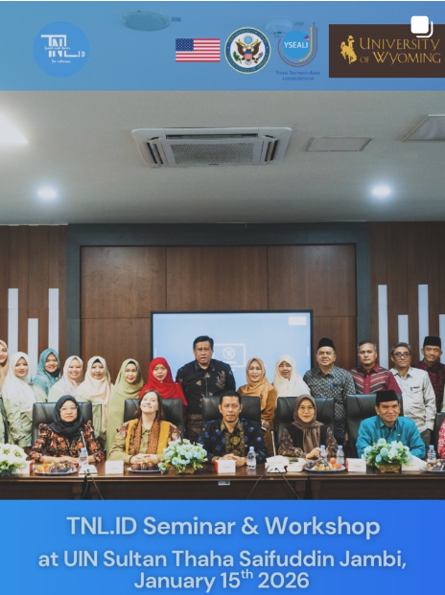
Ways to Incorporate Writing Center Approaches in and out of the Classroom
Location: Islamic State University
Audience: 50 English ed. students and 10 English ed. faculty
Goals:
Incorporate active lessons using collaborative and reflective processes to improve writing and speaking skills in English language learners.
Share what the UW Writing Center is and tools to replicate it

Slide 47
Ways to Incorporate Writing Center Approaches in and out of the Classroom
Brief introductions
What do students/you struggle with most when writing (think, pair, share)? (5 minutes)

Slide 48
5-Minute Reflective Writing
What are a few of your personal values for teaching writing?
Write a brief paragraph giving advice to a new teacher of writing. Include specific steps for working with a writer one-on-one.

Slide 49
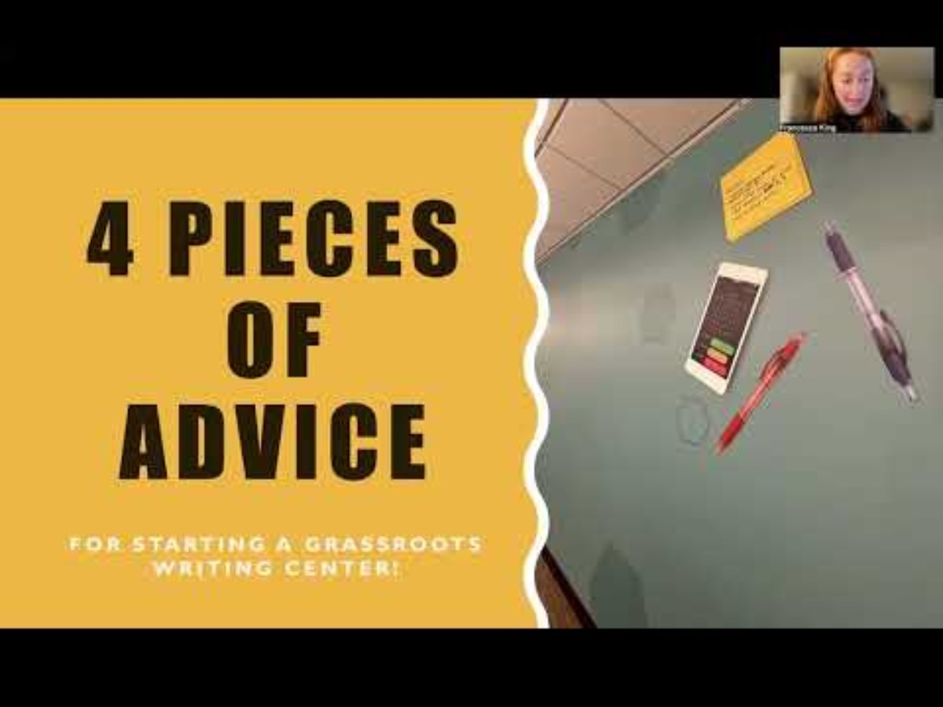
Lessons from a Writing Center Director (5 minutes)

Slide 50
What is a Writing Center (40 minutes)
Mission Statement from University of Wyoming
The UW Writing Center believes that effectively communicating ideas through writing provides opportunity for self-advocacy, efficacy, and community. We support writers at every level throughout the many stages of the writing process. We seek to provide writers with the tools they need to accomplish their goals, with the ultimate aim of making better writers and not just better writing.
Note: Each institution’s mission statement will differ.

Slide 51
Values and Alignment to PM
Writing Centers are student-centered, emphasizing process over product, collaboration and dialogue, equity and inclusivity, and writer agency & confidence building.
Small group discussion:
How does Writing Center practice align with Indonesian/Jambi teaching philosophies?

Slide 52
Pembelajaran Mendalam Alignment
Active learning → consultations prioritize discussion, not lecturing
Reflective learning → writers articulate choices and reasoning
Learning as meaning-making → WC methods help students connect ideas to lived experience
Collaborative learning → student–consultant dialogue mirrors peer-to-peer learning in classrooms
Character education (Profil Pelajar Pancasila) → empathy, independence, critical thinking

Slide 53
Writing Center Consultation Stages (1 of 3)
1. Beginning (Building Rapport & Agenda-Setting)
What consultants do:
Greet the writer warmly
Ask what they want to work on
Explain what the Writing Center is and what to expect.
Set 1–2 priorities (vocabulary, grammar, ideas, etc.)
Activity (5 min): Pairs practice a 1-minute “warm open.” Switch roles.

Slide 54
Writing Center Consultation Stages (2 of 3)
2. Middle (Setting agendas)
This is where the most happens in a consultation (35-40 minutes of a 50-minute session)
Explore Ideas. Ask open-ended questions. Help writer explain purpose, audience, ideas. Talk about writing before writing. | Read Together Writer reads their draft aloud. Listen for patterns, clarity, organization. Focus feedback on ideas/structure first Writer chooses what they want to change. | Prioritize Offer examples. Use guiding questions. Explain grammar patterns only after higher-order issues.

Slide 55
Writing Center Consultation Stages (1 of 3)
3. End (Setting Next Steps)
What consultants do:
Summarize what the writer accomplished
Encourage independence: “What will your next step be?”
Write a next steps plan

Slide 56
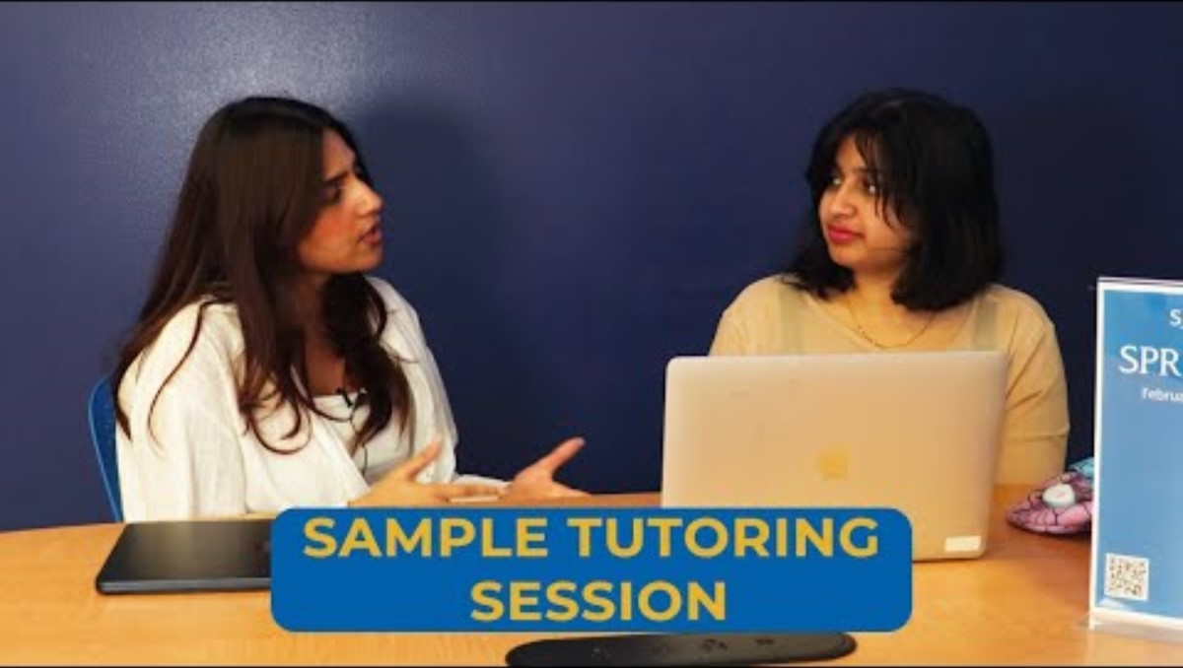
Look for the three stages in this Writing Center Consultation (SJSU)

Slide 57
Strategies in Example
Which strategies did the consultant use in the video?

Slide 58
Break Time (10 minutes)

Slide 59
Activity: Say It, Don’t Write It
Purpose
Reduces anxiety about grammar and spelling
Promotes speaking-to-writing transfer
Emphasizes that talk is a powerful drafting tool
Builds confidence and fluency
Helps writers hear the shape and logic of their ideas

Slide 60
Steps for Role Play (5 minutes per person)
Students pair up (new partner) – one is writer, other is consultant
Consultant: Build Rapport
Writer and Consultant: Set 1-2 goals for the session
Writer: Read out loud your paragraph on advice for writing teachers.
Consultant summarizes back what they heard.
Writer clarifies, adds, or changes ideas
Writer with consultant determine next steps plan (1-2 things to revise) and wrap up consultation.
Switch roles. (10 minutes total)

Slide 61
Debrief Questions (5 minutes)
What surprised you about the session?
What were your key takeaways?
How could this work in your own teaching practice?

Slide 62
Problem-Based Pedagogy
Researched Argument (RI) & Call to Action
Learning objectives:
The ability to find an original perspective on a current and significant issue
The ability to research broadly and specify a thesis after considering multiple perspectives
The ability to evaluate sources based on criteria and your own judgement
Stronger organizational and persuasive skills in your writing
The ability to fold the opposition into your arguments to improve your own stand
The ability to use many sources with precision and ethical judgement
Improved research skills using university databases and scholarly articles

Slide 63
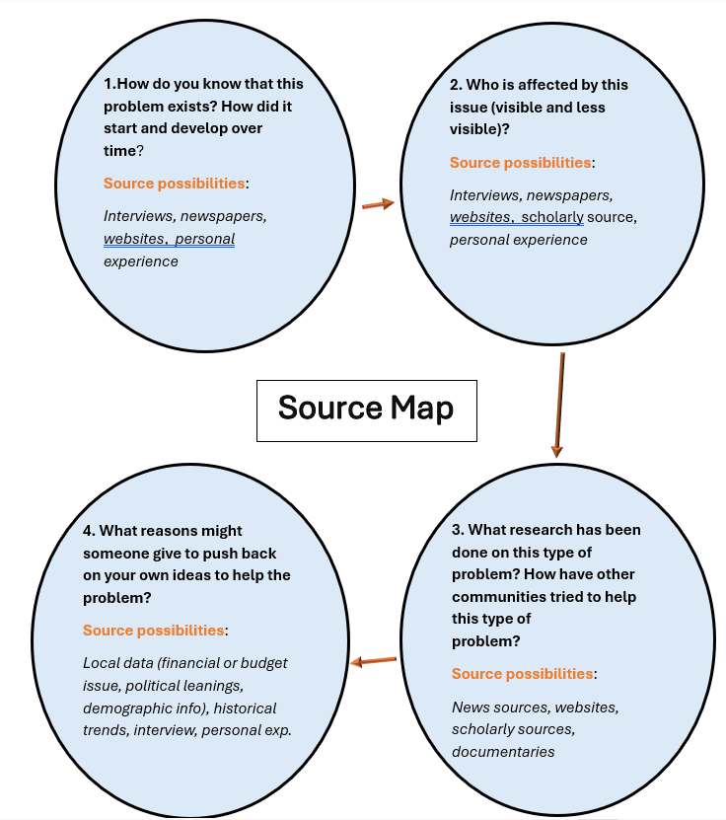
Source Map & Source Evaluation

Slide 64
Oral Presentation of RA & Call to Action
Introduce yourself. Tell us a bit about your background and the community you will focus on in the presentation. Describe why you chose your place and community.
Introduce the problem you researched in your essay. Describe background, ongoing issues, and who is affected by the problem. Offer evidence that the problem exists and needs addressing.
Give any key evidence that will connect with your audience and help them understand and care about the problem. Feel free to include personal examples.
Overview your recommended “Call to Action” steps. Provide enough detail for each step that your classmates understand who, what, how, and when the actions could occur.
Briefly introduce the obstacles/challenges you believe might interfere with your plan to help the issue. Explain your response to the obstacle(s), including which objections you understand or can agree with.

Slide 65
Time to Explore Resources
Writing Center Training
Writing Center Policies
Available after workshop on www.uwyo.edu/fye/karma-kitchen.html

Slide 66
Closing Reflection
One Writing Center principle I will use is …
One idea I want to explore further is …

Slide 67
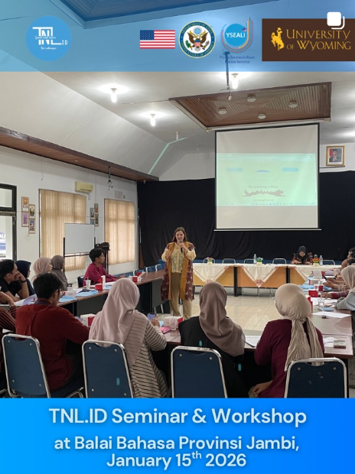
Writing the West: Active Writing Incorporating Culture & Place
Location: Language Institution of Jambi Province
Audience:
Language Ambassadors of Jambi Province (junior/senior/vocational) (30)
Goals:
Understand writing culture and academic life at the University of Wyoming
Introduce creative writing in culture context to the language ambassadors

Slide 68
Writing the West: Active Writing Incorporating Culture & Place
By the end of the session, participants will be able to:
Connect writing to place and culture
Identify ways landscapes, history, and communities can inspire meaningful writing topics.
Explore how place-based education strengthens student voice and engagement in writing.
Incorporate hands-on, participatory learning
Learn using a hands-on, participatory activities that move beyond lecture
Integrate movement, discussion, and collaboration into writing lessons to promote deeper learning.
Incorporate cultural themes into writing
Create writing that reflect an area’s values and experiences—such as (for Wyoming) resilience, wide-open spaces, community, and connection to nature.
Adapt writing to diverse student levels and subjects using regional context.

Slide 69
Kamu ada di mana? Where are you from? (15 minutes)
Pair up and describe a place that is meaningful to them using three sensory details (e.g. “wind blowing my hair in my eyes,” “endless golden prairies). (See sensory word list on next slide.)
Full group introductions with one detail from that place and names.

Slide 70
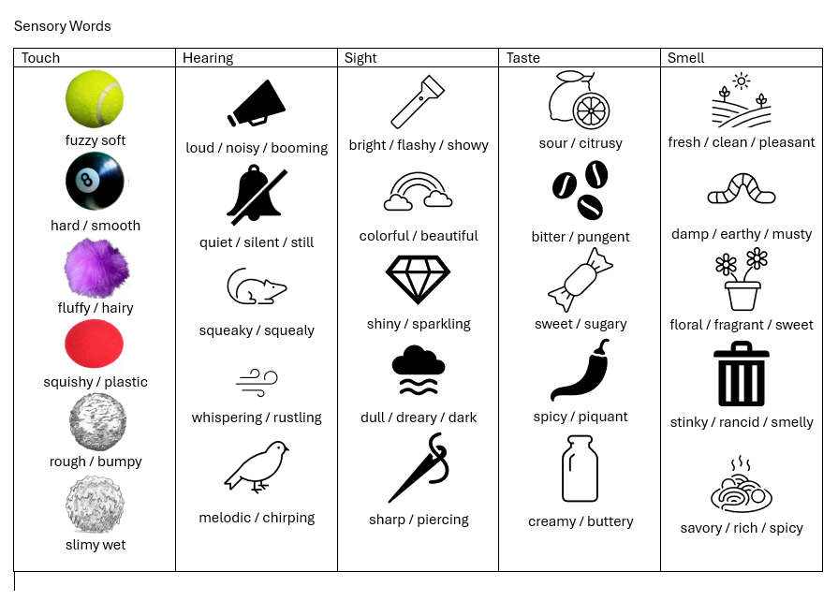

Slide 71


Slide 72
Finding sensory words in pairs (5 minutes)
Wyoming seems empty but it’s full of wonder. People in Wyoming don't get talked about at all. When you see the national weather map on TV, the word Wyoming isn't even on the state. It's like it gets erased. What I saw was something very different in terms of the beauty, not just of the landscape, but of the people. When I first moved here, one of the things I noticed is that people in Wyoming tend to really value the quiet and their personal space. I can see why. There’s so much space here full of beautiful things, but there's so much space that you can relax and kind of have a little space instead of always having to share it with other people. Wyomingites, I noticed, were quiet, soft spoken; they weren't bragging about themselves. Road to New Places — Re-Storying the West

Slide 73
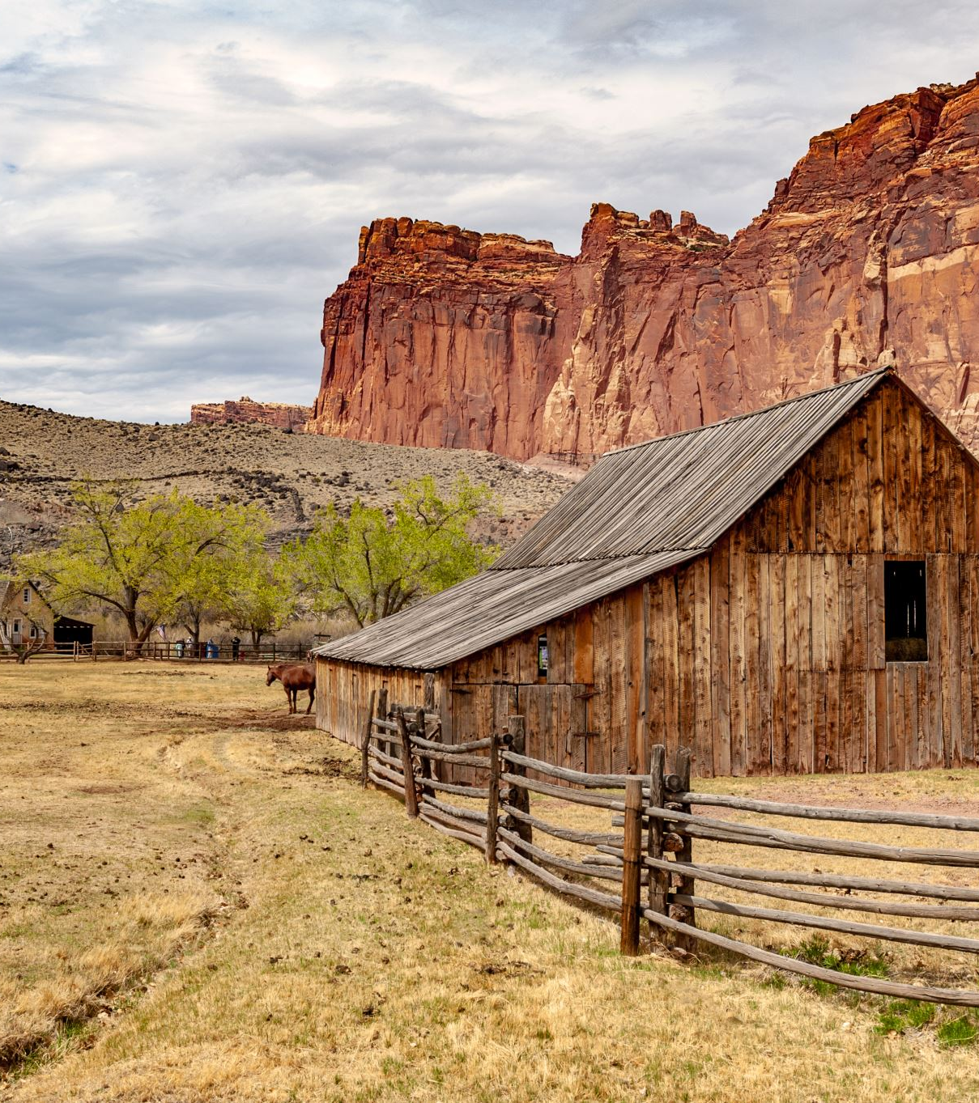
Why Place Matters in Writing (10 min)
How does the environment help us tell a story? What about history? Community values?
Examples from Wyoming: open spaces, ranch work, coal history, Native American homelands
Resources for Teachers:
Richard L. Fricks (January 10, 2025) The Power of Place: Infusing Fiction with a Sense of Home – The Pencil Driven Life
Learning the Language of Home: Using Place-based Writing Practice to Help Rural Students Connect to Their Communities by Erin Donovan, Coastal Carolina University, 2014

Slide 74
Discussion & Activity (35 minutes)
Where is your school?
What are some important stories to the area?
Activity: Writing Walk (30 minutes)
Either walk around outside and notice colors, textures, sounds, weather, human things, non-human things. Take short notes (field notes), not polished writing. Or find images or photographs on your laptop.
Return indoors and free-write for five minutes: What is this place trying to say? Share in pairs, then foursomes.
Debrief: How can a writing walk work indoors, on a field trips, with historical photos?

Slide 75
Break Time (10 minutes)

Slide 76
Culture-Based Writing
5 cultural values of Wyomingites:
Resilience and independence
Wide-open spaces and big blue skies
Weather: windy and snowy
Community interdependence
Connection to land, water, wildlife
Brainstorm (5 minutes): In small groups, list 3-5 cultural values from Jambi (or other home region). Examples on next slide.

Slide 77
Pembelajaran Mendalam – English Vocabulary
Mindfulness (berkesadaran)
Meaningfulness (bermakna)
Joyfulness (menggembirakan)
PM integrates intellectual, emotional, spiritual, and physical development through:
Olah pikir (thinking)
Olah hati (ethics)
Olah rasa (aesthetics)
Olah raga (physical activity)

Slide 78

Say It First Writing Workshop (50 minutes)
From the list of values describing Wyoming, I chose the value “community interdependence” and found a story to share.
Vocabulary:
Six degrees of separation: idea that all people are six or fewer social connections from each other.
Stretch: expansive road or time
Steamboat: name of horse logo for Wyoming →
Listen: One Degree — Re-Storying the West
Listen with reading: One Degree — Re-Storying the West

Slide 79
Discussion Questions
What does Dr. Aldrich mean about one degree of separation for Wyomingites?
What behavior changes are necessary when you live in such a place as Wyoming with so few people?

Slide 80

Your Turn
In pairs, choose one value from the created list.
Talk together about stories that show this value. (10 minutes)
Write your story independently. (5 minutes)

Slide 81
Stations (50 minutes)
Small-Group Stations (choose 2 of 3):
Station A: Map My Community (25 minutes)
Create a map of your community without looking at a real map.
Include places that are important to you and sensory words about those locations
Discuss: Where did you start in creating your map? Why? What do you think you missed? Why?
Station B: Community-Based Interviews (25 minutes)
Choose one type of worker in your community or family, such as farmers, batik crafters, nurses, doctors, teachers, etc.
Write five interview questions you might ask them to get them to share a story with you.
Station C: Re-Storying the West Read and Summarize (25 minutes)
Find another story on the website about Wyoming and listen/read it. Tell a partner what it is about. Then write about it.
Share out

Slide 82
Closing
In a circle, share one thing you learned today.

