Slide 1
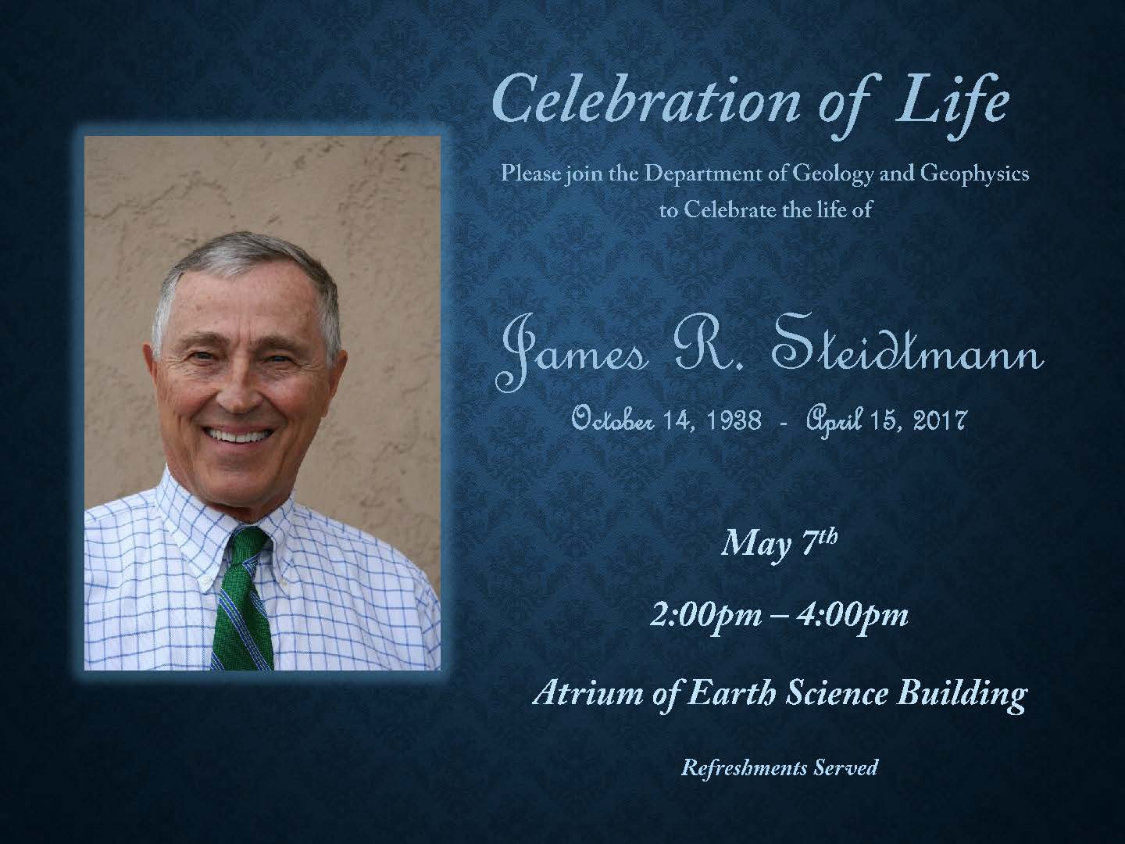

Slide 3
•

Slide 4
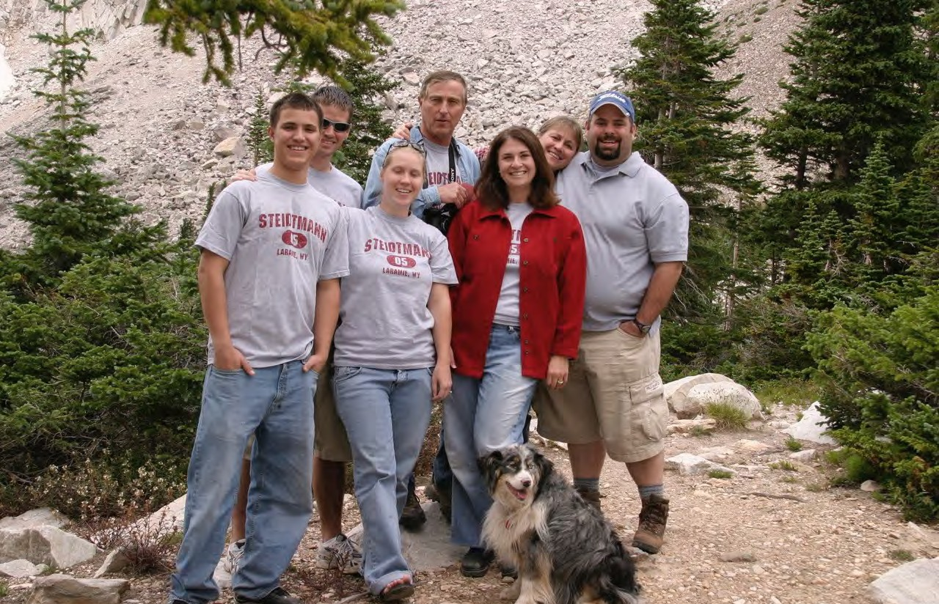

Slide 5
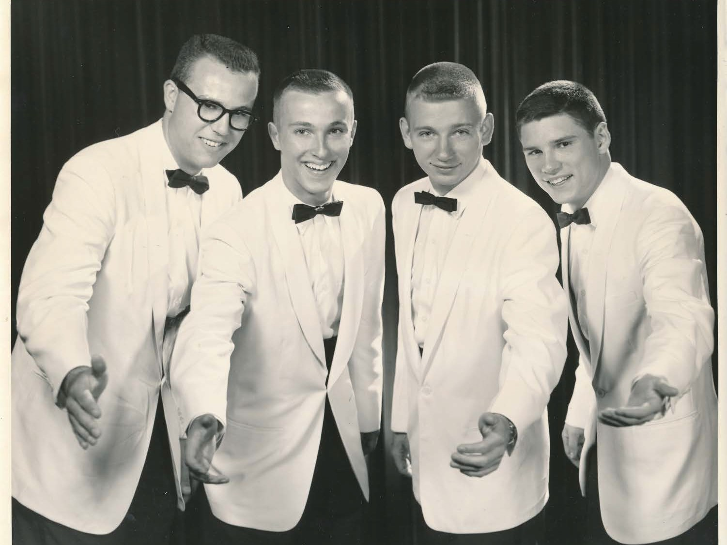
“The Blue Boys”

Slide 6
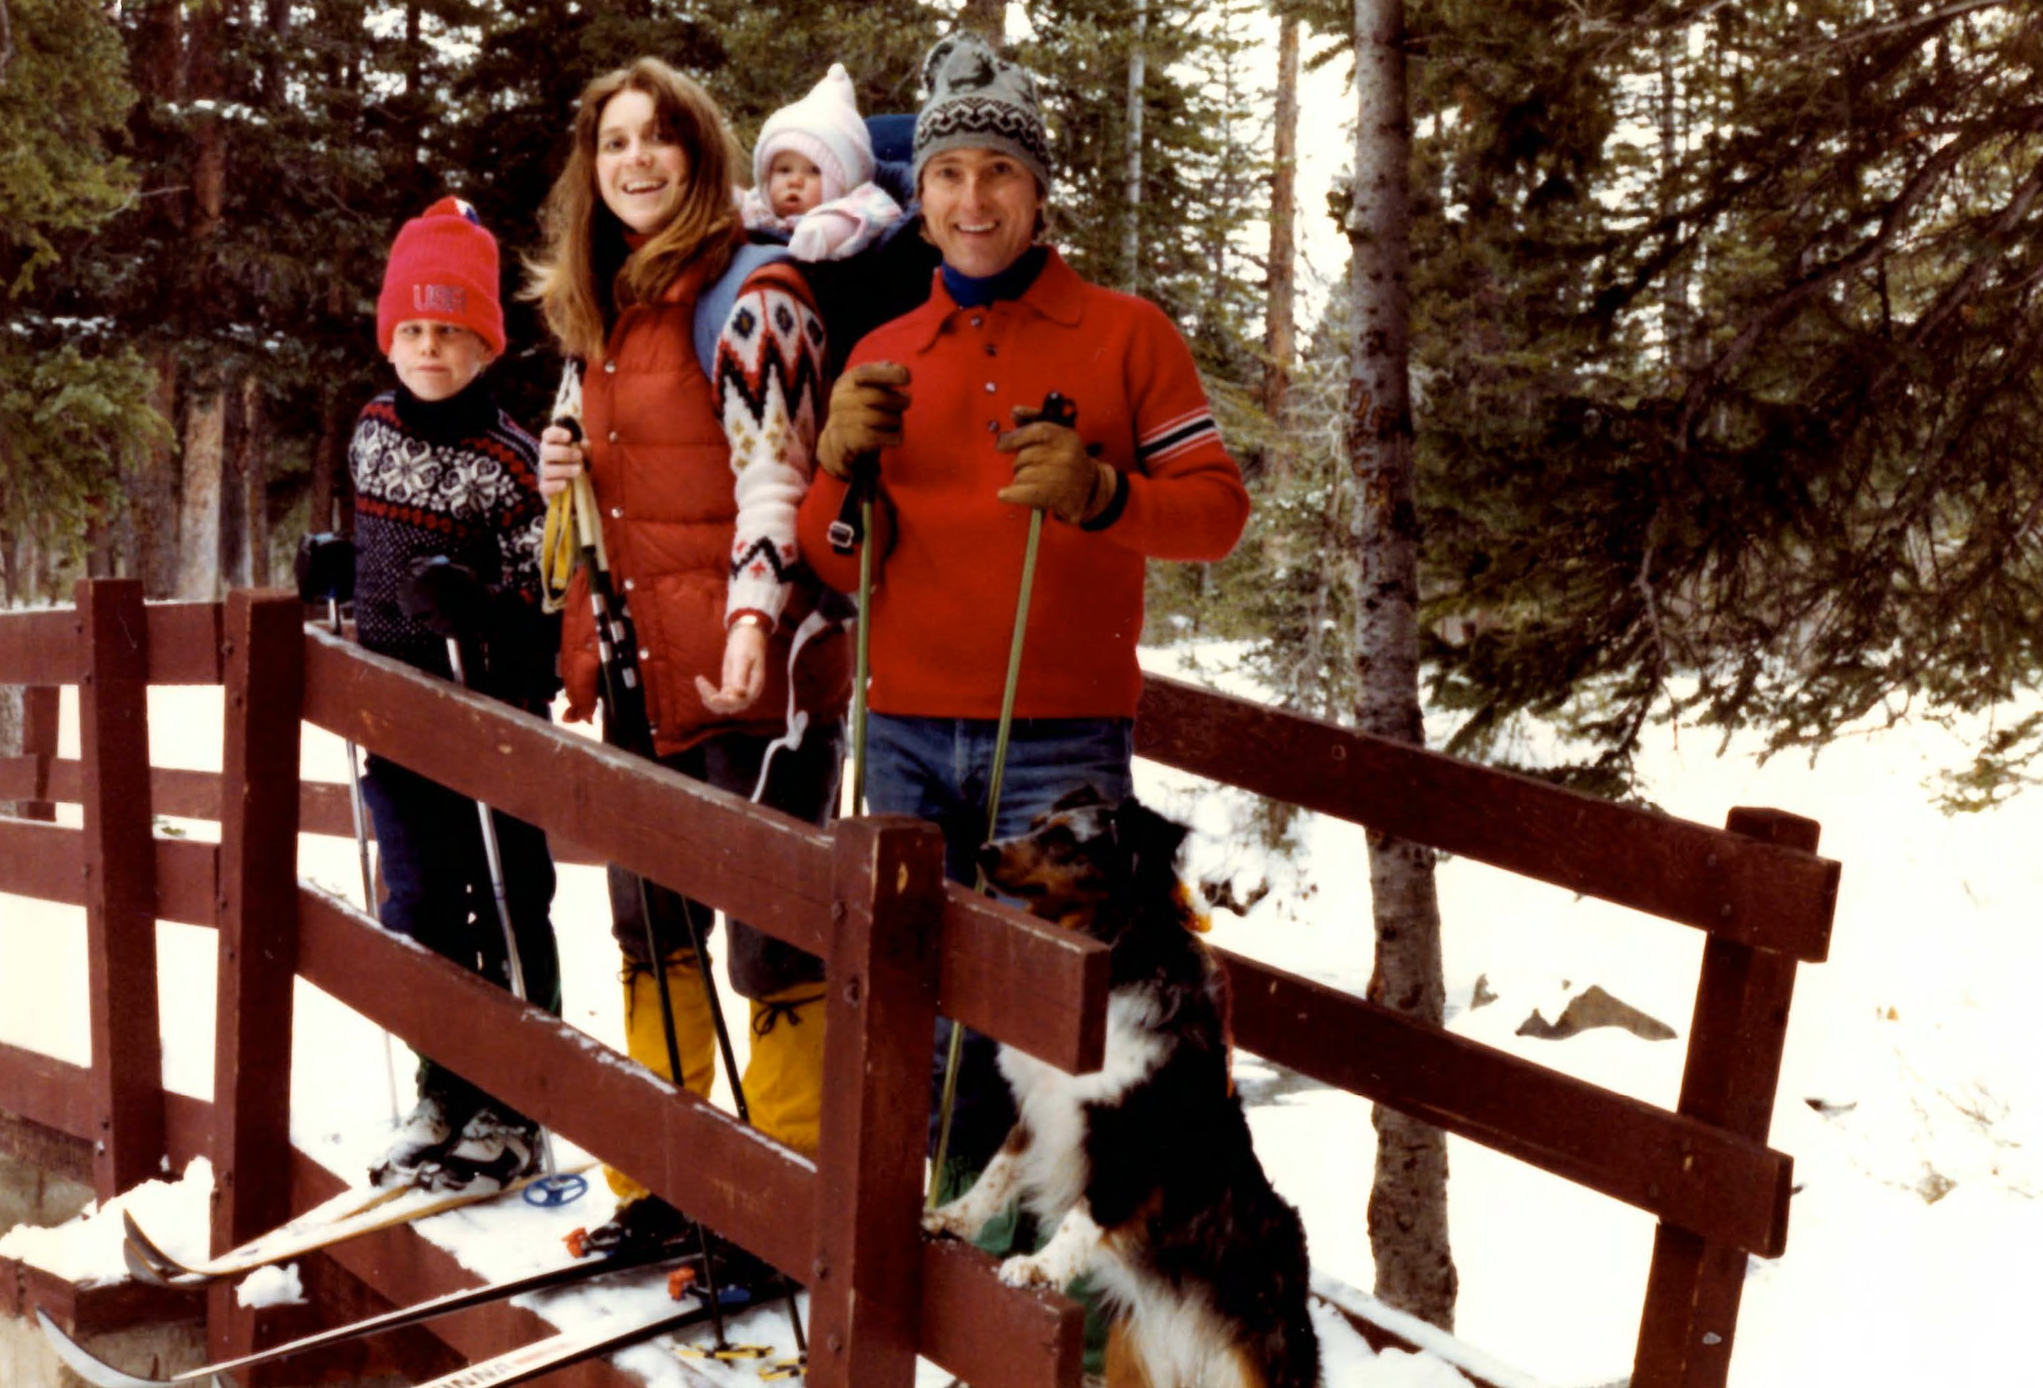

Slide 8
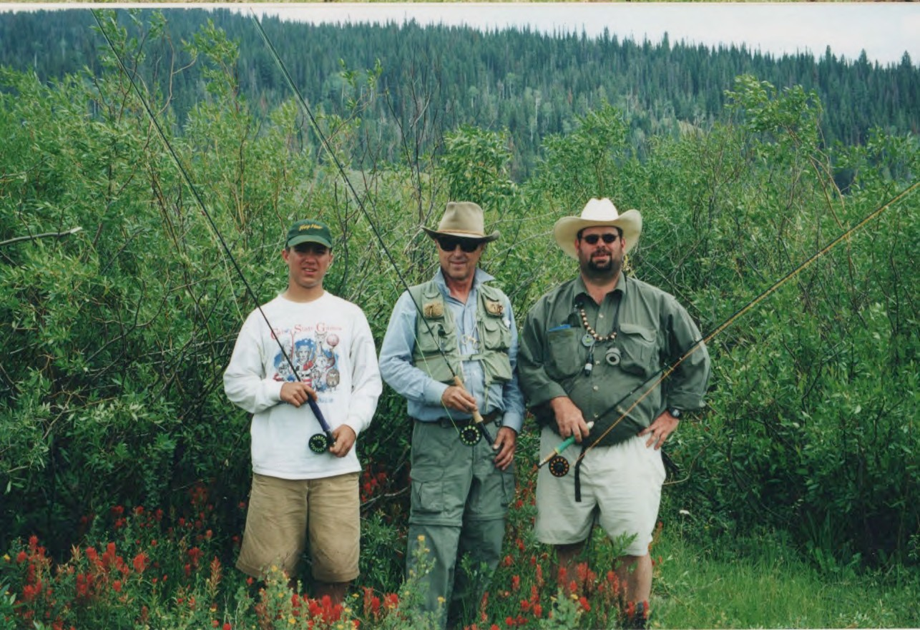

Slide 9
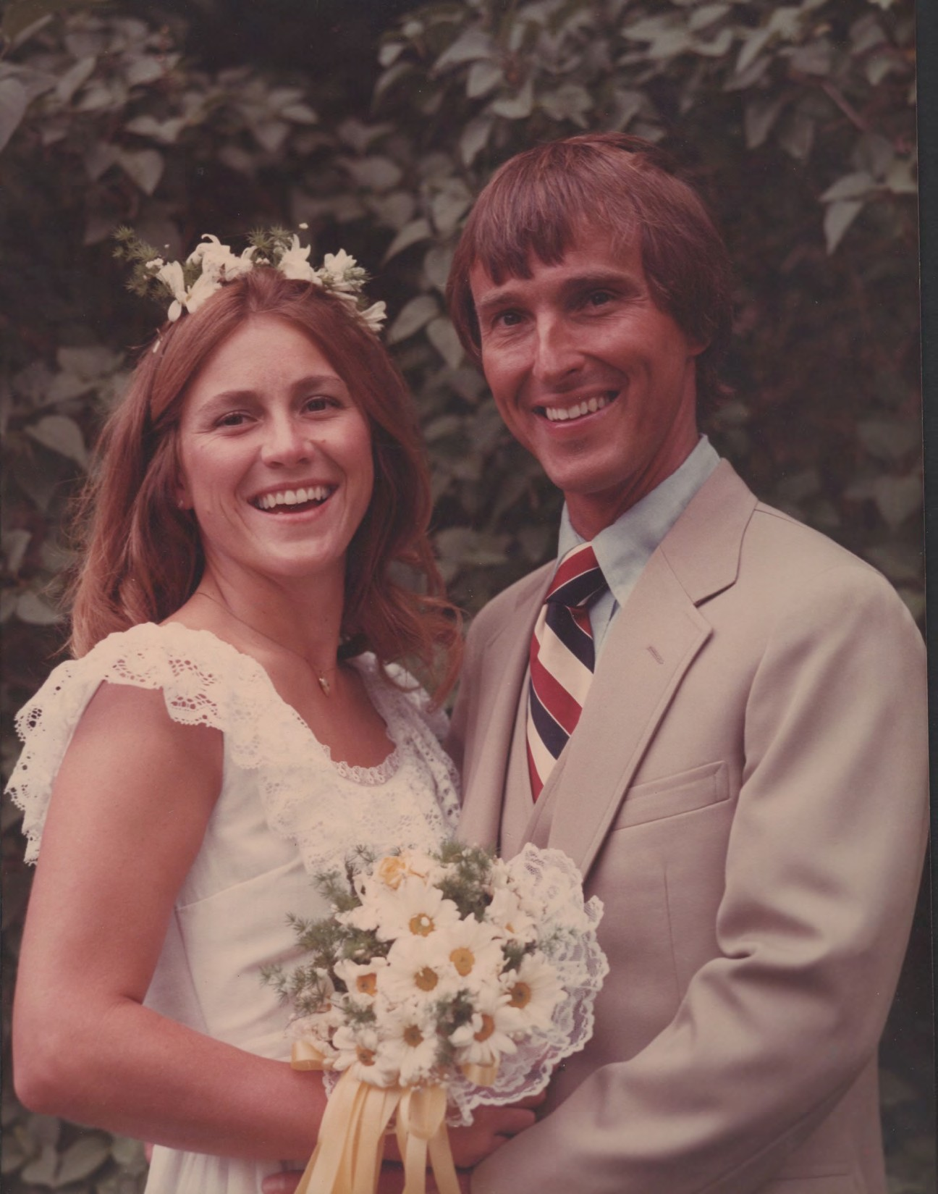

Slide 10
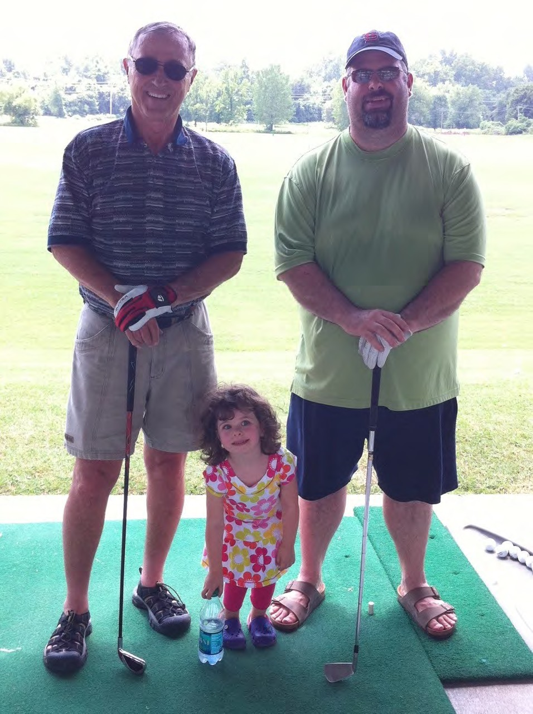

Slide 11


Slide 12
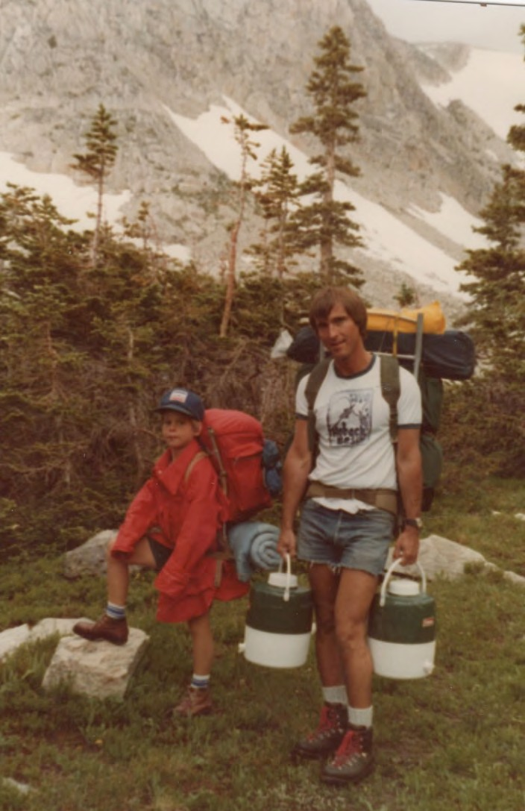

Slide 13
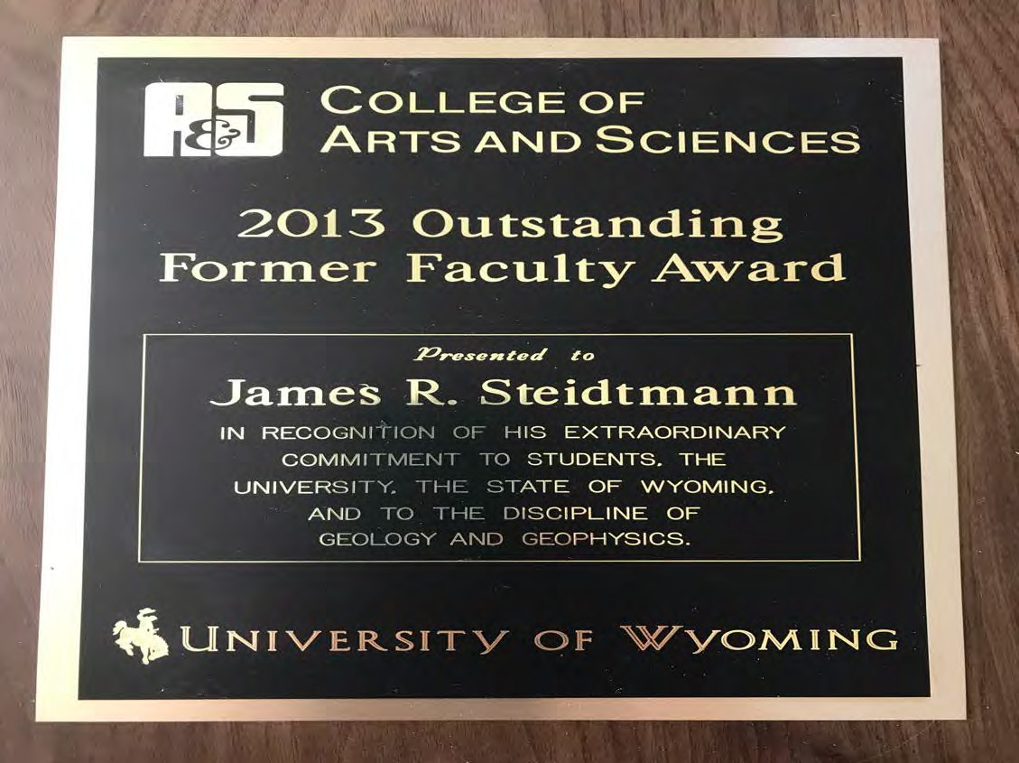

Slide 14
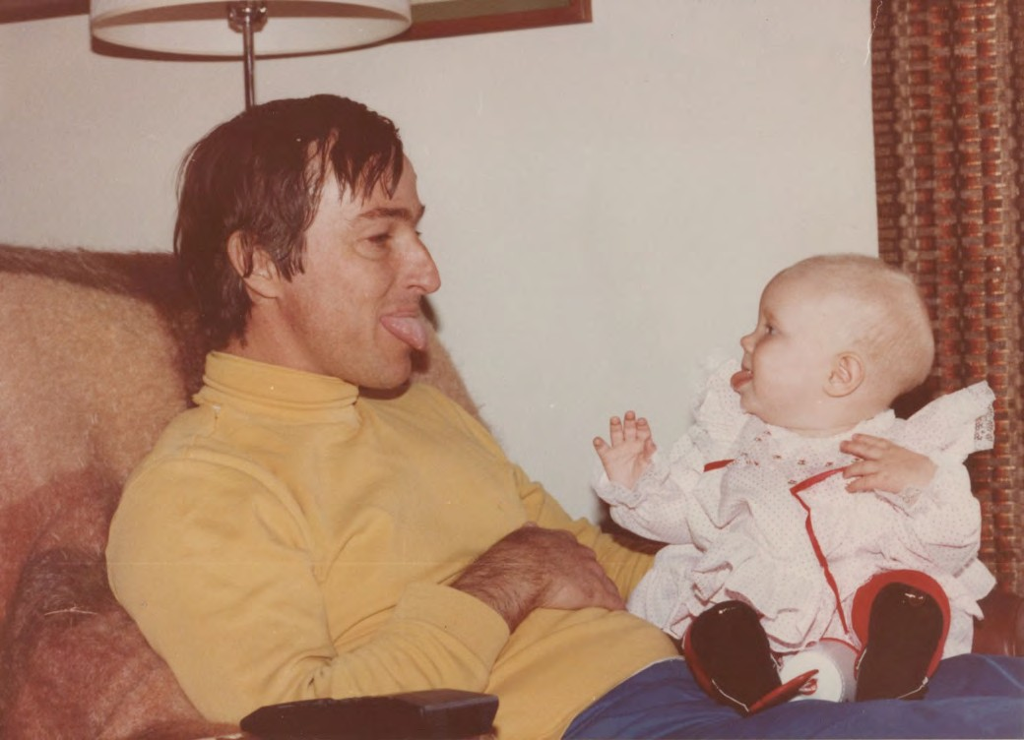

Slide 15
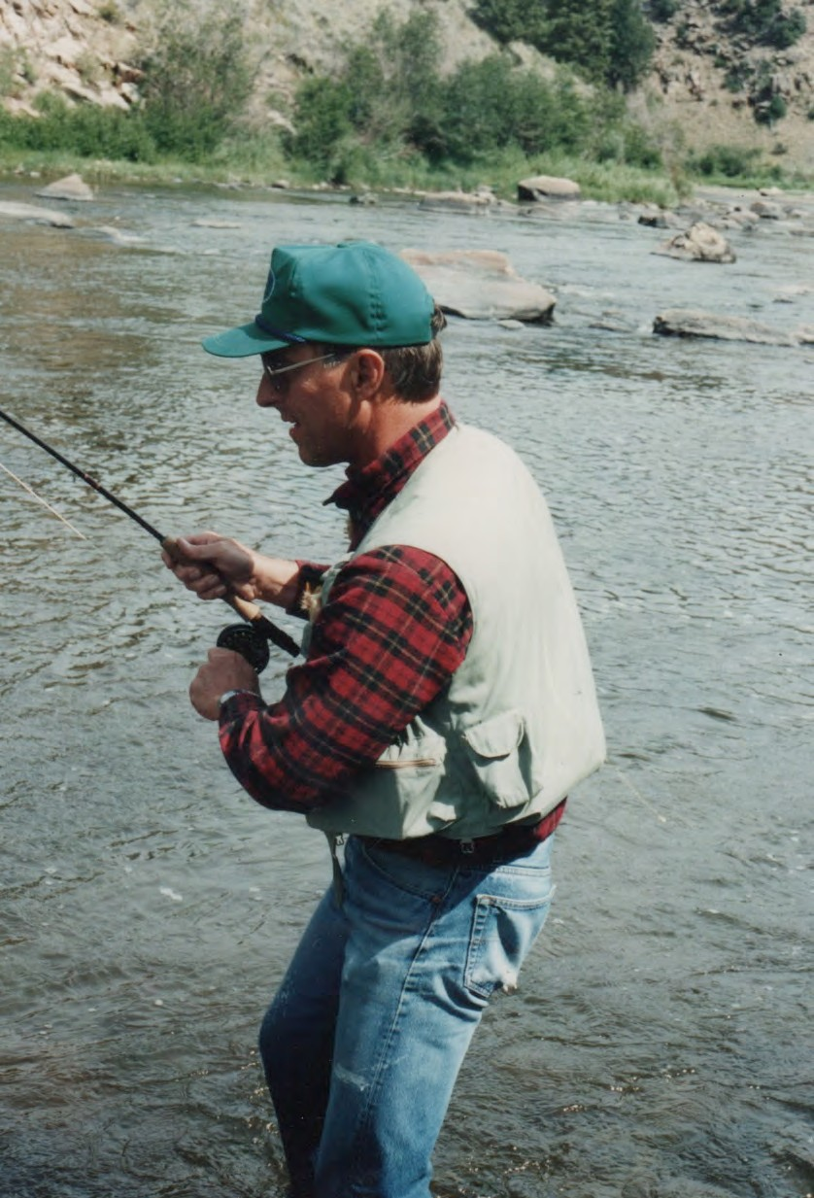

Slide 16
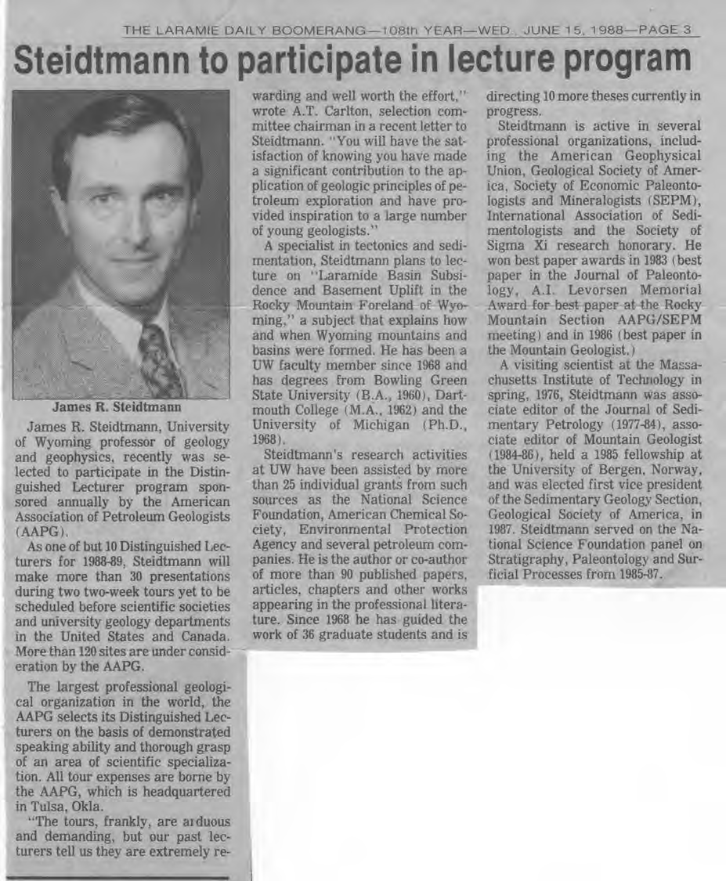

Slide 17
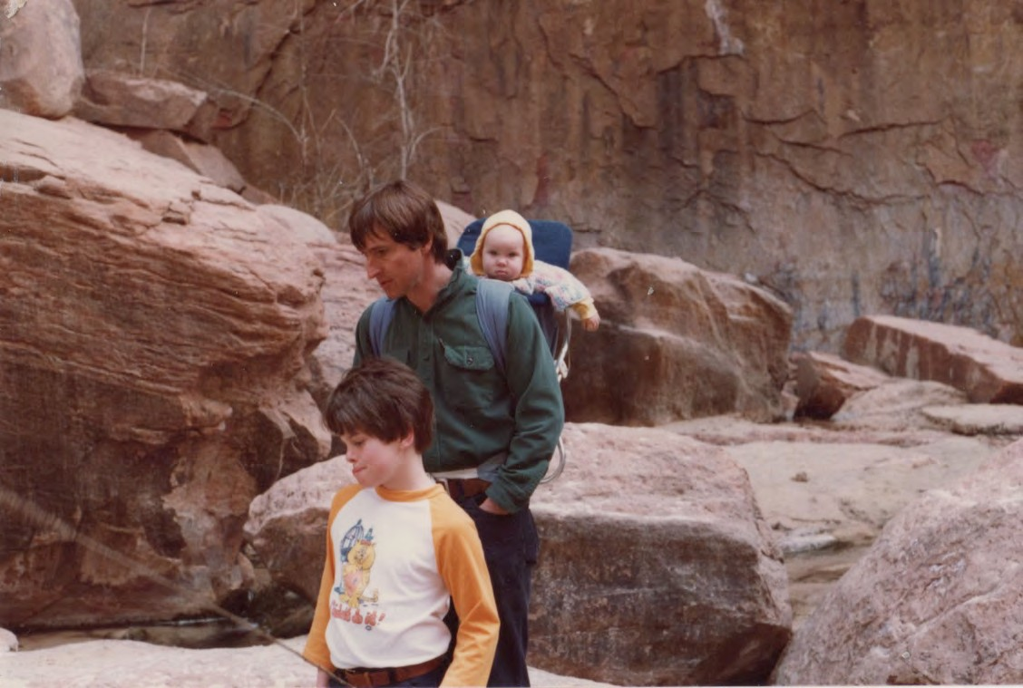
You can’t start kids too early to look at rocks.

Slide 18
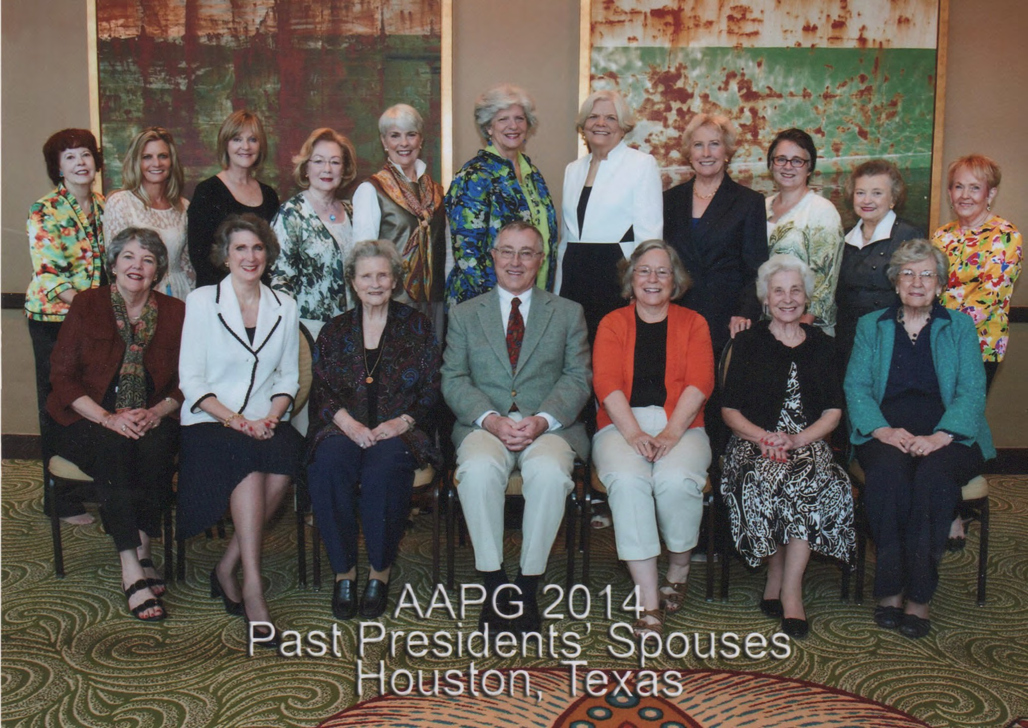

Slide 19
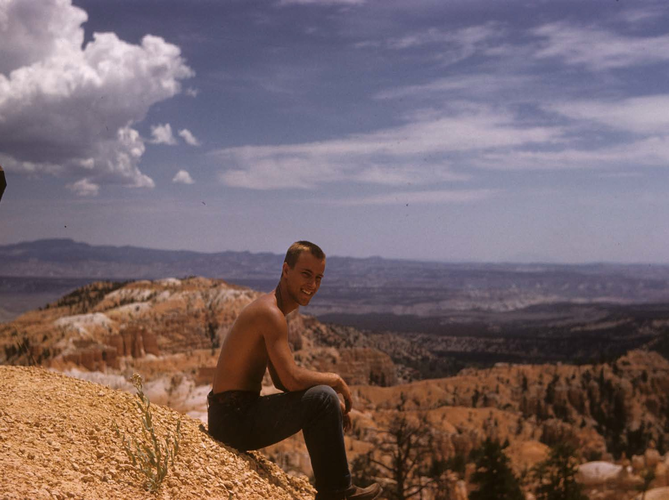

Slide 20
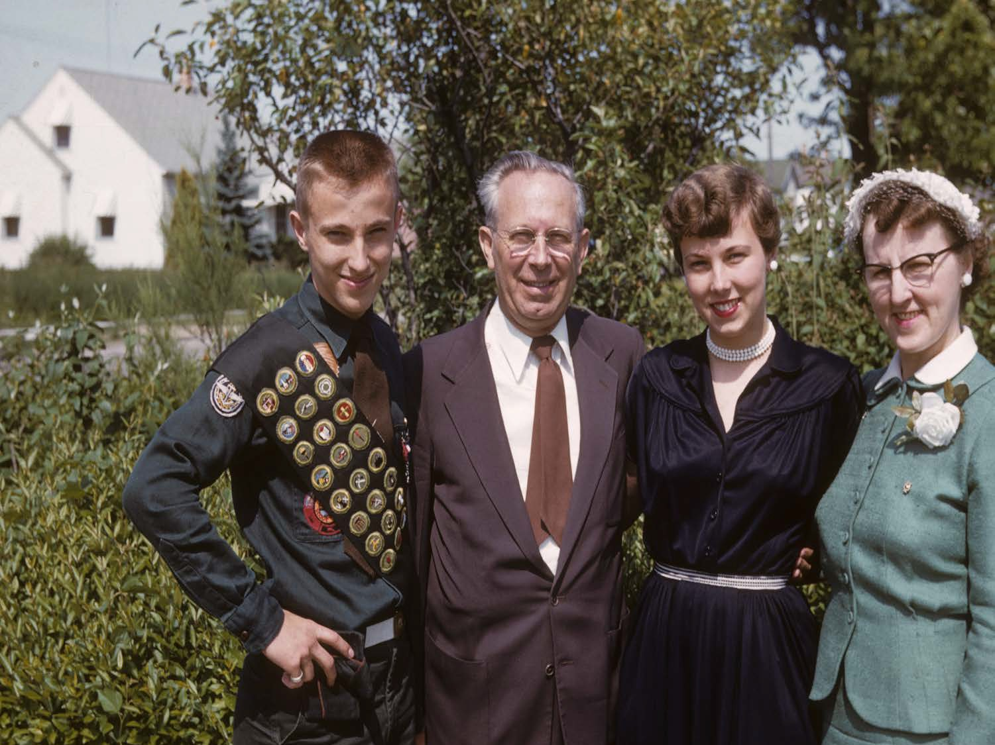
Eagle Scout

Slide 22
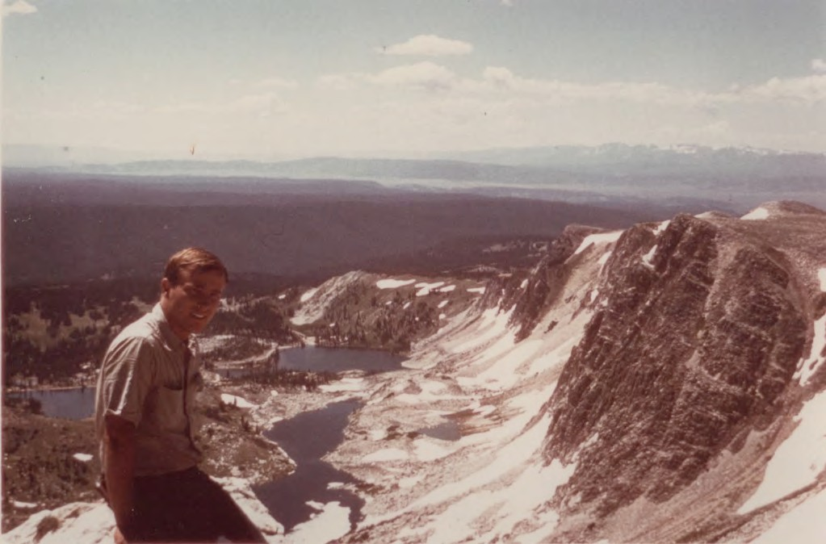

Slide 23
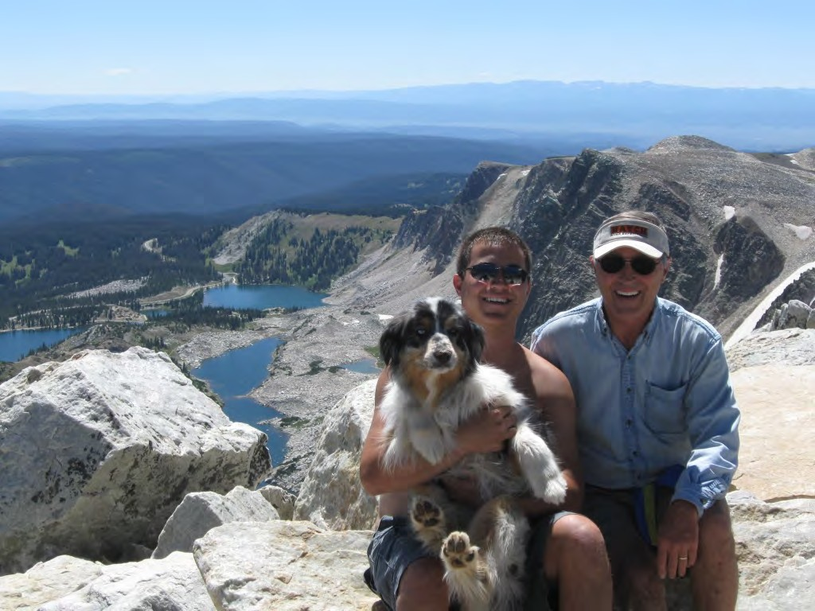

Slide 24
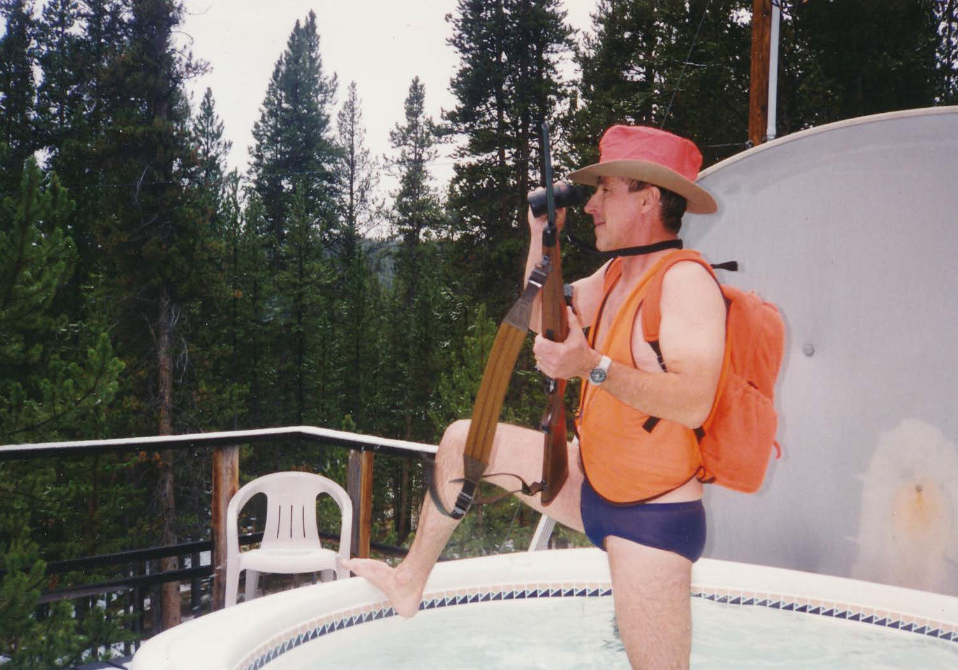

Slide 26
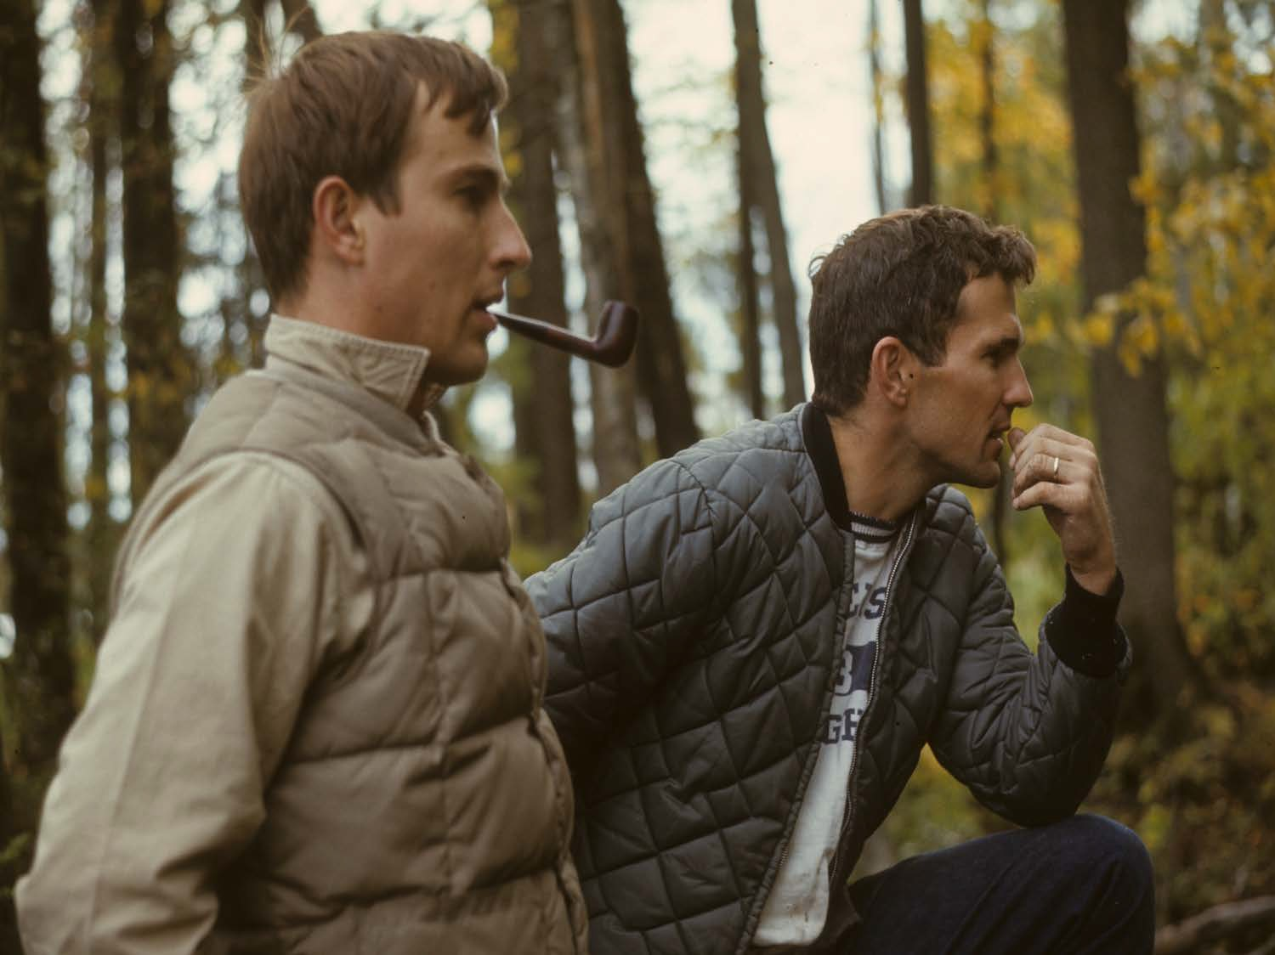

Jim McClurg

Slide 27
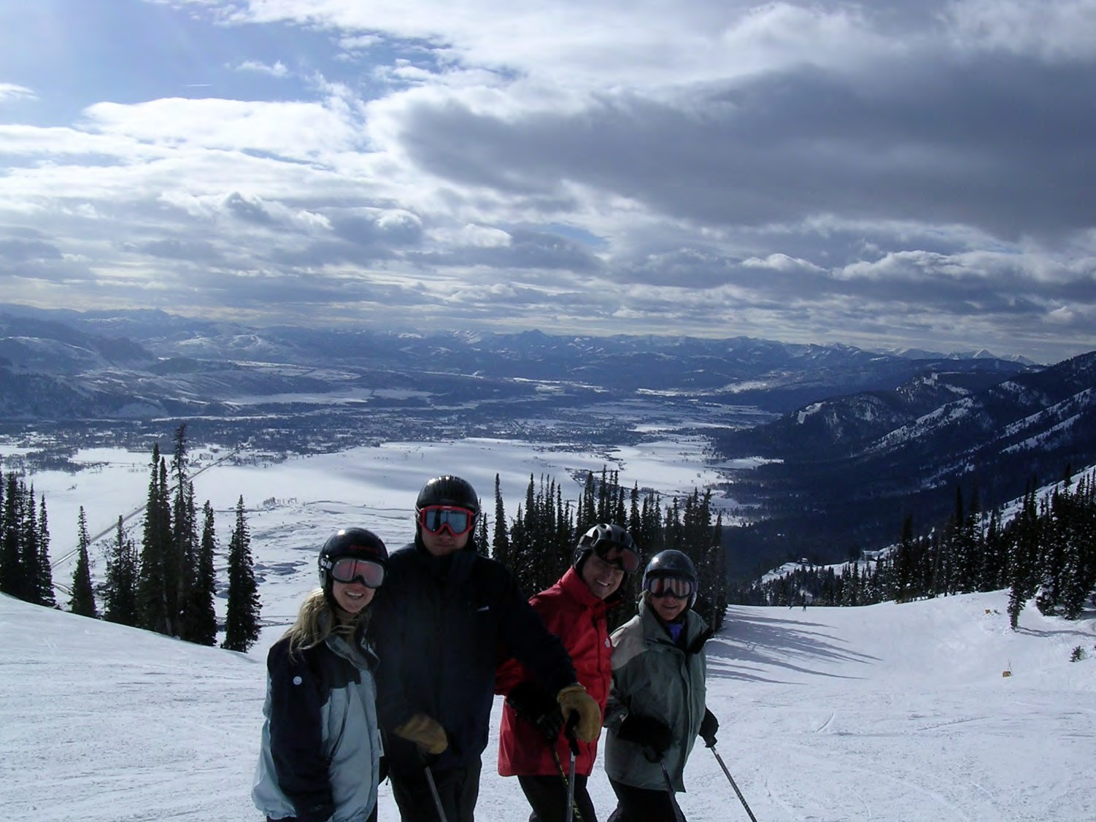

Slide 29
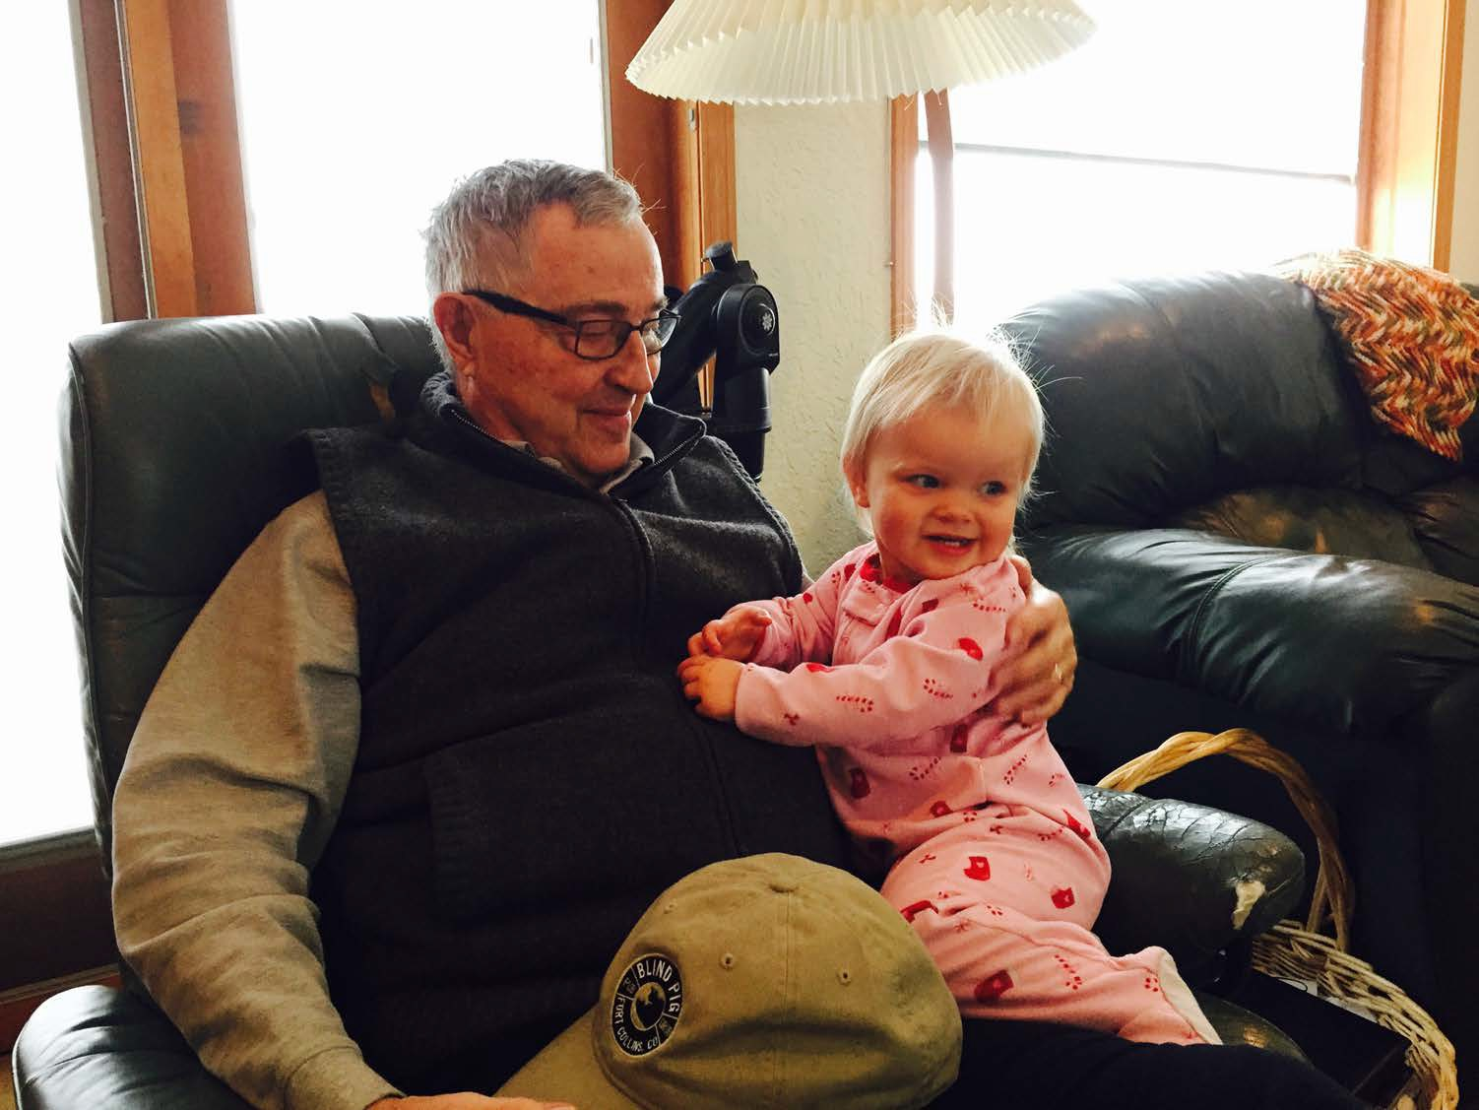

Slide 30
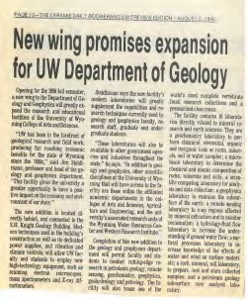
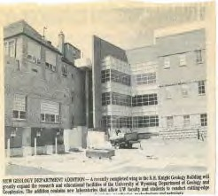
Jim and the Earth Science Building

Slide 31
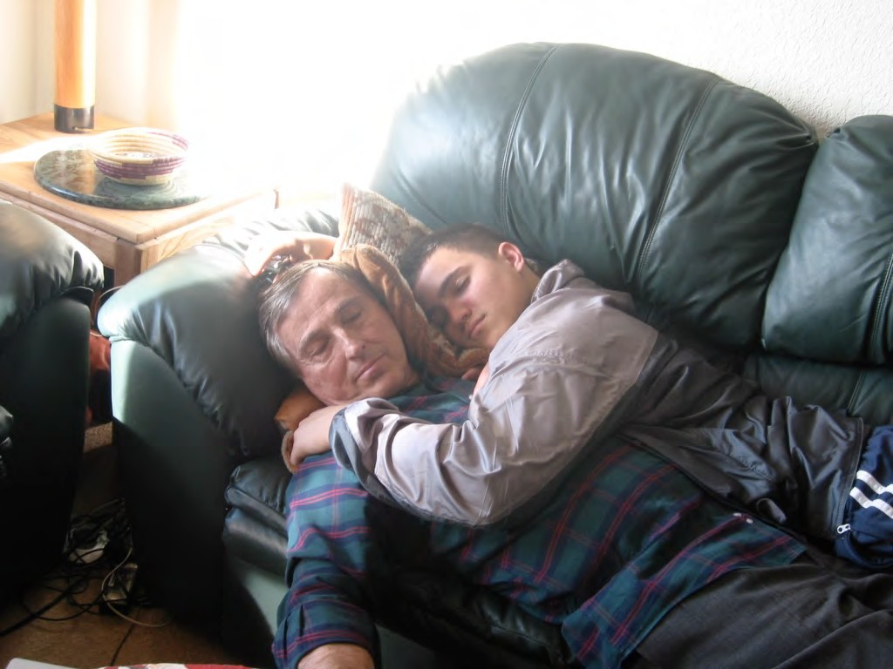

Slide 32
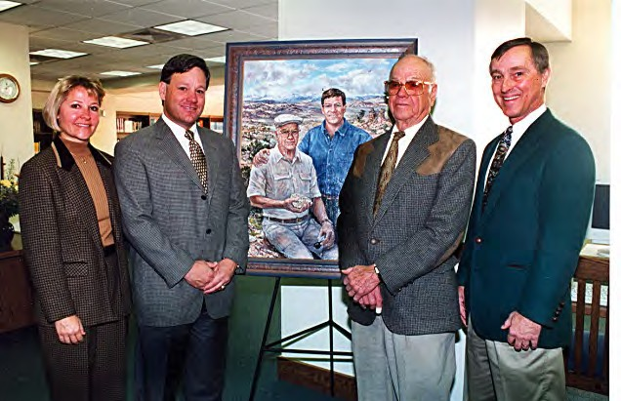
Brinkerhoﬀ Library Dedication

Slide 33
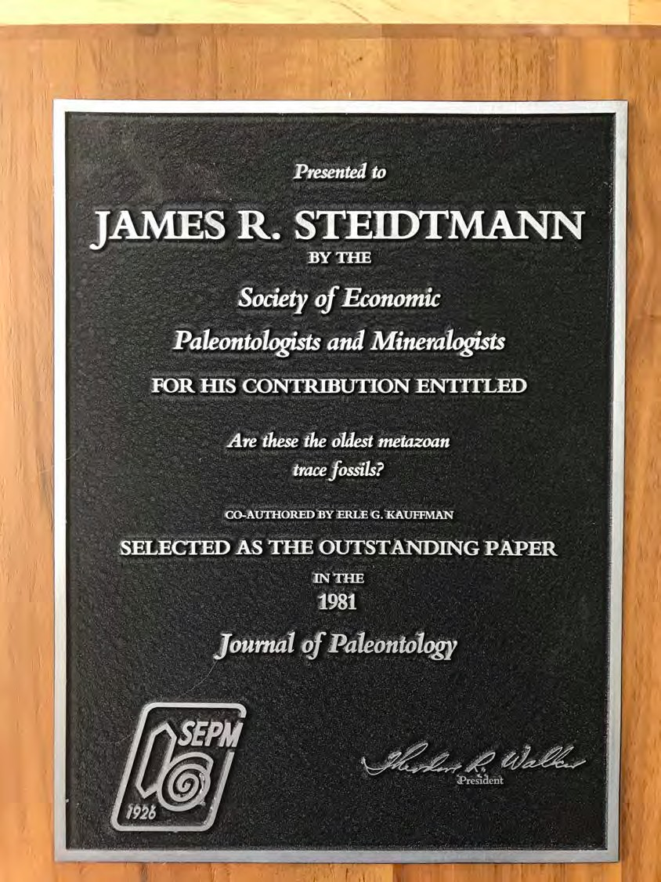

Slide 34
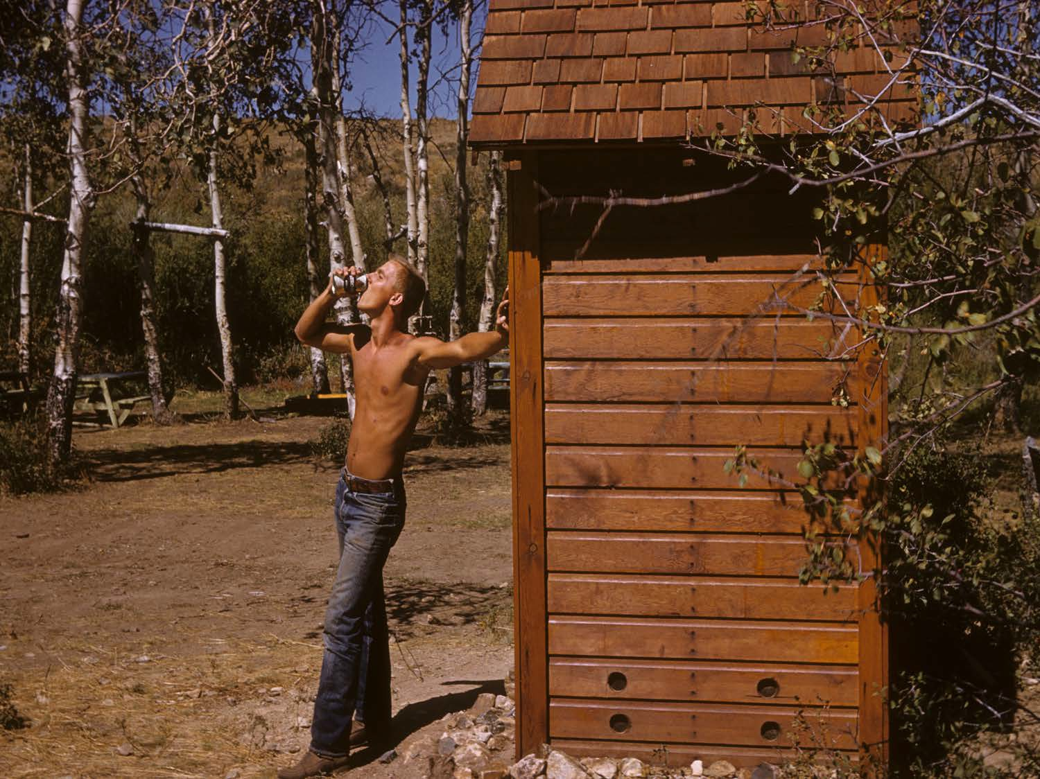

Slide 35
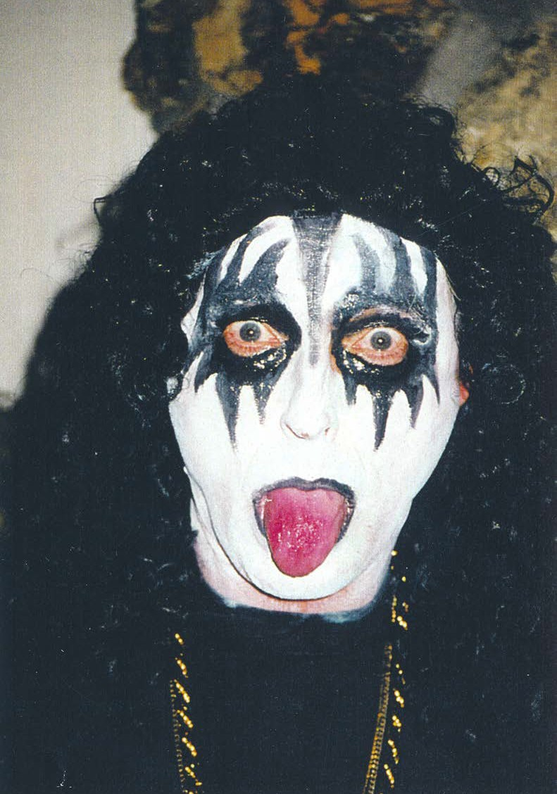

Slide 36
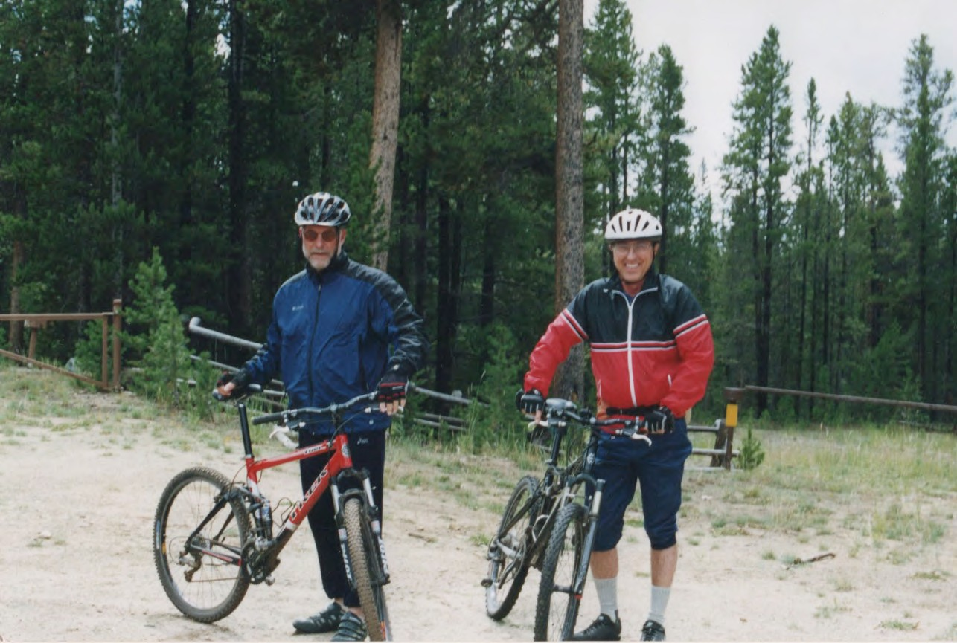

Slide 37
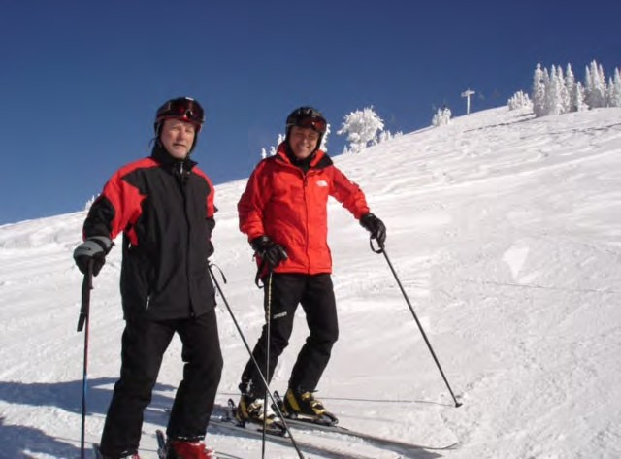

Slide 38
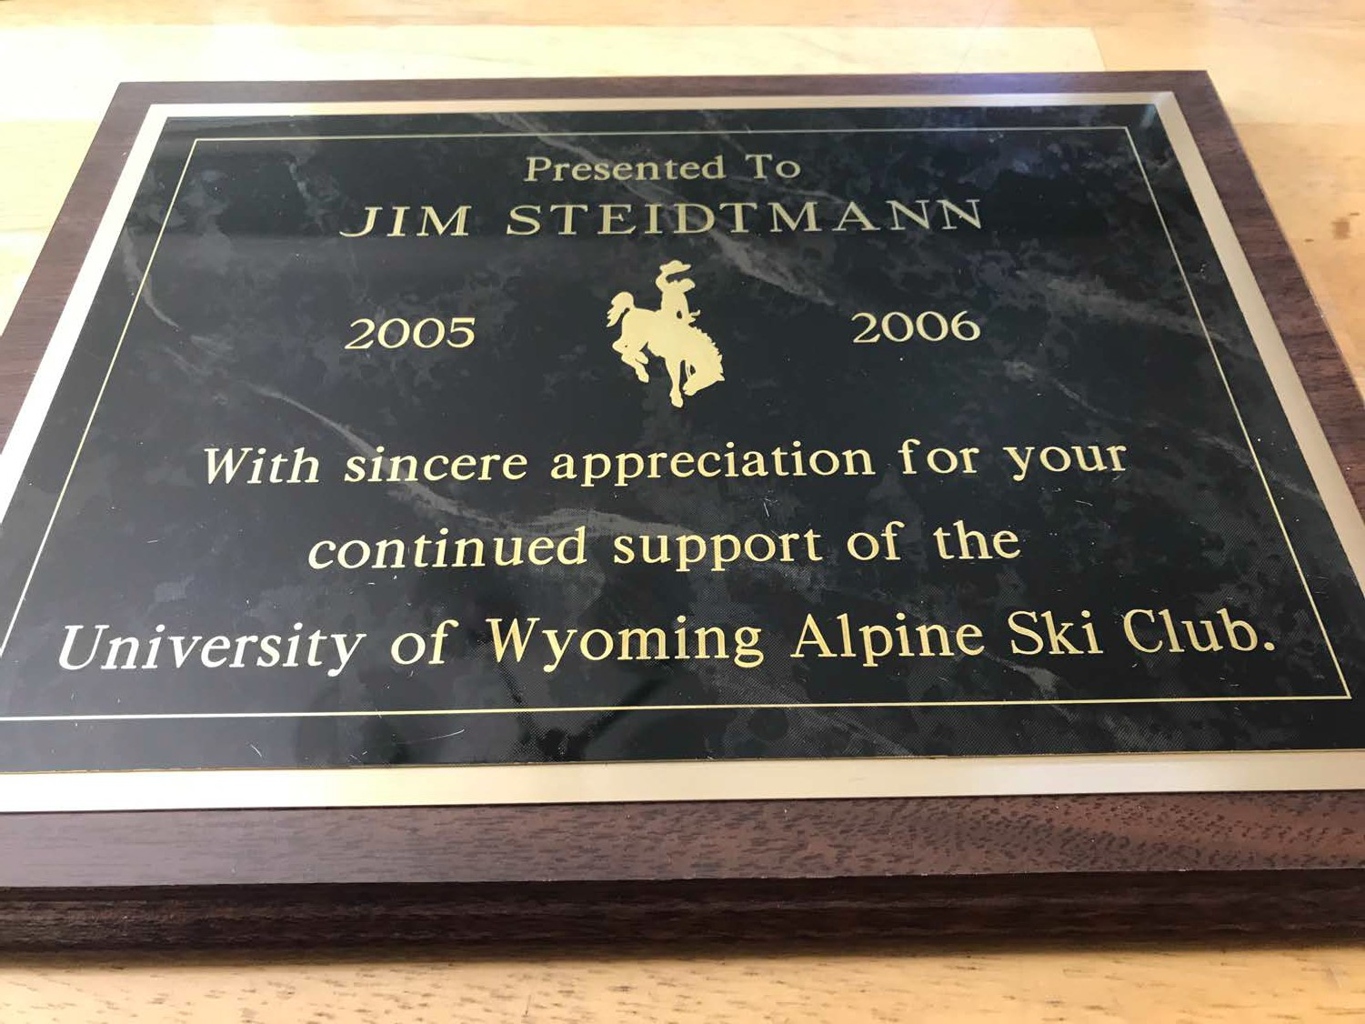

Slide 39
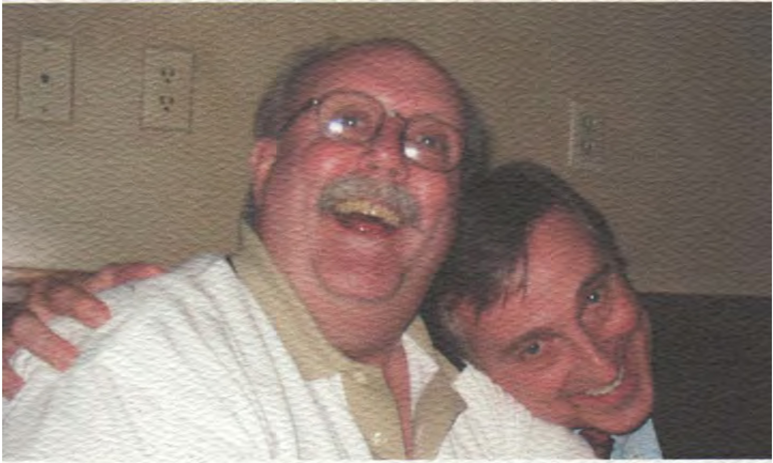
Someone was mugging for the camera! (maybe two someones...)
Remembering the fun times!
Visits to Wyoming AAPG conventions
How to give a talk with just ONE projector
A beautiful day at the cabin Classic jokes
"Upping the game" when following Jim's presentations
"Across the raging desert sands..." Laughing, talking, learning
A life well lived by a friend who will always be in our hearts
"

Slide 41
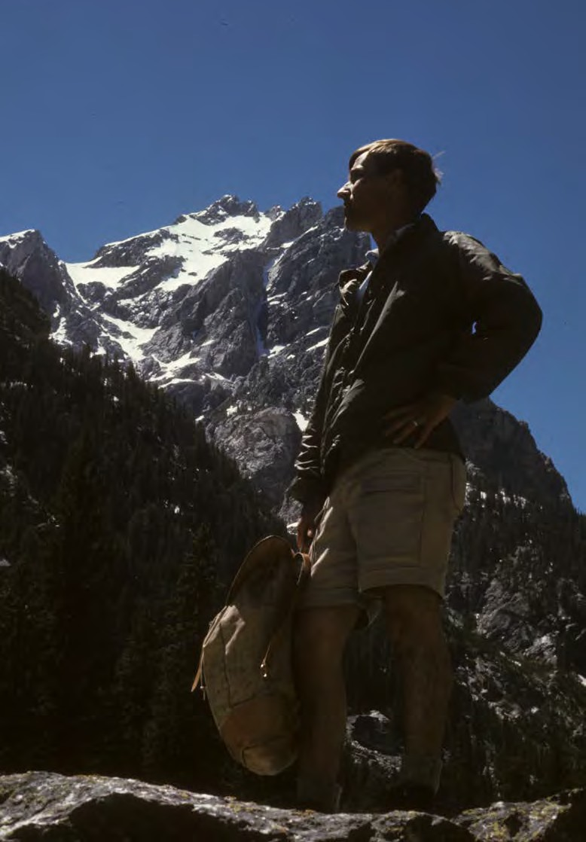

Slide 42
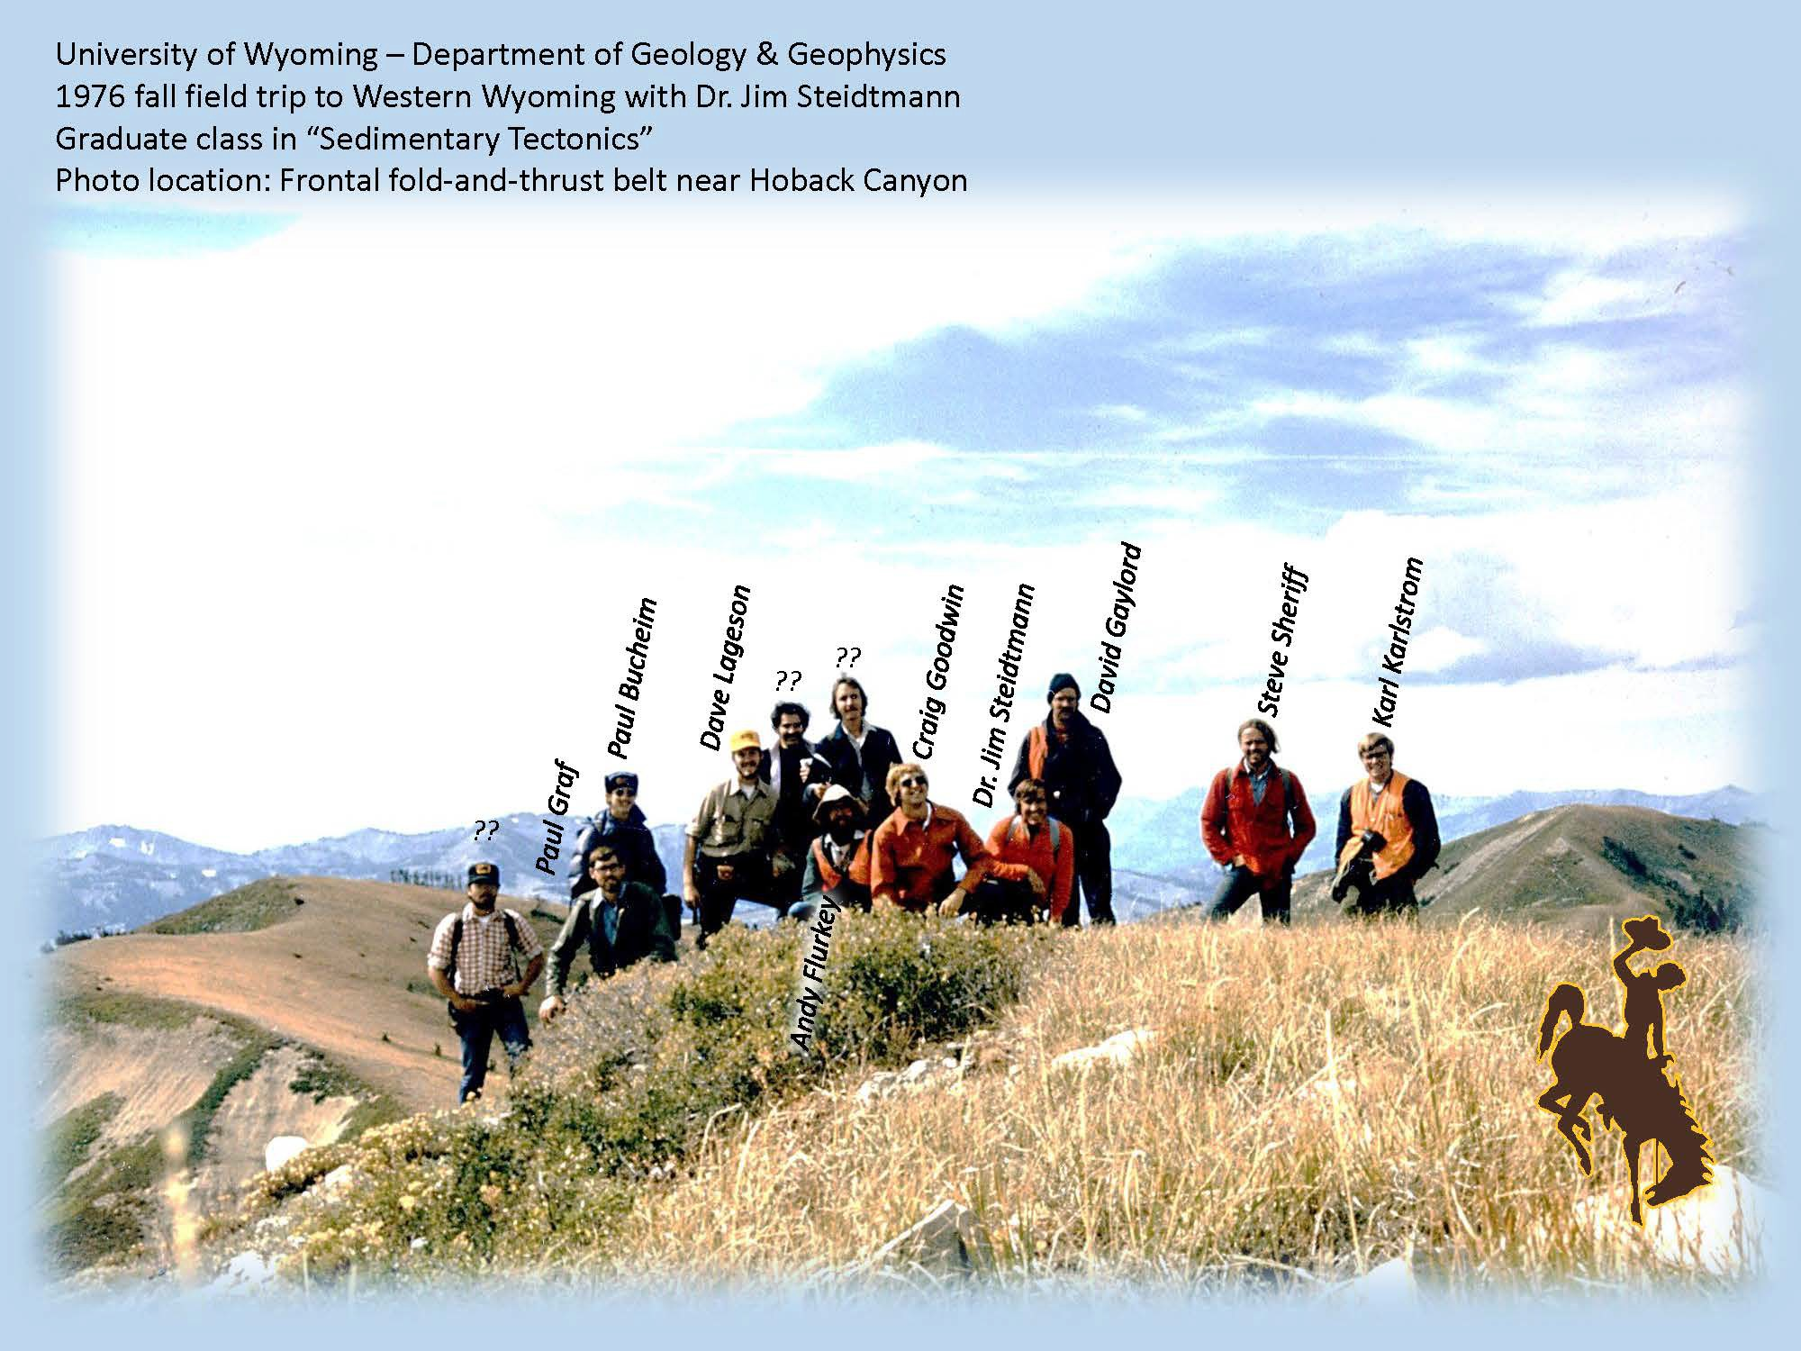
University of Wyoming – Dept. of Geology & Geophysics 1976 Graduate Class in “Sedimentary Tectonics” Fall Field Trip to Western Wyoming with Dr. Jim Steidtmann
Photo locaCon: Frontal fold-and-thrust belt near Hoback Canyon

Slide 43
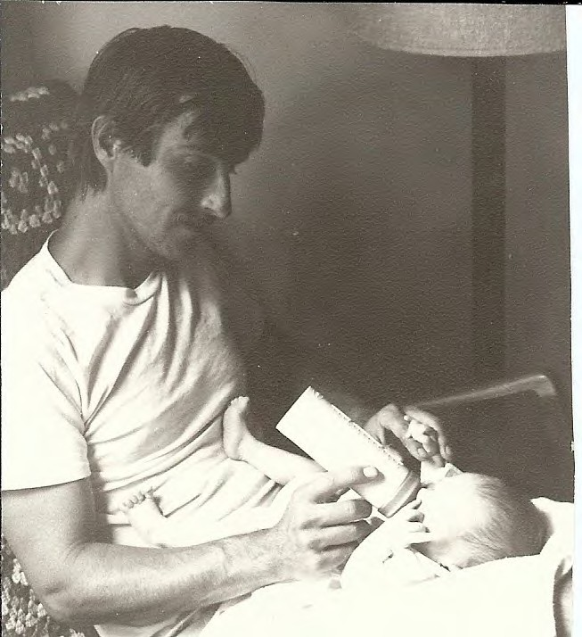

Slide 44
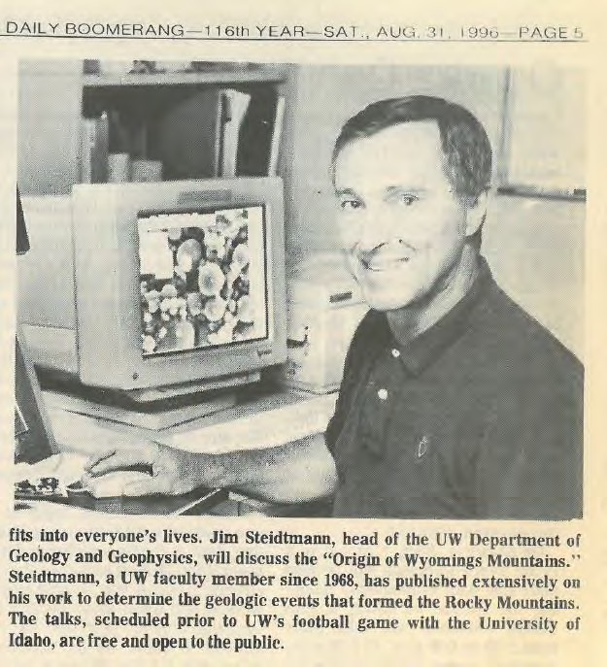
Jim gave lots of lectures to various organizations.
He so loved Wyoming’s Mountains and wanted to share his love with others.

Slide 45
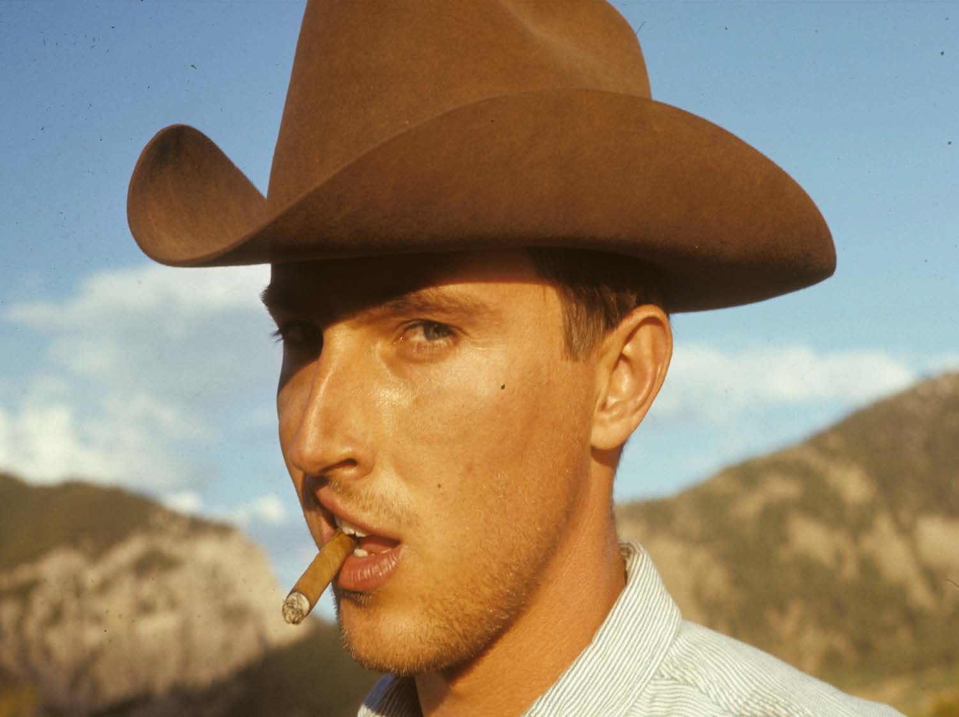

Slide 46
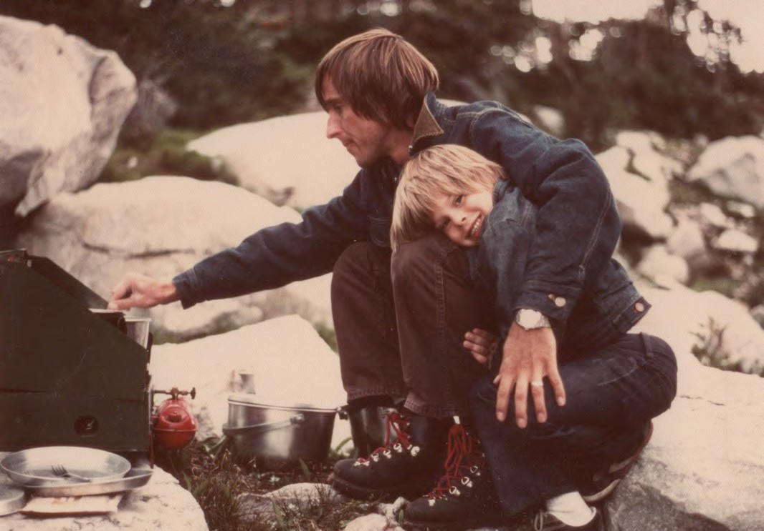

Slide 47
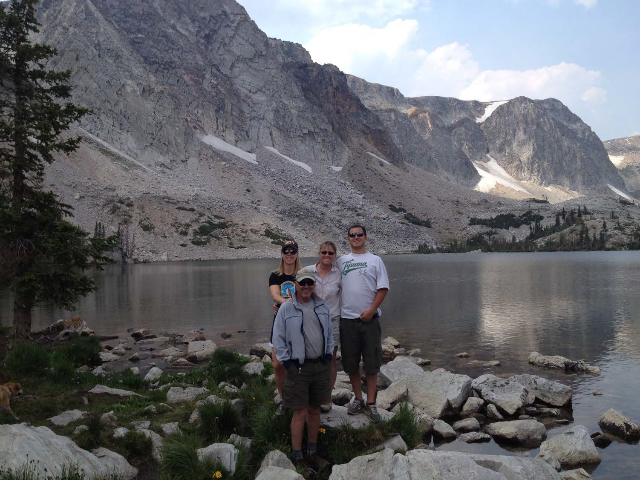

Slide 48
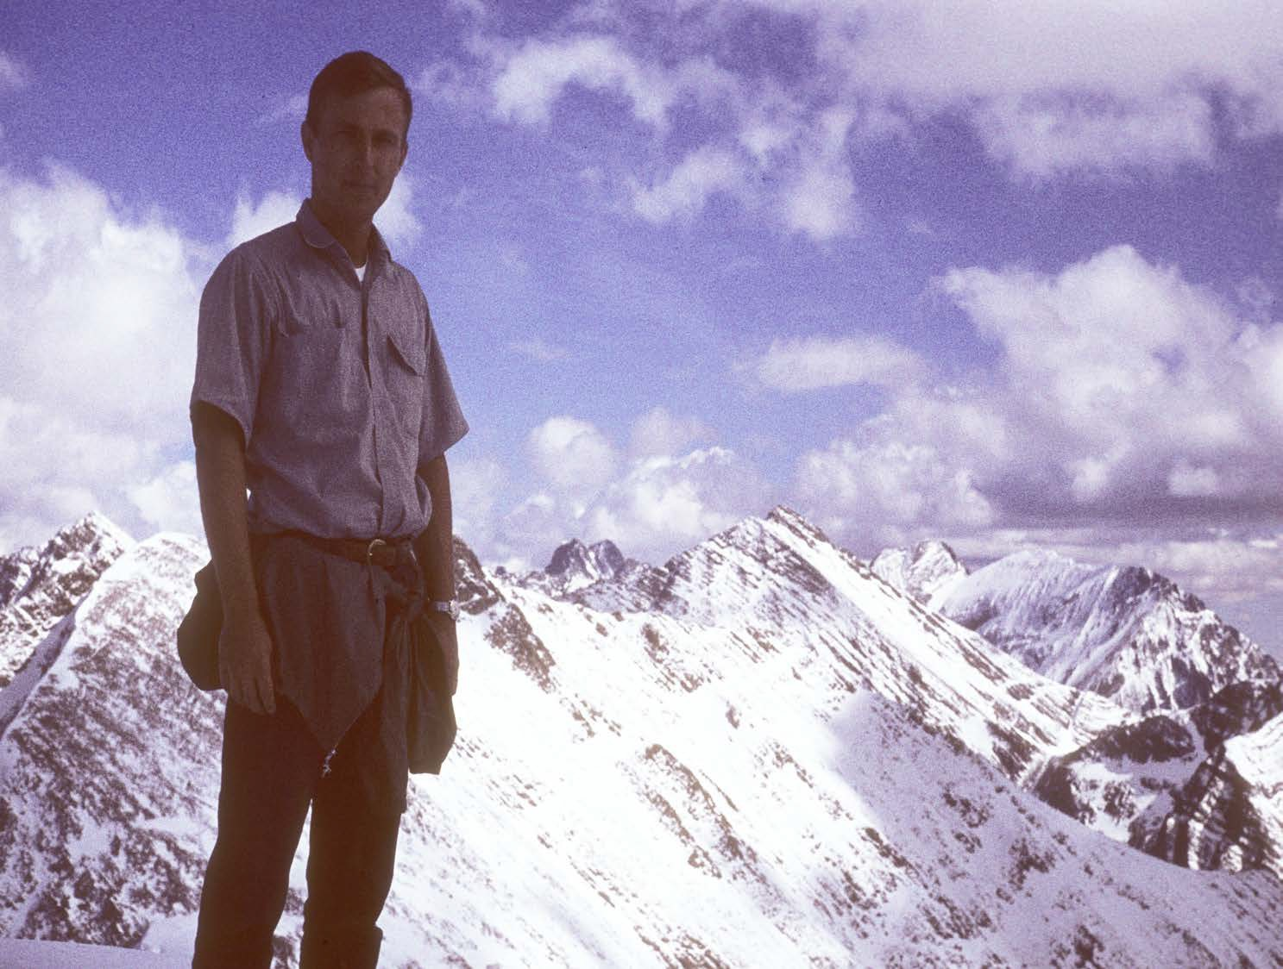

Slide 49
