Slide 1
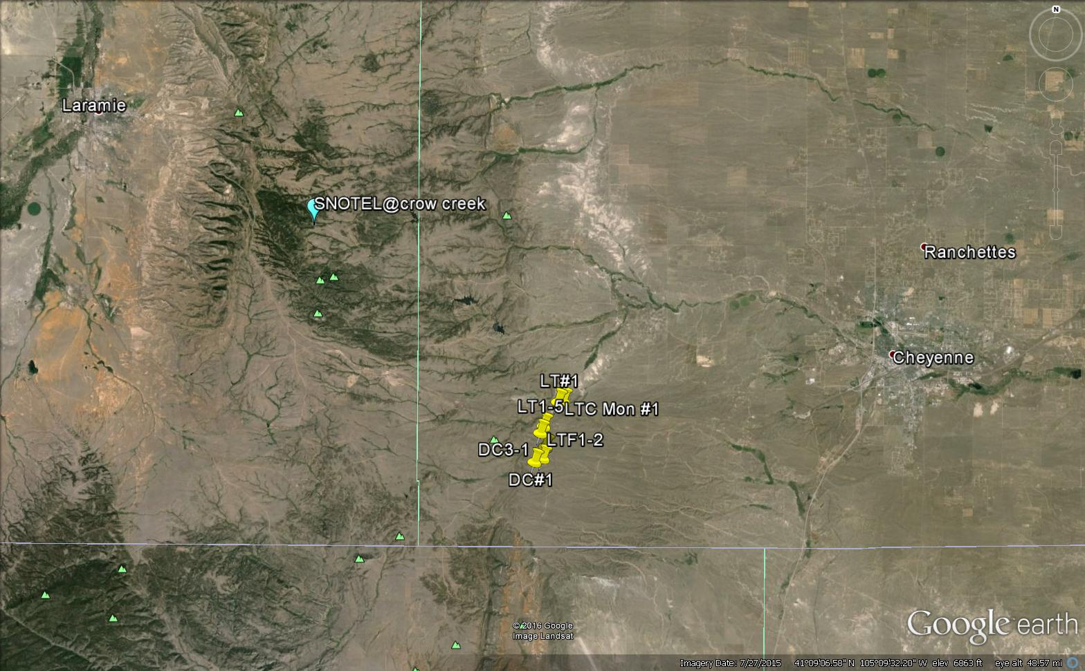
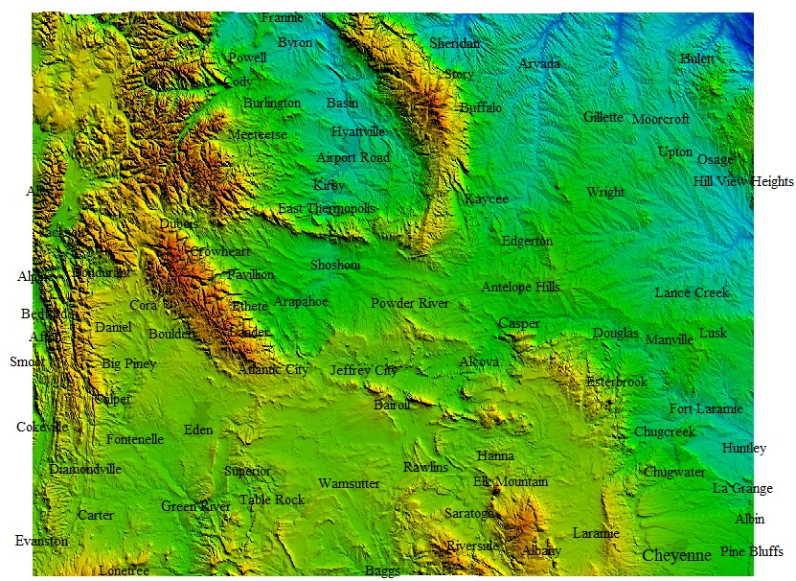
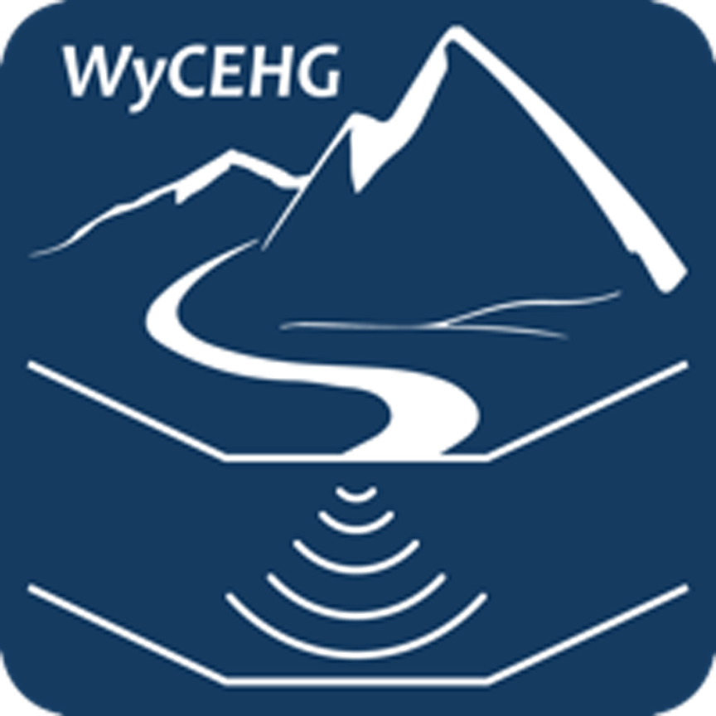

Casper Aquifer Monitoring Program &
UW Golf Course
Long-Term GW Monitoring
Blair Wallis
Fractured Rock
research well field
Monitored reservoirs
Casper drilling site (7/12/17)
Red Buttes
Belvoir Ranch
High plains aquifer monitoring well network (ALTAS site)
NEW: 8 stream & shallow GW monitoring sites (8/13/17)
* For both the Range and the basins, there are extensive streamflow and soil moisture data as well as limited (but growing) snow data .

