Slide 1
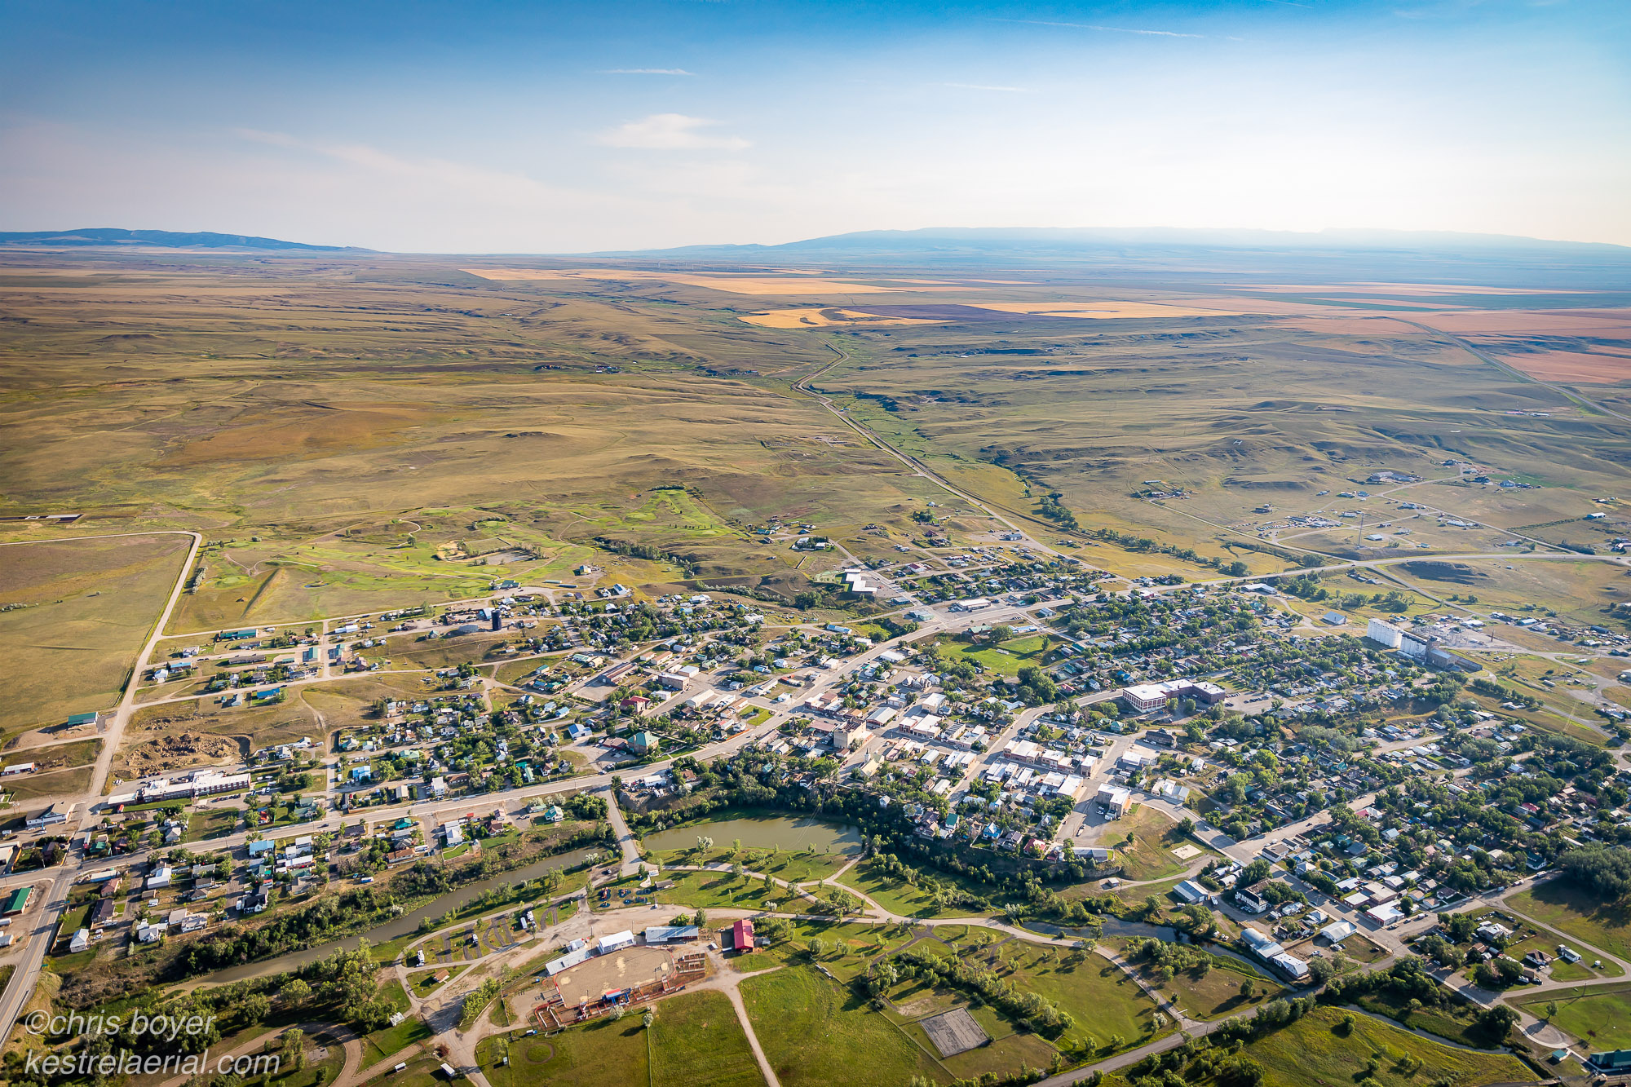

Building Resilient Communities: Mitigating Impacts and Securing Long Run Benefits from Industrial Development
Dr. Grete Gansauer
Assistant Professor,
Sustainable Communities
grete.gansauer@uwyo.edu

Slide 2
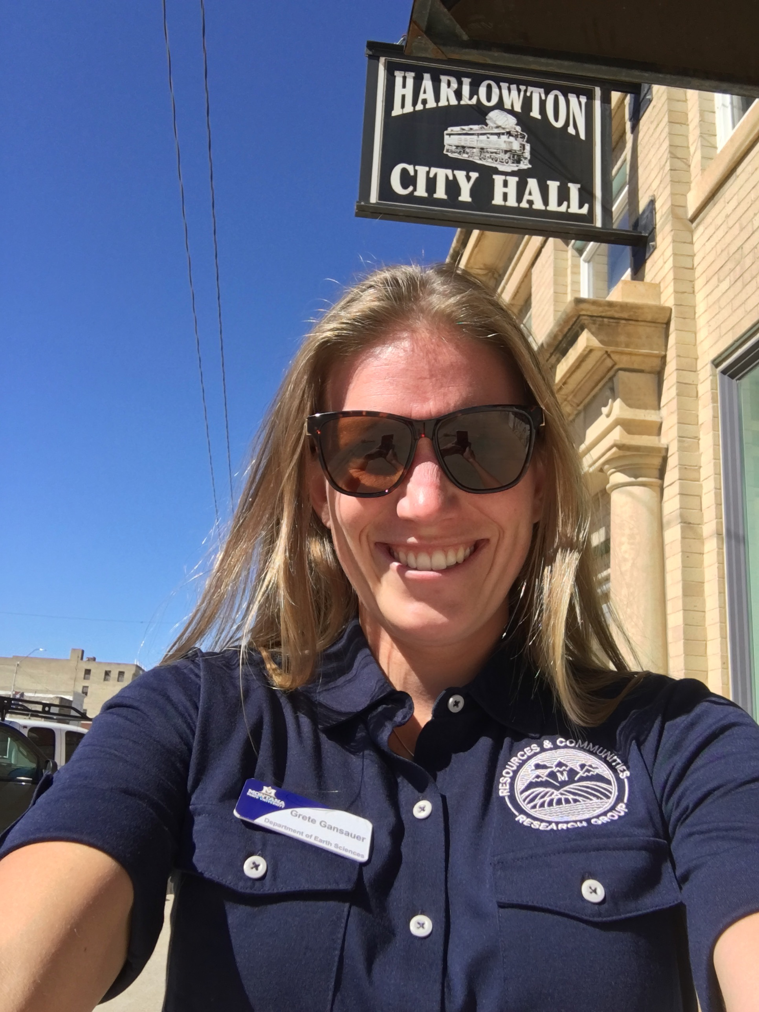
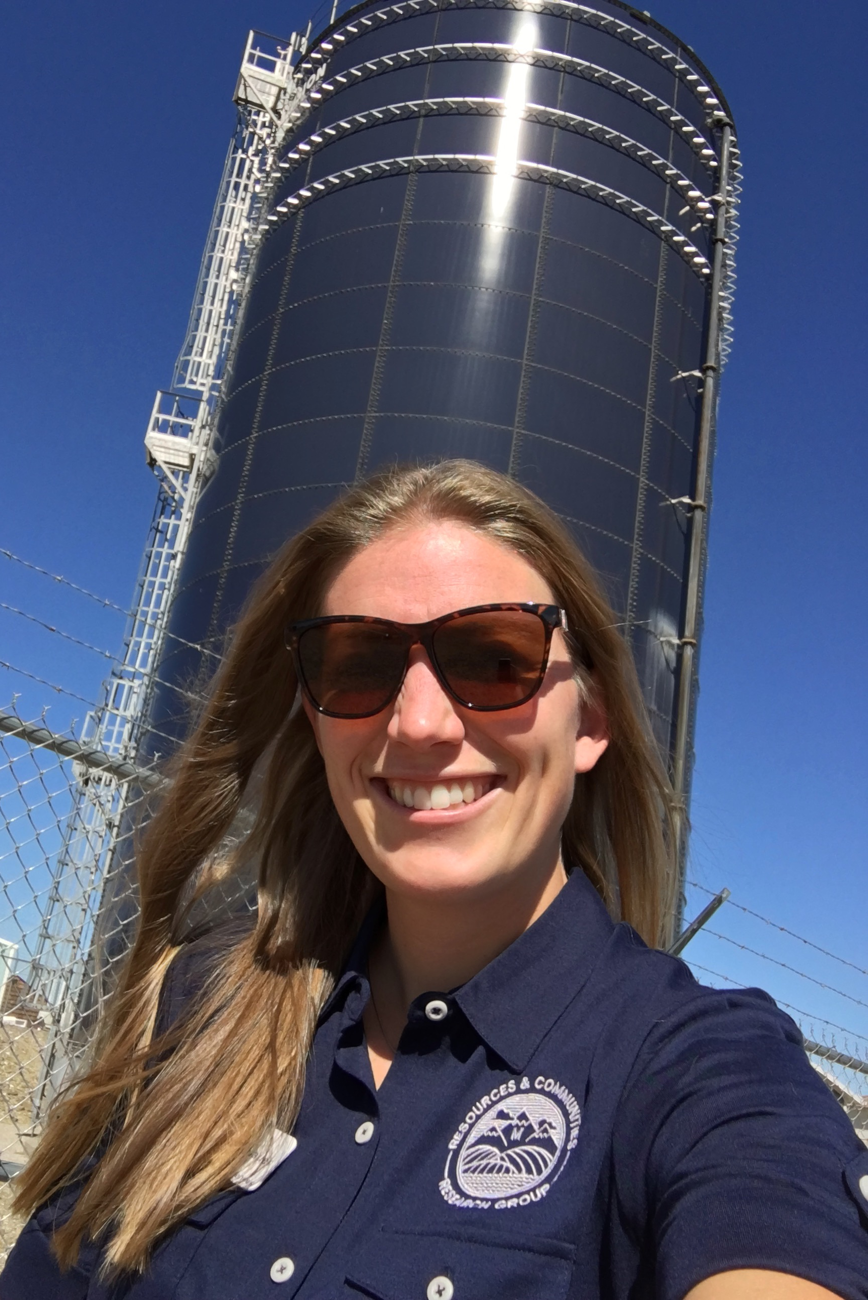
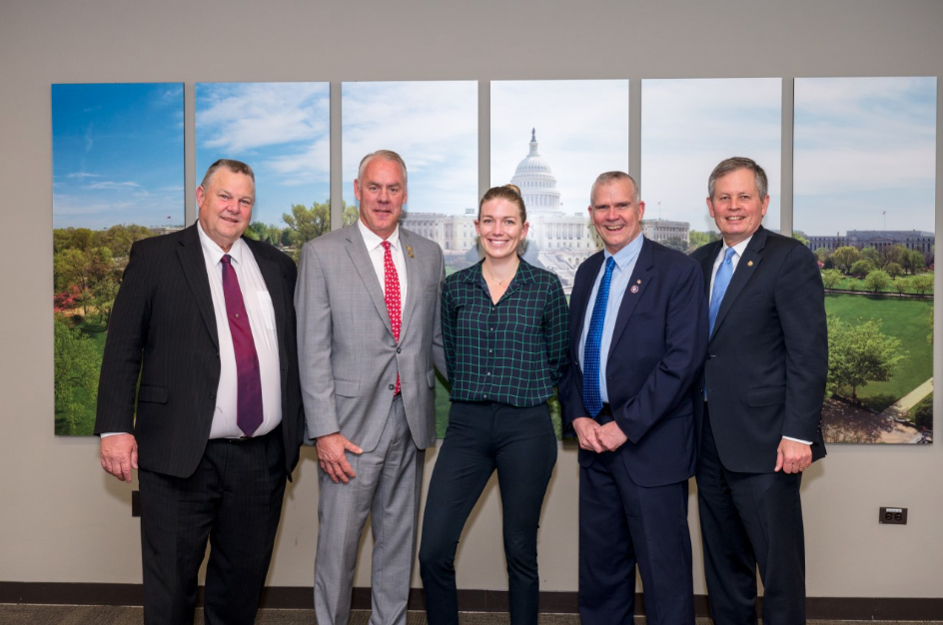
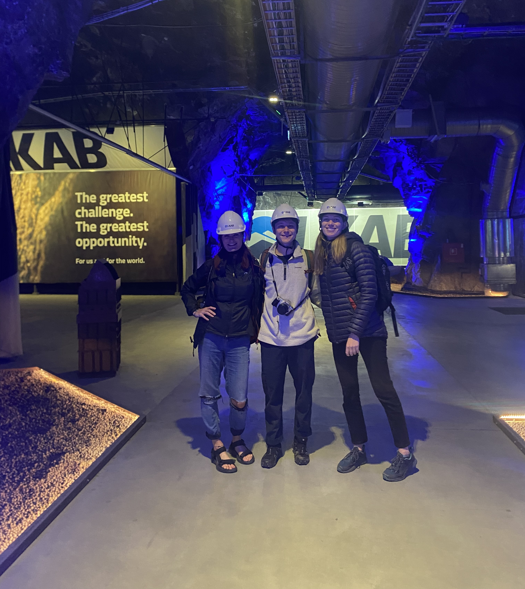
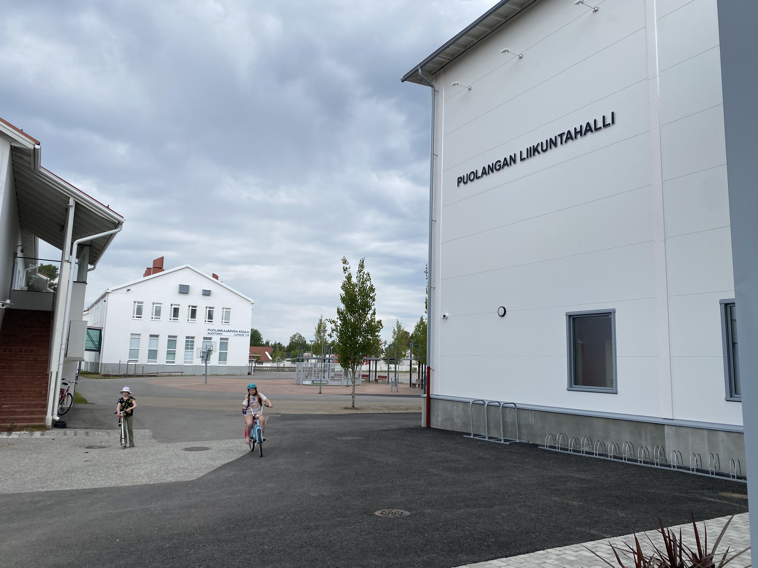
My expertise: Rural Development, Resource Economies, Infrastructure
Who I am:
Rural development & rural policy researcher
Focused on building resilient communities, resource production, infrastructure
Who I am NOT:
A lawyer
A nuclear expert
With Harlowton, MT’s new water tower, Sept. 2020.
Field work in Northern Sweden & Finland rural / mining communities, 2023 - 2025
With the MT delegation in DC, May 2023.

Slide 3
I. Building Resilient Communities

Slide 4
What is resilience?
Infrastructure and Services:
Infrastructure demands within local fiscal capacity
Infrastructure + service impacts are coupled to tax structure & revenue sources
Infrastructure & services maintain high quality of life & meet social need
Environmental Quality :
Environment is clean and healthful (soil, water, air quality)
Environment regenerates and provides ecosystem services
Cultural values sustained
Resilient communities:
Adapt to change
Balance economic development with social and environmental values over the long run
Economic structure:
Firm structure retains and recirculates value locally
Capital leakage mitigated by embedding value locally
Diversified economic base
Employment opportunities enable upward mobility
Regional Autonomy & Institutions:
Technical & Administrative Capacity
Democratic decision-making & planning
Collaborative institutions + shared vision
Notes:
For regional autonomy and institutions – think about process. It’s not only about the outcomes, but also the process f how developers enter a community
Don’t forget – cultural land use can be simple, it doesn’t have to be a sacred burial site to have a cultural impact on the community. For example, I worked with a community where an abandoned industrial site was used by locals as a dog walking area and as kids for biking. So when the site became redeveloped, that threatened that cultural land use!

Slide 5
Why does industrial development tend to threaten resilience?
Environmental Quality :
Public costs in environmental quality: public health, degradation
Viewshed / soundscape impacts
Cultural land use impacts (ranching, hunting, public access, etc.)
Infrastructure and Services:
Industrial infrastructure demand shouldered by local tax base
Infrastructure over-adapted to specific industrial context = potential for fixed capital liabilities
Infrastructure doesn’t meet social need
Vulnerable communities:
Subject to market volatility
High public cost
High external value capture
Low Value Retention
Economic structure:
Capital leakage: value produced locally extracted and accumulated elsewhere (corporate + tax structure)
Private value capture
Regional Autonomy & Institutions:
Divisive community politics – difficult to form a united vision
Strain on existing institutional capacity
Notes:
For regional autonomy and institutions – think about process. It’s not only about the outcomes, but also the process f how developers enter a community
Don’t forget – cultural land use can be simple, it doesn’t have to be a sacred burial site to have a cultural impact on the community. For example, I worked with a community where an abandoned industrial site was used by locals as a dog walking area and as kids for biking. So when the site became redeveloped, that threatened that cultural land use!

Slide 6
Building resilient communities means maximizing community value retention
Breaking the boom-bust cycle means retaining the benefits of the boom for the long-run
Community
Shared public benefit
As much as possible, democratically managed
Value
Not just ‘jobs, jobs, jobs’! – think about community values and needs
Building local financial capital (public, quasi-public, private)
Built environment + infrastructure
Cultural value
Ecosystem services, environmental quality
Retention
Embed, Recirculate, Reinvest locally
Direct reinvestment to economic diversification + local business
Intergenerational benefits from short-run value creation

Slide 7
Maximizing community value retention means
Mitigating Impacts
Minimizing community costs
Securing Long-Run, Community Benefits
Maximizing community value
and

Slide 8
Impact Mitigation
VS
Community Benefits
Strategies to avoid or minimize negative impacts from a development project.
Examples:
Noise barriers
Dust control
Stormwater runoff measures
Road reconstruction
Social and economic measures designed to improve community wellbeing. They do not have to directly address direct project impacts.

Slide 9
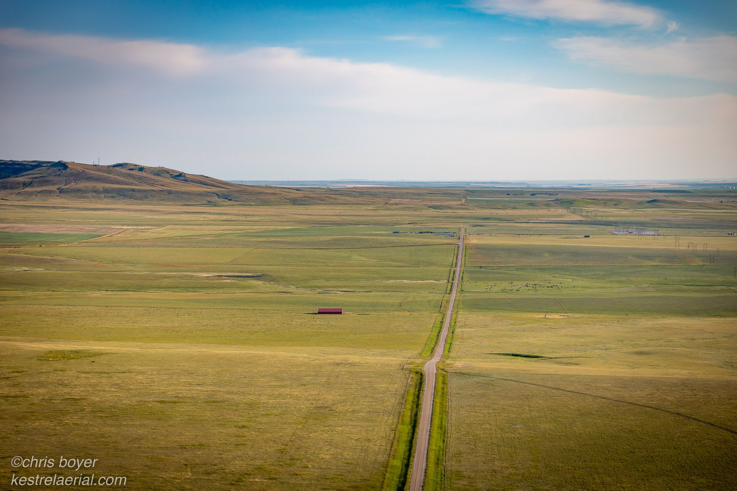
Tools to do this
Community Benefits Agreements (legally binding)
Legal contract between a community coalition & developer that ensures measurable, long-run benefits to the community. (Often an MOU.)
Community Benefits Plans (not legally binding)
Often, a plan of action to negotiate a community benefit agreement.
Or, may be a non-binding agreement between developer and community about general expectations, governance and benefits.
Notes:
Local governments face legal restrictions when incorporating community benefits into agreements, primarily due to limitations on their ability to impose conditions on development as a "quid pro quo" for zoning approvals, often stemming from state laws, and concerns about potential violations of the Takings Clause and Equal Protection Clause under the federal constitution; however, they can still influence private development through agreements related to public land disposition or public subsidies for private activities on their land.

Slide 10
II. Mitigating Impacts

Slide 11
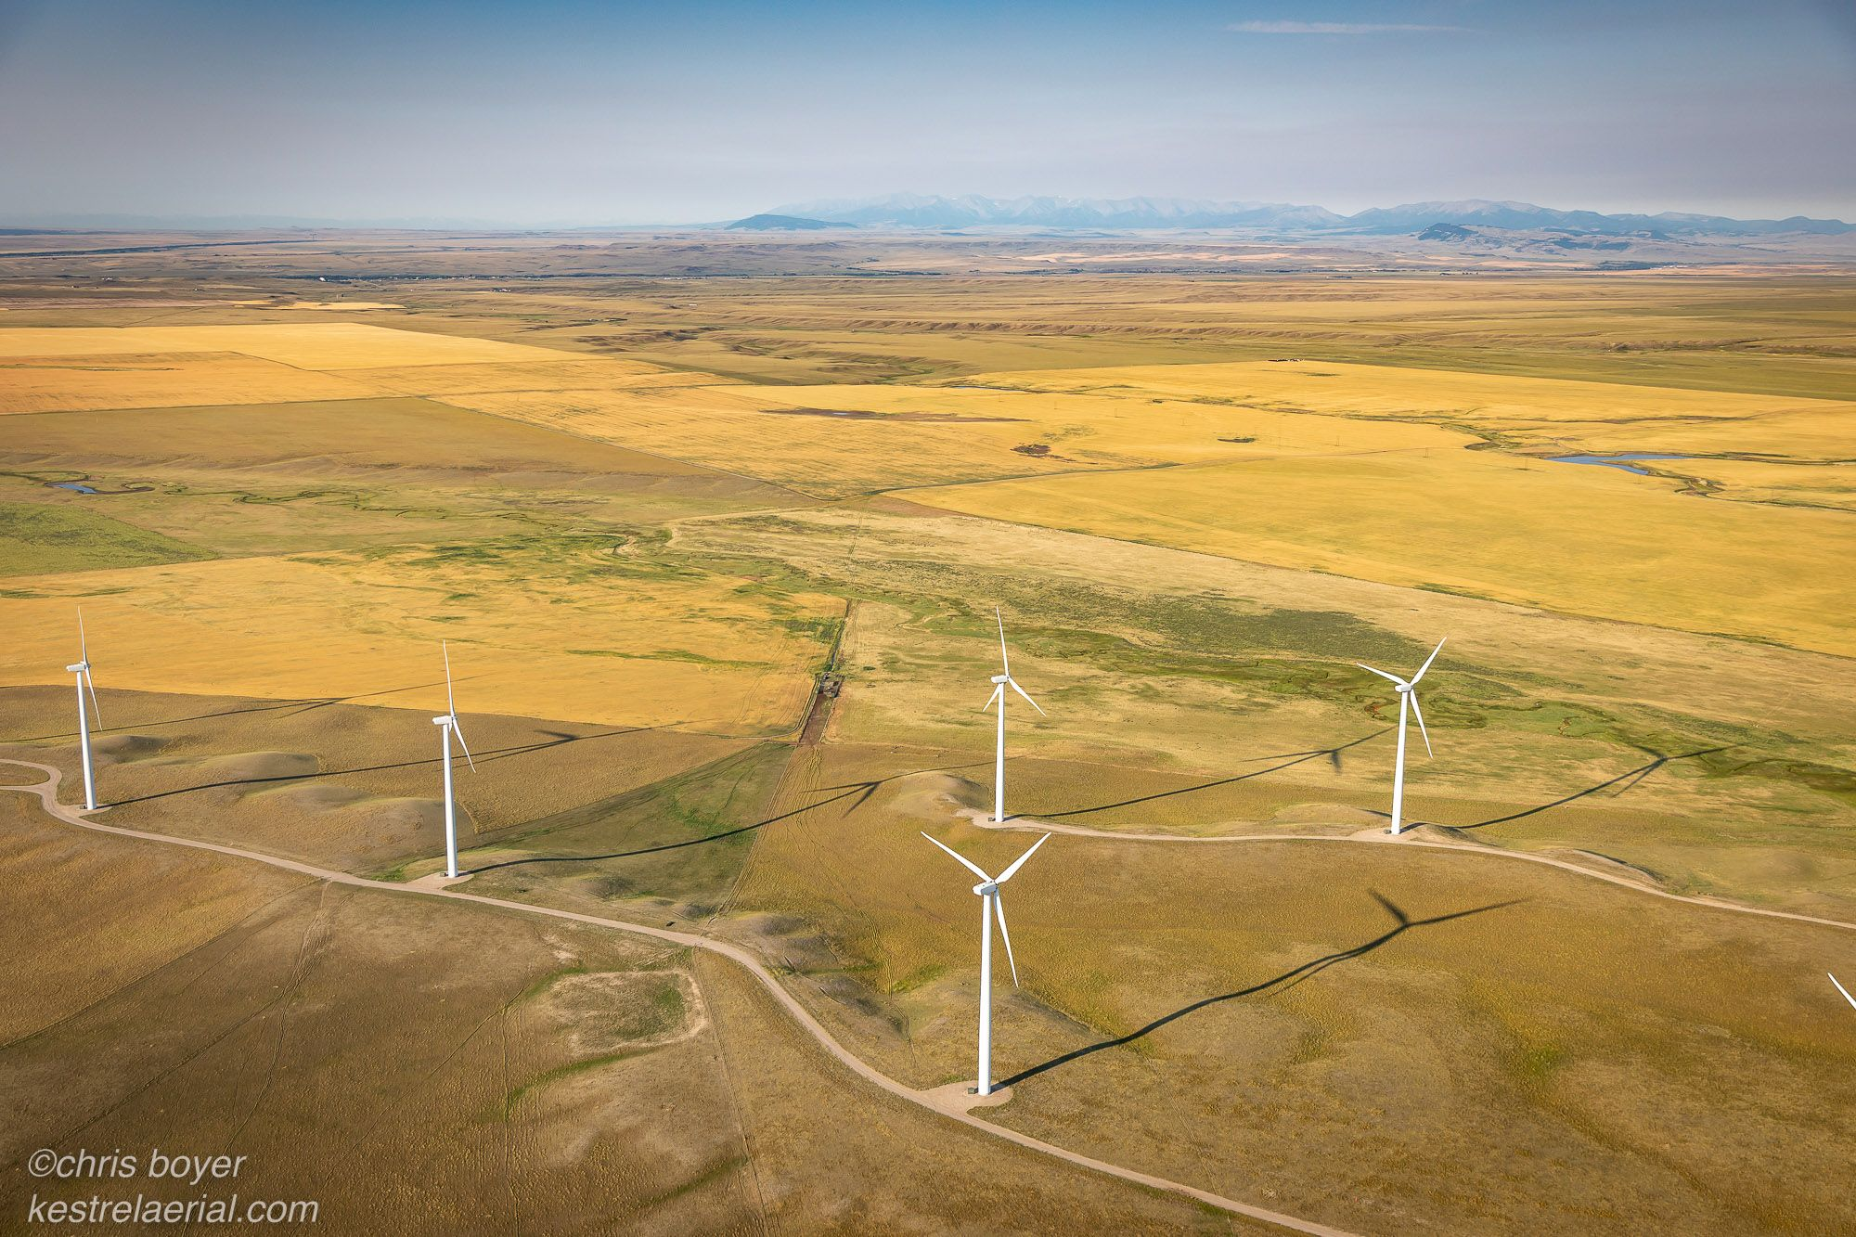
Mitigating Impacts
Screenshot 2023-11-29 at 2.14.28 PM
Mitigating impacts is not a “benefit” – this should be the bare minimum!
  Ideally negotiating benefits goes beyond impact mitigation.
Think long-term and throughout the life of the project. Costs can be short and long-run
  Adaptive planning should account for both
  Project decommissioning is also an impact! Planning for this at the outset is important for mitigating economic impacts to the community, protecting private property rights, & leveraging investment to diversify
Wind energy co-located with agriculture in Central Montana. Photo: Kestral Aerial Photography

Slide 12
Mitigating Impacts Examples
Potential Community Costs & Impacts | Example Strategies to Mitigate
Short run: Capacity (technical, time) limitations on local institutions and community leaders during development
Short run: Construction boom impacts to infrastructure & local workforce
Long run: Over-adapted infrastructure to specific industry = blighted fixed capital liabilities
Long run: Degraded environmental quality, public health concerns

Slide 13
Mitigating Impacts Examples
Potential Community Costs & Impacts | Example Strategies to Mitigate
Short run: Capacity (technical, time) limitations on local institutions and community leaders during development | Technical assistance and advisory support; Regional, intergovernmental coordination to pool capacities
Short run: Construction boom impacts to infrastructure & local workforce | Local hiring and pipeline pathways to sustained employment; Impact fees
Long run: Over-adapted infrastructure to specific industry = blighted fixed capital liabilities | Infrastructure finance/ownership structures to balance risk profile; Retrofit existing industrial facilities
Long run: Degraded environmental quality, public health concerns | Environmental monitoring requirements/ funding; clear remediation responsibility

Slide 14
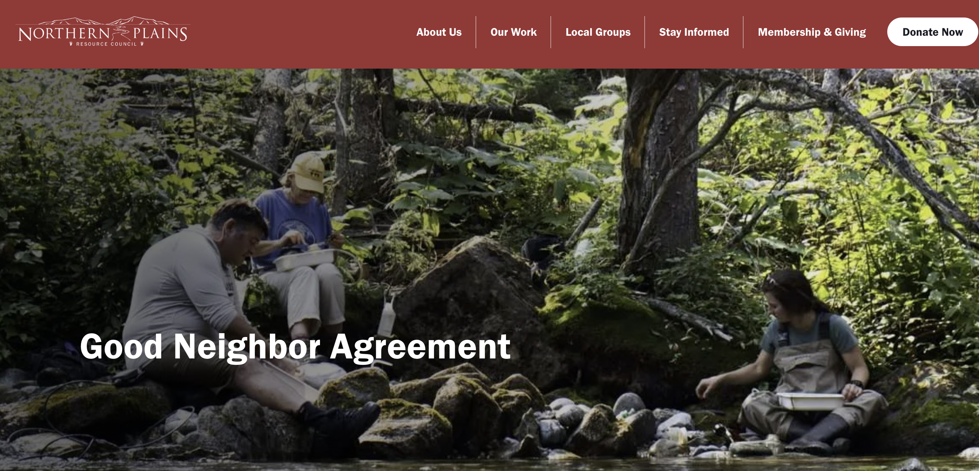
Real World Example: The Good Neighbor Agreement
Signed in 2000 between a community coalition in Stillwater & Sweetgrass Counties (MT) and Stillwater Mine
Focus on mitigating environmental impacts:
  Water Quality Monitoring
  Adaptive Management Planning for riparian ecosystems
  Traffic plans to protect public safety and minimize road impacts of mine production
*See Page 2 in the handout*
More information at: northernplains.org/good-neighbor-agreement/

Slide 15
III. Securing Long-Run Benefits

Slide 16
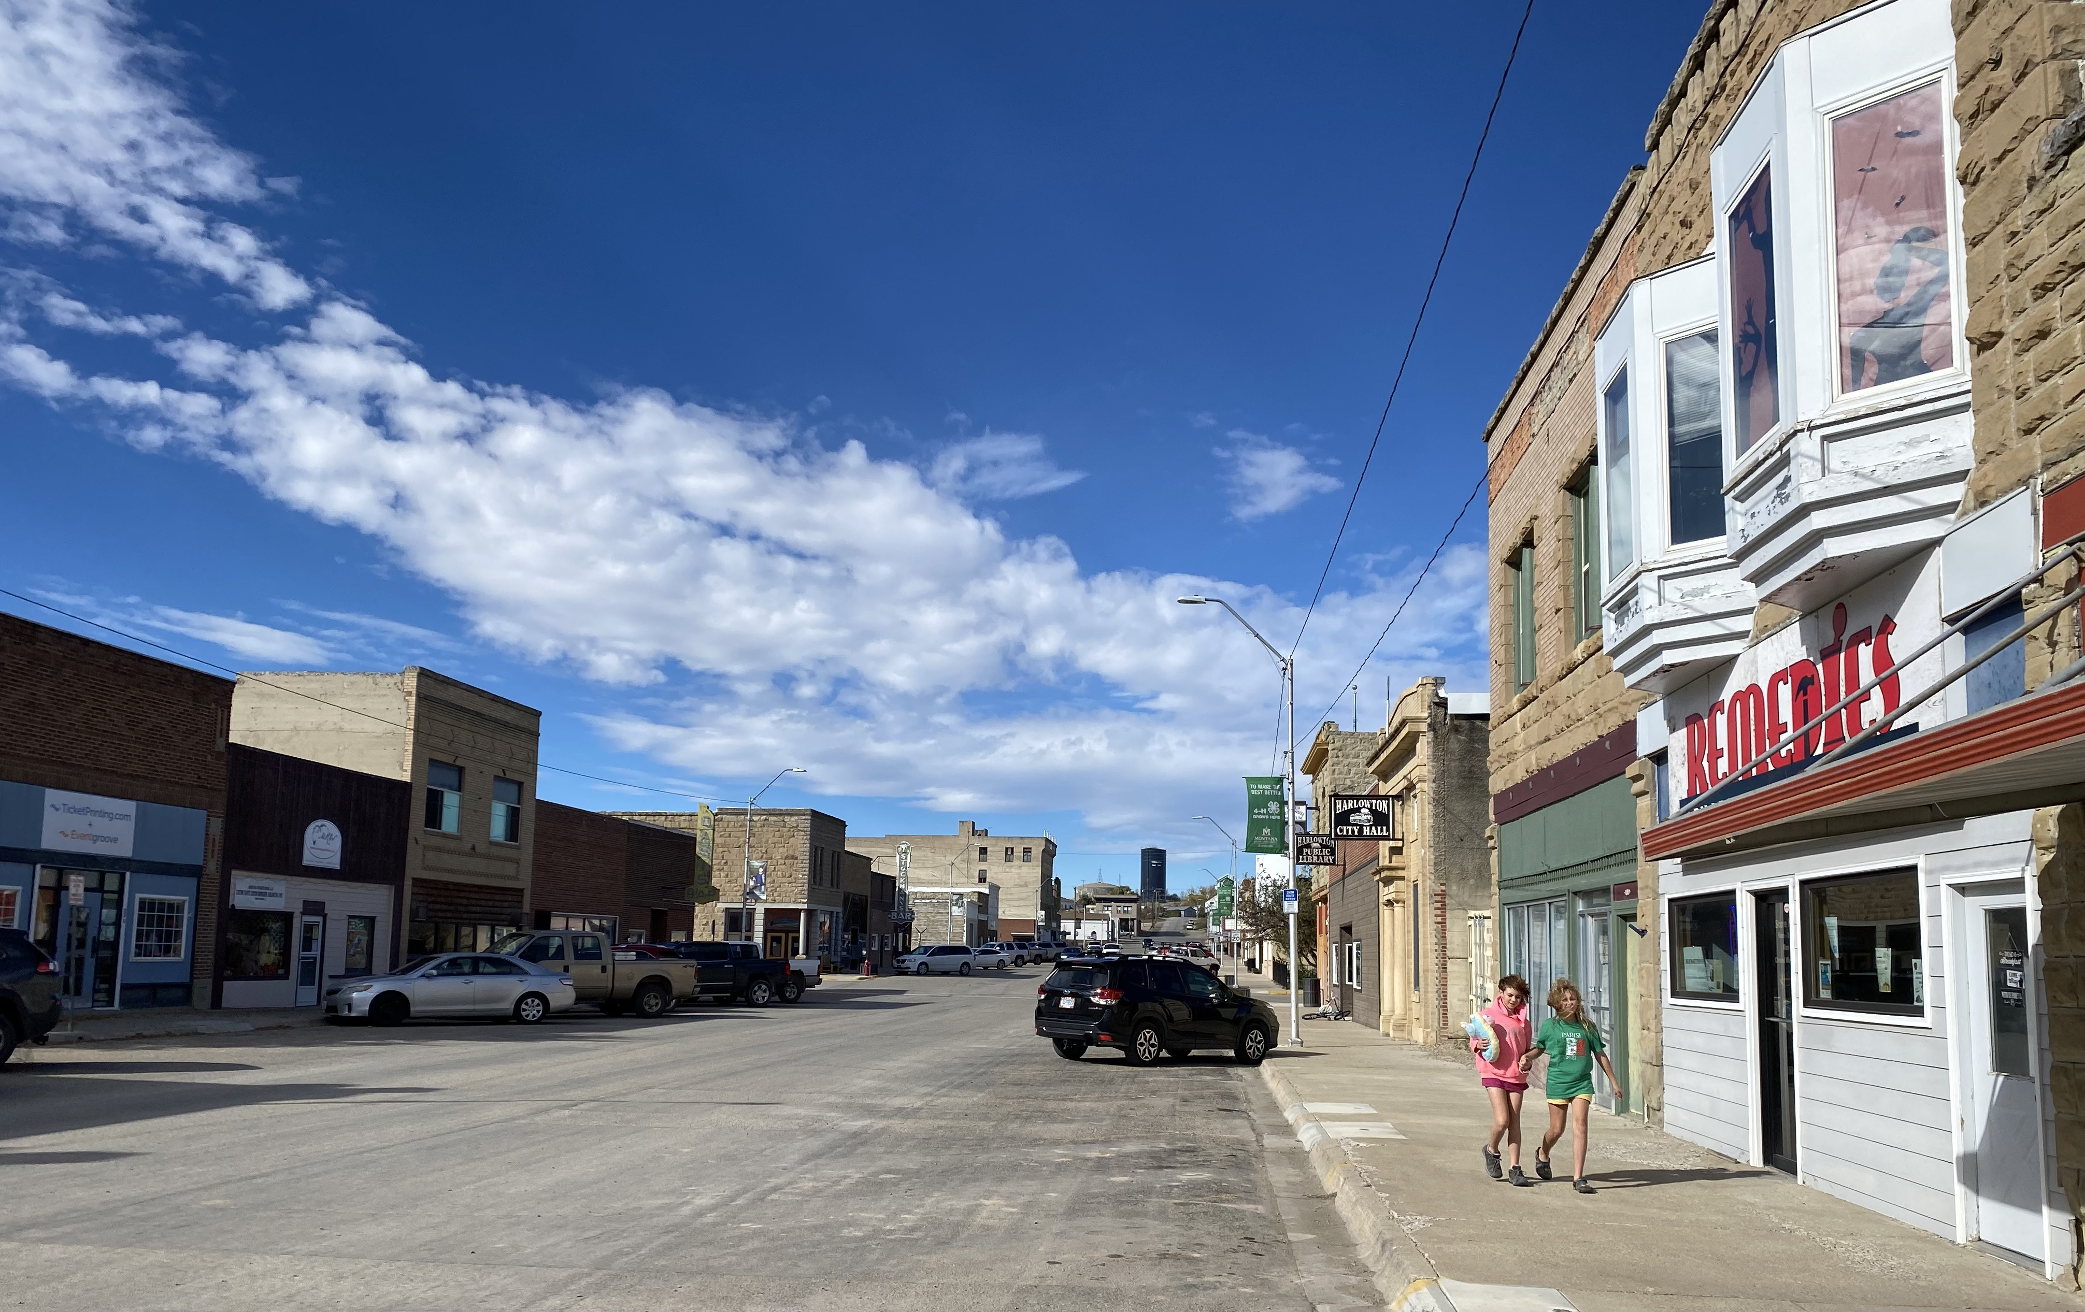
Securing Long Run Benefits
Industry is good at creating short-run benefits. Here, focus on creating lasting benefits ‘beyond the boom’
Multi-stakeholder collaboration and coalition building in developer negotiations
  Not only local governments
  Think beyond what is required in the permitting process
How can the value of this development be embedded locally?
  ...to meet current needs?
  ...for future generations?
  ...to provide high quality services while relieving individual taxpayer burdens?
Photo: Grete Gansauer. Harlowton, MT, October 2023

Slide 17
Potential long-run benefits, maximizing community value
Potential Long-run benefits | Strategies to capture long-run community value
Long run: Improve quality of life and local amenities (e.g., outdoor recreation; leisure facilities; child/senior/healthcare)
Long run: Improve local access to capital and financial capital for community benefit
Long run: Develop infrastructure which meets community/social, not only industrial, need (e.g., emergency services, water/sewer, transportation & mobility)

Slide 18
Potential long-run benefits, maximizing community value
Potential Long-run benefits | Strategies to capture long-run community value
Long run: Improve quality of life and local amenities (e.g., outdoor recreation; leisure facilities; child/senior/healthcare) | Industry partnerships to fund improvements to local services and built capital + facilities for working families
Long run: Improve local access to capital and financial capital for community benefit | Industry partnerships to fund non-profits, a community foundation (endowment), local economic development fund, etc.
Long run: Develop infrastructure which meets community/social, not only industrial, need (e.g., emergency services, water/sewer, transportation & mobility) | Tax structures and impact fees to fund maintenance of high-impact infrastructures; also to distribute investment toward social need

Slide 19
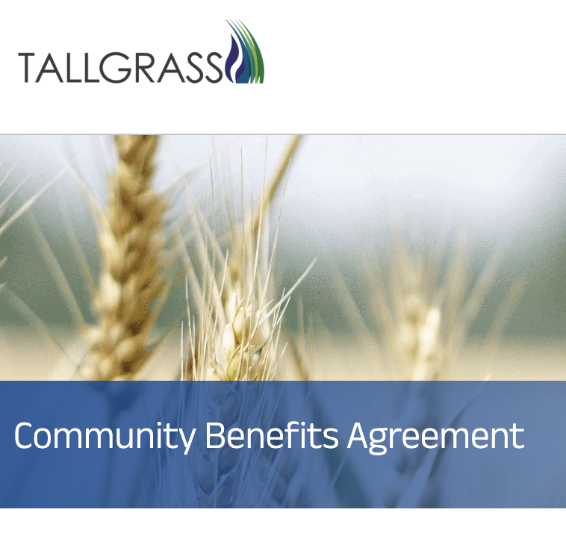
Real World Example: Tallgrass CO2 pipeline, Nebraska
Signed in 2024 between a community coalition and pipeline developers.
Focus on long run benefits & securing value within the community:
  Community fund: $500K for local nonprofits
  Emergency management: $600K for emergency response training, equipment, information management
  Protecting landowners: easements returned to landowners at decommissioning + decide on removal process
*See Page 2 in the handout*
More information at: tallgrass.com/CBA

Slide 20
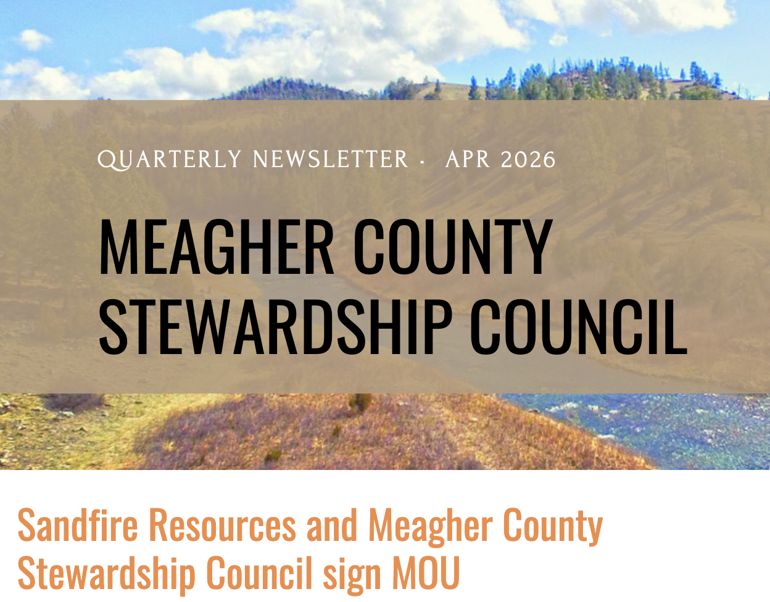
Real World Example: Meagher County Stewardship Council + Sandfire Resources (Montana)
Signed in 2026 between a community coalition and mining company.
Focus on long run benefits & economic diversification beyond mine life:
  Establishes Long-Term Community Investment Fund ($100K/yr. contribution) + Economic Development Revolving Loan Fund
  Capacity: supports operating expenses of community council ($120K/yr.)
  Supports School District educational programs and youth initiatives ($30K/yr.)
  Environmental quality monitoring and management (water quality, weeds, erosion). ($120K+/yr.)
*See Page 2 in the handout*
More information at: meaghercountystewardshipcouncil.org

Slide 21
IV. Key Takeaways

Slide 22
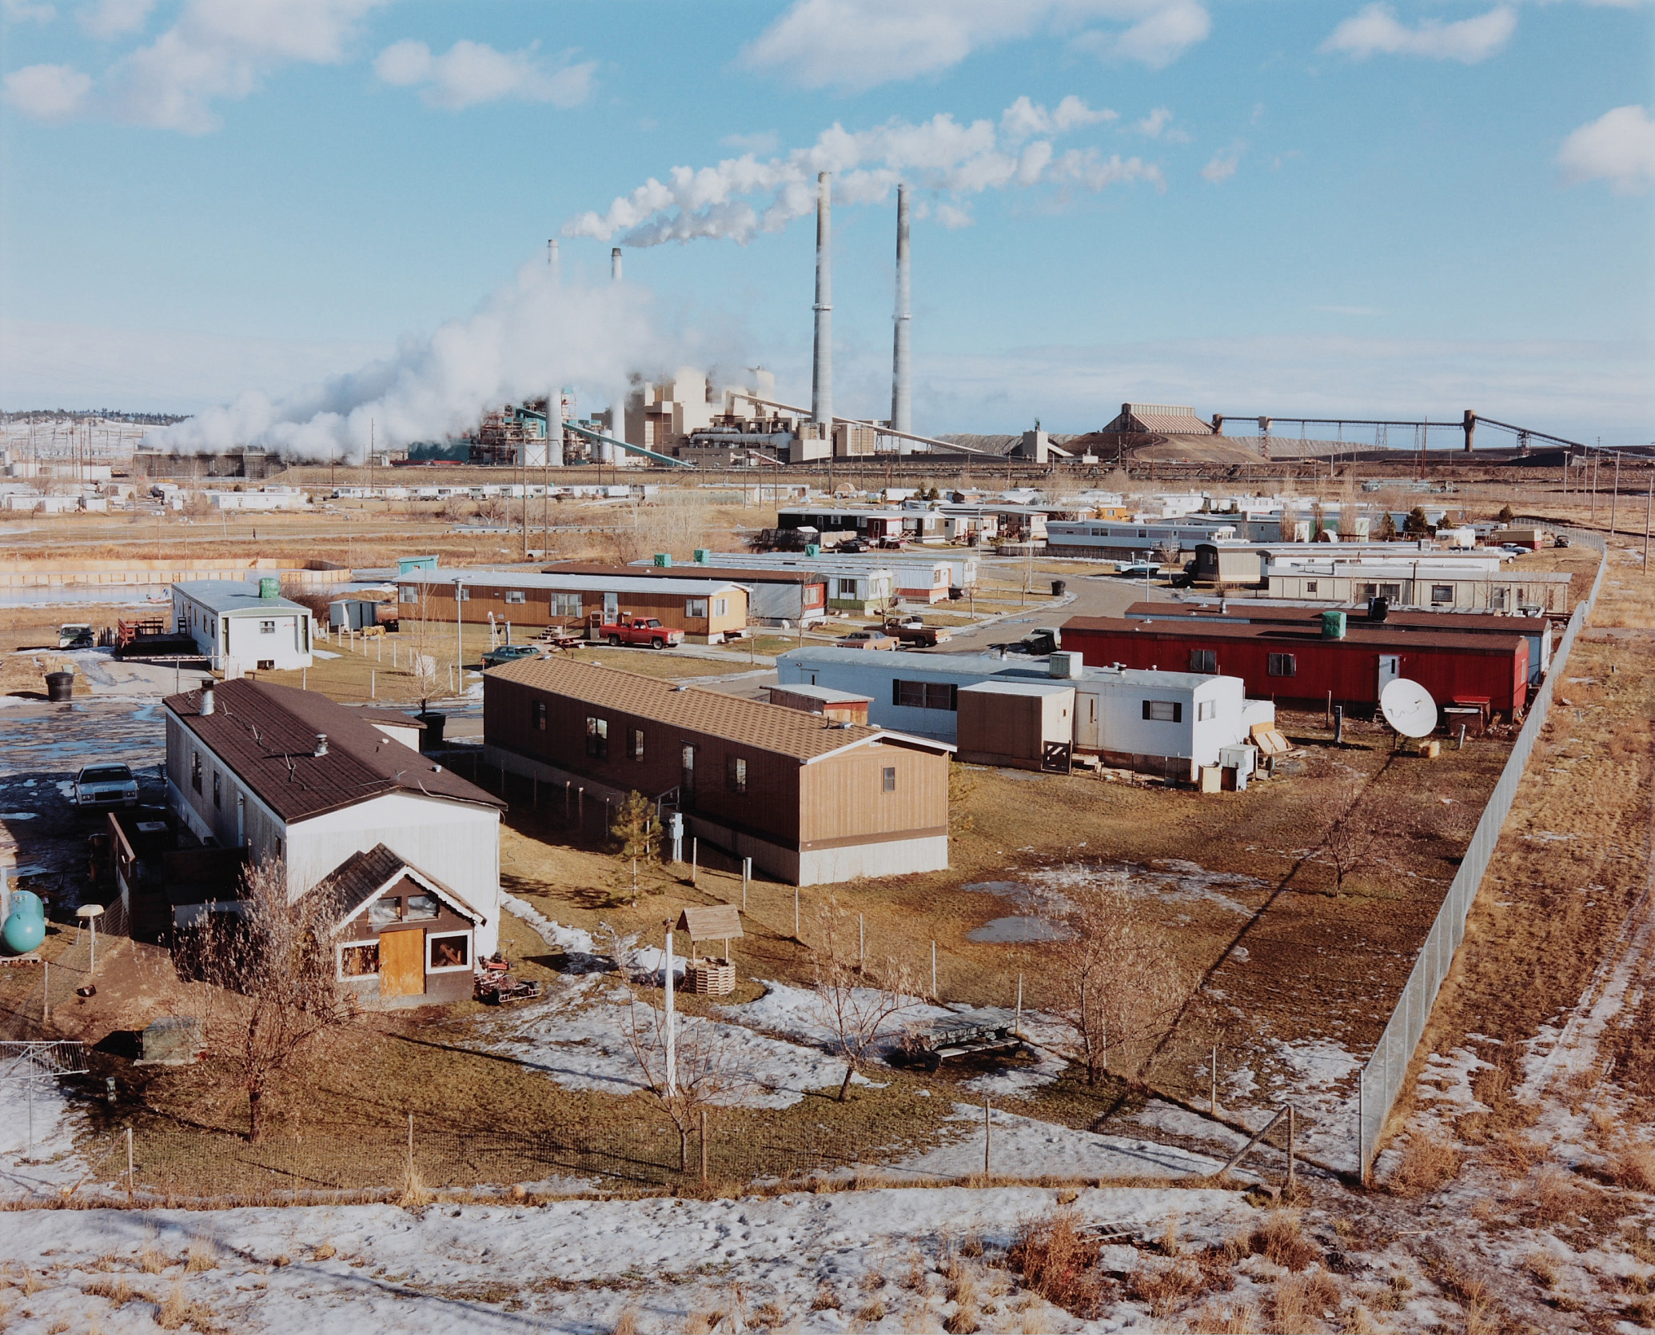
Key takeaways
Screenshot 2023-11-29 at 2.14.28 PM
Building economic resilience is more than attracting projects that bring ‘jobs jobs jobs’
Negotiating and economic planning to build resilience should address both:
Mitigating Impacts
Securing long-run, community benefit
...with a focus on:
Value retention & economic diversification
Environmental Quality
Quality of Life & wellbeing
Meeting need in the community
Collaborative development of community priorities
CBAs offer a roadmap for negotiating community benefits with industrial developers of all kinds
Colstrip, Montana. Photo by David T. Hanson
Notes:
Based on my research,

Slide 23
Questions? grete.gansauer@uwyo.edu

Slide 24
V. Workshop: Mitigating Impacts and Securing Long-Run Benefits Brainstorm

Slide 25
Instructions
Two mini-sessions (25 mins each), within your table groups
Mitigating Impacts Brainstorm
Securing Long-Run Community Benefits Brainstorm
*Refer to pages 3-6 (especially page 4!) in the handout for ideas and examples.*

Slide 26
Mitigating Impacts Brainstorm
In small groups, discuss:
What are impacts you have witnessed from various types of development in communities you know?
  Consider: environmental, social/ cultural, infrastructure, local business, sound/view/landscape
What strategies have you seen, or might be effective, in mitigating impacts?
How might this apply to nuclear or other development in your community?
How might your community need support in mitigating impacts? (technical/legal assistance, regulatory/policy/permitting landscape, governance partnerships, advocacy, etc.)

Slide 27
Securing Long Run Benefits Brainstorm
In small groups, discuss:
What are priorities or needs in your community which would improve quality of life, well being, environmental quality or economic security?
What aspects of incoming development risk making your community more vulnerable?
How the values from 1 & 2 translate into negotiations with a developer? Or, what could you ask for to fulfill these values / needs?
In what ways might your community need support in negotiating or securing long-run benefits?
  Consider: Technical assistance; collaborative facilitation & internal conflict resolution; legal assistance; political organizing; economic planning assistance; public engagement

Slide 28
Wrap Up & Takeaways
What stand-out themes are emerging from this conversation?
In what ways can Ruckelshaus Institute, the facilitators, or others follow-up and build on this conversation?

Slide 29
Thank you! grete.gansauer@uwyo.edu

Slide 30
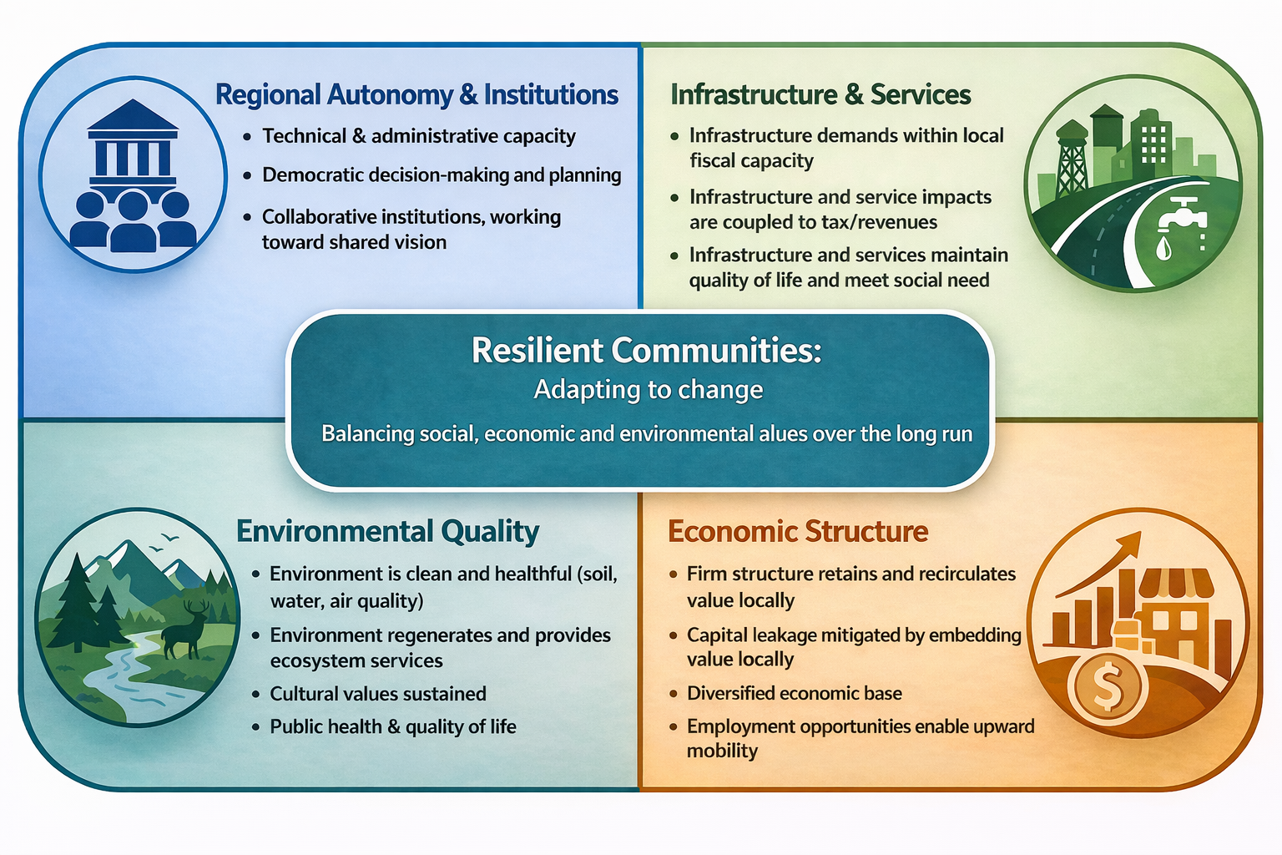
What is resilience?
Notes:
So in thinking about resilient regional economies, we want to see:
Regional autonomy & Institutions– regions have the technical capacity and financial capital to meet their needs, and decisions are driven by democratic engagement
Sustainable infrastructure and public services – infrastructures and public goods which are collectively consumed are sustained by local tax structures and revenue sources, and impacts are coupled to revenue streams
Environmental quality – the environment is clean and healthful, and aligned with local cultural values – especially here in Wyoming where we value open space and the outdoors
And Economically – Economic structure retains and recirculates value locally, community members have pathways to build a livelihood and experience upward mobility and economic opportunity
Note that this goes a bit deeper than “jobs jobs jobs!” – because when industry comes to town, the people in those jobs jobs jobs are going to need housing, wrap around and basic services, and the amenities that make for a strong quality of life
Social capital: High local autonomy/ self determination; democratic & inclusive decision-making; productive affective stance
Environmental capital: Clean & healthful environment, industrial harms mitigated, resource/economic base maintained, intact ecological function.
Economic capital: Firm structure retains/circulates value locally, local government revenues sufficient, local pathways for upward mobility
Public service and infrastructure provision: Local institutions can meet demand for basic/critical services

Slide 31
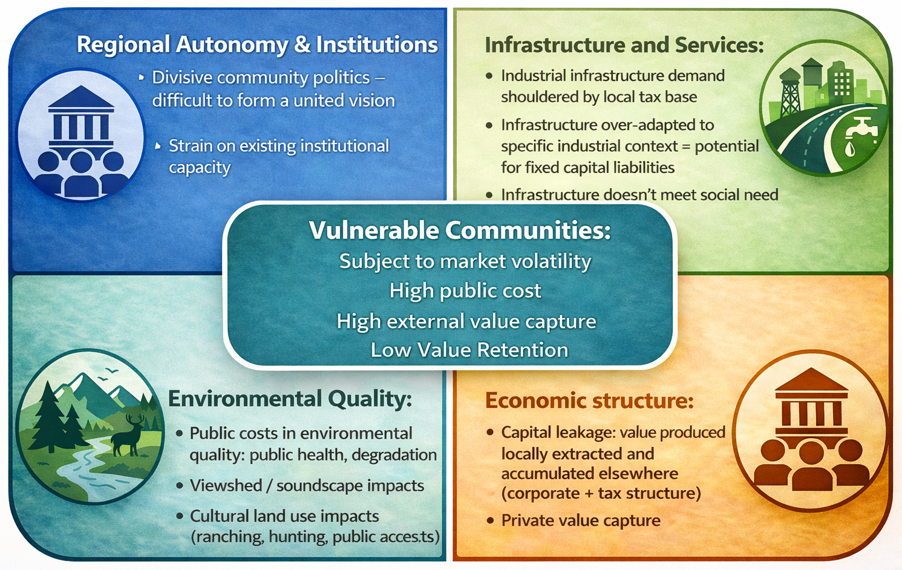
Why does industrial development tend to threaten resilience?
Notes:
For regional autonomy and institutions – think about process. It’s not only about the outcomes, but also the process f how developers enter a community
Don’t forget – cultural land use can be simple, it doesn’t have to be a sacred burial site to have a cultural impact on the community. For example, I worked with a community where an abandoned industrial site was used by locals as a dog walking area and as kids for biking. So when the site became redeveloped, that threatened that cultural land use!

