Slide 1


Nuclear Workforce Development
at
UW School of Energy Resources
Selena Gerace
Nuclear Energy Emerging Issue Forum
April 14, 2026

Slide 2

Workforce Training Pathways
1. High School / Apprenticeships
2. Trade Schools and community colleges
3. University of Wyoming
4. Employment-Direct and Indirect jobs
5. Upskilling-bootcamps internships

Slide 3
Types of Workforce Needs for Nuclear Industries
Skilled Trades
Business, Legal, Communications, and Policy
Engineers, Technicians, and Radiologists
Carpenters
Electricians
Operators of Heavy Equipment
Masons
Pipefitters
Sheetmetal workers
Welders
Mechanics
Project managers
Accountants
Cyber Security Specialists
Communicators
Health Physicists
Lawyers
Subject Matter Experts
Policy Analysts
Entrepreneurs
Financial Managers
Chemists
Chemical Engineers
Radiation Protection Specialists
Reactor Operators
Scientists
Nuclear Engineers
Safety and Environmental Impact Specialist
Civil Engineers
Mechanical Engineers

Slide 4

Nuclear Workforce Training Across UW
Many departments and areas of expertise contributing to nuclear workforce training:
  The School of Energy Resources
  College of Engineering and Physical Sciences
    Mechanical Engineering
    Chemistry
  Utilizing longstanding strengths in Mining, Petroleum Engineering, Materials Science, Chemistry, and Geoscience

Slide 5

Nuclear Workforce Development at UW School of Energy Resources
Nuclear Science Certificates
  Partnership with College of Engineering and Physical Science
Nuclear Modules for High School Student
Nuclear Energy Research Center​ (NERC)
  Student research opportunities
  Increasing nuclear research and educational capacity

Slide 6
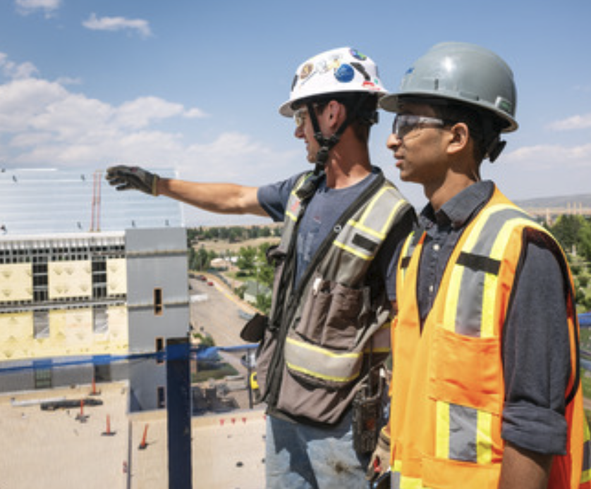
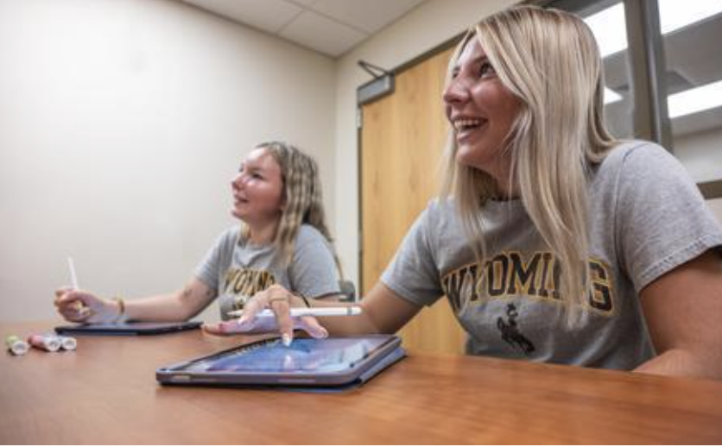
Nuclear Science Certificates
Undergraduate and Graduate Level
15 Credit Hours
Courses
  Nuclear Energy Physics
  Nuclear Power Systems
  Law and Nuclear Technology
  Nuclear Fuel Cycles
  Nuclear Forensics
  Nuclear Materials
  Advanced Energy Project Outreach and Communications
In-person
  Exploring opportunities to make it online to extend reach and accessibility​
Began in Fall 2025

Slide 7
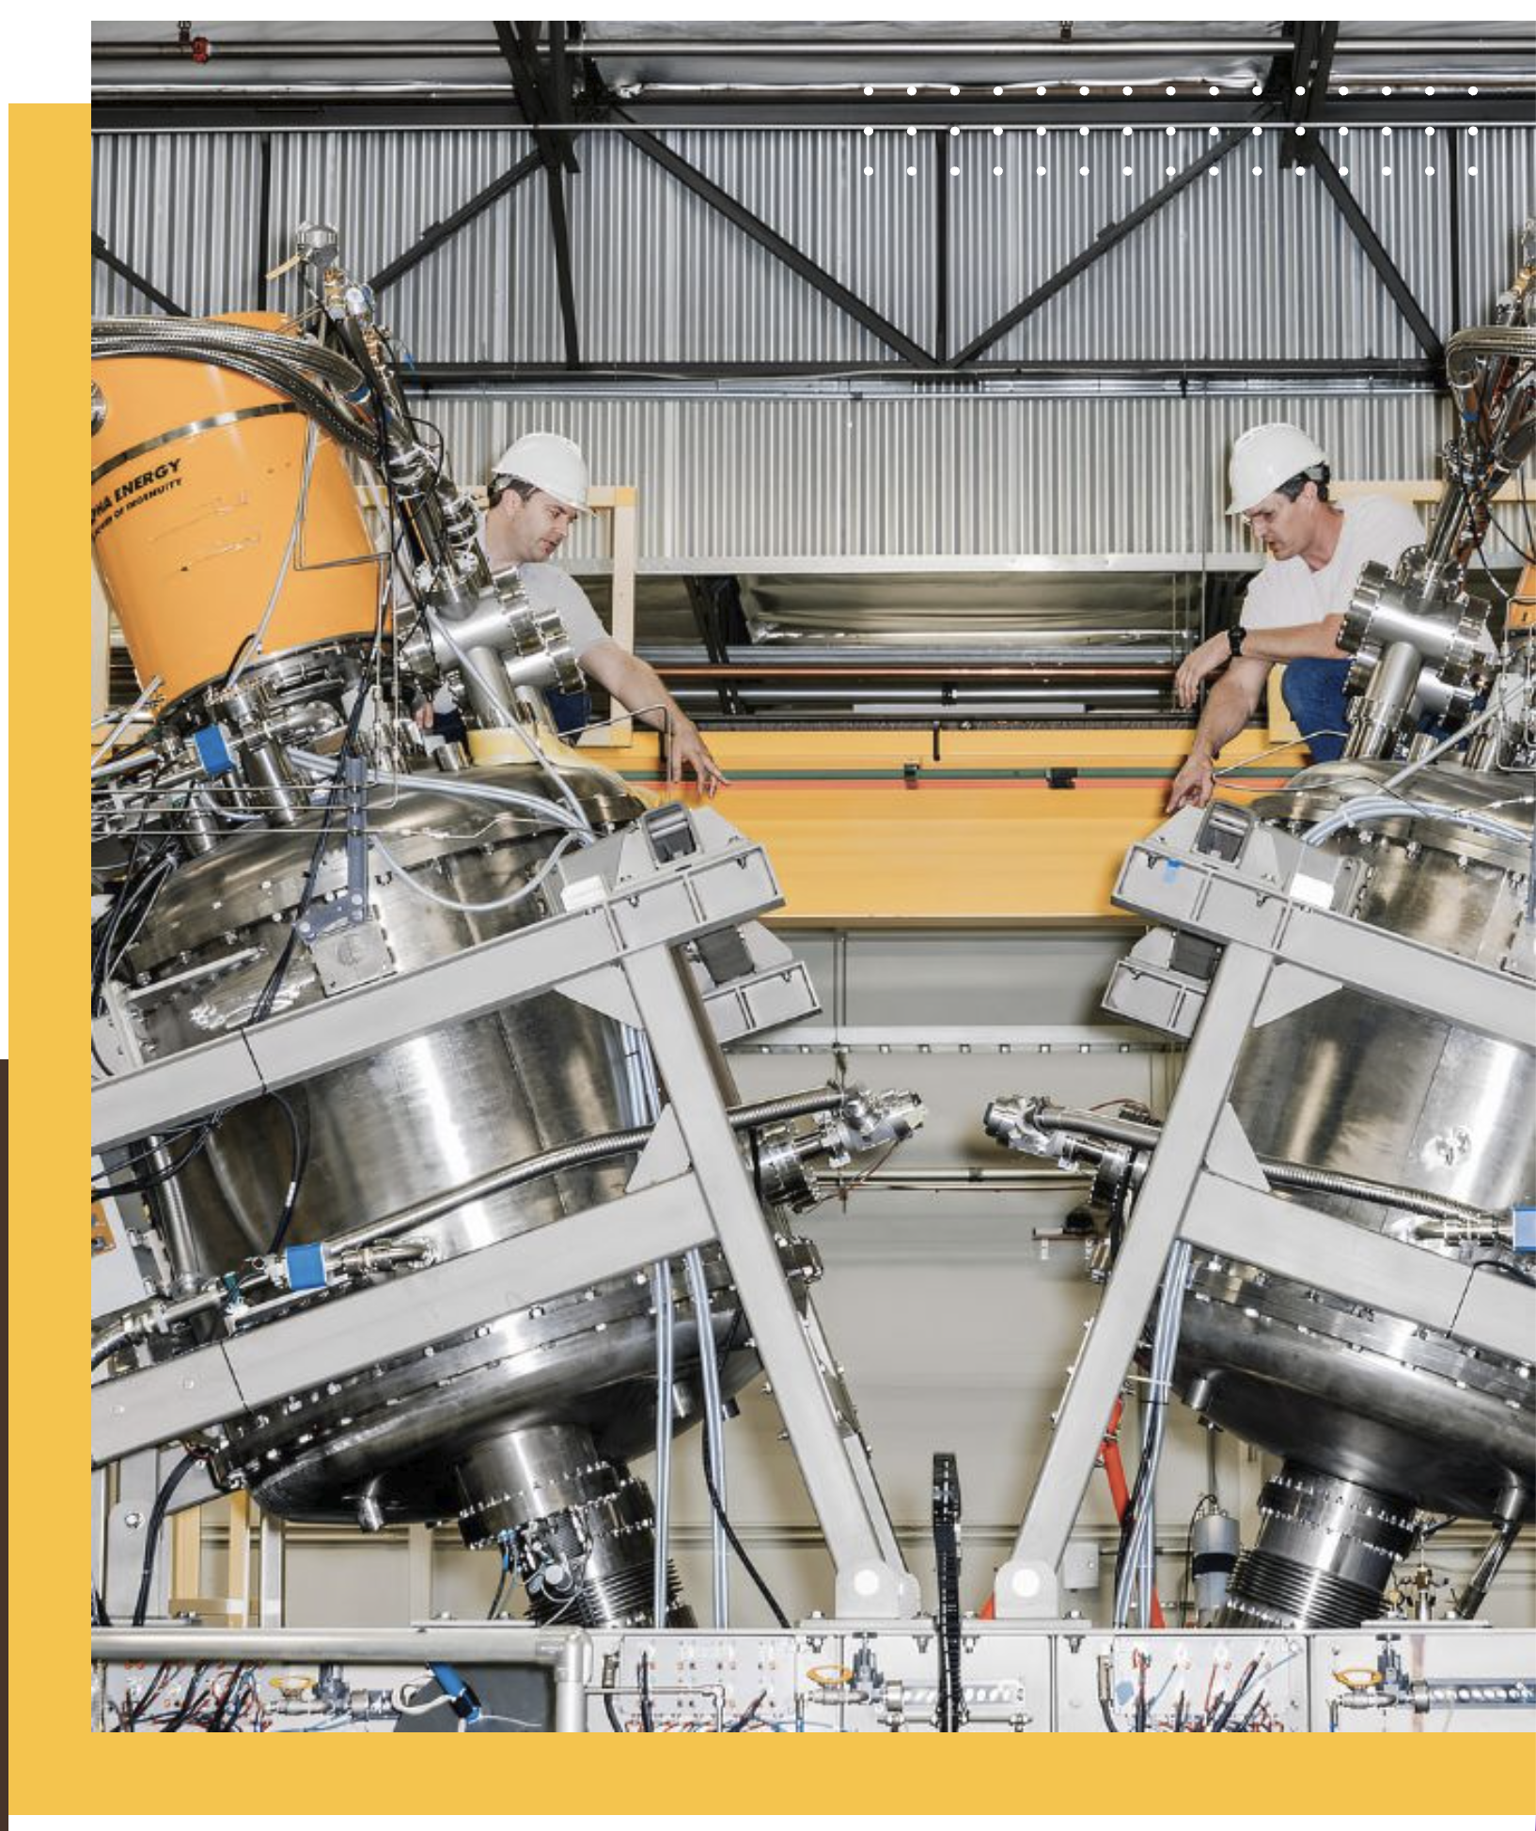
Nuclear Science Certificates
Developed based on industry feedback of workforce needs​
  TerraPower and BWTX​
  Programs like Chemistry and Mechanical Engineering provide a lot of the necessary training, but need some nuclear specifics training to be competitive for jobs
Current Enrollment
  8 Undergraduate students and 1 Graduate student
    Physics, Mechanical Engineering, Petroleum Engineering, Chemical Engineering, Chemistry, Environmental Geology, and Electrical Engineering
  Many classes have had much higher enrollment
    A total of over 80 students enrolled in Nuclear Science Certificate classes

Slide 8
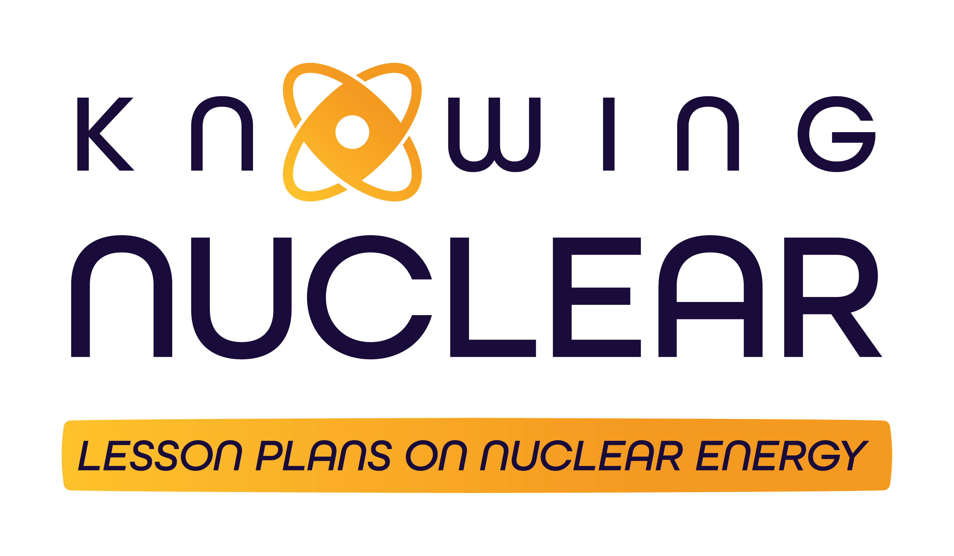
Nuclear Modules for High School Students
Knowing Nuclear (in-development)
  7 Modules, topics such as:
    Nuclear Science: How Do Nuclear Reactors Work?
    Introduction to Nuclear Forensics
    Overview of Radioactive Waste
  Aligned to State Standards
Uranium Modules (on website)
  Students use methods from geology, geophysics, computer science, chemistry and engineering to identify where uranium deposits are located
  Aligned to State Standards

Slide 9
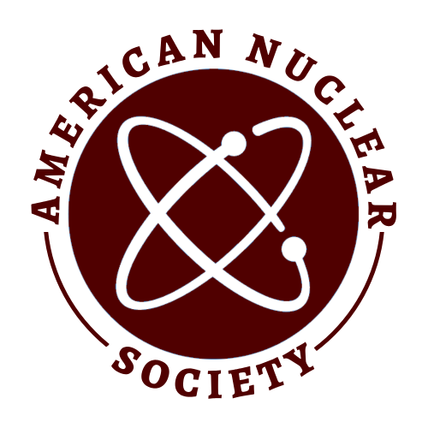

SER’s Nuclear Energy Research Center
Nuclear Energy Research Center​ (NERC)
  Student research experience, projects such as:
    Open Architecture for Nuclear Reactor Design (DOE-funded project)
    Evaluation of licensing process Terrapower facility
  Student Chapter of American Nuclear Society established at UW
  Established Wyoming's first nuclear chemistry core facility
    DOE-supported
    Enabling practical wet chemistry and analytical work​
  Hosted the Nuclear Innovation Bootcamp in 2024​
    Training for students and early-career professionals
    A non-profit organization, housed within the Nuclear Innovation Alliance.
    2-week intensive seminar-style workshop combined with group projects

