Slide 1
Nuclear Energy – An Emerging Issues Forum
Milling and Mining – A State of the Industry
April 13, 2026
Lost Creek ISR Processing Plant

Slide 2
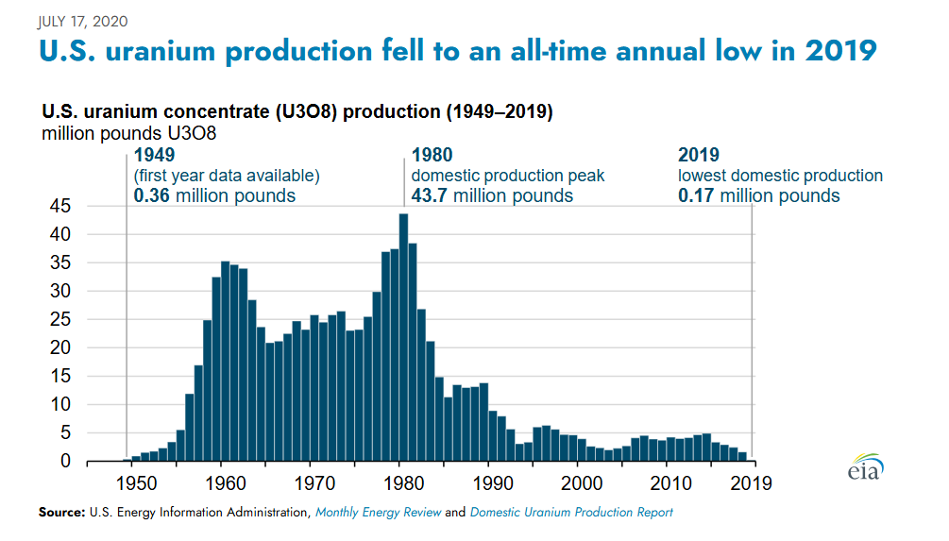
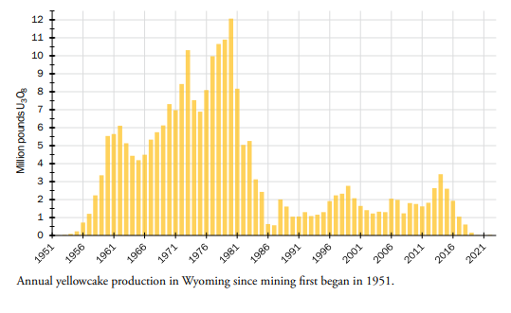
Historic USA/Wyoming U3O8 Production
Ur-Energy’s Wyoming Uranium Assets
Wyoming has been a significant producer in the past
WSGS

Slide 3
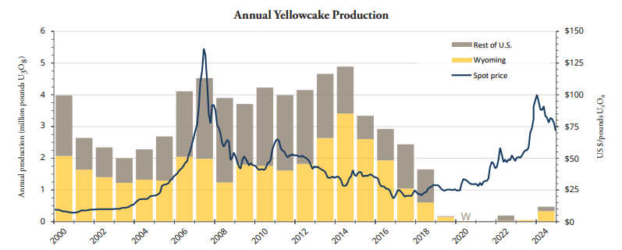
Total USA – Historic U3O8 Production
Over last two decades, Wyoming has produced the majority of the USA’s uranium
Ur-Energy’s Wyoming Uranium Assets
WSGS
Dramatic increase in USA in 2025

Slide 4
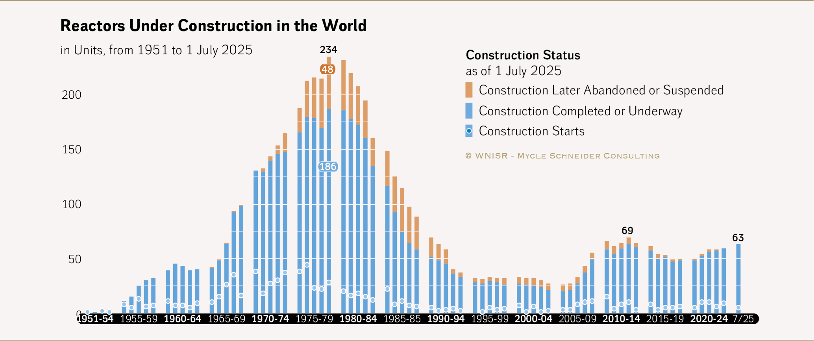
Nuclear Powerplant Construction
Approximately 50% of the nuclear powerplants currently in construction are in China
Ur-Energy’s Wyoming Uranium Assets
As of April 2026, there are 94 operable nuclear reactors in the USA

Slide 5
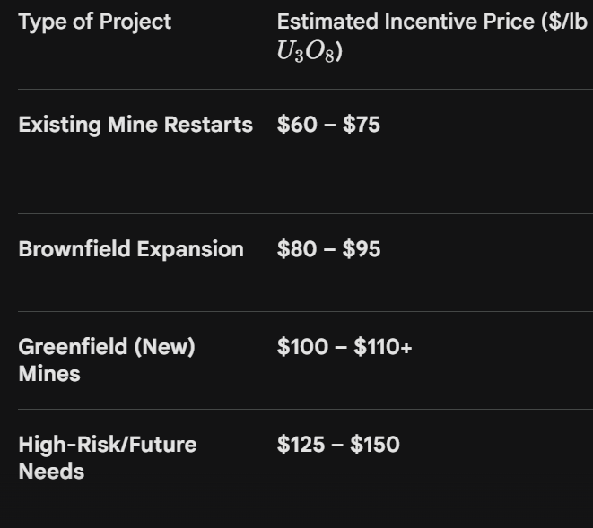
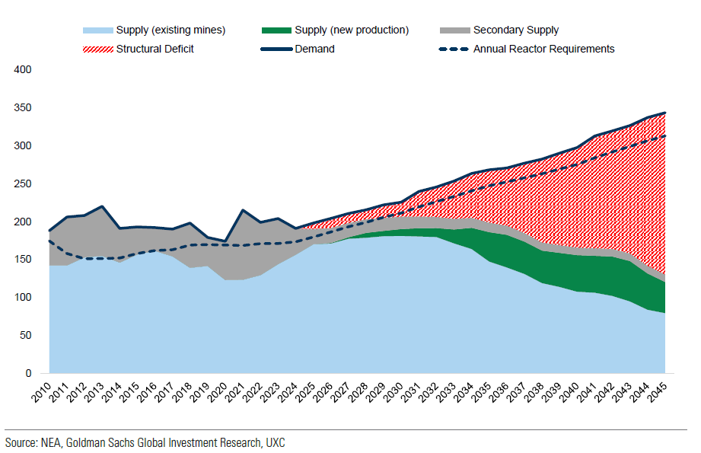
Uranium Supply Demand Curve
Incentive Pricing Estimates - 2026
Ur-Energy’s Wyoming Uranium Assets
In-Elastic Demand
million lbs
Combined estimated mineral resources for Lost Creek and Shirley Basin are 21.0M lbs. Measured and Indicated and 10.4M lbs. Inferred
A typical nuclear powerplant requires 500,000 lbs (250 tons) of U3O8 equivalent per year.
A similar sized coal fired plant would require 3.75 million tons of coal.

Slide 6
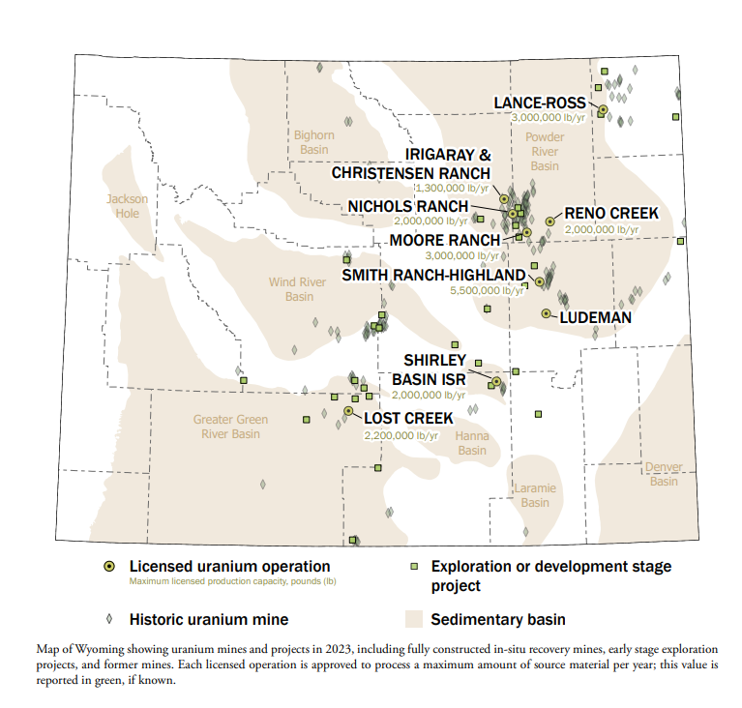
Wyoming – 2023 ISR Expl/Dev/Prod Activity
Ur-Energy’s Wyoming Uranium Assets

Slide 7
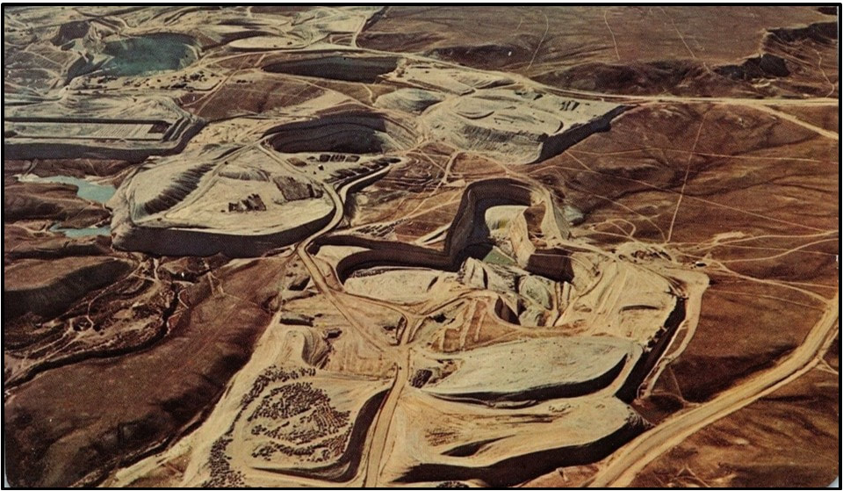
What does a uranium mine look like?
Historically
Photo of Gas Hills from late 1970’s

Slide 8
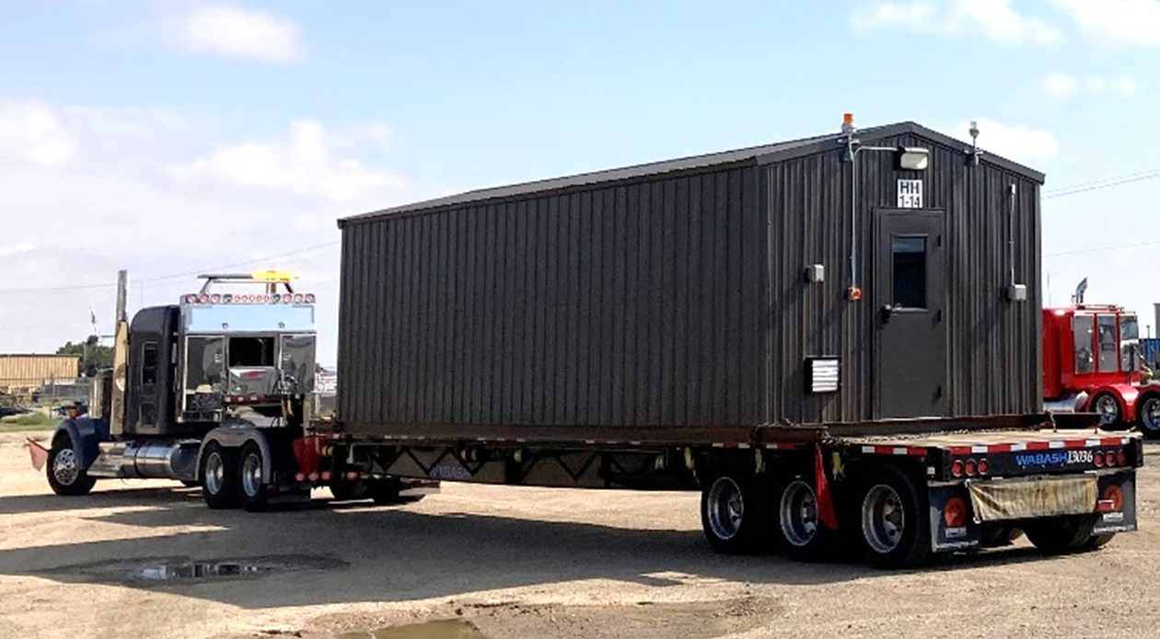
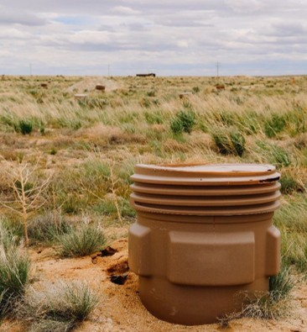
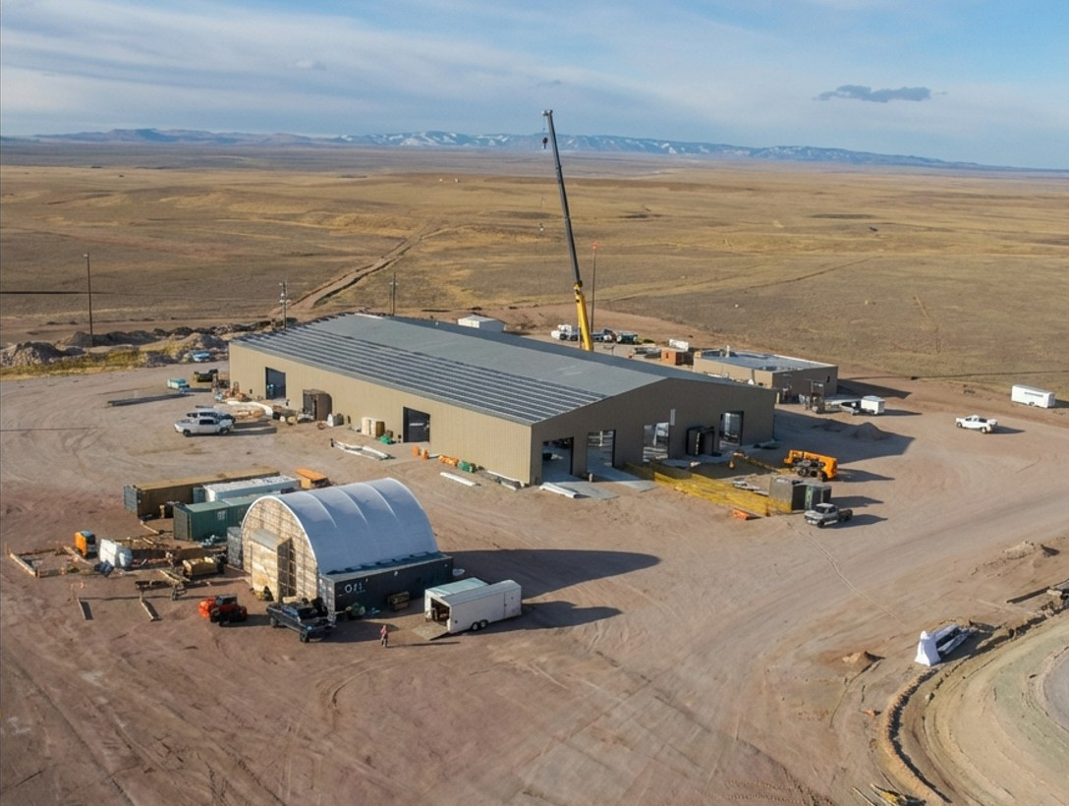
What does a uranium mine look like?
Today
Ur-Energy Operations - Current

