Slide 1
Nuclear Energy:
A Brief History
Christine King
Idaho National Laboratory

Slide 2
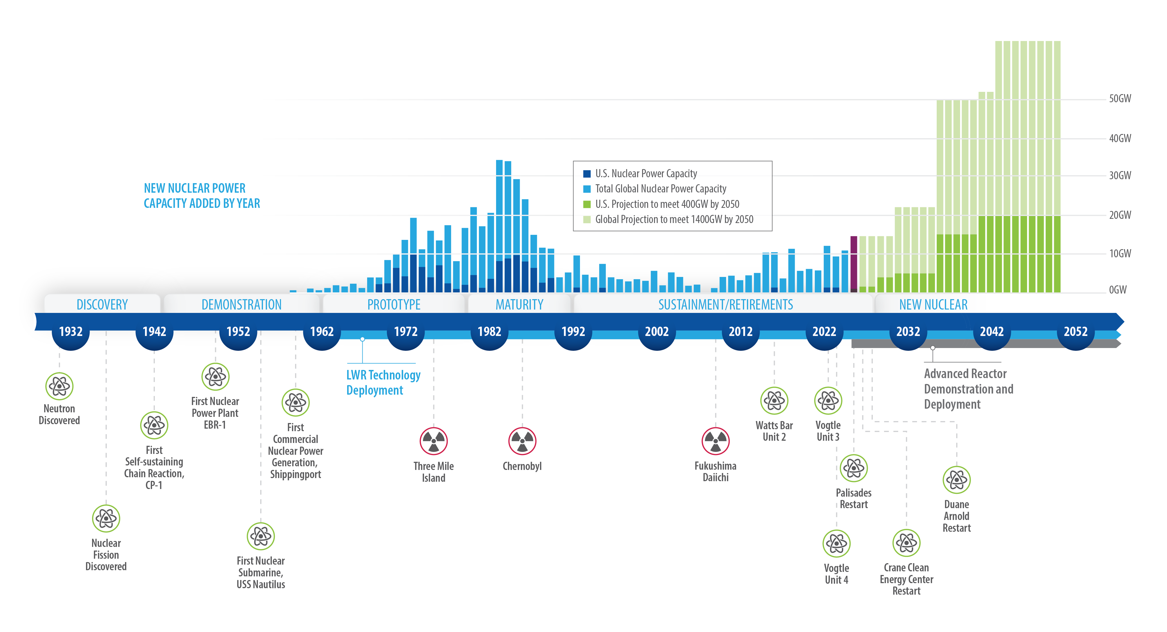
The past and future of nuclear power
Notes:
23-50477-R19_Nuclear_History_Timeline-2052*
Source: https://www.spglobal.com/marketintelligence/en/news-insights/latest-news-headlines/new-build-nuclear-must-face-down-industry-s-costly-past-72854285
All global capacity including US) additions 1960- present plus projection to 2050: https://www.spglobal.com/marketintelligence/en/news-insights/latest-news-headlines/new-build-nuclear-must-face-down-industry-s-costly-past-72854285
U.S capacity: 1970-2023: https://www.eia.gov/todayinenergy/detail.php?id=57280
US capacity prior to 1960: https://www.eia.gov/todayinenergy/detail.php?id=30972
US projected capacity: https://liftoff.energy.gov/advanced-nuclear/

Slide 3
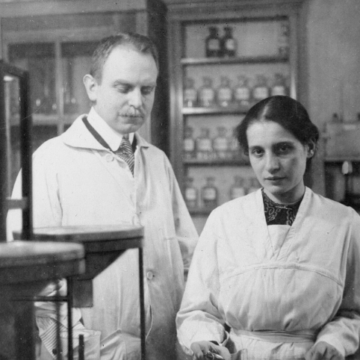
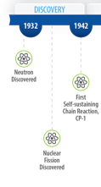
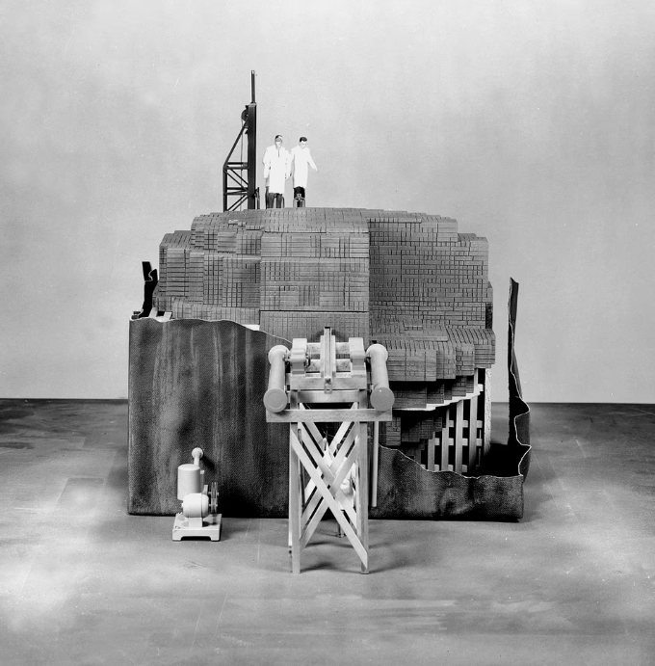
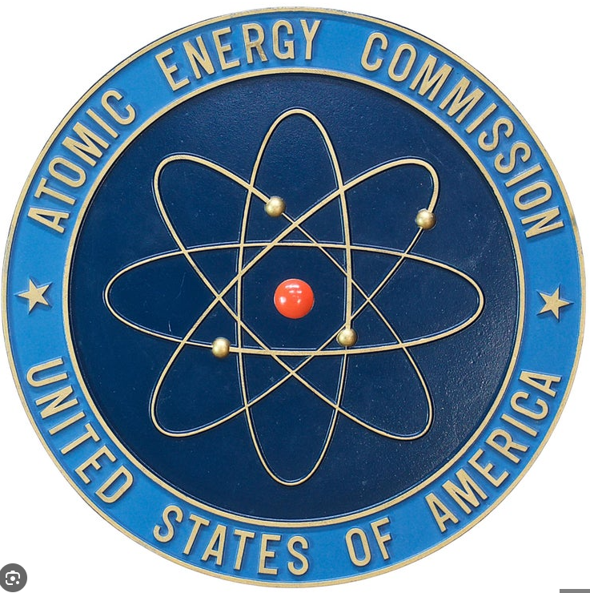

Discovery of the Neutron and Atomic Energy
Discovery of electron (1897)
Atom has a complex structure
Discovery of proton (1919) and neutron (1932)
Discovery of Atomic Energy (Fission)
In Germany 1938: bombarding elements with neutrons
European scientists immigrate to US
Einstein letter to Truman led to early Government support 1939-1941
Pearl Harbor Dec 7, 1941, accelerates research
Manhattan Project
Pile experiments and creating a self-sustaining reaction: CP-1
Establishment of laboratory complex
1945 Hiroshima and Nagasaki
Notes:
During neutron bombardment, nuclei of most elements changed somewhat,
uranium nuclei changed greatly
loss of mass resulting from the splitting process must have been converted into energy in the form of kinetic energy that could in turn be converted into heat
The possibility of such a "chain reaction" (left) completely altered the prospects for releasing the energy stored in the nucleus. A controlled self-sustaining reaction could make it possible to generate a large amount of energy for heat and power, while an unchecked reaction could create an explosion of huge force.

Slide 4
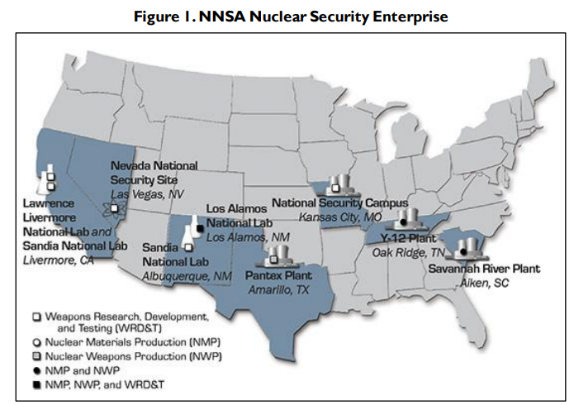
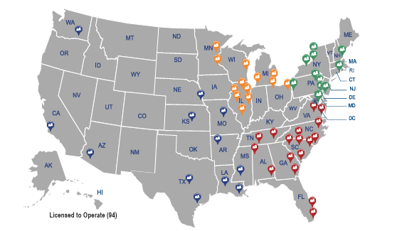
1940s First Reactor and Peaceful Use Atomic Energy
Pivot Point: Atomic Energy Act of 1946
Atomic Energy Commission
Civilian control of nuclear energy development
Two development tracks for nuclear energy. Defense (weapons) and power generation (military and commercial)
Notes:
he nuclear weapons complex (referred to as the Nuclear Security Enterprise by DOE) consists of namely nine government-owned, contractor-operated sites in seven states and a Tennessee Valley Authority (TVA) nuclear reactor. These nine sites include three laboratories, five component fabrication/materials production plants, one assembly and disassembly site, a geologic waste repository, and one testing facility that now conducts research. The overview summarizes operations at each of these sites.
National Labs:
Los Alamos National Laboratory
Lawrence Livermore National Laboratory
Sandia National Laboratories
Testing and Research:
Nevada National Security Site
Production:
Kansas City National Security Campus
Savannah River Site
Pantex Plant
Y-12 National Security Complex
TVA’s Watts Barr Reactor
Support:
Waste Isolation Pilot Plant (WIPP)

Slide 5
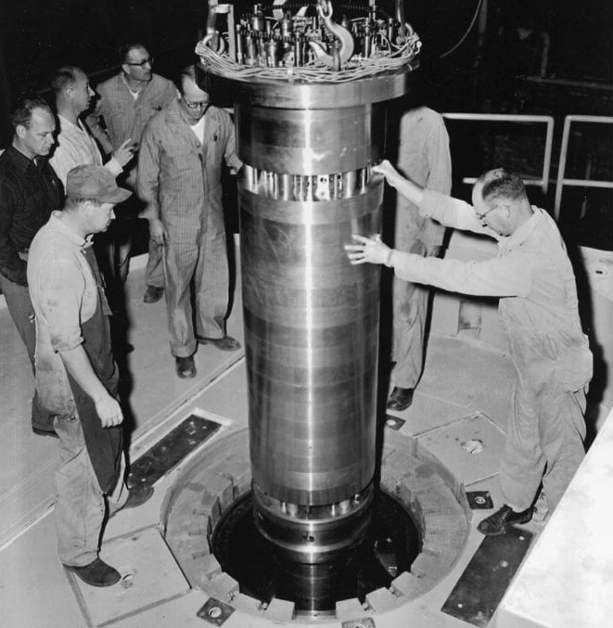
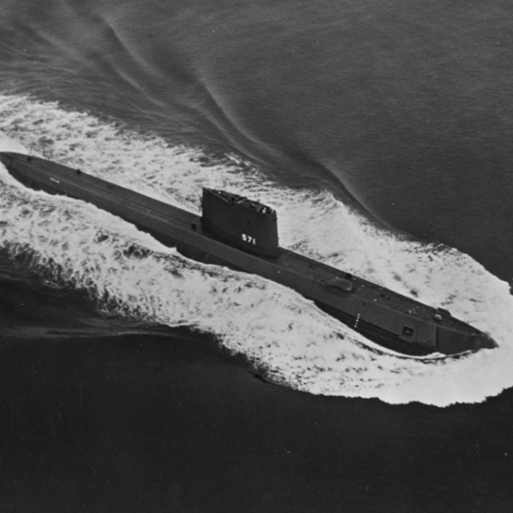
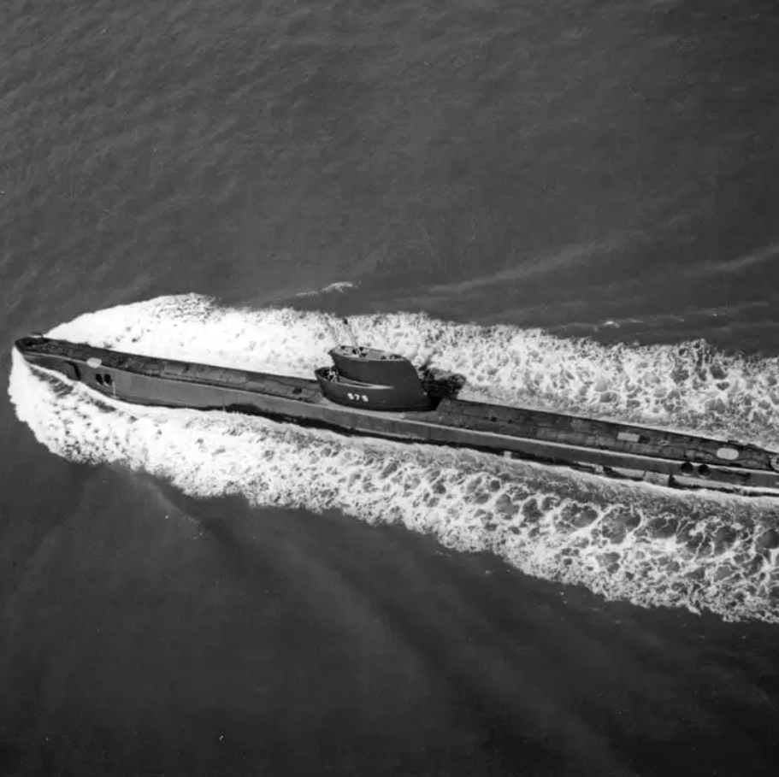
Labs Take the Lead: Propulsion for Navy, Power for the People
EBR-I
Early Experimental Reactors
1940’s: Clementine, X-10, and CP-3
1951: EBR-I (INL), First reactor to produce useable power; initial concept based on uranium scarcity
Naval propulsion:
1954: S1W (PWR) prototype; used in the Nautilus
1955: S1G (sodium) prototype; used in the Seawolf. Sodium offered better performance, but the power conversion technology was not mature
Commercial Shipping: 1959-1972
NS Savannah, first nuclear-powered (PWR) cargo ship
MGCR (Maritime Gas Cooled Reactor project)
GE 630 air cooled reactor project
Seawolf
Nautilus

Slide 6
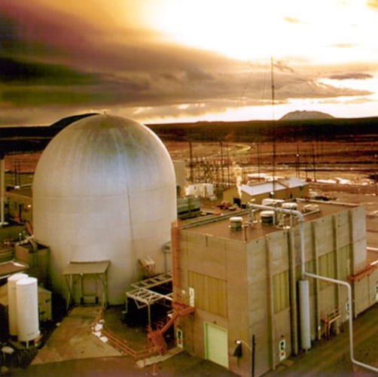

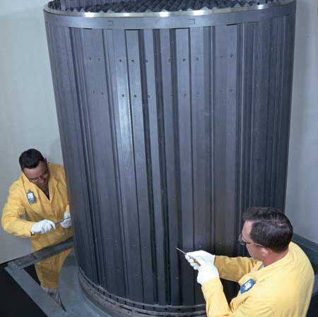
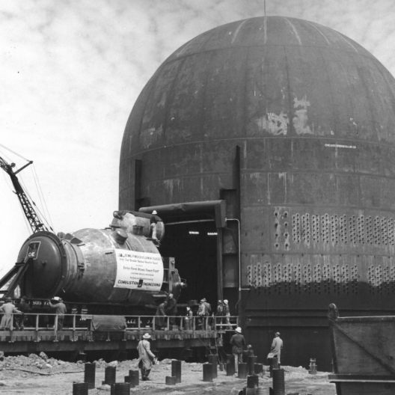
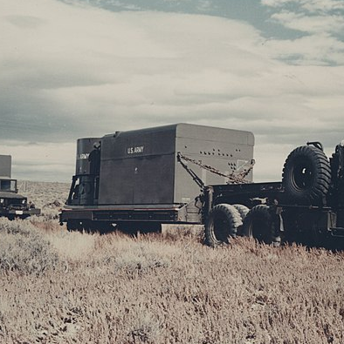
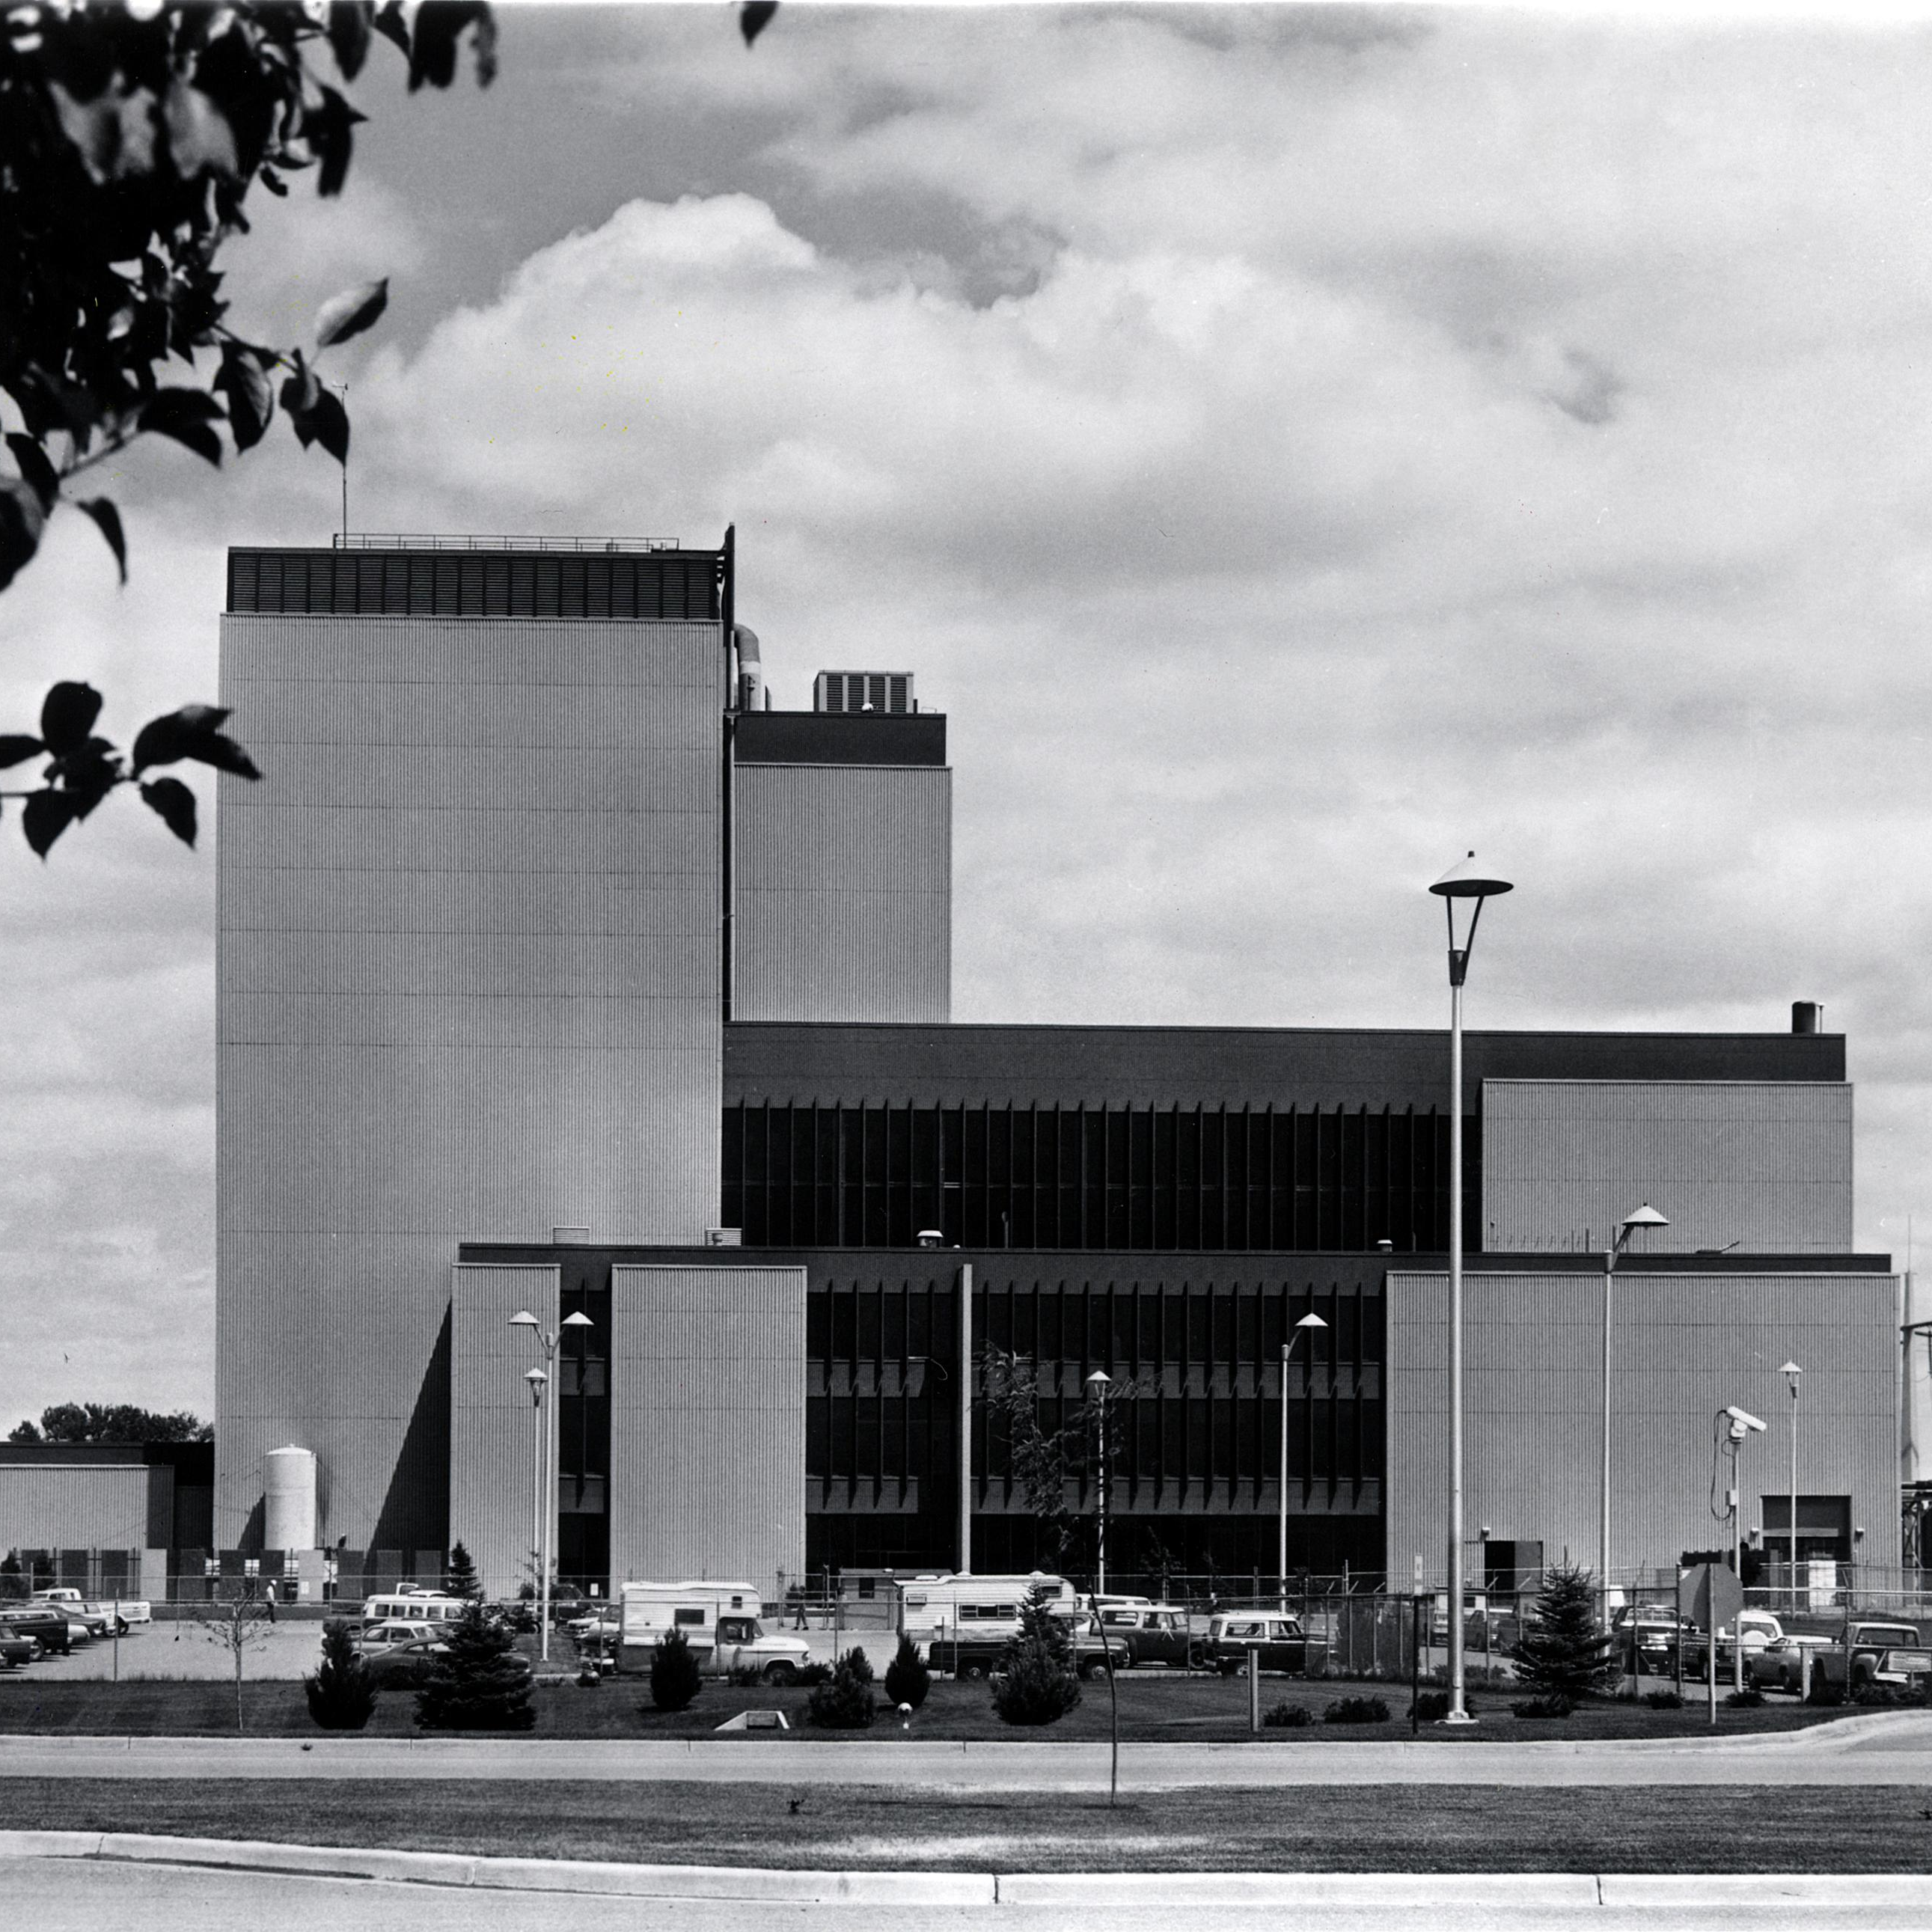
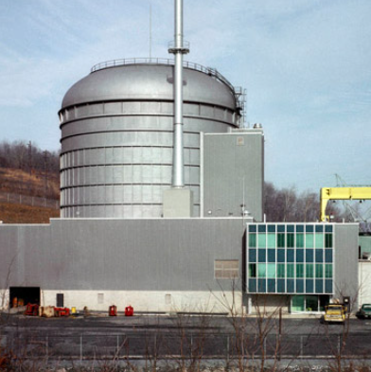
Non-LWR Reactor Power Applications
Different coolants, fuels, and neutron spectrums
Sodium Cooled Fast Spectrum (similar to Natrium)
Improved safety & performance vs LWR
1958-1984: Liquid metal fast breeder reactor project, included Fast Flux Test Facility & Clinch River
1964-1994: Experimental Breeder Reactor II; closed fuel cycle demo.
1966-1975: Fermi-1: First commercial demo
1986: EBR-II demonstrates inherent safety simulating both TMI and Chernobyl style accident scenarios.
1984-1994: Integral Fast Reactor program (Using EBR-II)
Gas Cooled
1961-1965: ML-1 mobile microreactor (US Army)
1966-1974: Peach Bottom I: first commercial demo
1975-1989: Fort St Vrain
Molten Salt
1964-1969: MSRE (molten salt reactor experiment), first molten salt fueled and cooled reactor
Advanced Fuel
Early 1980’s-present: Triso fuel development
EBR-II
TRISO
MSRE
ML-1
Fermi-I
PB-1
FSV

Slide 7
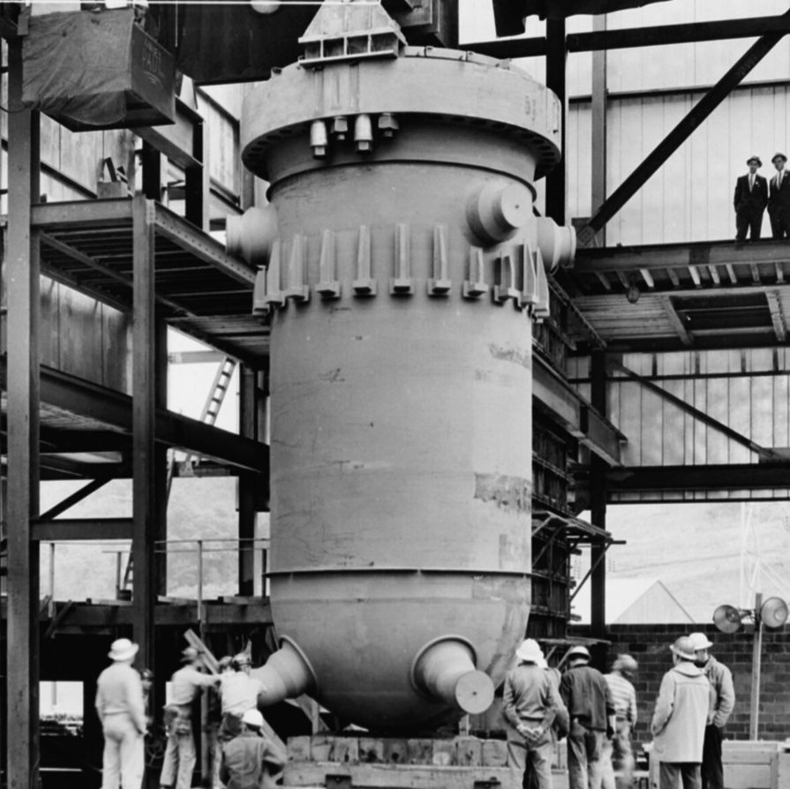
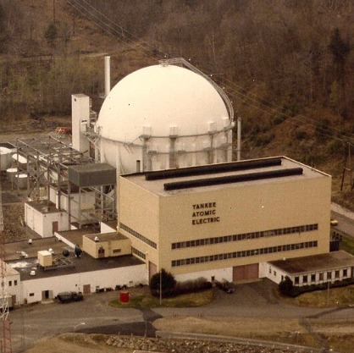
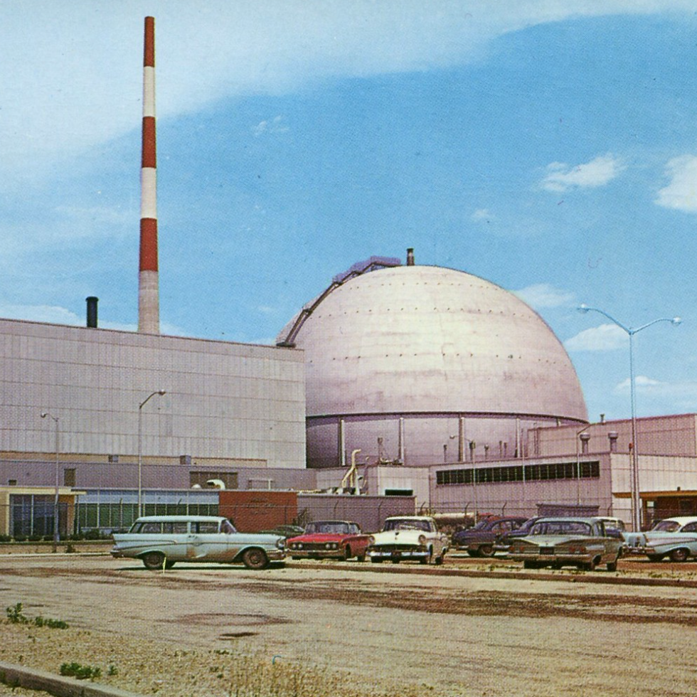
Pivot Point: Rickover Decision Light Water Reactor
Design Criteria
"First Mover" Reliability: Light Water Reactor (LWR) technology was the most technically mature and dependable option available for submarine propulsion
Safety and Reliability: Need a design with no margin for error. LWR allowed for well-understood control over reactor operations.
"Closed-Loop" Advantage: Using light water in a "closed-loop" system, reduced the risks of contamination and allowed the vessel to produce its own distilled water for the system.
Operational Criteria
Emergency Safety (Cooling): LWRs used an abundant coolant; even in a worst-case scenario, the crew had an unlimited supply of water to cool the reactor, mitigating the risk of a catastrophic meltdown.
Simplicity and Compactness: LWRs allowed for a smaller reactor core, which was essential for fitting into submarines.
Operational Familiarity: The Navy had extensive experience with conventional steam engines, making the pressurized water system (type of LWR) familiar and easier for personnel to operate.
Shippingport
Dresden
Yankee Rowe
Post-demo buildout begins in 1960
Yankee Rowe PWR (pressurized LWR)
Dresden and the first commercial BWR (boiling LWR)
Notes:
Admiral Hyman G. Rickover chose Light Water Reactor (LWR) technology—specifically Pressurized Water Reactors (PWRs)—for the US Navy's nuclear program primarily because it was the most technically mature, dependable, and safe option available for submarine propulsion, offering a crucial "closed-loop" safety advantage.
The Mariners' Museum and Park +4
His decision was driven by engineering realities rather than theoretical performance, prioritizing reliability to ensure the nuclear program’s success.
Key Reasons for Choosing LWR Technology:
Safety and Reliability: Rickover required a design with no margin for error. The PWR was chosen because it was considered the safest option, allowing for tight, well-understood control over reactor operations.
The "Closed-Loop" Advantage: Using light water (common water) allowed the Navy to operate a "closed-loop" system, which significantly reduced the risks of contamination and allowed the vessel to produce its own distilled water for the system.
Emergency Safety (Cooling): LWRs used an abundant coolant—water—which ensured that even in a worst-case scenario, the crew had an unlimited supply of water to cool the reactor, mitigating the risk of a catastrophic meltdown.
Simplicity and Compactness: Compared to alternatives like heavy water or graphite reactors, light water reactors allowed for a smaller reactor core, which was essential for fitting into submarines.
Operational Familiarity: The Navy had extensive experience with conventional steam engines, making the pressurized water system (which powers turbines with steam) familiar and easier for personnel to operate.
"First Mover" Reliability: When making the decision, LWR was the only design mature enough for immediate naval application, allowing the land-based Mark I prototype to work efficiently.
The Mariners' Museum and Park +4
Rickover’s focus on the PWR was not universal; it was chosen over other potential options—such as liquid sodium reactors (used briefly on the USS Seawolf)—because it proved more reliable, leading to the success of the USS Nautilus and establishing the standard for the nuclear navy

Slide 8
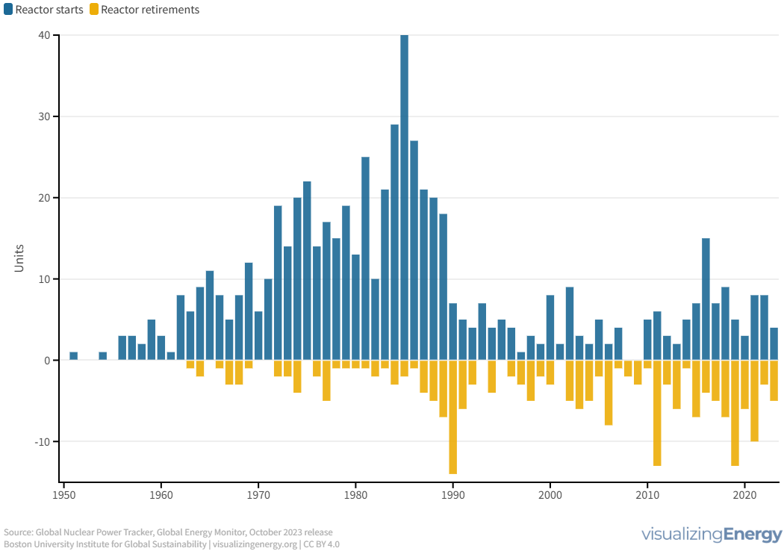
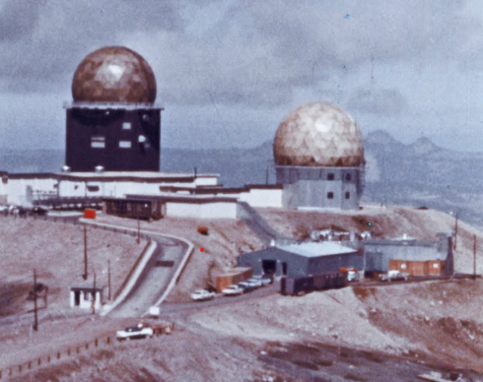
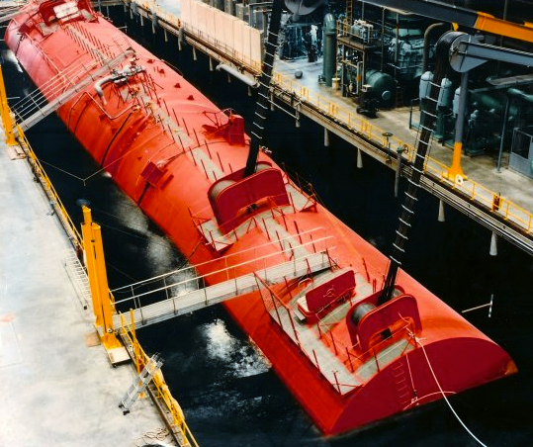
LWR Commercial and Research
Global Nuclear power reactor starts and retirements
1951-2023
Experimental, research, demonstration, and commercial reactors are included.
1957-1977: Army PWR microreactors, including Sundance Air Force Station in WY (7 total built)
1965: the S5G is built, the first natural circulation PWR
1960’s-1980’s: LWR buildout in full swing
  Energy Crisis, rising build costs and TMI result in cancellations.
1990: End of LWR buildout: numbers peak at 112
2011: Post Fukushima, work begins on accident tolerant fuel and the first LWR-SMRs are proposed.
Sundance AFS
S5G Prototype

Slide 9
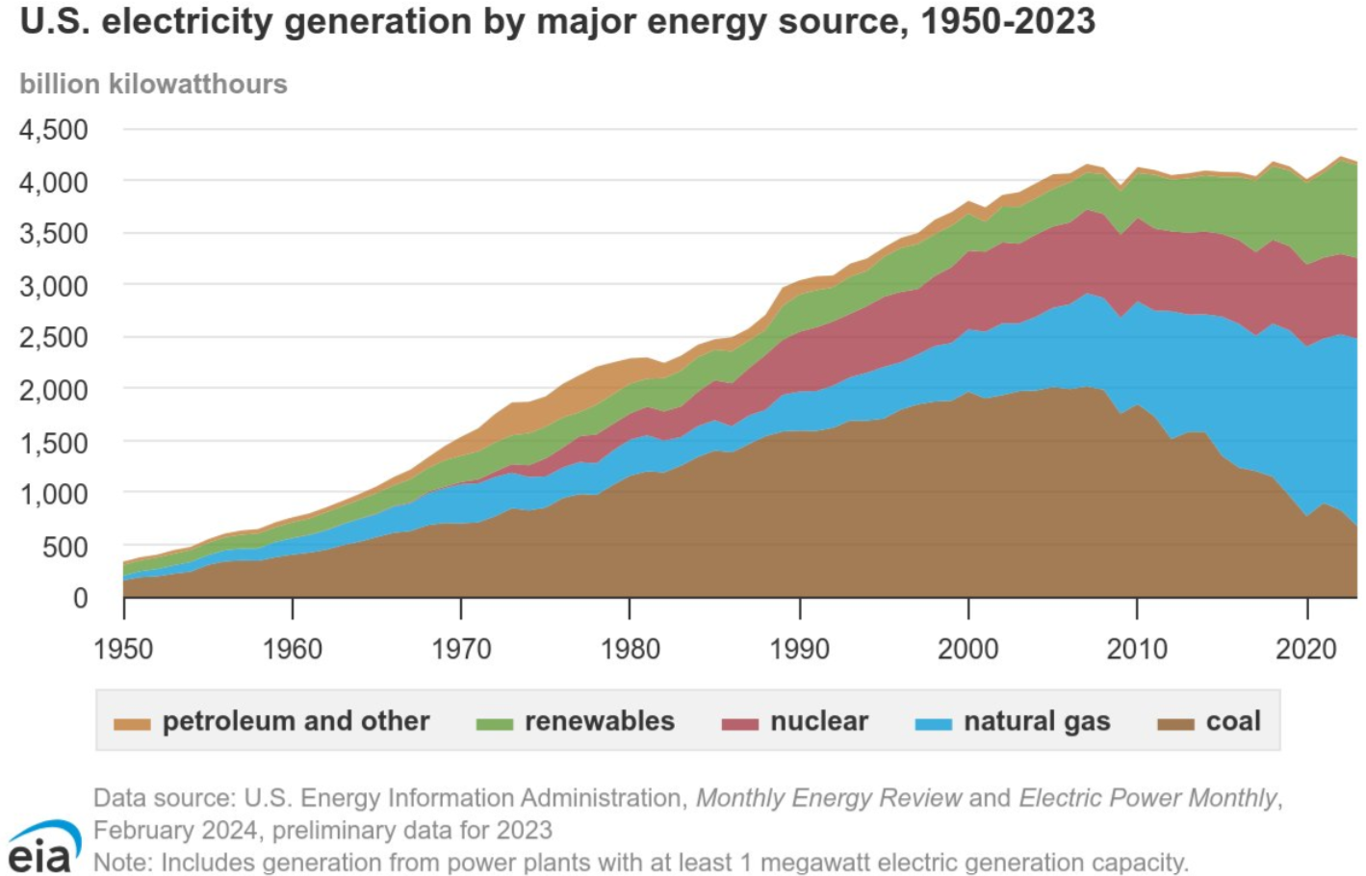
Pivot Point: 1990’s 2010’s- Stagnation & Change
Key Takeaways:
No new builds and a nuclear renaissance that fails to materialize
Electricity demand increasing (Data centers)
Adding renewables to the grid introduces the need to flex our larger resources
Flexible, dispatchable generation is the new paradigm

Slide 10
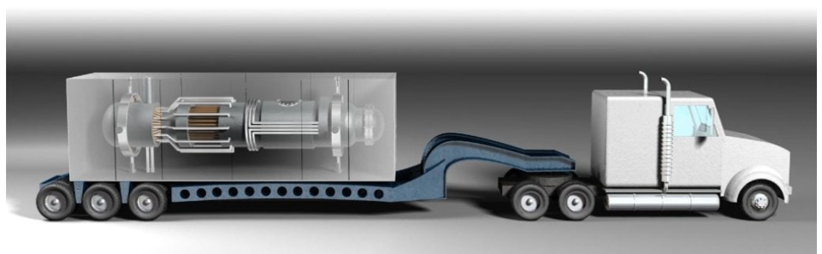
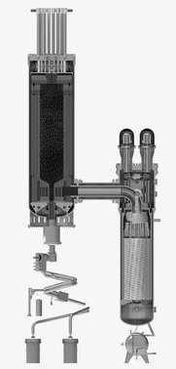
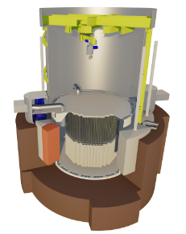
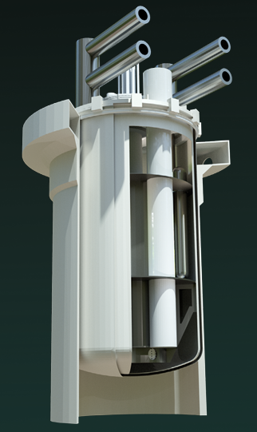
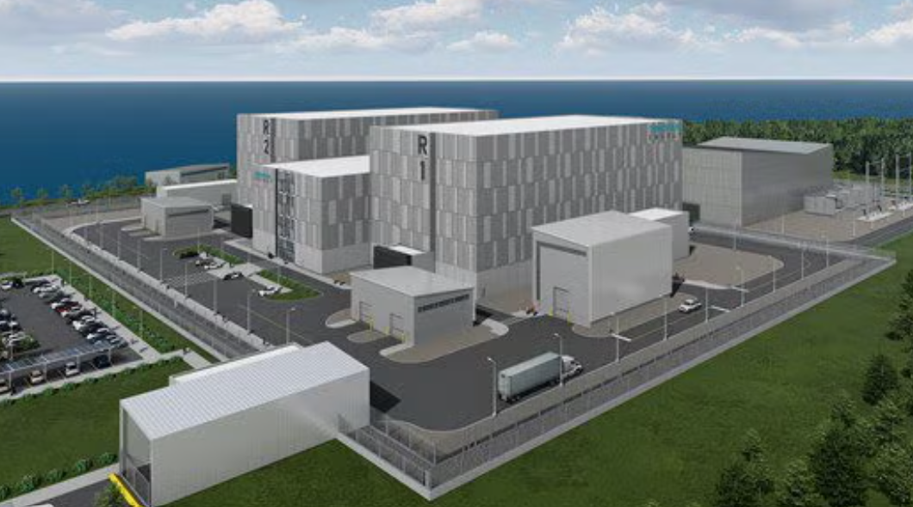
The Past and the Future Come together
New Sizes: SMR’s and Microreactors
Greater siting flexibility
Lower overhead costs
Assembly line production
Alternative technologies finding commercial footing
Sodium fast reactors
HTGR’s
Molten salt cooled and fueled reactors
Gas Fast Reactors
XE-100
Moltex SSR-W
Natrium
Terrestrial IMSR

Slide 11
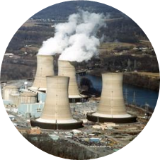
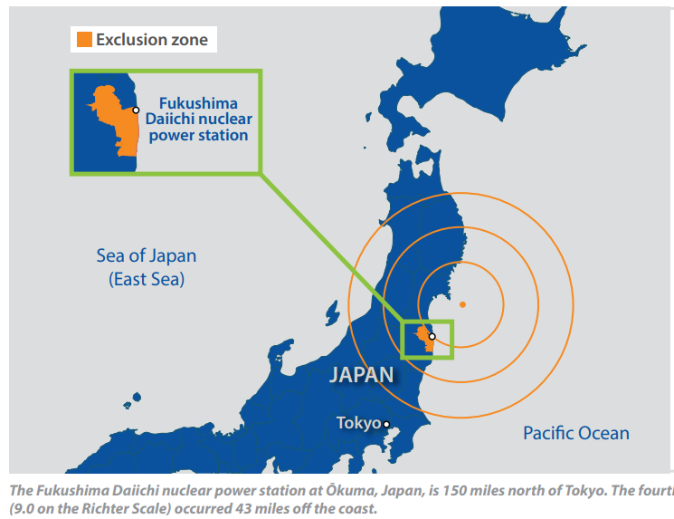
LWR Commercial Accidents
TMI (Pressurized Water Reactor) 1979
combination of equipment malfunctions, design-related problems and worker errors led to TMI-2’s partial meltdown
Significant number of changes required for similar plants related to training of personnel, new instrumentation, and new oversight procedures
INPO as a mechanism for plant owners/operators to share lessons learned
Fukushima Daiichi (Boiling Water Reactor) 2011Tōhoku quake and tsunami
Tsunami exceeded the plant’s design basis and flooded the site’s emergency power supplies and electrical distribution system.
This extended loss of power severely compromised core cooling and containment integrity and ultimately led to core damage in three reactors.
US Response: FLEX Strategy - emergency equipment for extreme events
  Locally: each site has backup emergency equipment
  Regionally: two emergency response centers, Memphis and Phoenix
  stores and maintains critical spares for the entire U.S. nuclear industry.
  Each set of equipment can be transported by truck or air to a plant site anywhere in the country in 24 hours.

Slide 12
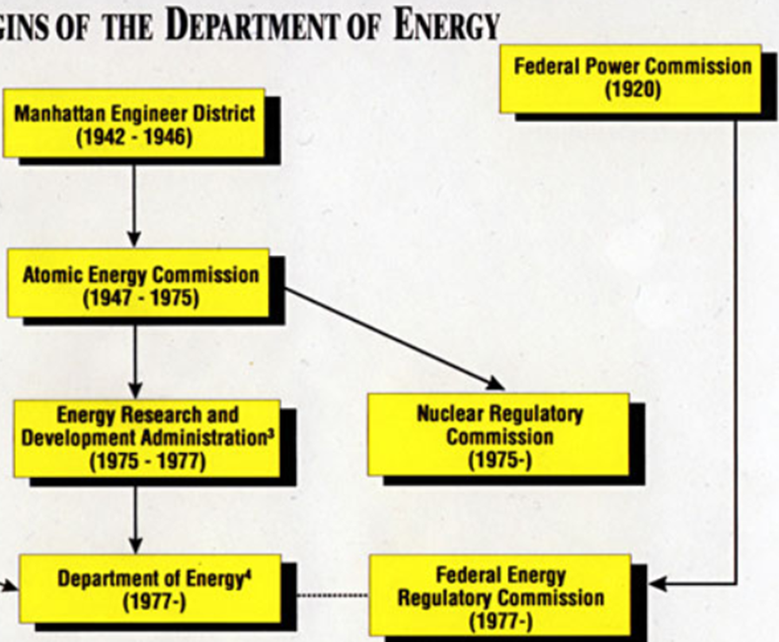
PIVOT POINTS: Reorganization and Federal Agencies
1970: National Environmental Policy Act (NEPA)
establish a national policy for the environment
requires Federal agencies to assess the environmental effects of proposed major Federal actions prior to making decisions.
1974 Energy Reorganization Act: splits Atomic Energy Commission
an R&D arm, Energy Research and Development Administration (ERDA)
a regulator, Nuclear Regulatory Commission (NRC)
1977: Department of Energy Organization Act
transfers ERDA functions to the new Department of Energy
1982:Nuclear Waste Policy Act
federal framework permanent disposal of high-level radioactive waste and spent nuclear fuel
1989: Office of Environmental Management
complete the safe cleanup of nuclear waste, materials, and facilities from five decades of nuclear weapons development and nuclear energy research.
Origins of the Department of Energy

Slide 13
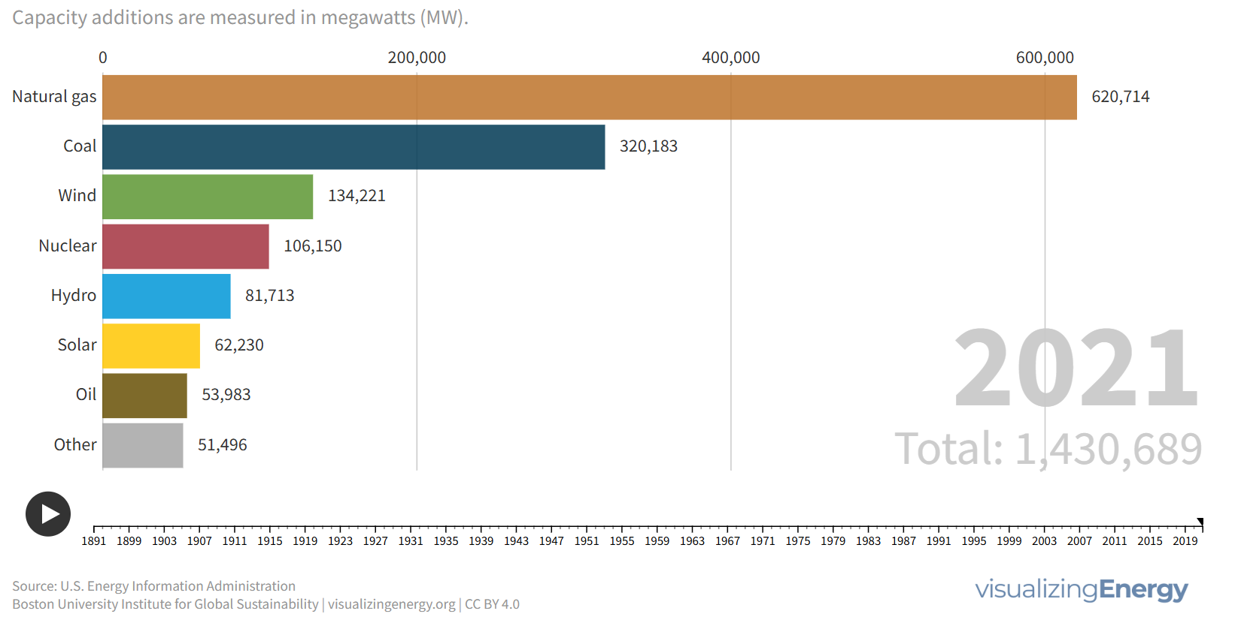
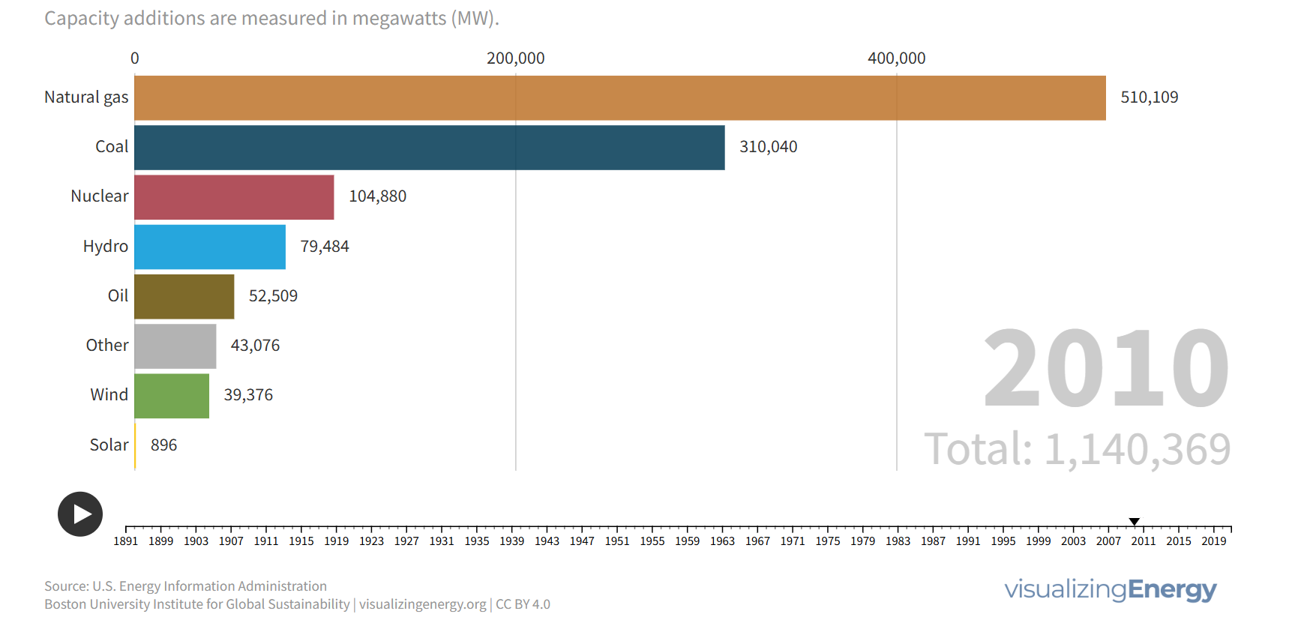
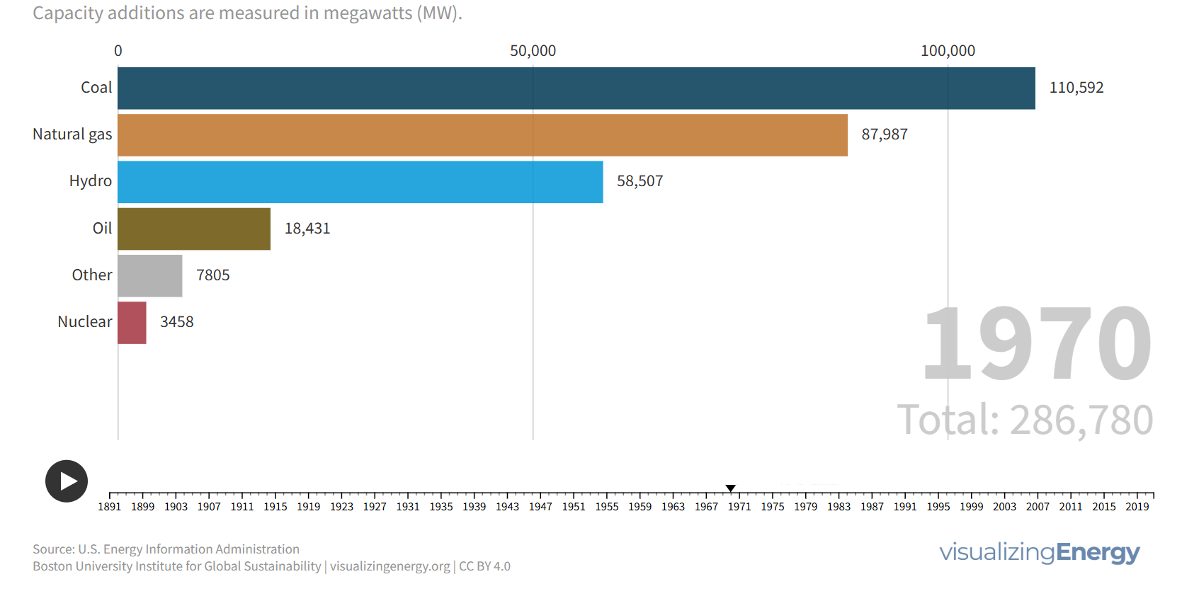
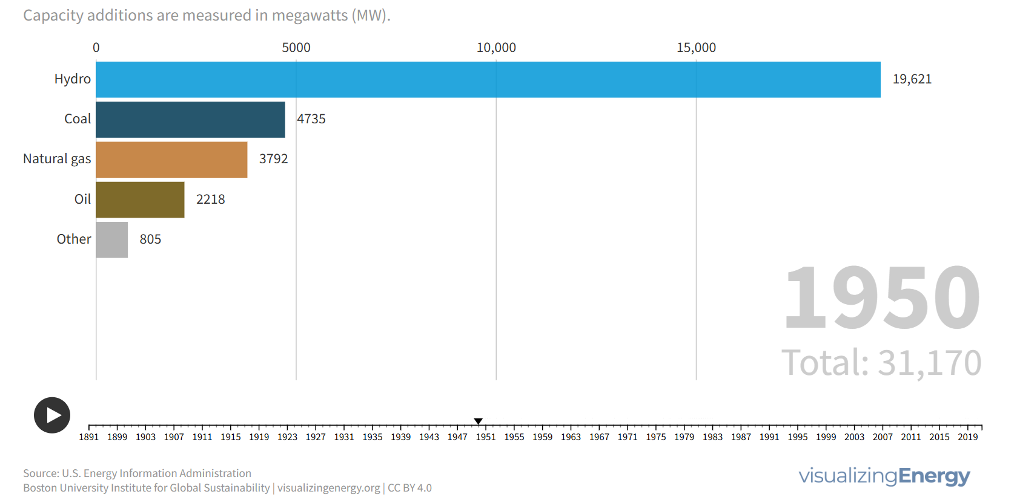
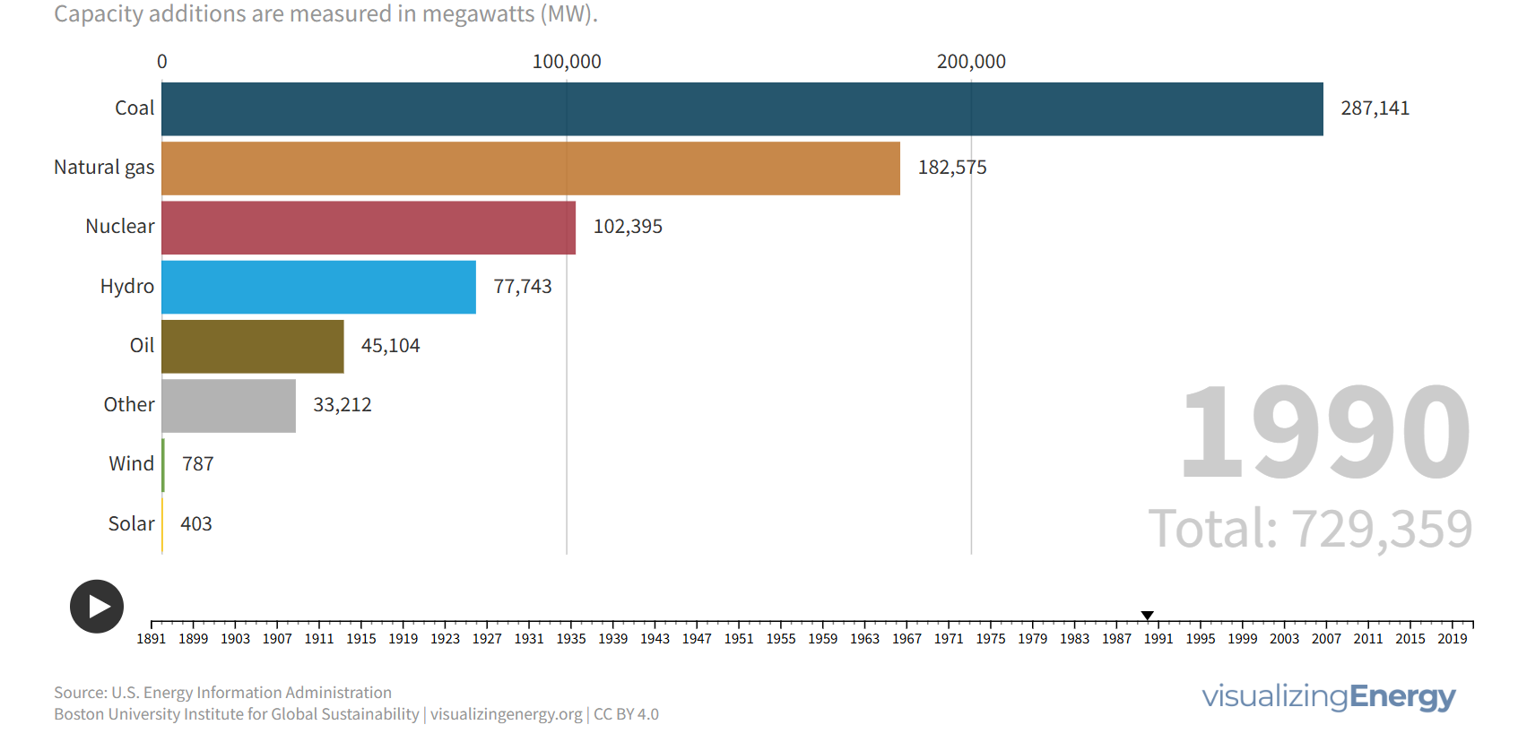
Conclusion and Questions

Slide 14
The past and future of nuclear power
Notes:
23-50477-R19_Nuclear_History_Timeline-2052*
Source: https://www.spglobal.com/marketintelligence/en/news-insights/latest-news-headlines/new-build-nuclear-must-face-down-industry-s-costly-past-72854285
All global capacity including US) additions 1960- present plus projection to 2050: https://www.spglobal.com/marketintelligence/en/news-insights/latest-news-headlines/new-build-nuclear-must-face-down-industry-s-costly-past-72854285
U.S capacity: 1970-2023: https://www.eia.gov/todayinenergy/detail.php?id=57280
US capacity prior to 1960: https://www.eia.gov/todayinenergy/detail.php?id=30972
US projected capacity: https://liftoff.energy.gov/advanced-nuclear/

Slide 15
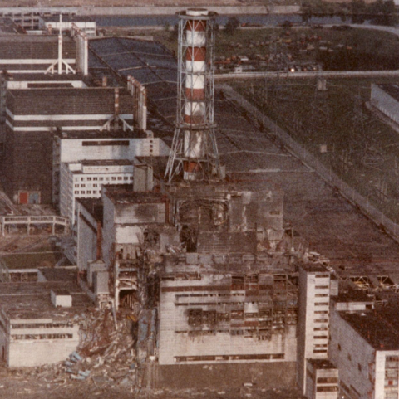
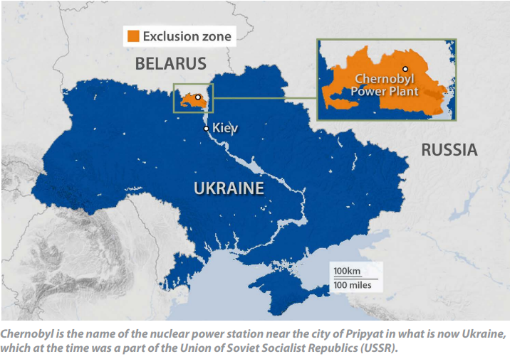
Other Commercial Accidents
Chernobyl (RBMK Design) 1986
During a loss-of-power cooling test managers ordered the operators to violate safety protocols.
Attempts to shut down the reactor exposed a design flaw that triggered a power surge, causing two explosions.
The Chernobyl disaster resulted from an unsafe design, operator error, poor management, inattentive oversight, a cavalier approach to safety and human arrogance.
The RBMK reactor design, which focused on energy production over safety, has never been allowed outside the former USSR.

