Slide 1
Uranium Recovery Regulations and Reclamation
Wyoming DEQ’s protection standards
Brandi O’Brien
Land Quality Division Administrator
Wyoming Department of Environmental Quality
April 13, 2026
Nuclear Energy: An Emerging Issue Forum

Slide 2
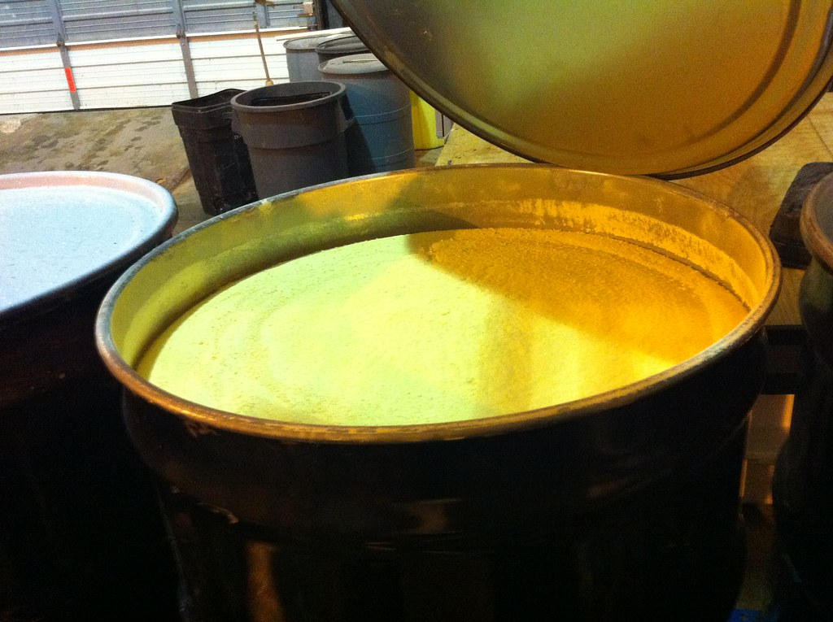
Summary
LQD’s Regulatory Programs
Staff Qualifications
Regulatory Requirements
Accountability
Historical vs Current
Waste and Reclamation
This Photo by Unknown Author is licensed under CC BY-NC-ND

Slide 3
Land Quality Division’s Regulatory Programs for Uranium Recovery
Non-Coal Permit to Mine
Agreement State Program

Slide 4
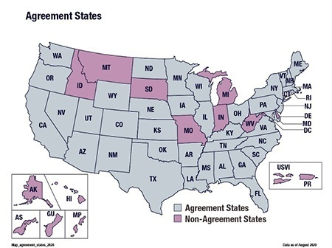
Agreement State – A state that has entered into an agreement with the NRC to obtain regulatory authority
Atomic Energy Act (Section 274) provides a statutory basis under which NRC relinquishes to the States portions of its regulatory authority to license and regulate byproduct materials (radioisotopes); source materials (uranium and thorium); and certain quantities of special nuclear materials.

Slide 5
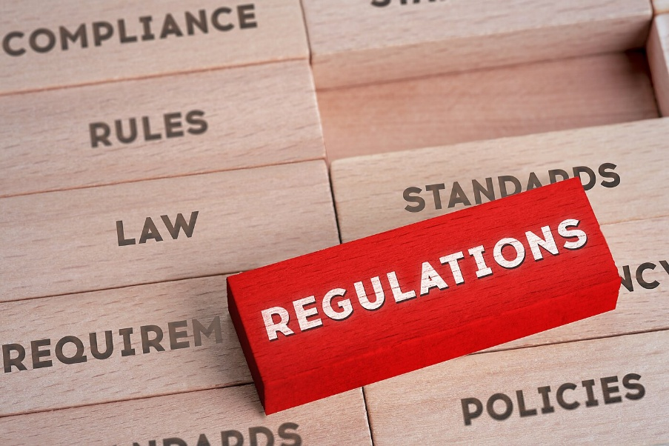
Land Quality Division’s Regulatory Programs for Uranium Recovery
Land Quality Division (LQD) | Agreement State Program (Uranium Recovery Program)
Permit to Mine | Source Material License
Non-Coal Rules and Regulations | URP Regulations (Based on NRC Regulations)
Environmental protection and reclamation focus | Radiation protection, and human health and environment focus
Covers both conventional mines and ISR | Covers conventional mills and ISR
Lots of overlap between the two programs.
This Photo by Unknown Author is licensed under CC BY-SA-NC

Slide 6
URP Staff Qualifications
Background on Uranium Recovery
Code of Federal Regulations
Wyoming State Statutes and Rules and Regulations
Federal and State Regulatory Guidance
NRC and URP Inspection Manuals
Industry Codes and Standards
Inspection Accompaniments
NRC Management Directives
Review of Significant Events at Uranium Recovery Facilities
Directed Review of Selected Uranium Licensing Casework
Formal Training

Slide 7
Applicable Protection Standards
Radiation Protection
Environmental Protection
Dose limits to the public
Dose limits to employees
Uranium intake limits
External dose rate limits for various areas
Maximum air concentration values for various areas
Ground water protection
Surface water protection
Topsoil protection
Wildlife protection
Revegetation
Well plugging and abandonment

Slide 8
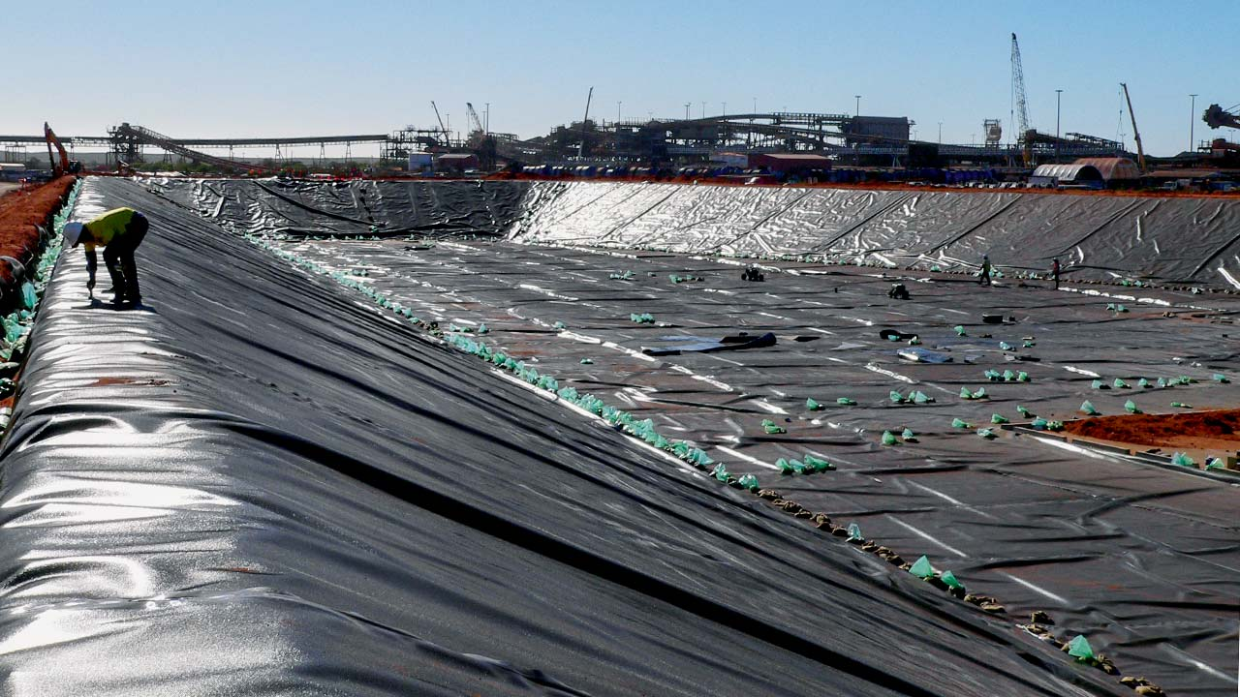
Historical vs Current
Outdated Standards
Current Standards
https://www.naue.com/gb/solutions/mining/evaporation-ponds/
Unlined evaporation ponds
  Often relied on clay liners
Tailings cells unlined
  Previously insufficient ground water monitoring requirements
Little or no reclamation bond required
Inappropriate locations of mills
  Next to rivers or in places not protective of ground water or surface water
Evaporation ponds have double liners with leak detects
  Capacity limits to ensure no overflow
  Mechanisms to pump leaks back into the pond or to other ponds
Tailings cells required to be lined
  Significant ground water monitoring requirements in place
Reclamation bond requires annual review to ensure full reclamation could be done in case of bond forfeiture

Slide 9
Properties of Uranium
Isotope | % by weight | Half-life | % radioactivity
U-238 | 99.28 | 4.47 billion years | 48.2
U-235 | 0.72 | 700 million years | 2.3
U-234 | 0.0055 | 244,000 years | 49.5
Uranium is a heavy metal
  Intakes limits based on chemical toxicity to the kidneys (for yellowcake dried at lower temps)
Uranium eventually decays into radon
  One of the largest dose contributors at uranium recovery operations
Fresh yellowcake can’t deliver an external dose
Aged yellowcake can deliver a skin dose due to beta emissions

Slide 10
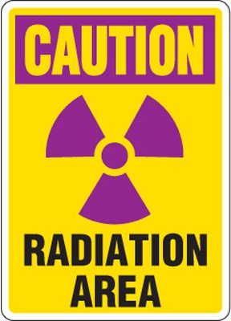
Doses are typically low at modern uranium recovery facilities due to engineering controls and protective measures.
Worker doses are typically well below the 5 rem per year limit
Dose to public is typically well below the 100 mrem per year limit
Extremely conservative assumptions made
Areas where highest doses are typically found
Filters (external dose rate)
Shaker tables (radon)
Yellowcake storage (if not shipped out regularly)
Bottoms of tanks
Header houses (radon and external if filters are present)
RO units

Slide 11
Accountability
Sampling Requirements
  Air
    Particulate (short-term and long-term monitoring)
    Radon
  Ground water
  Surface water
  Swipes
    Looking for surface contamination
    Soil
Reporting Requirements
  Quarterly reports
  Semi-annual effluent monitoring reports
  Annual ALARA report
  Annual LQD permit to mine report
  And more
Inspections
Annual ALARA audit
Bioassays
Dosimetry
Reclamation bond
Even the regulators are audited - IMPEP

Slide 12
Groundwater at ISR Facilities
Baseline Water Sampling
Aquifer Exemption
  Water is of such quality that it is not and cannot be used as drinking water
Monitoring Wells
  Ensure that fluids do not leave the wellfield
Excursions
  Early detection before fluids could leave the aquifer exemption boundary
  Increased monitoring requirements if detected
Groundwater Cleanup
  Must meet Target Restoration Values (TRVs) determined during baseline water sampling
Alternate Concentration Limits (ACLs)
  Can be applied for if TRVs cannot be met, BUT
    Operator must first demonstrate that they have cleaned up the water as must as possible
    The operator must demonstrate that ACLs are protective of surrounding aquifers

Slide 13
Waste and Reclamation
11e.(2)
  Contaminated waste generated from milling uranium or thorium
  UMTRCA – Disposal at licensed facilities and long-term care and maintenance by DOE
Convention Mill Reclamation | ISR Reclamation
11e.(2) tailings cells | No 11e.(2) tailings cells disposal
Transfer to DOE for long term care and maintenance | Typically, license is terminated with unrestricted release
Anything not going to DOE must have all soil contamination cleaned up | All soil must have contamination cleaned up
Groundwater must be cleaned up to not affect waters outside the long-term boundary | Groundwater must be cleaned up to not affect outside the aquifer exemption area
There can be monitoring wells left for the DOE | All wells are plugged and abandoned
Any remaining structures must be decontaminated or disposed of.

Slide 14

Questions?
Brandi O’Brien
Administrator, Land Quality Division
307-777-7046
Brandi.OBrien@wyo.gov
deq.wyoming.gov/land-quality/uranium/

