Slide 1
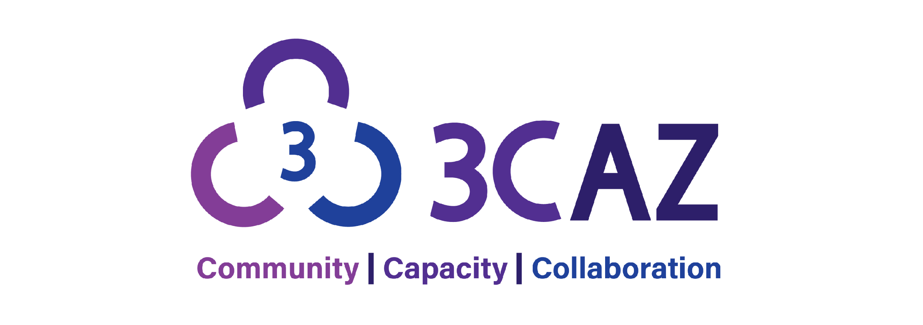



Logo was developed by the U.S. Department of Energy to indicate receipt of DOE funding. Not an endorsement by DOE.
Notes:
Nich - welcome

Slide 2
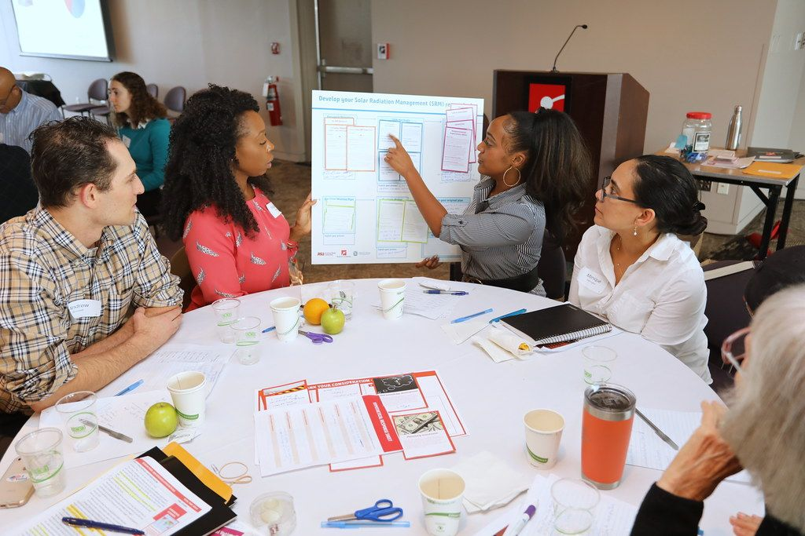
Project Overview: Community, Capacity, Collaboration in AZ (3CAZ)
Funded by Department of Energy (2023-2025)
Project to inform a process for deciding where to build storage facilities for that waste that’s based on a process that is fair and community-driven.
What do people prioritize in collaboration between communities and the DOE for this topic?
Can we create activities that communities can use to shape their interactions with DOE?
We’re not trying to convince anyone that it’s a good idea to host a nuclear waste storage facility. We’re neutral. We want to make sure communities have a say in this process.
Some additional information can be found here: energy.gov/ne/consent-based-siting-consortia
Notes:
Primarily text slide

Slide 3
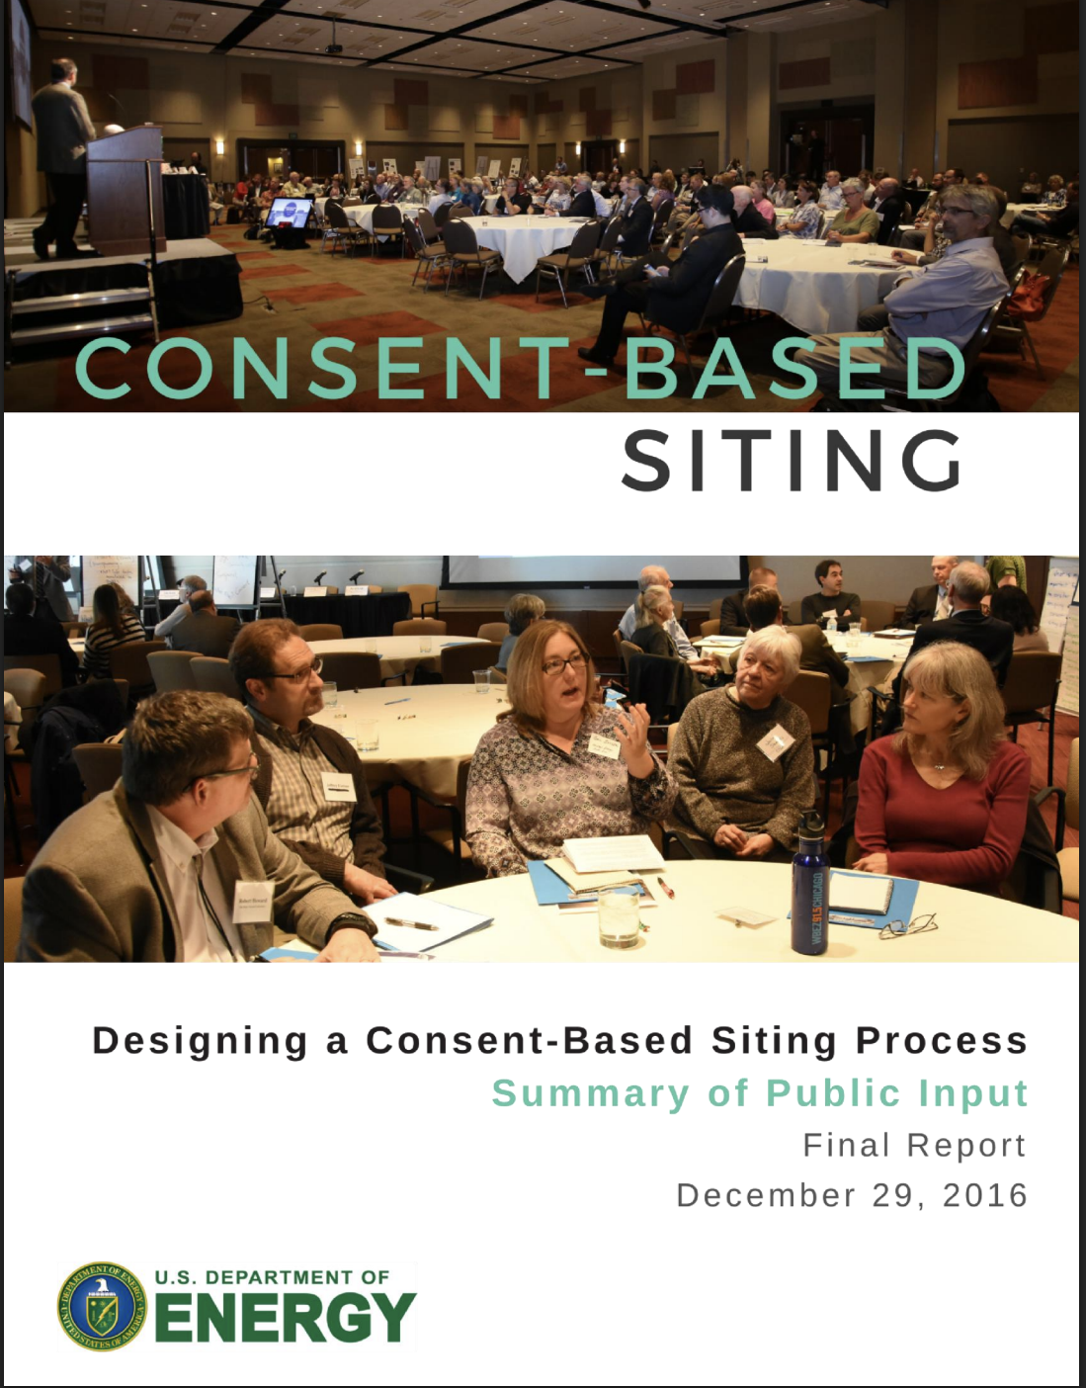
How to Decide? Twists and Turns in Creating a Consent-Based Siting Process for Nuclear Waste
*2010-2012: President Obama establishes Blue Ribbon Commission for America’s Nuclear Future
*2013: Recommendations to DOE to pursue a “Consent-Based Siting” Process
*2015-2016: DOE holds public meetings; hears public concerns to understand values; roundtable discussions
Also engages ECAST at ASU to do pTA project nationwide
*December 2016: DOE releases report
*January 2017: Program halted due to change
in administrative priorities.
*2021-2022: RFI for a CBS process
*2023: RFP to inform a CBS process for CISF
*2023-2025: 12 Consortia members chosen, inc. ASU ECAST
Notes:
Tell us about your work?
What has existed and how has it changed?
What have you learned about people want? What would people like to see to fill this gap?

Slide 4
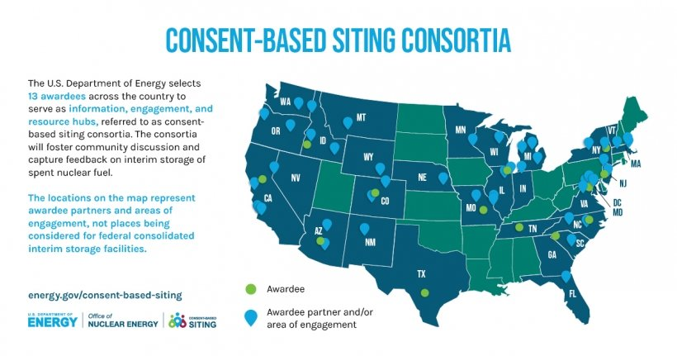
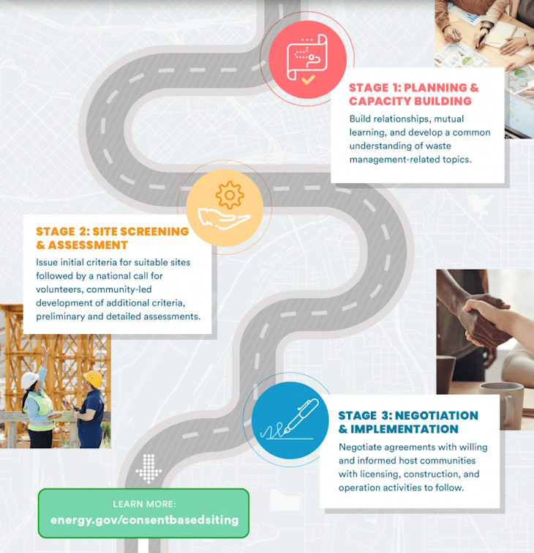
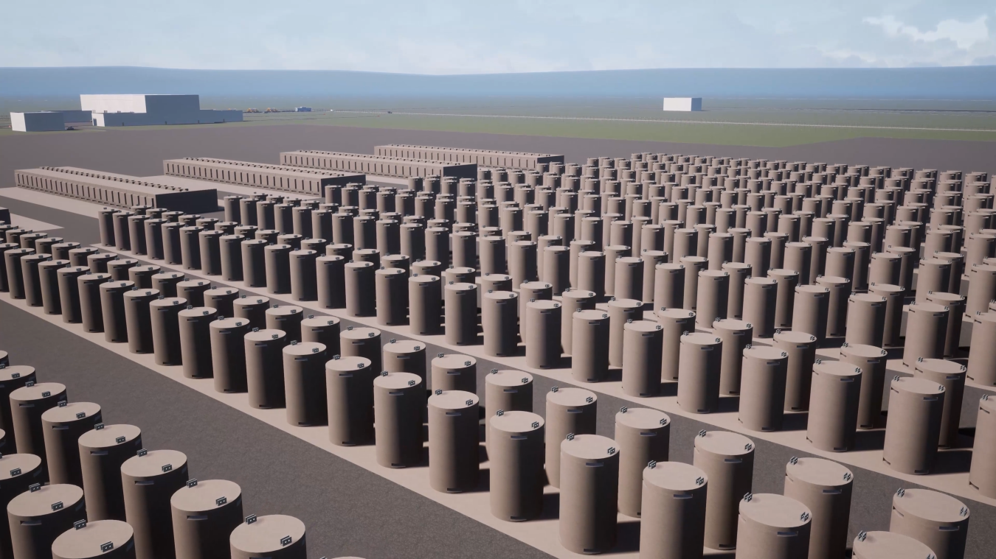

Slide 5
Project Overview
2023 - 2024
Problem Framing & Forum Design
Narratives Development & Community Framing Dialogues
Workshop with Stakeholders
Forum Design, Testing, & Expert Review
Finalize Forum Content
March - June 2025
Regional Deliberative Forums
Forum Host Site Selection & Training
Participant Recruitment
Forums
Data Collection
June 2025 - January 2026
Analysis & Amplification
Preliminary Analysis & Results
Expert Review
Workshop with Stakeholders
Finalize and Disseminate
Notes:
Primarily text slide

Slide 6
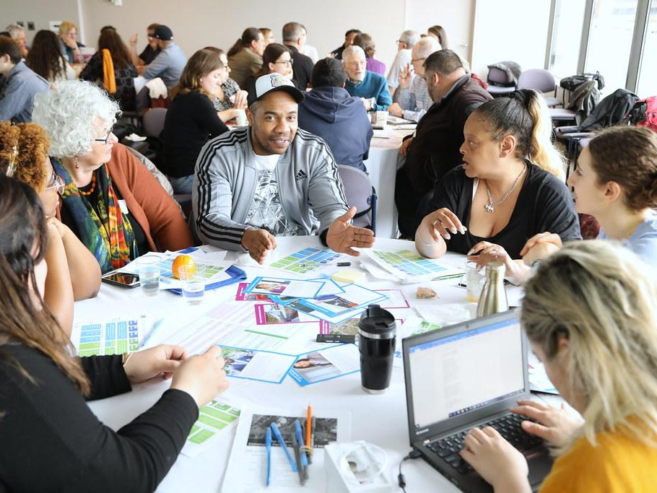
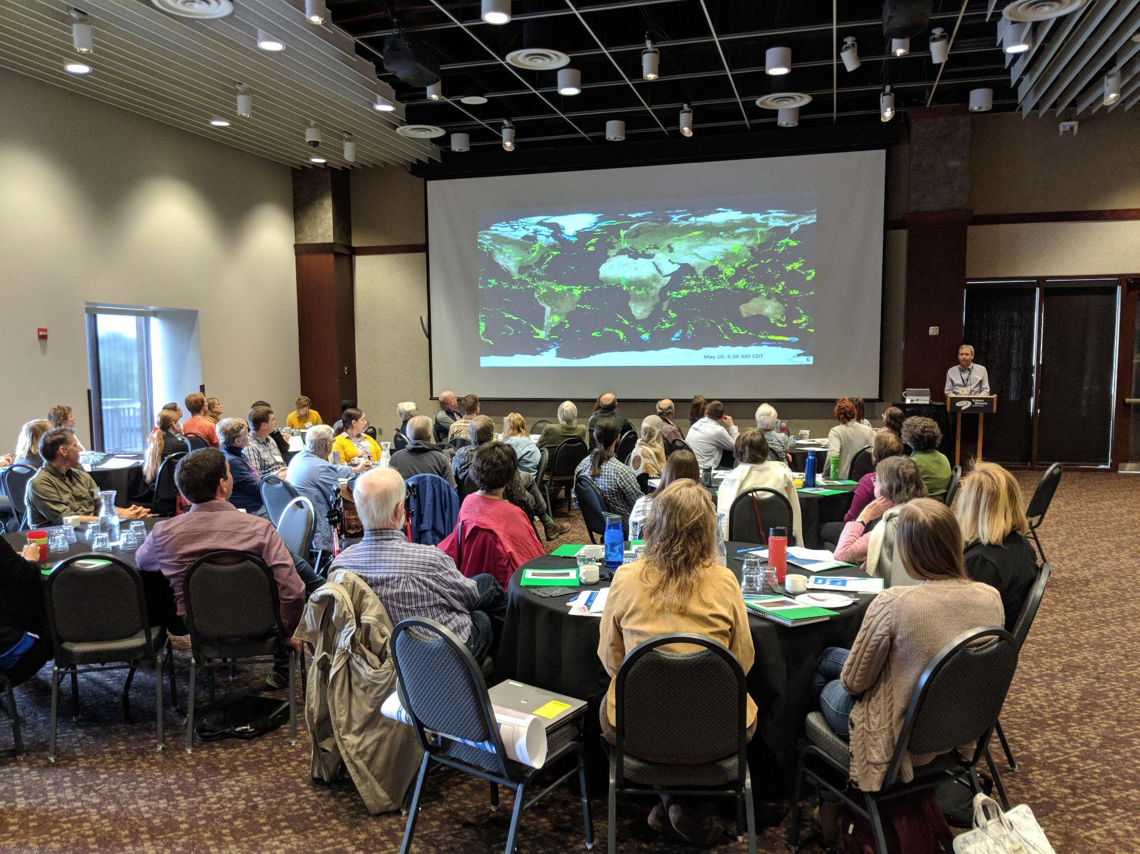
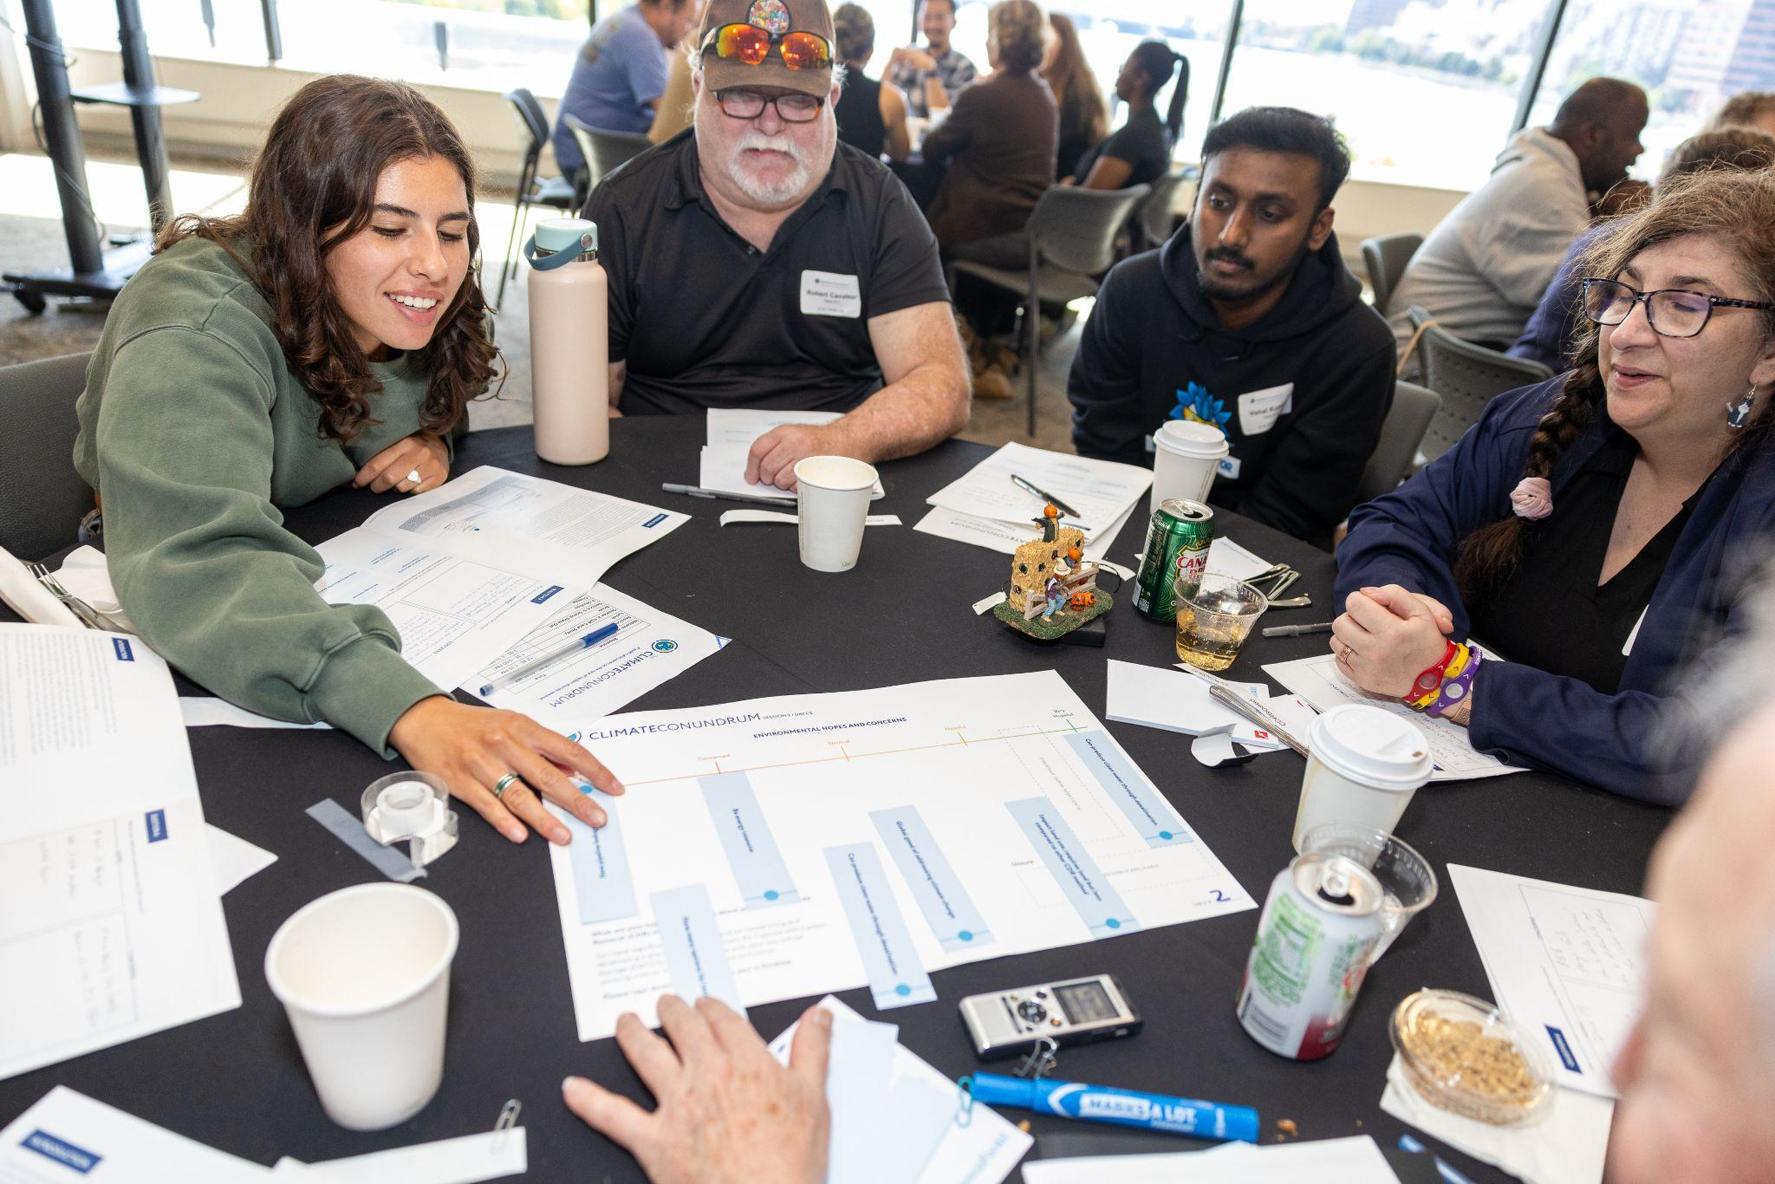
Forum Overview
A day-long, multi-table facilitated engagement divided into sessions for non-expert citizens to learn about, discuss, and inform a process for collaboration-based siting about spent nuclear fuel.
Notes:
Primarily text slide

Slide 7
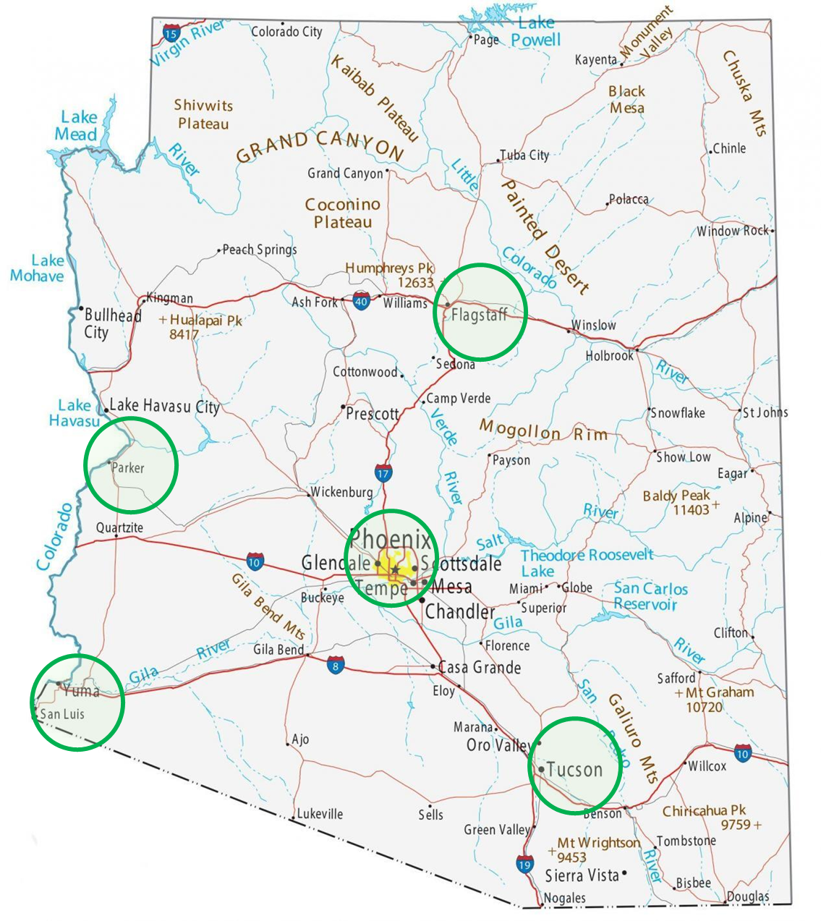
Guiding Questions for Forums
What do people prioritize in collaboration between communities and the DOE for this topic?
Can we create activities that communities can use to shape their interactions with DOE?
Notes:
Primarily text slide

Slide 8
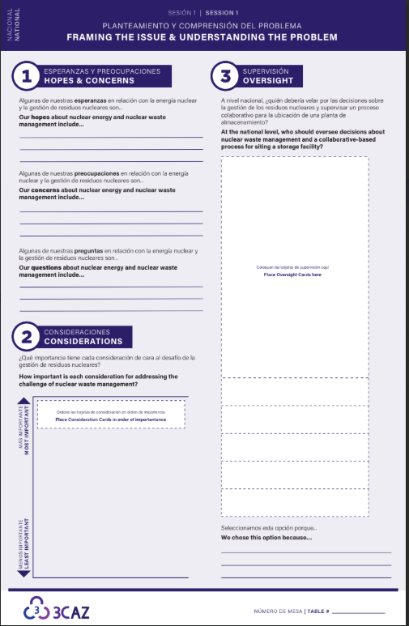
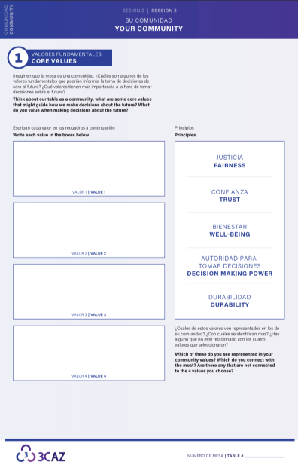
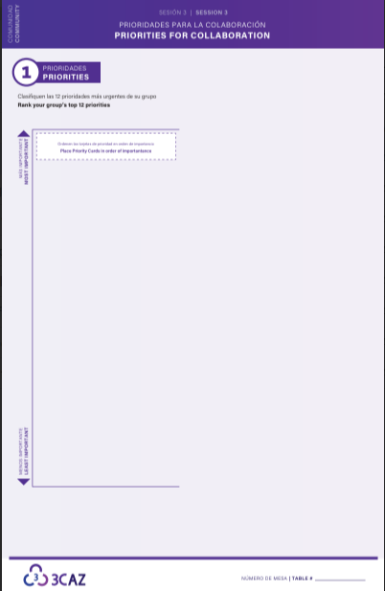
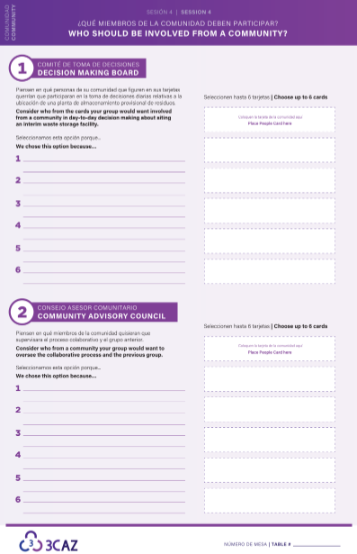
Four sessions total
Community Level Discussion
National Level Discussion
Notes:
Primarily text slide
Framing, Your Community, Priorities for Collaboration, Who should be at the table(s)

