Slide 1
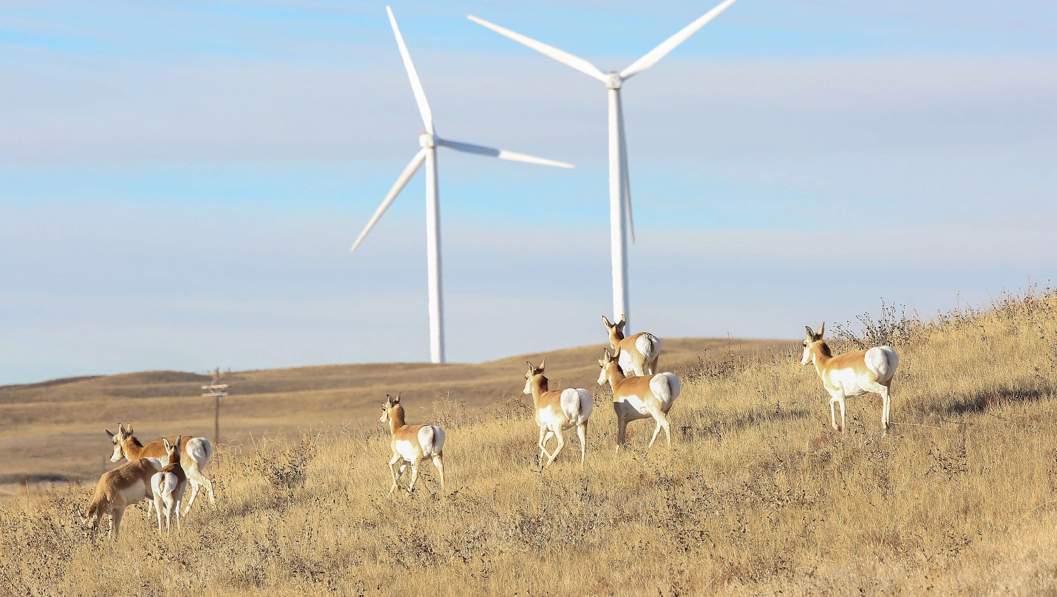
Renewable Energy on State Trust Land
Bryan Leonard
SER Associate Professor
Haub School of Environment and Natural Resources | School of Energy Resources
University of Wyoming

Slide 2
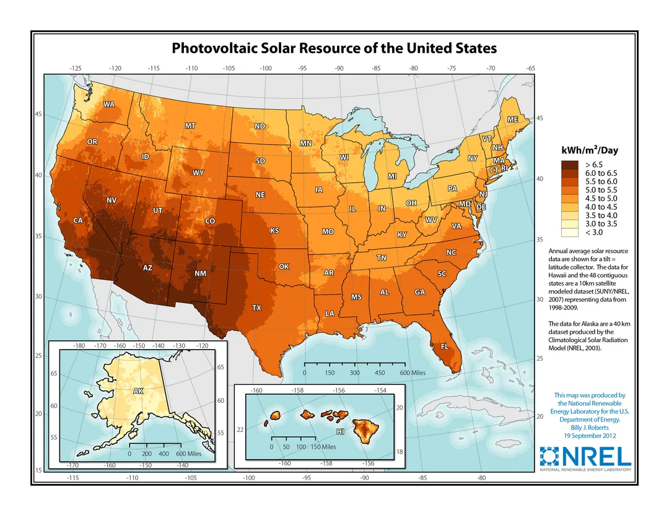

Slide 3
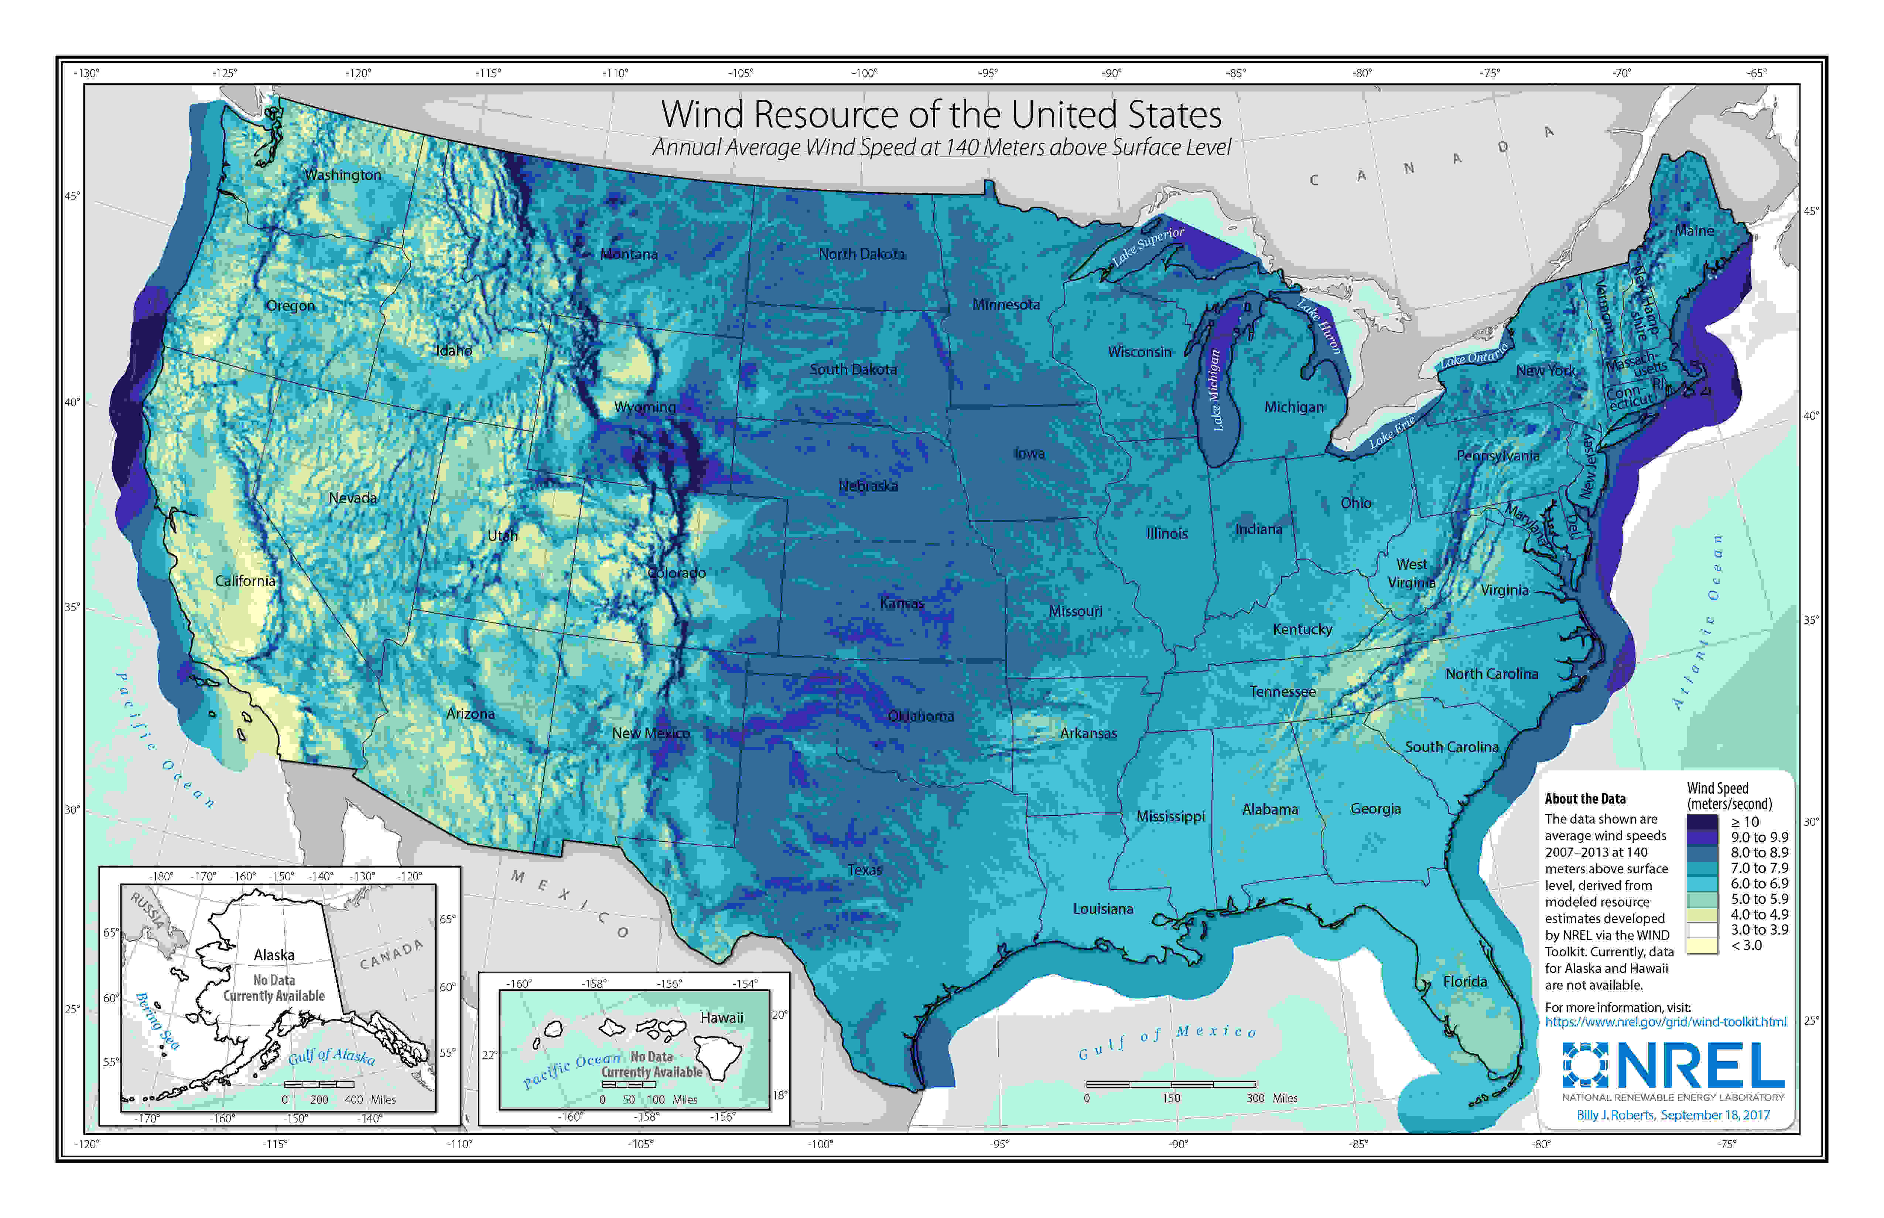

Slide 4
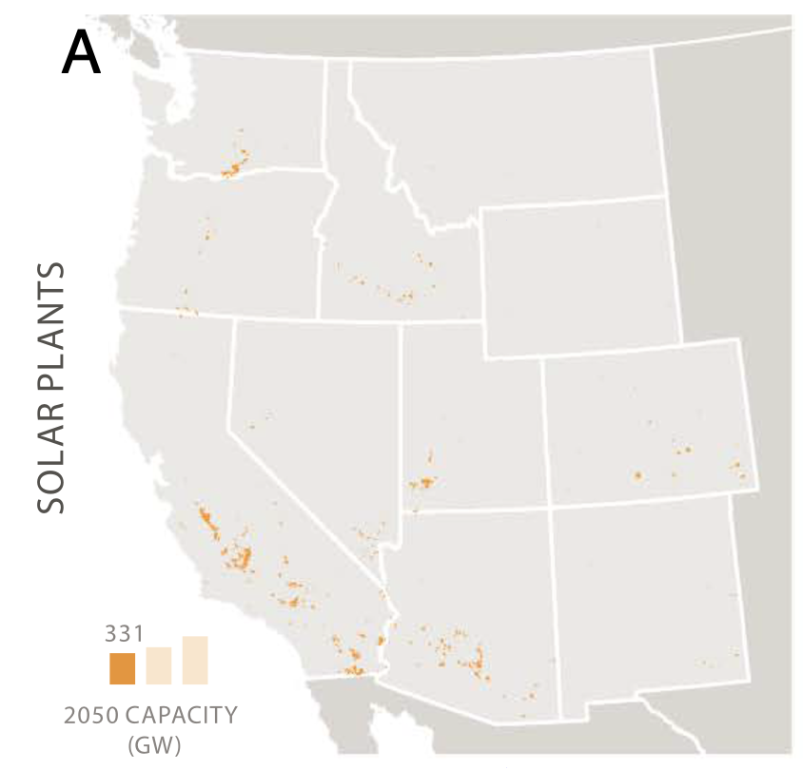
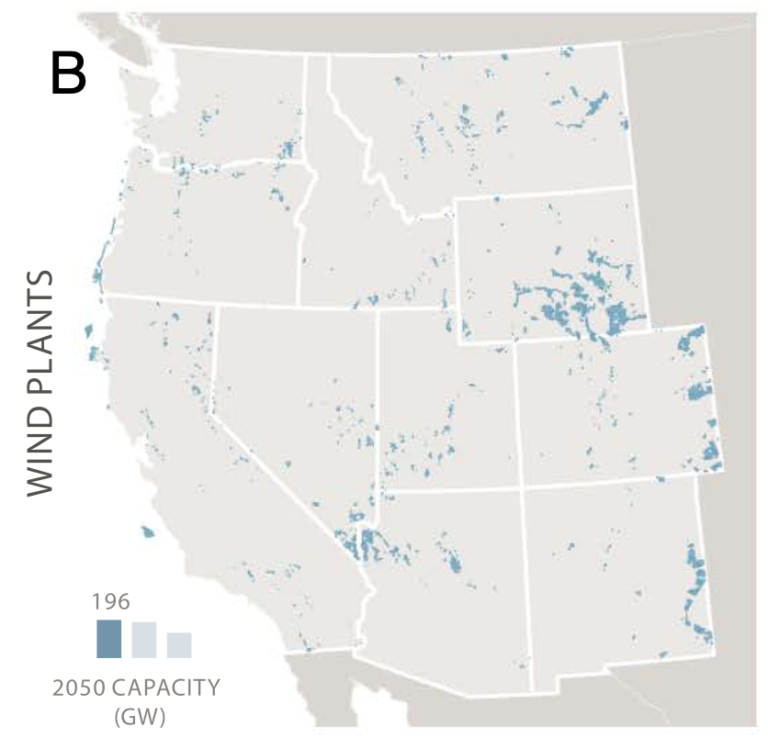

Slide 5
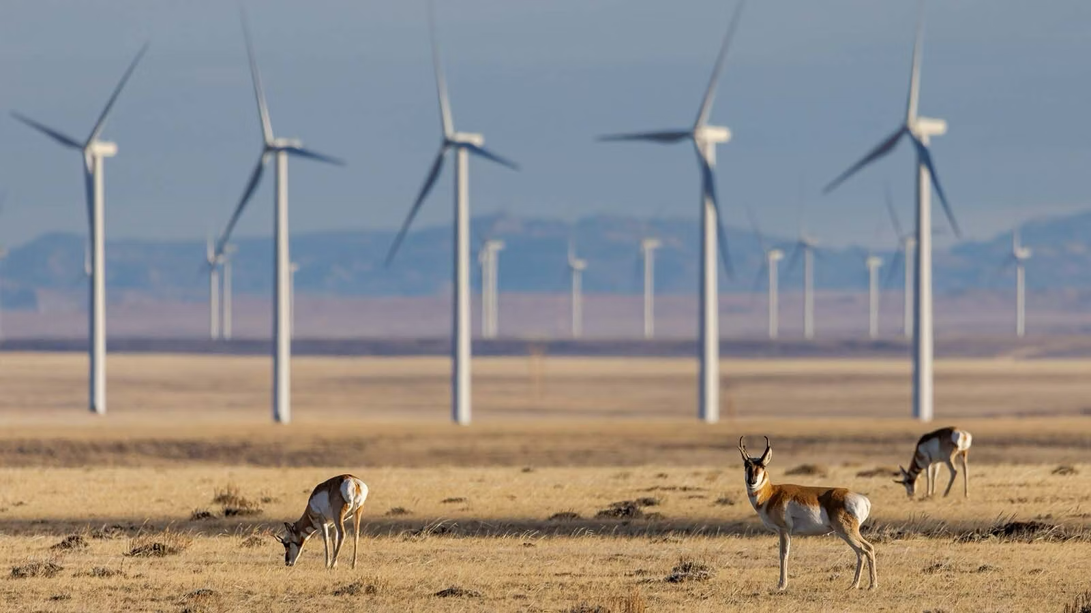
The Importance of Scale
 | United States | 11 Western States | Wyoming
Avg. Utility-Scale Solar Footprint | 85 acres | 155 acres | 423 acres
Avg. Total Turbine Footprint | 100 acres | 137 acres | 72 acres
Avg. Total Windfarm Footprint | 4,000 – 7,650 acres | 5,500 – 10,350 acres | 2,900 – 5,450 acres
Wind Assumptions:
1 2 MW turbine requires 1 surface acre
40-75 acres between turbines
*Implies 8 – 16 turbines/section

Slide 6
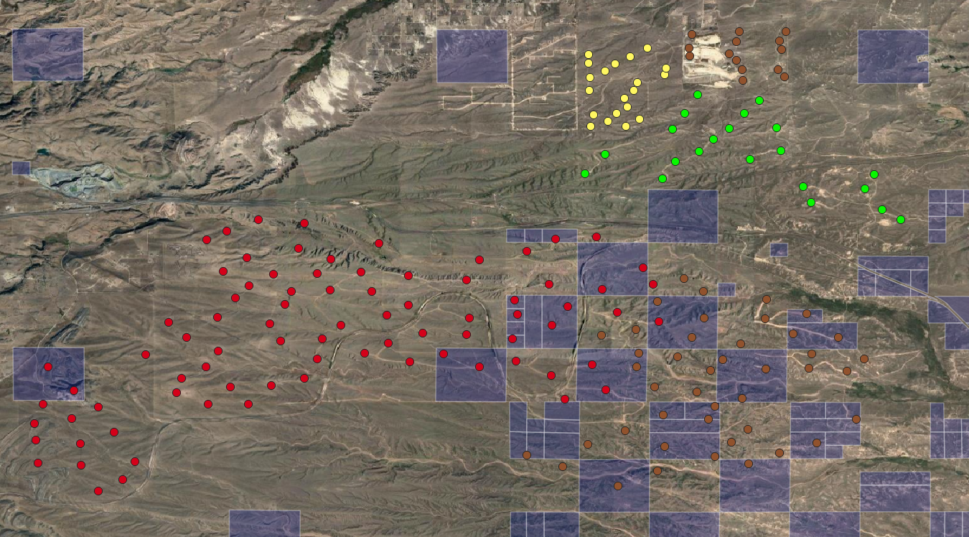

Slide 7
Leasing and Pricing
Typically, more like private land than federal
Solar: usually flat rate per acre or per MW of capacity
Wind: often tied to actual production
30+ year terms
Option contracts and “planning leases”
Upfront fees vs. royalties and ongoing fees
Partial vs. total leasing of relevant area

Slide 8
Renewables to Date
 | AZ | CA | CO | ID | MT | NV | NM | OR | UT | WA | WY
Solar Total | 67 | 475 | 96 | 9 | 6 | 40 | 64 | 100 | 33 | 2 | 1
Solar Trust | 4 | 1 | 41 | 0 | 0 | NA | 6 | 1 | 20 | 0
Wind Total | 11 | 128 | 40 | 26 | 31 | 3 | 40 | 47 | 8 | 32 | 34
Wind Trust | 17?? | 1 | 25 | 1 | 1 | NA | 14 | 0 | 0 | 19 | 20
Trust Revenue FY 2020 | $9.5m | NA | $1.8m | NA | $109k | NA | $1.2m | NA | $1.2m | $1.2m | $72k

