Slide 1
Office of State Lands
and Investments
State Trust Land - An Emerging Issue Forum
“Kelly Parcel”
Cody Booth
Assistant Director April 22, 2025

Slide 2
Trust Land Management Objectives
All State Trust Land sales, acquisitions, exchanges, and long term lease proposals are evaluated using the following objectives:
NOTE - A transaction does not need to meet all of the Trust Land Management Objectives, however each objective is analyzed in priority order.

Slide 3
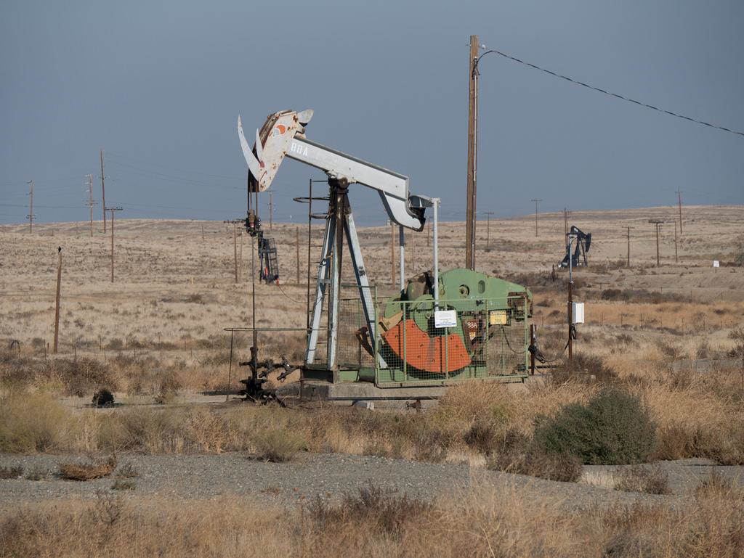
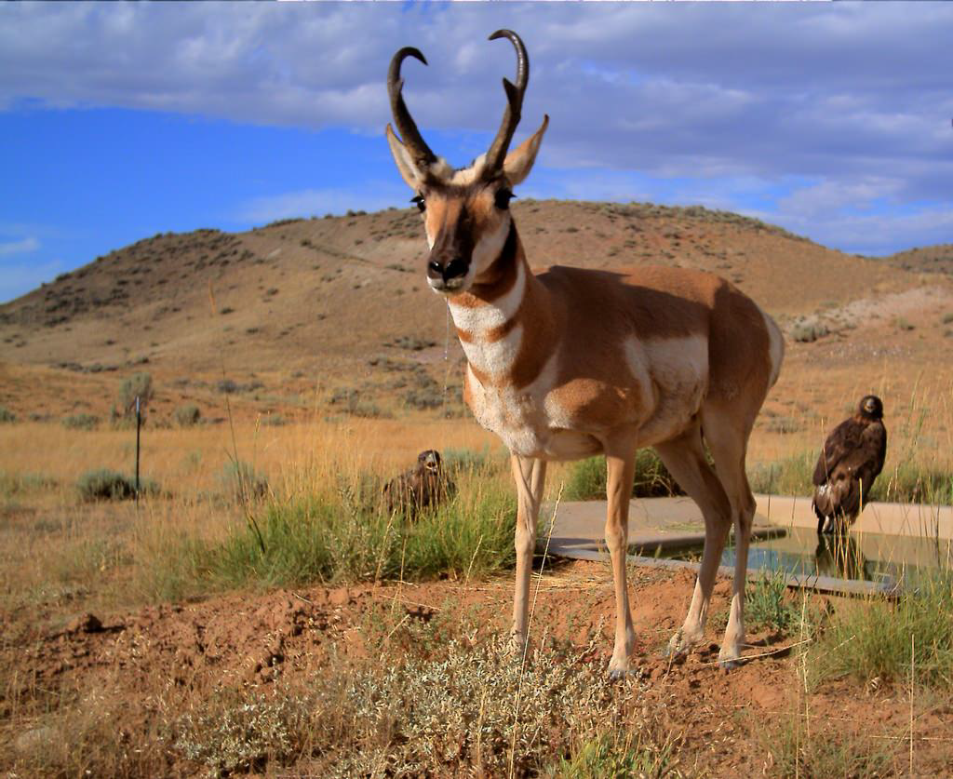
Trust Land Management Objectives
Better meet the beneficiaries’ short and/or long term objectives:
Revenue
Improve income generating potential
Alone or in combination with other state lands
Single or multiple uses
Investment Value
Improve returns
Improve portfolio diversification
Improve appreciation potential
Improve intrinsic natural resource values (i.e. habitat, water)

Slide 4
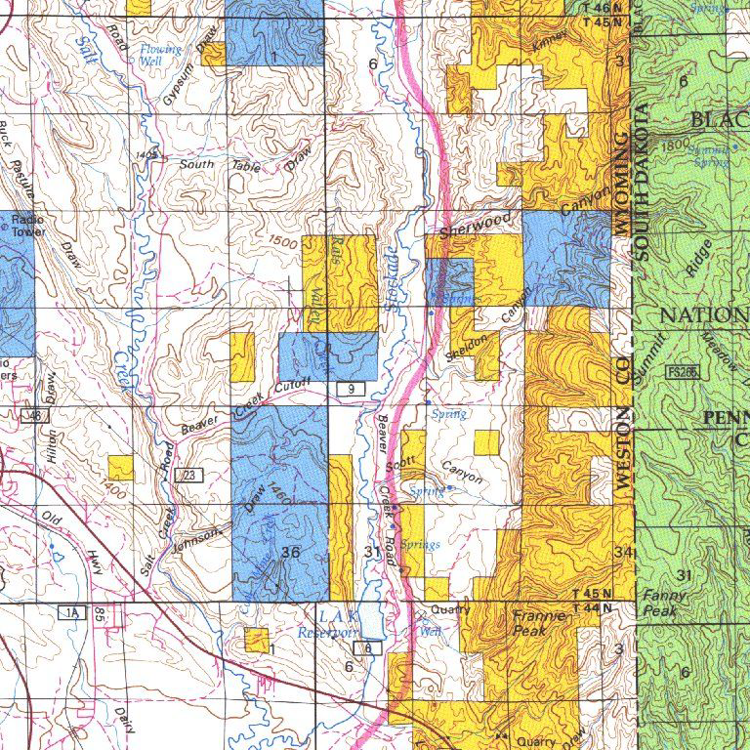
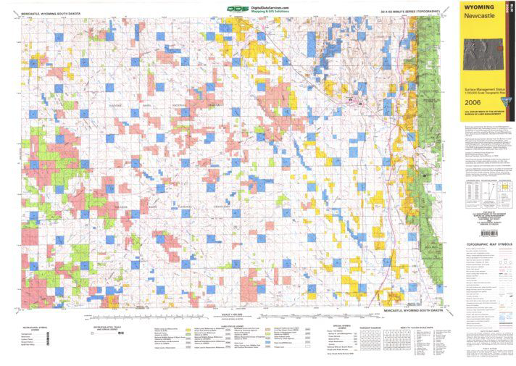
Trust Land Management Objectives
2. Improve the manageability of the land asset:
Consolidate ownership patterns
Leverage management resources of other agencies/entities
3. Meet a specific school and/or community need:
Improve stability
Provide growth opportunity
Improve access/recreational opportunity

Slide 5
Disposal Process
PROPOSAL SUBMITTED
CATEGORY 1
CATEGORY 2 DIRECTOR’S REVIEW
PREPARE DETAILED ANALYSIS
PUBLIC COMMENT PERIOD
PUBLIC HEARING(S) and WRITTEN PUBLIC COMMENT
SIXTY (60) Days
PUBLISH DETAILED ANALYSIS
BOARD CONSIDERATION
ADVERTISEMENT PERIOD
THIRTY (30) DAYS
PUBLIC AUCTION
Board of Land Commissioners’
Rules and Regulations, Chapter 26, Section 4
CLOSING

Slide 6
Background
State Trust Land
And
Grand Teton National Park

Slide 7
Historic Timeline
2003
2010
2010
2011
2012
2013
The Grand Teton National Park Land Exchange Act
Board Notice to the Department of Interior
Agreement for the Conveyance of Interest in Lands
House Enrolled
Act 22
Sale of the Jackson Lake Parcel
Sale of Snake River Parcel
Public Law 108-32
Authorized federal acquisition of identified state trust lands by
Donation
Purchase
Exchange
As the Federal Government had been unable to complete a transaction under Public Law 108-32, The Board Planned to sell the Kelly Parcel at auction.
The Board and the Department of Interior entered into an agreement for the Department to acquire state trust lands within the boundary of Grand Teton National Park
On a parcel-by-parcel basis
For a specified amount
On or before a specific date
Conditioned on the Wyoming Legislature granting direct sale authority
The Wyoming Legislature granted direct sale authority.
The Department of Interior acquired the Jackson Lake Parcel
Mineral Estate Only
$2,000.00
January 5, 2012
The Department of Interior acquired the Snake River Parcel
Surface and Minerals
$16,000,000.00
January 5, 2013

Slide 8
Historic Timeline
2014
2014
2014
2015
2016
2016
Department of Interior Failed to Acquire Antelope Flats Parcel
Agreement for the Conveyance of Interest in Lands Amended
Senate Enrolled
Act 69
Department of Interior Stops Work on Exchange
Senate File 88
Sale of Antelope Flats Parcel
The Department was unable to secure funding to acquire the Antelope Flats Parcel by the deadline and asked to seek an alternative method of conveyance.
Allowed an exchange transaction between the the Department and the Board for the remaining 2 parcels.
Reappraisal
Deadline of January 5, 2016
If not complete by the deadlines, the Board would place the remaining parcels on the CAT I Disposal List
Granted authorization to complete an exchange with several conditions.
Created the State Land Exchange Advisory Panel
The Department of Interior made the decision to stop work on an exchange and concentrate on acquiring the Antelope Flats Parcel by purchase.
Wyoming Legislature attempted to extend the authorization granted in Senate Enrolled Act 69. The attempt was not successful.
The Department of Interior acquired the Antelope Flats Parcel.
Surface and Minerals
$46,000,000.00
December 12, 2016

Slide 9
Historic Timeline
2016
2017
2021
2021
2023
2024
Sale of Kelly Parcel
Detailed Analysis Published and Sixty Day Public Comment Period Begins
Expiration of All Authorizations
House Bill 164
Senate File 119
Kelly Parcel is Placed on the CAT II Disposal List
Both the Amended Agreement for the Conveyance of Interest in Lands and Senate Enrolled Act 69 expired on December 31, 2016.
Pursuant to the amended agreement, the Board placed the Kelly Parcel on the CAT I Disposal List
Wyoming Legislature attempted to extend the authorization granted in Senate Enrolled Act 69. The attempt was not successful.
Wyoming Legislature attempted to grant direct conveyance authorization of the Kelly Parcel to the Department of Interior. The attempt was not successful.
The Director placed the Kelly Parcel on the CAT II Disposal List on February 18, 2021.
Sixty Day Public Comment Period from October 2, 2023 through December 1, 2023.
The Department of Interior: Grand Teton National Park, acquired the Kelly Parcel.
Surface Only
$100,000,000.00
December 27, 2024

Slide 10
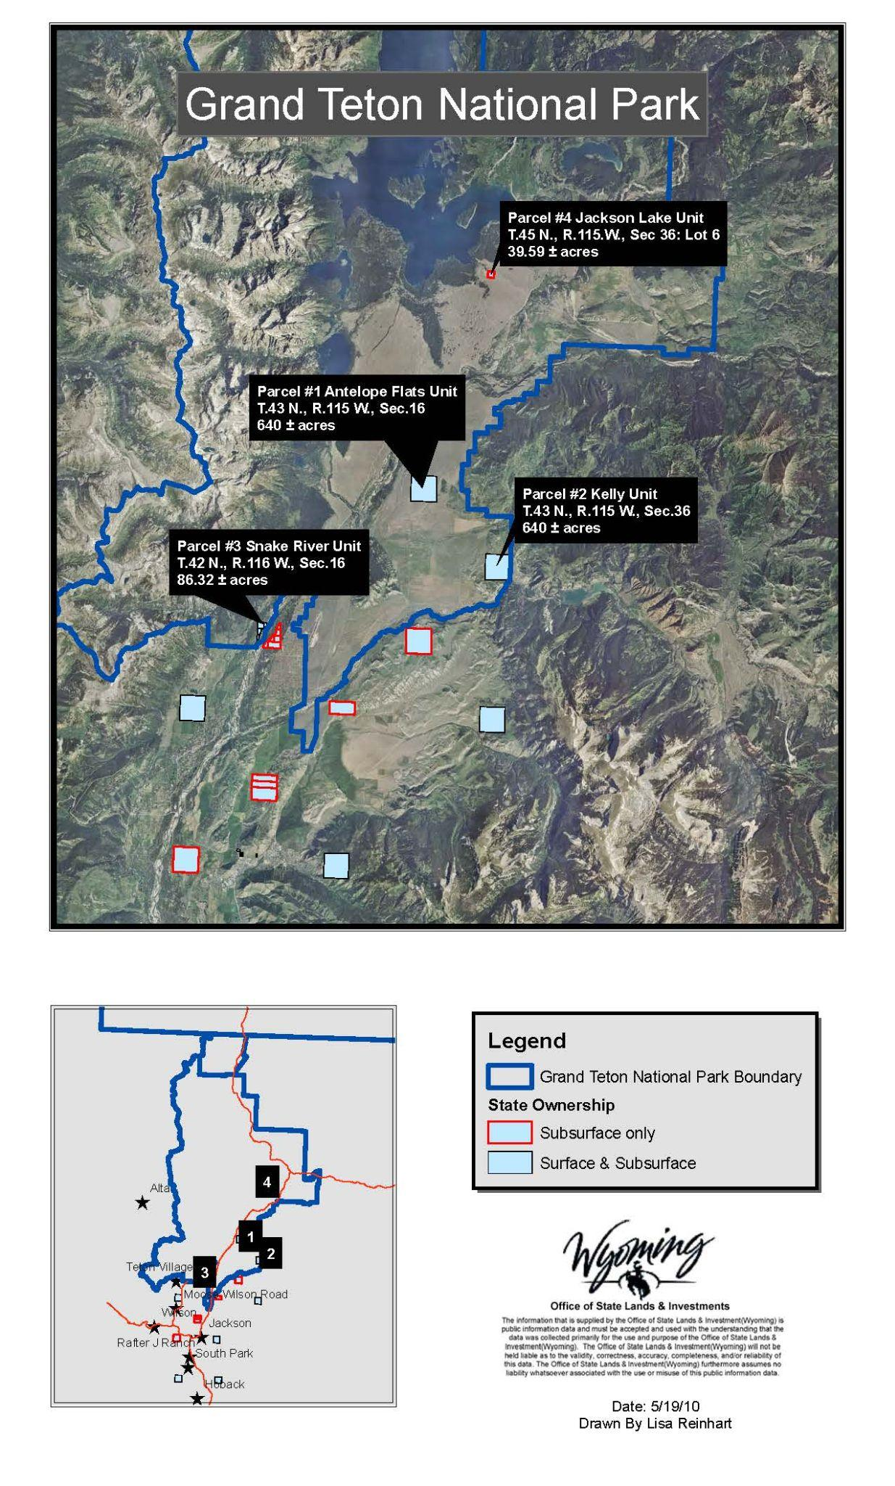
State Trust Land within Grand Teton National Park
Parcel | Estate | Acres | Amount | Date
Jackson Lake Parcel | Mineral Only | 39.59 | $2,000.00 | January 5, 2012
Snake River Parcel | Surface and Mineral | 86.32 | $16,000,000.00 | January 5, 2013
Antelope Flats Parcel | Surface and Mineral | 640 | $46,000,000.00 | December 12, 2016
Kelly Parcel | Surface | 640 | $100,000,000.00 | December 27, 2024

Slide 11
Kelly Parcel Disposal

Slide 12
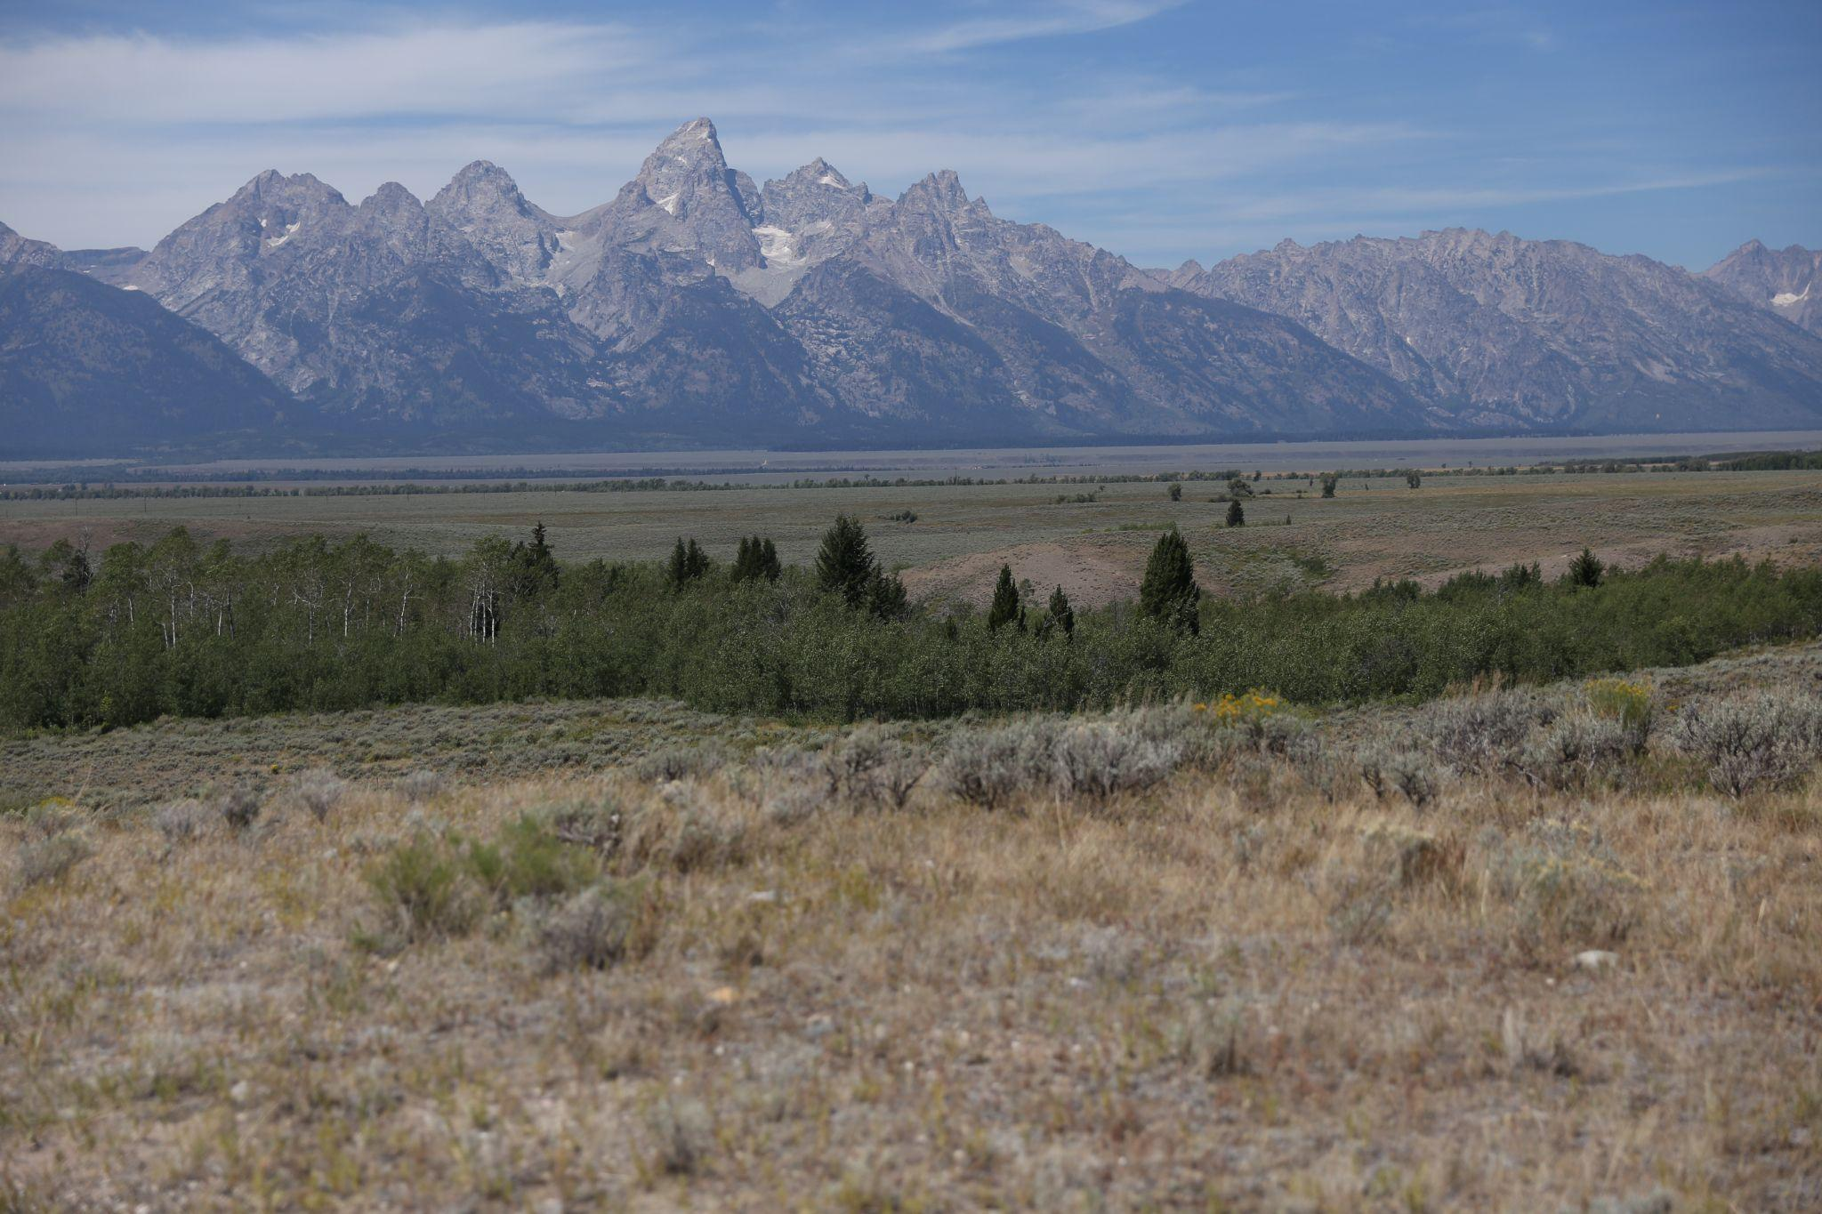
Disposal
State Trust Land
14 miles northeast of Jackson, WY
640 acres
Surrounded by Grand Teton National Park, Bridger-Teton National Forest, and the National Elk Refuge
Public Access is provided by the Gros Ventre Road
Development is limited by scenic easement
Existing uses:
Grazing and agriculture, Easements, and Temporary Use Permits

Slide 13
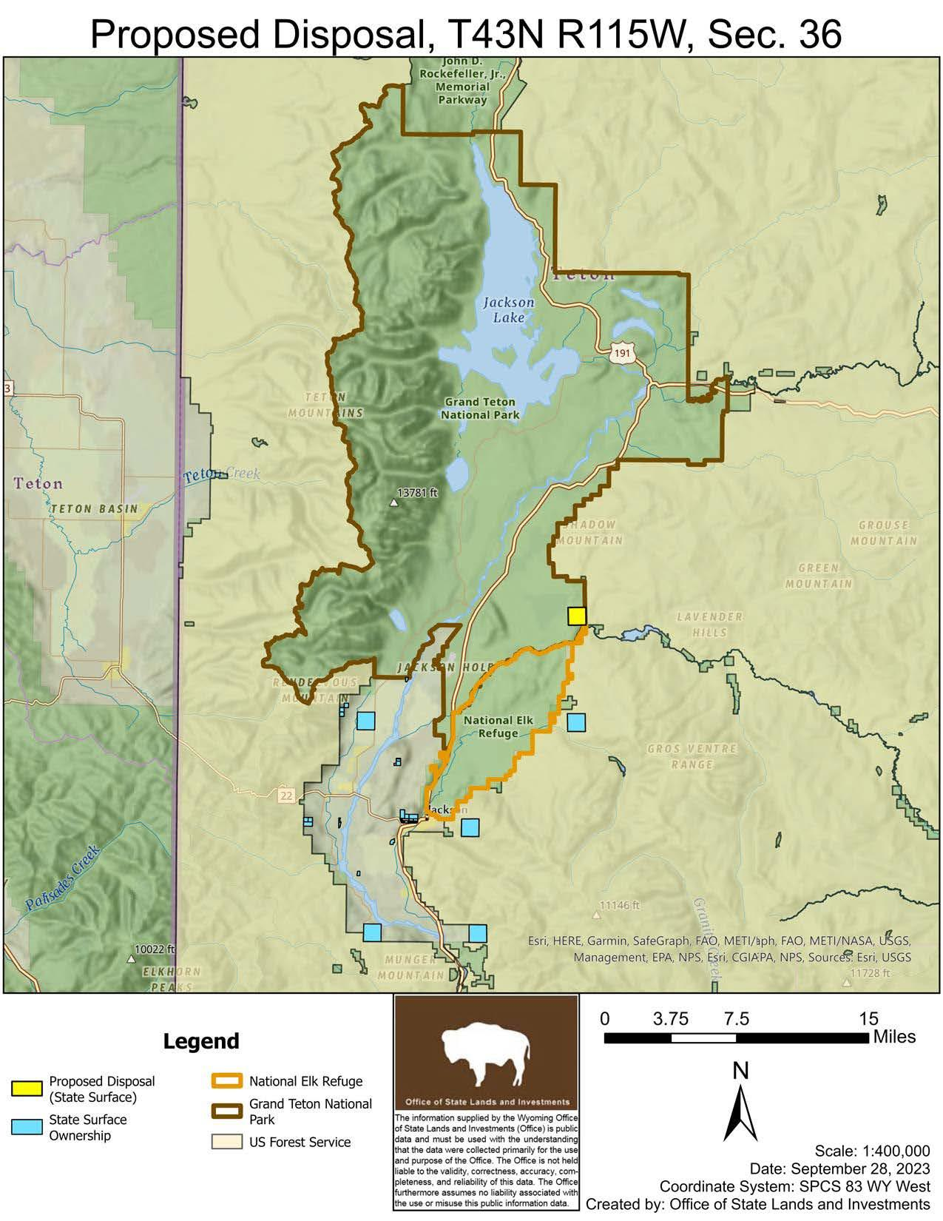

Slide 14
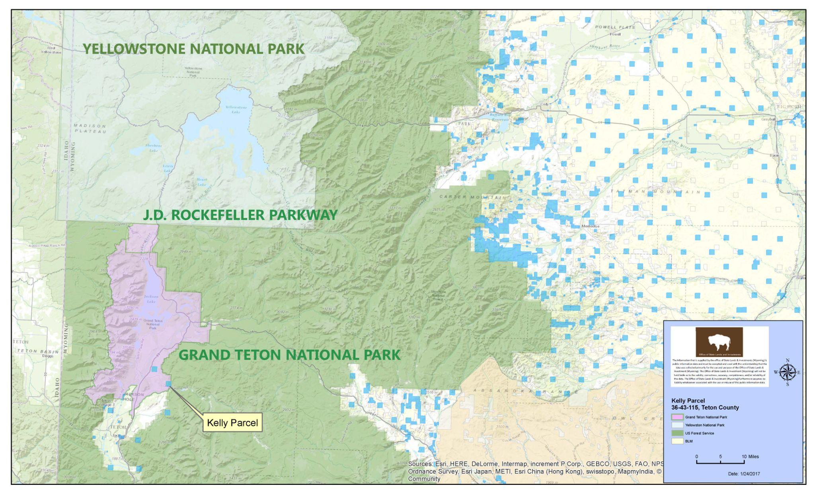

Slide 15
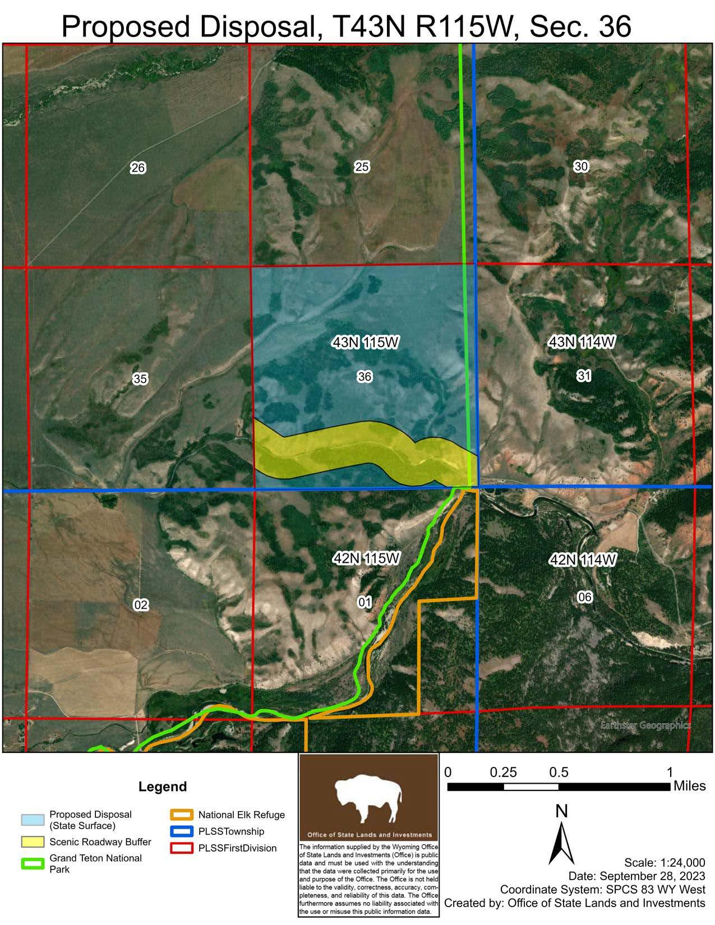

Slide 16
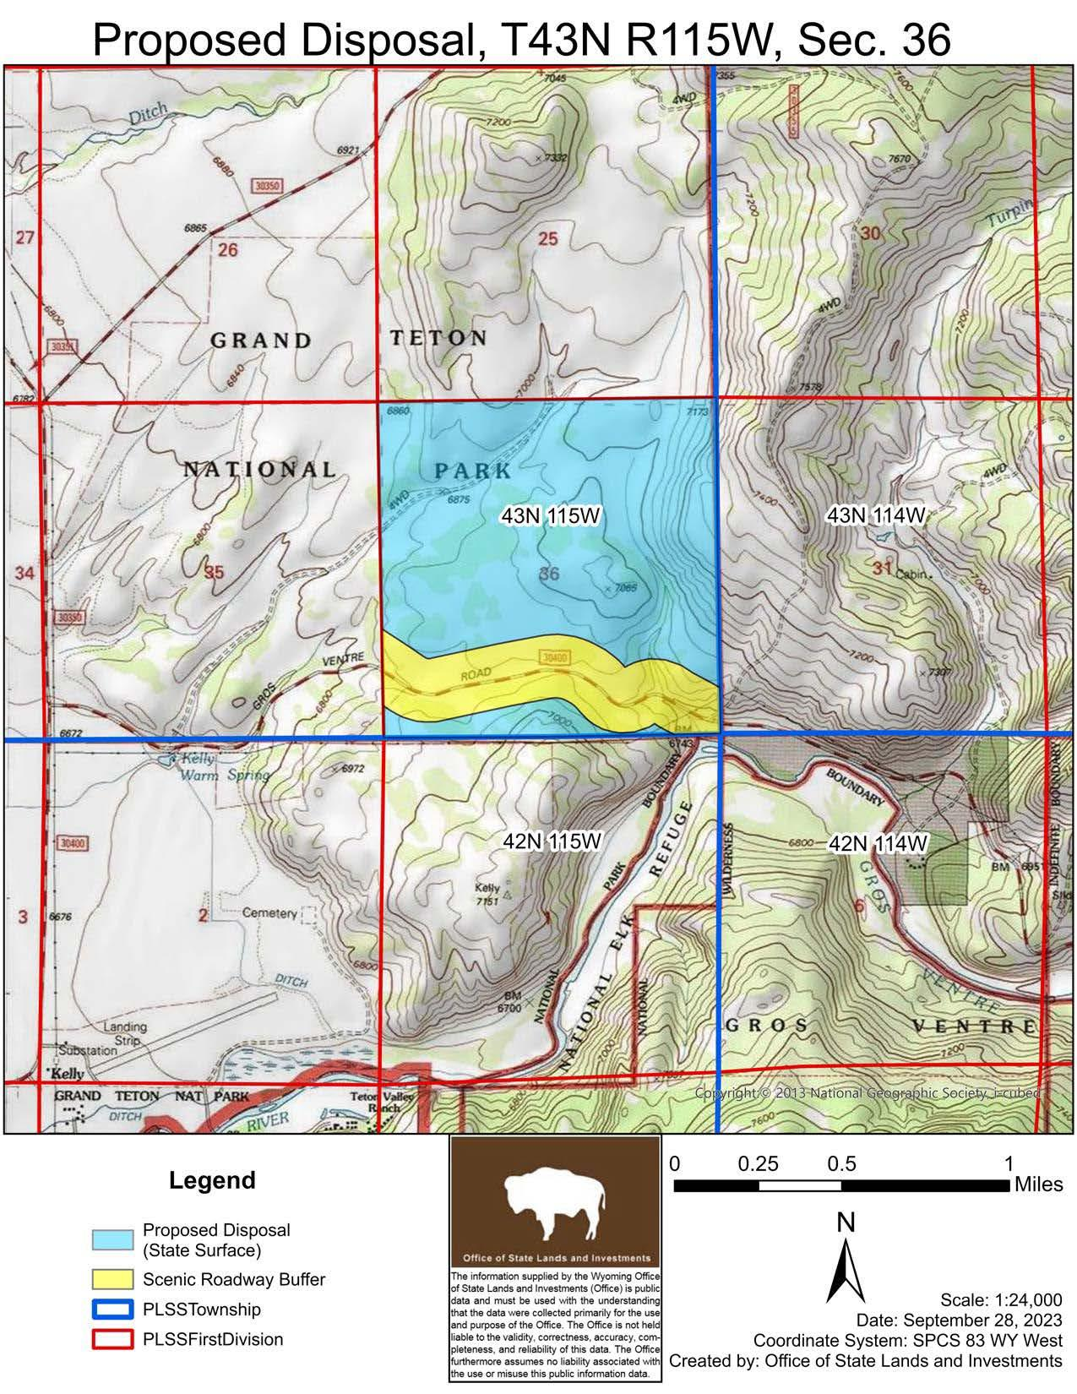

Slide 17
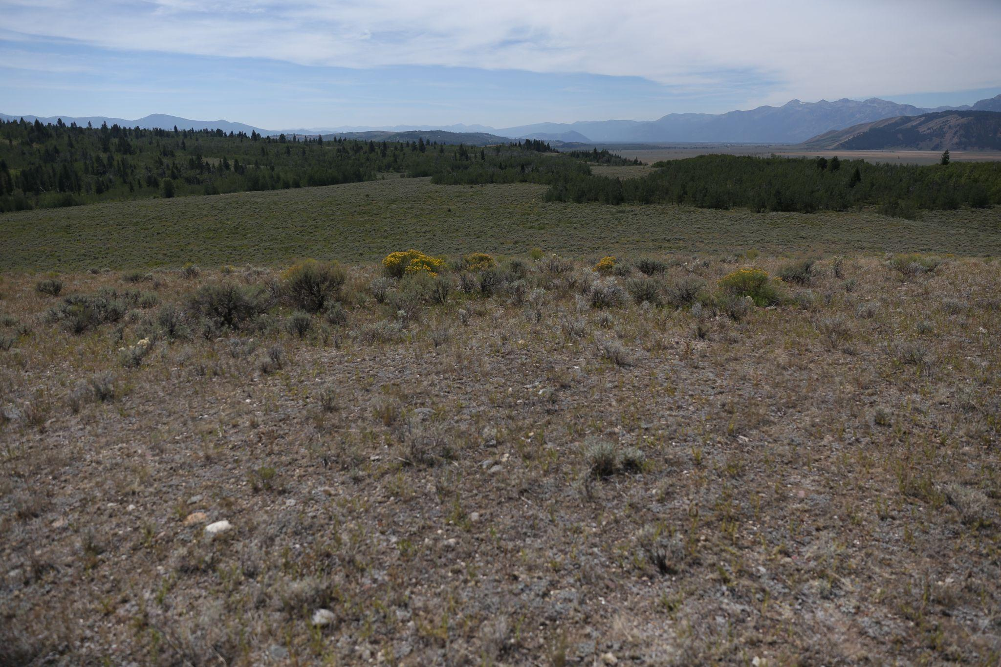
Disposal
State Trust Land
Category I Disposal List by the Board of Land Commissioners on December 31, 2016
Category II Disposal List by the Director on February 18, 2021
October 2, 2023- December 1, 2023
Sixty (60) day comment period
Four (4) public hearings
Jackson, Casper, Cheyenne, Cody
Board of Land Commissioners Consideration on December 7, 2023. Action: Tabled until fall of 2024
Board of Land Commissioners Consideration on November 7, 2024. Action: Approved.
Sale of the Kelly Parcel on December 27, 2024

Slide 18
Disposal
State Trust Land
Appraised Value
640 acres @ $97,539.06 per acre
$62,425,000.00
Pursuant to the 2024 House Enrolled Act No. 50 Direct sale of the Kelly Parcel to the United States cannot be for a value less than one hundred million dollars ($100,000,000.00)

Slide 19
Disposal
State Trust Land
Revenue Generation
Existing Annual Income
Grazing and Agriculture Leasing $1,805.65
Temporary Use Permits $1,040.00
Total Annual Income $2,845.65

Slide 20
COMPARISON OF ANTICIPATED RETURNS TO THE STATE’S BENEFICIARIES
Potential 10-year Return
10-Year Comparison of Existing Uses, Appreciation/Income versus Earnings
 |  | 10 Year Hold (low) | 10 Year Hold (high) | Versus | 10 Year Disposal
 | Appraised Value | 3.52% Appreciation + Current Income (x10 yrs.) | 7.2% Appreciation + Current Income (x10 yrs.) |  | 6.4% Investment Earnings
Appreciation + Income OR Earnings | $62,425,000.00 | $22,002,056.50 | $42,487,489.00 |  | $64,000,000.00
Future appreciation in land value is unknown, and can only realized upon a sale. This comparison highlights the possible value of the parcel if held after a 10 year period, to the tangible amount deposited into the Common School Permanent Land Fund over the same period.

Slide 21
State Trust Land/Grand Teton National Park
Parcel | Value | Date Disposed | Time Invested (years) | Annual Earnings | Earnings to Date
Jackson Lake Parcel | $2,000 | January 2012 | 13 | $100 | $1,300*
Snake River Parcel | $16,000,000 | January 2013 | 12 | $800,000 | $9,600,000*
Antelope Flats Parcel | $46,000,000 | December 2016 | 9 | $2,300,000 | $20,700,000*
Total | $62,002,000 | -- | -- | $3,100,100 | $30,301,300*
*Earnings are based on an estimated average of 5% annual rate of return
Kelly Parcel | $100,000,000 | December 2024 | -- | $6,400,000 | --
Total | $162,002,000 | -- | -- | $9,500,100 | --

Slide 22
Powder River Basin Acquisition
Wyoming Statute 9-4-715 (k) and (o)
Funds received from sales of state trust land, plus up to $2,000,000.00, can be used to purchase land and improvements within Wyoming
Deeded
Federal
Letter of Intent
Signed November 7th, 2024
Currently
Coordinating with the Bureau of Land Management (BLM) to identify parcels
Cursory feasibility analysis by the BLM

Slide 23
Conclusion
The Kelly Parcel was generating $2,845.65 and was appreciating at an estimated 3.52-7.2%
$22-42.5 million dollars in revenue in ten (10) years.
The sale results in an estimated 6.4% ROI
$64 million dollars in revenue in ten (10) years.
Not only do the proceeds from the sale of the Kelly Parcel generate significant revenue, it is preserved for future generations to come within the Department of Interior.

Slide 24
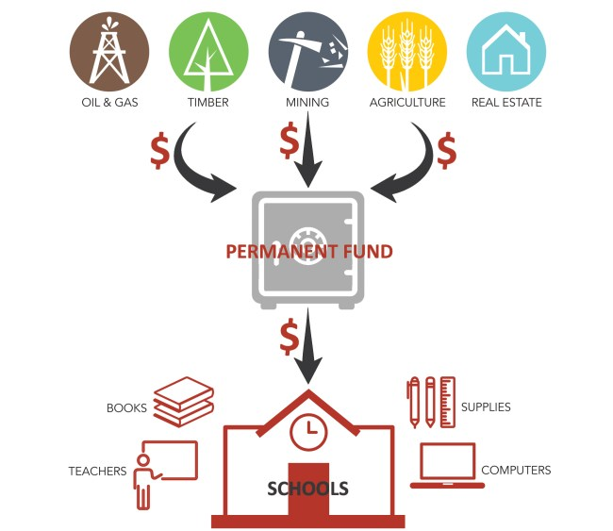
Questions??

Slide 25
Thank You!
Stacia Berry, Director (307) 777-3428 stacia.berry1@wyo.gov
Cody Booth, Assistant Director Trust Land Management Division (307) 777-6637 cody.booth@wyo.gov | Ben Bump, Assistant Director Field Services Division (307) 777-6545 benjamin.bump@wyo.gov
Kelly Norris, State Forester Wyoming State Forestry Division (307) 777-5662 kelly.norris@wyo.gov | Jennifer Doering, Assistant Director Administrative Services Division (307) 777-7028 jennifer.doering1@wyo.gov

