Slide 1
Wyoming Office of State Lands and Investments

Slide 2
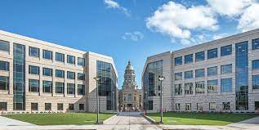
Office of State Lands & Investments
Administrative Arm
of the State Board of
Land Commissioners
and the State Loan
and Investment Board
Statutory responsibility to carry out the policy directives of the Boards

Slide 3
Mission Statement
Effectively managing natural resources and funds for
current and future generations

Slide 4
Director
Deputy Director
Trust Land Management Division
Administrative Services Division
Field Services Division
Wyoming State Forestry Division

Slide 5
State Board of Land Commissioners
(SBLC)
State Loan and Investment Board
(SLIB)
Created by Wyoming’s Constitution
(Article 18, Section 3)
Created by Wyoming Statute
(W.S. § 11-34-102)
OSLI Director
=
Secretary of the Board
OSLI Director
=
Chief Executive Officer of the Board

Slide 6
State Board of Land Commissioners (“SBLC”)

Slide 7
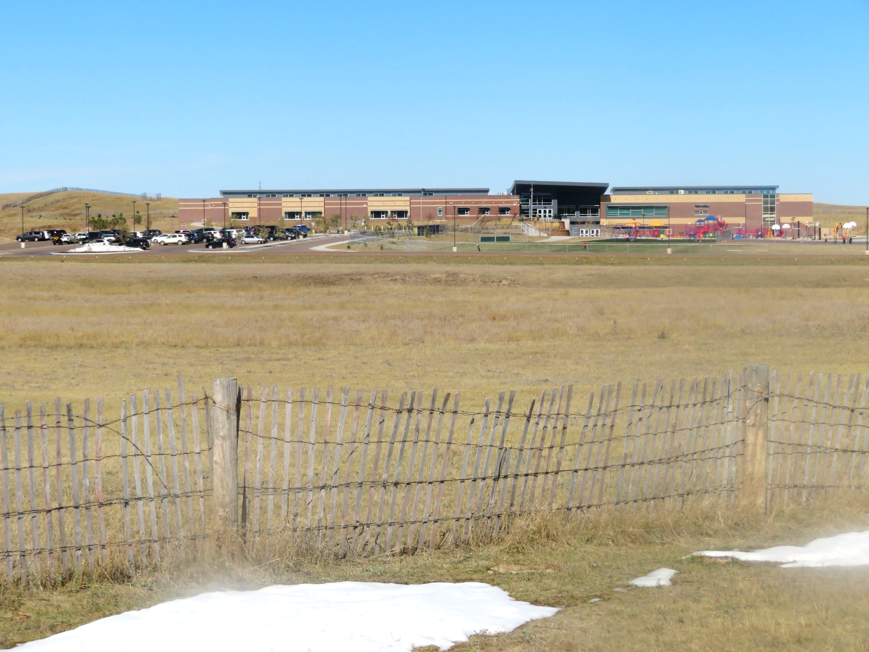
Impact.
5 Year Revenue: $818 Million
K-12 Funding: $548 Million
Notes:
Start with a Bang!
Wyoming’s Board of Land Commissioners has generated $1.9 billion for public education in the past decade. July 2007 - June 2017
I’ll give you a little bit of background about how we earn the money.

Slide 8
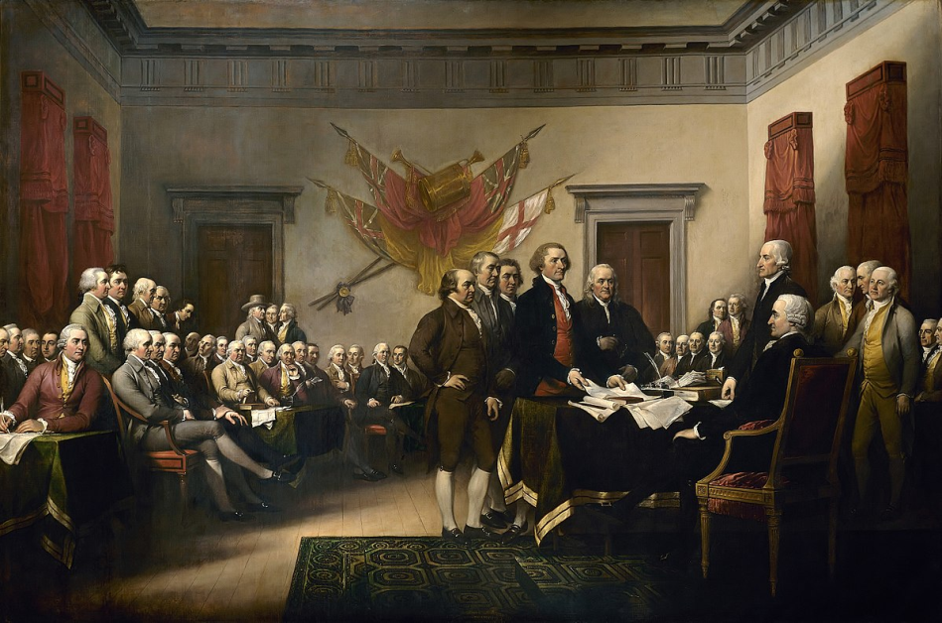
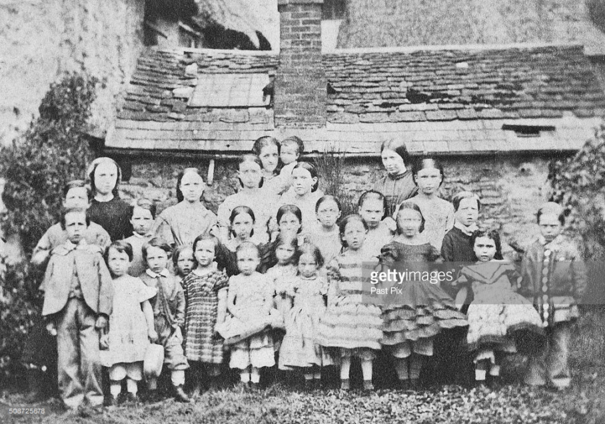
US History
1780s … Our Founding Fathers consider the concept of lands for schools.
~1780s
America’s Founders
~1860s
American Schoolchildren
Notes:
A quick history lesson.
Let me set the stage for you.
It’s the 1780s. We’ve signed the Treaty of Paris ending the American Revolution.
Britain has relinquished the Ohio Territory to the United States.
Confederation Congress is trying to gain control of this land among competing claims: existing States, native American tribes, illegal settlers, people who wanted to move west.
Confederation didn’t have power to tax, and were out of cash after the war, and wanted to be able to sell the land.
Needed a way to measure, divide and distribute the land.
A couple of Ordinances were passed by the Confederation Congress in 1785 and 1787 to address these issues that contained some critical elements to understanding land boards today.
Set up a system by which undeveloped lands could be surveyed.
It divided land into 6x6 mile areas known as “Townships,” each containing 36 square mile “sections” or “lots.”
“Jefferson Grid,” as the idea was originally proposed by Thomas Jefferson. Wanted an orderly pattern for future settlement.
Established the concept of reserving land for public schools (Section 16).
Founding fathers believed educated citizens were key to a stable democracy. Idea of school at “center” replaced with support for schools.
So Wyoming State Land Board can trace its roots back to the founding days of the country

Slide 9
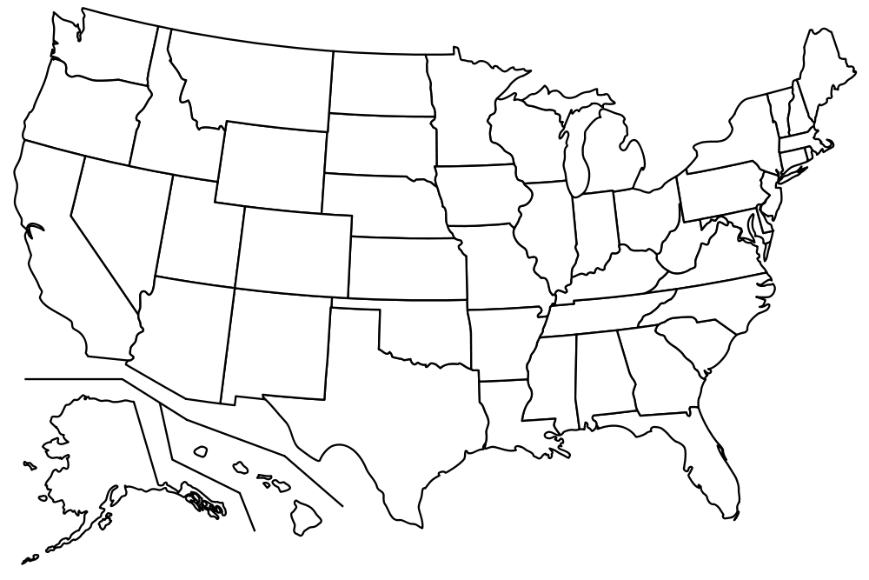
States with Trust Land
Notes:
The first state to participate to receive federal grant at statehood was Ohio in 1802
Nearly every state to join the union after Ohio received trust land
Most recent was Alaska in 1958
This is a map of states that received trust lands at statehood, though not all still have them today. Some states that originally received trust lands (like Ohio and Kansas) sold off all the land.
(Today there are 23 remaining states - we collectively manage a total of 156 million surface acres and 177 million sub-surface acres. 2ND largest landowners in the US.)

Slide 10
History and Nature of Trust Land
Organic Act
Approved by Congress on July 25, 1868
Provided temporary government for the Territory of Wyoming
Provided that sections numbered 16 and 36 in each township in the territory shall be reserved for the purpose of public schools in the state
6 | 5 | 4 | 3 | 2 | 1
7 | 8 | 9 | 10 | 11 | 12
18 | 17 | 16 | 15 | 14 | 13
19 | 20 | 21 | 22 | 23 | 24
30 | 29 | 28 | 27 | 26 | 25
31 | 32 | 33 | 34 | 35 | 36
6 | 5 | 4 | 3 | 2 | 1
7 | 8 | 9 | 10 | 11 | 12
18 | 17 | 16 | 15 | 14 | 13
19 | 20 | 21 | 22 | 23 | 24
30 | 29 | 28 | 27 | 26 | 25
31 | 32 | 33 | 34 | 35 | 36
6 | 5 | 4 | 3 | 2 | 1
7 | 8 | 9 | 10 | 11 | 12
18 | 17 | 16 | 15 | 14 | 13
19 | 20 | 21 | 22 | 23 | 24
30 | 29 | 28 | 27 | 26 | 25
31 | 32 | 33 | 34 | 35 | 36

Slide 11
History and Nature of Trust Land
Wyoming Constitution
Constitutional Convention September 2, 1889 to September 30, 1889
Ratified by the Wyoming voters on November 5, 1889
Article 18:
-The proceeds from the sale and rental of all lands and other property donated, granted or received, or that may hereafter be donated, granted or received, from the United States or any other source, shall be inviolably appropriated and applied to the specific purposes specified in the original grant or gifts.
-All funds belonging to the state for public school purposes is deemed trust funds in the care of the State, which is kept for the exclusive benefit of public schools.
-Income from perpetual funds and rents from unsold school lands is exclusively applied to the support of free schools in every county.

Slide 12
Constitutional Framework
Wyoming Constitution, Article 18, Section 1:
The State of Wyoming accepts the grants of lands made by the United States to the state, for educational purposes, for public buildings and institutions and for other objects
Wyoming Constitution, Article 18, Section 3:
Board of Land Commissioners shall have direction, control, disposition and care of all lands granted to the state
State Trust Land is owned by the State and held in a Trust for the benefit of public education in the State and other state institutions. The Board of Land Commissioners is the trustee of trust lands.

Slide 13
Board of Land Commissioners
The Board of Land Commissioners is composed of the Governor, Secretary of State, State Auditor, State Treasurer, and Superintendent of Public Instruction.
The Board is constitutionally charged with optimizing revenue from state trust lands to support public education and beneficiary institutions, while concurrently striving to protect, conserve, and maintain the lands so they may be used by future generations.

Slide 14
Constitutional Framework
Article 18, Sec. 4:
The Legislature:
Enacts the necessary laws for the sale, disposal, leasing or care of all lands granted to the State
Passes laws for suitable safekeeping, transfer and disbursement of land grant funds

Slide 15
Act of Admission Framework
Wyoming Act of Admission, Section 5:
All lands herein granted for educational purposes shall be disposed of only at public auction… But said lands may… be leased for mineral, grazing, agricultural, or other purposes, provided that the term of agricultural and grazing leases shall not exceed 10 years; and such land shall not be subject to preemption, homestead entry, or any other entry under the laws of the United States, whether surveyed or unsurveyed, but shall be reserved for school purposes only.

Slide 16
Direction, control, disposition and care
W.S. 36-2-107 (a)
The Board of Land Commissioners shall have the power and authority to promulgate and adopt rules and regulations not inconsistent with the laws of the state, as it may from time to time deem necessary in the direction, control, disposition and care of all state lands, and to preserve the value of the land and to recognize the fiduciary duties of the state land office.

Slide 17
Statutory Principles:
State land trust shall be managed under a total asset management policy.
State land trust is intergenerational and must be managed with a focus on protecting the corpus for the long term.
Trust land should remain a substantial component of the trust portfolio.
All leases shall provide a fair market value return, considering the lessees’ management practices and risk.
Investment policies must protect permanent land fund from effects of inflation.

Slide 18
State Trust Land Beneficiaries
Land Grant/Fund | Beneficiary
Common School | Wyoming Public Schools K-12
University | University of Wyoming
Fish Hatchery | Wyoming Game and Fish
Agricultural College | University of Wyoming
Deaf, Dumb, Blind | School for the Deaf
Poor Farm
Penitentiary | Penitentiary
Public Buildings at the Capitol | Public Buildings at the Capitol Complex
Penal, Reform, or Education Institutions | Retirement Center, Honor Farm, Women’s Center, Conservation Camp, Youth Treatment Center, Boys and Girls School
Insane Asylum | Wyoming State Hospital
Miner’s Hospital | Miner’s Hospital Board
Soldiers and Sailors Home | Veteran’s Home
State Law Library | State Law Library
State Library | State Library
Omnibus (SPEP&R Grant Lands – State Charitable, Education, Penal and Reform Institutions) | Department of Health, Department of Corrections, Department of Family Services

Slide 19
The Trust Assets
Trust Land
3.4 million surface acres
Trust Minerals
3.9 million mineral acres
State Permanent Land Fund
Over $6 billion

Slide 20
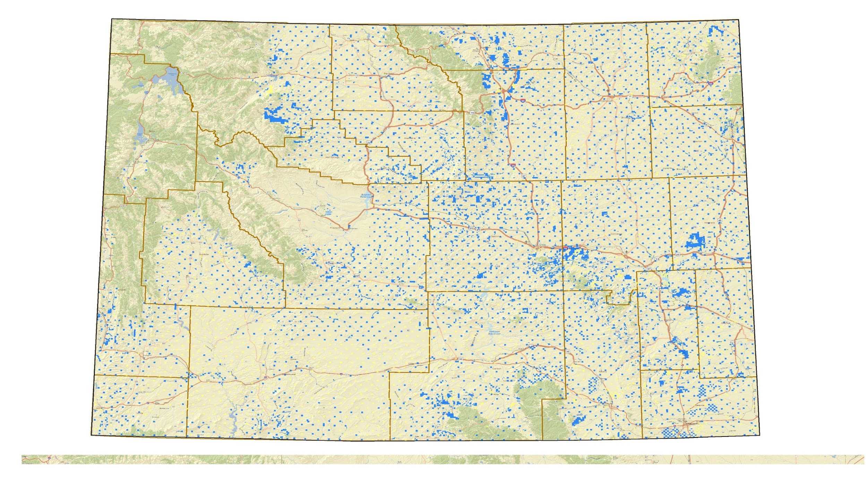
Wyoming State Trust Lands

Slide 21
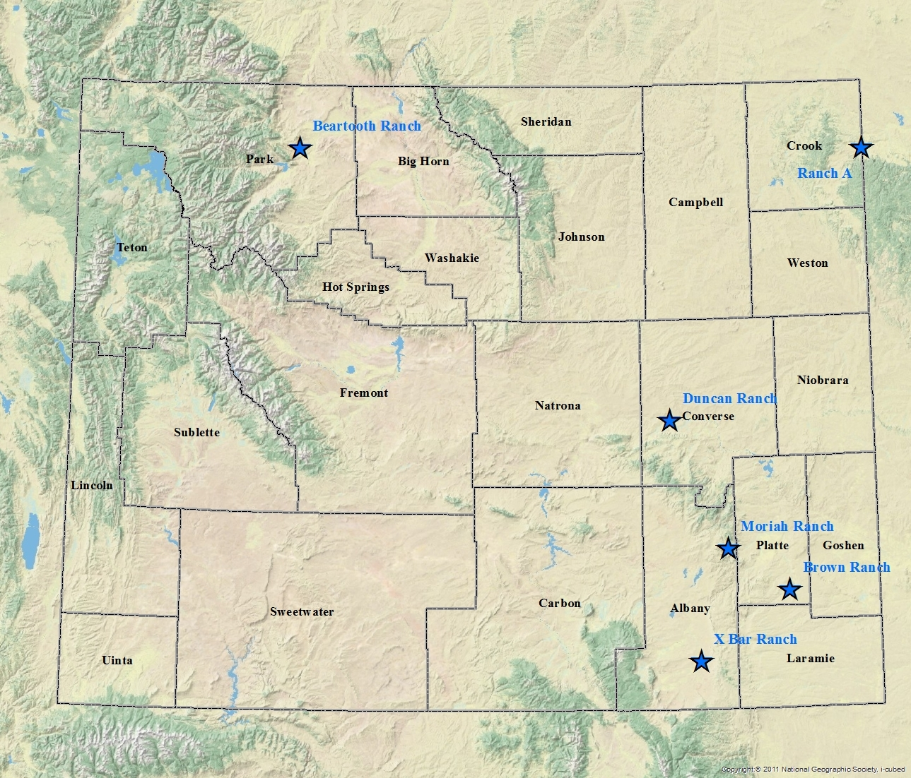
Board Managed Ranches
Bull Creek Ranch

Slide 22
The “How”
Grazing and Agricultural Leasing
Easements
Temporary Use Permits
Special Use Leasing
Land Sales, Exchanges, and Acquisitions
Renewable Energy Leasing
Mineral Leasing
Forest Product Sales
Carbon Capture Leasing
Always searching for opportunities for new and compatible uses

Slide 23
Trust Land Management Objectives
When evaluating courses of action with State Trust Land, OSLI follows what are known as Trust Land Management objectives.
A proposal need not meet all objectives.
The objectives are listed in order of decreasing priority (highest to lowest).

Slide 24
Trust Land Management Objectives
1. Better meet the beneficiaries’ short and/or long term objectives:
Revenue-
Improve income generating potential
Alone or in combination with other state lands
Single or multiple uses
Investment Value-
Improve returns
Improve portfolio diversification
Improve appreciation potential
Improve intrinsic natural resource values (i.e. habitat, water)

Slide 25
Trust Land Management Objectives (cont.)
2. Improve the manageability of the land asset:
Consolidate ownership patterns
Leverage management resources of other agencies/entities
3. Meet a specific school and/or community need:
Improve stability
Provide growth opportunity
Improve access/recreational opportunity

Slide 26
Management Paradigm
State Trust Land “Public” Land
Office of State Lands BLM/Forest Service
and Investments
Optimize Revenue vs. Multiple Use & Sustained Yield

Slide 27
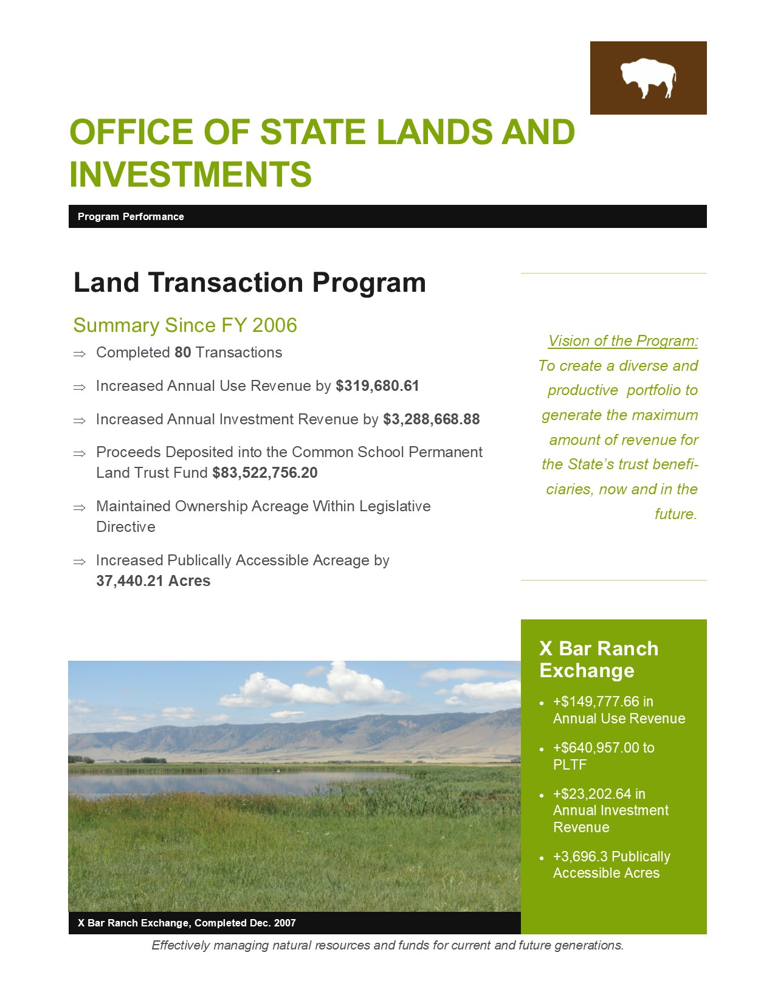

Slide 28
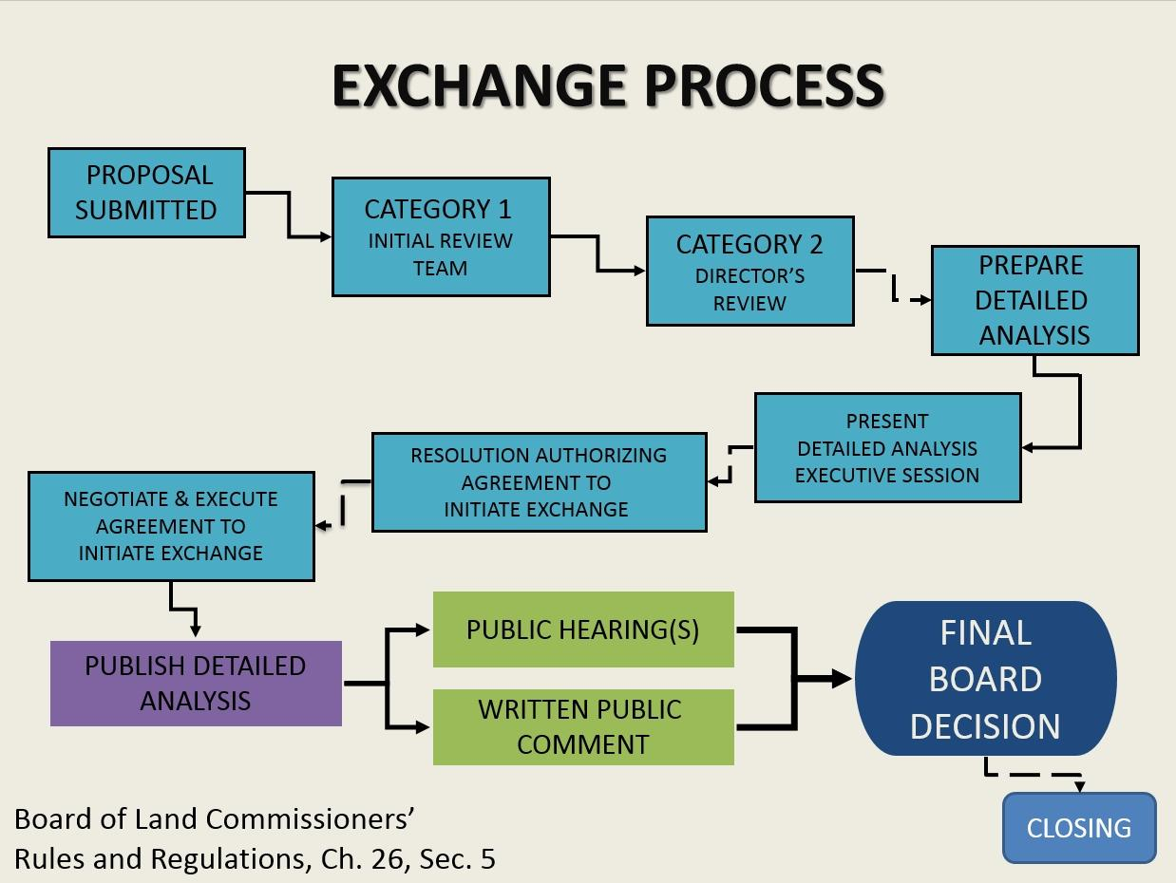

Slide 30
Disposal Process
PROPOSAL SUBMITTED
CATEGORY 1
CATEGORY 2 DIRECTOR’S REVIEW
PREPARE DETAILED ANALYSIS
PUBLIC COMMENT PERIOD
PUBLIC HEARING(S) and WRITTEN PUBLIC COMMENT
SIXTY (60) Days
PUBLISH DETAILED ANALYSIS
BOARD CONSIDERATION
ADVERTISEMENT PERIOD
THIRTY (30) DAYS
PUBLIC AUCTION
Board of Land Commissioners’
Rules and Regulations, Chapter 26, Section 4
CLOSING

Slide 31
State Trust Land
Revenue

Slide 32
Trust Land Earnings
86% of state trust lands are classified as “Common School Trust Lands,” more commonly referred to as “State School Sections” and support K-12 education
14% of state trust lands generate revenues to support other state institutions such as UW and the Veterans Home
Grazing is the most prevalent use on state trust lands with approximately 4,000 grazing leases covering over 98% of state trust land surface acreage. We rely on our grazing lessees to help us manage our surface acres.
Mineral development generates the most income for the state trust land beneficiaries

Slide 33
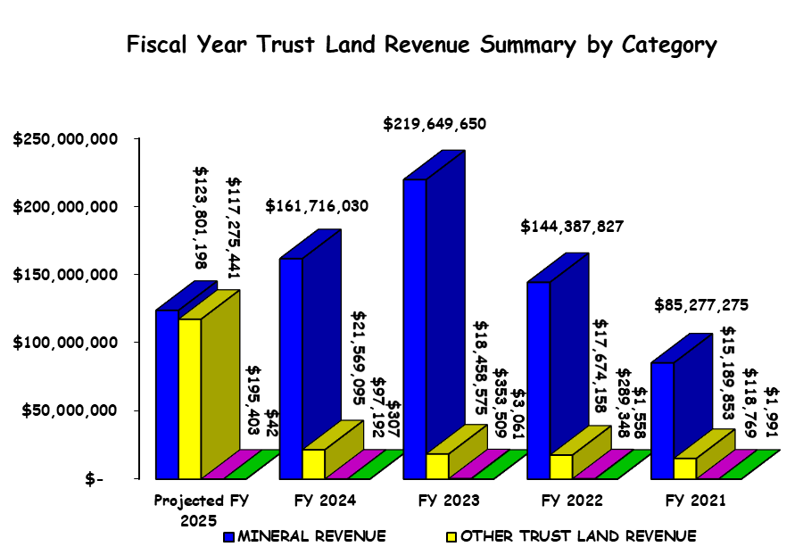

Slide 34
Wyoming OSLI Mineral Leasing
FY 24 Revenue
$241,272,084 Total Trust Land Revenue
$123,801,197 mineral revenue (51.35% of total)
$100,325,748 oil and gas revenue (81.04% of total)
12th highest
$$ spent per pupil nationwide
($3,619/pupil higher than US avg.)
https://worldpopulationreview.com/state-rankings/per-pupil-spending-by-state
Per Pupil Spending by State June 2023

Slide 36
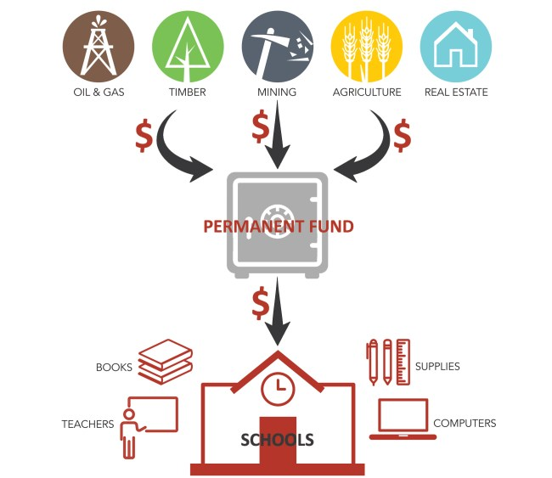
Questions??

Slide 37
Thank You!
Stacia Berry, Director (307) 777-6629 stacia.berry1@wyo.gov
Cody Booth, Assistant Director Trust Land Management Division (307) 777-6637 cody.booth@wyo.gov | Ben Bump, Assistant Director Field Services Division (307) 777-6545 benjamin.bump@wyo.gov
Kelly Norris, State Forester Wyoming State Forestry Division (307) 777-5662 kelly.norris@wyo.gov | Jennifer Doering, Assistant Director Administrative Services Division (307) 777-7028 jennifer.doering1@wyo.gov

