Slide 1
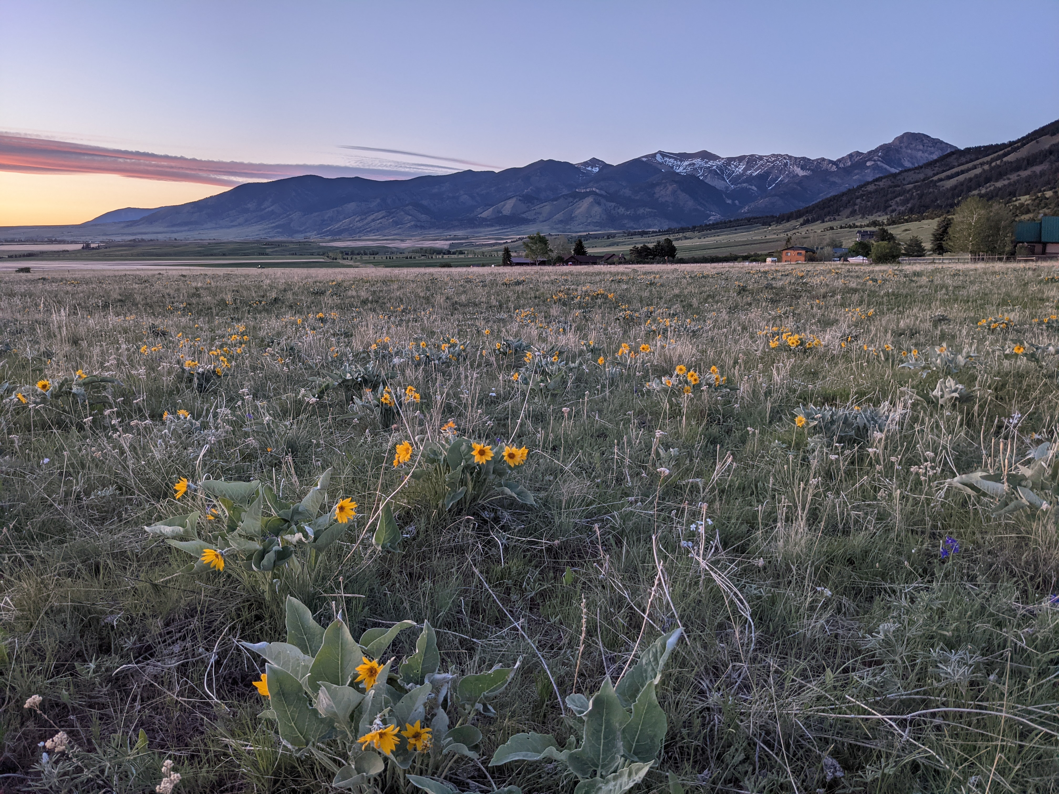
Conservation on Trust Lands Across the West
Barriers, Opportunities, and Emerging Strategies Shawn Regan PERC

Slide 2
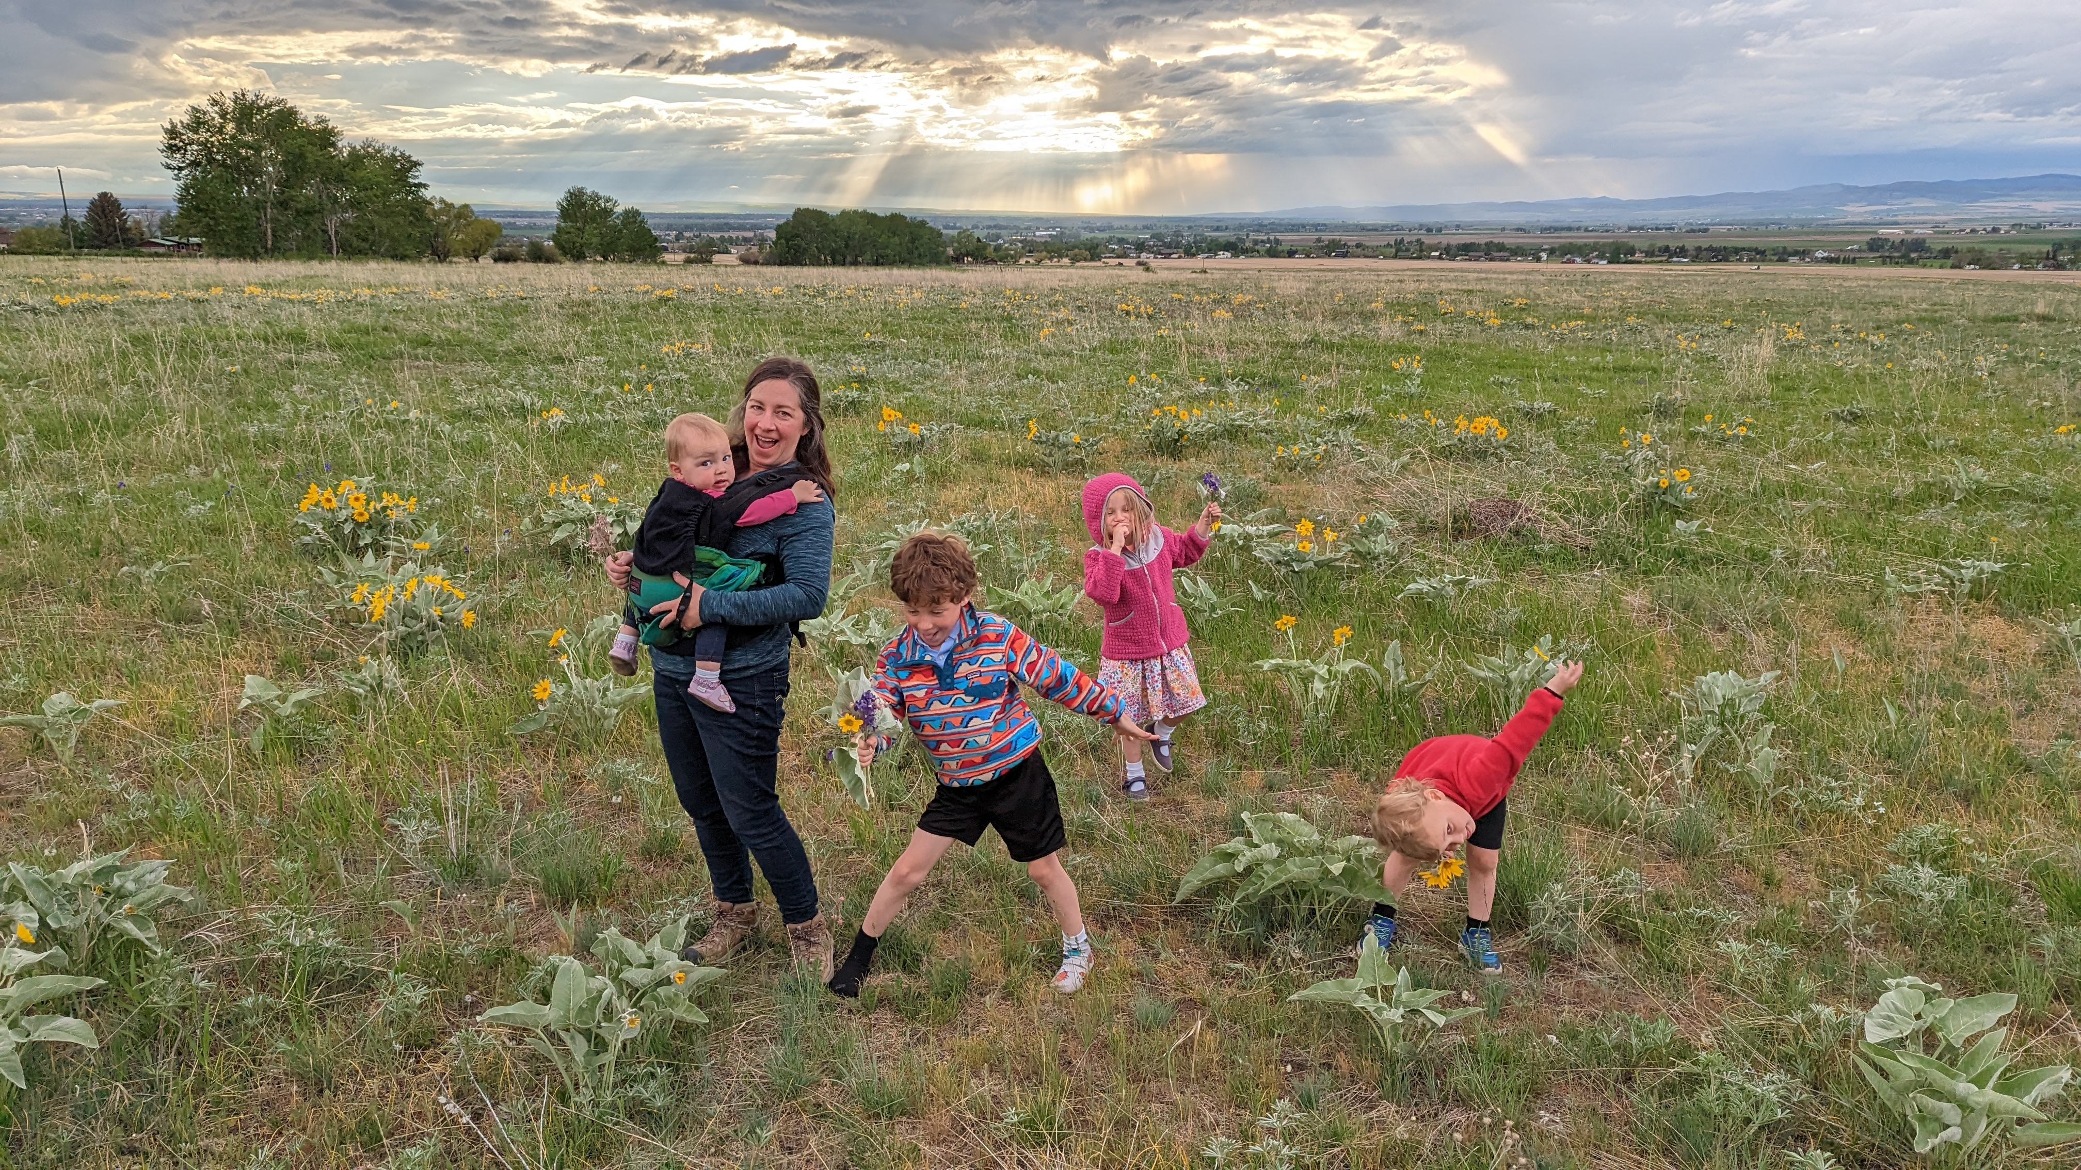

Slide 3
Trust Lands 101
Managed for a specific purpose: revenue generation for beneficiaries
Traditional uses: timber, grazing, energy
Growing interest in non-extractive uses—like conservation
Notes:
Not managed for specific uses like grazing or timber, but for a specific purpose: revenue generation for beneficiaries, typically schools.
Traditionally: timber, grazing, energy development.
Increasing interest in non-extractive uses—like conservation—as a way to diversify revenue while preserving or even enhancing trust assets.

Slide 4
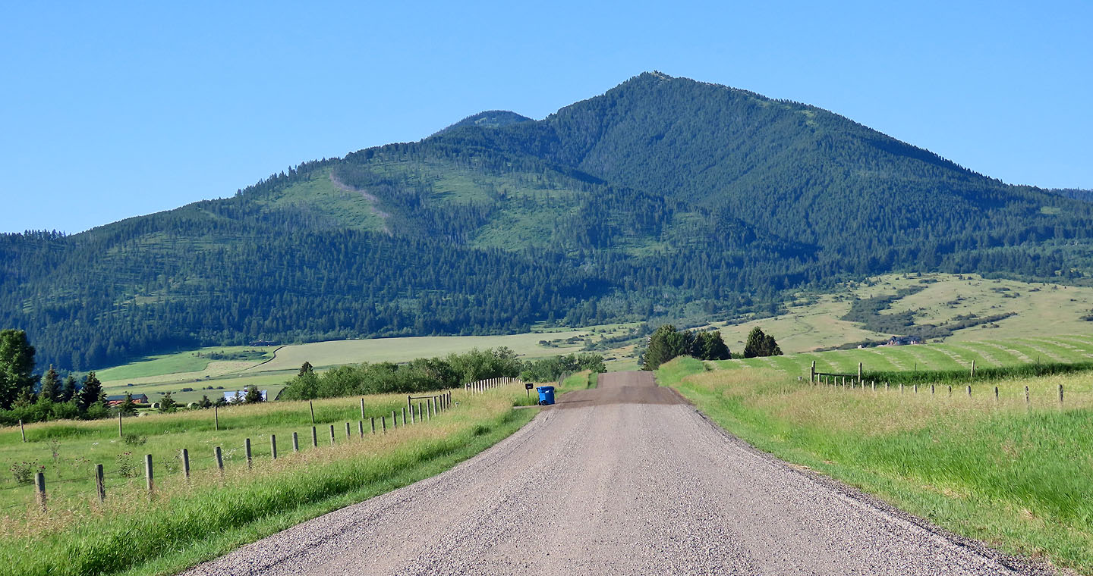
Case Study: Timber Conservation License
Notes:
Timber sale proposed on state trust lands outside of Bozeman
Area with significant conservation, amenity, scenic values
Local group wanted to keep the trees standing
Montana allowed for a “timber conservation license in lieu of sale”
If a group outbid a timber company, they could acquire a timber conservation license
This made sense – the state doesn’t have an obligation to lease land for timber harvesting, but for revenue maximization – and if a group bids more to keep the trees standing, the state should consider that bid. And in theory the trees would still be standing later and could be sold.
But this tool had only been used once before on a very small scale, and this example raised all sorts of questions:
How to structure the lease? How long should it be for?
How should a timber harvest bid be compared to a conservation bid?
Trees would still be standing and could be sold later
But if the trees were harvested, it would take 100 years for them to grow back
What about resource impacts/wildfire?
If groups could bid to stop harvesting, what would the broader impacts be on the local timber industry, mills, etc.?
The state initially proposed to offer a 5 year licence, but later agreed to offer a 25-year license. The conservation group eventually won the bid for $400,000
Acquired 25-year license
This conservation license, however, was not without controversy. Political backlash – the legislature repealed the statute that allowed for timber conservation licenses.

Slide 5
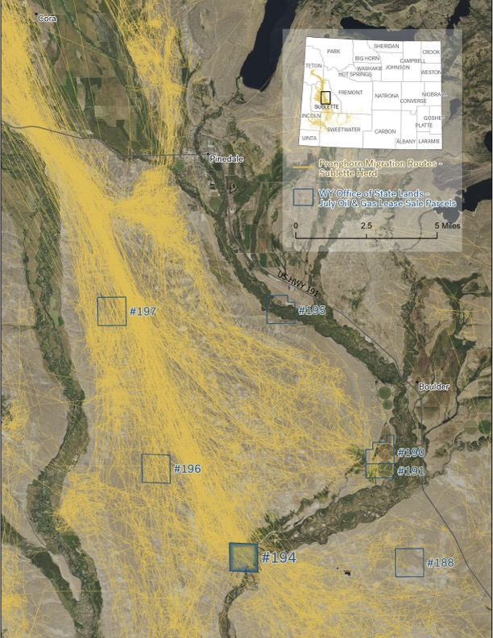
Other Creative Conservation Opportunities
Ecosystem service leases, mitigation banks
Migration corridors: Energy-conservation partnerships with surface stipulations
Habitat leases, easements, land exchanges
Notes:
That’s just one example – albeit a bit controversial – other creative examples:
Colorado - ecosystem services lease, conservation/mitigation banks
Wyoming: State trust lands in the path of a migration corridor, bottleneck
Conservation use leases could be awarded in high-priority areas to prevent surface impacts
Creative partnerships with industry groups to develop energy resources while still conserving key conservation values – timing restrictions, surface use stipulations
Habitat leases in sensitive riparian areas or wildlife habitats
Conservation easements
Land exchanges and sales to place high-priority lands in permanent protection.

Slide 6
Opportunities and Benefits
Diversifies and stabilizes revenue streams
Conflict resolution
Better outcomes:
Identify where conservation is the highest-value use
Enable win-win strategies – energy + conservation partnerships
Notes:
Revenue Diversification:
Create new income streams
Conflict Resolution:
Use voluntary, market-based tools to resolve land-use conflicts—less legal and political conflict.
Avoid litigation
Better Outcomes:
Helps identify where conservation is the highest-value use, and where development is most appropriate. * Supports win-win strategies—energy + conservation partnerships.

Slide 7
Barriers and Open Questions
Unclear authority
How to structure, price, and compare bids?
Procedural barriers:
Eligible uses, bidder restrictions, pre-classified use types
Concerns over long-term asset impacts
What about other creative partnerships?
Joint bids with industry
Voluntary negotiation with existing lessees
Stacking of uses
Notes:
Structural Barriers:
Many states don’t have clear authority to offer conservation leases.
How to structure/price conservation? Duration? Royalties vs. rent? Apples to oranges.
Procedural Barriers:
Narrowly defined eligible uses.
Restrictions on who can bid or qualify.
Pre-classified “use types” can box out innovation.
Implementation Challenges:
Resource impacts: Some uses increase long-term value; others may involve risks.
Creative Opportunities Worth Exploring:
Joint bids from conservationists + industry to reduce surface impacts.
Voluntary renegotiation of existing leases in sensitive areas (e.g. migration corridors).
Stacking of uses—e.g., grazing + habitat leases.

Slide 8
The Path Forward?
Conservation doesn’t have to be at odds with the trust model—it’s about expanding the revenue toolbox to reflect new and emerging values.
The challenge is figuring out how to structure these tools, price them appropriately, and accommodate them within the trust land framework.

