Slide 1
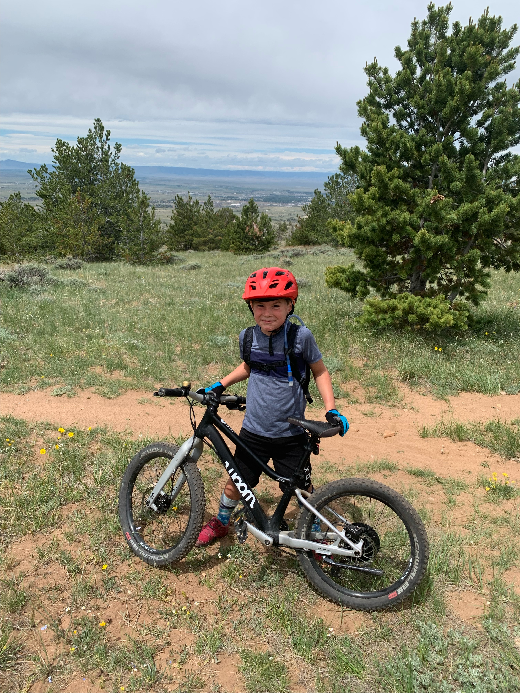
Recreation on State Trust Lands: Trends, Models, and Principles

Slide 2
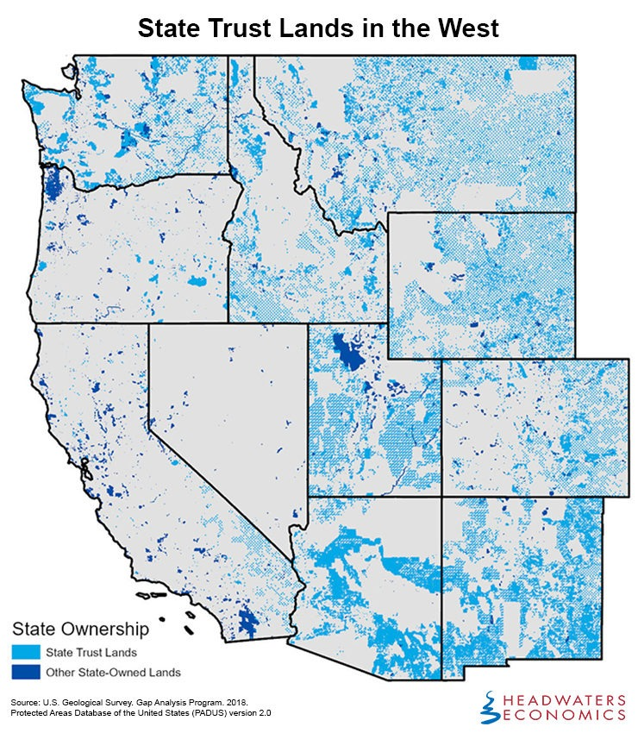
Background
46 million acres of state trust land across nine states in the American West, granted at statehood
Managed as fiduciary trusts – primarily for public schools
Increasing interest in recreational opportunities on state trust lands

Slide 3
Recreational Demand
Outdoor recreation is growing – 57% of American’s participated in 2023.
* Consumer spending on recreation has grown even faster than participation (up 43% since 2012)
Western states lead recreation GDP (MT 4.6%, WY 4.1%, UT 3.4%)
Offers the potential to diversify trust revenue portfolios and can contribute to growing the states’ recreational economies.
Can often complement – rather than displace – traditional revenue-generating uses.
Many trust lands are near popular destinations and rank high on amenity indices – making them suited for recreation and tourism.

Slide 4
Typology of Recreational Use on State Trust Lands
Hunting & Fishing: Broadly permitted; often monetized through state agency agreements or private leases
Motorized Use: varies widely; often restricted to roads/trails; some states charge via decals or permits
Non-Motorized Recreation: Broadly allowed; managed through permits, open access, or leases
Camping: Ranges from prohibited (WY) to permitted with restrictions (MT, AZ), to lease-only (CO)
Commercial & Long-Term Special Uses: Managed through permits for mobile uses (outfitters) and special use lease for permanent facilities (like ski areas or mountain bike trail systems); both ensure fair market return.
Notes:
Commercial or larger more long-term comm

Slide 5
Challenges and Opportunities
Fiduciary Tensions: Revenue vs. access
Access Barriers: Up to 28% of the land in some states are legally inaccessible.
Administration Complexity: enforcement, permitting, fee collection
Opportunity: Federal models (e.g. FLREA) offer guidance on scalable, fair fee structures.
Notes:
Proponents of charging for recreational access argue that state trust lands should be managed like other trust assets, ensuring that beneficiaries receive fair compensation for any use that draws on the land’s value. For example, Colorado generated over $3.1 million in recreation-related revenue in fiscal year 2022–2023 from a combination of general recreational use, public access programs administered through state agencies, and private recreational leases. Similarly, Arizona charges for recreational access through permits administered by the State Land Department, with recreational permitting generating $552,480 in revenue for the state's trust land beneficiaries in fiscal year 2024. These examples demonstrate that charging for recreation can provide a revenue stream that supports the trust’s mission while still allowing the public to enjoy these lands.
On the other hand, some argue that charging for recreational access is inconsistent with broader public land traditions, particularly in the West, where access to natural spaces is often expected to be free or minimally restricted
Some states have sought middle-ground solutions, such as waiving fees for low-impact recreation while requiring permits for higher-impact uses like camping, OHV access, or guided hunting trips.

Slide 6
Key Considerations
Recreation on trust lands is no longer the exception – its an emerging norm
Recreation can align with fiduciary duty if structured carefully
Success requires balancing uses, stewardship, and revenue generation
Consider differentiated modes/prices for low- vs high-use impact uses
Geographic prioritization, proximity to national parks, high-amenity areas

Slide 7
Thank You

