Slide 1
SkillSurvey Texting Process

Slide 2
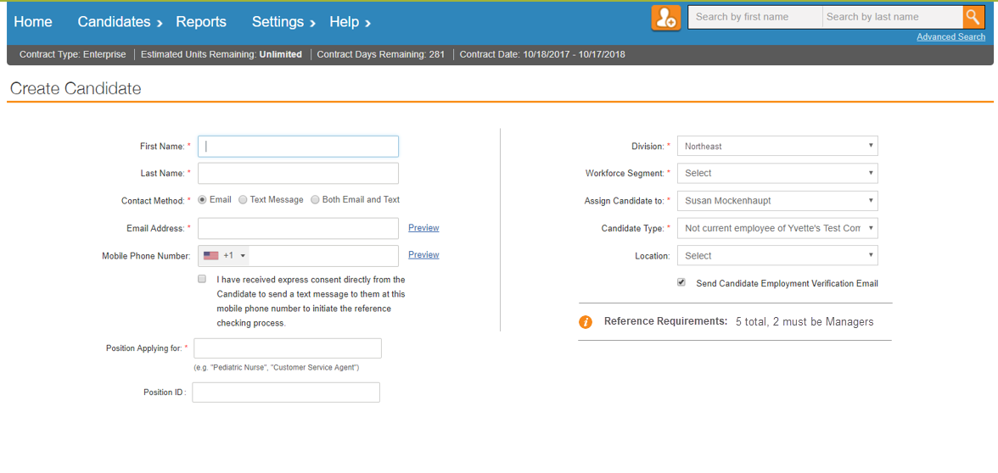
Create Candidates with Mobile Phone Numbers Get their consent
Make sure to ask your Candidates if it would be ok to send them a text before entering their mobile phone number.
You must check the consent box in order for a text to be sent out to the Candidate. If you check “Text” or “Both”, you cannot create a Candidate unless it’s checked.

Slide 3
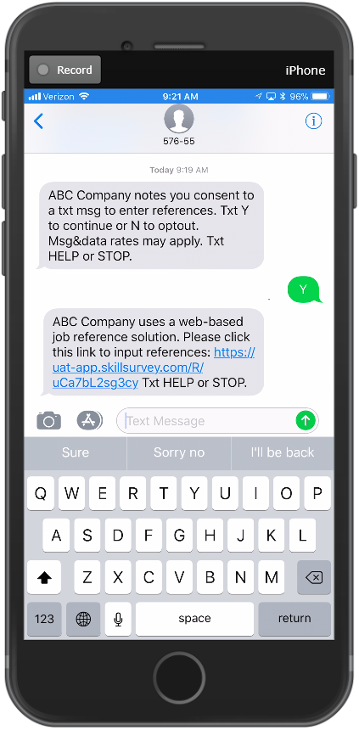
Candidate Receives Two (2) Texts
Your company name will show here
The Candidate will receive 2 texts.
The first text asks if they agree to receive texts as part of the process.
Text 1: ABC Company notes you consent to a txt msg to enter references. Txt Y to continue or N to opt out of txts. Msg&data rates may apply. Txt HELP or STOP.
If they say “yes”, then they receive a second text that contains a link to our mobile web pages to enter their References.
Text 2: ABC Company uses a web-based job reference solution. Please click this link to input references: (link). Txt HELP or STOP.
If they say “no”, they will be opted out of TEXTS ONLY and will not be able to receive texts from your company. If they want to opt back in, the Candidate can text SUBSCRIBE to 57655.

Slide 4
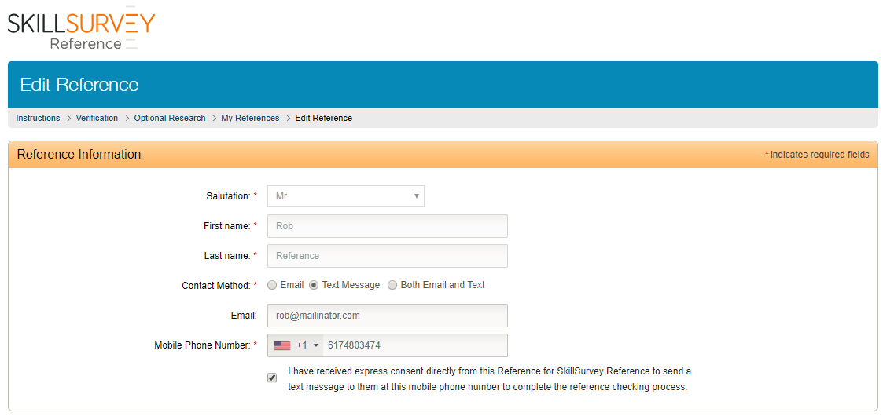
Candidate Enters References & Mobile Phone Numbers
Candidates must check a box to confirm they have consent from the Reference to send them a text.

Slide 5
Candidate’s Can View Reference Status
The Candidate can:
See the types of communications sent from the system via icons.
Click email icon to resend the email to their Reference.
Click the texting icon to see instructions for the Reference to text Resend to 57655 to resend a text.
Edit a Reference to enter an email address or mobile phone number.

Slide 6
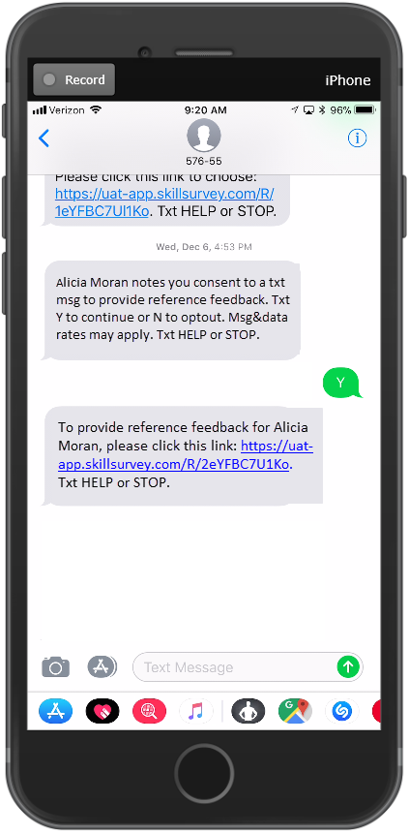
References Receive Two (2) Texts
Candidate’s name is shown here.
The Reference will receive 2 texts.
The first text asks if they agree to receive texts as part of the process.
If they say “yes”, then they receive a second text that contains a link to our mobile web pages to complete a survey.
Text 1: [Candi name] notes you consent to txt msg to give reference feedback. Txt Y to continue or N to opt out of txts. Msg&data rates may apply. Txt HELP or STOP.
Text 2: To provide reference feedback for [Candidate name], please click this link: (link). Txt HELP or STOP.
If they say “no”, the Reference will be placed on the Do Not Text list and you will be notified via email that the Reference opted out of texts.

Slide 7
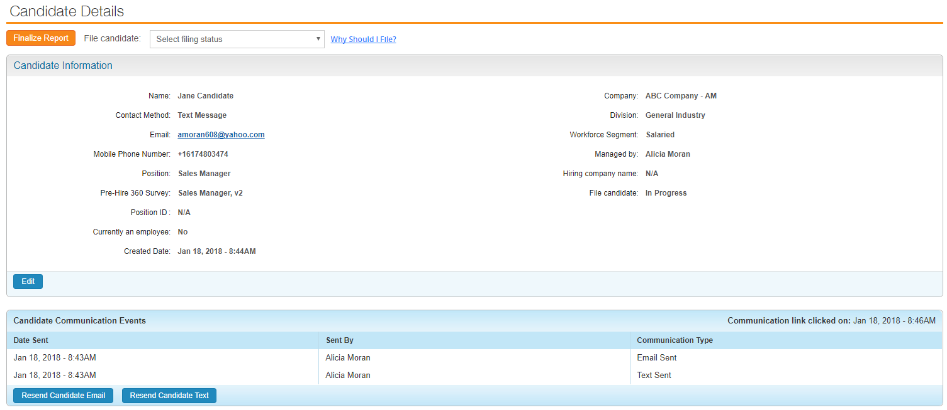
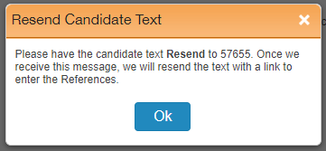
Resending Texts to Candidates from the Candidate Details Page
Click the “Resend Text Button” to see instructions to have the Candidate text the word RESEND to 57655. The system will send another text.
Note: Clicking this button does NOT resend a text. The Candidate has to text RESEND to 57655.

Slide 8
Resending Texts to References from the Candidate Details Page
Click the “Resend Text” icon to see instructions to have the Reference text the word RESEND to 57655. The system will send another text.
Note: Clicking this icon does NOT resend a text. The Reference has to text RESEND to 57655.

Slide 9
Questions?
Please contact your Client Relations Director or our customer support team at support@skillsurvey.com if you have any questions or experience any issues.

