Slide 1
How To Write An Effective Job Advertisement
By: Human Resources-Employment

Slide 2
Writing Your Job Ad
There are four sections when writing your job ad that require your attention:
Please Note
Essential Duties
Minimum Qualifications
Desired Qualifications
Be specific - the more detailed posting the easier it will be to screen applicants.
Using the KSAs from the PDQ can help write the perfect posting.

Slide 3
Please Note
Use this section to describe anything that candidates need to know.
The hours/days of week of the position if not a standard schedule.
If the position is grant-funded or on a calendar.
Specific weight lifting restrictions.
If there is more than one position available.
Position location if not in Laramie.

Slide 4
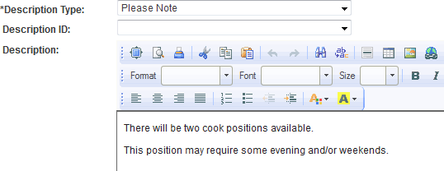

Slide 5
Essential Duties
This section automatically transfers over from the PDQ.
Departments may streamline the duties to remove information that is defining the duty.
Please do not add or remove job duties to this section.
Essential duties can be used when screening applicants.

Slide 6
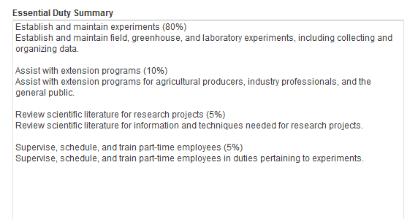
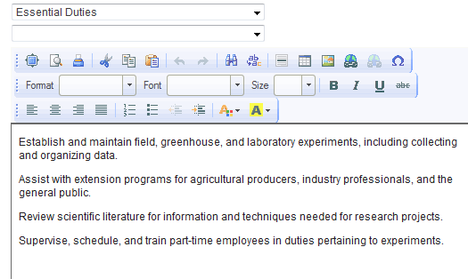
PDQ Essential Duties vs. The Ad’s Essential Duties

Slide 7
Minimum Qualifications
The degree and years of experience will come from the PDQ.
The degree can be specific i.e. Bachelor’s Degree in Accounting or a related field.
The years of experience must remain the same, however you can add equivalent combination of education and experience.
Please describe what ‘comparable experience’ means to your department.
Any licensure requirement will automatically fill from the PDQ. Departments can add additional requirements or the ability to obtain within a certain timeframe.
Every advertisement will contain the following statement “excellent interpersonal, written and/or verbal communication skills.”

Slide 8
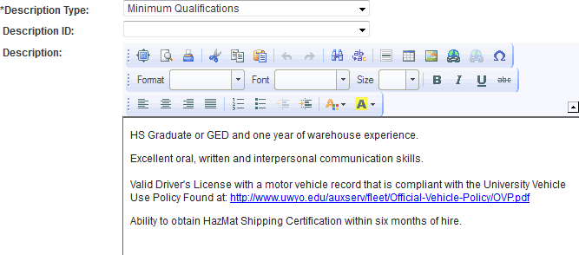
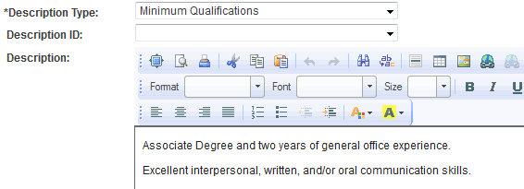
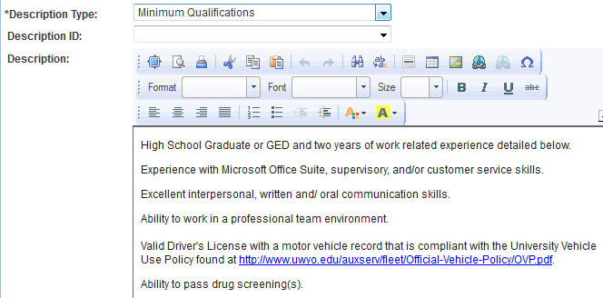

Slide 9
Desired Qualifications
This portion of the job posting comes across blank. Departments will need to add skills/abilities/experience/education.
Desired qualifications need to be job related and must related to the essential duties of the position.
You can include a certain amount of years experience or a degree, over and above the minimum qualifications.
Be specific as desired qualifications can be used to screen applicants if you choose.

Slide 10
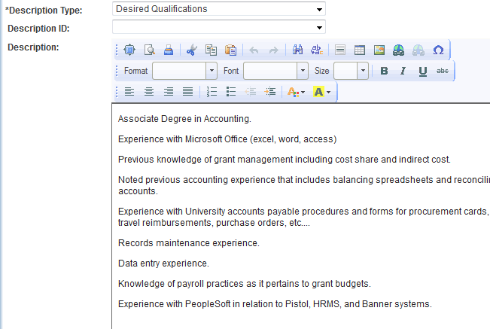
Good Example

Slide 11
Helpful Wording
Banner = student information systems.
UW experience = higher education setting.
PeopleSoft HR = experience with HR information systems.
Pistol = On-line financial systems.

Slide 12
Questions & Answers?

