Slide 1




CHS FACULTY DEVELOPMENT WORKSHOP
FINDING FUNDING OPPORTUNITIES
AND PUTTING TOGETHER AN EFFECTIVE BUDGET
May 4, 2023

Slide 2




Kara Enyeart
Grants Manager
College of Health Sciences
kenyeart@uwyo.edu
307-766-6570

Slide 3



Finding Funding Opportunities
There are many ways to search for funding opportunities. If you are not on the Research and Economic Development Division (REDD) listserve, send an email to research@uwyo.edu requesting that your name be added. REDD sends out daily announcements. Not all the emails are appropriate for CHS, but some are. Many of the professional organizations that you belong to have funding opportunities, as well as, the agencies you are currently working with.

Slide 4


Recommended Web Searches
Searchable database of federal and private funding opportunities.
https://pivot.proquest.com/funding_main
Pivot
Searchable database of federal funding opportunities.
https://www.grants.gov/web/grants/search-grants.html
Grants.gov
Lists funding opportunities specific to rural health by organization, state, topic and type of funding.
https://www.ruralhealthinfo.org/funding
RHI Hub

Slide 5
Additional Resources Provided by REDD
contact REDD for more information
https://www.uwyo.edu/research/proposal-development/funding-opportunities/index.html
Facutly Grant-in-Aid Program
Internal Competitions
Limited Submissions
Wyoming SBIR Phase 0 Program
Zoom recording New Faculty Orientation 2022
http://www.uwyo.edu/research/

Slide 6

You Have Identified an Opportunity
What's Next?

Slide 7



Step One
Send an intent to apply email to the CHS Grants Manager and REDD (research@uwyo.edu) when you have identified a funding opportunity. REDD requires five days prior notice to the submission date. REDD will add you to their review calendar. Fair warning, five days is not sufficient for both the CHS Grants Manager and REDD to review the documents and for the Dean to approve the submission.
You should expect the CHS internal review to be at least four days earlier than the REDD review date.

Slide 8


Step Two
Prepare your proposal for submission and work with the CHS Grants Manager. The draft proposal should be reviewed by the CHS Grants Manager prior to any documents being submitted to REDD. Provide the budget and budget justification to the CHS Grants Manager for review at least four days prior to the REDD submission review.
Once the CHS Grants Manager has reviewed the provided documents. A greensheet should be prepared, signed and sent to the CHS Grants Manager with supporting documents (abstract, narrative, budget and justification). The packet will be provided to the Dean for signature and sent onto REDD.

Slide 9
Things change. Stuff happens. Life goes on.
~Elizabeth Scott
ROAMWyo
REDD Training
May 17, 2:00-4:00
Berry Center Auditorium

Slide 10

Putting Together an Effective Budget

Slide 11





Work with the CHS Grants Manager
Working with the CHS Grants Manager provides you with in-house support to build a budget that not only meets the requirements of the funding agency, but the University of Wyoming.
Identify allowable and unallowable costs
Identifying expenses that are allowable for both the funding agency and the University are key.
Are indirect costs allowed?
Are fringe benefits allowed?
Are tuition and fees allowed?
CHS Budget Templates
The college templates are set up to assist you in budget development. The current fringe rates are filled in, as well as, some other suggestions on what items fall under which specific federal categories. The templates will do the math for you, so that it is easier to complete the federal forms. The templates can also be found on the college Research website https://www.uwyo.edu/hs/research/.

Slide 12
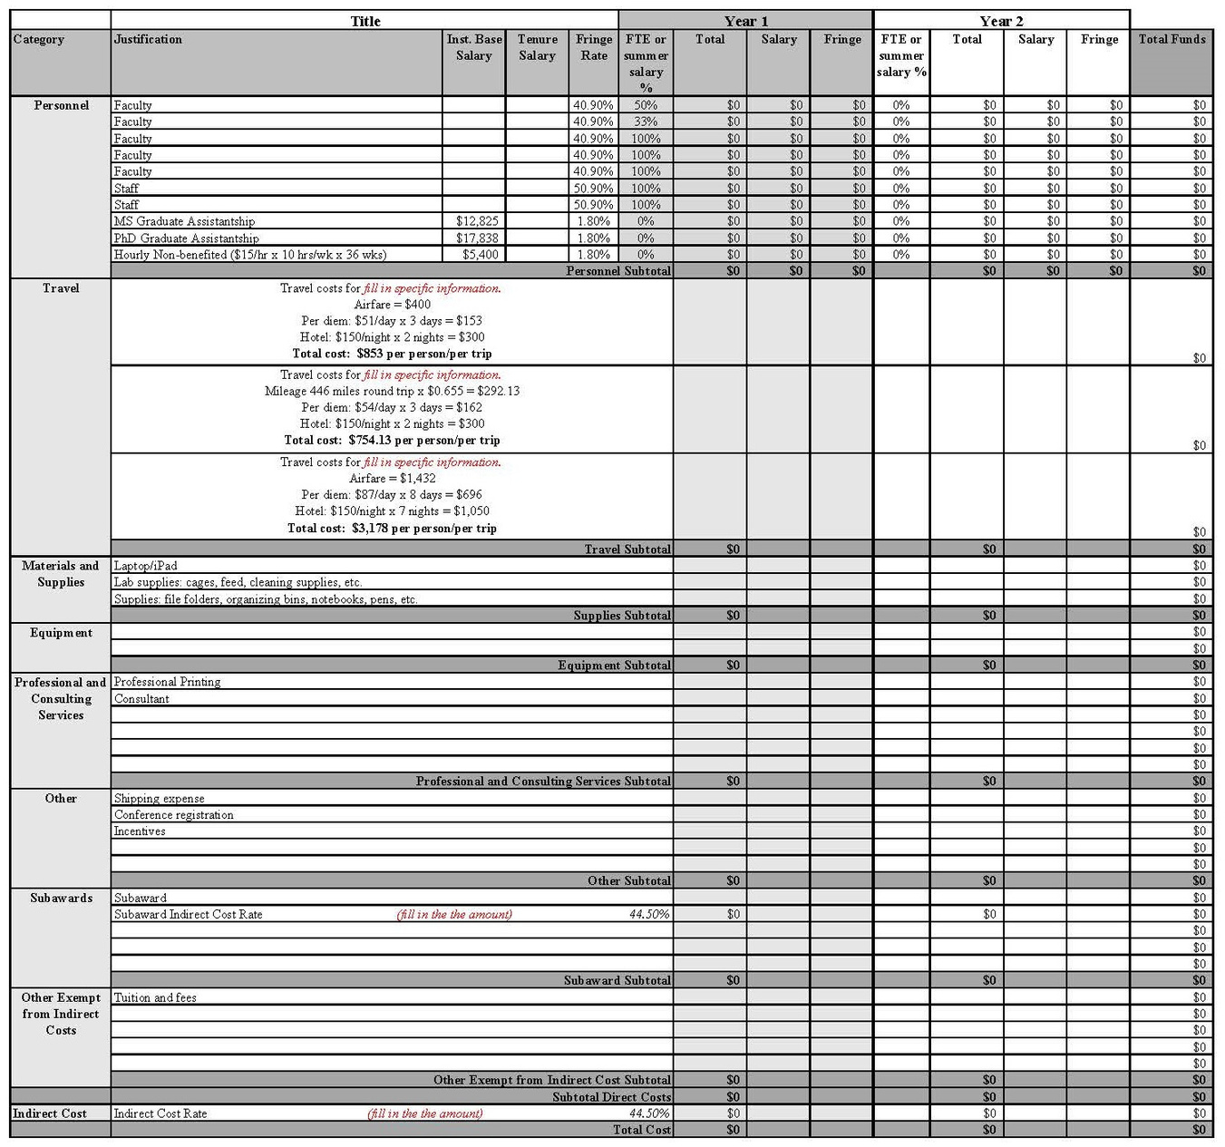

Slide 13
Personnel costs
Make sure to use your Institutional Base Salary.
Will any of the faculty be up for T&P during the period of performance?
If you are including a Graduate Assistantship, the University requires you to include T&F. (Make sure you are budgeting for the correct rate: PhD, MS or MCLS.)
If you are hiring hourly non-benefited employees DO NOT refer to them as Graduate students.
Personnel costs should include an escalation rate of 3%. This rate doesn't just cover raises, it also covers a potential increase to fringe and/or benefits.
FY24 Fringe rates:
Faculty 40.9% Staff 50.9% Student/Non-benefited 1.8%
Travel costs
Travel costs are based on location. If you are unsure of the location, I recommend estimating expenses using locations such as DC or San Diego.
https://www.gsa.gov/travel/plan-book/per-diem-rates?gsaredirect=perdiem
Registration is not a travel cost. It falls under "Other".

Slide 14
Supply vs. Equipment
If you plan to purchase an item and the cost of the item is less than $5,000 then the cost should be budgeted under Supplies. If it is above $5,000 it is considered equipment.
Honorariums
Honorariums are a "thank you" for participating in an event. There isn't an hourly rate connected to an honorarium. Honorariums should be budgeted under "Other".
If the honorarium is paid to a UW employee then it should be budgeted under Personnel.
Tuition & Fees
Tuition & Fees should be included if you have budgeted for a Graduate Assistantship. Tuition & Fees should include an escalation rate of 3%-4%.

Slide 15
Costs Exempt from Indirect Cost
Subawards - the portion of the subaward that exceeds $25,000
Tuition and fees
Participant costs
Rentals
Equipment
Indirect Cost
Indirect Cost is set by the U.S. Department of Health and Human Services and/or the funding agency. Check the Notice of Award to see what rate is required.
Budget Justification
A budget justification is required by REDD, even if the Funding agency doesn't require it. The budget justification is also part of the supporting documents that you are required to submit with the greensheet to the Dean.

Slide 16
Questions

Slide 17


THANK YOU
Email me at kenyeart@uwyo.edu to set up a time to meet to discuss your specific research interest.

