Slide 1

New faculty Orientation
College of Health Sciences
October, 2021

Slide 2

Goal: End in Mind
Understand your individual pathway to reappointment, tenure, and promotion.
Analyze strategies for communicating your work effectively.
Explain how to use wyofolio.

Slide 3

II. University Regulations and Expectations
Designation/Appointments
UW 2-1 (Academic Personnel), revised 7-1-19
Review Process/Procedures
UW 2-7 (Procedures for Reappointment, Tenure, Promotion and Fixed-Term)
UW 2-4 (APs)*
* Regulation retained until current APs complete extended term
Photo source: http://guamwaterworks.org/rules-regs/

Slide 4
Process for Fixed term contract review
Probationary Period
Year 1
Year 2
Year 3
Review for 3 yr fixed term
Annual review
Annual review*
* Annual review procedures consistent with unit and college protocol.

Slide 5
Process for Fixed term Rolling contract review
Probationary Period
Year 1
Year 2
Year 3
Review for 3 yr fixed term rolling contract
1st yr RTP review
Annual review*
* Annual review procedures consistent with unit and college protocol.

Slide 6
Process for rolling contract review
Rolling the contract forward
21-22 | 22-23 | 23-24 | 24-25 | 25-26 | 26-27
1
2
3
Outcome of positive annual review and recommendation to reappoint
1
2
3
1
2
3
1
2
3

Slide 7
Process for rolling contract review
Rolling the contract forward
1 2 3 4
-
-
+
Suspend
Terminate
Outcome of annual review with overall rating below ‘meets’ expectations
2 consecutive or
2 out of 3 overall ‘meets’ expectations needed to restore contract
-
-
+
+
Suspend
Suspend
Terminate
-
+
+
+
Suspend
Suspend
Restore
-
-
+
Suspend
Suspend
Terminate

Slide 8
How Fixed term faculty earn a promotion?
Promotion in rank requires a thorough performance review by peers, faculty, and administrators at the department, college, and university levels
See UW Reg 2-4 for qualifications and skills required at each rank
Promotion reviews may occur concurrently with reviews for fixed term appointments or renewals, but need not be simultaneous..but is usually after 6 years
Comment on “Years in”

Slide 9
IV. RTP Review Processes
Tenure & Promotion year only
External peer review
Joint appointment may require additional review
Department
Department faculty review
Department head’s recommendation
College-level faculty review
College
College Dean’s recommendation
University-level faculty review
University
Review by Academic Affairs
Review by President (on appeal)
Trustees’ action

Slide 10
Academic Freedom
The freedom to pursue your profession according to the standards of the profession.
Professors are free to set forth their conclusions without fear of dismissal, but only if their conclusions have been reached “by a scholar's method and held in a scholar's spirit.”
Declaration of Principles on Academic Freedom and Academic Tenure (1915)
Academic freedom defends the pursuit of knowledge, wherever it leads.
AAUP (2017)
UW Regulation 2-15 (Academic Freedom)
http://www.uwyo.edu/acadaffairs/academics/faculty-resources/tenure-promotion/tp_regulations.html

Slide 11
STANDARDS AND CRITERIA
The key question for Tenure:
Does the candidate’s record reflect both the commitment and the promise to sustain a career-long record of effective teaching, scholarship at the forefronts of knowledge, and effective service?
It’s not a matter of clearing the bar.
Tenure is not the finish line.

Slide 12
Typical Tenure Track Faculty Career Path
Tenure and promotion to Associate Professor, or termination
Yr. 1 review
(End of fall semester)
Mid-probationary (progress toward tenure) review
Ongoing excellence and impact through research, teaching and service;
Greater level of accomplishment and intellectual leadership
is expected
6
Probationary Period*
0
3
Additional Period of Growth
Annual Review
Promotion to Professor (optional)
Hired as Assistant Professor
* Faculty are on annual appointments during the probationary period. A review may result in recommendation to reappoint or terminate.

Slide 13
The buck stops
HERE!
Ultimately, you are responsible for your success.
So, it is really all about ME in R, T & P!

Slide 14
How do we answer this question?
Strong teaching, demonstrated early.
Capacity for strong scholarship, critical for teachers to remain effective throughout their careers.
Review of scholarly work by nationally or internationally recognized peers, as well as by UW students and faculty. You have to be a player in the game.
Service (including public engagement, when appropriate)
Clinical provision

Slide 15
V. Your role in preparation for the review
Early in academic year, meet with your department head (mentor) to discuss:
Performance goals
What the department head looks for and how s/he will evaluate your performance
Teaching, scholarship and service
Ways s/he can help you continually improve performance (e.g., formative assessment – ongoing teaching evaluation, periodic self-assessment, etc.)
http://www.uwyo.edu/acadaffairs/faculty-resources/tenure_promotion.html

Slide 16
Documentation of performance
Teaching evaluations (students, peers, administrators)
Research record (publications, grants, creative work)
Service (UW committees, community or statewide service,
professional organizations)
What are your duties?
Level of quality or attainment
Does the evidence meet department and discipline standards?
Evidence of progress
Job description and expectations
Record of previous years’ recommendations at all levels
Written evaluations by candidate, peers, and administrators
External evaluations
Letters from outside experts (T&P cases)
Letters from former students (optional, but…)

Slide 17
Faculty Narrative:
A picture is
NOT worth
a thousand words!
Clearly articulate in your case
what you are expected to do,
how you are doing it,
how the two are related.

Slide 18
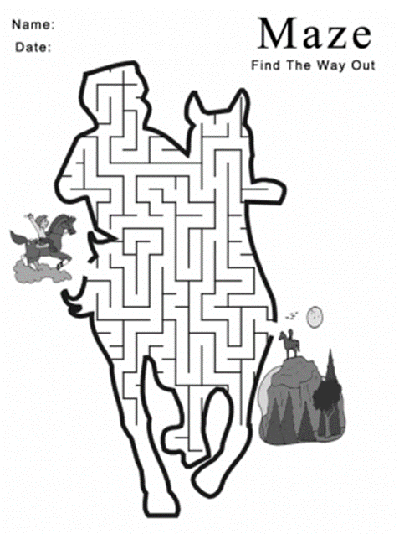
Tip #1 Prepare your narrative
for the
“stranger”
Precise and concise statement that leads the reader through the maze
Don’t assume that your colleagues will understand your research, teaching, and service.
The further your case file makes it through the system, the less familiar your audience will be.
It is not about educating your audience about your research, teaching or service.
It is about providing evidence of your scholarship, teaching effectiveness, and service.

Slide 19
Does your reflection on teaching do this?
Explain why you choose teaching strategies and methods?
Illustrate how you use feedback (i.e., student, peer, self) to modify and/or retain teaching strategies and methods?
Show connections to research- or evidence-based best practice?
Show a trajectory of improvement and/or sustained excellence?

Slide 20
Have you addressed these questions about scholarship?
Scholarship plan
How does my research/creative activity contribute to
the body of knowledge in my discipline?
What is the impact of my research/creative activity?
How is my research/creative product novel?
What makes my research/creative product relevant and meaningful?
Where am I now?
Where am I going?
How will the reviewer know I got there?

Slide 21
Does your narrative do this?
Show trajectory … connect the dots.
Illustrate how:
grants lead to publications?
presentations lead to publications?
publications lead to publications?

Slide 22
Does your reflection on service do this?
Provide evidence of contributing to the service mission of the university?
Reflect public engagement beyond the university community?
Provide evidence of your leadership role in service activities?

Slide 23
What about Collegiality?
Collegiality: ability to work both independently and constructively with others
Collegiality is not evaluated as a separate attribute
Collegiality comes into play if it has a negative effect on the research, teaching, and/or service mission of the department/college/university
Notes:
DJ to re

Slide 24
VI. CAREER STRATEGIES
Become a versatile, engaging teacher.
Identify and cultivate a national or international audience for your scholarly activities.
If external funding is available in your field, develop and follow a plan for seeking it.
Find ways to connect your scholarly work with your teaching.
Select a meaningful array of service activities.
Learn how to be a leader.
Maintain a passion for your discipline!!!!
These are strategies for staying sane, not just for getting tenured or promoted!

Slide 25
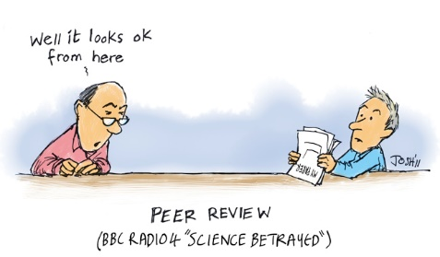
Peer Review!!
Daunting prospect!
Faculty have the right to expect thoughtful, non-capricious evaluation of their performance.

Slide 26

Peer Review – Who votes!
Based on UniReg 408

Slide 27

Peer Review – Tips for Evaluating!
Timidity is not an excuse for Abstaining!
Take time to read the packet carefully
Don’t just reiterate their CV- provide some objective evaluation
Use professional language in commentary (no first names) to provide a more persuasive argument

Slide 28
Now What?

Slide 29
WYOFOLIO
Documentation of performance
Teaching evaluations (students, peers, administrators)
Research record (publications, grants, creative work)
Service (UW committees, statewide service,
professional organizations)
Evidence of progress
Job description and expectations
Record of previous decisions at all levels
Written evaluations by candidate, peers, and administrators
External evaluations
Letters from outside experts (T&P cases)
Letters from former students

Slide 30
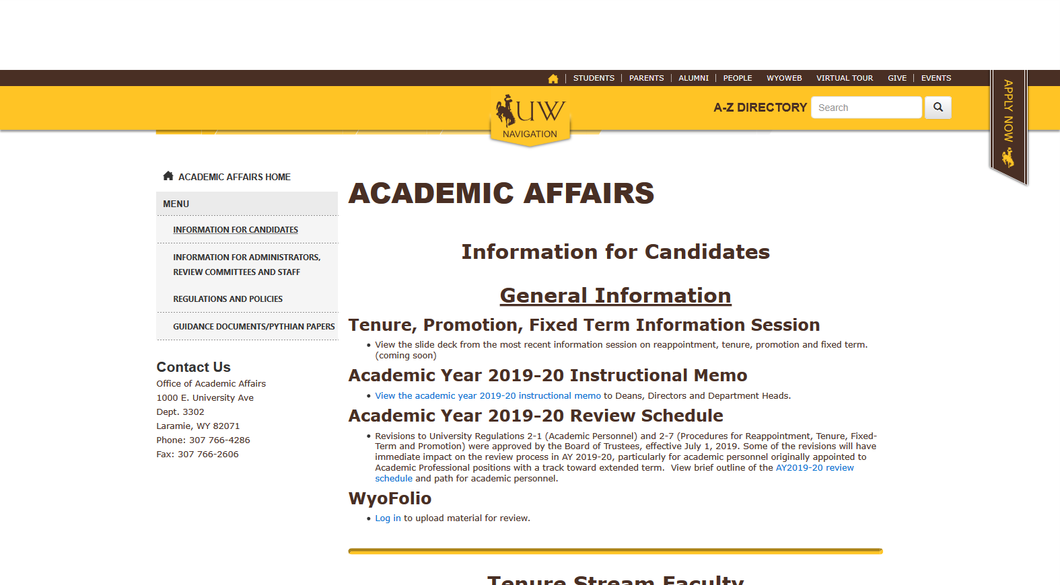
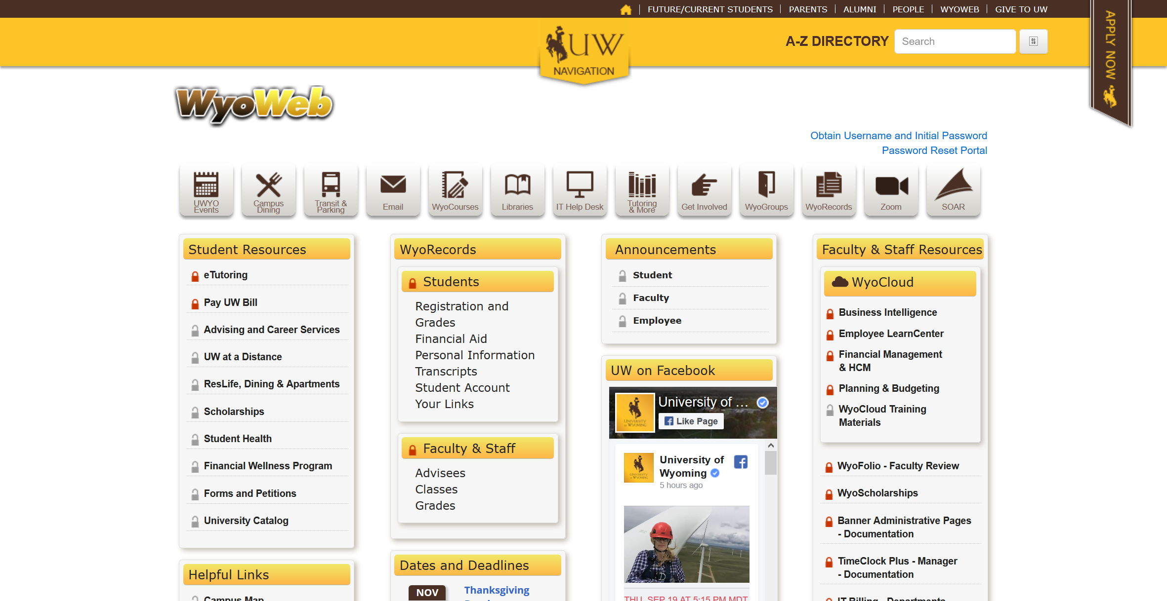
Your WyoFolio Case File

