Slide 1
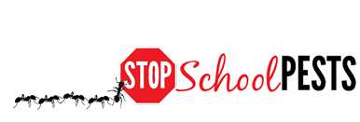
administrators
Self-Guided Educational Module
Lesson 1 of 2

Slide 2
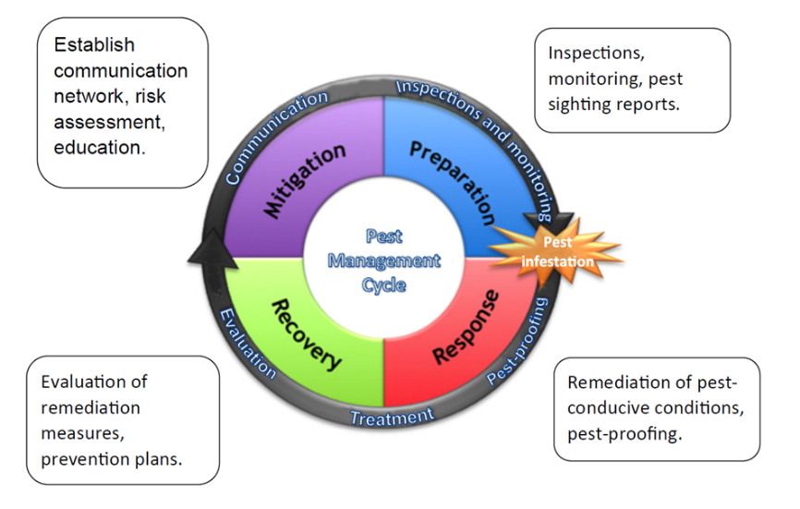
Learning Objectives
Describe key elements of coordinating an IPM policy and plan, including:
Development, implementation and maintenance
Describe how to uniformly enforce IPM policies
Dawn H. Gouge, University of Arizona

Slide 3
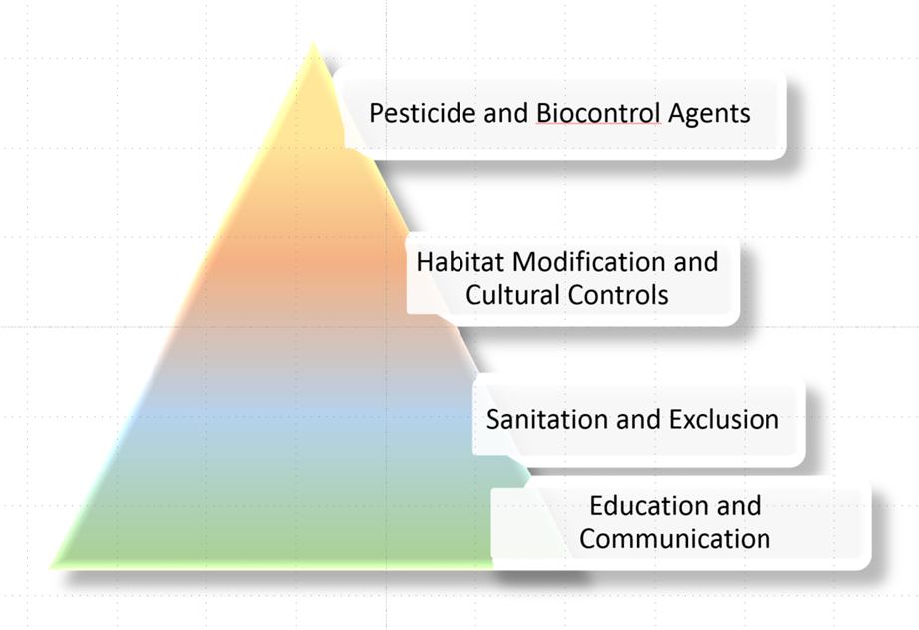
Review: What is IPM?
Integrated Pest Management (IPM): “long-standing, science-based, decision-making process that identifies and reduces risks from pests and pest management related strategies” -- National Roadmap for IPM
Dawn H. Gouge, University of Arizona

Slide 4
Develop an IPM Policy and Develop Your IPM Plan
Modify your current pest management program into an Integrated Pest Management (IPM) program
Each school district superintendent must appoint an IPM Coordinator to implement the district’s IPM program
An IPM policy is a generalized guide to help school personnel develop a more detailed plan of action
An IPM plan includes specific instructions about how to implement the policy at school facilities

Slide 5
IPM Policy and Plan
The IPM plan will help your school manage pests through prevention, monitoring and reduced risk pest management methods
It states what your school is trying to accomplish regarding pests and the use of pesticides
It reflects your site-specific needs
Your plan will differ from other districts
Your plan will be a working document and should be updated at least annually

Slide 6
Develop Your IPM Plan/Policy
Your IPM Plan should contain these components:
General school information
The name and title of your school IPM Coordinator
The names and titles of your school IPM Committee members
Identification and description of your school pest problem(s)
Description of your school IPM information flow (communication strategy) and training format

Slide 7
Develop Your IPM Plan/Policy
A record of pesticide(s) applied on school property
A record of non-pesticide actions taken on school property
School IPM Policy
Evaluation of your school IPM program
A description of the location of your school IPM plan and records

Slide 8
Your IPM Plan Should Include:
1. General school information
School district name
Address
Telephone number
E-mail address
Name of Plan preparer
Date prepared

Slide 9
IPM Coordinator
2. The name and title of your school IPM coordinator
The School IPM Coordinator:
Is in charge of pest management activities for the school district
Has the authority and support of the district administration

Slide 10
IPM Coordinator
The School IPM Coordinator:
Has primary responsibility for ensuring the IPM plan is carried out
Is the primary contact for the IPM Committee
Is tied directly to the integration of IPM activities
Through the coordination and commitment of all parties

Slide 11
IPM Committee
3. The names and titles of your school district IPM Committee members (IPM issues may be addressed within Indoor Air, Risk Assessment, Environmental Health, or Health and Safety Committees)
The District Committee should include individuals who have interest in or who are involved in activities directly or significantly related to pest management for the district

Slide 12
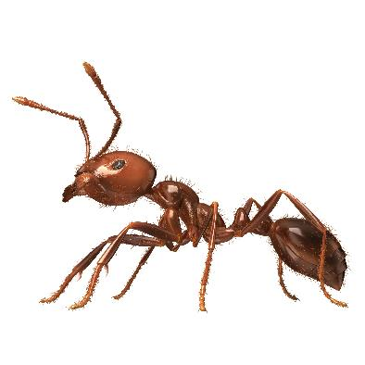
IPM and Pests
4. Identification and description of your school pest problem(s)
Properly identify and record your school pest problems
Prioritize and select the appropriate non-pesticide and pesticide treatment options

Slide 13
IPM Information Flow
5. Description of your district IPM information flow (communication strategy) and training format
Describe how pest problems specific to your district will be reported
Indicate the type of method that will be used and specific location of a pest and/or service log
Indicate who will be responsible for responding to sanitation and building repair problems
Identify the individual(s) providing IPM training

Slide 14
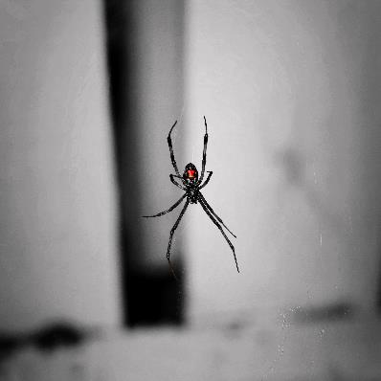
IPM and Pesticides
6. A record of pesticide(s) applied on school property
When the pest has been identified and its presence verified, pesticides are ideally used only by a licensed or certified pesticide applicator Licensing law requirements differ by state, but requiring licensed or certified applicators is a good district policy
Widow spiders commonly trigger pesticide applications, but are managed more effectively using a vacuum

Slide 15
IPM Records
7. A record of non-pesticide actions taken on school property
The IPM plan should include those non-pesticide pest management methods and practices such as sanitation/housekeeping, trapping, pest-proofing (caulking, sealing cracks, repairing screens) and managing lighting (i.e. using low UV lights)

Slide 16
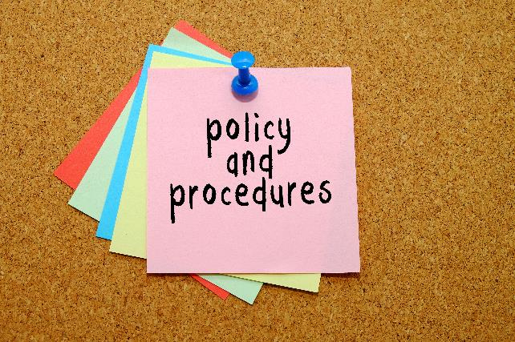
IPM Policy
8. Develop and present an IPM Policy for School Board Approval
The policy should state the intent of the district and school administrators to implement an IPM program
Should provide brief guidance on what generally is expected

Slide 17
IPM Policy and Pesticide Application Notification
A 72-hour notification period prior to any pesticide use is often required and posting a warning sign 72-hours prior to and 48 hours after any pesticide application is good policy, even if it is not required by state law – sensible exemptions can be established to encourage least-hazardous options
Keep all pesticide records - Again, state rules differ so determine how many years are required; a minimum of 4 years is a good minimum

Slide 18
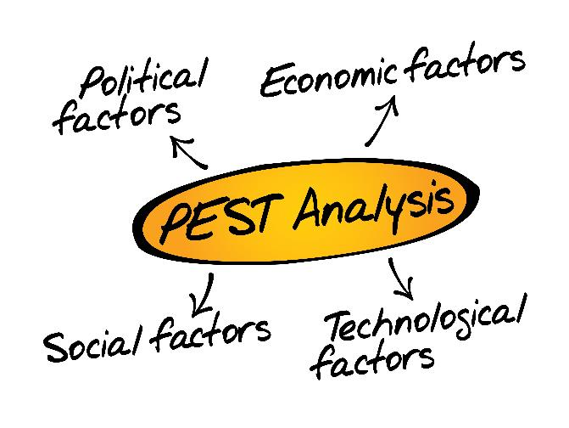
IPM Plan/Policy Evaluation
9. Evaluation of your school district IPM program
The IPM plan should be evaluated at least annually
Is the IPM plan working?
What changes are necessary?
Has new technology replaced some of the former pest management tactics?

Slide 19
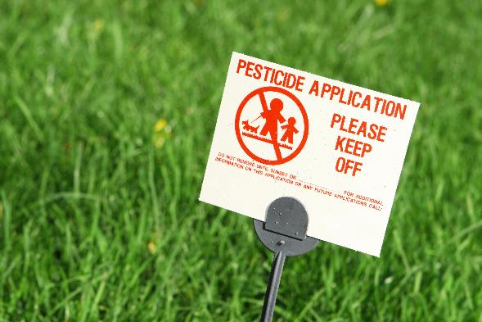
IPM Plan/Policy Storage
10. A description of the location of your school district IPM plan and records
The following should be kept at a central location, readily available when needed:
Records of pesticide use
Service reports
Logbook
Posting and notifications
Emergency waivers

Slide 20
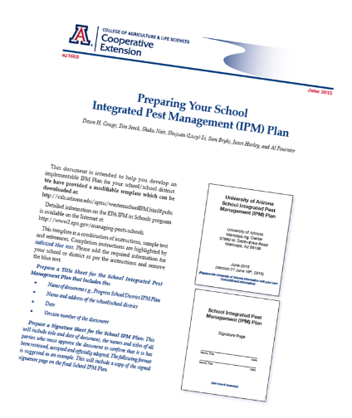
IPM Plan/Policy Template
A School Integrated Pest Management Plan Template is available on-line at: https://extension.arizona.edu/sites/extension.arizona.edu/files/pubs/az1669-2015.pdf The Template is intended to help you to develop an implementable IPM Plan for your school district - The document is a combination of instructions, sample text, and references that you can modify to fit your own situation

Slide 21
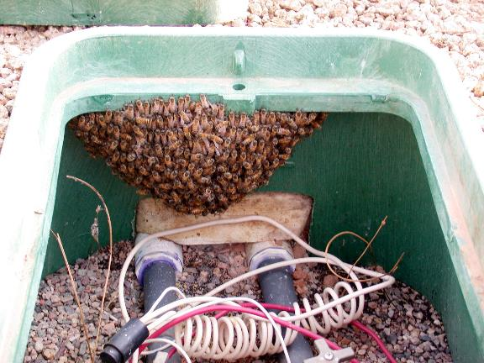
General Approach to Implementing the IPM Plan
Control strategies in an IPM program include structural and procedural improvements to reduce pest access to food, water, and/or suitable habitat used by pests
Feral honey bees in an irrigation valve box – Dawn H. Gouge, University of Arizona

Slide 22
Education and Communication
To manage pests effectively, it is important to understand:
What conditions can cause pest problems (referred to as pest conducive conditions)
Why and how to monitor for pests
How to accurately identify pests
Pest behavior and biology
Communicate about pest issues using a protocol for reporting pests or pest conducive conditions and maintain record of the actions taken and success achieved

Slide 23
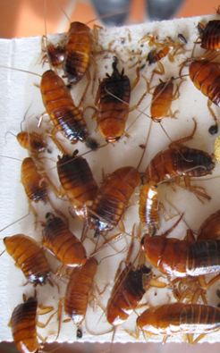
Inspect and Monitor for Pests and Pest Conducive Conditions
Periodic facility inspections for pests, pest signs, and conducive conditions that can cause pest problems form the backbone of many IPM programs
Annual indoor and grounds assessments
Monitoring for pests using traps in pest vulnerable areas, such as kitchens and pantry areas, is imperative
Rodent activity monitoring tools such as non-toxic bait may be advisable if rodents are an issue
Turkistan cockroaches on monitoring trap – Dawn H. Gouge, University of Arizona

Slide 24
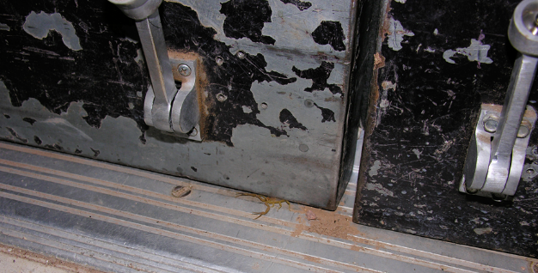
Preventative Maintenance and Pest-proofing
Scorpion entering under a door -
Kristen Clason, Indiana University
Pest-proofing operates at many levels, but begins with maintaining school facilities in good operating condition - Provide systematic inspection, identification, and correction of facility faults and equipment failures, either before they occur or before they develop into major defects
Pest-proofing a facility also involves the storage of food items in pest-proof containers and the placement of dumpsters further from kitchen doors to help keep pests away from vulnerable entry points

Slide 25
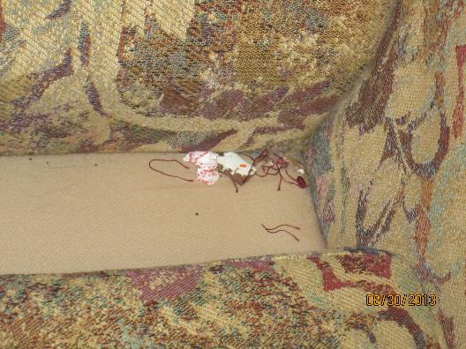
Improved Sanitation
Improve sanitation practices to eliminate food residues, grease, or spills that attract pests - Clean from a pest-prevention perspective, with special emphasis on kitchen floor-to-wall corners, under fixed equipment, cracks/crevices, and hard to reach recesses in food preparation and dish-washing areas
Pest vulnerable areas (PVAs) include those where food is consumed, stored or prepared
Under a couch cushion in a teachers lounge – Shaku Nair, University of Arizona

Slide 26
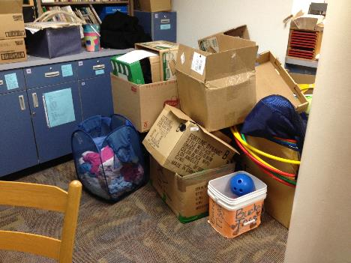
Habitat Manipulation
It is critical to make the school environment unattractive and unsupportive of pests, indoors and outdoors
Maintain uncluttered classrooms to reduce pest harborage and allow thorough cleaning - Maintain equipment, structures and vegetation on playgrounds and sports fields to deter pests
Class clutter generates problems – Dawn H. Gouge, University of Arizona

Slide 27
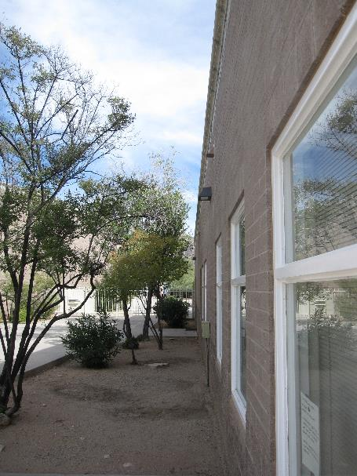
Cultural Control
Use physical and mechanical practices and controls to reduce pests - These include trapping rodents and insects, using correct drainage and mulching landscapes and keeping vegetation trimmed away from buildings
Vegetation should be trimmed away from buildings, and open damp soil areas indicate irrigation emitters that should be capped – Dawn H. Gouge, University of Arizona

Slide 28
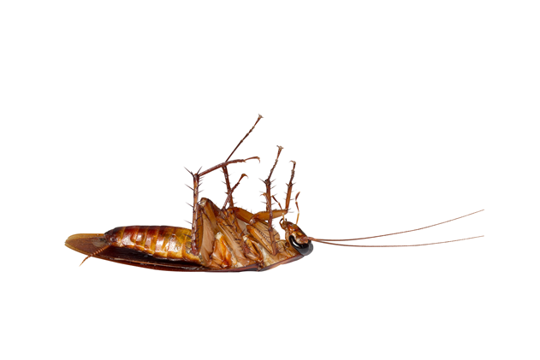
Chemical and Biological Pesticides
Only use pesticides when necessary
Use effective pesticides and application methods
Read pesticide labels prior to purchasing and approving their use to help ensure they can and will be used according to the EPA-accepted label, state laws, local ordinances and your school district policy

Slide 29
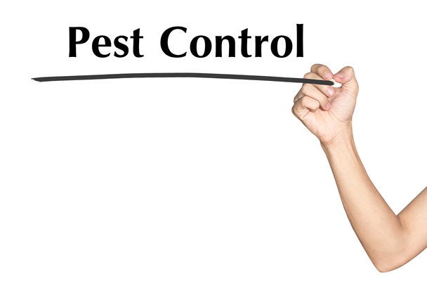
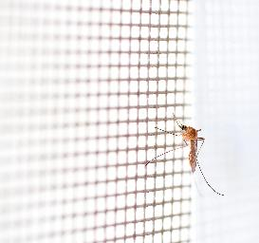
IPM Plan Implementation
Periodically review the IPM Plan implementation to ensure that all steps can and are being followed (annual review is recommended)
Periodically revisit the Plan to determine whether it is effective and if there is a need to revise it to keep up with the community’s needs and goals?
Conduct annual evaluations of pesticide use to monitor and document trends in pesticide use including toxicity of products and amounts applied

Slide 30
Secure Formal Approval of an IPM Policy and Plan
It is helpful to document the formal acceptance and endorsement of the IPM Policy/Plan by:
The District Environmental Health Committee
The District superintendent
The School Board
The State Department of Education or Tribal Council

Slide 31
Implement an IPM Plan
Implement an IPM Plan to:
Manage pests effectively and economically
Minimize the risk associated with pests and pest management practices
Maintain a safe, healthy, and beautiful facility
Proper implementation of an IPM plan can reduce pesticide use and risk of exposure to pesticides and pests

Slide 32
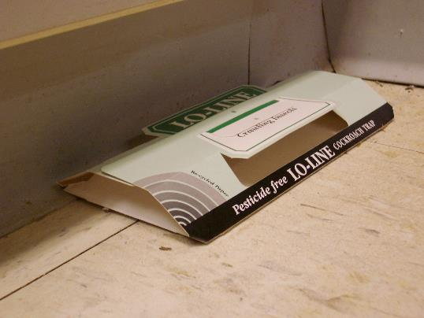
IPM Plan Implementation
Monitoring – Reporting – Action Protocol
Monitoring is an important requirement and the backbone of an IPM program
Information gathered will be recorded, reported and maintained by appropriate parties
Pest monitoring trap – Dawn H. Gouge, University of Arizona

Slide 33
How to Enforce Your IPM Policy
Educate, train and communicate with all faculty, administrators, staff, students and parents regarding IPM, pests and pesticide safety
Procure qualified IPM services through contracted service provider and/or well-trained staff
Schedule time for school personnel to receive annual training provided by the IPM Coordinator (or designee)
Work with the IPM Coordinator to make sure families, community members and staff are notified in advance of pesticide applications

Slide 34
References
School IPM Plan Template http://ag.arizona.edu/apmc/westernschoolIPM.html#pubs
Model Pesticide Safety and IPM Guidance Policy for School Districts by EPA Center of Expertise for School IPM http://www.epa.gov/pestwise/publications/ipm/Model-School-IPM-Policy.pdf
How to Develop an Integrated Pest Management (IPM) Policy and Plan for Your School District. PENN STATE. http://extension.psu.edu/pests/ipm/schools/facilitiesmanagers/resourcespaschools/faq/ipmschoolplan

