Slide 1

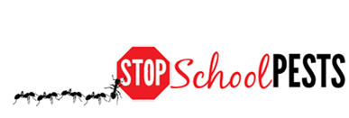
Introduction to School IPM
Lesson 1 of 1
Self-Guided Education Module

Slide 2

Learning Objectives
Describe IPM in understandable terms
Identify health, environmental and economic risks of pests and pesticides associated with schools and how IPM reduces risk
Identify the key elements of

Slide 3

Learning Objectives
  Key elements:
  Explain basic pest monitoring, inspection and reporting
  Identify pest-conducive conditions, pest-vulnerable areas and corrective actions
  Explain how to keep pests out of facilities
  Identify key pest groups and
  signs of pest infestations
  in buildings and on
  grounds

Slide 4

Learning Objective
Identify the important roles and responsibilities of the school IPM team

Slide 5

IPM in Understandable Terms
What is Integrated Pest Management (IPM)?
  A process that minimizes risks related to managing pest populations
  Pests need food, water and shelter,
  IPM encompasses strategies and
  methods that limit pest opportunities
IPM is a team effort and
involves all community
members!
Notes:
Because pests need food, water and shelter, IPM is really all about using common sense to improve sanitation and building maintenance in order to keep pests from thriving in facilities and on grounds. It is important that everyone knows they play a key role in IPM, and that by working together IPM can be more successful.

Slide 6
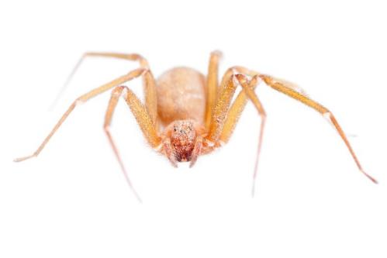
IPM in Understandable Terms
IPM focuses on correcting the fundamental reasons why pests are present, and requires management teams to determine:
  What are the pests?
  When do they show up?
  Where are they occurring?
  How did they arrive or get in?
  Why are they here?
Recluse spider
Notes:
Because pests need food, water and shelter, IPM is really all about using common sense to improve sanitation and building maintenance in order to keep pests from thriving in facilities and on grounds. It is important that everyone knows they play a key role in IPM, and that by working together IPM can be more successful.

Slide 7

Health, Environmental and Economic Risks of Pests and Pesticides in Schools and How IPM Reduces Risk
Two facts that support the need for IPM in schools include:
Children’s behavior – Children contact with chemicals to a greater extent than adults
Children have increased sensitivity to chemical insult as
they have
developing bodies
Notes:
Children play on the floor and on the ground, and put fingers in mouths which can increase potential for exposure to pests and pesticides.
Children are more sensitive to the effects of pesticides, due to their growing and developing bodies.

Slide 8
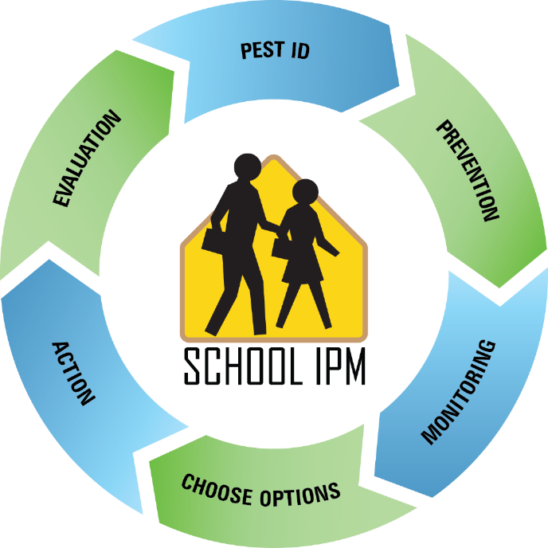
Health, Environmental and Economic Risks of Pests and Pesticides in Schools and How IPM Reduces Risk
IPM is a strategy that reduces:
Human health risk by reducing pest and pesticide
exposure
Environmental risks
by reducing
pesticide dependence
Economic risks by
reducing liability and extensive remediation
School IPM Action Wheel
- John Connett, University of Wyoming

Slide 9
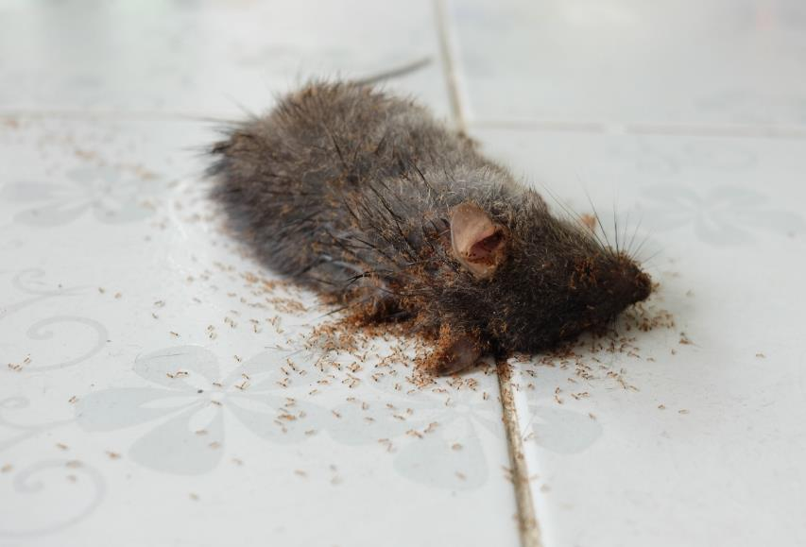
Health, Environmental and Economic Risks of Pests and Pesticides in Schools and How IPM Reduces Risk
Exposure to some pest allergens can trigger asthma, reducing pest exposure, reduces asthma
Pests can contaminate food causing food poisoning
and upset
stomachs
Pests can cause
physical harm
Ants utilizing a dead mouse carcass as a food source
Notes:
As discussed in the previous module, asthma sufferers may be sensitive to dust mites, cockroaches and/or rodent allergens.
Rats bite more than 45,000 people annually in the US, most are infants, children and the sick.

Slide 10
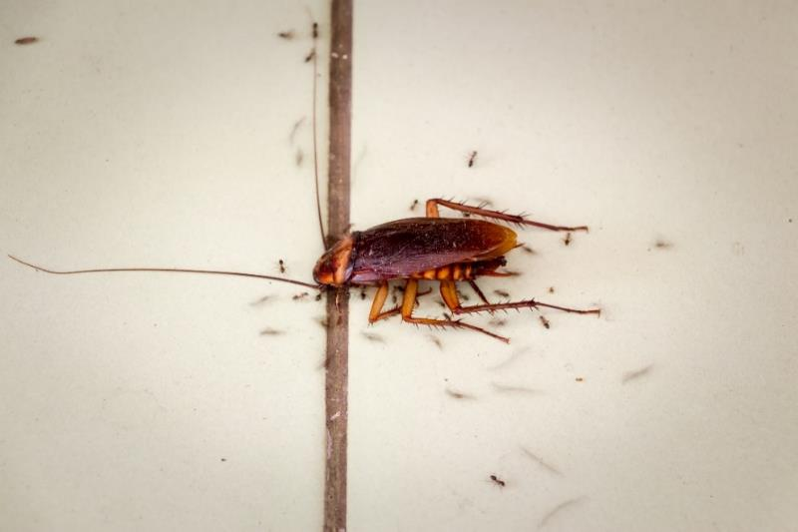
Health, Environmental and Economic Risks of Pests and Pesticides in Schools and How IPM Reduces Risk
Pest management problems in schools are common and include:
  Excessive and hazardous
  pesticide use
  Unchecked pest
  problems that
  become more
  difficult and
  expensive to
  manage
Cockroach being consumed by
ants on kitchen floor

Slide 11
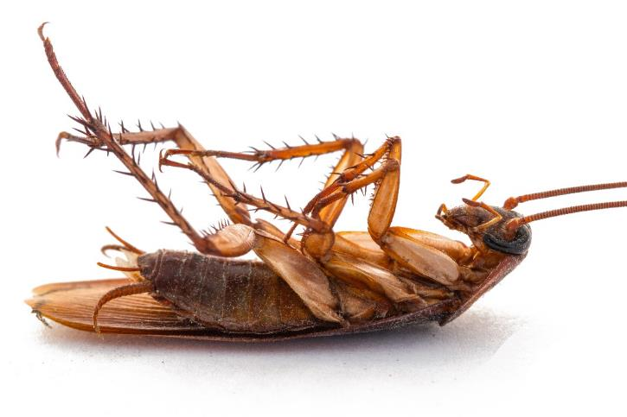
Health, Environmental and Economic Risks of Pests and Pesticides in Schools and How IPM Reduces Risk
An independent evaluation of 29 school systems in more than 14 U.S. states revealed that almost half violated legal requirements or district policies for pest control (Green et al., 2007)

Slide 12
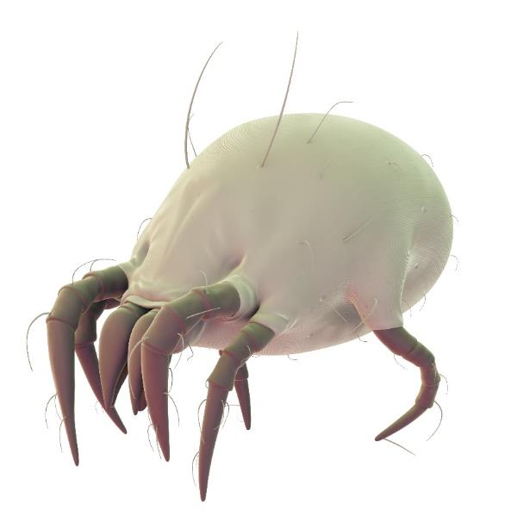
2.
Health, Environmental and Economic Risks of Pests and Pesticides in Schools and How IPM Reduces Risk
Pest related asthma triggers include exposure to allergens of:
  Cockroaches
  Rodents
  Dust mites
  Mold and mildew
  Certain weed pollen
Elimination of the
relevant pests leads to
reduced allergens
Dust mites live on mattresses, bedding, upholstered furniture, carpets and curtains

Slide 13
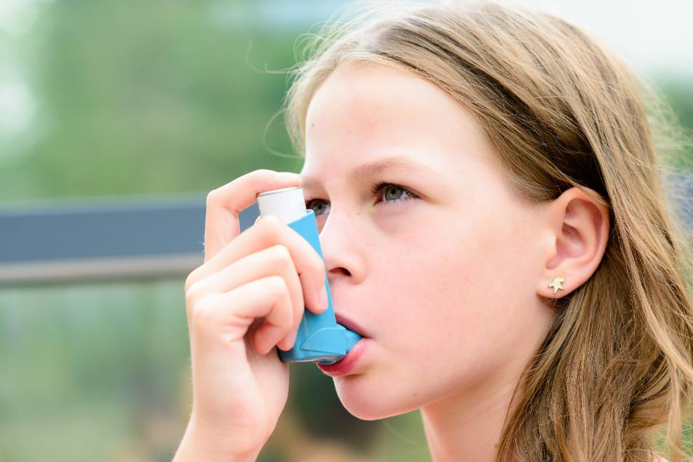
Health, Environmental and Economic Risks of Pests and Pesticides in Schools and How IPM Reduces Risk
Asthma affects about 9.5% of school children nationally and directly affects student
achievement

Slide 14

Health, Environmental and Economic Risks of Pests and Pesticides in Schools and How IPM Reduces Risk
US EPA and the Centers for Disease Control and Prevention recommend IPM in schools to reduce asthma problems
Asthma is the
number one
reason why
students miss
school

Slide 15
Health, Environmental and Economic Risks of Pests and Pesticides in Schools and How IPM Reduces Risk
Schools using IPM vs. conventional pesticide applications typically have:
  Lower levels of pesticide residues
  Lower allergen levels
  Lower pest exposure incidence
  A cost-effective approach
Much of the IPM
approach focuses
on preventative
action!
Notes:
An IPM approach focuses on fixing the problems that lead to pest infestations in the first place.

Slide 16
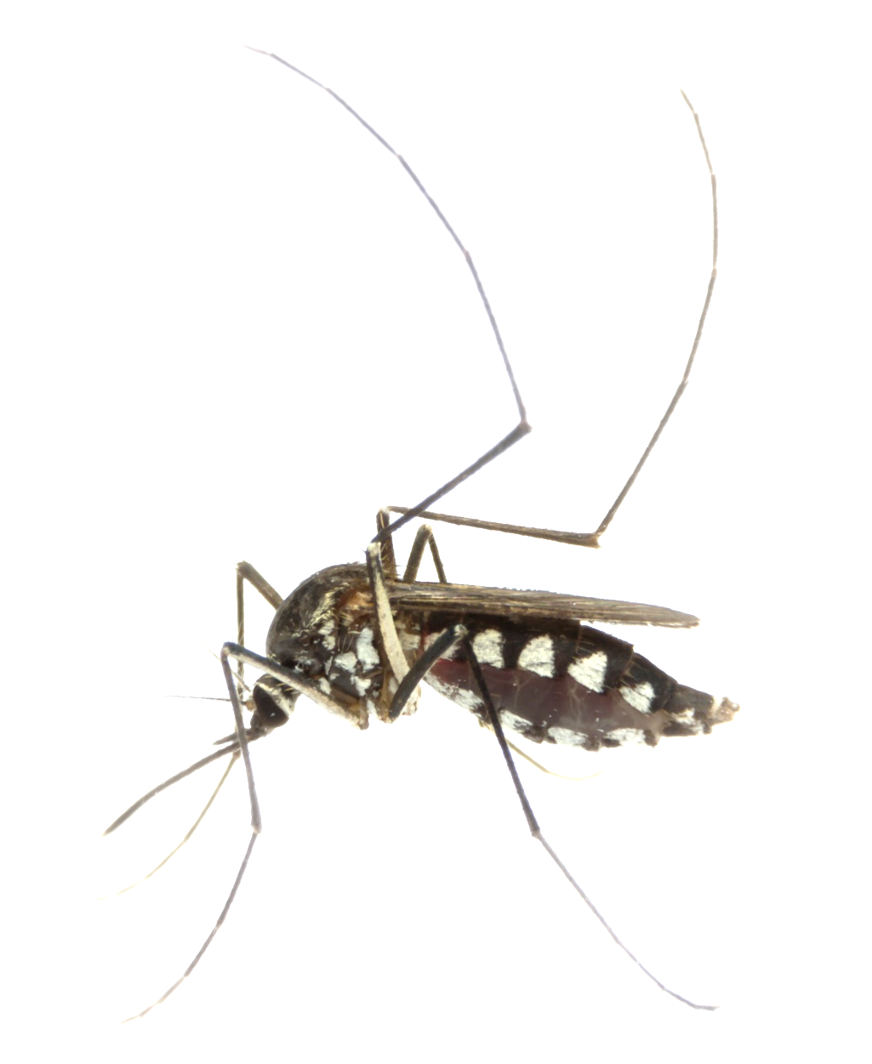
Health, Environmental and Economic Risks of Pests and Pesticides in Schools and How IPM Reduces Risk
Some pests vector disease causing pathogens
Ticks may vector bacteria that cause Lyme Disease or Rocky Mountain Spotted Fever
Mosquito vectors transmit viruses that cause flu-like symptoms or more severe symptoms such as brain
inflammation
Mosquitoes are critically important
vectors of disease causing pathogens

Slide 17
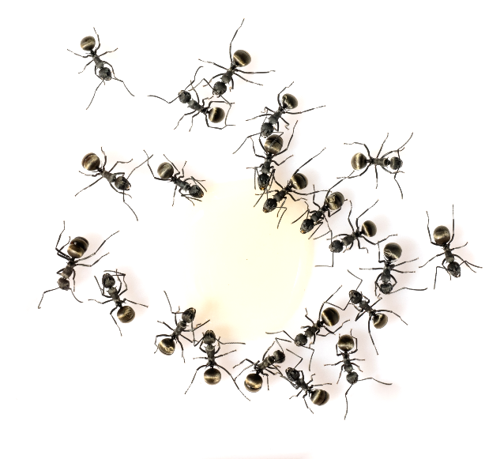
Health, Environmental and Economic Risks of Pests and Pesticides in Schools and How IPM Reduces Risk
Some pests can inflict a venomous bite or sting
Between 0.5 - 4% of the US population are prone to developing an allergy and a deadly hypersensitivity reaction to bee, wasp, hornet ort
to venom
Ants foraging on a spilt drink

Slide 18

Health, Environmental and Economic Risks of Pests and Pesticides in Schools and How IPM Reduces Risk
Pests can also cause building and grounds damage
Costs can add up significantly if the cause of problems goes unfixed
Litigation and
school closures
can be extremely
costly

Slide 19

Health, Environmental and Economic Risks of Pests and Pesticides in Schools and How IPM Reduces Risk
Accidental or inappropriate pesticide exposure may cause harmful effects
Acute effects occur from single exposures and develop within 24 hours
Chronic effects occur after many low-dose exposures over time
Delayed effects occur after 24 hours, sometimes as a result of multiple exposures

Slide 20

Acute effects include:
Health, Environmental and Economic Risks of Pests and Pesticides in Schools and How IPM Reduces Risk
Headache
Fatigue
Nausea
Diarrhea
Convulsions
Inability to breathe
Unconsciousness

Slide 21

Chronic effects include:
Health, Environmental and Economic Risks of Pests and Pesticides in Schools and How IPM Reduces Risk
Birth defects
Tumors, cancer
Genetic changes
Blood disorders
Nerve disorders
Reproductive effects
Developmental disorders

Slide 22

Delayed effects include:
Health, Environmental and Economic Risks of Pests and Pesticides in Schools and How IPM Reduces Risk
Memory loss
Tumors
Cancer

Slide 23

Health, Environmental and Economic Risks of Pests and Pesticides in Schools and How IPM Reduces Risk
Children are particularly vulnerable, as they:
Process toxicants differently compared to adults
Are at a critically sensitive
developmental stage
Have relatively rapid
metabolic rates
Are exposed to
pesticides due
to their behavior
Notes:
23
As discussed in the previous modules, children’s hand to mouth behavior, greater contact with floors, walls, ground and other treated surfaces puts them at a higher risk and exposure to pesticides.

Slide 24

Health, Environmental and Economic Risks of Pests and Pesticides in Schools and How IPM Reduces Risk
Pesticide-related health
risks result from:
  Exposure to pesticides in food and fluids they consume
  Exposure in air though breathing and from treated surfaces they contact
Tami Proffitt Photography
Notes:
In relation to body weight, infants and children eat and drink more than adults, increasing potential exposure to pesticides in food and water.

Slide 25

The National Academy of Sciences 1993 Landmark Report entitled
“Pesticides in the
Diets of Infants and Children”
Health, Environmental and Economic Risks of Pests and Pesticides in Schools and How IPM Reduces Risk
50%
estimates that
of lifetime pesticide exposure occurs in the first five years of life
Notes:
25

Slide 26

Children breathe more air, drink more fluids, and eat more food per kilogram of body weight compared to adults
Children breathe different air, closer to ground level, with higher levels of settling contaminants
Children can be affected by toxins to a greater extent compared to adults
Health, Environmental and Economic Risks of Pests and Pesticides in Schools and How IPM Reduces Risk
Notes:
26

Slide 27
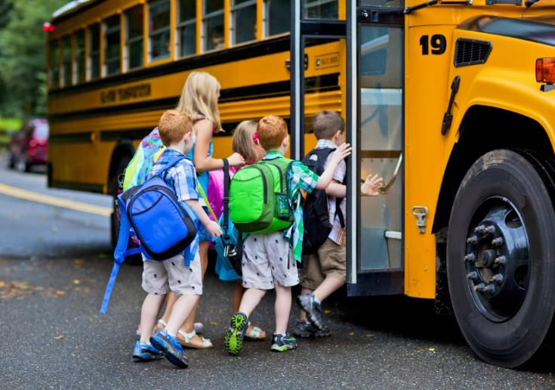
Children are still growing and developing, and therefore more likely to suffer adverse health effects
Health, Environmental and Economic Risks of Pests and Pesticides in Schools and How IPM Reduces Risk
Exposure effects
may be irreversible
Exposures early in life affect adult health
Notes:
27

Slide 28
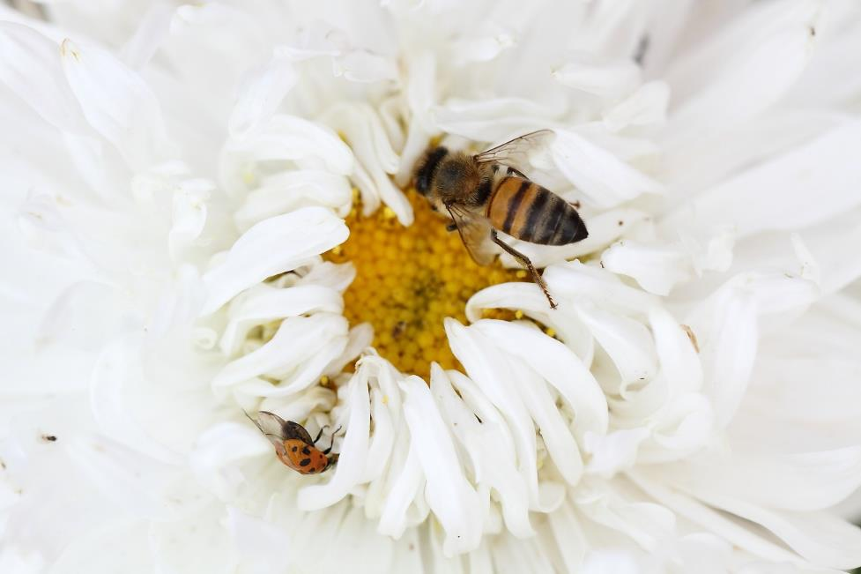
Health, Environmental and Economic Risks of Pests and Pesticides in Schools and How IPM Reduces Risk
Pesticide-related environmental risks include risks to:
Pollinators
Beneficial
arthropods
Non-target
plants and
animals
Notes:
Beneficial arthropods are insects, mites, spiders that play an important part in reducing pest species.

Slide 29

Health, Environmental and Economic Risks of Pests and Pesticides in Schools and How IPM Reduces Risk
Pesticides can persist for years in application
sites
Pesticide resistance
develops over time
and is more likely
to occur when the
same active ingredients
are used repeatedly
CropWatch, University of Nebraska
Notes:
Some pesticides persist in the environment for years and/or leak into streams, rivers, lakes and ground water.
Over-use of pesticides may lead to pests developing resistance to the pesticides. When this happens the pesticide eventually becomes completely useless.

Slide 30

13.
Health, Environmental and Economic Risks of Pests and Pesticides in Schools and How IPM Reduces Risk
Economic risks include:
Repeated (and ineffective) pesticide application costs
Unsafe pesticide exposure can result
in costly litigation
Unchecked pest infestations
may lead to site closures

Slide 31
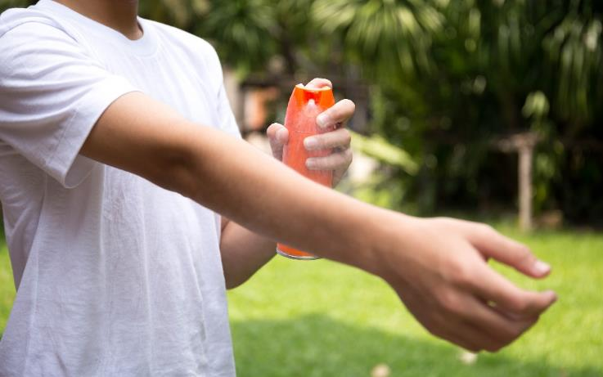
Health, Environmental and Economic Risks of Pests and Pesticides in Schools and How IPM Reduces Risk
31
Pesticide safety - Many household products are pesticides and these include:
Kitchen and bathroom disinfectants and sanitizers
Mosquito repellent
Rodent poisons
Flea and tick collars
Products that kill
mold and mildew
Weed killers

Slide 32
Health, Environmental and Economic Risks of Pests and Pesticides in Schools and How IPM Reduces Risk
32
Are some pesticides safer than others?
The EPA Conventional Reduced Risk Pesticide Program was developed to quickly register commercially viable alternatives to riskier conventional pesticides
  https://www.epa.gov/pesticide-registration/conventional-reduced-risk-pesticide-program
Be familiar with resources that help you recognize the safest product options
Notes:
The EPA Conventional Reduced Risk Pesticide Program accelerates the review and regulatory decision-making process for conventional pesticides that pose less risk to human health and the environment than existing conventional alternatives.

Slide 33
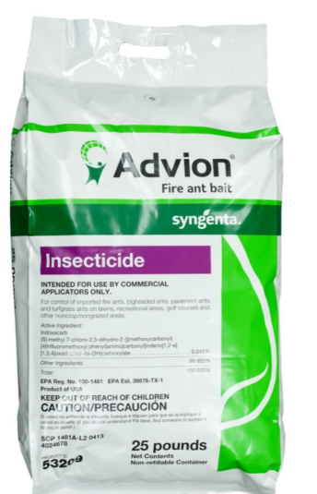
Health, Environmental and Economic Risks of Pests and Pesticides in Schools and How IPM Reduces Risk
33
Reduced risk pesticides have the following advantages:
  Low impact on humans and non-target organisms
  Low risk of groundwater contamination
  Low potential for pesticide resistance
  Compatible with IPM
Reduced risk/organophosphate alternative Indoxacarb fire ant bait – Dawn H. Gouge, University of Arizona
Notes:
The “reduced-risk” designation applies only to certain uses of a particular pesticide and may not include all legal uses for that product.

Slide 34
Health, Environmental and Economic Risks of Pests and Pesticides in Schools and How IPM Reduces Risk
34
Minimum-risk pesticides:
  Are exempt from EPA registration under Federal Insecticide, Fungicide and Rodenticide Act (FIFRA) https://www.epa.gov/minimum-risk-pesticides
  Have no EPA registration number
  May only contain ingredients from a limited list generally recognized as safe

Slide 35
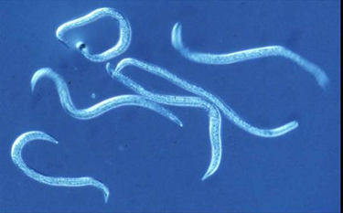
Health, Environmental and Economic Risks of Pests and Pesticides in Schools and How IPM Reduces Risk
35
Biopesticides:
  Are derived from natural materials including animals, plants, bacteria and certain minerals
  They must be registered with EPA
  https://www.epa.gov/pesticides/biopesticides
Insect parasitic nematodes
– Dawn H. Gouge, University of Arizona

Slide 36

Health, Environmental and Economic Risks of Pests and Pesticides in Schools and How IPM Reduces Risk
36
Biopesticides:
  Biochemical pesticides are
  naturally occurring substances in contrast to conventional pesticides which are generally synthetic materials
  Microbial pesticides consist of a
  microorganism as the active ingredient
  Plant-Incorporated-Protectants (PIPs) are pesticidal substances that plants produce from genetic material incorporated into the plant
Bt cotton –
Peter C. Ellsworth, University of Arizona

Slide 37

13.
Health, Environmental and Economic Risks of Pests and Pesticides in Schools and How IPM Reduces Risk
Liability risks are serious, schools have only one sensible choice and that is to practice IPM
Notes:
School boards risk litigation if the best and most current information is not used when making pest management decisions.

Slide 38
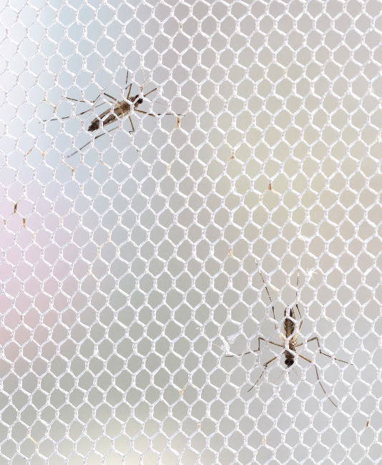
13.
How IPM Reduces Risk Associated with Pests and Pest Management Practices
IPM prevents many pest infestations from ever starting in the first place
Thus, minimizing human
contact with pests
IPM utilizes the safest,
most effective
management strategies,
tools and products
available
Notes:
School boards risk litigation if the best and most current information is not used when making pest management decisions.

Slide 39

Benefits of School IPM
3.
IPM protects human
and environmental health
Improves indoor air quality
Reduces the number
of missed school days for students and staff improving academic results

Slide 40

Benefits of School IPM
IPM has been documented to improve morale and staff satisfaction
IPM supports healthier, more comfortable and productive students
and staff
IPM generates
long-term
control of pests
Notes:
Pests and pesticide residue can cause unnecessary stress. IPM can lead to the above list and can typically cost less.

Slide 41
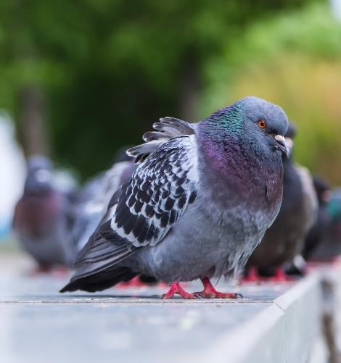
Key Elements of IPM
4.
Identification
Inspection and monitoring
Reporting
Sanitation and waste management
Maintenance and pest-proofing
Selecting management methods and products
Education and communication
Evaluation
Rules, regulations and policy
Notes:
Termites are essential decomposers and recyclers of wood in nature. In a building, termites can be expensive pests.

Slide 42
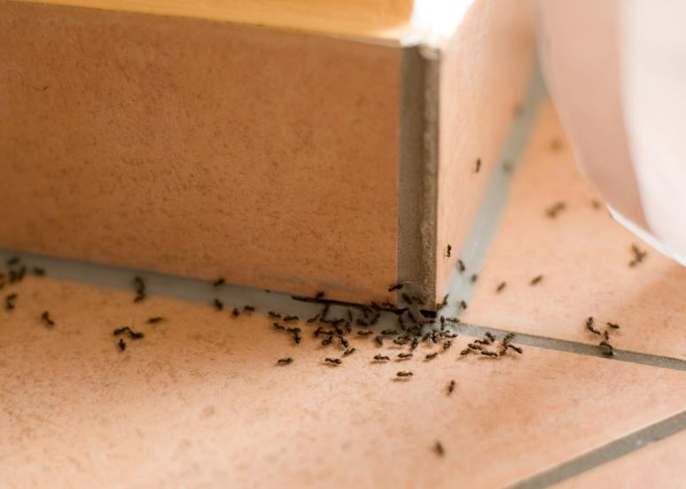
Key Elements of IPM - Identification
4.
Pest identification and location, the following must be determined so the appropriate action can be taken:
What is it?
Where is it?
How did it
get there?
Why is it there?
When is it
showing up?
Notes:
Termites are essential decomposers and recyclers of wood in nature. In a building, termites can be expensive pests.

Slide 43
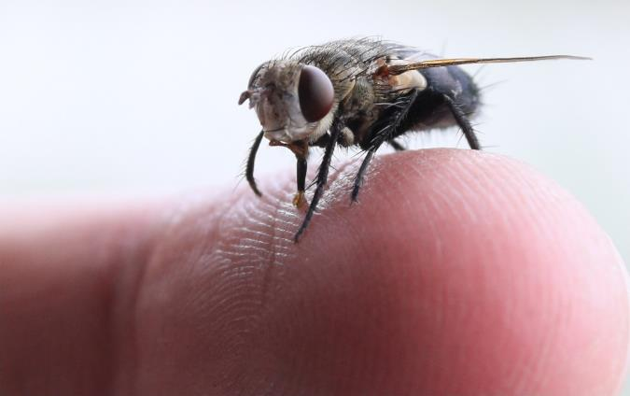
Key Elements of IPM - Identification
4.
Unless you know what it is and understand the ecology of the organism, you can not possibly know how to manage it
Ecology (from the Greek word “house”) is the study of interactions among living organisms (biotic) and their
environment (abiotc)
and includes biology,
geography, and
Earth science knowhow
Notes:
Termites are essential decomposers and recyclers of wood in nature. In a building, termites can be expensive pests.

Slide 44
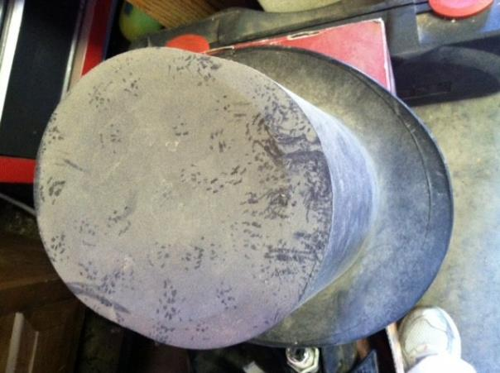
Key Elements of IPM – Inspect, Monitor, Measure
4.
Why inspect?
To detect pest problems as early as possible
To address pest
conducive conditions
before problems occur,
especially in pest
vulnerable areas
(PVA’s) like kitchens,
and food service
areas
Roof rat footprints –
Dawn H. Gouge, University of Arizona
Notes:
PVA’s can include cluttered storage areas, hard to reach places (under desks or behind couches/vending machines and areas where there is food, water and shelter for the pest.
For some pests the action threshold is one, such as a cockroach.

Slide 45
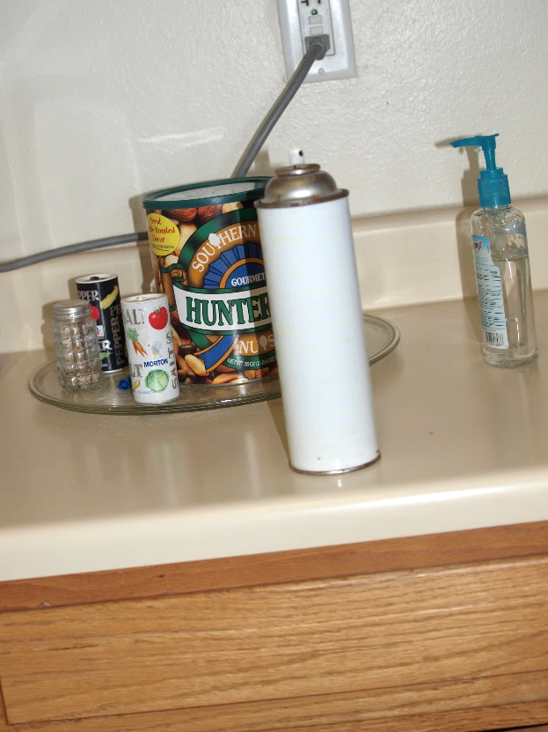
Key Elements of IPM – Inspect, Monitor, Measure
6.
Inspection involves the regular observation and recording of:
The physical condition of buildings and grounds
Assessment of pest conducive
conditions including sanitation
and exclusion
Detection of pest damage and
pest signs
Detection of unsanctioned pest
control attempts including
pesticides from home
Mystery spray being used because of flies in teachers lounge – Dawn H. Gouge, University of Arizona

Slide 46
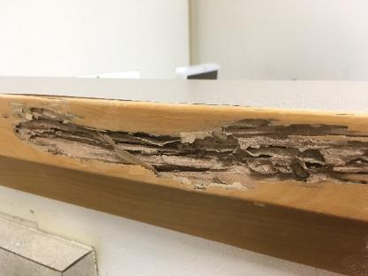
Key Elements of IPM – Pest-conducive Conditions
7.
Water is a critically important pest resource
Monitor and repair leaks
Repair leaky valve boxes
Keep flooring, machinery surfaces dry
Ensure rainwater drains away from buildings
Ensure air-conditioning
condensate does not pool
in drop ceiling tiles or attic areas
Subterranean termites in wood next to water saturated external ground –
Dawn H. Gouge, University of Arizona

Slide 47
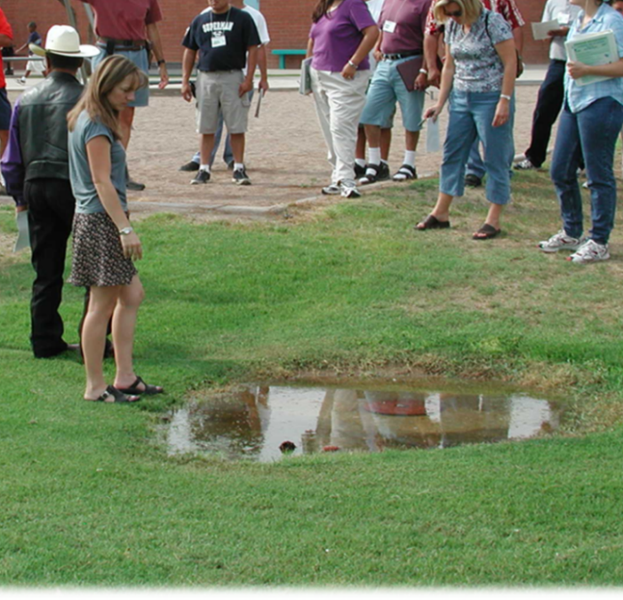
Key Elements of IPM – Pest-conducive Conditions
Under optimum conditions some mosquito species can develop from eggs to adults in less than a week
Leaking irrigation valve box generating an ideal mosquito breeding site – Marc Lame, Indiana University

Slide 48
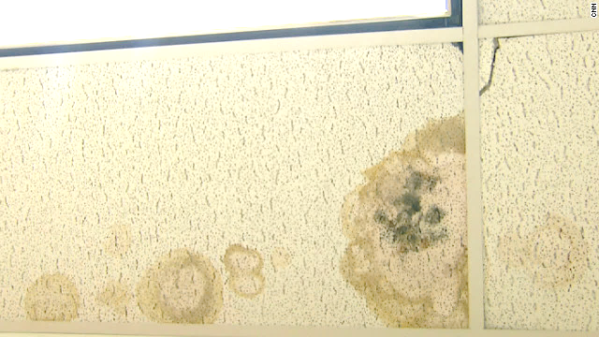
Key Elements of IPM – Pest-conducive Conditions
Exposure to mold can cause health problems for sensitive individuals
Exposure may cause or worsen conditions such as asthma, hay fever or allergy symptoms
Moldy ceiling tiles –
Dawn H. Gouge, University of Arizona
Notes:
Mold can cause health problems, especially to those with allergies or respiratory problems.

Slide 49
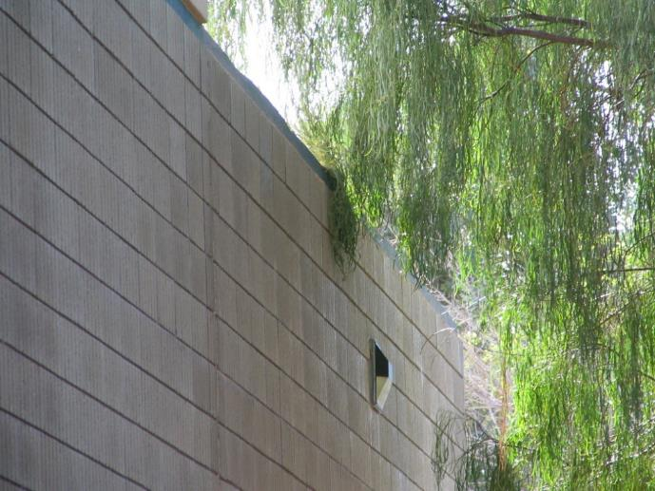
Key Elements of IPM – Pest-conducive Conditions
No plants should be planted against buildings, as they may provide pest harborage
Plants near to buildings should be pruned away from buildings to maintain three feet of clearance
At least a 12-inch
vegetation-free
perimeter around
building foundations
is advisable
Trees overhanging and contacting the school building – Dawn H. Gouge, University of Arizona

Slide 50
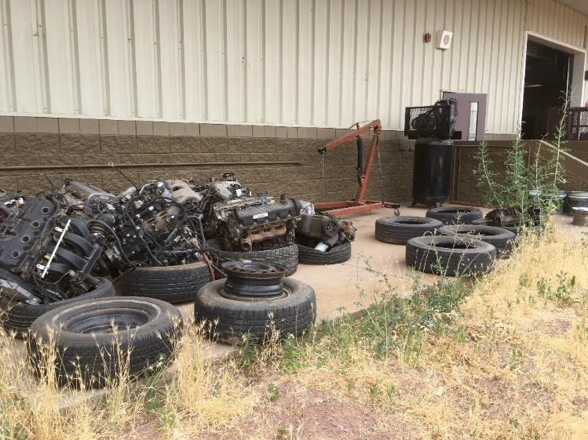
Key Elements of IPM – Pest-conducive Conditions
Remove outdoor clutter in a timely manner, as it provides pest harborage
Tires in particular
are excellent sites
for some mosquito
species to develop
in
Tires and old engines behind school building – Tom Green, IPM Institute of North America

Slide 51
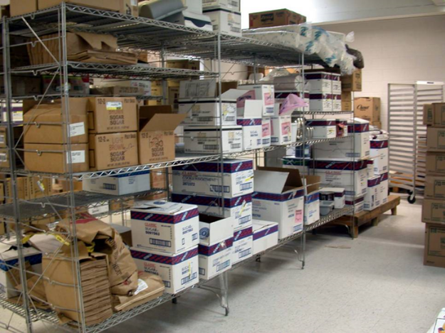
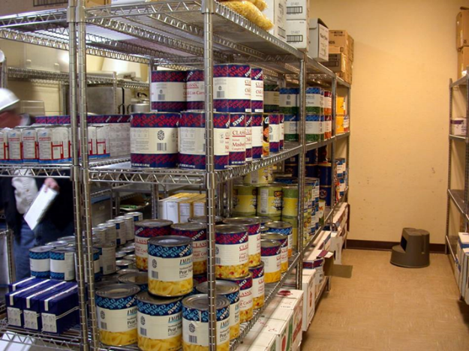
Key Elements of IPM – Pest-conducive Conditions
Jerry Jochim, Monroe County Community School Corporation
Problematic
Excellent
Cockroaches live in and feed on cardboard boxes
Unpack and date all items and store supplies neatly on shelves so that the oldest can be used first
Notes:
Wire rack shelving allows food debris to fall to floor. Maintaining at least six inch height on bottom shelf allows easy cleaning and inspection.

Slide 52
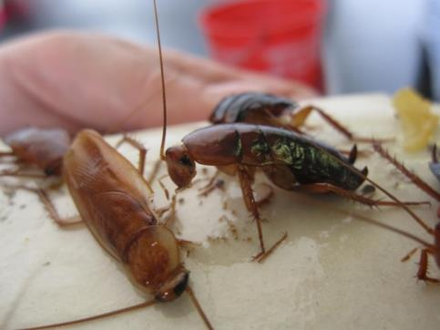
Key Elements of IPM – Inspect, Monitor, Measure
4.
Why monitor?
Using ongoing monitoring tools allows for constant assessment of pest activity when you can not be around
Monitoring helps determine pest population levels and how the pests are
accessing or being
introduced into the school
Sticky insect monitoring trap with Turkestan cockroaches – Dawn H. Gouge, University of Arizona
Notes:
PVA’s can include cluttered storage areas, hard to reach places (under desks or behind couches/vending machines and areas where there is food, water and shelter for the pest.
For some pests the action threshold is one, such as a cockroach.

Slide 53
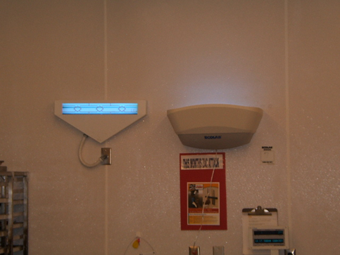
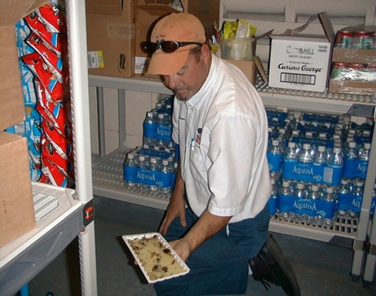
Key Elements of IPM – Inspect, Monitor, Measure
Marc Lame, Indiana University
Traps catch 24-7 and help you identify the pest, determine how many there are, assess the direction of travel and determine harborage locations

Slide 54
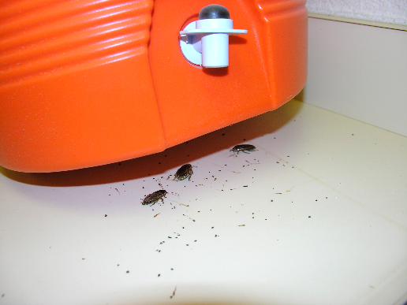
Key Elements of IPM – Inspect, Monitor, Measure
4.
Action thresholds:
Establish pest specific tolerance levels for particular pests in specific locations e.g., 1 German cockroach in a kitchen is cause for further investigation and action
The IPM coordinator
will establish indoor
and outdoor action
thresholds
Desert cockroaches under water cooler –
Dawn H. Gouge, University of Arizona
Notes:
PVA’s can include cluttered storage areas, hard to reach places (under desks or behind couches/vending machines and areas where there is food, water and shelter for the pest.
For some pests the action threshold is one, such as a cockroach.

Slide 55
Key Elements of IPM – Inspect, Monitor, Measure
4.
Action thresholds:
All school staff benefit from an awareness of the established pest threshold levels
Resources are available to help establish thresholds for common pests in common use areas
  http://articles.extension.org/pages/20415/school-integrated-pest-management-thresholds
  http://www.uwyo.edu/wyschool_ipm/about-school-ipm/keys/thresh-chart.html
Notes:
PVA’s can include cluttered storage areas, hard to reach places (under desks or behind couches/vending machines and areas where there is food, water and shelter for the pest.
For some pests the action threshold is one, such as a cockroach.

Slide 56
Rapid Review - Common Use Rooms
8.
Common Use Rooms
Strategies
Classrooms
Gymnasiums,
Locker Rooms
Restrooms
Hallways
Offices
Library/Computer Room
Multipurpose Room/Auditorium
Allow food and beverages only in designated areas
Don’t overwater indoor plants
Eliminate standing water and water-damaged materials
Store animal feed in sealed containers and clean cages regularly
Empty trash cans daily
Periodically clean out lockers and desks
Vacuum carpeted areas

Slide 57

Key Elements of IPM - Reporting
Pest sighting logs or work order systems can help school staff report and respond to pest problems
Systems
allow
methodical
data tracing
which may
be legally
required

Slide 58
Reporting - Sample Pest Sighting Log
Date/ time | Location | Pest | # of Pests | Person Reporting Sightings | Action Taken | Date Action Completed/ Person
6/1/13 10am | Class 2b | Pavement ants | 5 | Mrs. Smith, Teacher of 2b | Sealed entryway | 6/2/13 Mr. Burns, Maintenance
6/3/13 9pm | Kitchen pantry | German cockroach | 1 | Ms. Brown, Kitchen manager | Removed cardboard, placed monitoring traps to determine if cockroach came in with a delivery | 6/5/13 Mr. Jacobs, Contract PMP
6/5/13 7am | Admin office | American cockroach | 2 | Mr. Jones, Lead custodian | Replaced external doorway sweep | 6/6/13 Mr. Jones, Lead custodian
6/9/13 | Outdoor athletics storage | Widow spider in webbing | 1 adult | Mr. Jones, Lead custodian | Vacuumed web, spider and egg sacs, sealed void associated with web | 6/10/13 Mr. Jones, Lead custodian
6/9/13 | Booster club storage | Mouse | 1 | Ms. Frantic, Parent volunteer | Reduced clutter, improved sanitation levels, stopped volunteers propping door open during afterschool events | 6/14/13 Mr. Jones, Lead custodian

Slide 59
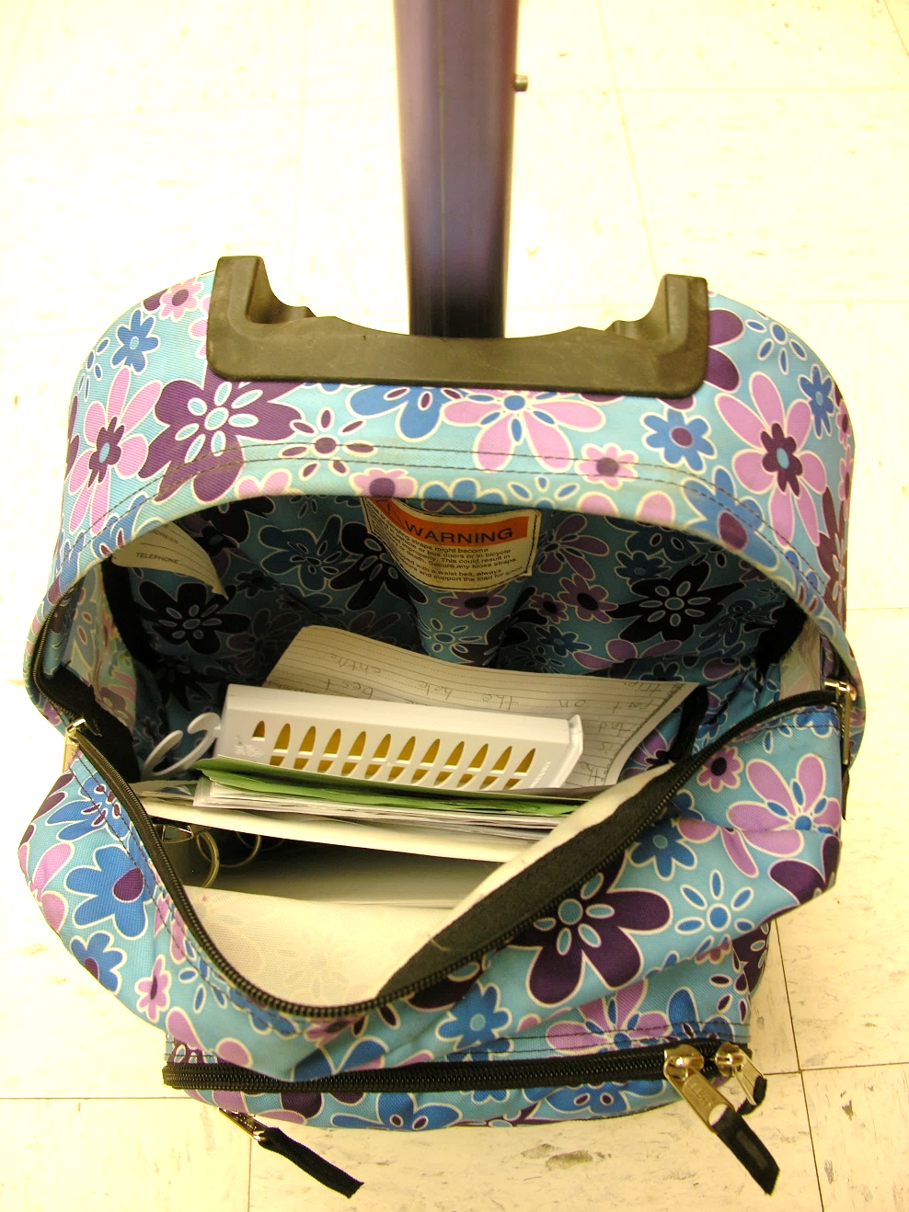
Key Elements of IPM - Reporting
Report:
  Pests found
  Signs of pests
  Supportive conducive conditions
  Pest entryways
  Unsanctioned pest control attempts
Student back-pack reported with chemical odor –
Kristen Clason, Indiana University

Slide 60
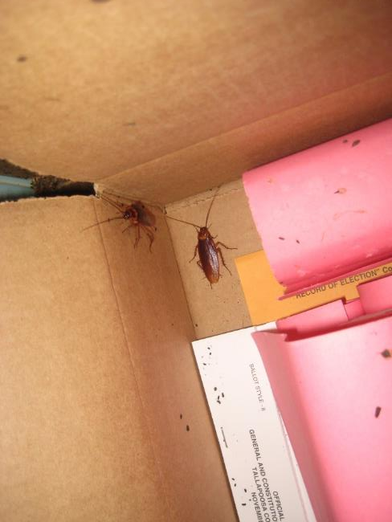
Key Elements of IPM - Reporting
6.
Recordkeeping is important because it allows:
Accurate flow of information
from one employee to another
IPM Coordinators to identify
trends in pest populations
Documentation of problems
and evaluation of solutions
Legal compliance
American cockroaches in cardboard boxes
– Dawn H. Gouge, University of Arizona
Notes:
Recordkeeping includes inspection and monitoring results, pest complaints and pest site applications.

Slide 61
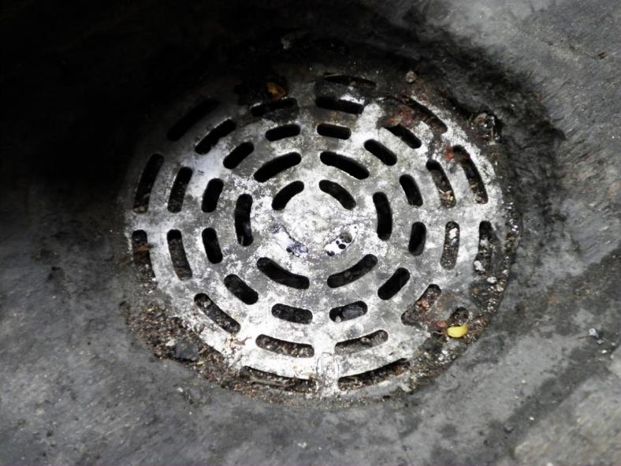
Key Elements of IPM – Sanitation and Waste Management
Good sanitation and waste management practices are a critically important component of pest prevention:
Improving
sanitation reduces
pest access to food
Our waste is often
a pest resource
just as supportive
as our food
Dirty floor drain
Notes:
Dirty floor drains provide food and shelter for flies, ants, cockroaches, mold and microbial pathogens.

Slide 62
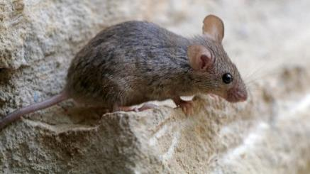
7.
Key Elements of IPM – Sanitation and Waste Management
Clean-up food spills immediately (some pests only need minutes to find a resource)
Restrict food and drinks to certain areas
Seal stored food in airtight containers (odors attract foraging pests)
Maintain clean dumpsters and keep surrounding areas free of debris
Deep clean of Pest Vulnerable
Areas like kitchens, cafeterias,
and food storage rooms

Slide 63
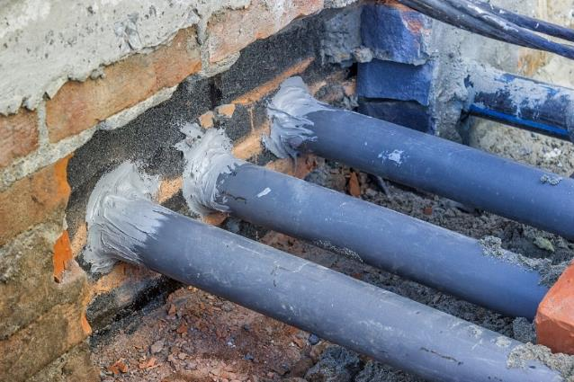
Key Elements of IPM – Maintenance and Pest-proofing
Prevent pest access to buildings by “pest-proofing” this includes preventing pests from the outside getting in, and preventing hitchhiking pests brought in by building occupants and in deliveries from spreading
Seal cracks, crevices
and holes around
exterior wall penetrations
Seal gaps or holes with rodent-proof materials where pipes, wires, or other similar objects enter buildings
Notes:
Improving maintenance such as improperly installed or damaged door sweeps and seals prevents pest access to the building. This is often called “pest-proofing”.

Slide 64
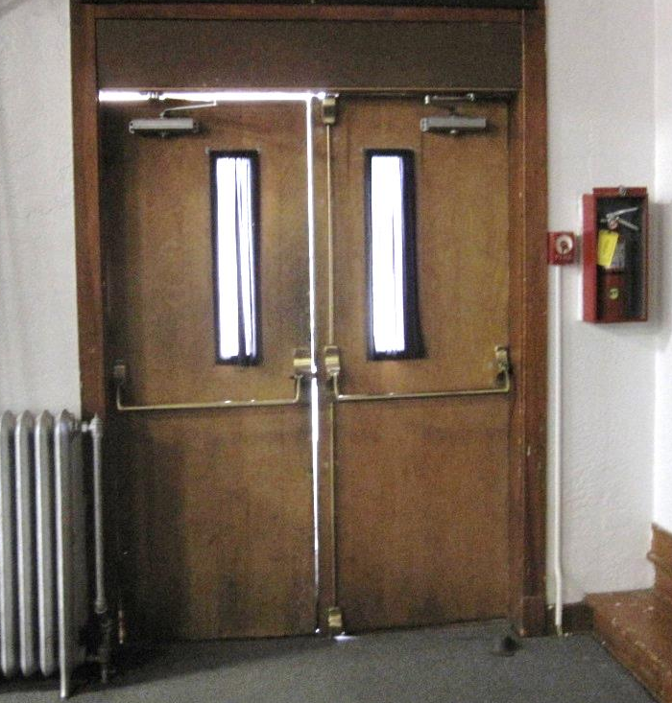

Key Elements of IPM – Maintenance and Pest-proofing
Effective door sweeps and seals can reduce pest entry up to 65%
Pest Entry Points
An open door to pests –
Dawn H. Gouge, University of Arizona

Slide 65
Rapid Review- Entryways for Pests
8.
Entryways for Pests
Strategies
Doorways
Windows
Openings around pipes
Areas around fans, air conditioners and building ventilation outlets
Exterior lighting
Roof flashing
Window wells
Keep exterior doors shut
Make sure door thresholds and door sweeps are sealing properly
Seal plumbing and electrical penetrations through walls
Make sure screens are the correct size and in good repair
Position exterior lights away from building to shine on building without drawing insects to entryways

Slide 66
Key Elements of IPM - Pest Control Products
8.
Many states require the IPM Coordinator or responsible Pest Management Professional to keep detailed IPM records, this could include:
  All pesticide products used and stored
  All tools used or actions taken to manage pests
Even in the absence of a policy or law, record keeping is a best practice fundamental
Products and methods used in schools should be the least hazardous and effective

Slide 67

Key Elements of IPM - Pest Control Products
8.
Some states offer detailed guidance regarding product use and the related legal obligations – State laws differ:
  Texas Common Green Category Products for Schools http://schoolipm.tamu.edu/files/2016/07/2016-Recognizing-Green-List-Products-for-Texas-Schools.pdf
  California Healthy School Act http://apps.cdpr.ca.gov/
  schoolipm/hsa_flowchart.pdf

Slide 68
Key Elements of IPM – Education and Communication
More IPM tools and tactics:
IPM Coordinators provide leadership and serve as the main point of contact regarding pest management in district facilities
An IPM Plan or policy keeps you organized
A schoolboard-approved IPM Policy provides direction and institutional memory
IPM training provides guidance to the community
Regular communications keeps everyone informed
Notes:
Identifying and training an IPM Coordinator establishes leadership for the implementation of School IPM.
An IPM Plan organizes your pest management practices for your common pest problems.
IPM training teaches your school administrators, faculty, food service staff, maintenance and custodial staff, students, nurses, health aides and parents how to prevent pest problems.
IPM communication such as Pest Presses, can alert staff and students to different pest issues at their school, ways to prevent pest presence and pest management solutions.

Slide 69
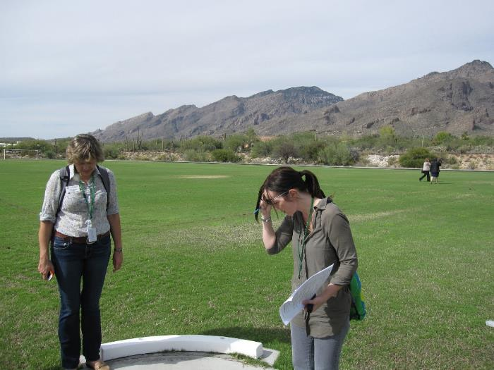
Key Elements of IPM – Education and Communication
Shaku Nair - University of Arizona
Form partnerships with surrounding groups:
Your pest management professional
Non-governmental organizations working to improve environmental
health and safety
University Extension
Your department of
health and State Lead
Agency responsible for
regulating pesticides

Slide 70

Key Elements of IPM - Evaluation
15.
Your IPM program should be evaluated annually to determine what is working and what is not?
Are pests persisting?
Are there any emerging issues?
Are pest management
methods and products the
least hazardous and effective?
Are there community communication challenges or education needs?

Slide 71
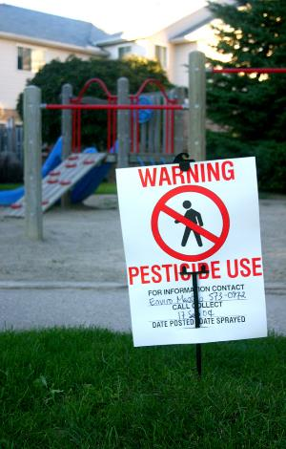
Rules, Regulations and Policy
15.
Regulations vary by State, but best practices do not, the following are important
steps that protect human safety
and district liability:
  Physical posting of pesticide
  treated areas
  Parent notification of pesticide
  applications or at a minimum annual notice of allowable control options
  Education of staff and a school district IPM policy

Slide 72

Rules, Regulations and Policy –
School District IPM Policy
15.
School IPM policies may include:
  Who can apply pesticides
  When and where they can be applied
  A list of allowable pesticide products
  Treated area posting details
  Pesticide application record keeping
  IPM coordinator contact information
  A registry of students and staff who are chemically sensitive

Slide 73
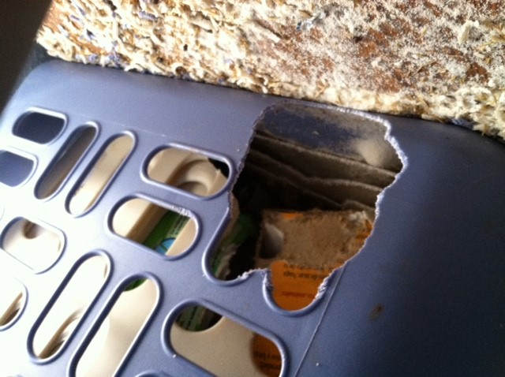
11.
Key Pest Groups and Signs of Infestation
Key indoor pest groups include:
  Ants
  Cockroaches
  Flies
  Mice and rats
  Spiders
  Termites
  Bed bugs
  Head lice
Roof rat damage –
Dawn H. Gouge, University of Arizona

Slide 74
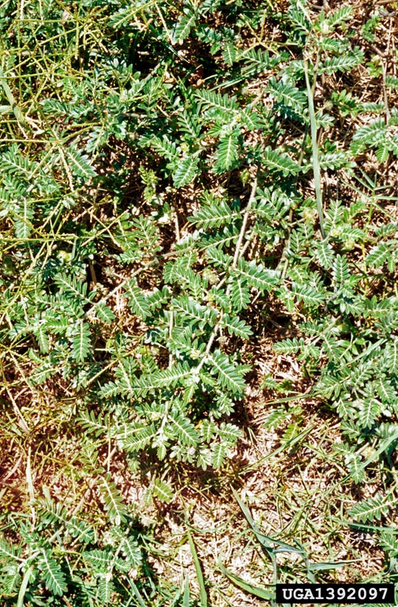
Key Pest Groups
and Signs of Infestation
Key outdoor pest groups include:
  Pigeons and sparrows
  Small mammals
  Snakes
  Turf, ornamental and tree insects/mites
  Disease vectors
  Stinging/venomous insects,
  spiders or scorpions
  Nuisance pests
  Weeds and plant pathogens
Puncturevine - Charles T. Bryson, USDA Agricultural Research Service, Bugwood.org

Slide 75
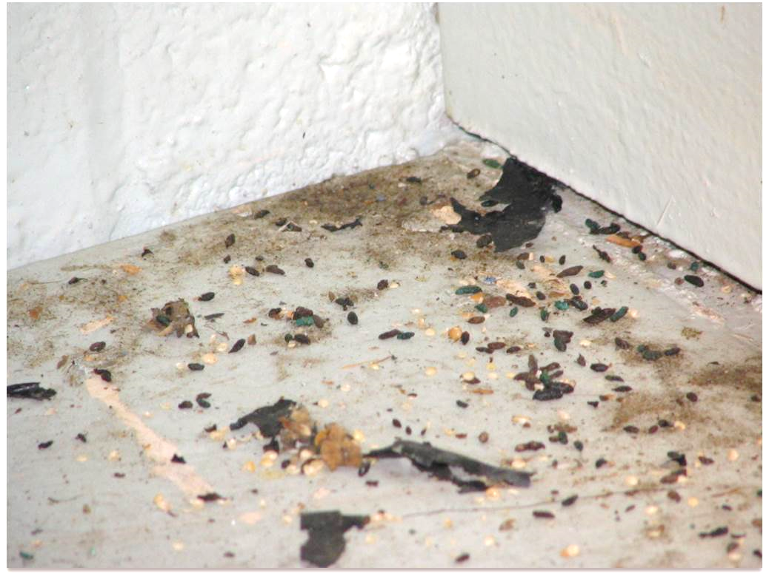
12.
Key Pest Groups and Signs of Infestation
Physical evidence of pest presence inside or out includes (pay attention to pest vulnerable areas):
Dead pests or pests caught in traps
Droppings, cast molts or hair
Grease marks
Nests or pest
structures e.g., termite
tubes
Damage
Mouse droppings – Dawn H. Gouge, University of Arizona

Slide 76
Rapid Review- Pest Vulnerable Areas
8.
Food Preparation
and Serving Areas
Strategies
Dining Hall/Cafeteria
Food Storage Rooms
Kitchen
Dishwashing Room
Teacher’s Lounge
Vending Machines
Remove trash daily
Place screens on vents, doors, windows and floor drain baskets in floor drains
Clean up all food spills immediately
Fix any leaky plumbing
Promptly clean food preparation equipment after use
Seal cracks and crevices
Remove paper, cleaning and food supplies from cardboard boxes; put boxes out for recycling

Slide 77
Roles and Responsibilities of the School IPM Team
The following key personnel all have an IPM roll to play:
School IPM Coordinator
School Administrator
School Nurse
Students and Teachers
Parents
Maintenance/
Custodial Staff
Grounds Staff
Kitchen Staff
Vendors/Contractors
Pest Management Professionals
Community Facility Users

Slide 78

Roles and Responsibilities of the School IPM Team
5.
The School IPM Coordinator is your primary contact for all pest management matters for your school, and they can communicate between your school and your pest management professional if you have a
contracted service provider
Usually the IPM Coordinator is
a part of the school facilities
management team
Notes:
In smaller districts the IPM coordinator may also be the superintendent, principal or person under contract to the school.

Slide 79
Roles and Responsibilities of the School IPM Team
5.
Avoid conflicts of interest – don’t appoint private contractors as IPM Coordinators
Coordinators should have the authority to request: cleaning, repairs, training, or other improvements
Coordinators implement daily operation of your IPM program and determine what IPM practices are needed
They evaluate and approve the need for pesticide applications
Notes:
To avoid conflict of interest it is generally recommended that the your IPM Coordinator NOT be employed by your contracted pest management service provider, if you have one.

Slide 80
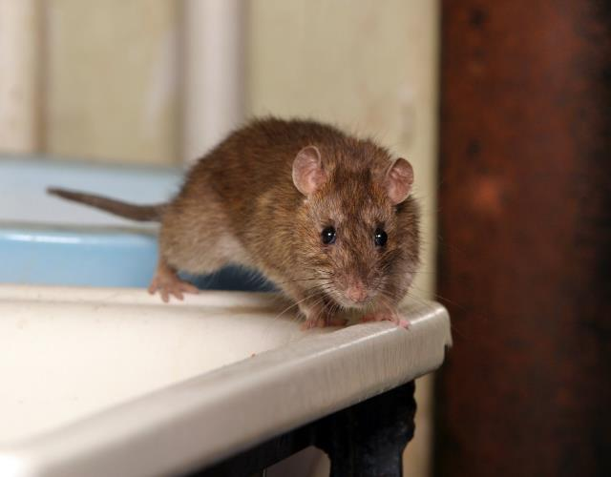
Roles and Responsibilities of the School IPM Team
The IPM Coordinator:
Educates individuals about their role in IPM
Works with everyone
in the school district
community
The IPM Coordinator
ensures that IPM is
included in new facility
as well as renovation: bid requests, contracts, design, plans and construction
Notes:
The IPM Coordinate works with everyone including: administrators, teachers, custodians, kitchen, grounds and maintenance staff, and parents and students, to prevent and solve pest problems.

Slide 81

Roles and Responsibilities of the School IPM Team
Administrators should:
Support IPM programs as part of sustainability efforts
Be aware of state laws about IPM in public
schools
Communicate with the
IPM Coordinator
regularly
Notes:
Administrators and school boards set the tone for the IPM program.
Administrators should be aware of state laws about IPM in schools including:
pesticide use in schools
any other regulations addressing pest management and the district’s IPM policy, if one is in place.

Slide 82

Roles and Responsibilities of the School IPM Team
The most important responsibilities of administrators are to:
Adopt and enforce an IPM policy
Include IPM as part of your
health and/or safety committee(s)
Designate an IPM Coordinator
Support maintenance and
sanitation priorities
Notes:
Administrators should encourage staff understanding and full participation in the IPM program.

Slide 83

Roles and Responsibilities of the School IPM Team
5.
School nurses should:
Be aware of the district IPM Policy, IPM Plan and pesticides used on school property
Be familiar with the signs and symptoms of pesticide poisoning
Be aware of signs of pest exposure
  Example: asthma

Slide 84

Roles and Responsibilities of the School IPM Team
The school nurse should also be:
Aware of students or staff with:
  Asthma
  Chemical sensitivities
  Allergies to
  stinging insects
Familiar with
common
communicable pests
e.g., head lice
Notes:
Nurses should have information on IPM strategies for pests that can impact student health.

Slide 85
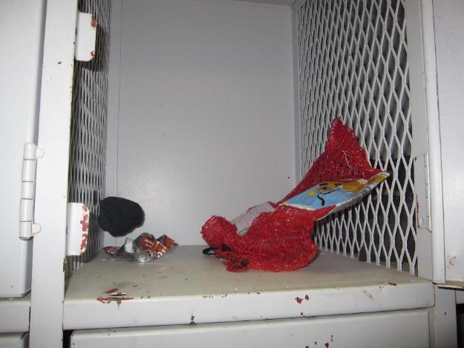
Roles and Responsibilities of the School IPM Team
Students and staff should avoid:
  Leaving food in lockers, classrooms and
  common areas
  Eating or drinking in
  areas not designated
  for food consumption
  Generating clutter
  indoors or outside
Half eaten granola bar and rubbish left in locker – Dawn H. Gouge, University of Arizona
Notes:
Students and staff can support IPM by practicing good sanitation and immediately reporting pest sightings to the school office.

Slide 86

Roles and Responsibilities of the School IPM Team
5.
Parent's (teachers and school staff) should:
Use IPM practices in their homes to extend
the health benefits of IPM
Support IPM in
school
Express concerns
about pests
and management
methods
Notes:
Parent support of IPM motivates and reinforces school staff efforts to provide effective, low-risk pest control.
Parents should express their concerns to the IPM Coordinator, school district superintendent, the school principal, school-based improvement committees or the parent-teacher organization.

Slide 87
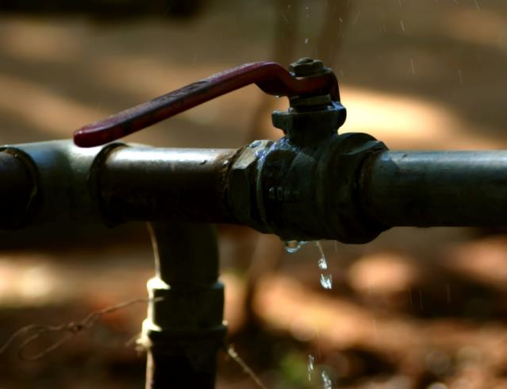
Maintenance/Custodial/Grounds Staff Role
5.
Roles and Responsibilities of the School IPM Team
Staff are responsible for recognizing and correcting conditions that may lead to pest problems on a daily basis
  Examples: landscape water leaks, good sanitation, etc.
Notes:
It is essential that all maintenance, custodial and grounds staff be adequately trained to recognize and prevent pest problems.

Slide 88
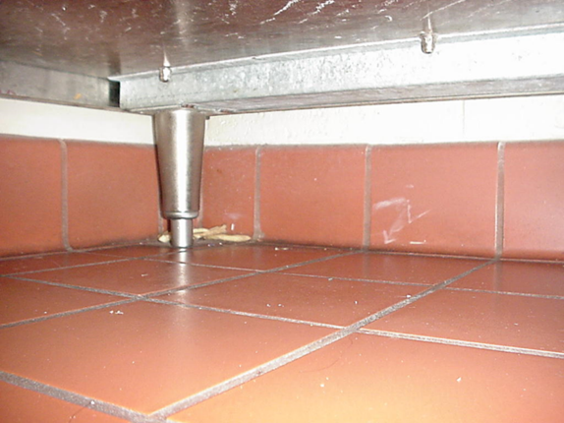
Roles and Responsibilities of the School IPM Team
5.
Kitchen staff should understand that:
Food handling, preparation and serving areas
are among the most pest vulnerable areas
Avoiding foodborne pathogens requires a good understanding of IPM
Keep areas under kitchen equipment clean and dry – Dawn H. Gouge, University of Arizona

Slide 89

Roles and Responsibilities of the School IPM Team
Vendors and Contractors can expect:
School districts to enforce good sanitation practices
Contracts to include specific best practices that are related to pest
avoidance
  Example: cleaning
  under, behind and
  inside vending
  machines
Notes:
School districts will enforce good sanitation practices by including specific language in bid specifications and contracts.

Slide 90

Roles and Responsibilities of the School IPM Team
Vendors and Contractors may expect:
Districts to prioritize the correction of problems that support pests
  Examples: irrigation leaks or cluttered pest harborage areas
Districts to administer
penalties for not
following their IPM
policy

Slide 91

Roles and Responsibilities of the School IPM Team
Pest management contractors should provide:
Services in-line with the school IPM policy
Regular consultation with the IPM Coordinator
Procedures for responses to pest sightings
Schedules for regular
inspections and
monitoring
Detailed record-
keeping practices
Notes:
Procedures for timely response to pest sightings.
Schedules for conducting regular inspections of pest-vulnerable areas.
Requirements for detailed record keeping of pest sightings and pesticide use.

Slide 92

Pest Management Contractor Role
Pest Management Contractors should:
Provide product labels and SDS documents to school staff
Give specific recommendations to correct
pest-conducive conditions
Facilitate proper pesticide
posting and notification
Dawn H. Gouge, University of Arizona
Notes:
SDS stands for safety data sheets.
Legal requirements for posting and notification vary by state.

Slide 93

Pest Management Contractor Role
Pest Management Contractors should:
Correctly diagnosis the cause of pest problems
Educate school staff
Promote least-
hazardous methods
Ensure that all
applicators are
licensed and
supervised by
trained personnel
Notes:
i.e., “why is the pest present?”
Educate school staff how to solve the root cause of the pest problem.
Promote the appropriate least-hazardous methods to correct pest problems.
Ensure that all applicators are properly licensed and supervised by knowledgeable, trained personnel.

Slide 94

Want to Review?
In this video you will see team members from University of Nebraska-Lincoln help a school implement an IPM program
Review this YouTube video to watch IPM in action https://www.youtube.com/watch?v=N44ScfbBtz4
Notes:
If you have time, click on the link to watch a video that summarizes up this modules.

Slide 95
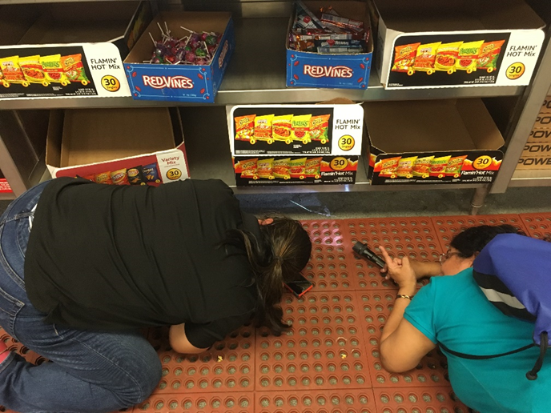
Check In!
Inspections can be fun learning experiences
- Dawn H. Gouge, University of Arizona
In this lesson
you learned
school
IPM
basics
Congratulations, you’ve completed the Introduction Module!

Slide 96
Resources
Arizona Cooperative Extension. (2009). Integrated Pest Management: The most effective way to manage pests in your school. http://ag.arizona.edu/pubs/insects/az1234.pdf
Center for Disease Control and Prevention. (2011). Asthma. http://www.cdc.gov/nchs/fastats/asthma.htm
Gouge, D. H., M. L. Lame and J. L. Snyder. (2006). Use of an implementation model and diffusion process for establishing Integrated Pest Management in Arizona schools. American Entomologist, 52(3): 190-196.
Green, T. A., D. H. Gouge, L. A. Braband, C. R. Foss and L. C. Graham. 2007. IPM STAR Certification for school systems. American Entomologist 53(3):150-156. http://www.entsoc.org/PDF/Pubs/Periodicals/AE/AE-2007/Fall/Green.pdf
Greene, A., and N. L. Breisch. (2002). Measuring integrated pest management programs for public buildings. Journal of Economic Entomology 95: 1-13.
Illinois Department of Public Health. (1994). Integrated management of structural pests in schools. http://www.idph.state.il.us/envhealth/pdf/imsps.pdf
USDA. (2013). National Roadmap for Integrated Pest Management. http://www.csrees.usda.gov/nea/pest/pdfs/nat_ipm_roadmap.pdf

Slide 97
Resources
Cornell University. (2012). Pesticide Safety Education Program, Module 9. http://psep.cce.cornell.edu/Tutorials/core-tutorial/module09/index.aspx
Hollingsworth, C. S., Coli, W. M., Murray, K. D., and Ferro, D. N. (Eds.). (2002). IPM for Northeast Schools. Ithaca: Natural Resource, Agriculture and Engineering Service Cooperative Extension. http://www.umass.edu/umext/schoolipm/for_viewing_only_ipmns.pdf
Maine Department of Agriculture, University of Maine Cooperative Extension. (2002). Outdoor Integrated Pest Management for Maine schools. http://www.maine.gov/agriculture/pesticides/schoolipm/pdf/outdooripm.pdf
Alavanja , M. C. R., J. A. Hoppin and F. Kamel. (2004). Health Effects of Chronic Pesticide Exposure: Cancer and Neurotoxicity*3 Annual Review of Public Health. Vol. 25: 155-197. http://www.annualreviews.org/doi/abs/10.1146/annurev.publhealth.25.101802.123020
United States Environmental Protection Agency. (2012). The Conventional Reduced Risk Pesticide Program, About Pesticides, Pesticide Product Labels, Reducing Pesticide Risk. http://www.epa.gov/pesticides/glossary/r-z.html
United States Environmental Protection Agency. (2012). Protecting Children’s Health, The National Pesticide Program. http://www.epa.gov/pesticides/health/protecting-children.pdf

Slide 98
Resources
Alarcon, W. A., G. M. Calvert and J. M. Blondell. (2005). Acute Illness Associated with Pesticide Exposure at Schools. Journal of American Medical Association. http://jama.jamanetwork.com/article.aspx?articleid=201292
Hurley, J. A and M. Merchant. (2013). Pest Management In and Around Structures. eXtension Indoor and Outdoor School IPM Strategies. http://www.extension.org/pages/20416/indoor-and-outdoor-school-ipm-strategies
New Jersey Department of Environmental Protection. (2013). New Jersey school Integrated Pest Management Program, Compliance and Enforcement. http://www.nj.gov/dep/enforcement/pcp/ipm-powerpoint.htm
University of Nebraska, Lincoln Extension. (2011). How to Conduct IPM in Schools. https://www.youtube.com/watch?v=N44ScfbBtz4
IPM Institute of North America. (2011). The Business Case for Integrated Pest Management in Schools: Cutting Costs and Increasing Benefits. http://www.ipminstitute.org/school_ipm_2015/ipm_business_case.pdf

