Slide 1


Facility Manager IPM PLAN and Policy
Lesson 1 of 3
Self-Guided Education Module

Slide 2
Learning Objectives
Describe key elements of an IPM policy and plan and their relationship to an IPM program including:
  Writing IPM policies and plans
  Securing formal approval of an IPM policy and plan
  Implementing and maintaining an IPM policy and plan including recordkeeping and evaluation

Slide 3

1. School IPM Policy
A clear IPM policy is necessary for successful transition from a conventional pesticide-based program to an IPM program
It is an important tool to have in support of establishing IPM long-term
An IPM policy expresses
your district’s commitment
to IPM

Slide 4

Policy Continued
The policy should be short and concise and explain the intention the district has to implement and practice IPM by setting specific program goals and objectives
A school board-approved IPM policy allows the entire community to participate in developing the program, and provides an
effective way to respond to
questions
A strong community equals a
sustainable program

Slide 5

Policy Continued
Implementing pest prevention is important - The policy should commit to preventing pests and reducing pest-conducive conditions as ongoing tasks requiring and participation from all parties
IPM components include:
Sanitation
Pest exclusion
Habitat modification
Pesticides necessary based on inspection and monitoring

Slide 6
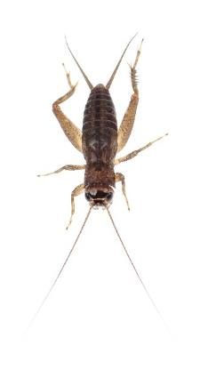
Policy Continued
The policy can include general provisions addressing clutter, sanitation and maintenance, providing a tool to help principals and other administrators get cooperation from staff
The IPM coordinator is responsible for day-to-day interpretation of the IPM policy
The policy guides development of a detailed IPM plan that must comply with the policy

Slide 7
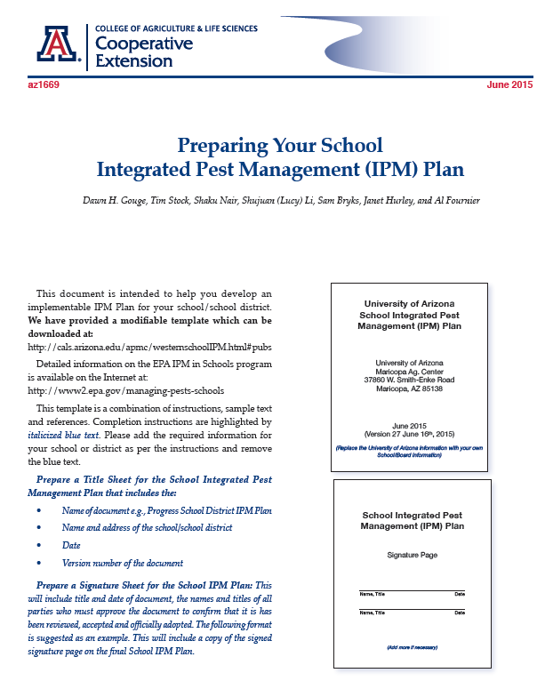
2. IPM Plan Template
The IPM plan is a blueprint detailing how your district or school will manage pests through prevention, monitoring and control methods
A helpful guidance document can be found at http://extension.arizona.edu/sites/extension.arizona.edu/files/pubs/az1669-2015.pdf
The plan is managed by the IPM
Coordinator and eases transitions
when key staff change
Your plan will be a living
(changing) document updated
annually or more often if
needed

Slide 8

Your IPM Plan Should Include:
A copy of your school IPM policy
General information about your district
The name and title of your school IPM coordinator
The names and titles of your school IPM or environmental health committee members
Identification and description of the pests that occur in your district and both chemical
and non-chemical measures
used to manage those pests

Slide 9

Your IPM Plan Should Include:
Description of your school IPM information flow, including a description of the location of your school IPM plan and pest log and application records
A list of pre-approved or preferred pesticide(s) that may be applied on school property when non-chemical measures do not provide
adequate control

Slide 10

General Information
School/District name
Address
City
Zip Code
Telephone number
E-mail address
Website
Prepared by
Date prepared

Slide 11

3. The IPM Coordinator
The district should appoint an IPM Coordinator who will have primary responsibility for ensuring that the IPM program, through the policy and plan, is carried out
The selection and choice of an IPM Coordinator is very important to the success and sustainability of an IPM program - The IPM Coordinator must be trained to:
Oversee staff to ensure implementation
of pest prevention measures
Oversee and coordinate
the activities of the IPM Committee

Slide 12
IPM Coordinator Continued
Manage pest control contractors engaged
in inspecting, monitoring and control of
pest problems
Communicate with principals and district
administration to carry out posting and
notification, recordkeeping and education
on the policy and plan
Ensure compliance with the IPM policy and plan, and maintain the plan to ensure it reflects current conditions and practices

Slide 13
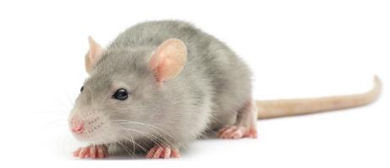
IPM Coordinator Continued
School facility managers, or individuals who have facility management leadership as part of their position responsibilities, are generally good candidates for the IPM coordinator role
In smaller districts without a dedicated facility manager, superintendents may be good candidates to serve as IPM coordinators
Anyone serving in the IPM coordinator role should receive initial training and continuing education

Slide 14
4. The IPM Committee
The IPM committee consists of individuals who have interests/concerns or who are involved in activities directly or significantly related to pest management at the school
Environmental health and safety or related committees may be charged with IPM responsibilities and thus serve as the IPM committee
The IPM coordinator can lead or help organize communication and meetings for the committee

Slide 15
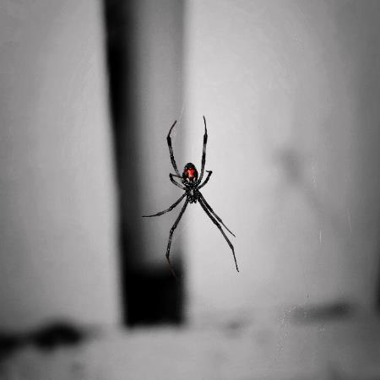
IPM Committee Continued
The committee:
Makes policy recommendations based on current pest issues and evaluates possible IPM solutions
Provides a forum for
communication and
information exchange
among members in an
effort to identify,
encourage and stimulate the use IPM

Slide 16

IPM Committee Continued
Members can include the school nurse, a representative of the food service staff, a teacher representative, a custodian, a representative of
the school athletic
department, a parks
superintendent or
others who utilize
the playing fields,
the pest
management professional, a PTA member, etc.

Slide 17
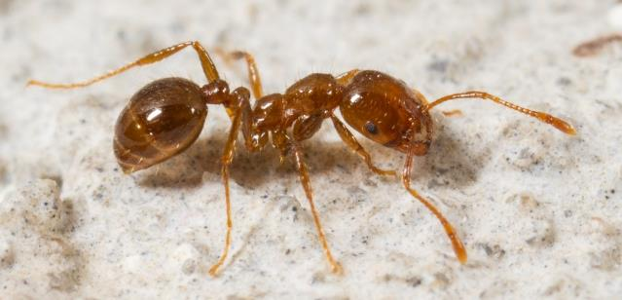
5. Identification and Description of Your School Pest Problem(s)
Pest identification is the on-going dynamic process of reporting and recording the pests in a school
Proper identification and inventory of your pest problems is critical to understanding management needs and selection of the appropriate
non-pesticide and
pesticide response
options

Slide 18
Identification and Description of Your School Pest Problem(s) Continued
Determine the most common pest problem(s)
The following questions should be asked with every pest sighting:
Is it a new or continuing problem?
What specific areas are being impacted?
What time of year does this pest problem occur?
Is the problem related to specific structural deficiencies or sanitation problems?

Slide 19
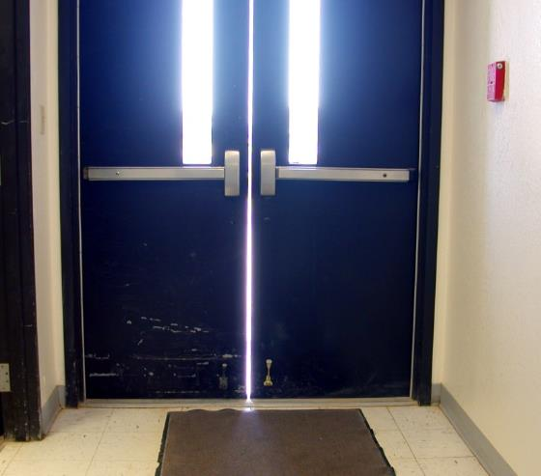
Identification and Description of Your School Pest Problem(s) Continued
The IPM plan should encourage those non-pesticide pest management methods and practices such as good sanitation and pest proofing(caulking, sealing cracks, repairing screens), etc.
Door in need of vertical sweeps – Dawn H. Gouge, University of Arizona

Slide 20
6. Describe Your School IPM Information Flow
Describe how pest problems specific to your school will be reported - Indicate the type of reporting system and the information required
Indicate who in the school will be responsible for responding to sanitation and building repair problems that are identified through inspection reports
Describe how pesticide applications will be documented including what information will be recorded, where and by whom

Slide 21
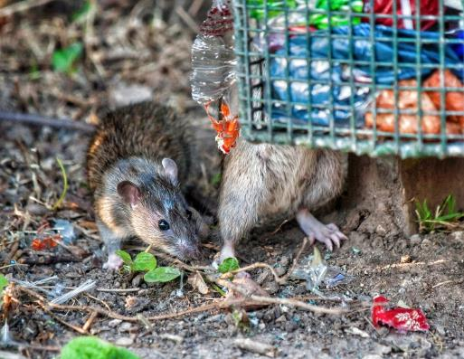
Information Flow Continued
Describe how staff, faculty and parents will be educated, IPM coordinators usually teach and/or coordinate the education effort
Records of pesticide use, non-chemical actions, service reports, pest-sighting logbook, posting, notification and emergency
waivers should be kept at
a central location readily
available when needed

Slide 22
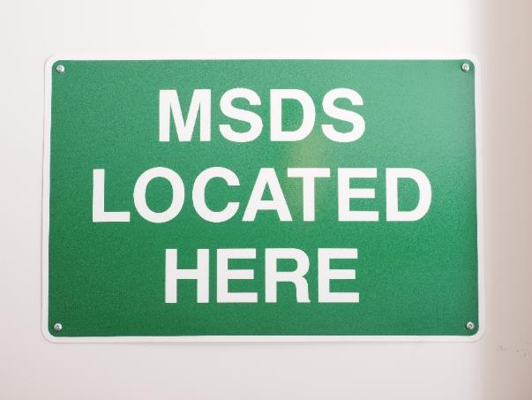

Information Flow Continued
Additional documents should include, Safety Data Sheets (SDSs), pesticide product labels and available manufacturer information about inert ingredients

Slide 23
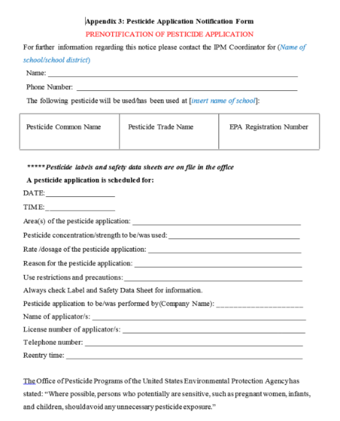
Information Flow Continued - Pesticide Application Notification
All parents and staff should be notified of a pesticide application prior to any pesticide applications in buildings or on grounds, with the exception of exempt applications
State law may or may not require
notification, Facility Managers should
review the legal requirements as he/she
writes this section of the IPM Plan
Parents may be notified each time
a non-exempt pesticide is applied,
or given guidance documents when
students are enrolled

Slide 24
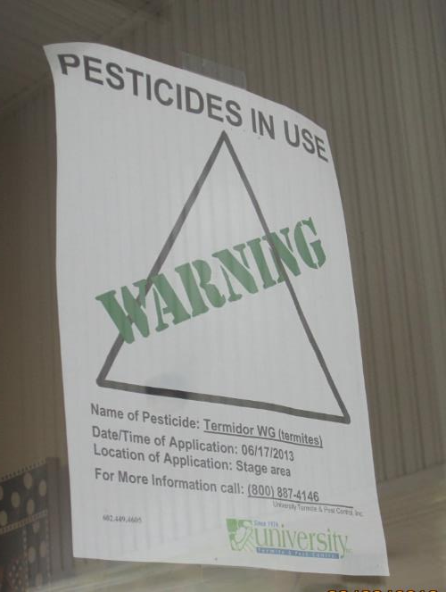
Pesticide Application Notification Continued
Signs should be posted on facility doors and near the site of planned applications at least three business days in advance of pesticide use, or at the time of application if it’s an emergency application
Pesticides in Use sign posted
– Dawn H. Gouge, University of Arizona

Slide 25
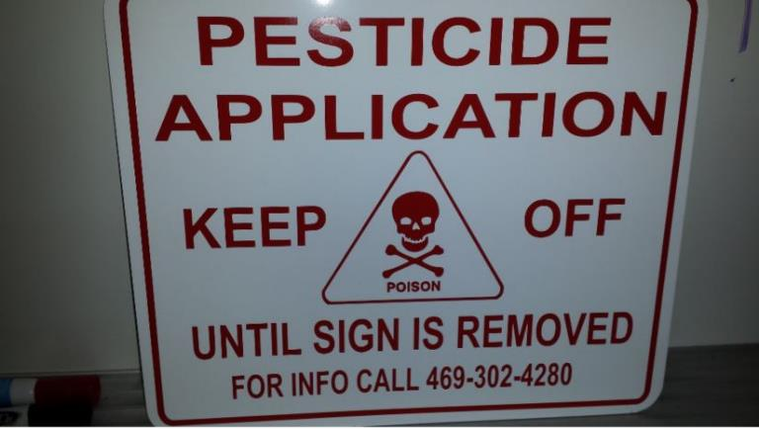
Pesticide Application Notification Continued
Outdoor application areas may be cordoned off and flagged
Signs shall remain in place for 72 hours after a pesticide application, or a longer period of time if specified by the pesticide label, district policy or state law
Pesticide Application sign posted
– Janet Hurley, Texas AgriLife Extension

Slide 26
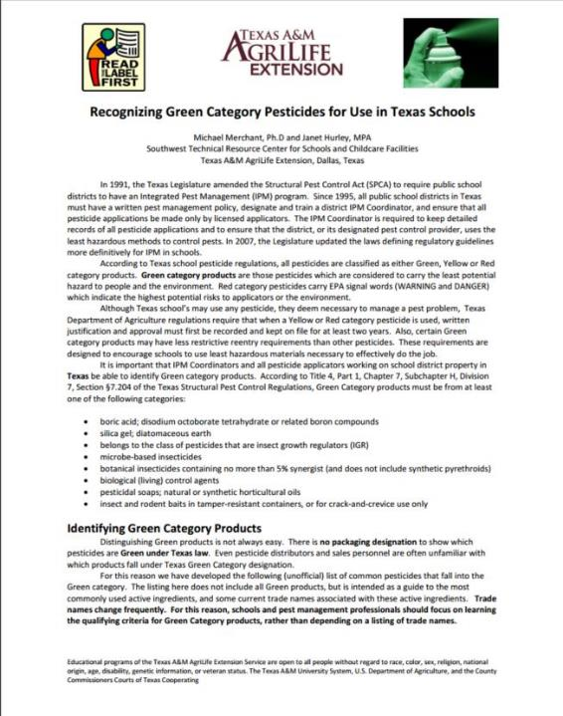
7. Pre-approved or Preferred List of Pesticides
The IPM coordinator and committee should determine which pesticides may be used if non-chemical measures
are not adequate
The objective is to
identify low-risk,
effective options
Green Category pesticide guide for schools in Texas
– Janet Hurley, Texas AgriLife Extension

Slide 27
Secure Formal Approval of an IPM Policy and Plan
It’s helpful to document the formal acceptance and endorsement of the IPM Policy/Plan by:
  The district Environmental Health Committee
  The District superintendent
  The School Board
  The State Department of Education
  or Tribal Council
  PTO/PTA

Slide 28

Maintain the IPM Policy and Plan
At a minimum, the IPM plan should be evaluated annually
  Is the IPM plan working?
  What changes are necessary?
  Has new technology replaced some of the former pest control tactics?
  Have federal, state or
  local rules changed?

Slide 29
Additional Documents: Pest-Sighting Logs
Facility Management should keep records of:
Information on the number of pests or other indicators of pest activity that can verify the need for action
Pest logs are used by facilities managers, kitchen staff, teachers and others to alert IPM managers and the IPM Coordinator of a looming problem
Evaluating pest logs can also assist in identifying trends such as weaknesses in sanitation, cluttering and behavior problems that may need to be addressed
Logs can be part of an existing electronic work-order system

Slide 30
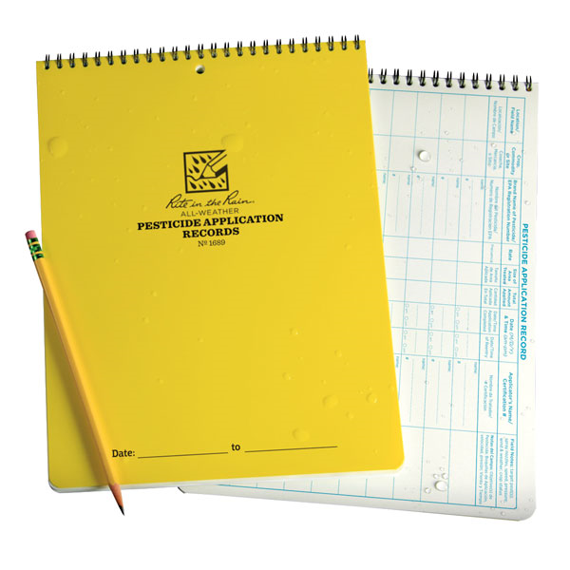
Additional Documents: Pesticide Application Logs
Records of pesticide use shall be maintained on site to meet the requirements of applicable regulatory agencies
The objective is to
create records from
which programs and
practices can be
evaluated in order to
improve the system
and eliminate ineffective
treatments
Pesticide application records – Rite in the Rain, JL DARLING LLC, WA

Slide 31
Check In!
In this lesson you learned
How to describe key elements of an IPM Policy and Plan and their relationship to an IPM Program including:
  Writing IPM policies and plans
  Secure formal approval of an IPM policy and plan
  Implementing and maintaining an IPM policy and plan
Next you will learn about other facility manager responsibilities!

Slide 32
Resources
How to Develop an Integrated Pest Management (IPM) Policy and Plan for Your School District. PENN STATE. Retrieved from http://extension.psu.edu/pests/ipm/schools/facilitiesmanagers/resourcespaschools/faq/ipmschoolplan
National Center for Environmental Health. (2009). Healthy Housing Reference Manual. Retrieved from http://www.cdc.gov/nceh/publications/books/housing/figure_cha04.htm
New Jersey Department of Environmental Protection Pesticide Control Program. How to Do… IPM at School A How to Manual for New Jersey Schools. Retrieved from http://www.state.nj.us/dep/enforcement/pcp/bpc/ipm/How_to_Do_IPM.pdf

