Slide 1
Facility Manager Responsibilities
Lesson 2 of 3
Self-Guided Education Module

Slide 2
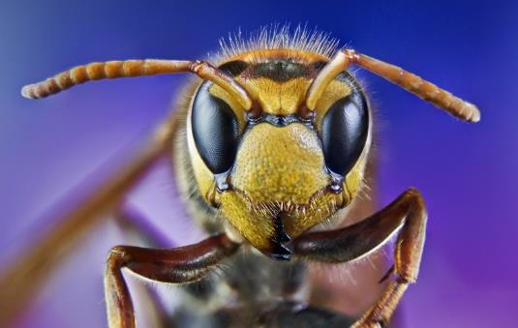
Learning Objectives
Explain the importance of:
Pest entry points
Proper storage procedure
Sanitation, exclusion, inspection and monitoring
Timely work order follow-up
Describe effective ways to educate lead staff about IPM practices and explain the importance of communication between them
Describe methods of tracking facility costs and IPM-related cost savings
Describe how to start an IPM program at your school

Slide 3
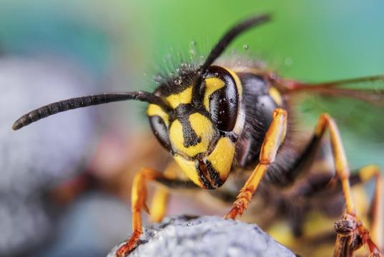
Facility Manager Key Points
Previous lesson:
Lead implementation of IPM policy and plan
Oversee pest sighting and pesticide application logs
Supervise contractors
Program evaluation and adjustment
This lesson:
Pest entry points
Proper storage procedures
Sanitation
Timely work order follow-up

Slide 4
Learn to Recognize Pest Entry Points
Any sign of a pest should trigger a search for possible points of entry
Broken/torn wire-mesh screen covers of windows
Dry P-traps in drains
Worn out door-sweeps/weather stripping
Hitchhikers in deliveries
Check for signs of pest presence (droppings, pests, webbing or holes in boxes)

Slide 5
Proper Storage Procedures
Proper storage of supplies/materials can prevent pest-conducive conditions
To permit proper cleaning and inspection:
Avoid storing boxes and items up against the walls
Leave 18-inch gaps under the lowest shelf so the floor can be cleaned underneath
Avoid using wooden pallets, milk crates, etc. to store things on

Slide 6
Sanitation in Storage Areas
Storage areas are pest-vulnerable areas, often the source of infestations
Good sanitation practices:
Make sure corners are completely clean
After use, promptly clean mops and mop buckets; dry mop buckets and hang mops vertically on rack above floor drain, with mop head down
Clean trash cans regularly, use quality plastic liners in trash cans to reduce rips and use secure lids
Keep areas clean and as dry as possible, and remove debris

Slide 7
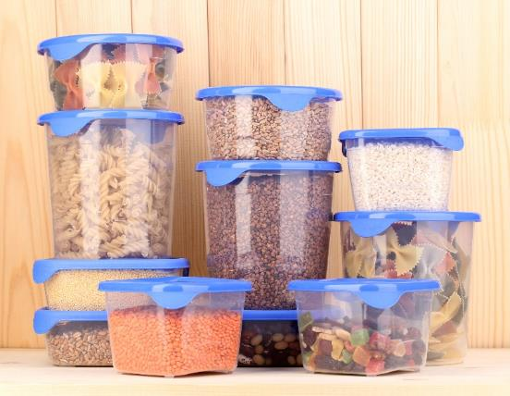
Pest Exclusion Strategies/Tactics
Avoid propping doors open
Close gaps that provide access to pests, mice can squeeze through a gap the size of a dime, rats need nickel-sized gaps
Avoid storing cardboard – provides ideal harborage for cockroaches
Avoid clutter
Keep food and water in sealed containers

Slide 8
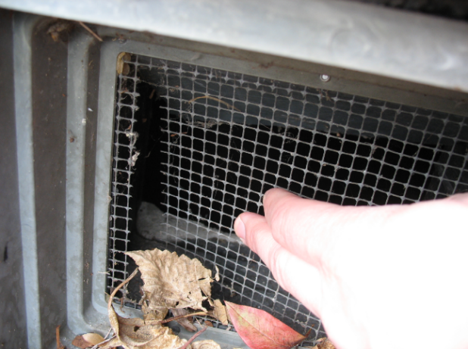
Pest Exclusion Tools
Replace worn door-sweeps - Effective sweeps can cut pest complaints by 65%!
Seal or fill gaps, cracks and crevices with suitable sealants
Cover windows and vents with wire mesh and replace with new wire when broken
Torn wire mesh on a vent – Jerry Jochim, Monroe County Community School Corporation

Slide 9
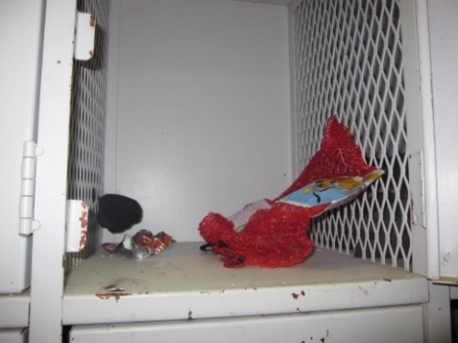
Key Elements of Inspection and Monitoring
What to look for:
Pests
Signs of pests
Pest-conducive conditions
Mouse dropping on a spoon
Dawn H. Gouge, University of Arizona
Wrappers and decomposing food in athletic locker
Notes:
What to look for:
Pests
Signs of pests
Pest conducive conditions - pest opportunities inviting pests for food, water, and harborage.

Slide 10
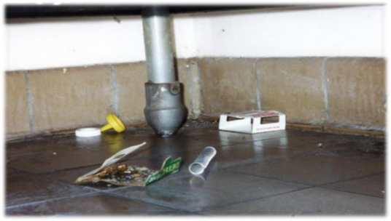
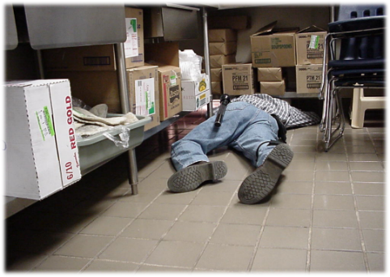
2.
Key Elements of Inspection and Monitoring
Where to look:
Dark corners
Hard-to-reach areas
Undisturbed places/under and behind stationary items
Warm or wet places
Food storage and preparation areas
Waste collection containers/areas
Suspended ceilings
Regular, careful inspection helps to keep pests and pest-conducive conditions under control rapidly and efficiently – Dawn H. Gouge, University of Arizona

Slide 11
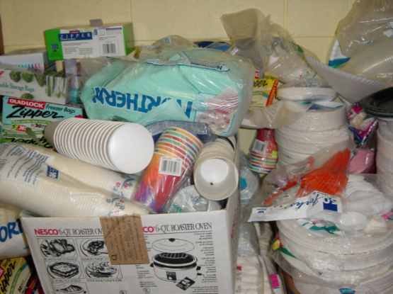
2.
Key Elements of Inspection and Monitoring
Where to look:
Warm walls with penetrations
Compressor motor voids in equipment
Unsealed floors and floor to wall junctures
Undisturbed containers
Cardboard boxes
Clutter
Booster club storage – Dawn H. Gouge, University of Arizona

Slide 12
2.
Key Elements of Inspection and Monitoring
Tools:
Monitoring traps
Bright flashlight
Hand lens
Marc Lame identifying an insect – Jerry Jochim, Monroe County Community School Corporation

Slide 13
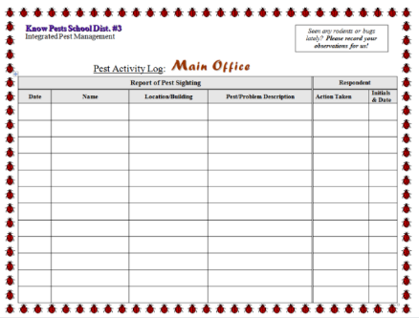
3.
Key Elements of Inspection and Monitoring
Frequency: Along with daily duties, communicate in writing to IPM Coordinators and others about pest issues and document your actions
Record date, time, location and:
Pests
Signs of pests
Pest-conducive conditions
If you do not have a work order system, develop pest sighting logs – Dawn H. Gouge, University of Arizona

Slide 14
Facility Manager Checklist
Facility managers have many responsibilities
A checklist can help make sure duties are completed in a timely manner

Slide 15
Example Inspection Checklist
8.
1.BUILDING MAINTENANCE SUPPLIES | Yes | No | N/A
1a. Developed appropriate procedures and stocked supplies for spill control
1b. Reviewed supply labels
1c. Ensured that air from chemical and trash storage areas vents to the outdoors
1d. Stored chemical products and supplies in sealed, clearly labeled containers
1e. Researched and selected the safest products available
1f. Ensured that supplies are being used according to manufacturers’ instructions
1g. Ensured that chemicals, chemical-containing wastes, and containers are disposed of according to manufacturers’ instructions
1h. Substituted less- or non-hazardous materials (where possible)
1i. Scheduled work involving odorous or hazardous chemicals for periods when the school is unoccupied
1j. Ventilated affected areas during and after the use of odorous or hazardous chemicals

Slide 16
Example Inspection Checklist
8.
2. GROUNDS MAINTENANCE SUPPLIES | Yes | No | N/A
2a. Stored grounds maintenance supplies in appropriate area(s)
2b. Ensured that supplies are used and stored according to manufacturers’ instructions
2c. Established and followed procedures to minimize exposure to fumes from supplies
2d. Reviewed and followed manufacturers’ guidelines for maintenance
2e. Replaced portable gas cans with low-emission cans
2f. Stored chemical products and supplies in sealed, clearly-labeled containers
2g. Ensured that chemicals, chemical-containing wastes, and containers are disposed of according to manufacturers’ instructions

Slide 17
Example Inspection Checklist
3. DUST CONTROL | Yes | No | N/A
3a. Installed and maintained barrier mats for entrances
3b. Used high efficiency vacuum bags
3c. Used proper dusting techniques
3d. Wrapped feather dusters with a dust cloth
3e. Cleaned air return grilles and air supply vents
4. FLOOR CLEANING | Yes | No | N/A
4a. Established and followed schedule for vacuuming and mopping floors
4b. Cleaned spills on floors promptly
4c. Performed restorative maintenance (as necessary)
5. DRAIN TRAPS | Yes | No | N/A
5a. Poured water down floor drains once per week (about 1 quart of water)
5b. Ran water in sinks at least once per week (about 2 cups of water)
5c. Flushed toilets once each week (if not used regularly)

Slide 18
Example Inspection Checklist
6. MOISTURE, LEAKS, AND SPILLS | Yes | No | N/A
6a. Checked for moldy odors
6b. Inspected ceiling tiles, floors, and walls for leaks or discoloration (may indicate periodic leaks)
6c. Checked areas where moisture is commonly generated (e.g., kitchens, locker rooms, and bathrooms)
6d. Checked that windows, windowsills, and window frames are free of condensate
6e. Checked that indoor surfaces of exterior walls and cold water pipes are free of condensate
6f. Ensured the following areas are free from signs of leaks and water damage:
Indoor areas near known roof or wall leaks
Walls around leaky or broken windows
Floors and ceilings under plumbing
Duct interiors near humidifiers, cooling coils, and outdoor air intakes

Slide 19
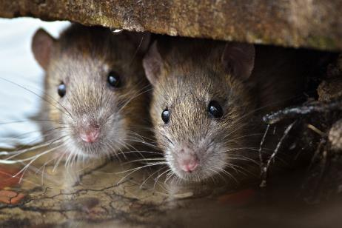
Example Inspection Checklist
7. COMBUSTION APPLIANCES | Yes | No | N/A
7a. Checked for odors from combustion appliances
7b. Checked appliances for back drafting (using chemical smoke)
7c. Inspected exhaust components for leaks, disconnections, or deterioration
7d. Inspected flue components for corrosion and soot
8. PEST CONTROL | Yes | No | N/A
8a. Completed the Integrated Pest Management Checklist

Slide 20
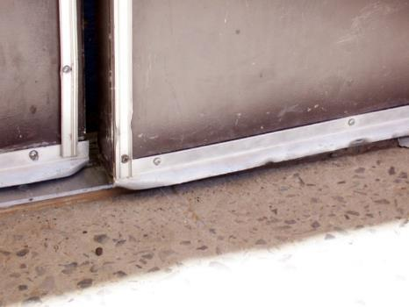
Timely Work Order Follow-Up
Enforce timely responses to priority pest problem related to building repairs
Often a small fix can avoid a big problem Repeated reporting of the same defect or damage is a waste of staff time
When ever possible centralize reports and track resolution times and costs
Use existing work-order systems where available
Ensure doors close completely to keep pests out – Dawn H. Gouge, University of Arizona

Slide 21
Effective Ways to Educate Staff
Staff, students, contractors and parents should be educated about potential school pest problems and IPM policies
Parents should be informed annually about the policy
Staff should receive training on their role in pest management
Communications to improve pest awareness are of great benefit to the community

Slide 22
Effective Ways to Educate Lead Staff
Training is one of the most essential elements of the IPM plan
Identify the individual(s) providing the training and who will receive the training
If students and staff are shown the connection between food, water, clutter and pests, they are more likely to participate positively

Slide 23
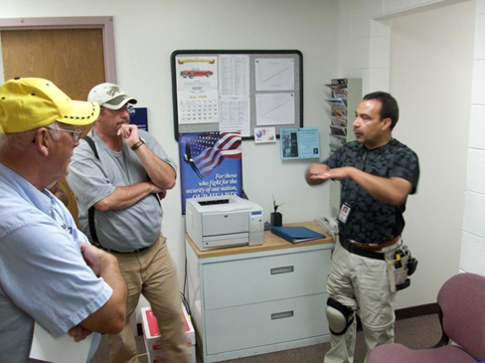
Effective communication
Get to know your lead front-line staff and contractors
Communicate with them, show interest in their work, ask questions, help them to help you
Let them know what pests you observe, when and under what situations (e.g., cockroaches were noticed after a new supply of art material in cardboard boxes)
Respond to their recommendations and direction
Ricardo Zubiate teaching Salt Lake City School District Staff - Marc Lame, Indiana University

Slide 24
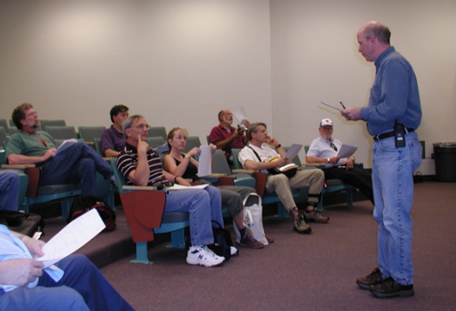
2.
Effective communication
Learn more about IPM from experts
Ask questions
Consider discussing IPM and its advantages with your colleagues, principal and parents of students at suitable venues such as a PTA meeting or faculty meeting
Implementing IPM is easier with group support
Set an example, demonstrate your success with IPM
Dr. Robert Corrigan, RMC Pest Management Consulting teaching - Mary Grisier, EPA Region 9

Slide 25
Methods of Tracking Facility Costs and IPM-Related Cost Savings
The IPM Cost Calculator is a free online tool that allows schools to estimate their pest risks using geographic location, current pest problems and facility conditions
http://schoolipm.tamu.edu/forms/ipm-cost-calculator/

Slide 26
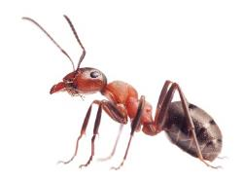
Methods of Tracking Facility Costs and IPM-Related Cost Savings
13.
The IPM Cost Calculator
Using information about your location, presence of pests and the condition of your school, the IPM Cost Calculator estimates overall pest risk for your school
The Calculator also allows you to create your own budget and see how improving certain features will affect your overall pest risk

Slide 27
How to start an IPM program at your school!
Leverage support from your district administration
Discuss IPM with your school staff (nurse, food service managers, lead custodian, pest manager, and principals) and environmental health committee
Evaluate your current pest management methods against what you have learned

Slide 28
How to start an IPM program at your school!
Explain the benefits of IPM and why it is important for schools
Discuss how to start an IPM program, who might be interested in being part of the planning committee and who might serve as the district IPM Coordinator

Slide 29
How to start an IPM program at your school!
Identify state, Extension service and/or local resources; they may be able to help you with setting up your IPM program State services may provide pest identification, run educational events, facilitate the transition from calendar based programs to IPM, evaluate pest management options, etc.

Slide 30
How to start an IPM program at your school!
Coordinate an initial IPM inspection and site evaluation There are a number of readily available evaluation guides that will help you The more inspections you do the better you become at identifying problems and implementing effective solutions
Inspection of doors which may need door sweeps – Shaku Nair, University of Arizona

Slide 31
How to start an IPM program at your school!
Use inspections as fact-finding exercises as well as educational opportunities for the staff Prioritize remediation actions to focus on those that will make the biggest difference quickly
You may introduce the idea of pest sighting logs, a monitoring program and pest management record keeping system as you conduct your inspection

Slide 32
Check In!
In this lesson you learned
The importance of pest entry points, proper storage procedure, sanitation, timely work order follow-up
Effective ways to educate lead staff about IPM practices
Methods of tracking facility costs and IPM-related cost savings
How to start an IPM program at your school
Next you will learn about key exterior and landscape pest groups!

Slide 33
Resources
Bayer Environmental Science. (2010). Ant Identification Guide. http://www.backedbybayer.com/system/product_guide/asset_file/3/Ant-ID-Guide.pdf
Green, T.A., D.H. Gouge, J.A. Hurley, M.L. Lame and M.D. Snyder. (2014). School IPM 2020: A Strategic Plan for Integrated Pest Management in Schools in the United States.
How to Develop an Integrated Pest Management (IPM) Policy and Plan for Your School District. PENN STATE. Retrieved from http://extension.psu.edu/pests/ipm/schools/facilitiesmanagers/resourcespaschools/faq/ipmschoolplan
How to Do… IPM at School A How to Manual for New Jersey schools. New Jersey Department of Environmental Protection Pesticide Control Program http://www.state.nj.us/dep/enforcement/pcp/bpc/ipm/How_to_Do_IPM.pdf
National Center for Environmental Health. (2009). Healthy Housing Reference Manual. Retrieved from http://www.cdc.gov/nceh/publications/books/housing/figure_cha04.htm
New Jersey Department of Environmental Protection Pesticide Control Program. How to Do… IPM at School A How to Manual for New Jersey Schools. Retrieved from http://www.state.nj.us/dep/enforcement/pcp/bpc/ipm/How_to_Do_IPM.pdf

