Slide 1

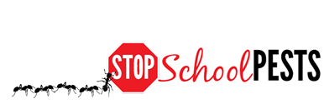
IPM FOR food service staff
Lesson 1 of 2
In-Person Education Module

Slide 2
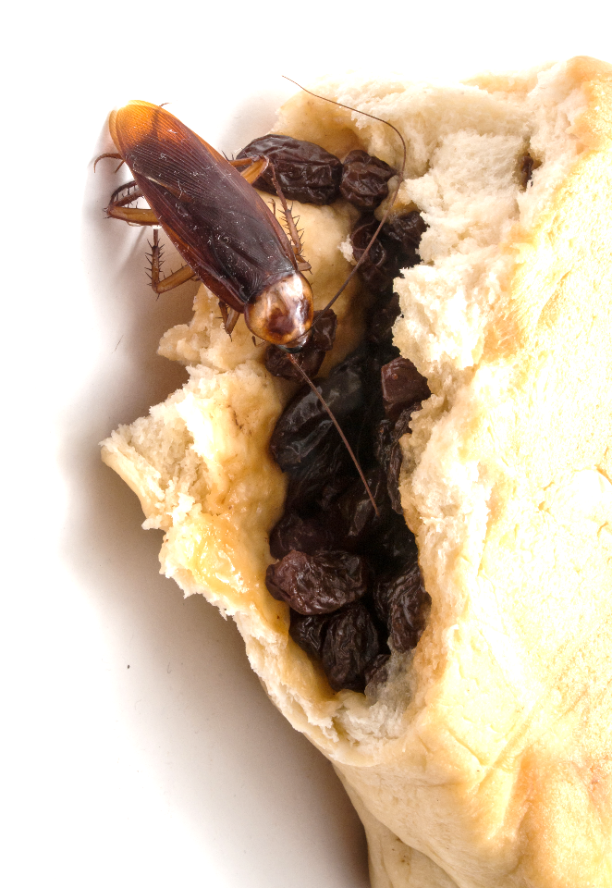
Learning Objectives
Identify common pests
in kitchens and pantries, including:
  Ants
  Cockroaches
  Flies
  Rodents

Slide 3
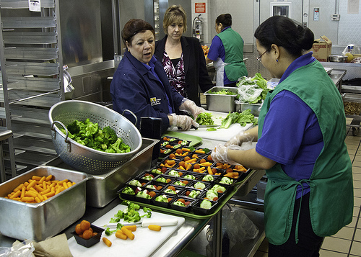
1.
Food Service Staff and IPM
(Integrated Pest Management)
Food service staff are among the most important people in a school IPM program
Because they deal with FOOD!
Food service professionals at Arlington Public Schools discuss the day’s lunch
- Bob Nichols, USDA

Slide 4
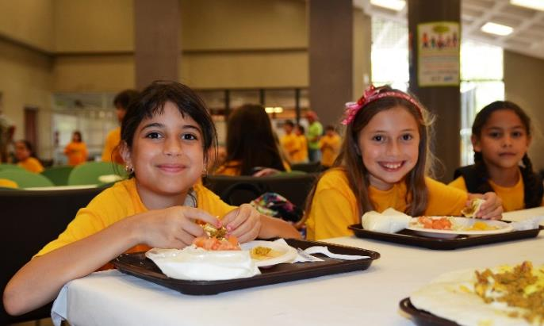
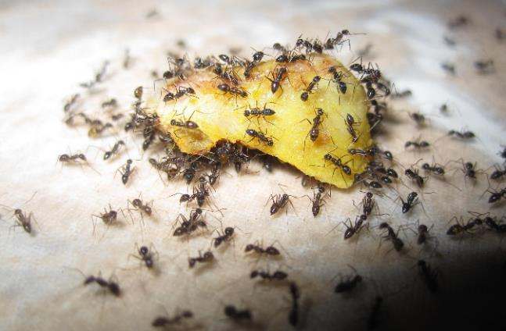
1.
Why Pests?
Food is a necessity for people and pests
Food service areas provide:
  Food
  Water
  Shelter
School children enjoying their lunch
- USDA
Ants enjoying their lunch
- Zainichi Gaikokujin

Slide 5

1.
Food Safety
Food safety is a top priority for food service staff
Food can become unsafe
Three hazard groups
  Biological
  Chemical
  Physical

Slide 6

1.
Food Safety - Biological Risks
Bacteria, viruses, fungal or parasitic pathogens
May be transferred to food from either the outside or the inside of a pest body, and
contaminate food

Slide 7
1.
Food Safety - Biological Risks
Biological pathogens can be introduced in many ways, some do not involve pest organisms at all
But effective pest
management helps
reduce risk

Slide 8
1.
Food Safety - Chemical Risks
If food is contaminated with cleaning products, sanitizers, disinfectants or machine lubricants
Never bring pesticides from home
Pesticides pose hazards to humans
if used inappropriately around food
Many antimicrobial products are
pesticides and important tools
in food preparation areas

Slide 9
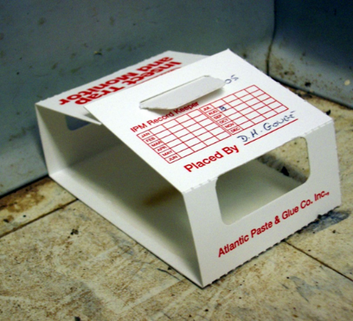
1.
Food Safety - Physical Risks
Physical hazards may be organic (e.g., bones) or non-organic (e.g., glass) objects
Never place insect traps inside kitchen cooking equipment
Lethal and live rodent traps should be housed securely in rodent stations
Insect monitoring traps should
be in out-of-the way locations
Sticky insect monitoring trap
– Dawn H. Gouge, University of Arizona

Slide 10
What is IPM?
IPM = Integrated (Intelligent) Pest Management
A sensible, environmentally friendly, and effective way to solve pest problems safely around food
For more information on IPM, refer to IPM resource sites
(https://www.epa.gov/managing-pests-schools)

Slide 11
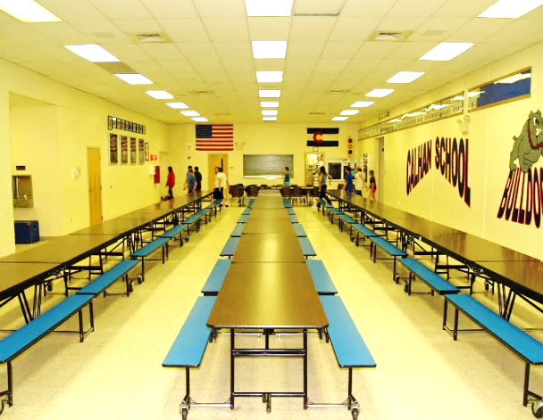
Food Service Staff and IPM
Involvement of food service staff in a school IPM program is important because:
Food service areas are the
most prone to pest activity
  They receive regular
  deliveries
  May provide pests with
  food, water, warmth
  and shelter
Procedures in food service areas
influence the whole school
School cafeteria
- David Shankbone

Slide 12
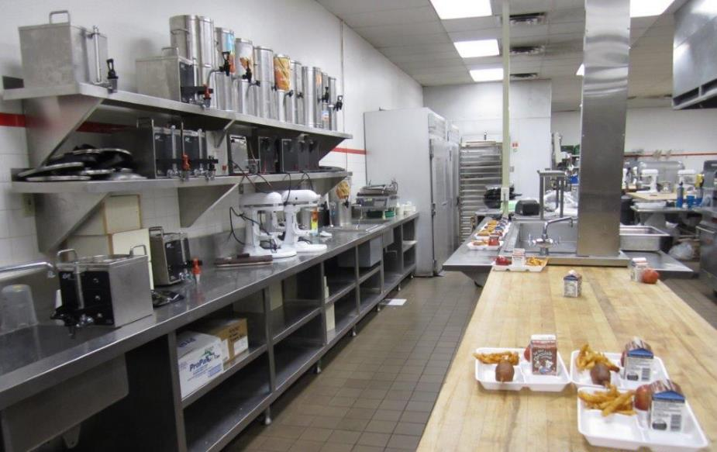
Food Service Staff and IPM
Clean and well-maintained food service areas are essential for the health and well-being of all
Well maintained food service area at High School
- Dawn H. Gouge, University of Arizona

Slide 13
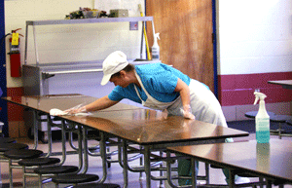
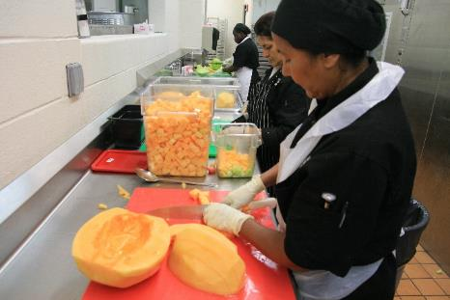
1.
IPM is Not an Additional Item on Your To-Do List
Food service staff have very demanding jobs involving different tasks
IPM does not add to your responsibilities
IPM involves making slight changes in your daily activities
IPM is everyone’s job
Cleaning up after mealtime
- National Education Association
School lunches require huge quantities of cut fruit
- DC Central Kitchen

Slide 14
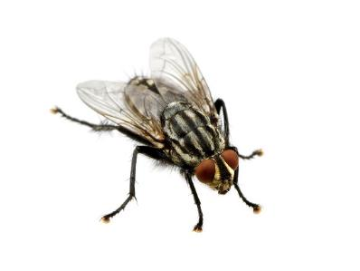
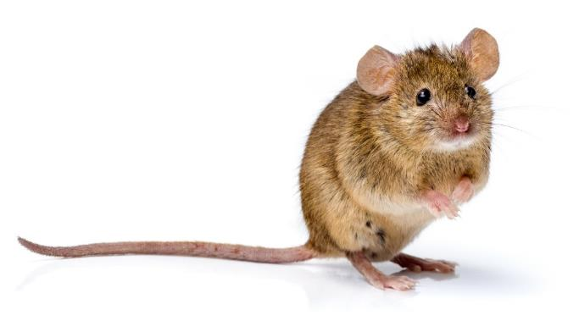
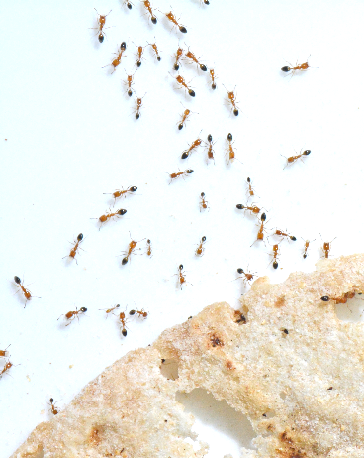
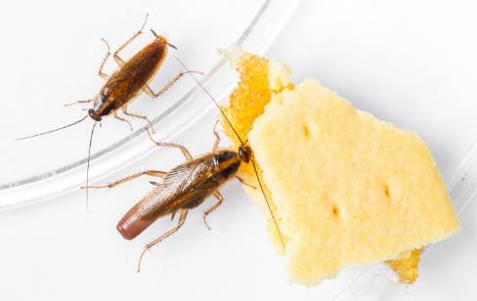
Pests in Food Service Areas
Being aware of common pests is the first step Problematic pests in food service areas include:
Ants
Cockroaches
Flies
Rodents

Slide 15
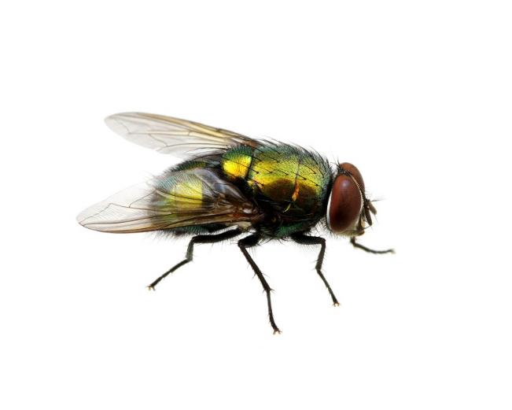
Pests in Food Service Areas
There should be a zero tolerance for ants, cockroaches, flies and rodents
If pests touch a food contact surface, the surface must be cleaned and sanitized
  Clean the surface of dirt and debris
  Rinse the surface with clean water
  Sanitize the surface
  Allow the surface to air-dry

Slide 16

Pests in Food Service Areas
Sanitizers must be used correctly
to be effective and safe
Read product directions carefully
  Water is the correct temperature
  Use test kits to ensure correct strength
  Items being sanitized spend the correct amount of time in the sanitizer
Directions and dilutions vary between different products

Slide 17
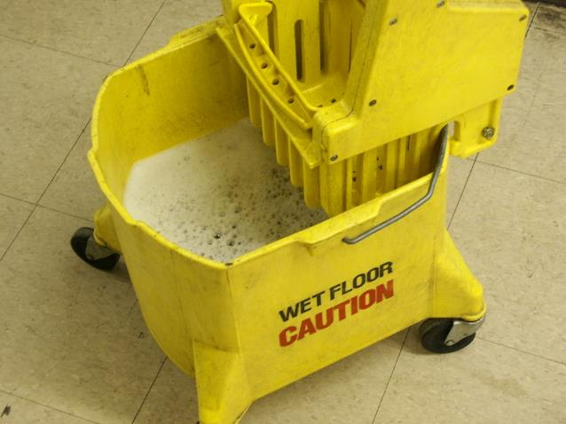
Pests in Food Service Areas
Store cleaning chemicals away from food, in designated areas
Always empty mop water and other dirty liquids into the designated floor drains

Slide 18
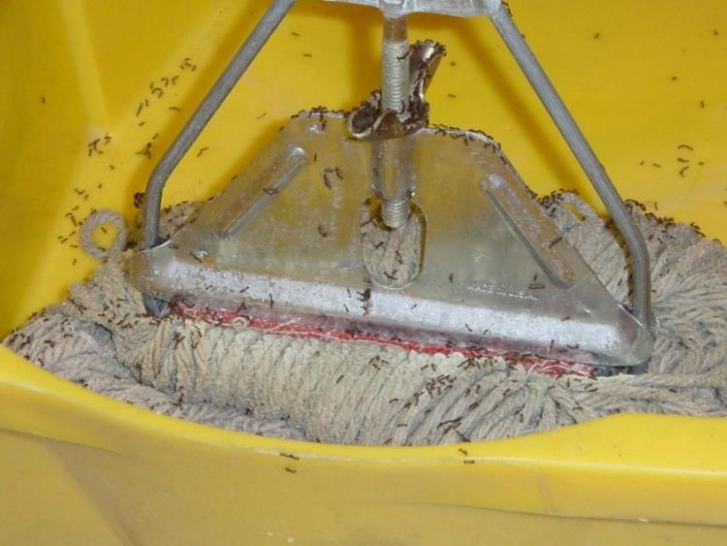
Pests in Food Service Areas: Ants
Ants can invade (trail to forage on food) and/or infest (set up home within buildings or food items) and contaminate food materials, bite, and/or sting
Ants invade a mop bucket after mopped up pop - Jerry Jochim, Monroe County Community School Corporation

Slide 19
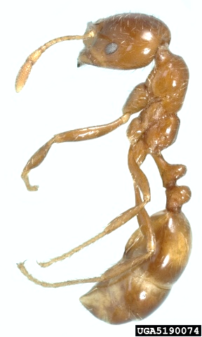
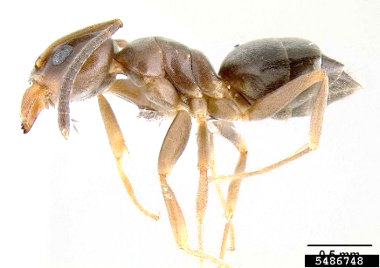
Pests in Food Service Areas: Ants, but what kind?
A good ID feature is the number of “nodes”
One node
Two nodes
Odorous house ant
- Eli Sarnat, Antkey, USDA APHIS ITP, Bugwood.org
Black imported fire ant
- Natasha Wright, Cook's Pest Control, Bugwood.org
One-node ants
  Argentine ant
  Crazy ant
  Tawney crazy ant
  Odorous house ant
  Rover ant
Two-node ants
  Acrobat ant
  Fire ant
  Pavement ant
  Pharaoh ant
  Thief ant

Slide 20
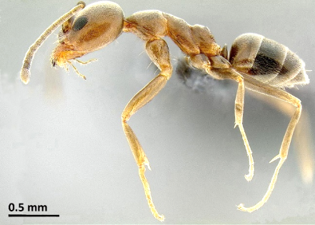
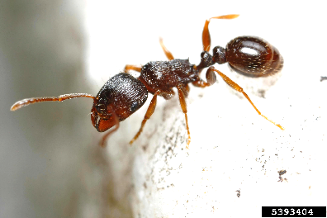
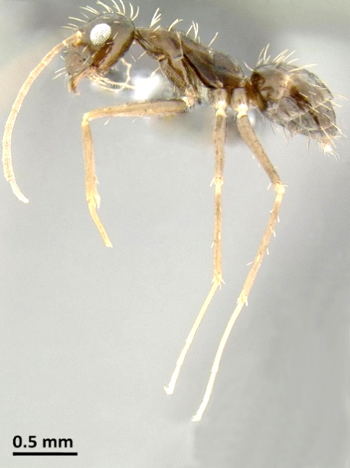
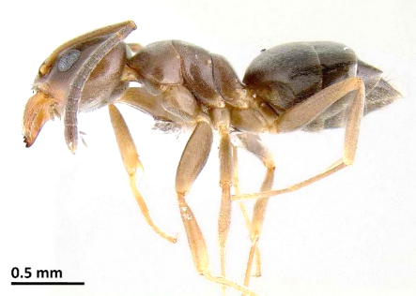
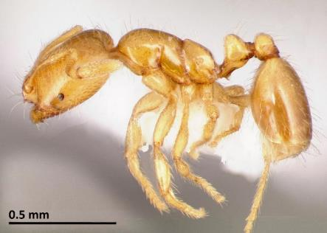
Pests in Food Service Areas: Ants
Ants differ in size, appearance, habits and food preferences
Pavement ant - Joseph Berger, Bugwood.org
Argentine ant - Eli Sarnat, Antkey, USDA APHIS ITP, Bugwood.org
Crazy ant -
Eli Sarnat, PIAkey: Invasive Ants of the Pacific Islands, USDA APHIS ITP, Bugwood.org
Odorous house ant - Eli Sarnat, Antkey, USDA APHIS ITP, Bugwood.org
Thief ant
- AntWeb.org

Slide 21
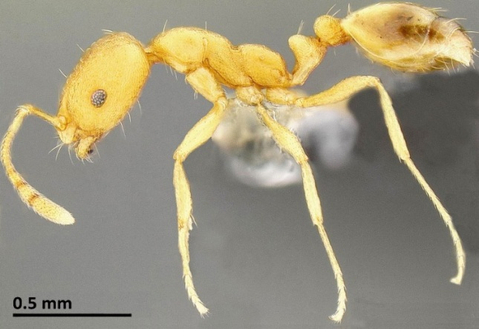
Pests in Food Service Areas: Ants
Pharaoh ant (infester)
  Tiny, inconspicuous, light-colored ant, can enter closed containers and screw-top jars
  Attracted to sweets, but will eat almost anything
  Is a public health hazard because more than a dozen pathogenic bacteria are
  associated with this species
Pharaoh ant
- Eli Sarnat, PIAkey: Invasive Ants of the Pacific Islands, USDA APHIS ITP, Bugwood.org

Slide 22
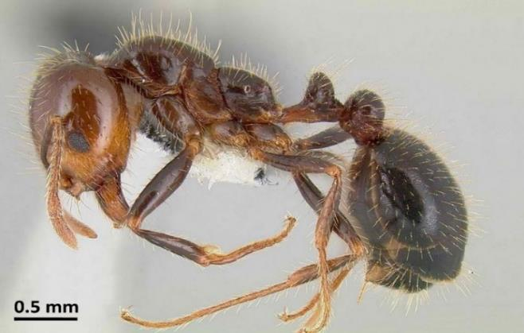
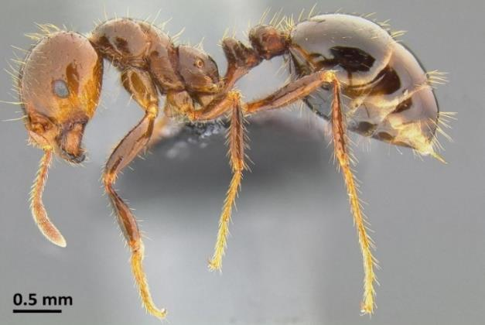
Pests in Food Service Areas: Ants
Eli Sarnat, PIAkey: Invasive Ants of the Pacific Islands, USDA APHIS ITP, Bugwood.org
Fire ants (stinging invader)
Native or introduced species may be encountered
Report fire ants to your school IPM Coordinator
Southern fire ant
Red imported fire ant

Slide 23
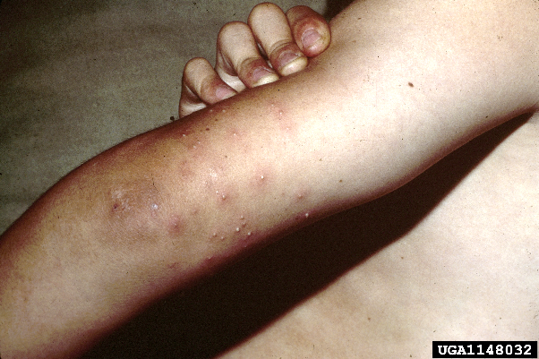
Pests in Food Service Areas: Ants
Fire ants pose a serious risk to students
and school personnel
  Generally outdoor ants,
  but invade structures to
  forage on food, water or
  to outside temperatures
  Will aggressively bite
  and sting on disturbance
Fire ant stings can result in raised pustules and other allergic reactions - USDA APHIS PPQ Imported Fire Ant Station, USDA APHIS PPQ, Bugwood.org

Slide 24
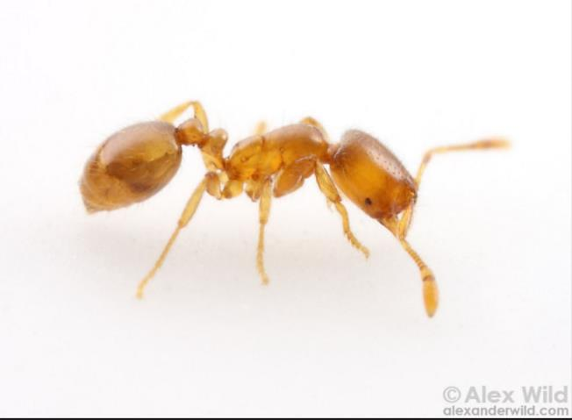
Pests in Food Service Areas: Ants
Thief ants
  Small and often go unnoticed
  Generally outdoor ants,
  but invade to
  forage on food
  They contaminate food
  and if ingested in large
  numbers are poisonous
Thief ant – Alex Wild, alexanderwild.com

Slide 25
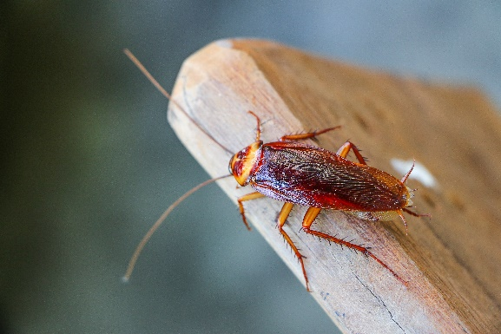
Pests in Food Service Areas: Cockroaches
  Cockroaches are regarded as a sign of unsanitary conditions
  However, occasional cockroaches can be found even in the cleanest kitchens
  Even a single cockroach should be taken seriously
  Have monitoring traps
  where new deliveries
  are stored

Slide 26
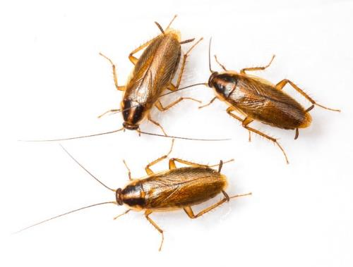
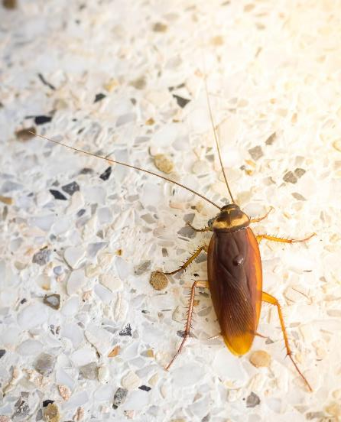
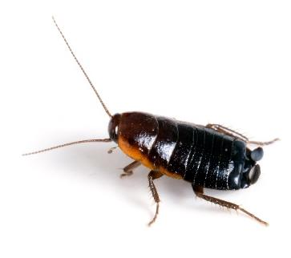
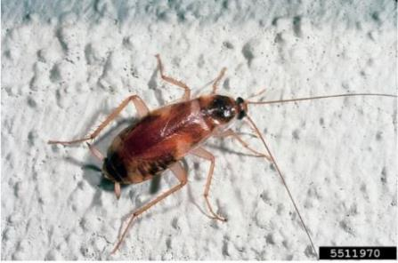
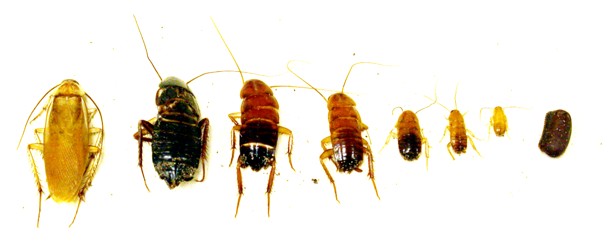
Pests in Food Service Areas: Cockroaches
American cockroach
German cockroaches
Oriental cockroach
Brownbanded cockroach - Kansas Department of Agriculture, Bugwood.org
Turkestan cockroach –
Dawn H. Gouge, University of Arizona
Notes:
National Center for Environmental Health, 2009

Slide 27
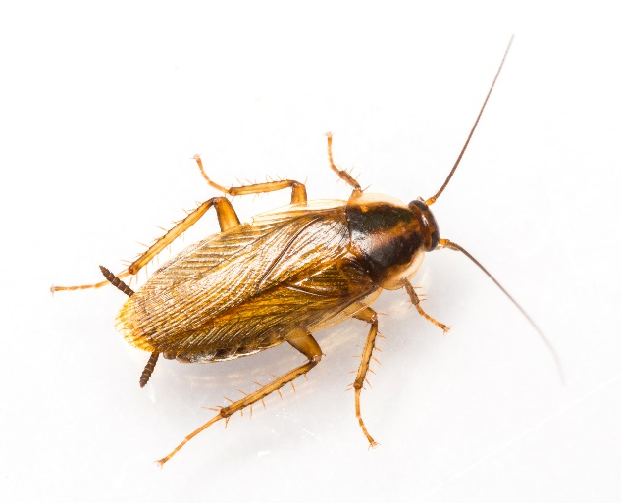
Pests in Food Service Areas: German Cockroaches
  German cockroaches
  Most problematic indoor species
  Produce allergens that can trigger asthma symptoms
  Carry and spread
  disease-causing
  microbes on and in
  their bodies
German cockroach

Slide 28
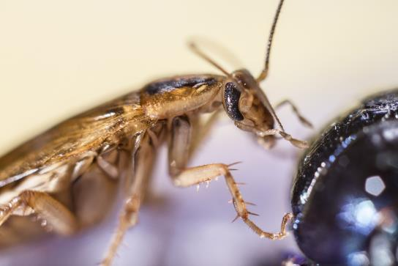
Pests in Food Service Areas: German Cockroaches
  Prefer warm and wet environments
  They are an “indoor only” infester
  Often introduced in deliveries and thrives in cardboard
  Monitor closely using insect
  monitoring traps in pantries
  and food preparation areas
  Cockroach poop looks like
  grains of pepper
German cockroach

Slide 29
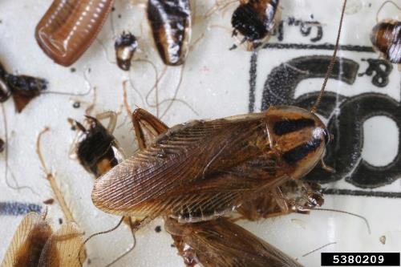
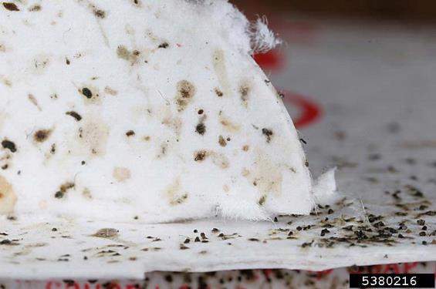
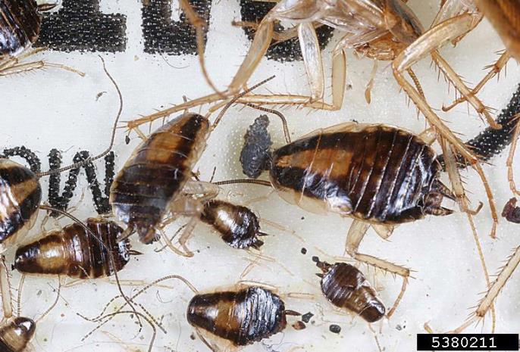
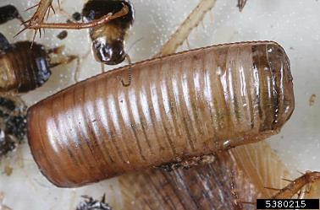
Pests in Food Service Areas: German Cockroaches
Gary Alpert, Harvard University, Bugwood.org
German cockroach poop
German cockroach adult
German cockroach egg case
German cockroach immatures on a sticky monitoring trap

Slide 30
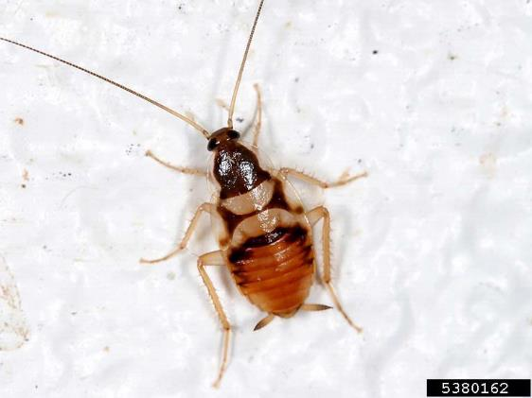
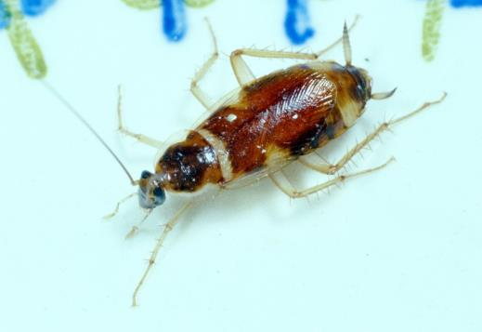
Pests in Food Service Areas:
Brownbanded Cockroaches
  Brownbanded cockroaches are most often found in drier classroom, office or storage areas
  They are an “indoor only” species
Brown-banded cockroach –
Clemson University - USDA Cooperative Extension Slide Series, Bugwood.org
Brown-banded cockroach –
Gary Alpert, Harvard University, Bugwood.org

Slide 31
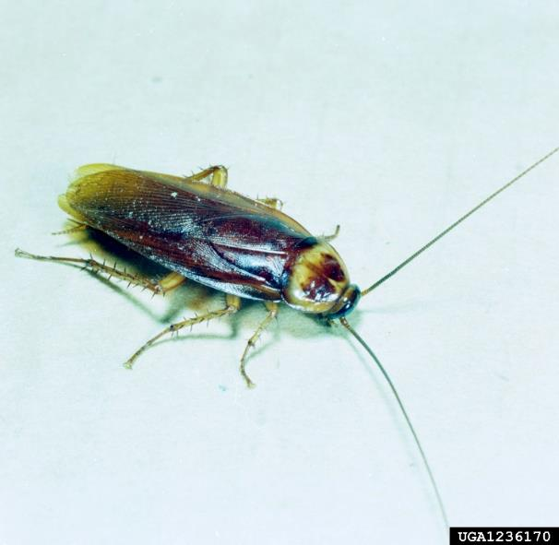
Pests in Food Service Areas: American Cockroaches
  American cockroaches are an “outdoor” species generally found near moisture
  Drawn indoors by extreme temperatures or food sources
  Strong greasy odor
  Travel readily between
  garbage and clean areas
American cockroach,
Clemson University - USDA Cooperative Extension Slide Series, Bugwood.org

Slide 32
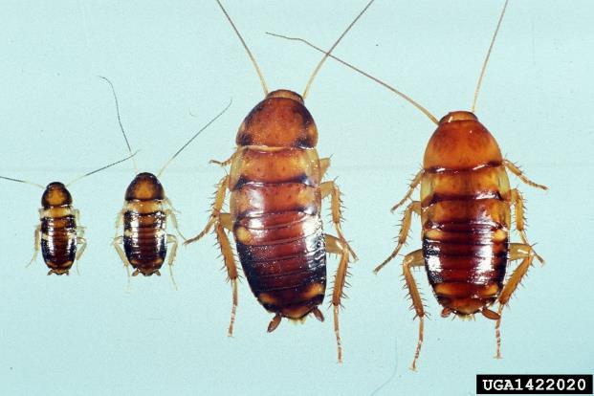
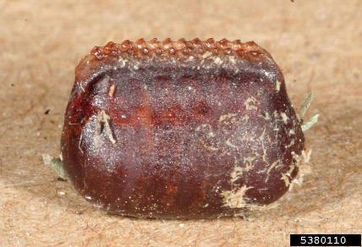
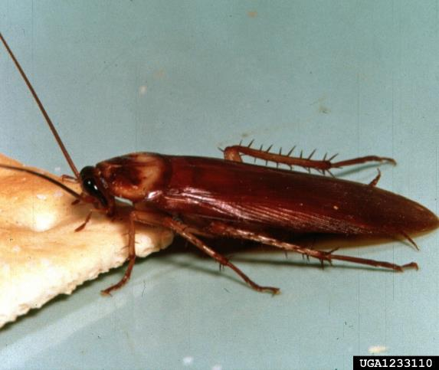
Pests in Food Service Areas: American Cockroaches
American cockroach egg case - Gary Alpert, Harvard University, Bugwood.org
American cockroach nymphs - Daniel R. Suiter, University of Georgia, Bugwood.org
American cockroach adult -
Clemson University, USDA Cooperative Extension Slide Series, Bugwood.org

Slide 33
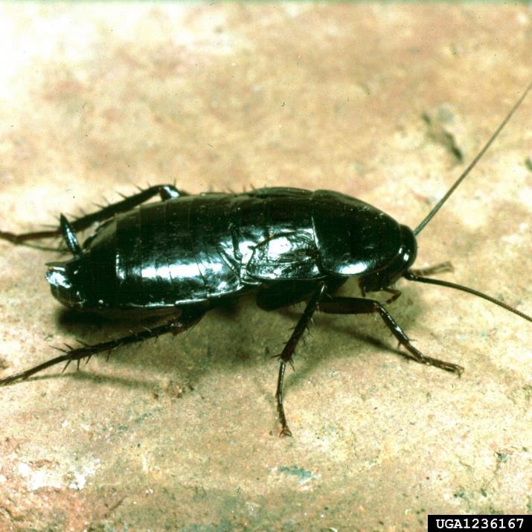
Pests in Food Service Areas: Oriental Cockroaches
  Oriental cockroaches are an “outdoor” species generally found near
  moisture, and
  high organic matter -
  sewers, basements,
  and mulch
Oriental cockroach -
Clemson University, USDA Cooperative Extension Slide Series, Bugwood.org

Slide 34
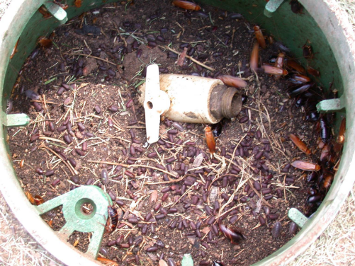
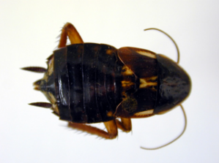

Pests in Food Service Areas: Turkestan Cockroaches
  Turkestan cockroaches are an “outdoor” species generally found near moisture,
  Males fly and are drawn to buildings by external lighting
Dawn H. Gouge, University of Arizona
Turkestan cockroach,
female
Turkestan cockroach,
male
Turkestan cockroaches in an irrigation box

Slide 35

Pests in Food Service Areas: Cockroaches
  Once indoors, many cockroaches can thrive in food service areas
  Many carry disease-causing pathogens
American cockroaches love human food, but will survive on many things we think of as waste just as readily – Dawn H. Gouge, University of Arizona

Slide 36

Pests in Food Service Areas: Flies
“Filth” flies
  Larger species including: house fly, flesh flies, bottle flies, little house fly, stable fly and cluster fly
  Smaller species including: fruit flies, humpbacked flies, drain flies and fungus gnats
All thrive in decaying organic
matter
House fly

Slide 37

Pests in Food Service Areas: Flies
Contaminate food, dishes and work surfaces with disease-causing pathogens
Filth flies readily move from waste to food and back
They do not bite
Flesh fly

Slide 38






Pests in Food Service Areas: Larger Flesh Flies
Little house fly - Pest and Diseases Image Library, Bugwood.org
House fly
Cluster fly - Whitney Cranshaw, Colorado State University, Bugwood.org
Stable fly - Whitney Cranshaw - Colorado State University, Bugwood.org
Flesh fly - David Cappaert, Bugwood.org
Bottle fly

Slide 39


Pests in Food Service Areas: Flies
Moth flies, humpbacked flies, fungus gnats and fruit flies are attracted to decaying organic residues in dirty drains
Can infest the drains very rapidly
Report them immediately
Small filth flies breed in dirty drains like this one – Dawn H. Gouge, University of Arizona
Moth fly -
Whitney Cranshaw, Bugwood.org

Slide 40


Pests in Food Service Areas: Flies
Fruit flies (also called vinegar flies) are attracted to ripe or decaying fruit, vegetables, and sweet or sour
fermenting food
Fruit flies on bread
- Pest and Disease Image Library, Bugwood.org
Adult fruit fly
- Joseph Berger, Bugwood.org

Slide 41




Pests in Food Service Areas: Small Filth Flies
Fruit flies - Joseph Berger, Bugwood.org
Fungus gnat – Dawn H. Gouge, University of Arizona
Moth fly - Joseph Berger, Bugwood.org
Humpbacked fly - Susan Ellis, Bugwood.org

Slide 42

Pests in Food Service Areas: Flies
Flies lay eggs in decaying organic matter
Fly larvae (maggots) are small, carrot-shaped, and lack legs
Maggots feed in the decaying matter till they pupate
Hot water and bleach
will not kill them
Green bottle fly maggot and pupa - Mohammed El Damir, Bugwood.org

Slide 43

Pests in Food Service Areas: Flies
Some maggots jump short distances (e.g., cheese skipper flies)
Flies have extremely
high reproductive rates
Populations can
explode very quickly
Cheese skipper flies - Susan Ellis, Bugwood.org

Slide 44

Pests in Food Service Areas: Flies
Keep doors and windows closed
Monitor wet places where organic matter accumulates (drains, under kitchen drainage mats, in the bottom of garbage receptacles, etc.)
Rubber drainage mats can be found in most commercial kitchens, they must be cleaned underneath or they can become fly breeding sites – Dawn H. Gouge, University of Arizona

Slide 45

Pests in Food Service Areas: Flies
Insect Light traps (ILTs) are
helpful monitoring and catch traps
Avoid electrified grid traps
ILTs attract flying insects which become trapped on an adhesive glue panel
Position light traps to intercept flying insects as they enter
Experts should install and maintain the lights to maximize efficiency
Wall mounted ILT

Slide 46

Pests in Food Service Areas: Rodents
Contaminate large quantities of food
Damage structures
Destroy documents, computer and electrical systems
Enter structures in search of food and shelter
Once indoors, they can thrive, often going unnoticed if there is no monitoring or inspection
Mice gnawing electric wire
- Dawn H. Gouge, University of Arizona
Rodent damage on equipment vent hose
- EPA

Slide 47



Pests in Food Service Areas: Rodents
The most common rodents are the roof rat, Norway rat and house mouse
Norway rat – Dawn H. Gouge, University of Arizona
Roof rat eating dog poop
House mouse

Slide 48

Pests in Food Service Areas and Waste Management
Remove food waste as soon as possible
Use quality garbage can liners
Clean the inside and outside of
garbage receptacles away from
food preparation areas
Clean sweeps, and mops,
buckets, and dustpans daily
and in a location away from
food preparation areas
Keep the lids of external waste
receptacles closed
Filthy cleaning equipment can
generate pest problems, clean
all equipment regularly – Shaku Nair,
University of Arizona
Notes:
National Center for Environmental Health, 2009

Slide 49

Pests in Food Service Areas and Waste Management
Food attracts insect and rodent pests
Pests gain access in deliveries, under doorways, around wall penetrations, and in many other ways
Pests want food water and shelter
Report pests or pest signs immediately
Report building entry points,
drain issues, or particular
deliveries that generate
pest sightings
Unclean kitchens develop pest problems very quickly
Notes:
National Center for Environmental Health, 2009

Slide 50

Pests in Food Service Areas
Indian meal moth,
a common stored product pest
Other pests
Insects (termites, stored product moths and beetles, wood-feeding beetles, crickets, true bugs)
Spiders
Vertebrates such as squirrels, feral cats, birds, etc.
These pests can usually be managed by general pest-proofing, good sanitation and sound kitchen management
Notes:
National Center for Environmental Health, 2009

Slide 51

Pests in Food Service Areas
Important points to remember:
Reject deliveries that arrive with pests within
Don’t let them get inside
Don’t give them food or water
Don’t give them places to hide
Monitor constantly and
report consistently
Rodent activity
Notes:
National Center for Environmental Health, 2009

Slide 52

Check In!
In this lesson you learned:
How to identify common
pests in kitchens and pantries, including:
  Ants
  Cockroaches
  Flies
  Rodents
  Congratulations, you have completed the School IPM for Food Service Staff Module – Lesson1!
  Next you will learn about implementing IPM in your food service area in Lesson 2

Slide 53
Resources
Food Service Checklist. IPM Institute of North America. http://www.ipminstitute.org/school_ipm_2015/foodservicechecklist.doc
Food Service IPM. Texas Cooperative Extension, Southwest Technical Resource Center http://schoolipm.tamu.edu/files/2010/11/Food_Service_IPMSmall.pdf
Get Tough on Pests in Food Service Areas. NC State University Cooperative Extension. http://schoolipm.ncsu.edu/documents/IPMforFoodserviceemployees.pdf
School IPM for Kitchen Staff. IPM Institute of North America. http://www.ipminstitute.org/School_IPM_Toolbox/School_IPM_for_kitchen_high_res_Aug_07.ppt
Safer Pest Control Project: IPM in Action http://www.spcpweb.org/factsheets/IPM_Picture_Tour_w_cover.pdf
Management of Ants in Childcare Settings. EPA. http://www2.epa.gov/sites/production/files/documents/Module09.pdf
Managing Mice and Rats In and Around Childcare. EPA. http://www2.epa.gov/sites/production/files/documents/Module05.pdf

