Slide 1
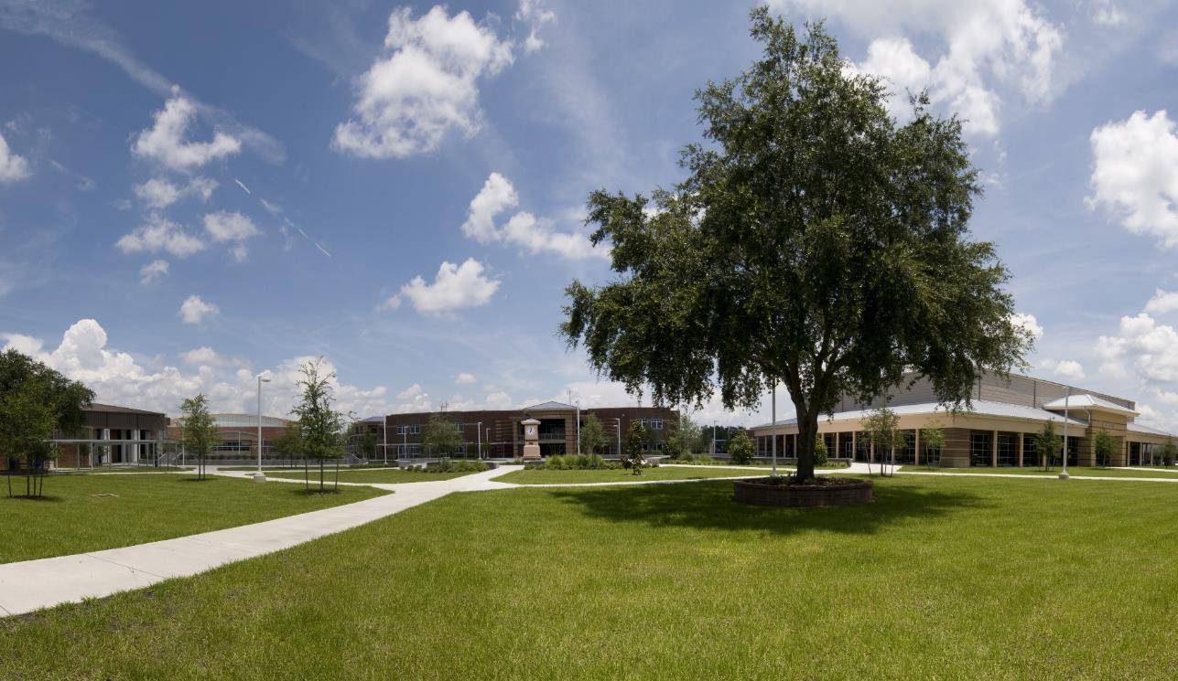
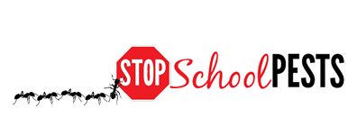
Practices to maintain healthy Landscapes
Lesson 1 of 4
Self-Guided Educational Module

Slide 2
Learning Objectives
Describe the zone management approach
The principles behind sustainable landscapes
Cultural controls
Physical controls
Biological controls
Explain the importance of landscaping practices specific to pest exclusion
Explain sound pruning practices

Slide 3
Zone Management Approach
Classifying landscape sites:
Locate a map of your school grounds and divide it into zones (high, medium and low maintenance) according to intended use, water use and/or visibility Highly visible sites where appearance is key, such as lawns by main entry doors, are likely to be high-maintenance zones
High-maintenance plants, such as dogwood or crabapple, should be excluded from all zones; low-maintenance plants can be used in all zones

Slide 4
Zone Management Approach
Once you have labeled the grounds according to zone, learn about the best plants for your area
A little research at the planning stage can go a long way toward reducing plant replacement and landscape management costs, including time and money spent on IPM activities
Tami Proffitt Photography

Slide 5
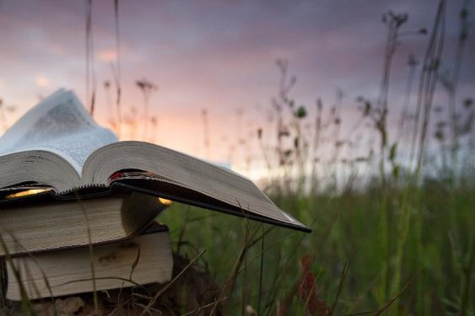
Landscape IPM
Landscape IPM includes:
Structural pests that can enter a building, such as rodents or insects
Plant pests including insects, diseases, weeds and wildlife
Practices to manage both types of pests are covered throughout this learning module

Slide 6
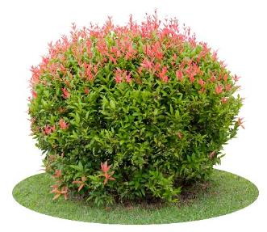
Selecting Plants
Plant selection should be based on the plant suitability for the specific site and function
Select plants that are tolerant to insects, diseases and wildlife pests in your region
Plants that are native generally tend to:
Require less water
Require less maintenance
Benefit from native pollinators
Keep in mind that some native plants require more maintenance and are susceptible to disease

Slide 7
Plant Selection
Contact your local University Extension office for a list of plants that are pest, heat and drought-resistant for your region
Consider maintenance zones when selecting plants
Since the majority of ground managers are working from established landscapes, focus on gradually phasing out high-maintenance/pest-prone plants and start replacing them with lower maintenance plants

Slide 8
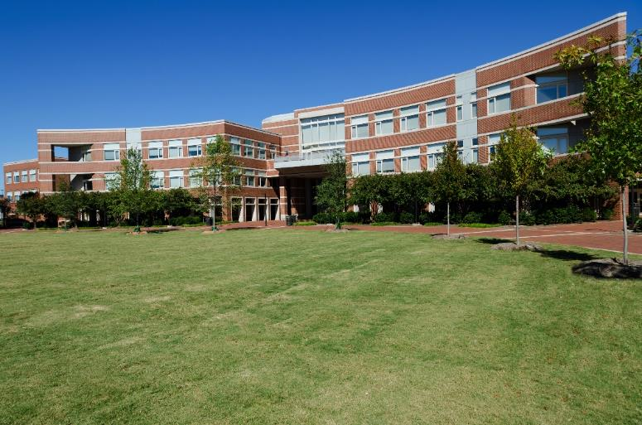
Principles Behind Sustainable Landscapes
Cultural controls
Physical controls
Biological controls

Slide 9
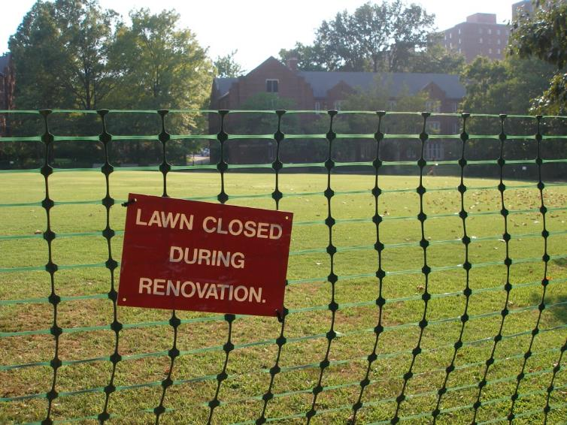
Cultural Controls
Cultural Controls
Practices that improve plant health and reduce plant problems
Monitor condition
Sanitation
Horticultural techniques
Notes:
Monitoring for what?

Slide 10
Cultural Controls
4.
Sanitation
Good sanitation practices can reduce or eliminate food for pests
Avoid plants that drop seeds or fruit, or tend to become weedy as this may attract insects, rodents and undesirable birds
Sanitation also involves removing diseased or pest-infested leaves or branches to reduce pathogen and insect populations

Slide 11
Cultural Controls
Horticultural techniques include:
Proper planting techniques, irrigation, soil testing, fertilizing, pruning and mowing - Done correctly, all will encourage healthy, thriving plants with fewer pest problems
Design/redesign landscape plantings to avoid or eliminate problem-prone plants Effective pest management begins with proper landscape design, plan gradual improvements to existing plantings to stay within time and expense budgets

Slide 12
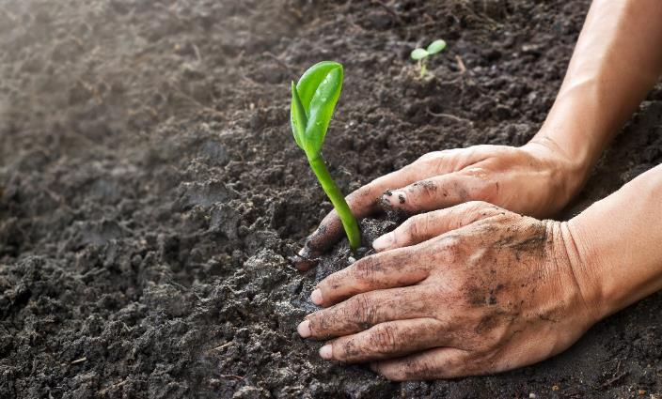
Physical Controls
Physical controls include:
Manipulating water, humidity, temperature and physical condition
Habitat modification
Use of barriers such as mulch
Removing pests by hand
Trapping pests

Slide 13
Physical Controls
4.
Habitat modification:
To survive, pests need food, water and the proper environment Removing dense vegetation near buildings decreases rodent habitat; eliminating standing water reduces mosquito breeding sites
Thinning branches improves air circulation and may reduce disease problems and tree/shrub loss due to extreme weather events

Slide 14
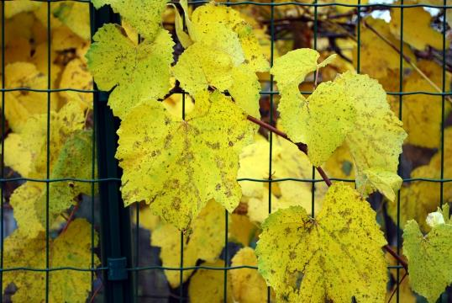
Physical Controls
Barriers are used to keep pests from plants in the same way window screens keep out flying and crawling insects
Landscape fabric is a good choice under hardscapes, such as walkways and tracks, but can be hard to remove Using degradable cardboard or newspaper is an option
Monitor mulch as it can be a good habitat for some pests
Netting can prevent wildlife from feeding plants, and can be invisible from a distance

Slide 15
Physical Controls
Removing pests by hand
In some situations, this may be the safest and most economical strategy Use care and protective gloves with poisonous species, such as browntail moths or poison ivy
Trapping
Many traps are available including snap traps for mice and rats, flypaper and other sticky traps, cone traps for yellowjackets and box traps for skunks and raccoons
Note that some traps can attract more insects to the areas, e.g., Japanese beetle traps

Slide 16
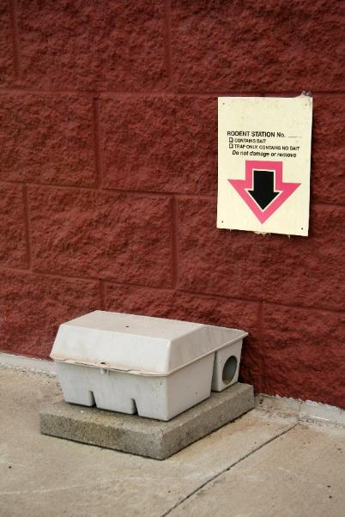
Physical Controls
4.
Place traps in inaccessible areas and use tamper-resistant stations to enclose traps to avoid injury to children By involving students in the IPM program, they will have more of a stake in guarding against misuse and vandalism Trap placement is crucial to the effectiveness of the trap
Tamper-resistant station

Slide 17
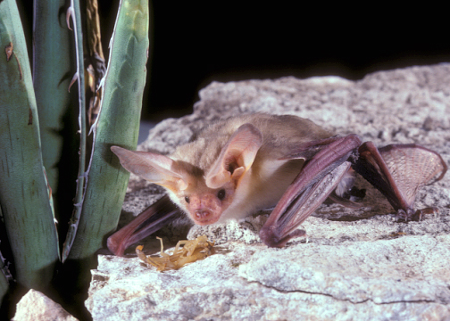
Biological Controls
Using living organisms to naturally suppress pest populations
Biological controls usually target specific pests Some can become established, providing long-term or even permanent control
Pallid bat with scorpion - Bat Conservation International

Slide 18
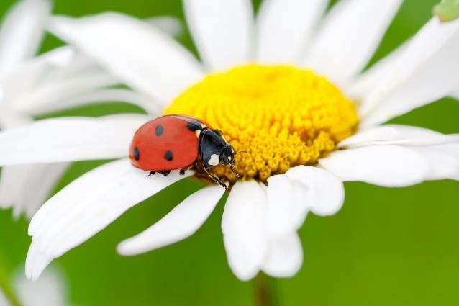
Biological Control
Many species of birds, bats and insects can suppress pest populations, acting as biological control agents
Because they control pests, they are often known as beneficial organisms
Lady beetles are familiar beneficial insects, they feed almost exclusively on soft-bodied insects and insect eggs

Slide 19
Biological Control
Maintaining or increasing the number of beneficial organisms can be an effective way to manage pests
Including flowering plants in the landscape can attract and support beneficial organisms that are natural enemies of pests
Avoid placing flowering plants that may attract stinging insects along walkways or near entryways

Slide 20
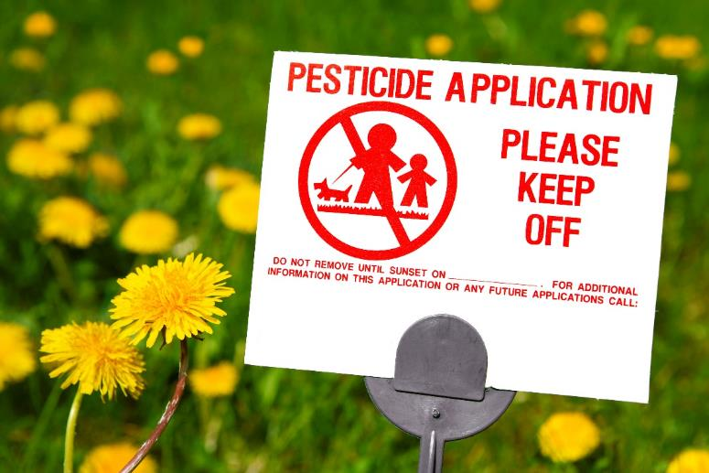
Pesticides
Pesticides
May be used in specific situations when other methods do not provide adequate control
If pesticides are used, signs should be posted and students, teachers, administration should be notified ahead of application

Slide 21
Pesticides
Some pesticides are lethal to biological controls, so apply pesticides with their survival in mind
Treat only when populations reach action thresholds
Time treatments to be least disruptive to beneficial organisms
Avoid broad-spectrum insecticides, toxic to many species of insects
Select targeted, low-risk pesticides, such as Bacillus thuringiensis, insect growth regulators, and baits formulated to attract only the target pest

Slide 22
When Using Pesticides
Remember that a pesticide applicator license may be required for pesticide applications on school property, including mold control, weed killers, disease control and rodent baits
Make certain that you are in compliance with local, state and federal laws (which change over time)
Follow guidelines in your school district IPM policy and plan when using pesticides on school grounds

Slide 23
Landscape Management Tips
4.
Know your plants
Tolerance level for common problems
Landscape preparation
Mulch
Pruning
Fertilizer
Irrigation

Slide 24
Landscaping Practices to Avoid Problems
4.
Match the plant to the site - plants should be adapted to existing environmental conditions
Some plants cannot grow in full sun, light requirements are especially important for grasses
Use USDA hardiness zones as a plant selection aid http://planthardiness.ars.usda.gov/phzmweb/interactivemap.aspx
Select landscape plants that are resistant to common pest problems and environmental stresses imposed by the site

Slide 25
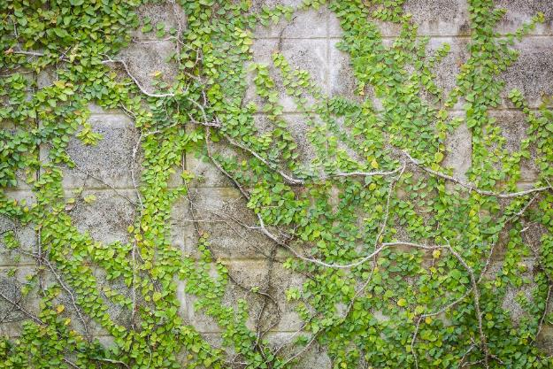
4.
Landscaping Practices to Avoid Problems
Shrubs should be pruned away from buildings and shaped so they do not create places for rodents to hide
Keep tree limbs pruned at least six feet away from buildings
Remove vines climbing on buildings or growing low to the ground next to buildings

Slide 26
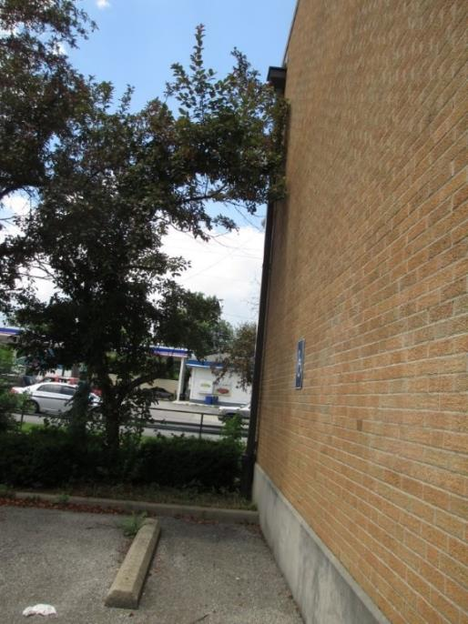
Landscape Management Tips
Pruning
Use certified arborists to prune trees and shrubs or have staff trained appropriately
Generally, no more than 25% of tree canopy per year should be removed
Overgrown trees allow easy access to buildings for pests – Shaku Nair, University of Arizona

Slide 27
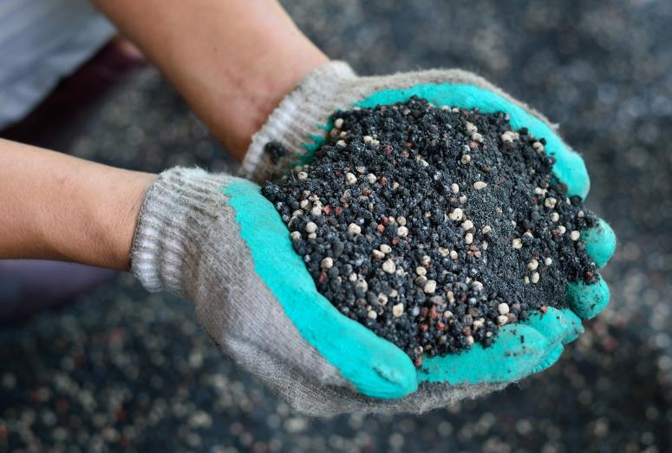
Landscape Management Tips
Fertilizing
Fertilize plants only as necessary, over-fertilization promotes rapid growth, requires more maintenance and can leave plants susceptible to certain pest problems
Use slow-release or time-release nitrogen fertilizers

Slide 28
Landscape Management Tips
Irrigating
Soils will differ from school to school and even within a specific site Familiarity with the soils and their ability to accept/hold and move water is critical to proper irrigation and water conservation
Irrigate early in the morning, infrequently and with longer durations to encourage deep rooting, most irrigation systems should not be set to turn on every day

Slide 29
Sound Pruning Practices
Why prune:
Maintaining plant health includes the removal of diseased, dying, injured and dead branches; removal of crossovers, which can rub together and damage limbs and harbor disease
Control of visibility and safety concern: remove hazardous branches before they fall, correct and repair damage
Renovating or rejuvenating old or overgrown plants
Formal hedges require continuous pruning to maintain their size and shape
Notes:
http://extension.arizona.edu/sites/extension.arizona.edu/files/pubs/az1499.pdf
http://extension.oregonstate.edu/linn/sites/default/files/pruning_pub_handout2012.pdf

Slide 30
Sound Pruning Practices - Trees
1. Maintain health of tree: a) remove all dead, dying, and diseased limbs; b) remove crossovers, which can rub together and damage limbs and harbor disease; c) remove hazardous branches before they fall; d) correct and repair damage
2. Raise the canopy to increase pedestrian, vehicular, or visual zone
3. Rejuvenate the tree by the removal of old wood in such a way that encourages the formation of new wood (remove no more than 1/3 of the wood in one year)
Notes:
http://extension.oregonstate.edu/linn/sites/default/files/pruning_pub_handout2012.pdf

Slide 31
Sound Pruning Practices - Trees
4. Improve the aesthetic quality of the tree and thus, its value
5. Slow the tree’s growth by timely removal of foliage (but best to select right plant for the site)
6. Fruit trees: a) increase fruit production; b) develop strong 45-degree angles to support fruit load; c) remove limbs that grow down or straight up; d) maintain tree size; e) maintain fruit spurs

Slide 32
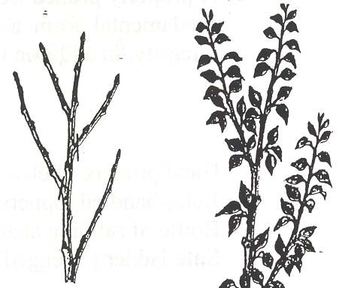
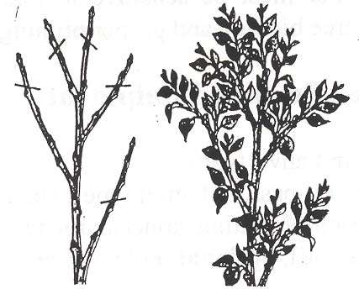
Types of Pruning Cuts
Oregon State University Extension
Heading Cuts: Several buds left on the cut branch grow, making denser, more compact foliage on more branches
Thinning Cuts: Branches are removed entirely, leaving no buds to grow
Energy is diverted into remaining branches, which grow more vigorously

Slide 33
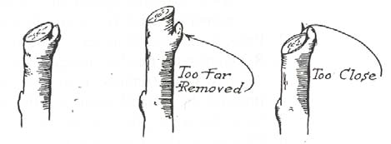
Angle of Cuts
Oregon State University Extension
Always make cuts close to a node Branches grow only at these nodes, and if you leave too long a stub beyond the node, the stub will die and rot
correct
Notes:
http://extension.oregonstate.edu/linn/sites/default/files/pruning_pub_handout2012.pdf

Slide 34
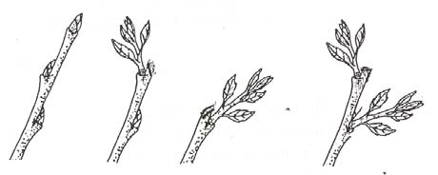
Placement of Cuts
Oregon State University Extension
Prune to the lateral bud that will produce the branch you want, the placement of that bud on the stem points in the direction of the new branch
An outside bud, pruned with a slanting cut just above the bud, will usually produce an outside branch, a flat cut above the bud allows two lower buds to release and grow shoots

Slide 35
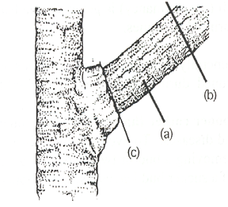
Pruning Thick, Heavy Branches
Oregon State University Extension
1. Undercut the bottom of the branch about 1/3 of the way through, 6-12 inches out from the trunk (a)
2. Make a second cut from the top, about 2-inches farther out from the under-cut, until the branch falls away (b)
3. Cut back the resulting stub to the branch collar (c) (not flush with the trunk)

Slide 36
When to Prune Trees
Generally the best time to prune trees is during the dormant period, usually in late winter (November – March)
Pruning can be done year-round, as needed E.g., remove dead or diseased branches any time
Pruning done during the dormant season tends to have an invigorating effect on tree growth
Pruning done during peak growth times tends to slow growth
Generally, berries and tree fruits are pruned November until bloom
Prune blooming ornamentals during and immediately after bloom

Slide 37
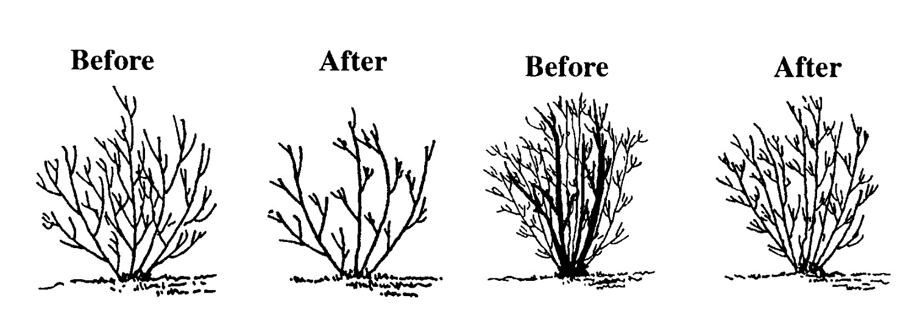
How to Prune a Shrub
Oregon State University Extension
Selective thinning: removing branches back to the point of attachment to another branch (left), or to the base of the plant (right) This type of pruning opens the plant canopy, increasing light and air movement, it is a technique suitable for all plants and the most desirable method
Notes:
http://extension.arizona.edu/sites/extension.arizona.edu/files/pubs/az1499.pdf

Slide 38
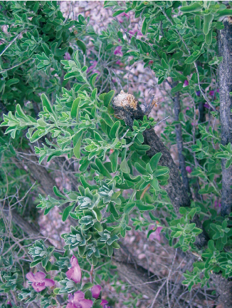
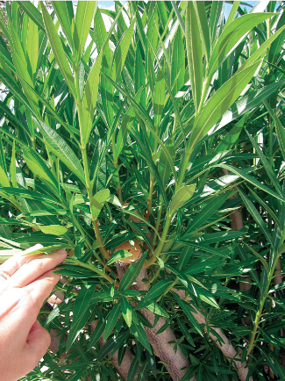
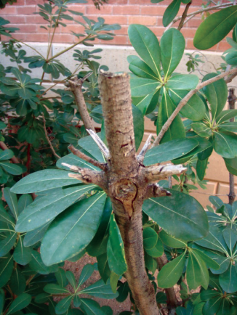
Heading Cuts
Heading cuts: remove parts of a stem or branch resulting in multiple new shoots just below the cut (left and middle) This can create a bushy plant and is sometimes done when plants are very young to stimulate more branches Leaving stubs should be avoided (right) as they will usually die back
Shujuan Li, University of Arizona

Slide 39
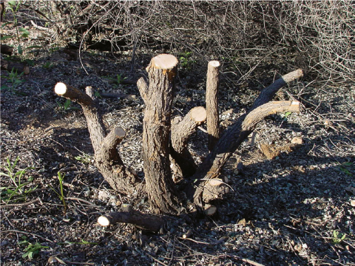
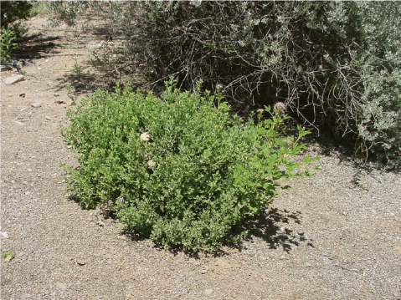
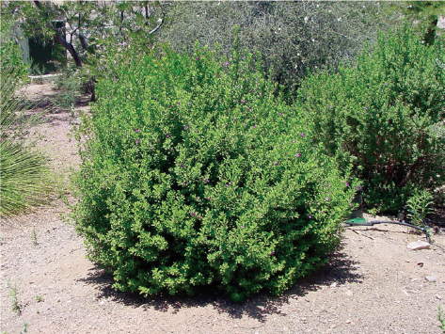
Renovating or Rejuvenating
Renovating or rejuvenating: Rejuvenating shrubs that are overgrown starts by cutting them at 12-18 inches above the ground in late winter or early spring By fall the shrub has grown a full new canopy
Shujuan Li, University of Arizona

Slide 40
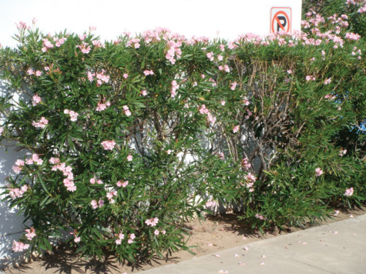
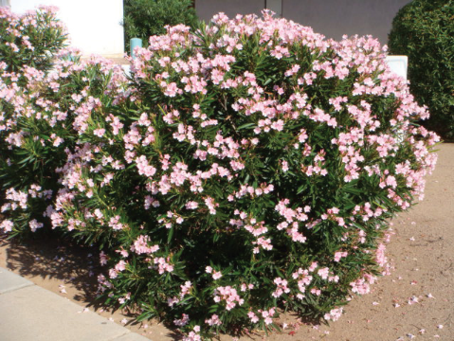
Shearing is not a good practice
Shearing shrubs entails cutting back branches to a uniform surface This should not be done other than for formal hedges or special topiaries Regular shearing of shrubs removes flower buds, flowers, and reduces their beauty – it’s bad practice
Oleander is not well suited for shearing (left), kept in its natural shape an oleander shrub will flower from spring to fall (right) – Shujuan Li, University of Arizona

Slide 41
When to Prune Shrubs
Generally, pruning takes place after flowering shrubs have completed flowering
Spring flowering shrubs should be pruned in late spring
Summer or fall flowering shrubs should be pruned after flowering or in late winter to early spring
Selective pruning of a few branches can be done on most plants throughout the year

Slide 42
Shrub Pruning Summary
Don’t prune unless it is really necessary Pruning just to demonstrate work is being done is not a sound practice and increases plant stress and the need for plant replacement
Use the appropriate, sharp tool for the job
Prune at the right time of year
Use the natural growth form of the shrub as a guide for natural pruning
Shear only formal hedges, and understand that this may necessitate additional water and resource support for the plants to stay healthy

Slide 43
Check In!
This lesson you learned:
The zone management approach
The principles behind sustainable landscapes
The importance of landscaping practices specific to pest exclusion
Sound plant pruning practices
Next you will learn more about cultural turf management!

Slide 44
Resource List
Iowa State University. (2010). Plant and Insect Diagnostic Clinic. http://www.ipm.iastate.edu/ipm/info/plant-diseases/turf-grass-rust
Maine Department of Agriculture, Conservation and Forestry. School IPM. http://www.maine.gov/dacf/php/integrated_pest_management/school/index.shtml
Rutgers Cooperative Extension. IPM Report Card for School Grounds: General Requirements. http://entomology.osu.edu/schoolipm/IPMfiles/ReportCardGeneral.pdf
Texas A&M Agrilife Extension. Landscape IPM Module 6. http://schoolipm.tamu.edu/videodvd/
Umass Extension Center for Agriculture. Best Management Practices For Lawn and Landscape Turf. http://extension.umass.edu/turf/sites/turf/files/pdf-doc-ppt/lawn_landscape_BMP_2013_opt.pdf
University of California Agricultural and Natural Resources. (2009). How to Manage Pests. http://www.ipm.ucdavis.edu/PMG/r785100411.html

