Slide 1
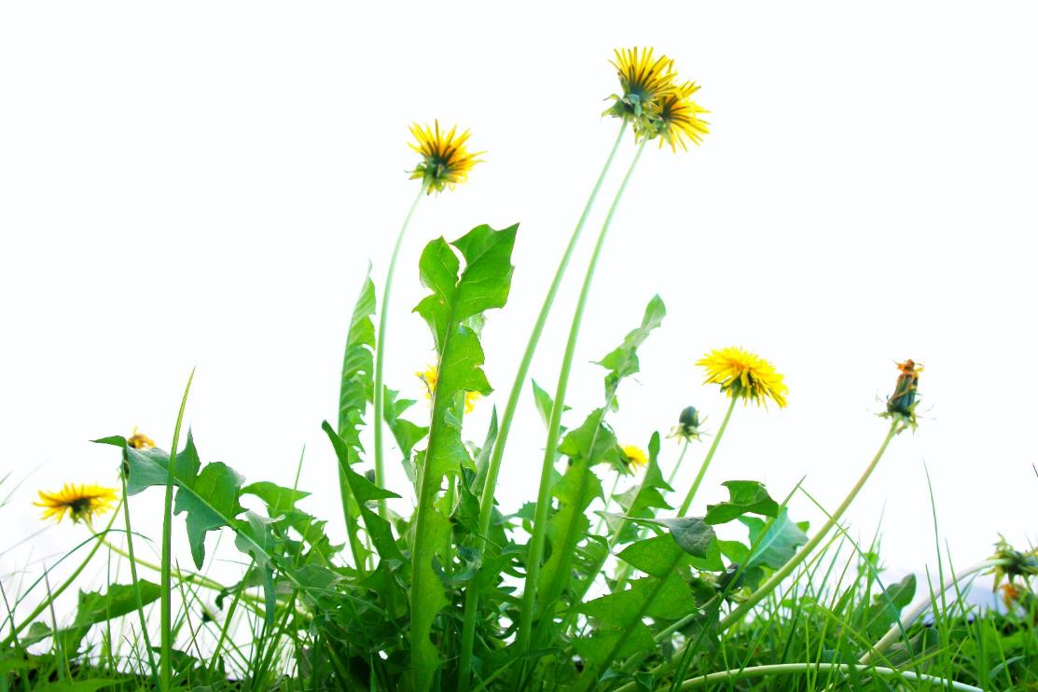
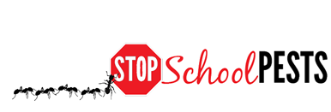
common turfgrass weeds and insects
Lesson 3 of 4
Self-Guided Educational Module

Slide 2
Learning Objectives
Identify plant species suited for site-specific environmental qualities, pest pressure and use
Identify and describe how to manage common turfgrass weeds
Identify and describe how to manage common turfgrass insect pests
Identify and describe how to manage common turfgrass vertebrate pests

Slide 3

IPM for Lawn and Turfgrass
IPM for lawns and turf is a long-term approach to maintaining healthy and reduced risk outdoor areas - This approach includes:
  Site assessment
  Monitoring
  Prevention
  Management
  Evaluation of
  practices

Slide 4

Components of an IPM Program on School Grounds
Promoting turfgrass health:
Select grass species that will thrive on the site and support the site use
Prepare the site properly
Provide cultural care
It is critical to consider
the use of the turf when
selecting turfgrass
species and cultivars
Notes:
Cultivar? Was cultivator?

Slide 5
Selecting Turfgrass
Select a turfgrass seed mix that will thrive in the area
Grasses with disease resistance are generally only resistant to one disease and may be susceptible to other turfgrass diseases
Certain grasses containing endophytes can prevent outbreaks of above-ground insect pests
Select grass types that can tolerate the level of play or traffic on the area

Slide 6
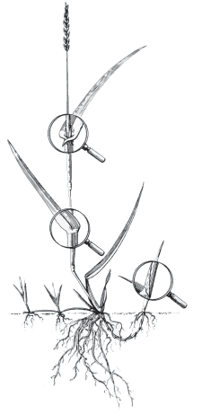
Turfgrass Identification
University of Georgia College of Agricultural and Environmental Sciences
Seedhead
Blade
Roots comprise almost half of the entire grass plant
Ligule
Sheath
Auricles
Node
Midrib
Collar
Stolon
Tiller
Bud Leaf
Crown
Rhizome

Slide 7
Turfgrass Selection
 | Kentucky Bluegrass | Perennial Ryegrasses | Tall Fescue | Fine Fescue
Growth habit | Rhizomatous | Bunch | Bunch | Bunch, some rhizomes
Leaf texture (blade width) | Medium-Fine | Medium | Course | Very Fine
Establishment from seed | Slow | Fast | Medium-Fast | Medium
Seeding rate | 1 to 2 lb./1,000 ft.² | 5 to 9 lb./1,000 ft.² | 5 to 9 lb./1,000 ft.² | 3 to 5 lb./1,000 ft.²
Annual nitrogen fertilizer | 3 to 4 lb./1,000 ft.² | 2 to 4 lb./1,000 ft.² | 2 to 4 lb./1,000 ft.² | 1 to 2 lb./1,000 ft.²
Drought tolerance | Poor | Poor | Some | Some
Shade tolerance (min. 4 hours direct sun) | Poor | Poor | Good | Excellent
Wear tolerance (traffic) | Good | Good | Good | Poor
9

Slide 8
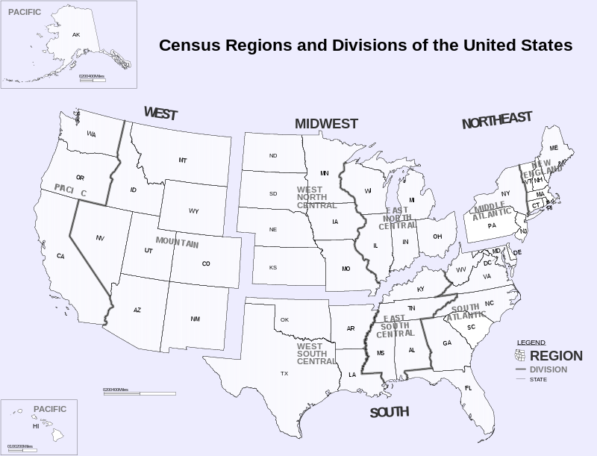
Census Regions and Division of the United States - Inkscape

Slide 9
Examples of Turfgrass Species – North Central
Turfgrass Characteristics
Grass species | Growth habit | Leaf texture /color | Preferred environment | Tolerance attributes
Kentucky bluegrass | Rhizomes | Fine to medium Dark green | Well drained, sunny areas High nutrient and water requirements | Cold - high Wear - high Drought - low Shade - low
Supina bluegrass | Stolons | Fine to medium Light green | Sun to dense shade High nutrient and water requirements | Cold - high Heat - low Drought - low Wear - very high
Perennial ryegrass | Bunch | Fine to medium | Well drained soils Moderate fertility and water requirement | Cold - low Heat - low Drought - moderate Shade - low Wear - high
Tall fescue | Bunch | Medium to coarse | Well drained soils Open sunny areas. Low fertility requirement | Cold - low Heat - high Drought -high Shade - moderate Wear - moderate
Fine fescue | Bunch, some rhizomes | Medium to fine | Cool, dry, well drained, shade tolerant, well drained | Cold - high Heat/salt - low Drought - moderate Wear - moderate Shade - moderate

Slide 10
Examples of Turfgrass Species – Northeastern
Turfgrass Characteristics
Grass species | Growth habit | Leaf texture | Preferred environment | Tolerance attributes
Kentucky bluegrass | Rhizomes | Medium to fine | Sunny, well drained | Cold - high Heat - moderate Drought - moderate Wear – moderate Shade - low
Fine fescue | Bunch, some rhizomes | Medium to fine | Cool, dry, well drained, shade tolerant, well drained | Cold - high Heat/salt - low Drought - moderate Wear - moderate Shade - high
Perennial ryegrass | Bunch | Medium to fine | Well drained, moderate fertility | Cold - low/moderate Heat /moderate/high Wear - high Drought - low Shade - low
Tall fescue | Bunch | Medium to coarse | Sun and shade | Cold - low/moderate Heat - high Drought - moderate Wear - high Shade - moderate Salinity - moderate

Slide 11
Examples of Turfgrass Species – Western
Turfgrass Characteristics
Grass species | Growth habit | Leaf texture | Preferred environment | Tolerance attributes
Kentucky bluegrass | Rhizomes | Medium to fine | Sunny, well drained High elevation | Cold - high Heat - moderate Drought - moderate Wear - moderate
Supina bluegrass | Stolons | Fine to medium Light green | Sun to dense shade High nutrient requirements | Cold - high Heat - low Drought - low Wear - very high
Bermudagrass (southwestern) | Rhizomes & stolons | Fine, medium to coarse | Sunny, tolerates most soil conditions High fertility requirement Low – medium elevation | Cold - moderate Heat/salt - high Drought - high Wear - high
Perennial ryegrass | Bunch | Medium to fine | Well drained, moderate fertility | Cold - low/moderate Heat /moderate/high Drought - low Wear - high Shade – low
Tall fescue | Bunch | Medium to coarse | Sun and shade | Cold - low/moderate Heat - high Drought -moderate Wear - moderate Shade - moderate Salinity - moderate

Slide 12
Examples of Turfgrass Species –
Pacific Northwest
Turfgrass Characteristics
Grass species | Growth habit | Leaf texture | Preferred environment | Tolerance attributes
Kentucky bluegrass | Rhizomes | Medium to fine | Sunny, well Drained Recovery – slow in late fall | Cold - high Heat - moderate Drought - moderate Wear - moderate
Fine fescue | Bunch, some rhizomes | Medium to fine | Cool, dry, well drained, shade tolerant, well drained | Cold - high Heat/salt - low Drought - moderate Wear - moderate Shade - high
Perennial ryegrass | Bunch | Medium to fine | Well drained, moderate fertility, sunny | Cold - low/moderate Heat /moderate/high Wear - high Drought - low Shade - low
Tall fescue | Bunch | Medium to coarse | Sun and shade | Cold - low/moderate Heat - high Drought - moderate Wear - moderate Shade - moderate Salinity - moderate

Slide 13
Examples of Turfgrass Species – Southern
Turfgrass Characteristics
Grass species | Growth habit | Leaf texture | Preferred environment | Tolerance attributes
Bermudagrass | Rhizomes & stolons | Fine, medium to coarse | Sunny, tolerates most soil conditions | Cold - moderate Heat/salt - high Drought - high Wear - high
Zoysiagrass | Rhizomes & stolons | Fine, medium to coarse | Sun to moderate Shade. Recovery is slow | Cold - good Heat/salt - high Drought - high Wear - high
Centipede | Rhizomes & stolons | Medium to coarse | Sunny, tolerates low pH conditions | Cold - fair Heat - good Salinity - poor Wear - poor/moderate
Tall fescue | Bunch | Medium to coarse | Sun and shade | Cold - low/moderate Heat - high Drought - moderate Wear - high Shade - moderate Salinity - moderate
Fine fescue | Bunch, some rhizomes | Medium to fine | Cool, dry, well drained, shade tolerant, well drained | Cold - high Heat/salt - low Drought - moderate Wear - moderate Shade - high

Slide 14
Managing Turf Weeds
Keep turfgrass healthy to out-compete weeds
Use certified seed for overseeding, the seed has fewer weed seeds than low-quality seed mixes
Soil pH can be a huge factor in weed invasion and turf decline
Avoid fertilizer applications when common annual weed seeds may be germinating
Establish weed population thresholds by management zone
Low visibility, low maintenance zones can tolerate more weeds

Slide 15
Weed Monitoring: The Transect Method
Randomly choose a series of representative transects for sampling
Walk each transect, stop at 20 or more evenly spaced sampling units (steps or measures) and record the presence/absence of weeds in a 3x3 foot area in front
Estimate the percentage of area covered by weeds in each 3x3' sample and calculate the average over all 20 samples
Monitor regularly, recognize trends and develop thresholds for action based on management zones
Samples | Covered by weeds
10 | 40% | (10x40%) = 400% | 400% + 100% = 500% 500%/20 sites = 25%
10 | 10% | (10x10%) = 100%

Slide 16
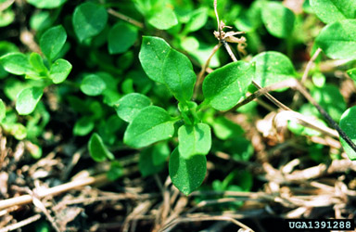
Common Turfgrass Weeds: Northeast
Weeds
Velvetleaf
Common ragweed
Common lambsquarters
Hairy galinsoga
Eastern black nightshade
Common chickweed
Giant foxtail
Yellow foxtail
Large crabgrass
Yellow nutsedge
Common Chickweed
- John D. Byrd, Mississippi State University, bugwood.org

Slide 17
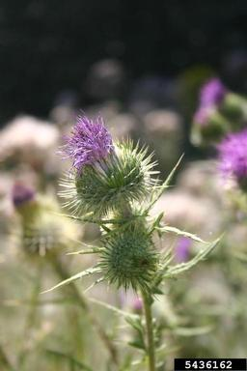
Common Turfgrass Weeds: Midwest
Weeds
Bull thistle
Canada thistle
Carolina geranium
Chicory
Common purslane
Curly dock
Large crabgrass
Mouseear chickweed
Common mallow
Perennial sowthistle
Bull thistle -
Eric Coombs, Oregon Department of Agriculture, bugwood.org

Slide 18
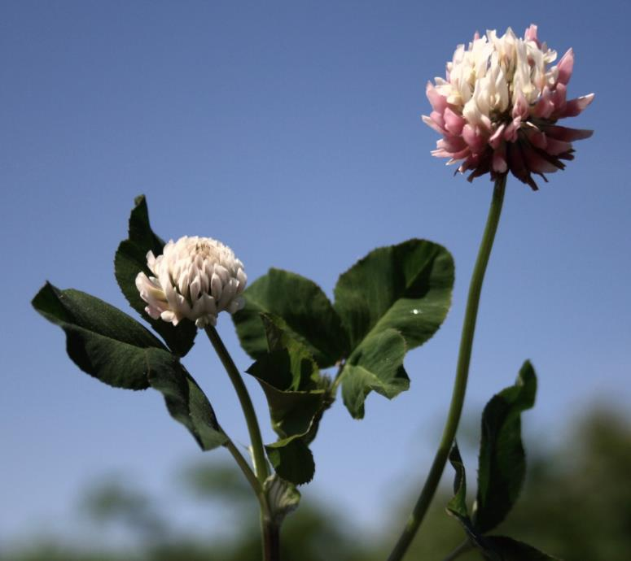
Common Turfgrass Weeds: Pacific Northwest
Weeds
Annual bluegrass
Buttercup
Chickweed
Clover
Crabgrass
White clover
Moss
Plantain
Thistles
Red sorrel
White clover
- Tim Miller, Washington State University

Slide 19
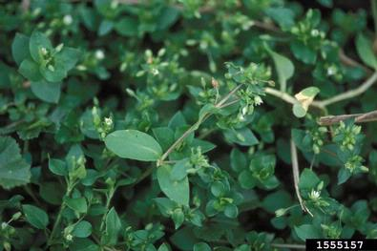
Common Turfgrass Weeds: South
Weeds
Dallisgrass
Bahiagrass
Annual bluegrass
Spurge
Chickweed
Crabgrass
Dandelion
Common chickweed -
Ohio State Weed Lab Archive, The Ohio State University

Slide 20
Identify, Monitor, Manage Turfgrass Weeds
Annual Weed Species
Summer annual weeds germinate in spring, grow to maturity during summer and die by fall or winter
If herbicides are needed to control summer annuals, apply pre-emergent herbicides in the spring to prevent germination
Winter annual weeds germinate in the fall and winter, grow actively in spring and die by summer
If herbicides are needed to control winter annuals, apply pre-emergent herbicides in the early fall to prevent germination

Slide 21
Identify, Monitor, Manage Turfgrass Weeds
Biennial weeds: Grow during the spring, summer and fall of their first year, survive the following winter, and then produce seed in the second growing season
Perennial weeds: Live more than two years and spread by seeds and vegetative means such as bulbs, rhizomes, tubers or nutlets
If herbicides are needed for perennial or biennial weeds, use fall applications of selective broadleaf herbicides

Slide 22
Site Selection and Preparation
  It is especially important to get difficult perennial weeds under control before planting, trying to grow turfgrasses on poor sites may take additional work
  Irrigate the site before planting to allow weed seeds on site to germinate before grass seed is planted
  Sites with limited water, less than four to six hours of direct sunlight, and/or minimal nutrients may be poor sites for growing turfgrass, but many weed species can survive in these conditions

Slide 23
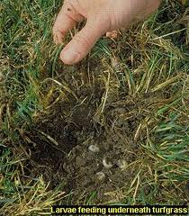
Identifying and Monitoring Turfgrass Insects
Insect pests can vary by region and are important indicators of turfgrass health
Monitor and record data on pests that may need to be managed in your region and at your site
Masked chafers (white grubs)
- University of California IPM, http://www.ipm.ucdavis.edu

Slide 24
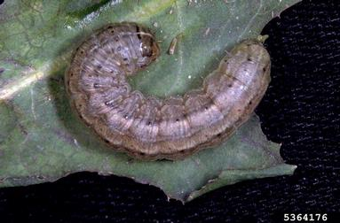
Common Turfgrass Pests: Northeast
Insects
Beetle grubs
Sod webworms
Chinch bugs
Billbugs
Cutworms
Army cutworm
- Frank Peairs, Colorado State University, Bugwood.org

Slide 25
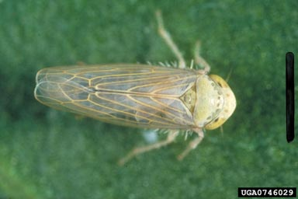
Common Turfgrass Pests: Intermountain West
Insects
Billbugs
Chinch bug
Banks grass mite
Leafhoppers
Beet leafhopper -
G. Oldfield, USDA, Bugwood.org

Slide 26
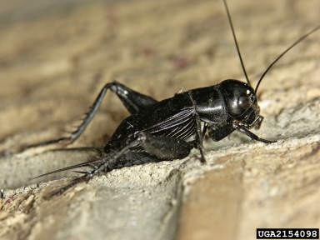
Common Turfgrass Pests: Midwest
Insects
White grubs
Billbugs
Sod webworm
Aphids
Crickets
Field Cricket -
Joseph Berger, Bugwood.org

Slide 27
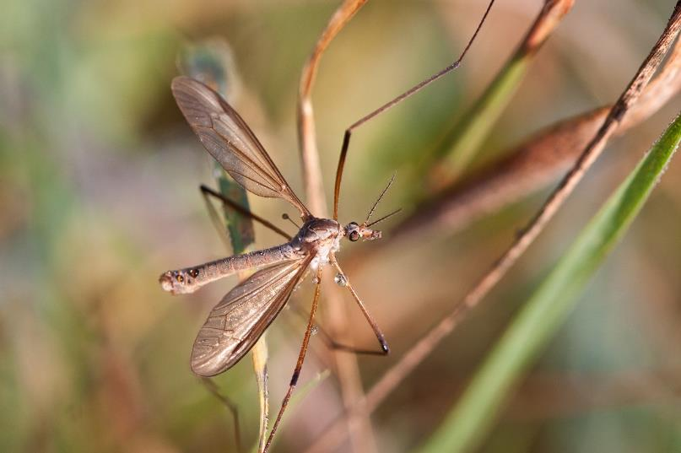
Common Turfgrass Pests: Pacific Northwest
Insects
European cranefly
White grubs
Chinch bug
Billbugs
European cranefly

Slide 28
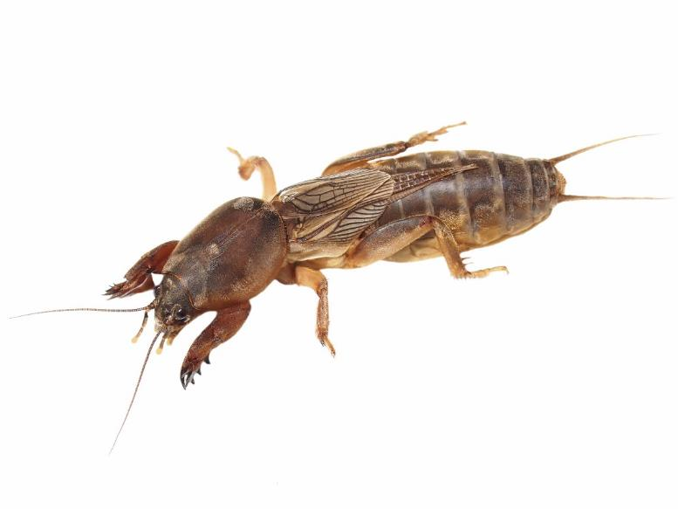
Common Turfgrass Pests: Gulf Coast
Insects
Armyworms
Red imported
fire ants
Grasshoppers
Mole crickets
Southern chinch bugs
Tropical sod webworm
White grubs
Mole cricket

Slide 29
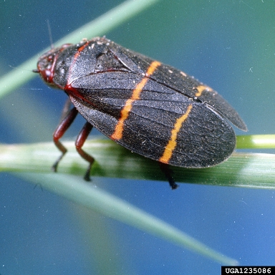
Common Turfgrass Pests: South
Insects
Fire ants
Chinch bugs
Spittlebugs
Sugarcane beetles
Henbit
Spurges
Twolined spittlebug -
Clemson University, USDA Cooperative Extension Slide Series, Bugwood.org

Slide 30
Managing Turfgrass Insect Pests
Healthy turf rarely requires insecticide treatment for insect pests
Insect pest problems are often limited to small areas of turf that have cultural issues that need correcting such as improper pH, low fertility, poor drainage and turf root growth, overwatering or improper mowing
The right question to ask is, why is this pest here? Not which pesticide should I use?

Slide 31
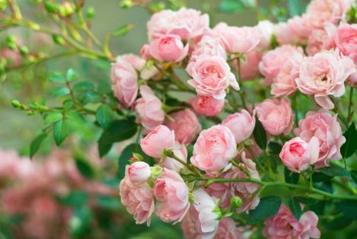
Managing Turfgrass Insect Pests
In regions affected by grubs,
avoid planting roses, grapes
or oaks to avoid attracting beetles, the adult
stage of grub species
Grub-infested turf suffers root loss; heavily infested turf may need light and frequent irrigations to survive the summer heat
Avoid excessive night lighting which can attract beetles that will lay eggs in turf

Slide 32
Managing Turfgrass Insect Pests
Dethatching reduces chinch bug activity for up to two years where sod-forming lawn grasses have been planted
Consider grass cultivars that contain “endophytes” for areas with chronic chinch bug, billbug, cutworm or sod webworm problems
Endophytes can effectively control other above ground-feeding insects as well
If insecticides are needed to control insects, irrigate and remove thatch first to draw grubs into the upper root zone - Treat affected spots only

Slide 33
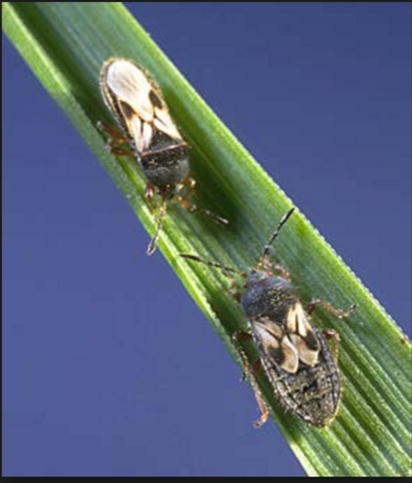
Chinch Bugs
Chinch bugs reach peak populations during high heat Dry turf is particularly susceptible to this insect because of the added environmental stress
Particularly susceptible turf includes:
  Kentucky bluegrass
  Perennial and annual
  ryegrass
  Tall and fine fescue
  St. Augustine grass
Chinch bugs feed on grass blades and can cause damage at high densities – Ohio State University Extension

Slide 34
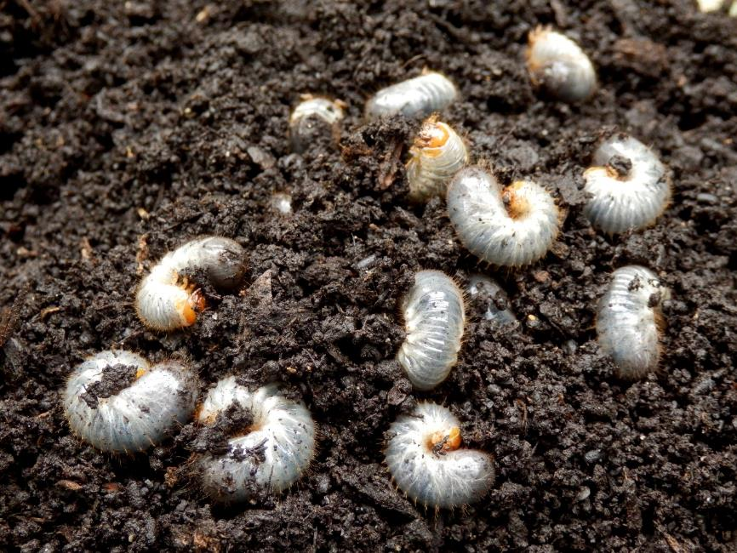
White Grubs
Turf damage can peak in late summer as grubs increase in size and feeding capacity

Slide 35
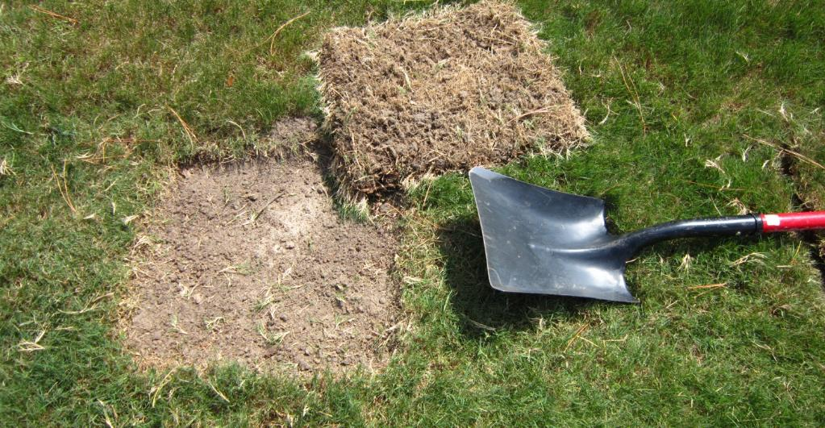
Managing Grubs
Use a shovel to determine the number of grubs per square foot before initiating any treatment
  Establish action threshold levels
Square foot of turf removed – David Shetler, Ohio State University

Slide 36
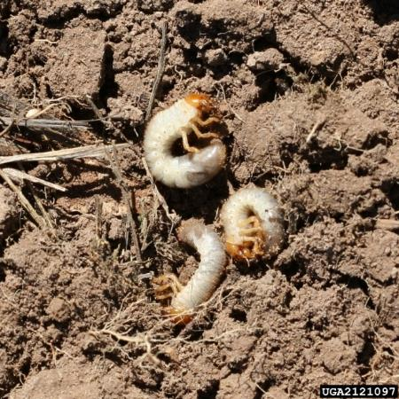
White Grubs
White grubs are typically one of the following species:
Japanese beetle
June beetle
European chafer
Asian garden beetle
Oriental beetle
Asiatic garden beetle
Northern masked chafer
Black turfgrass ataenius beetle
May-June beetle white grubs -
Steven Katovich, USDA Forest Service, Bugwood.org
Creative Commons License

Slide 37
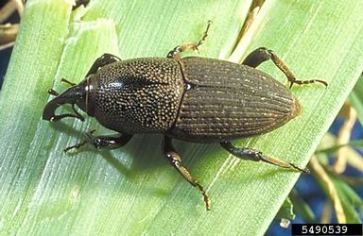
Billbug
Billbug larvae tunnel through plants while feeding on the stem
Damage frequently appears from late June through early August
Signs of damage include spotty, straw-colored patches of grass scattered throughout the lawn
Billbug -
David Shetlar, Ohio State University, Bugwood.org

Slide 38
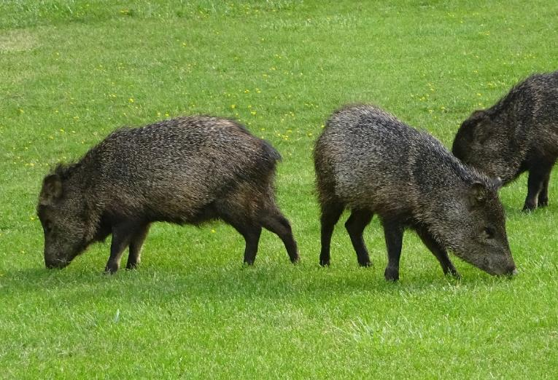
Identifying Turfgrass Vertebrates
Pocket gophers
Prairie dogs
Meadow voles
Moles
Rabbits and hares
Ground squirrels
Deer
Collared peccary
(Javelina)
Javelina
Notes:
European Crane fly removed as it is not a vertebrate

Slide 39
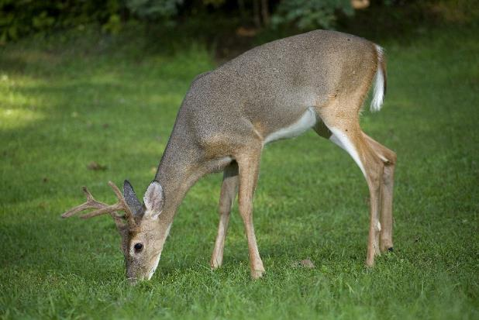
Monitoring and Managing Turfgrass Vertebrate Pests
Vertebrate pests can harm turfgrass when they dig to look for pests to eat
By controlling the insect pest population, you will in turn, deter vertebrate pests from visiting
Monitor for signs of
vertebrate activity as
this may be a sign that
you have a pest
infestation

Slide 40
Check In!
This lesson you learned:
How to identify plant species suited for a site’s environmental qualities, pest pressures and use
How to identify and describe how to manage common turfgrass weeds
How to identify and describe how to manage common turfgrass insect pests
How to identify and describe how to manage common turfgrass vertebrate pests
Next you will learn about common turfgrass diseases!

Slide 41
Resources
Insect Images. (2010). Lawn and Turf. Retrieved from http://www.bugwood.org/
Iowa State University. (2010). Plant and Insect Diagnostic Clinic. Retrieved from http://www.ipm.iastate.edu/ipm/info/plant-diseases/turf-grass-rust
Maine Department of Agriculture, Conservation and Forestry. School IPM. Retrieved from http://www.maine.gov/dacf/php/integrated_pest_management/school/index.shtml
Rutgers Cooperative Extension. IPM Report Card for School Grounds: General Requirements. Retrieved from http://entomology.osu.edu/schoolipm/IPMfiles/ReportCardGeneral.pdf
Texas A&M Agrilife Extension. Landscape IPM Module 6. Retrieved from http://schoolipm.tamu.edu/videodvd/
Umass Extension Center for Agriculture. Best Management Practices For Lawn and Landscape Turf. Retrieved from http://extension.umass.edu/turf/sites/turf/files/pdf-doc-ppt/lawn_landscape_BMP_2013_opt.pdf
University of California Agricultural and Natural Resources. (2009). How to Manage Pests. Retrieved from http://www.ipm.ucdavis.edu/PMG/r785100411.html

