Slide 1
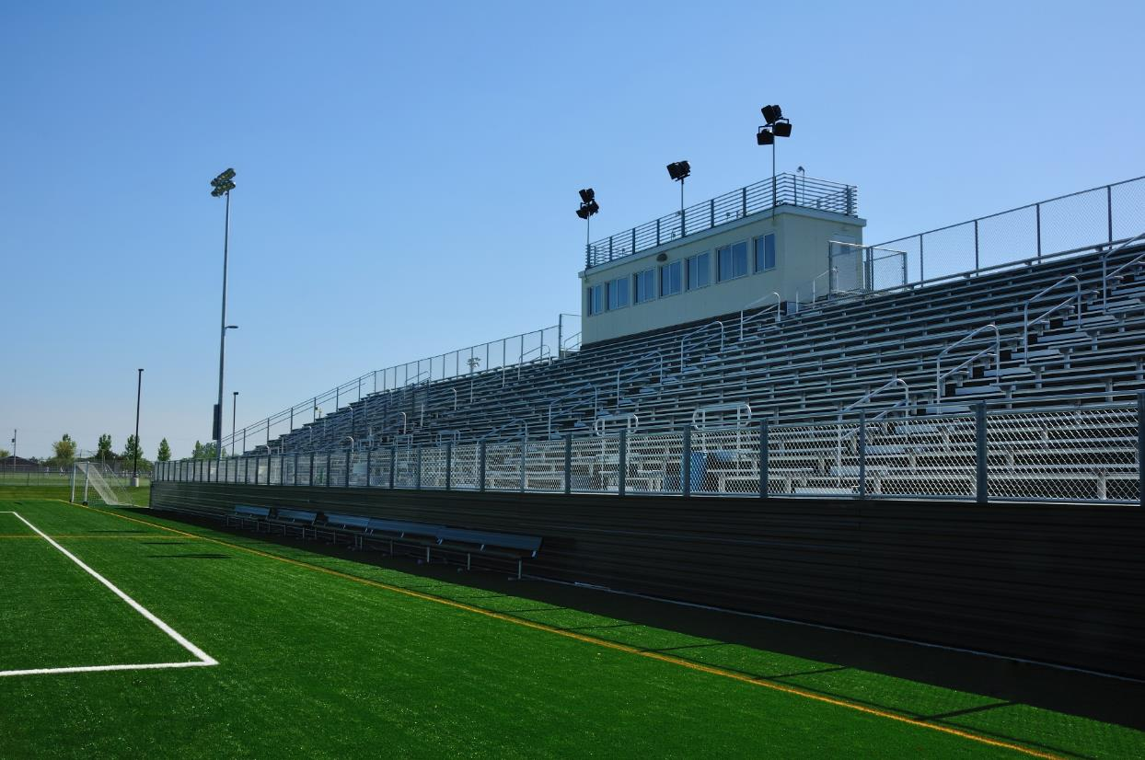
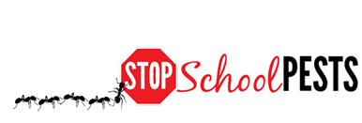
Common Turfgrass diseases
Lesson 4 of 4
Self-Guided Educational Module

Slide 2
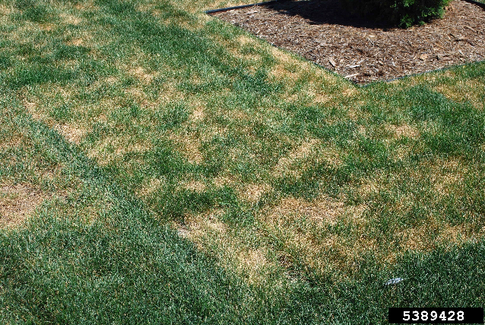
Learning Objectives
Identify and describe how to manage common turfgrass diseases
Describe how to avoid and reduce stresses on turfgrass
Spring dead spot - Howard F. Schwartz, Colorado State University, IPMImages.org

Slide 3
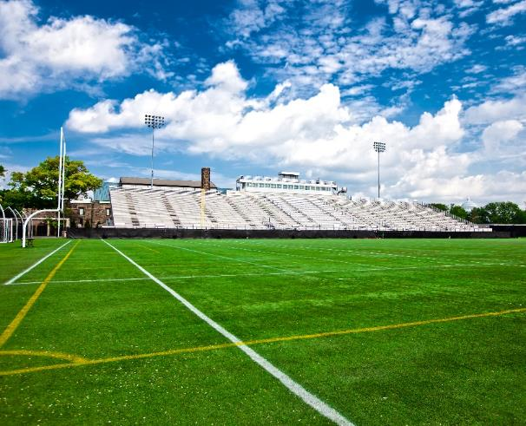
Regions
Weather and climate greatly impact severity and incidence of turfgrass diseases This learning lesson contains examples of diseases that may or may not be common in your part of the country
Most disease issues can be managed with cultural techniques including proper variety selection, and irrigation and mowing practices

Slide 4
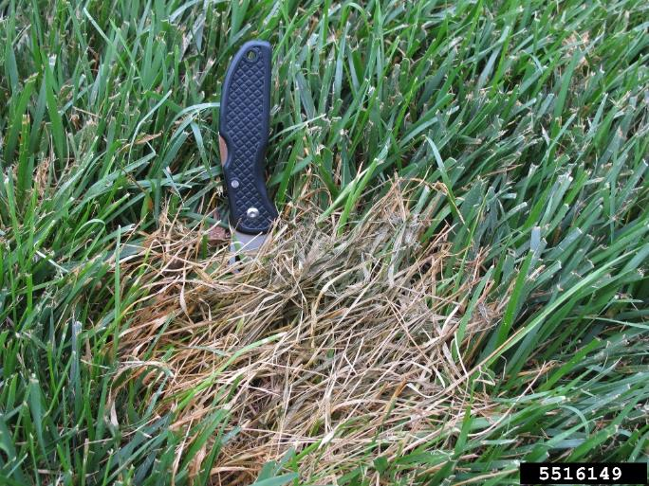
Identifying, Monitoring and Management of Turfgrass Disease
Fairy ring
Spring dead spot
Pythium blight
Dollar spot
Rusts
Leaf spot
Red thread
Pythium root and stem
rot - Lee Miller, University of Missouri, Bugwood.org

Slide 5
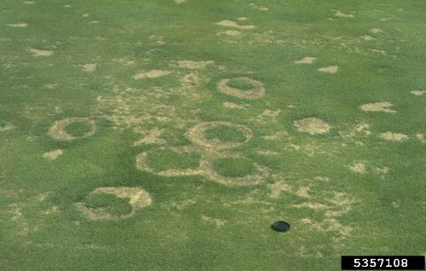
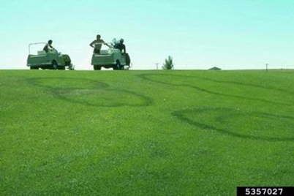
Fairy Rings
Identification: Fairy rings are circular and can range in size from a few centimeters up to many meters in diameter
Symptoms: Large dark green rings sometimes accompanied with a thin ring of dying/dead turf inside, or rings of mushrooms without loss of turfgrass
Green rings, also fairy rings -William M. Brown Jr., Bugwood.org

Slide 6
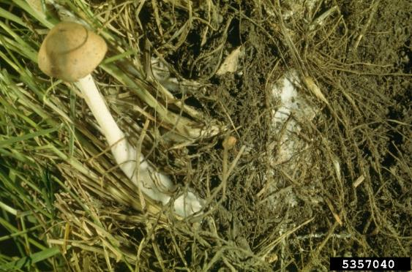
Fairy Rings
Cause: A number of species of fungi which decompose organic matter often buried deep within the soil
Management: Proper fertilization and irrigation along with regular dethatching will help reduce symptoms of this disease
Fairy ring fruiting bodies - Lester E. Dickens, Bugwood.org

Slide 7
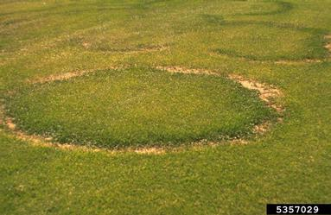
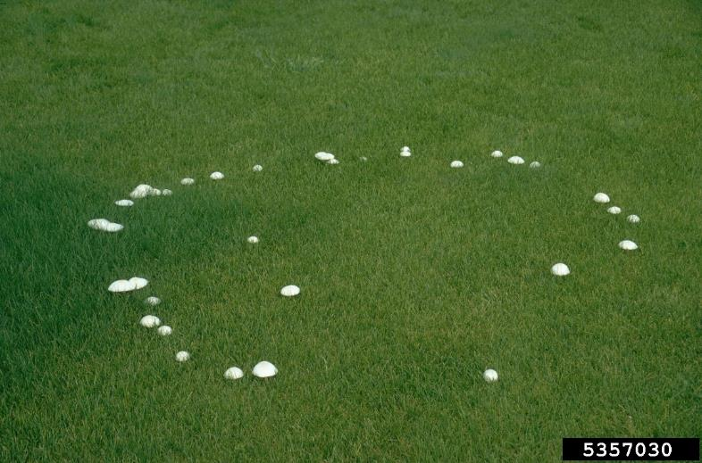
Fairy Ring
Dead rings
Live rings
William M. Brown Jr., bugwood.org
Notes:
Dr. Alec Kowaleski (Oregon State University turfgrass agronomist

Slide 8
Spring Dead Spot
Identification: Appears as circular areas of dead grass, 6 to 12 inches in diameter when warm-season turf emerges from winter dormancy
Symptoms: Dark, sunken areas can be seen on affected areas and may become black and breakable in advanced staged of infection
Cause: Spread of the pathogen which survives in old debris and roots
Management: Remove infected areas and reduce organic matter accumulation, avoid later fall fertilization, and maintain proper pH

Slide 9
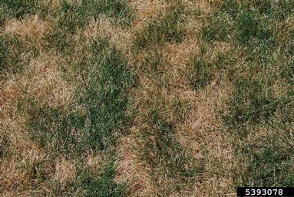
Spring Dead Spot
Spring dead spot is very problematic on bermudagrass used in transition zones, were deep winter dormancy is present
Spring dead spot - Howard F. Schwartz, Colorado State University, Bugwood.org

Slide 10
Pythium Blight
Identification: Look for cotton-like strands (mycelia) and small, circular spots of dead grass that run together as disease progresses
Symptoms: Leaf blades blacken, rapidly wither, and turn reddish-brown Leaves lie flat, stick together, and appear greasy
Cause: Fungus develops in low spots that remain wet and during periods of high humidity
Management: Pythium blight is an indicator of over-fertilization and overwatering and/or poor drainage
Cultivation may improve drainage

Slide 11
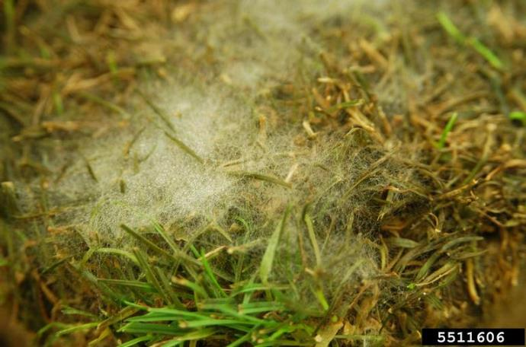
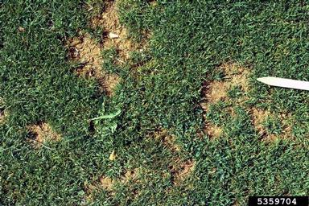
Pythium blight
Cottony white mycelium can be observed early in the morning during periods of high heat and humidity
Pythium blight - Ward Upham, Kansas State University, bugwood.org
Pythium blight - William M. Brown Jr., Bugwood.org

Slide 12
Dollar Spot
Identification: Spots the size of a silver dollar that often merge to form large, irregular areas of infected turf
Symptoms: Leaves appear water-soaked initially, then brown A reddish band extending across the leaf appears
Cause: Excessive leaf wetness and fog contribute to disease development, as does water stress, excess thatch, and poor nutrition
Management: Dollar spot is an indicator of low fertility, a fertilization application will mitigate the disease

Slide 13
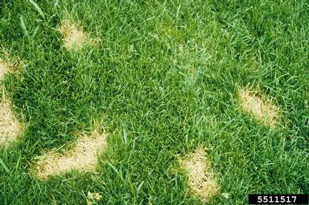
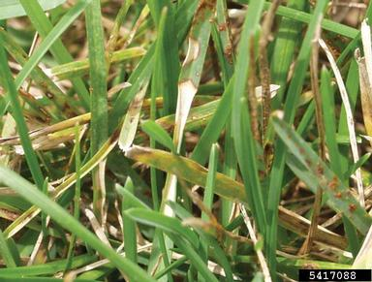
Dollar spot
Dollar spot infestations begin as quarter-size spots and increase to silver dollar-size spots that multiply rapidly
Dollar spot - Ward Upham, Kansas State University, bugwood.org
Dollar spot - Barb Corwin, Turfgrass Diagnostics, Bugwood.org

Slide 14
Rusts
Identification/Symptoms: Bumps appear as powdery masses of yellow, orange, purple, black or brown spores on leaves and sometimes on stems Infected turf will color your shoes orange
Cause: Disease is favored during periods of warm days and cool nights, especially in turf with low fertility
Management: Fertilization will help prevent this disease

Slide 15
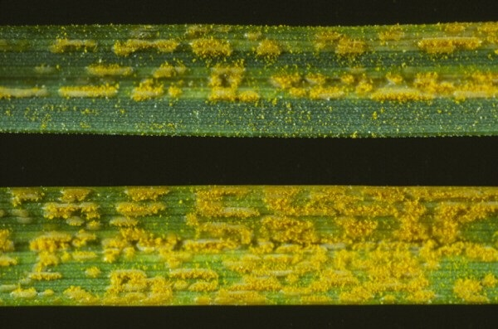
Rusts
In low fertility situations, rust will typically begin to develop in the late summer to early fall
Rust - R.S. Byther, WSU Plant Pathologist Emeritus

Slide 16
Leaf Spot
Identification: Spots may vary from small discrete dots and raised areas to irregular yellow or brownish patches that cover much of the leaf surface
Symptoms: Leaves with obvious lesions
Cause: Multiple fungal pathogens associated with excess organic matter, poor drainage and excessive fertilization
Management: Core cultivation and vertical mowing will decrease organic matter, and improve surface drainage

Slide 17
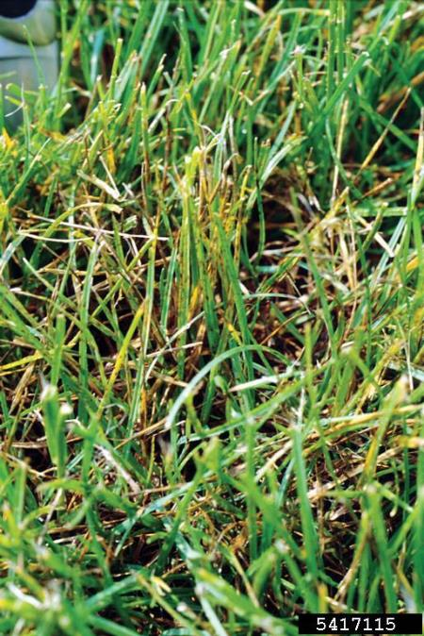
Leaf Spot
When leaf spot develops on Kentucky bluegrass and the turf is not fertilized and aerated, it will progress into melting out, which can kill turf and result in bare spots
With low light levels, leaf spot is far more severe
Leaf spot on Kentucky bluegrass - Ned Tisserat, Colorado State University, Bugwood.org

Slide 18
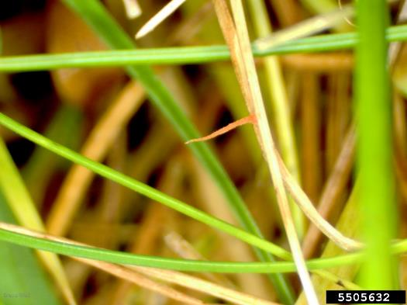
Red Thread
Identification: Pink, gelatinous fungal crusts projecting from the leaves
Symptoms: Disease may kill turfgrass in patches that are 2 to 8 inches in diameter A pink web of fungal threads binds the leaves together
Management: Provide proper irrigation and fertilization
Red thread - Bruce Watt, University of
Maine, Bugwood.org

Slide 19
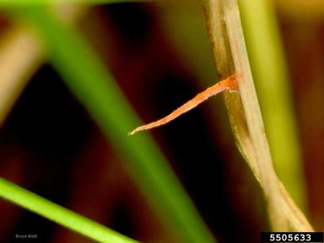
Red Thread
Adequate nitrogen can usually prevent this disease from occurring
Red thread - Bruce Watt, University of Maine, bugwood.org

Slide 20
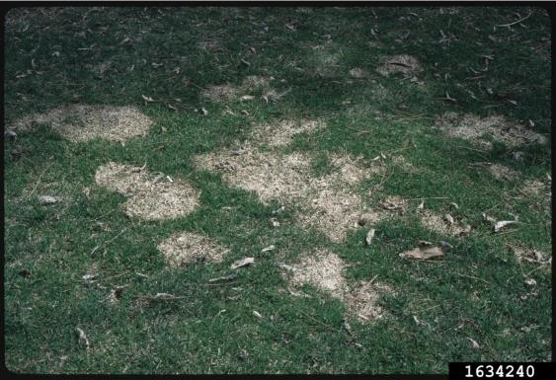
Managing Disease in Turfgrass
Many fungi that cause turf disease can also survive on organic matter, and disease development can be a sign of excessive organic matter
Reducing organic matter through frequent cultivation is the typical recommendation
Snow mold - Penn State Department of Plant Pathology & Environmental Microbiology Archives, Penn State University, Bugwood.org

Slide 21
Managing Disease in Turfgrass
Most fungi require moisture to germinate and infect, so overwatering can contribute to disease problems
Irrigate in the early morning to limit leaf wetness during the night Always try to avoid late afternoon or nighttime irrigation if possible
Apply water only as fast as the turf accepts it to avoid puddles and run-off

Slide 22
Managing Disease in Turfgrass
Good turf management is the first step in turf disease management
Proper mowing
Proper fertilization
Irrigate appropriately
Annual cultivation
Dethatch sod forming grasses and aerate
Fungicides should be used only if cultural measures do not provide adequate control

Slide 23
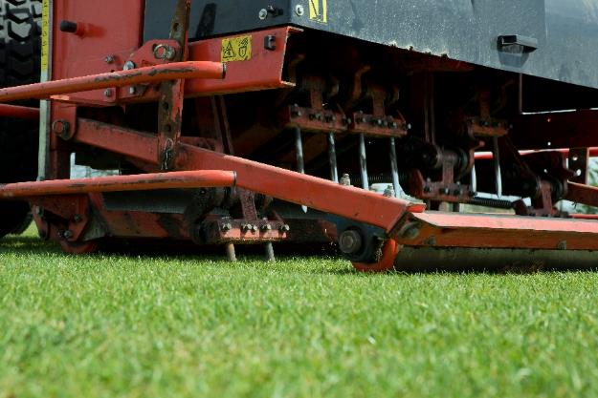
Managing Turf Stress
Aerate to relieve soil compaction, encourage drainage and prevent thatch buildup
Limit field access under wet soil conditions
Promote a resilient, deeply rooted turf in the off-season
Raise mowing heights during summer stress, especially if rainfall is the only source of water

Slide 24
Managing Turf Stress
Water deeply and infrequently to encourage a deep root system
Overwatering reduces root growth and turf resilience, and encourages weeds and diseases
Evaluate irrigation system to eliminate areas with standing water and/or “missed” areas
Water in the early morning to limit evaporation and reduce fungal disease problems

Slide 25
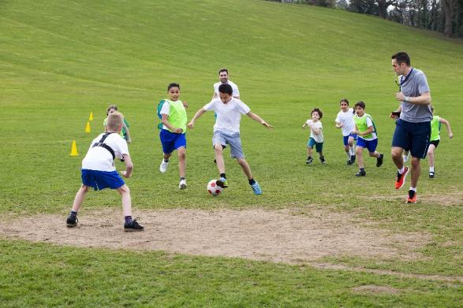
Managing Turf Stress
Consider drought-tolerant turf varieties that are suitable for your area
When setting up an irrigation program start with 0.2 inches per event applied 2 or 3 times a week Increase or decrease the number of days and depth you irrigated accord to plant response

Slide 26
Check In!
In this lesson you learned:
How to identify and manage common turfgrass diseases
How to avoid and reduce stresses on turfgrass
Congratulations, you have completed the School Grounds IPM learning module!

Slide 27
Resources
Iowa State University. (2010). Plant and Insect Diagnostic Clinic. http://www.ipm.iastate.edu/ipm/info/plant-diseases/turf-grass-rust
Maine Department of Agriculture, Conservation and Forestry. School IPM. http://www.maine.gov/dacf/php/integrated_pest_management/school/index.shtml
Michigan State University http://www.msuturfdiseases.net/details/_/necrotic_ring_spot_13/
Rutgers Cooperative Extension. IPM Report Card for School Grounds: General Requirements. http://entomology.osu.edu/schoolipm/IPMfiles/ReportCardGeneral.pdf
Texas A&M Agrilife Extension. Landscape IPM Module 6. http://schoolipm.tamu.edu/videodvd/
Umass Extension Center for Agriculture. Best Management Practices For Lawn and Landscape Turf. http://extension.umass.edu/turf/sites/turf/files/pdf-doc-ppt/lawn_landscape_BMP_2013_opt.pdf
University of California Agricultural and Natural Resources. (2009). How to Manage Pests. http://www.ipm.ucdavis.edu/PMG/r785100411.html

