Slide 1

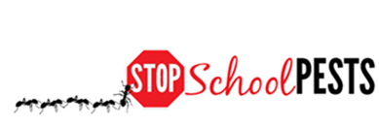
IPM FOR Maintenance staff
Self-Guided Education Module
Lesson 1 of 1

Slide 2

Learning Objectives
Explain the importance of routine, proactive building and facilities maintenance to maintain structural integrity and prevent pest entry and pest conducive conditions
Explain the
importance of timely work order follow-up

Slide 3

Learning Objectives
Describe the key elements of sanitation (clean environment) and exclusion, (habitat prevention) including: strategies, tactics, and tools
Describe the key elements of inspection and monitoring, including what to look for, where to look, tools used, and frequency
Explain the importance of effective communication, education, and cooperation between school staff

Slide 4
What is IPM?
IPM = Integrated (Intelligent) Pest Management
A sensible, environmentally friendly, and effective way to solve pest problems
For more information on IPM, refer to resource sites https://www.epa.gov/managing-pests-schools
&
                https://ipminstitute.org/projects/school-ipm-2020/updates/
                &
                http://ischoolpestmanager.org/

Slide 5
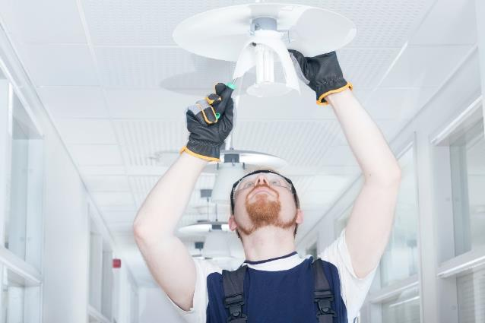
Maintenance Staff and IPM
Maintenance responsibilities include everything from fixing furniture and drains, changing
light bulbs and locks, installing
appliances, collecting and
emptying trash
Often they are asked to drop
current tasks to attend to an emergency
Many are also responsible for the maintenance and care of landscaping and grounds surrounding a building
Please refer landscape/grounds module if you are responsible for landscape and/or grounds maintenance at your school

Slide 6
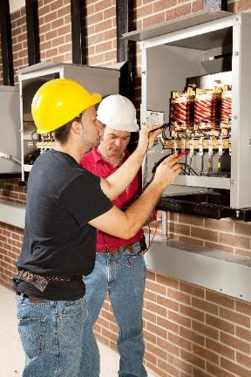
Maintenance Staff and IPM
Why should maintenance staff be involved in school IPM?
Maintenance staff are among the most important people in a school IPM program because they:
  are staff members who regularly see every part of the school and work with all other staff members
  perform a variety of tasks that are needed to maintain a healthy learning environment throughout the school
  regularly maintain the school to help keep pests out and therefore, reduce pest and pest management associated risks

Slide 7

Pests Love To Go To School!
Schools are great places for pests because there are many different areas and spaces they can thrive (e.g., food service, storage areas, classrooms, lockers, etc.)
Pests often find everything they need to survive: food, water and shelter, all in one
place!

Slide 8

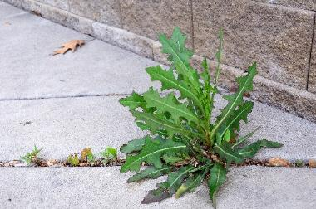
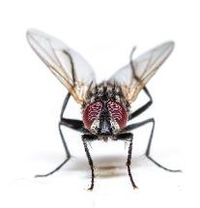
Pests in schools
Being aware of common pests is the first step in their management - Problematic pests in and around schools include:
  Animal pests: Ants, cockroaches, flies, termites, scorpions, mosquitoes, rodents, pigeons, etc.
  Plant pests: Insects such as aphids, whiteflies, scales, and weeds

Slide 9
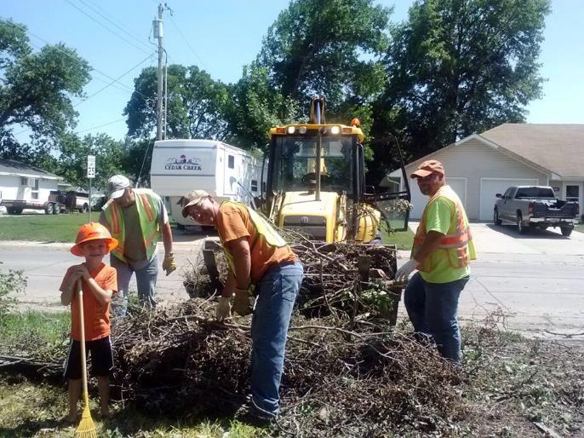
1.
IPM is Not an Additional Item on Your to-do List
Maintenance staff have very demanding jobs
IPM does not add to your responsibilities!
IPM only involves making slight changes in your daily activities, that will make your life easier and your working environment healthier!
IPM is not your job alone, it is everyone’s job
Maintenance staff with young helper, moving debris from fallen tree - Jason Moore, Street Superintendent, City of Beatrice, Nebraska

Slide 10
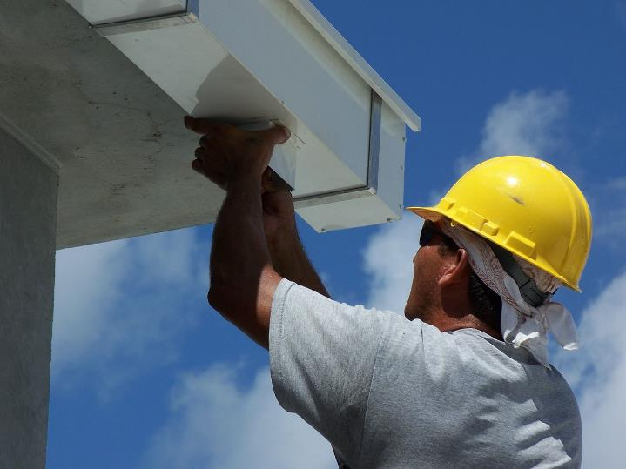
Maintenance Staff and IPM
Dedicated maintenance staff actually implement IPM as they go about their regular daily duties
Rain gutters channel water away from building foundations, reduce erosion, prevent leaks in basements and crawlspaces, protect painted or stained surfaces by reducing exposure to water, and provide a means to collect rainwater for later use
Maintenance staff installing a rain gutter on a building - Ethoseo from Wikimedia commons

Slide 11
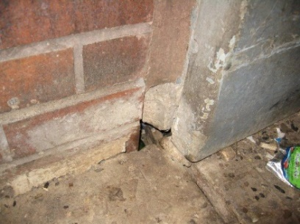
Maintenance Staff and IPM
Routine, proactive maintenance is important
  To maintain structural integrity of the school buildings
  To prevent pest entry and pest conducive conditions
Gaps in foundation provide access to pests such as rodents - Dawn H. Gouge, University of Arizona

Slide 12
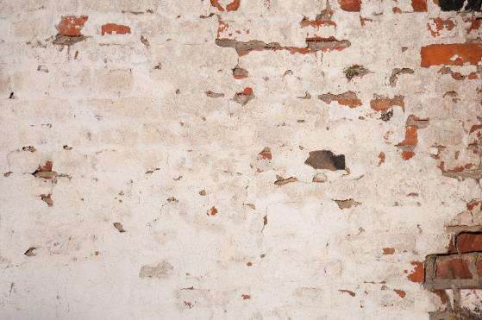
Routine, Proactive Maintenance
Maintain structural integrity of buildings
Major factors that can affect structural integrity are moisture, wear and tear due to use, natural degradation, and pest activity
Minimize these effects by regularly monitoring your buildings
Perform structural repairs and reinforcements as soon as possible
Gaps in wall plaster can lead to moisture retention and weakening

Slide 13
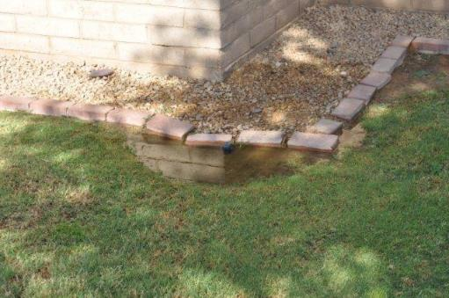
Routine, Proactive Maintenance
Maintain structural integrity of buildings
Moisture can cause structural weakening, unsightly discoloration and deformation, and support mold and other pests
Avoid moisture accumulation in and around the building, e.g., water
puddling near foundation
or walls
Waterproofing should be
done using quality materials
Avoid water accumulation around building foundation – Shaku Nair, University of Arizona

Slide 14
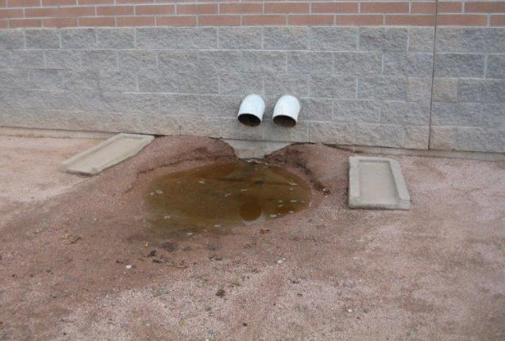
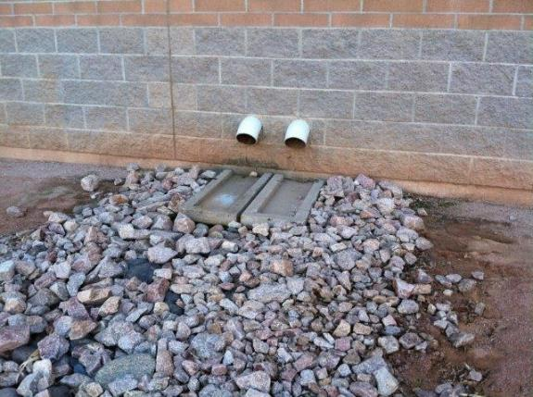
Routine, Proactive Maintenance
Maintain structural integrity of buildings
Incorrect placement of splash-guards (left) leads to puddling of water near building foundation and soil erosion. This has been corrected by correct placement of splash-guards (right) and addition of rocks and rip-rap to control erosion
– Shaku Nair, University of Arizona

Slide 15
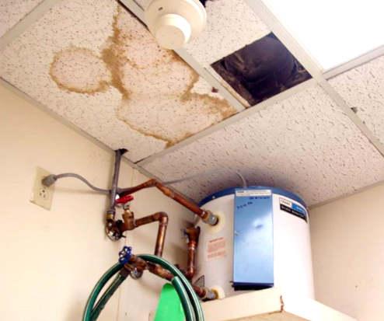
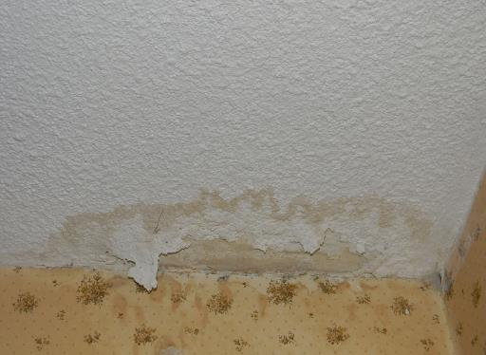
Routine, Proactive Maintenance
Water leaks
Water leaks can indicate faulty plumbing, damaged roofs, or other problems
Water leaks can attract mold, carpenter ants, termites, flies, and rodents
They can also weaken the structure and lead to other problems such as electrical short circuits
Repair water leaks promptly – Dawn H. Gouge, University of Arizona
Drywall water damage
- Herbert Bernstein, WikiMedia Commons

Slide 16
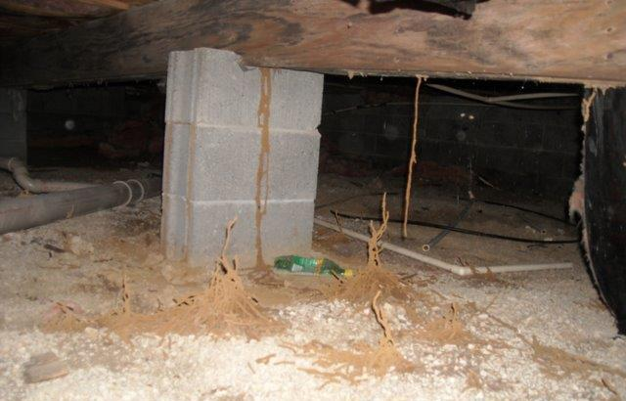
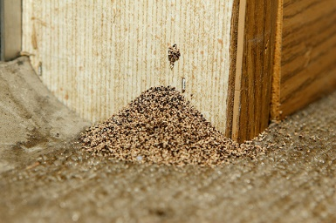
Routine, Proactive Maintenance
Maintain structural integrity of buildings
Be aware of structural pests attracted to water damaged wood such as termites, wood-destroying beetles, and mold
Monitor for pest activity and take necessary action as soon as they are noticed
Sign of western drywood termite damage - Kevin (ibkev2002), Flickr
Subterranean termite shelter tubes in a basement
- Larry Ralph Jr., Indiancrawlspacerepair

Slide 17
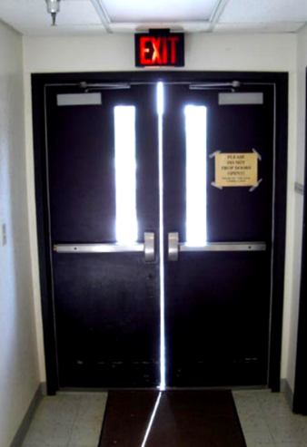
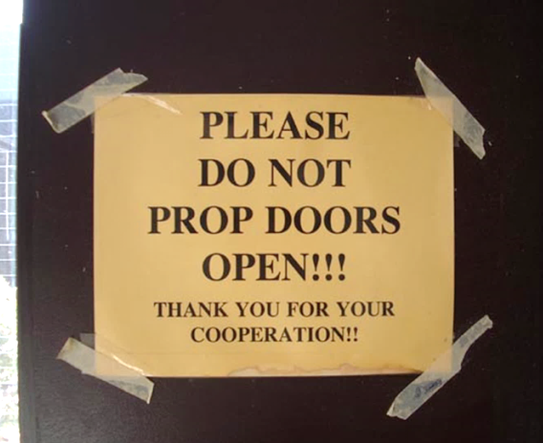
Routine, Proactive Maintenance
Prevent pest entry
Seal your buildings, make sure doors seal and self-close correctly
The vertical gap in the doorway (right) should be closed with brushes
Exterior doors should never be left propped open - Mice can enter through a ¼” gap
Effective door sweeps can cut
pest complaints by 65%
Even if this door is not propped open, the vertical gap gives easy entry to flying and crawling pests – Dawn H. Gouge, University of Arizona

Slide 18
Routine, Proactive Maintenance
Prevent pest entry
Check that escutcheon plates (pipe collars) are in place
Seal around pipe-chases and conduits that enter walls or drop ceilings
Loose escutcheon plates – Dawn H. Gouge, University of Arizona
Gap in drop ceiling - Janet Hurley, Texas AgriLife Extension

Slide 19
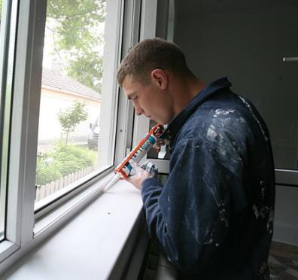
Routine, Proactive Maintenance
Sealing gaps
Use high quality silicon based (elastomeric) sealants to seal small cracks and crevices, and high quality concrete fillers, or steel wool to fill larger gaps
Sealing gaps around window frames keeps pests out and reduces heating/cooling expenses -WikiMedia Commons
Gaps in wall at pipe entry points Gaps have been sealed
- J. G. Kaufmann, WikiMedia Commons

Slide 20
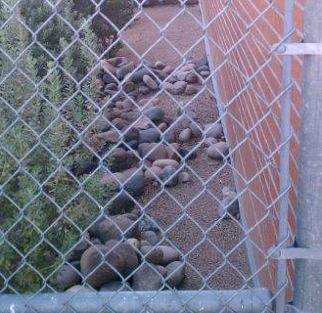
Routine, Proactive Maintenance
Prevent pest entry
Seal around windows, doors, gaps in masonry, wall penetrations
Eliminate any unscreened access from outside
Ensure air doors are set correctly
Create space around your buildings - allow at least 1 foot gap between the building and vegetation
Ensure that access panels are not left open – Jerry Jochim, Monroe County Community School Corporation
Ensure space between vegetation and building – Dawn H. Gouge, University of Arizona

Slide 21
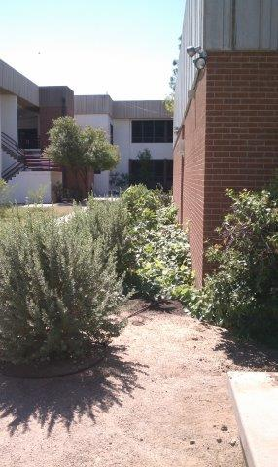
4.
Routine, Proactive Maintenance
Shrubs should be pruned away from buildings and shaped so they do not create places for rodents to hide
Keep tree limbs pruned at least six feet away from buildings
Remove vines climbing on buildings or growing low to the ground next to buildings to prevent pest access
These shrubs need trimming
and pruning – Dawn H. Gouge, University of Arizona

Slide 22
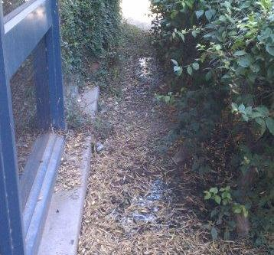
Routine, Proactive Maintenance
Avoid pest conducive conditions
Clean debris out of external drainage catch areas to reduce pest harborage
Prevent debris and moisture from accumulating near building walls and foundations
Grate and drain covers should be removed and cleaned out periodically – Dawn H. Gouge, University of Arizona
Pests such as rodents and flies are attracted to moist organic matter – Marc Lame, Indiana University

Slide 23
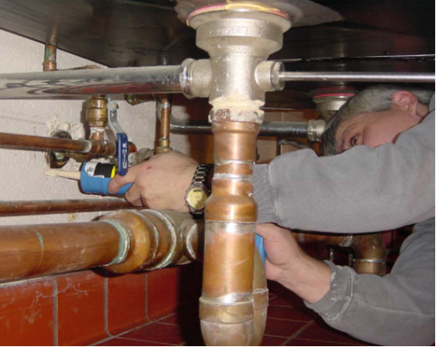
Routine, Proactive Maintenance
Avoid pest conducive conditions
Pests such as cockroaches spend daytime hours harboring in cracks and crevices, including open plumbing and electrical pipe entry points, and unsealed crevices
Correct these conducive conditions, especially in areas where food is stored, prepared, or served
Sealing around escutcheon plates – Jerry Jochim, Monroe County Community School Corporation

Slide 24
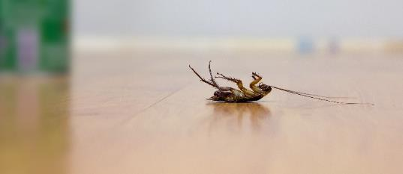
Routine, Proactive Maintenance
When Using Pesticides
Remember that a pesticide applicator license may be required for pesticide applications on school property, including mold control, weed killers, insecticides, and rodent baits
Make certain that you are in compliance with local, state, and federal laws
Be aware of pesticides and chemicals that are legally allowed on school premises and
ensure proper notifications are
in place

Slide 25
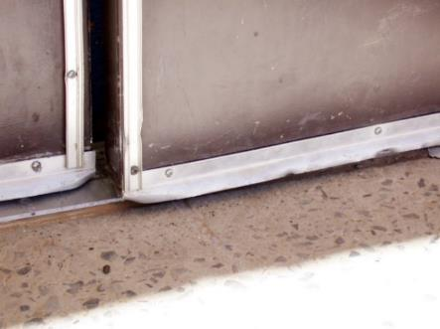
Timely Work Order Follow-Up
Enforce timely responses to priority pest problems related to building repairs
Often a small fix can avoid a big problem
Repeated reporting of the same defect or damage is a waste of staff time
Whenever possible, centralize
reports and track resolution
times and costs
Use existing work-order
systems when possible
Ensure doors close completely to keep pests out – Dawn H. Gouge, University of Arizona

Slide 26
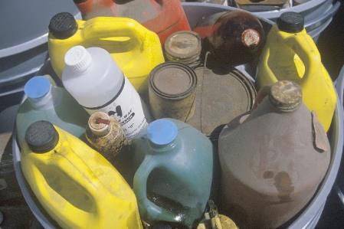
Key Elements of Sanitation and Exclusion
Sanitation and exclusion are basic steps in IPM
Sanitation involves cleaning, including the removal of hazardous wastes or materials that might pose health risks
In school environments, this involves proper disposal of garbage and other wastes, so that they do not interfere with school activities, or contaminate the school water supply or the school
premises in general
Joseph Sohm, Shutterstock.com

Slide 27
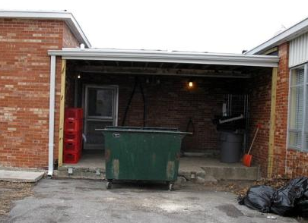
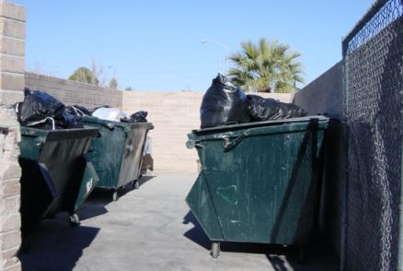
Key Elements of Sanitation and Exclusion
Waste management is an important part of sanitation
    Ensure that dumpsters are kept clean, covered, and well maintained
    Place dumpsters on a concrete or asphalt surface 20-30 feet away from building entryways
    Areas around the dumpster should be kept free of debris that can also shelter pests
Dawn H. Gouge, University of Arizona
This dumpster is too close
to the kitchen entryway
Good placement of dumpsters, in separate enclosed area, but lids should be closed

Slide 28
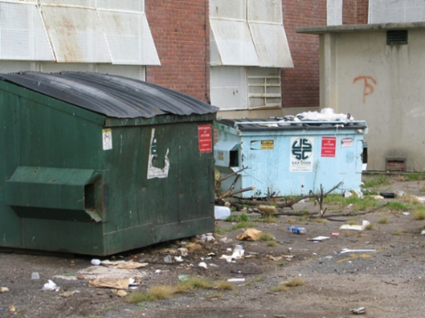
1.
Key Elements of Sanitation and Exclusion
Waste management
Your dumpster capacity should be sufficient; you should not have overflowing containers the day before collection
Discourage administrators from
getting huge containers that are
emptied only once a month
Dumpsters can become homes
for feral cats, rats, and all
kinds of pests
Poorly managed dumpsters
and dumpster area – Marc Lame, Indiana University
Notes:
Objective 1

Slide 29
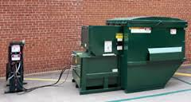
1.
Key Elements of Sanitation and Exclusion
Waste management
Your service provider should rotate out dirty dumpsters for clean ones – you often need to request this
Dumpsters should be emptied at least weekly, more often in hot weather
Consider sealed, leak-proof, self-contained compactors, available in many sizes – Shaku Nair, University of Arizona

Slide 30
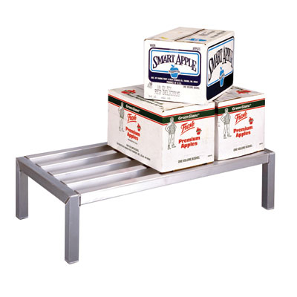
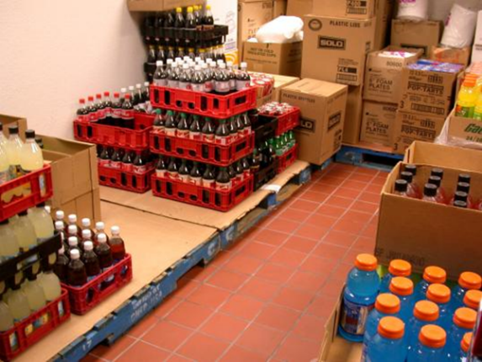
Key Elements of Sanitation and Exclusion
Sanitation also involves proper storage of supplies and materials - This helps to:
Prevent pest-conducive conditions
Permit proper cleaning and inspection
Aluminum dunnage racks are ideal, as you can see and clean beneath them
Cardboard covered wooden pallets are pest prone
- Dawn H. Gouge, University of Arizona

Slide 31
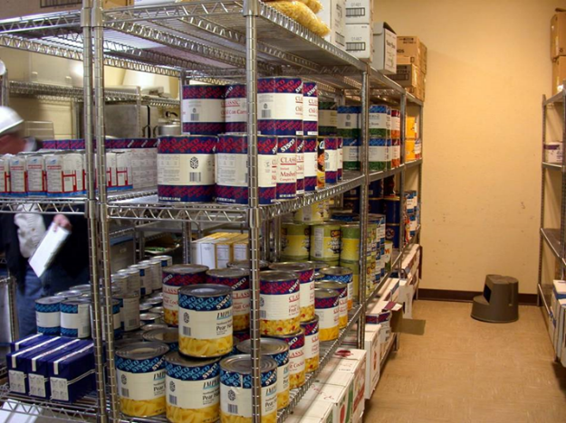
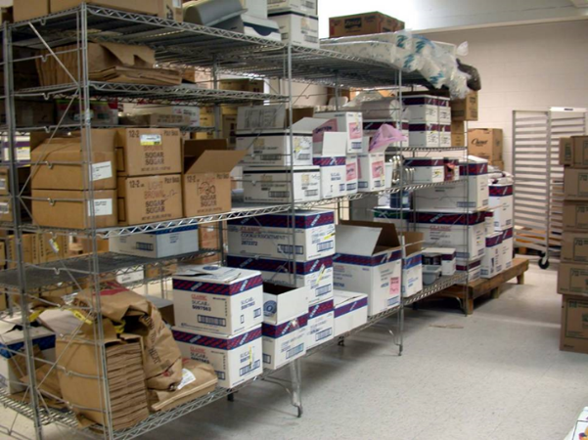
Pest Exclusion Strategies/Tactics
Corrugations in cardboard boxes provide excellent harborage for cockroaches
Avoiding cardboard in storage is an important part of cockroach management
Kitchen pantry, before and after
cardboard removal (inspect, date and organize supplies as they arrive) - Marc Lame, Indiana University

Slide 32
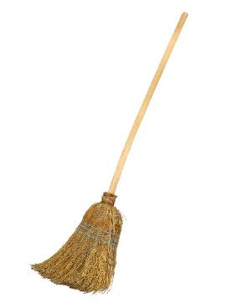
Equipment cleaning
Keeping cleaning equipment in good and clean working condition is equally important to avoid attracting pests
Hang brooms 6 inches off the vertical wall
Food and other residues can accumulate in all of the following:
  Garbage receptacles
  Brooms, dusters, and brushes
  Mops and buckets
    Vacuum cleaners,
    polishers, scrubbers
Natural fiber brooms are difficult to clean,
select cleaning tools that are easy to maintain

Slide 33
Cleaning Equipment Maintenance and Storage
Emptying
Vacuum cleaners, floor scrubbers, and other pieces of equipment usually need to be emptied of debris or chemicals before they are stored
Wiping Down, Washing, and Rinsing
After use, each piece of equipment should be wiped down and, when appropriate, washed and rinsed to prevent build up of grit and grime

Slide 34
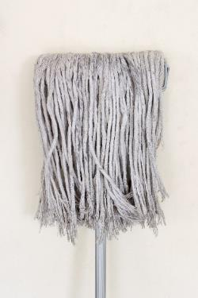
Cleaning Equipment Maintenance and Storage
Storage
Once brooms, mops, and other tools are clean, store the items on off-the-floor racks, and away from the vertical wall
Clean and dry mop heads may be stored in transparent plastic totes or on wire shelving
Avoid heaping them on the floor or on solid
shelving, they provide great harborage for
spiders and cockroaches, and even
nesting materials for mice
Store equipment off the floor and in a
manner that will allow it to dry rapidly

Slide 35
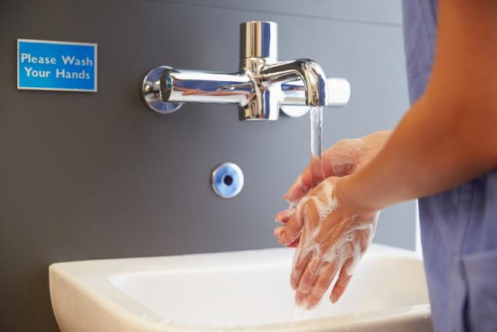
Thorough cleaning procedures
Above all, keep yourself safe, clean, and hygienic!
Remember to wash your hands thoroughly after cleaning up, especially if using chemicals products

Slide 36
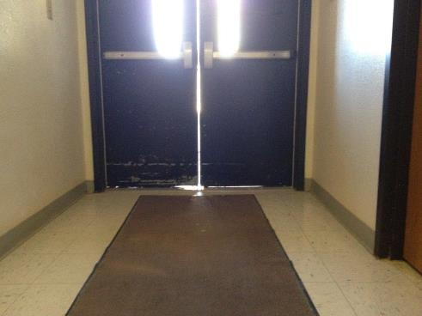
Pest exclusion involves denying pests access to food, water and shelter
Key Elements of Sanitation and Exclusion
Any sign of a pest should trigger a search for possible points of entry
Watch out for worn out door-sweeps
and weather stripping
Watch out for hitchhikers in deliveries
  Check for signs of pest presence (droppings, pests, webbing or holes in boxes and insect monitoring traps in storage areas after a delivery)
This door needs new door-sweeps and weather stripping – Dawn H. Gouge, University of Arizona

Slide 37
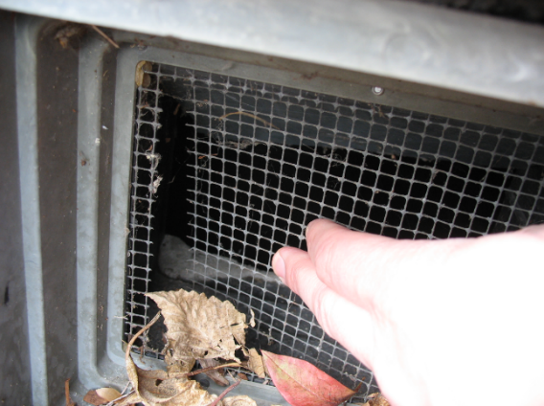
Pest Exclusion Strategies/Tactics
Replace worn door-sweeps - Effective sweeps drastically reduce the number of invading pests and can cut pest complaints by as much as 65% in some situations
Seal gaps, cracks, and crevices with suitable sealants
Cover windows and vents with wire mesh and replace with new wire mesh when broken
Torn wire mesh on a vent – Jerry Jochim, Monroe County Community School Corporation

Slide 38
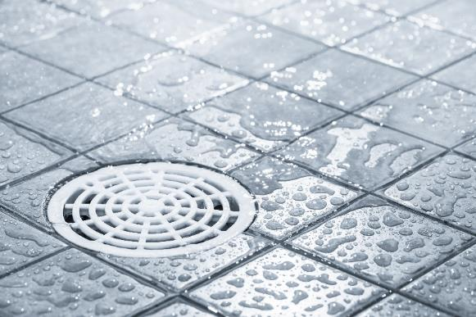
3.
Pest Exclusion Strategies/Tactics
P-traps in drains prevent gases, odors, and insects from entering buildings
Keep them filled with water, dry P-traps can create access to your building from the sewer for American cockroaches
Inspect drains periodically to prevent P-traps from drying out

Slide 39
Pest Exclusion Strategies/Tactics
Avoid propping doors open, a propped door is both a security risk and a pest invitation
Close gaps that provide access to pests, young mice can squeeze through a gap the size of a dime; young rats need nickel-sized gaps; American cockroaches can pass through a gap the width of a quarter
Avoid clutter, both inside and outside, especially near external doorways
This door should be closed
Jerry Jochim, Monroe County Community School Corporation
This space needs de-cluttering!

Slide 40
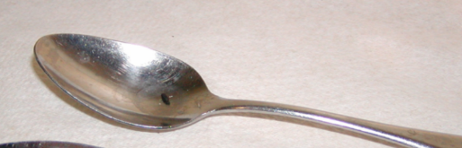
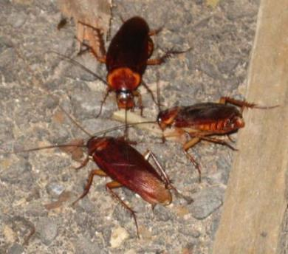
2.
Key Elements of Inspection and Monitoring
The best way to know if or when pests are present is by regular inspection and monitoring
What to look for:
Pests
Signs of pests
Pest conducive conditions - pest opportunities inviting pests for food, water, and harborage
Mouse poop on a spoon
Dawn H. Gouge, University of Arizona
Cockroaches feeding on crumbs

Slide 41
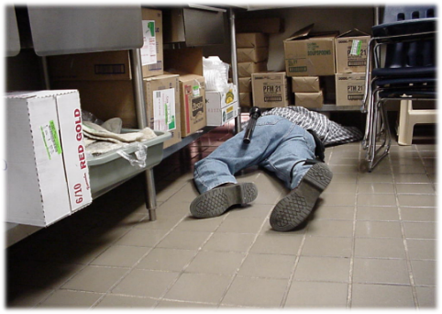
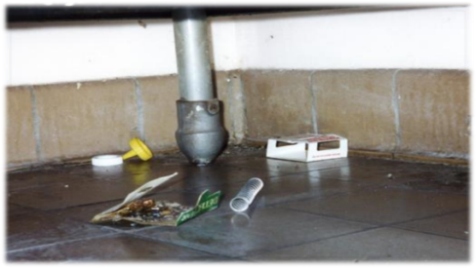
2.
Key Elements of Inspection and Monitoring
Where to look:
Dark corners
Hard-to-reach areas
Undisturbed places/under and behind stationary items
Warm and/or wet places
Food storage and/or preparation areas
Waste collection containers/areas
Suspended ceilings
Regular, careful inspection helps to keep pests and pest-conducive conditions under control rapidly and efficiently – Dawn H. Gouge, University of Arizona

Slide 42
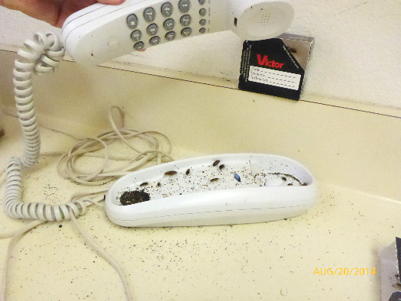
2.
Key Elements of Inspection and Monitoring
Where to look:
Warm walls with penetrations
Compressor motor voids in equipment
Unsealed floors and
floor to wall junctures
Undisturbed containers
Cardboard boxes
Clutter
German cockroaches in telephone in heavily infested teachers lounge – Dawn H. Gouge, University of Arizona

Slide 43

3.
Key Elements of Inspection and Monitoring
Frequency: Along with daily duties, communicate in writing to IPM Coordinators and others about pest issues; document your actions
Record date, time, location and:
If actual pests have been spotted
Signs (evidence) of pests
Pest-conducive
conditions

Slide 44
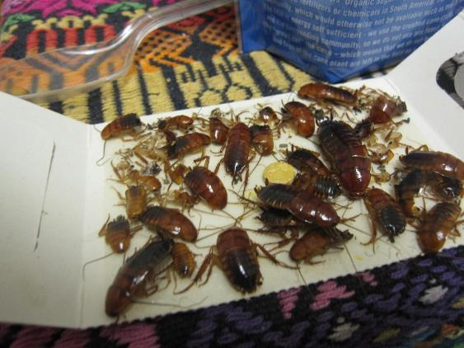

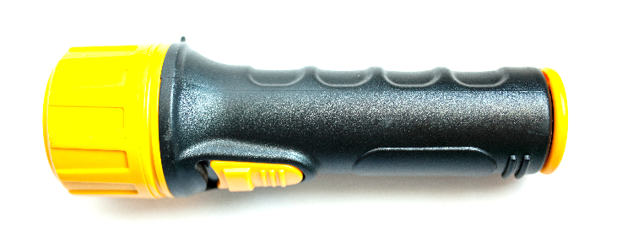
2.
Key Elements of Inspection and Monitoring
Tools:
Monitoring traps
Bright flashlight
Hand lens
Turkestan cockroaches on monitoring trap in teachers lounge – Dawn H. Gouge, University of Arizona

Slide 45
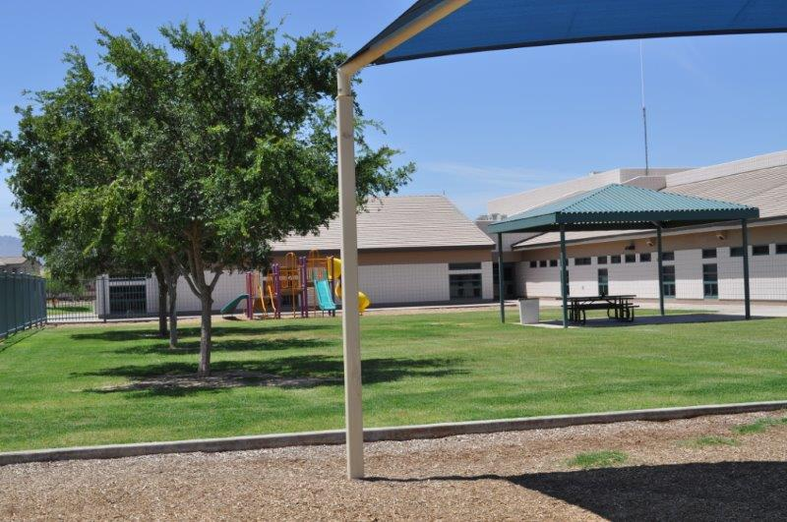
Maintenance Staff and IPM
Clean and well-maintained school premises are essential for the health and well-being of all people who learn, play or work in the area – Dawn H. Gouge, University of Arizona

Slide 46
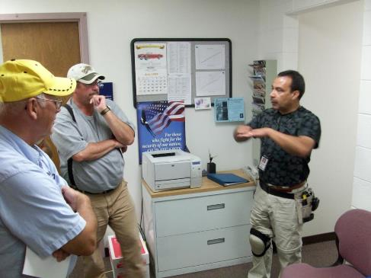
Effective Communication
Maintenance staff know more about the school premises than most other school staff - Let others know what you do, and how you can help them to manage pests
Get to know your lead front-line staff, contractors and other staff in your school
Communicate with them, show interest in their work, ask questions, help them to help you
Ricardo Zubiate teaching Salt Lake City School District Staff - Marc Lame, Indiana University

Slide 47
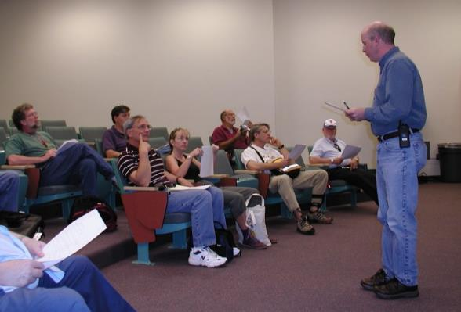
Effective Communication
Learn more about IPM from experts
Ask questions
Consider discussing IPM and its advantages with your colleagues and other school staff, faculty, and parents at PTA, staff and faculty meetings
Implementing IPM is easier with group support
Set an example;
demonstrate your success
with IPM
Dr. Robert Corrigan, RMC Pest Management Consulting teaching - Mary Grisier, EPA Region 9

Slide 48

Maintenance Staff and IPM
“I am proud of
what I do to make my
school a better place
to learn and work”
Dan Vezie, Maricopa Unified School District, AZ
Dan Vezie, Maricopa Unified School District receiving a recognition award – Shujuan Li, University of Arizona

Slide 49

Check In!
In this lesson you learned:
The importance of routine, proactive maintenance to maintain structural integrity and prevent pest entry and pest conducive conditions
The importance of timely work order follow-up
Key elements of sanitation and exclusion, including: strategies, tactics and tools
Key elements of inspection and monitoring, including: what to look for, where to look, tools used and frequency
The importance of effective communication, education, and cooperation between school staff
  Congratulations, you have completed the School IPM for Maintenance Staff Module!

Slide 50
Resources
Picture tour: IPM in Action – Safer Pest Control Project http://www.spcpweb.org/factsheets/IPM_Picture_Tour_w_cover.pdf
Get tough on pests in school facilities – NC State Cooperative Extension http://schoolipm.ncsu.edu/documents/Custodial_and_Maintenance_staff.pdf
School IPM for maintenance and grounds staff – IPM Institute http://schoolipm.ncsu.edu/documents/Custodial_and_Maintenance_staff.pdf
CA Dept. of Pesticide Regulation – IPM for Maintenance and Operations staff http://apps.cdpr.ca.gov/schoolipm/mo_staff/main.cfm
Implementing and IPM Program for Schools and Child care facilities – NC State University http://schoolipm.ncsu.edu/documents/Manual-Chapter2.pdf
Indoor and outdoor school IPM strategies http://www.extension.org/pages/20416/indoor-and-outdoor-school-ipm-strategies#.VNLCCy5kSpc

