Slide 1

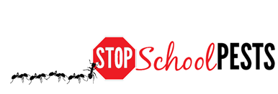
School IPM FOR Nurses
In-Person Education Module
Lesson 1 of 2

Slide 2
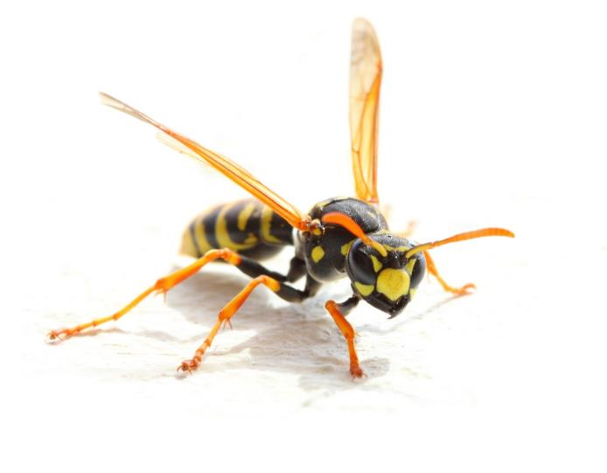
Learning Objectives – Learning Lesson 1
Identify health risks associated with:
    Bed bugs
    Head lice
    Scabies mites
    Ringworm
    Fleas
    Honey bees
    Stinging wasps
    Fire ants
    Spiders and scorpions
    Mosquitoes
    Bats and rabies
    Ticks
    Stinging caterpillars
    Venomous snakes
    Commensal rodents

Slide 3
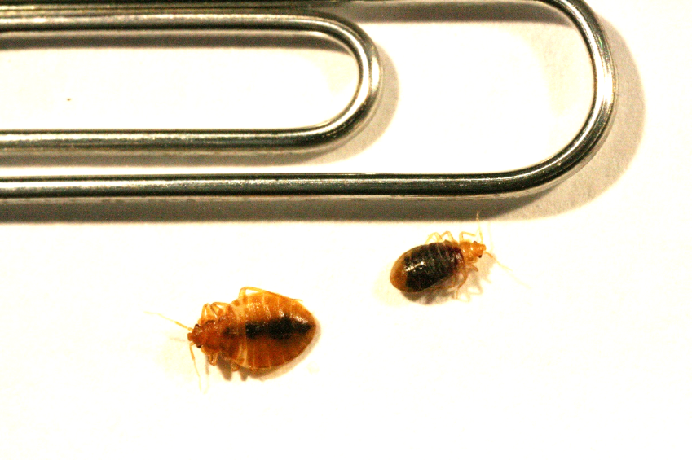
Learning Objectives – Learning Lesson 2
Measures to prevent or reduce the spread of: bed bugs, head lice, scabies mites, and ringworm
Pesticide poisoning symptoms
Bed bugs next to paperclip –
Dawn H. Gouge, University of Arizona

Slide 4
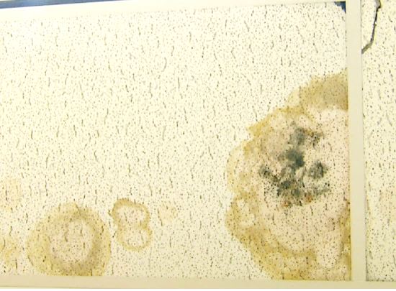
Learning Objectives - Learning Lesson 2
Identify allergy and asthma triggers in classrooms
    Chemical sensitivity
    issues
Mold on ceiling tile - Dawn H. Gouge, University of Arizona

Slide 5
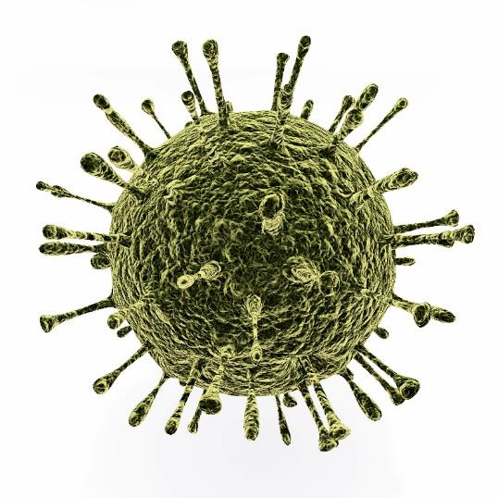
Learning Objectives - Learning Lesson 2
Emergency hotlines and resources
Notifying parents about bed bugs
Prevent encounters with mosquitoes, ticks, and stinging insects
Sanitation measures for
norovirus and flu
Norovirus

Slide 6

1. 1. 1.
Identify Health Risks Associated with Common Pests
What the pest is?
Why are they in school?
What health risks do they pose?
How to prevent schools from being transfer zones?
Management of many of these pests can be found in other learning lessons
We provide scientific information for consideration, but do not provide medical treatment recommendations

Slide 7
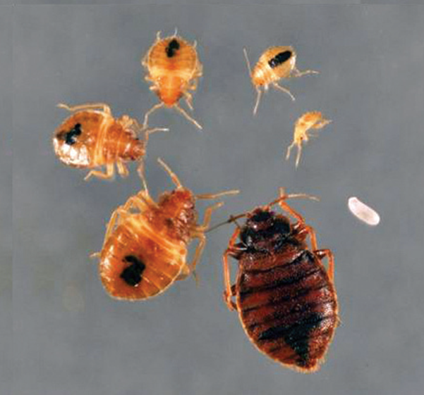
1.
Bed Bugs
Blood-feeding
ectoparasites
Hitch-hike in from home
Fall off clothing or back-packs
Transfer between people unlikely but possible
Bed bug life stages –
Changlu Wang,
Department of Entomology,
Rutgers

Slide 8
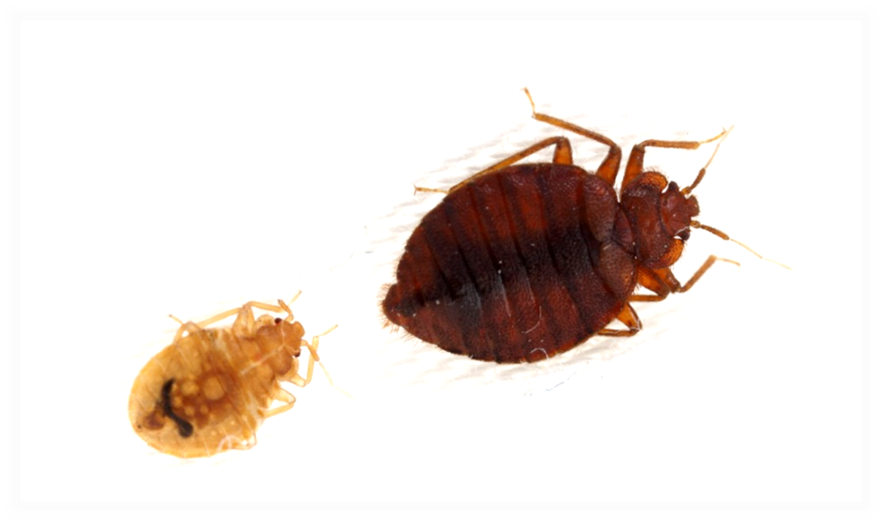
1.
Bed Bugs
Adults the size of an apple seed
Not effective vectors of
pathogens under normal living conditions
Bed bugs –
Alex Wild,
alexanderwild.com

Slide 9
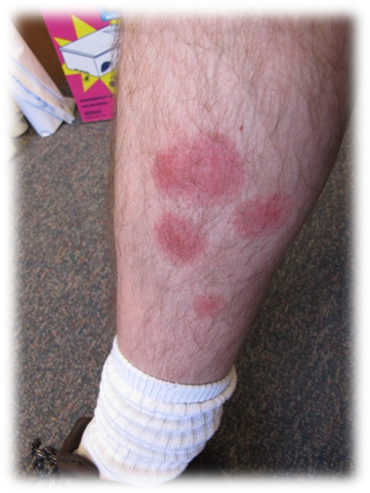
1.
Bed Bugs
Bites cause itching, and swelling
Scratching - open sores
Reactions vary
Bites do not confirm bed
bugs
Students may need clean clothes and back-pack
at school
Containerize articles from home
Bed bug bite reactions –
Tim Stock,
Oregon State University

Slide 10
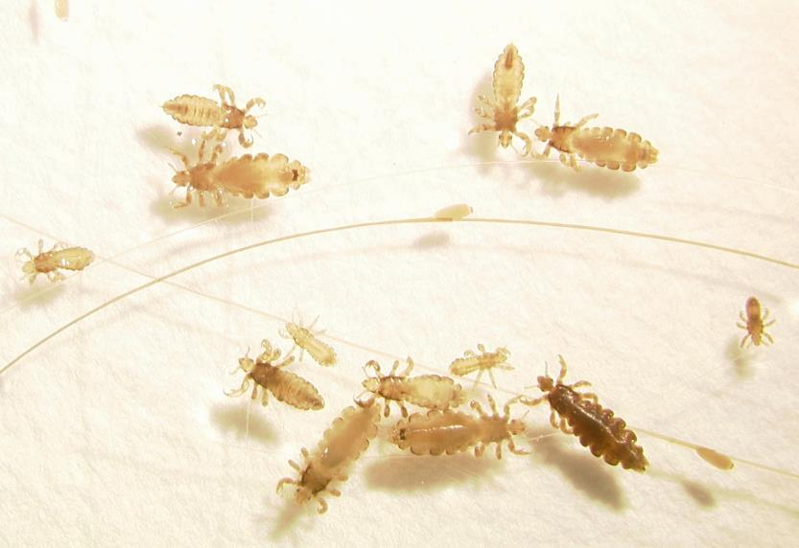
1.
Head Lice
Blood feeding ectoparasites - scalp
Children of preschool and elementary age
Lice may transfer
due to head–to-head
contact, or sharing of
pillows and mats
Head lice –
Shujuan Li, University of Arizona

Slide 11
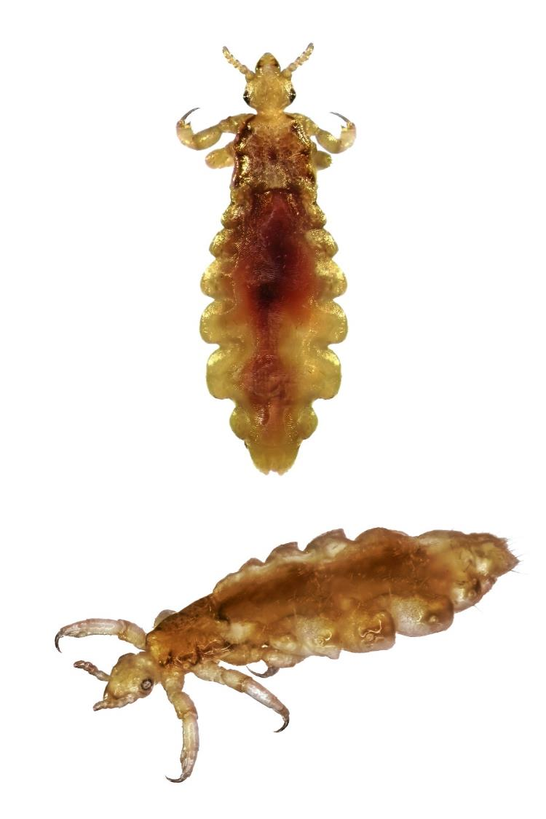
1.
Head Lice
Size of a sesame seed
(2-3 mm long)
Tan in color
Crawl rapidly
Die off scalp within 2 days
1% of students affected
Head lice

Slide 12

1.
Head Lice
Lice feed many times each day
Cause itching and sleeplessness
Scratching may lead to secondary skin infections
Do not transmit disease
causing pathogens
Head lice feeding causes itching

Slide 13
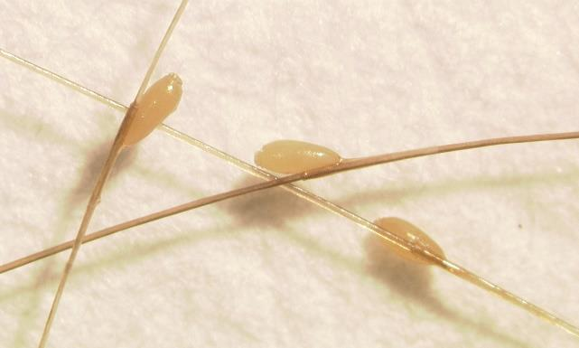
1.
Head Lice
Females attach nits to hair 1 mm from the scalp
Nits need body warmth
Unhatched eggs are not obvious
Nits are easily
seen at the hairline
Nits >1cm - hatched
Head lice nits –
Shujuan Li, University of Arizona

Slide 14

1.
Head Lice
Finding nits alone is not a reason to treat
Discourage head-to-head contact
Discourage
pillow sharing

Slide 15
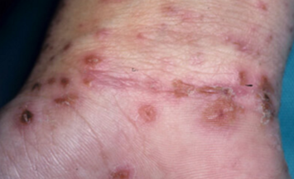
Human Scabies Mites
Infestation of the skin
Female burrows into the upper layer of skin
Spread by direct, prolonged, skin-to-skin
contact
Mites are small
and may be below
the skin surface
Scabies mites, MedicineNet.com

Slide 16
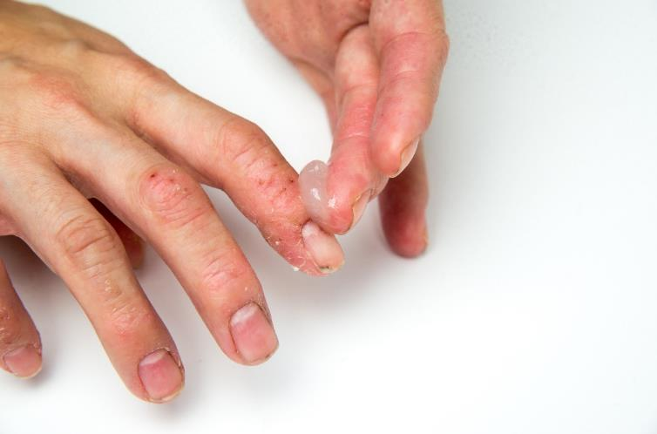
Scabies Mites
Application of topical pesticide cream
for scabies mites
Hospitals, childcare
facilities, and schools
At normal room
temperatures mites
survive <3 days
Eliminated using
prescription treatments
Once treatment starts individuals are not infectious

Slide 17
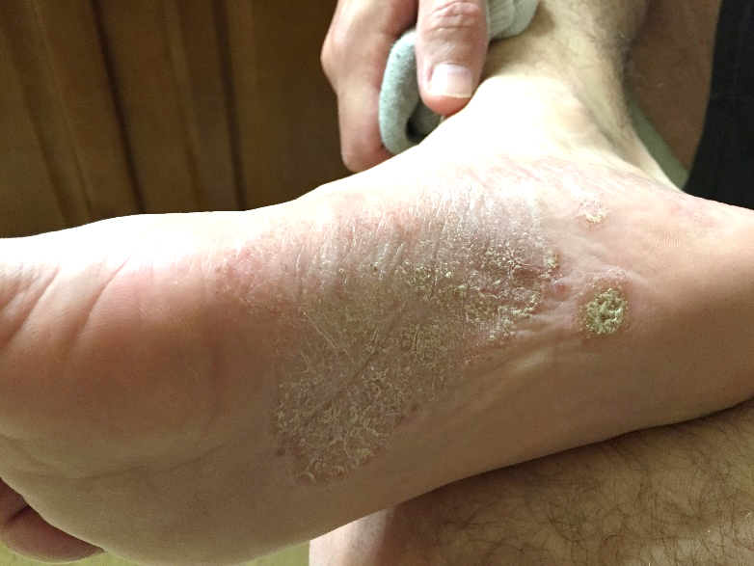
Ringworm
Common fungal skin infection
Dermatophytes – live off
dead tissues (skin,
hair, and nails)
Scaly, crusted
rash
May itch
Ringworm infection –
Dawn H. Gouge, University of Arizona

Slide 18


Ringworm
Tinea capitis
Tinea faciei
Tinea barbae
Tinea
corporis
Tinea manus
Skin on body,
scalp, feet, groin
Children
Warm, moist climates
Contagious
Contracted from an infected person, animal, object, surfaces, or soil
Several areas of the body may be affected
Tinea cruris
Tinea unguium (nails)
Tinea pedis

Slide 19
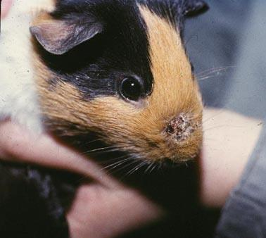
Ringworm
Transmitted from animals to humans
Cats commonly affected
Class pets should
be free of ringworm
Exclude feral cats
from classrooms
Class pet guinea pig
with ringworm - vetbook.org

Slide 20
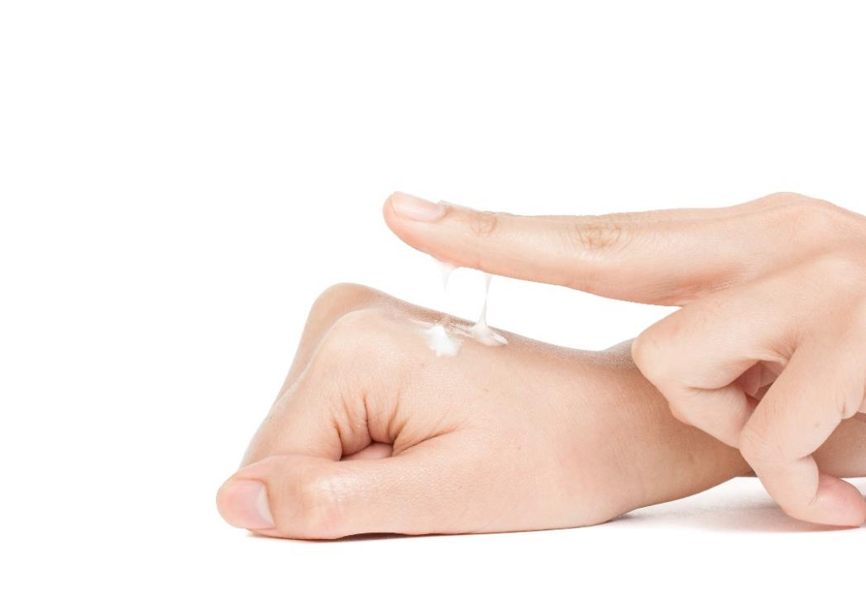
Ringworm
Clean hard surfaces with disinfectant
Prescription antifungal medications before
returning to contact sports
Medications - topical
and/or oral
Topical antifungal cream

Slide 21
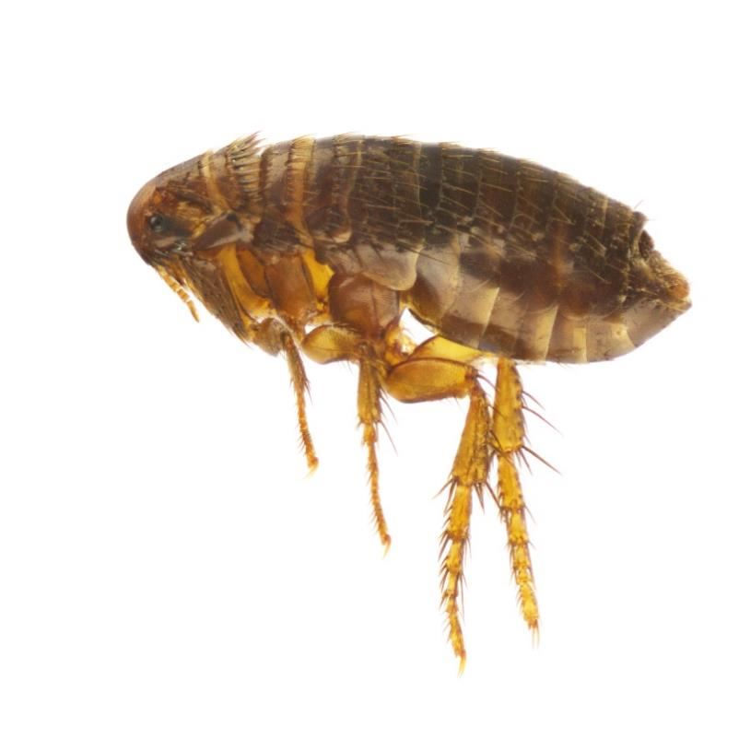
1.
Fleas
Blood feeding ectoparasites
Can, but usually do not vector pathogens
Brought into school on feral animals including rodents
Cat flea

Slide 22
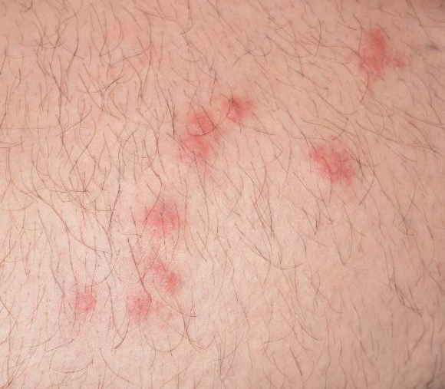
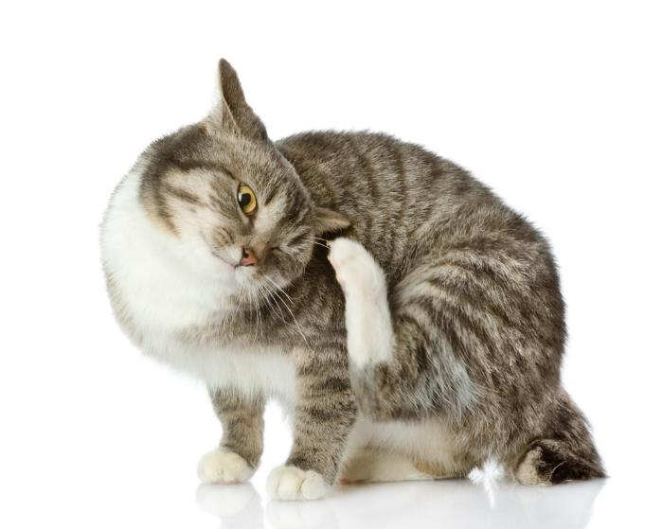
1.
Fleas
Flea bites
Bites may itch,
and swelling
Scratching - open sores
Do not allow feral animals
on-campus
Campus animals, must be spayed/
neutered, inoculated,
free of ectoparasites
Rodents should be
managed carefully
Cat with fleas

Slide 23
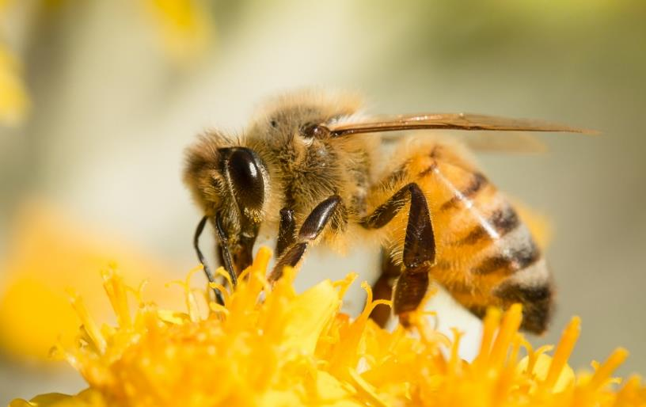
Honey Bees
Flying insects related to wasps and ants
Social insects
Feed on nectar and pollen
Careful
landscape
planning
Honey bee

Slide 24
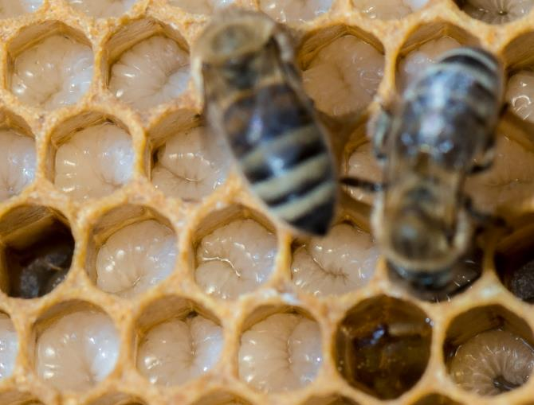
Honey Bees
Workers have barbed stingers
Sting if trapped against the skin
Groups of bees will sting
defensively - brood
Africanized bee stings
are no more venomous
Larger % of Africanized
bee colonies are
defensive
Honey bees tending brood

Slide 25
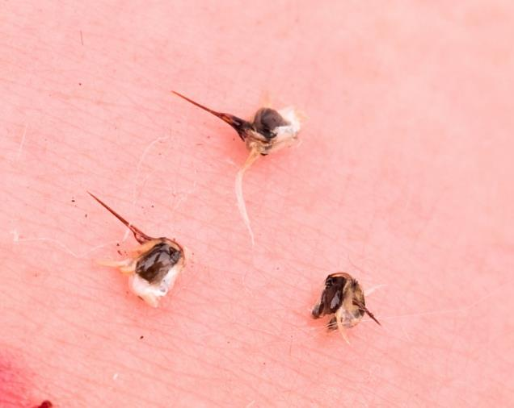
Honey Bees
Severe reactions can be life threatening (anaphylaxis)
0.5% of children and 3% of adults will experience anaphylaxis
More commonly there
will be pain and
swelling
Honey bee stings in skin

Slide 26
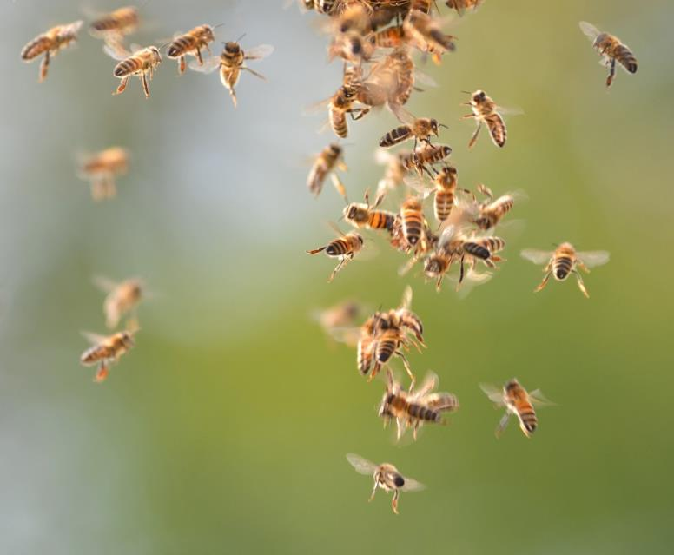
Honey Bees
Very few fatalities due to “bee attacks”
Fatalities more commonly occur due to accidental death
when people panic
Honey bees
flying

Slide 27
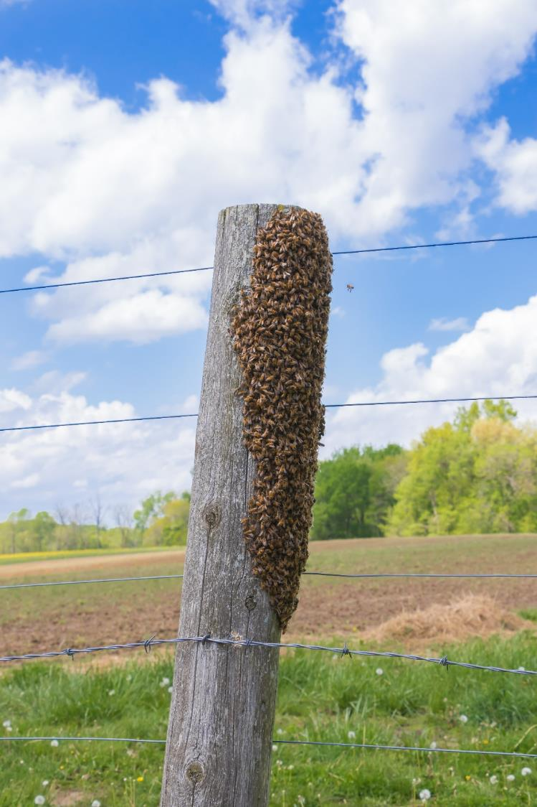
2.
Honey Bees
Condon off swarms
- caution tape
Swarms move within 72 hours of arriving
Honey bee swarm

Slide 28
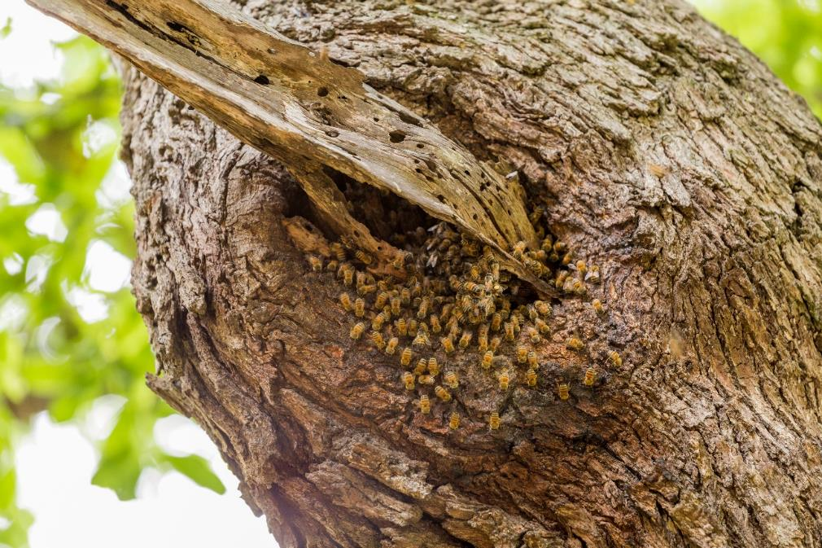
2.
Honey Bees
Honey bee
colonies on
school
premises
should be
remediated
as early as possible
Document and update allergies regularly
Honey bee colony discovered
in a tree trunk

Slide 29
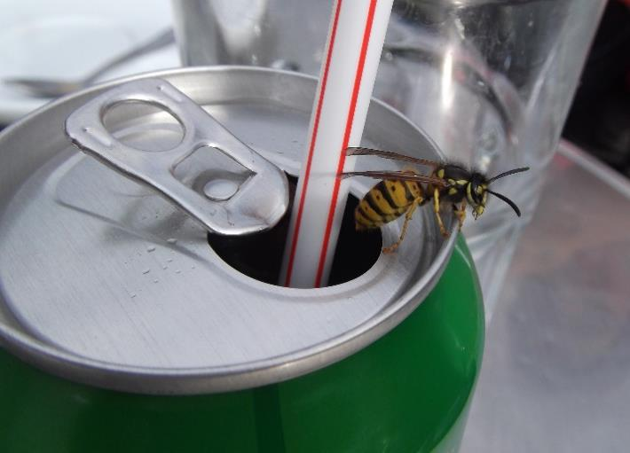
1.
Wasps – Yellowjackets, Hornets and Paper Wasps
Yellowjackets, hornets and paper wasps are stinging, flying insects
Attracted to human food and drinks, and trash
Do not allow sugary
drinks outside of
cafeterias
Prohibit food and
drink containers in
outdoor trash
receptacles
Yellowjacket on a soda can

Slide 30
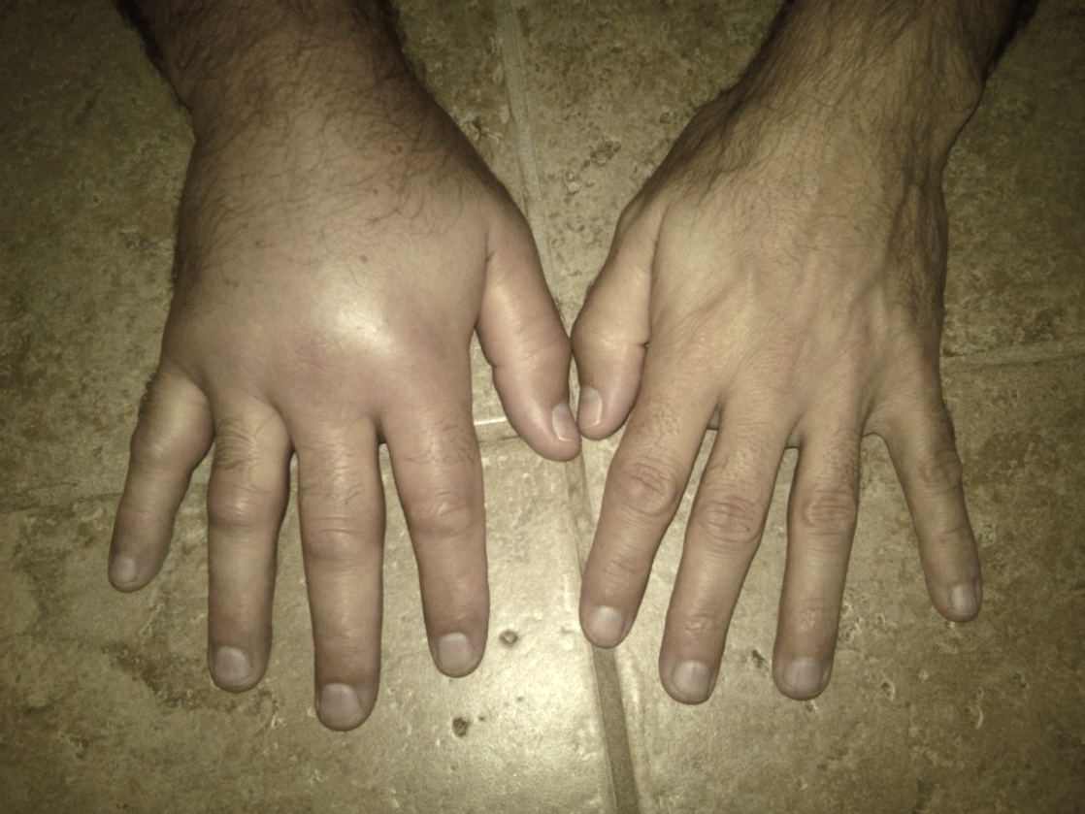
2.
Stinging Wasps – Yellowjackets, Hornets and Paper Wasps
Social insects
Give multiple, painful stings, swelling is common
Allergic reactions
can be severe
(anaphylaxis)
Swelling due to paper wasp stings – Dawn H. Gouge, University of Arizona

Slide 31
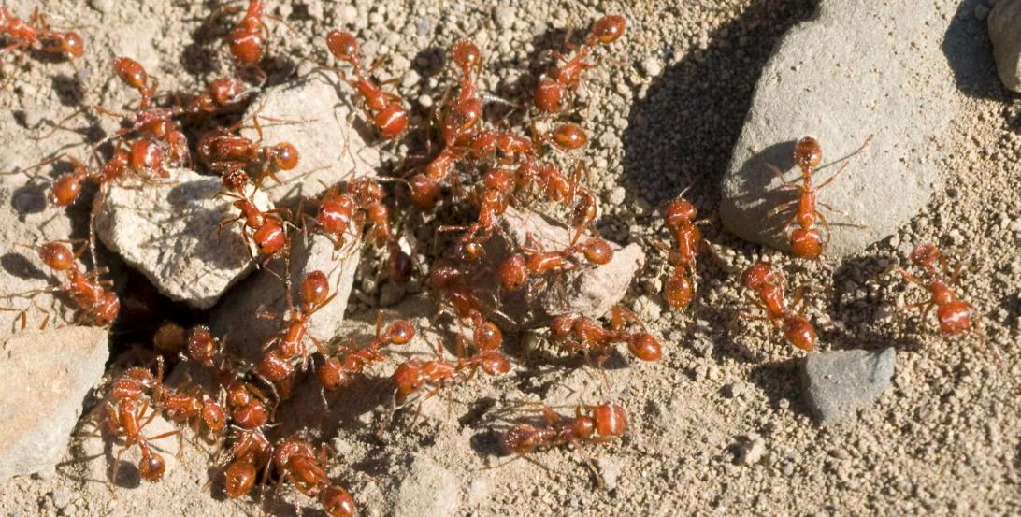
3.
Fire Ants
Fire ants are stinging, social insects
Can elicit a severe allergic reaction (anaphylaxis)
Common reactions: burning pain, swelling,
redness of the skin and fluid filled blisters
Hundreds of stings can be sustained rapidly

Slide 32

Symptoms of Anaphylaxis – Mayo Clinic
Symptoms usually occur within minutes, but can occur longer:
Skin reactions, hives, itching, flushed or pale skin
Feeling warm
Lump in throat
Constriction of airways
Swollen tongue or throat
Weak and rapid pulse
Nausea, vomiting or diarrhea
Dizziness or fainting
Seek emergency medical help immediately

Slide 33
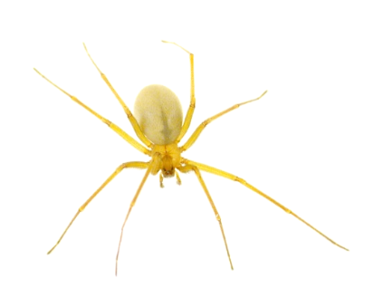
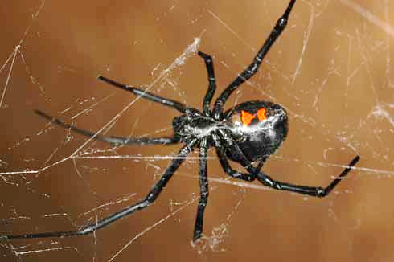
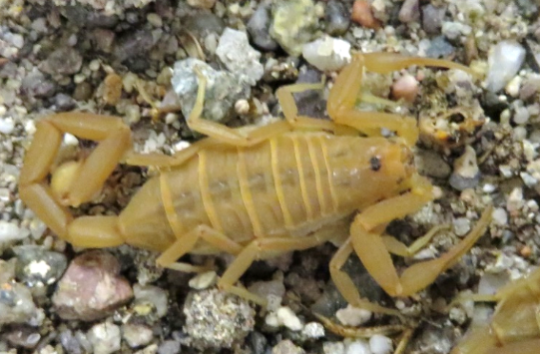
3.
Spiders and Scorpions
Most spiders and all scorpions are venomous
Very few are medically important
Recluse spider
Widow spider
Bark scorpion
Images – Dawn H. Gouge, University of Arizona
Notes:
http://www.ipm.ucdavis.edu/PMG/PESTNOTES/pn74149.html

Slide 34
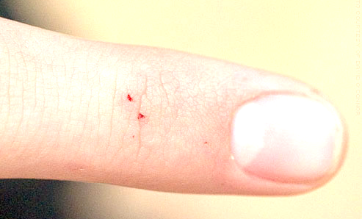
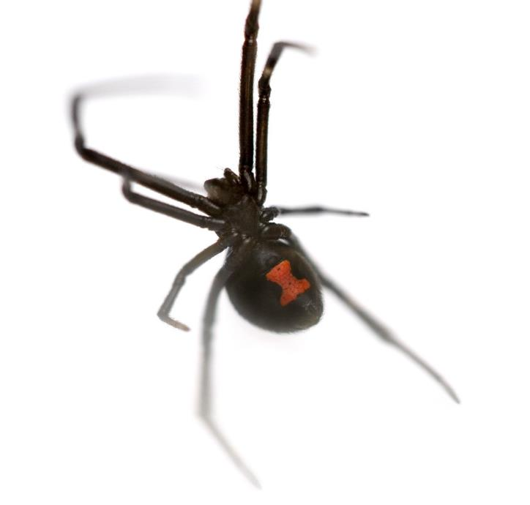
Widow Spiders
Spider bite
Potentially serious bite
reaction - neurotoxic venom
Most commonly:
  Sharp pain, some
  swelling, redness
  Fang marks
  Tap tests -
  sharp pain
Southern widow spider

Slide 35
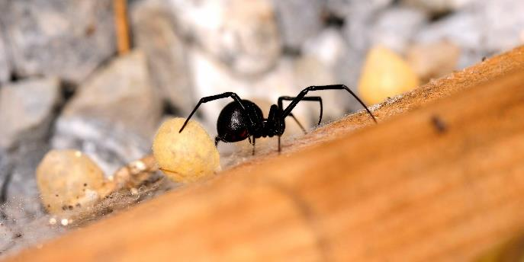
Widow Spiders
Severe symptoms may occur within an hour:
  Muscle cramps, spasms increase for 6 to 12 hours
  Chills, fever, nausea, or vomiting
  Sweating
  Severe belly, back, chest pain
  Headache
  Stupor, restlessness,
  shock
  High blood pressure
Days - weeks
Western widow spider

Slide 36
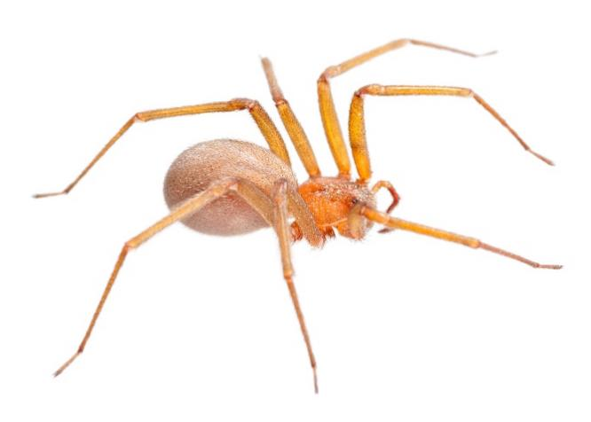
Recluse Spiders
Potentially serious bite
- cytotoxic venom
Most commonly:
  Painless bite
  Fang marks
  Bite site appears red,
  within a few hours a "bull's-eye" lesion, and a flow direction
  Blisters turn bluish/black as tissue becomes necrotic
Recluse spider

Slide 37
Recluse Spiders
Most bites are minor with no necrosis
Some produce severe dermonecrotic lesions
Some experience severe systemic symptoms
Typical recluse bite reaction – Steven Roybal

Slide 38
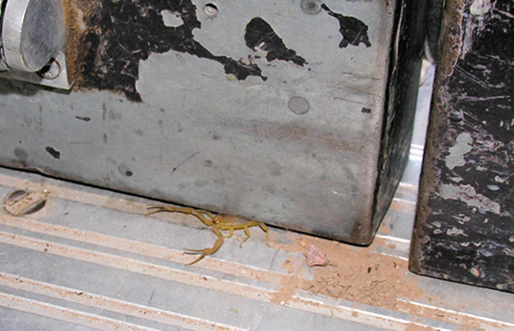
Bark Scorpions
Neurotoxic venom
Arizona bark scorpion is
considered dangerous
Antivenin available
All Centruroides spp.
  pain, numbness, frothing,
  difficulties in breathing, muscle twitching, convulsions
Individuals <70lb seek immediate medical care (911)
Allergic responses (anaphylaxis) are rare
Bark scorpion entering under a door – Kristen Clason

Slide 39
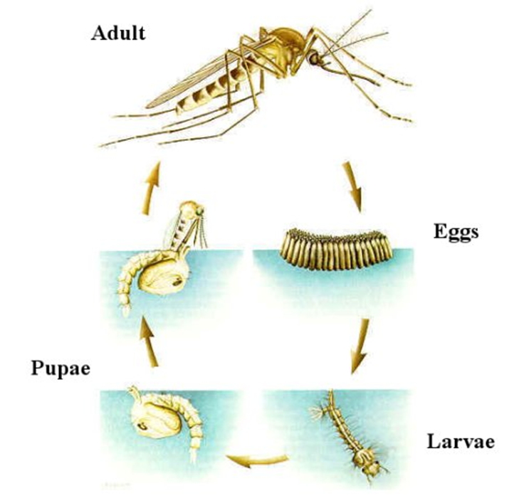
Mosquitoes
Adults are delicate flies
Females take blood meals
Immature stages develop in water
Many species are nuisance pests
Generalized mosquito life cycle: Mosquitoes need water to complete their life cycle – American Mosquito Control Association

Slide 40
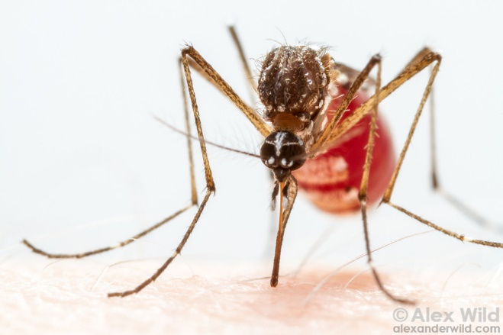
Mosquitoes
Yellow fever mosquito
– AlexWild.com
Some species transmit
harmful pathogens
Viruses that cause
West Nile Fever,
Chikungunya, Western Equine Encephalitis, LaCrosse Encephalitis, St. Louis Encephalitis, Eastern Equine Encephalitis, Zika, and Dengue
Mosquito vectored Plasmodium causes locally-acquired malaria sporadically

Slide 41
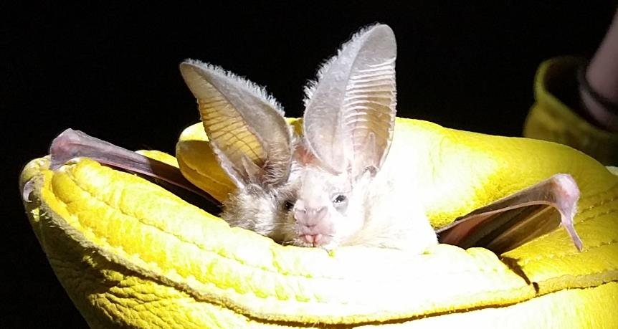
Bats
Most are
nocturnal
Some solitary,
others live in colonies
May roost on the sides of buildings
Attracted to lights that attract flying insects after dark
Bats may enter buildings
Most grounded bats are sick or injured
California leaf-nosed bat
Robert LaMorte,
University of Arizona

Slide 42
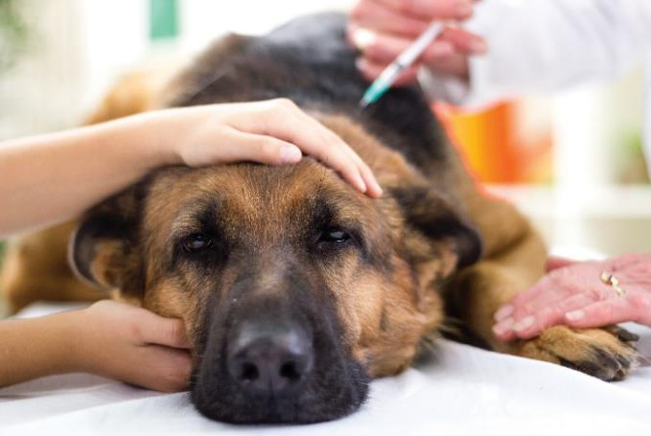
Bats and Rabies
Vaccinate pets
Principal rabies hosts
Source of rabies exposure
Occurs when people handle a bat
Most rabies exposures can be avoided
People who have contact with a bat or awake to find a bat in the room should seek advice from a health care provider or their local health department
Rabies is always fatal to humans

Slide 43
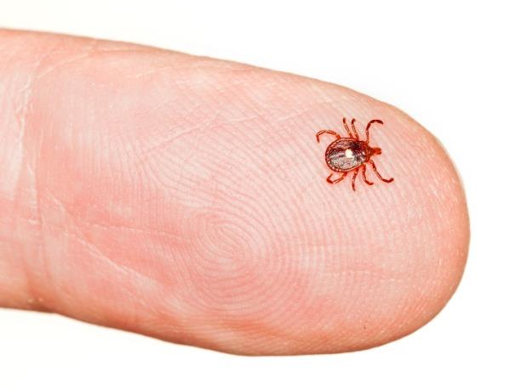
Ticks
Lone star tick
Ectoparasitic, blood feeding arachnids
Vector pathogens that cause:
  Lyme, Colorado tick fever, Rocky Mountain spotted fever, tularemia, tick-borne relapsing fever, babesiosis, ehrlichiosis, anaplasmosis and others
Bites - secondary infections
Proteins in saliva occasionally cause progressive, flaccid, ascending paralysis (tick paralysis)

Slide 44
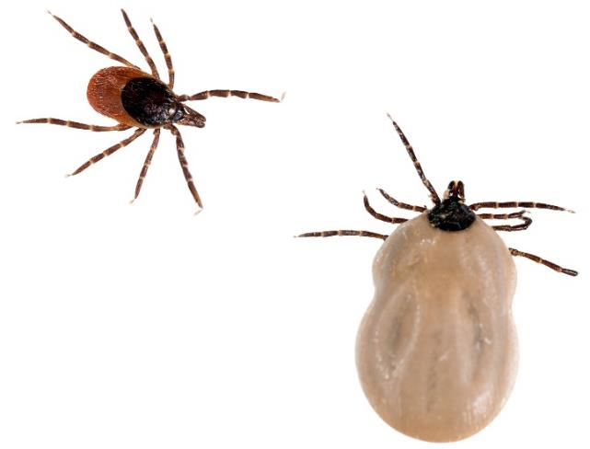
Ticks
Black-legged deer tick
Bite reactions vary:
  Minor inflammation
  Severe systemic reactions
  (rash, fever, nausea, vomiting, diarrhea,
  shock, death)
  Severe allergic reactions (edema, pain, erythema, tissue necrosis, ulceration, prolonged healing)
  Expanding erythematous lesions
  Anaphylactic shock
More common during summer, possible year-round.
Rapid removal of a tick is imperative!

Slide 45
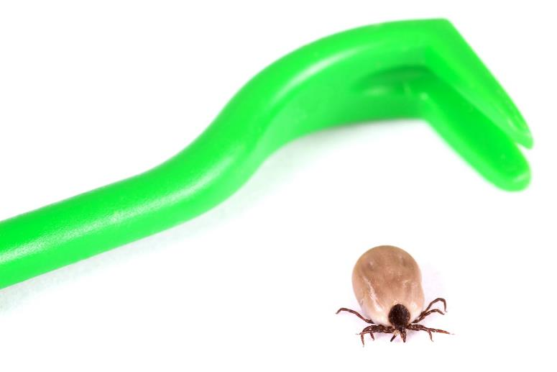
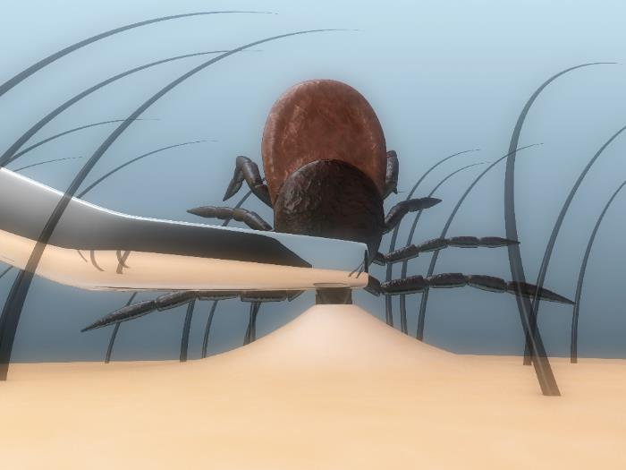
Ticks and Minimizing the Chance of Pathogen Transfer
Remove them
immediately
Tick scoop
Without irritating them
Use tweezers, tick scoop or twister to quickly remove the tick causing a minimum of disturbance

Slide 46
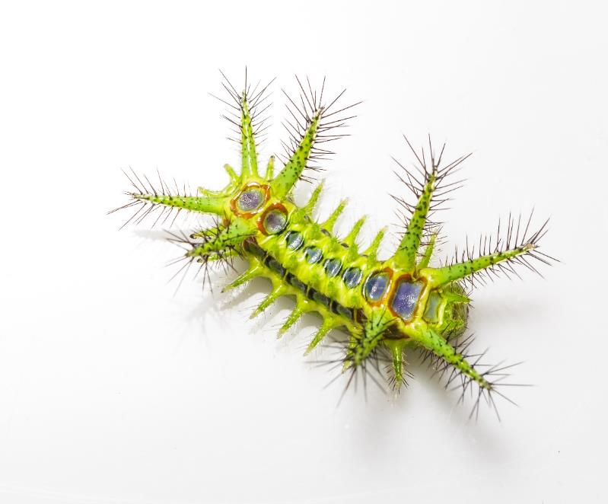
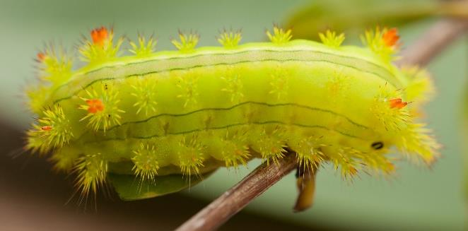
Stinging Caterpillars
Stinging nettle slug caterpillar
Specialized urticaceous
setae
Setae are hollow and contain toxins from poison-gland cells
When brushed, the setae embed in skin releasing toxins
Green Io moth caterpillar

Slide 47
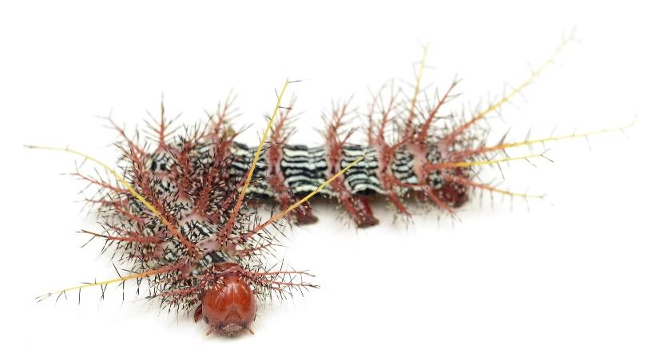
Stinging Caterpillars
Buck moth caterpillar
Slight - intense stinging, itching, burning, dermatitis, rash, lesions, or pustules, inflammation, swelling, numbness, fever, nausea, and, pain
Severe for individuals with allergies or sensitive skin
Allergic reactions to venom are rare (anaphylaxis)

Slide 48
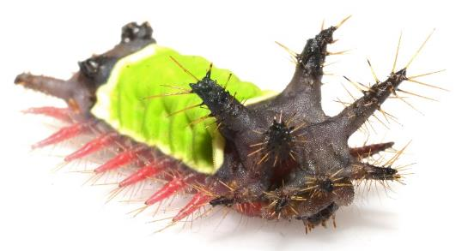
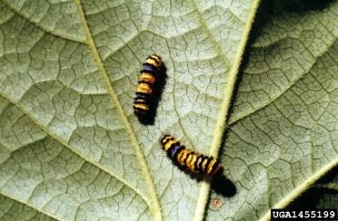
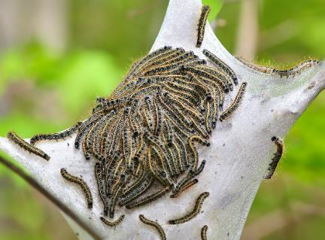
Stinging Caterpillars
Duct tape - skin
Water irrigation - eyes
Respiratory exposure – antihistamines, oxygen, 911
Swelling may occur, so remove restrictive clothing and jewelry
Western grapeleaf skeletonizer - Whitney Cranshaw, Colorado State University, Bugwood.org
Saddleback moth
Eastern Tent
Notes:
Io
Hag
Tent

Slide 49


Venomous Snakes
Copperhead snake
>20 venomous snakes
  Coral snakes
  Pit vipers
Bite if provoked or accidentally disturbed
Immediate medical treatment is essential 911
95% of deaths are related to western
and eastern diamondback
rattlesnakes
Western
diamondback
rattlesnake
Notes:
Buck moth
Saddle back
Puss

Slide 50

Venomous Snakes
Call 911
Remain calm, keep victim calm
Immobilize limb
Remove jewelry and clothing
Position victim so bite is at or below level of the heart
Cleanse the wound, don't flush it with water, cover with a clean, dry dressing
Apply a splint to reduce movement, but keep it loose
Don't use a tourniquet or apply ice
Don't cut the wound or attempt to remove the venom
Don't allow the victim to drink caffeine or alcohol
Don't try to capture snake, remember its color and shape
Eastern coral snake

Slide 51


House Mice, Roof and Norway Rats
Contaminate food
Cause considerable damage
Bite
Transmit vectors and pathogens
that cause diseases e.g.,
salmonellosis
Cause of allergies
Trigger asthma
House mouse
Norway rat – Dawn H. Gouge,
University of Arizona

Slide 52
Check In!
Identify health risks associated with common pests:
    Bed bugs
    Head lice
    Scabies mites
    Ringworm
    Fleas
    Honey bees
    Stinging wasps
    Fire ants
    Spiders and scorpions
    Mosquitoes
    Bats and rabies
  Next you will learn more about a nurse’s role in IPM!
    Ticks
    Stinging caterpillars
    Venomous snakes
    Commensal rodents

Slide 53
Resources
Bats http://extension.arizona.edu/sites/extension.arizona.edu/files/pubs/az1456.pdf
Bed bugs http://extension.arizona.edu/sites/extension.arizona.edu/files/pubs/az1625-2014.pdf
Bee and wasp stings http://www.ipm.ucdavis.edu/PMG/PESTNOTES/pn7449.html
Fire ant management http://ag.arizona.edu/urbanipm/buglist/fireants.pdf
Head lice http://www.cdc.gov/parasites/lice/head/
Head lice management http://ag.arizona.edu/urbanipm/buglist/headlice.pdf
Mammal pests including rattlesnakes http://ucanr.org/sites/vpce/files/86153.pdf
Mouse management http://ag.arizona.edu/urbanipm/buglist/mousemanagement.pdf

Slide 54
Resources
Mosquitoes http://www.cdc.gov/nceh/ehs/topics/mosquitoes.htm
Mosquitoes http://extension.arizona.edu/sites/extension.arizona.edu/files/pubs/az1221.pdf
Pests that sting, bite or injure http://www.ipm.ucdavis.edu/PMG/menu.house.html#STING
Scabies http://www.cdc.gov/parasites/scabies/
Scorpions http://extension.arizona.edu/sites/extension.arizona.edu/files/pubs/az1223.pdf
Spiders and management guidelines http://www.ipm.ucdavis.edu/PMG/PESTNOTES/pn7442.html
Ticks http://www.tickencounter.org/
Ringworm http://www.nlm.nih.gov/medlineplus/ency/article/001439.htm
Vertebrate pests-reptiles http://www.ipm.ucdavis.edu/PMG/menu.house.html#DESTROY

Slide 55


Resources
http://www.ipm.ucdavis.edu/PMG/PESTNOTES/pn74149.html
http://extension.arizona.edu/sites/extension.arizona.edu/files/pubs/az1223.pdf
This nurse
knows pests

