Slide 1

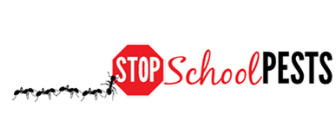
TEACHING IPM (Using IPM as a Curriculum Element)
In-Person Education Module
Lesson 2 of 2

Slide 2

Learning Objectives
Describe how an IPM curriculum meets common core requirements for biology, biodiversity, ecology,
evolution, problem solving,
teamwork, etc.
Describe a lesson plan that
incorporates IPM into
science-related curriculum
Classroom educator training and lesson plan – Rebecca Baldwin, University of Florida
http://entnemdept.ufl.edu/bug_club/BBBB%20Articulate%20Published%202012/player.html

Slide 3

What is IPM?
IPM focuses on:
investigating,
discovering,
and fixing the reasons why pests are a problem
IPM is a sensible, science based, environment-friendly, and effective
Active investigation and problem solving
Cost-effective, sustainable, least possible risk

Slide 4
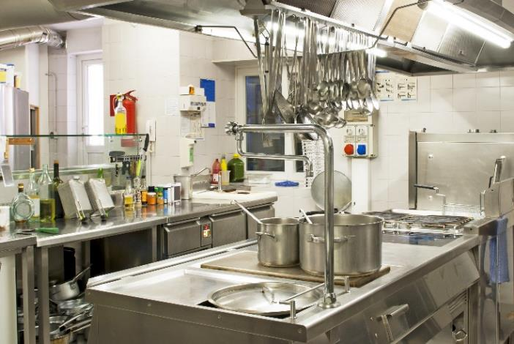
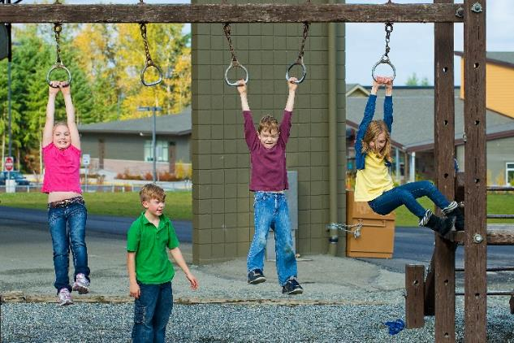
1.
IPM = Integrated (Intelligent) Pest Management
Combination of methods that are:
  Location specific
  Dynamic
  Low risk
  Cost effective

Slide 5

1.
IPM = Integrated (Intelligent) Pest Management
Pollution prevention strategy
Risk reduction strategy
Pesticide resistance strategy

Slide 6
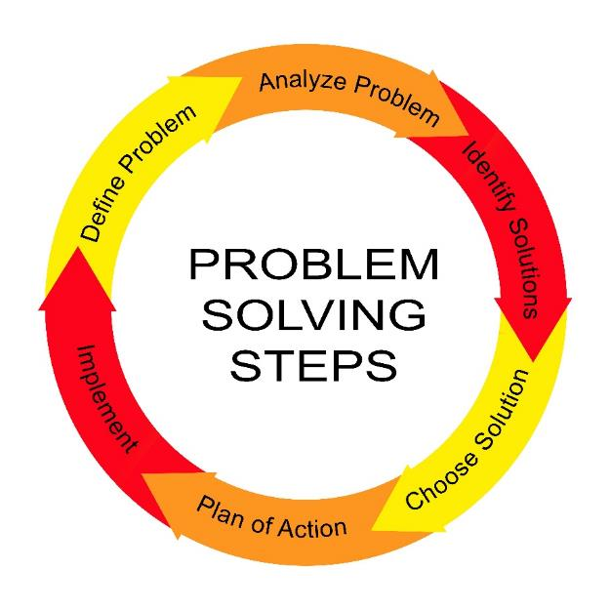
Why Include IPM in Your Curriculum?
Protecting themselves and their environment
Role to play in school and at home
Appreciate a safe and healthy learning environment
Teamwork and respect for the
Earth and life
Problem solving process
Common sense!

Slide 7
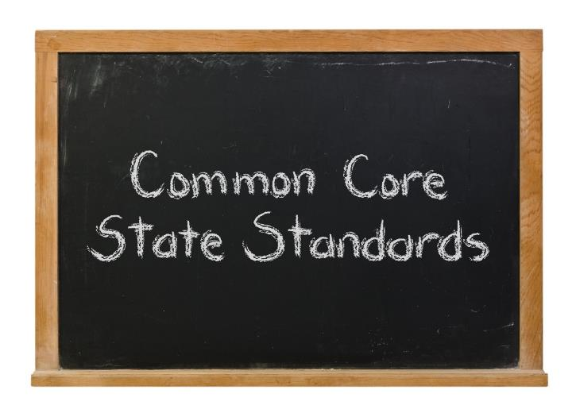
IPM in Your Curriculum
Common core requirements
“Building on the best of existing state standards, the Common Core State Standards provide clear and consistent learning goals to help prepare students for college, career, and life.”
http://www.corestandards.org/read-the-standards/

Slide 8

IPM in Your Curriculum
Does IPM fit common core requirements?
Yes!
  science,
  math,
  language,
  arts
  social studies

Slide 9

1.
IPM in Your Curriculum
IPM involves:
Biology
Environmental Science
Chemistry
Math
Economics
Psychology
Ecology

Slide 10

1.
IPM in Your Curriculum
Key elements of IPM
Monitoring and inspection
Identification
Thresholds
Preventing pests
Action (least-risk)
Keeping records
Education, communication
Constant evaluation

Slide 11
IPM in Your Curriculum
Key elements of IPM
Subjects/skills involved
Monitoring and inspection
Identification
Establishing thresholds
Preventing pests, resource management
Action (least-risk)
Keeping records
Education, communication
Constant evaluation
Observation and analysis
Biology, biodiversity, logic
Math, logic
Biology, environmental science, engineering
Science based decision-making
Documentation
Writing, speaking, art
Self-improvement, analysis

Slide 12
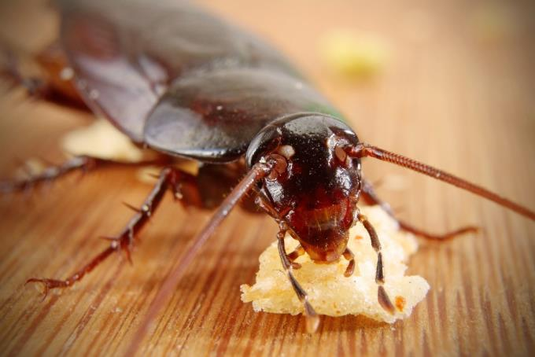
IPM in Your Curriculum: Biology
Pests are biological entities, each adapted to thrive given resources and supportive conditions
How do biotic and abiotic conditions affect animals and plants?
What do pests need?
  Food
  Water
  Shelter

Slide 13

IPM in Your Curriculum: Biology
Example 1: Grades K-2 students:
  Identify the different forms of life in and around your school?
  Where can you find them?
  What and how do they eat and drink?
  How are they beneficial?
  Can they be harmful?
  Characterize a fictitious
  lifeform

Slide 14

IPM in Your Curriculum: Biology, Problem-solving
Example 2: Grades K-2 students:
  Insect life cycles
  Different life stages of different insects
  Put them in developmental order
  Discuss where the insects are found
  and what they do

Slide 15

IPM in Your Curriculum: Biology/Biodiversity
Example 3: Grades 6-8 students:
  Place monitoring traps around the school
  Explore the school and look at the trap catches
  Describe resources available
  Discuss life cycle requirements
  How the pests are managed

Slide 16
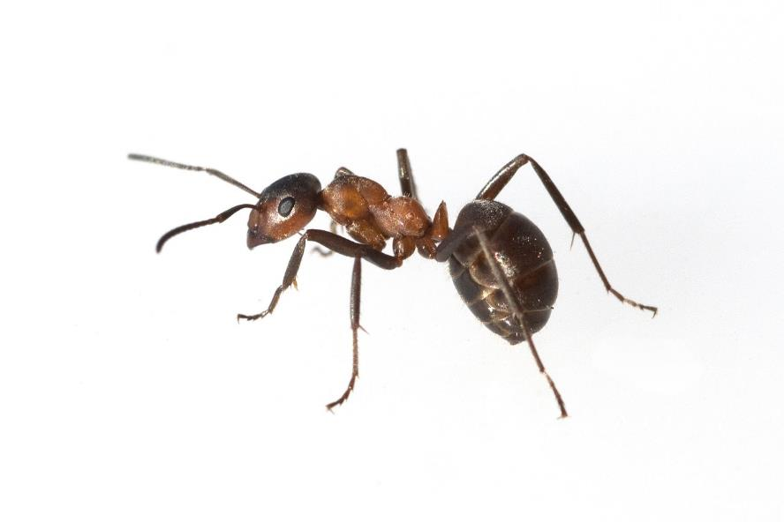
IPM in Your Curriculum: Biology/Evolution
Example 4: Grades 6-8 students:
  List different pests found in your school
  Where?
  How do they reproduce?
  Introduce the concept of r vs. K strategy
  Adaptations and evolution
  Pesticide resistance
Formica rufa, also known as the red wood ant, southern wood ant, or horse ant - Manfred Ruckszio, ShutterStock

Slide 17
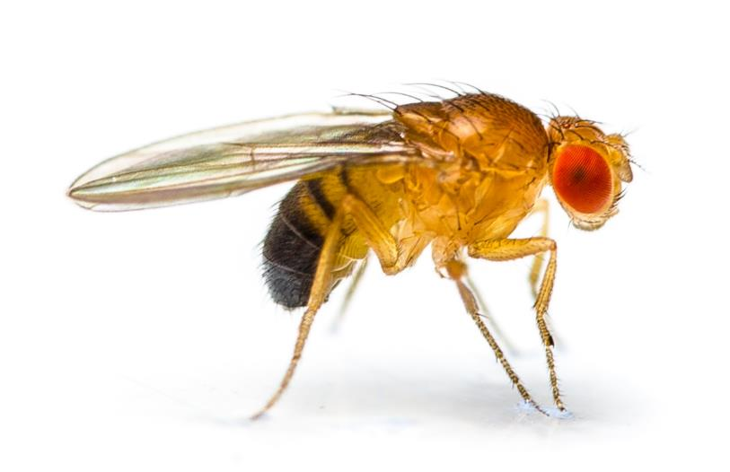
IPM in Your Curriculum: Problem-Solving
Example 5: Grades 6-8 students:
  Set up a fruit fly infestation in a classroom
  Life cycle and habitat needs of fruit flies
  How the fly infestation might have been avoided and how it should be controlled
Fruit fly (Drosophila
melanogaster) - Roblan, ShutterStock

Slide 18
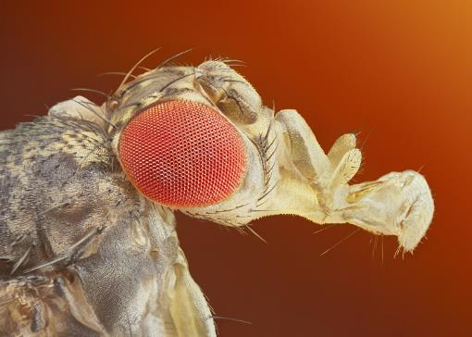
IPM in Your Curriculum: Problem Solving
Example 5 continued: Grades 6-8 students:
  Garbage removed, drains cleaned
  No fruit flies in the classroom
  Source: http://www.ipminstitute.org/School_IPM_Week/schoolipmweek_ideas_for_
  ambassadors.htm#College
Fruit fly (Drosophila
melanogaster) - Sebastian Janicki, ShutterStock

Slide 19
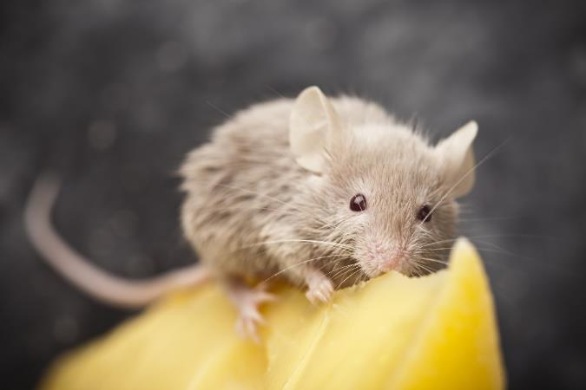
IPM in Your Curriculum: Environmental Science/
Ecology
Example 6: Grades 9-12 students:
  Analyze your school environment
  What kinds of organisms?
  Describe microhabitats
  Number organisms
  Establish action thresholds
  Describe management
  measures

Slide 20
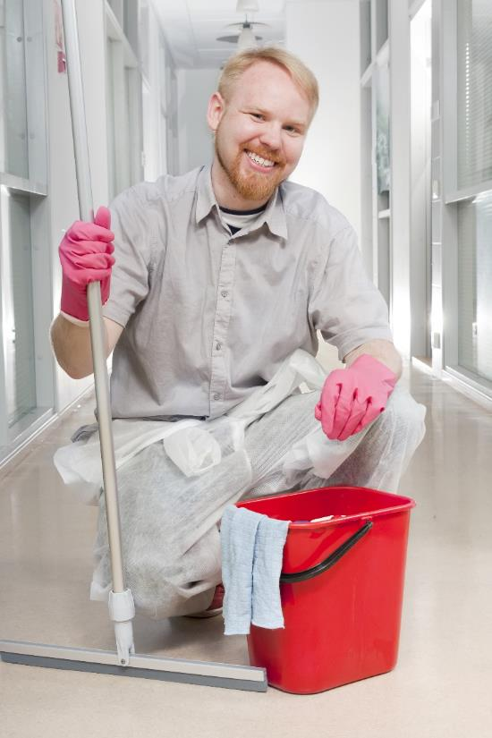
IPM in Your Curriculum: Teamwork
Example 7: Grades 10-12 students:
  Investigate pest management in your school
  Work with a school staff member to find out what they do
  Share findings

Slide 21

IPM in Your Curriculum: Teamwork
Example 7: Grades 10-12 students:
  Roles in IPM
  Cooperation
  Design a school IPM policy and plan
  Student credit for participating in
  Environmental Health
  committee

Slide 22
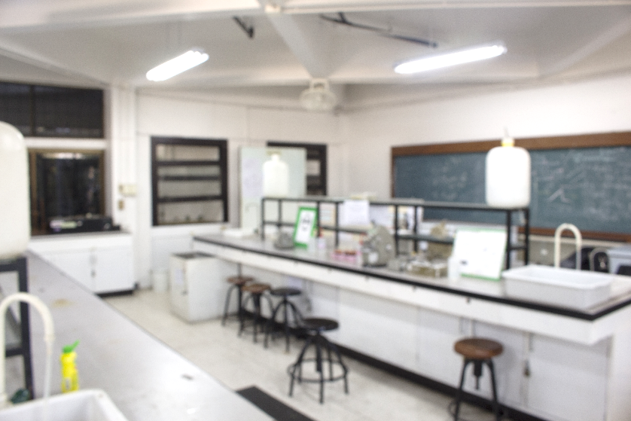
IPM in Your Curriculum
Not an additional item to cover in your curriculum
Real world problem-solving process
Combine knowledge from different subjects
Hands-on
science labs

Slide 23
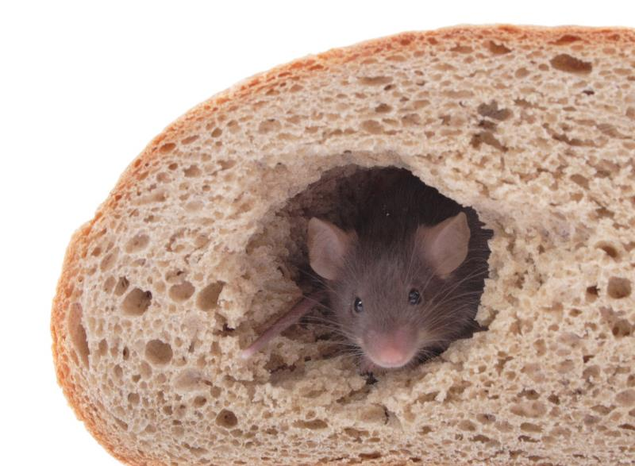
IPM in Your Curriculum – Concepts to Consider
  A weed is a plant out of place
  A pest is any animal that competes with humans for food, water and shelter
  IPM is an ecological approach to pest management
  In-depth investigations
  Excluding pests
  Sanitation
  Clutter control

Slide 24

IPM in Your Curriculum
Current global issues
  Pesticide pollution
  Invasive species and biodiversity
  Environmental safety and health tradeoffs
  Food security
  Role of government in environmental decision-making
  Genetic engineering as a pest management tool
  Human and animal infectious diseases
  Quarantine
  Pesticide resistance problems
  and many more…

Slide 25

A Lesson Plan with IPM
Title: Human environmental
impacts
Grade level: 8 – 10
Two 50-minute classes
Lecture, discussion, student poster presentations
Basic purpose of this lesson:
  Global issue focus
  Gather, interpret, evaluate and use information to explain phenomena in the natural world

Slide 26

A Lesson Plan with IPM
Learning objectives:
Identify different ways human activities influence the environment
Environmental pollution - pesticides
Increased pesticide use
Judicious pesticide use,
alternate methods and IPM

Slide 27

A Lesson Plan with IPM
Materials:
  Computer/internet
  Library
  Poster paper and boards
  Stationery
Preparation:
  Students cover environmental science basics
    Basic plant and animal biology and ecology
    Read up about human environmental impacts

Slide 28
A Lesson Plan with IPM
Activity:
Teacher to introduce general human activities influencing the environment
Discussion
Teacher covers environmental
pollution and
specifically, pesticides

Slide 29

A Lesson Plan with IPM
Activity:
Teacher will cover historical use of pesticides and how it affected the environment
Cover alternate methods of
pest management and the
benefits of reducing
dependence on pesticides
Rachel Carson 1962 Silent Spring 1962. Boston, Houghton Mifflin

Slide 30

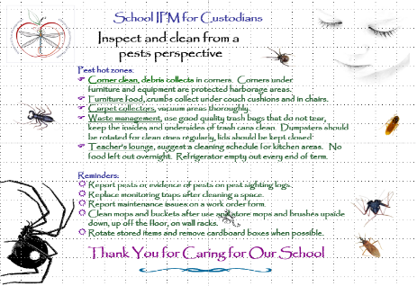
A Lesson Plan with IPM
Activity:
Student groups of 3-5
Each group assigned to research a pest management problem
Two weeks to produce a
poster
Teacher to provide
resources
Student poster – Dawn H. Gouge,
University of Arizona

Slide 31
A Lesson Plan with IPM
Activity:
Poster presentations to classmates
Peers ask questions and provide feedback
IPM is a “human intervention” but generally less harmful on the environment since ecological
impacts and sustainability
are considered

Slide 32
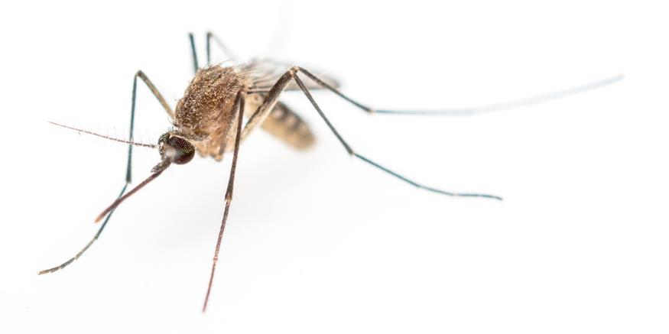
A Lesson Plan with IPM
Safety:
  No safety issues
  Concept discovery:
  Introduction to IPM
Independent activity:
  How to apply IPM concept?
  Homework assignment

Slide 33
A Lesson Plan with IPM - Talk about the IPM Pyramid, risk and proactive activities
Reactive
remediation
Higher risk
Pesticides
Physical/mechanical
control
Cultural/sanitation
practices
Education &
Communication
Lower risk
Proactive
prevention
IPM Pyramid – Dawn H. Gouge, University of Arizona

Slide 34

A Lesson Plan with IPM
Conclusion/wrapping up:
  The benefits of IPM
  Questions and answers
Assessment/grading:
  Student grades
  based on content,
  teamwork,
  involvement

Slide 35

A Lesson Plan with IPM
Connections to other subjects:
Social studies: economics, history, geography, health
Math: calculate pest populations, direct cost benefits, indirect cost impacts, etc.
Language arts: refine
language skills,
presentation skills,
and artistic talents

Slide 36
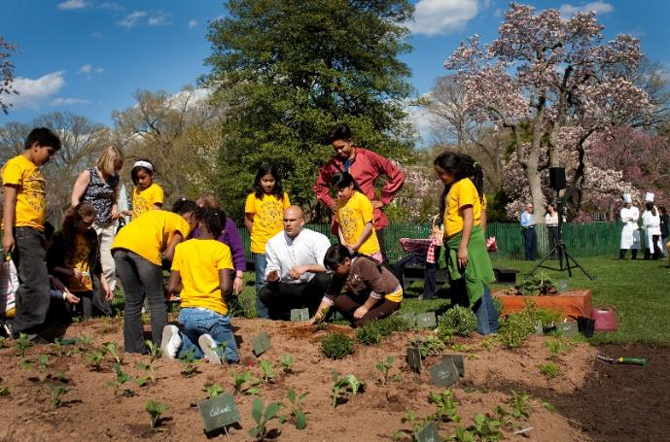
Farm to School Initiative – A National Movement
School districts source more foods locally
Provide complementary educational activities to students
Food-related education is integrated into the regular, standards-based
classroom curriculum
Supporting
local economies
Michelle Obama & Sam Kass show Bancroft students how to plant a garden - Samantha Appleton, Wikimedia Commons

Slide 37

Farm to School Initiative
United States Department
of Agriculture (USDA)
Farm to School Program
  research
  training
  technical assistance
  grants
A list of regions, along with the names and contact information for regional and national USDA Farm to School Program staff, can be found at http://www.fns.usda.gov/farmtoschool/farm-school

Slide 38
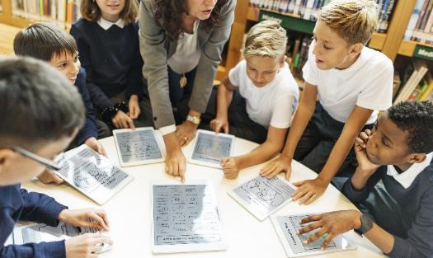
Check In!
In this lesson you learned:
How IPM meets common core requirements for biology/biodiversity, ecology, evolution, problem solving, teamwork, etc.
Lesson plans that incorporate IPM into science-related curriculum
Congratulations, you have completed Using IPM as a Curriculum Element
There are many other resources available see http://maine.gov/dacf/php/integrated_pest_management/school-ipm-curricula/index.shtml

Slide 39
Resources
National School IPM Information Source: IPM for School Faculty and Staff. http://schoolipm.ifas.ufl.edu/Florida/faculty.htm
IPM Institute of North America. Ideas for classroom activities. http://www.ipminstitute.org/School_IPM_Week/schoolipmweek_ideas_for_ambassadors.htm#College
Texas A&M University. Insects in the classroom: Bugs as teaching tools for all ages. Lesson plans.
http://iitc.tamu.edu/1998and2000/lesson_plans.html
eXtension. (2014). School Integrated Pest Management for Teachers. http://www.extension.org/pages/21012/school-integrated-pest-management-for-teachers#.U9h98rHLNeo
PennState Extension. IPM for Teachers Curriculum.
http://extension.psu.edu/pests/ipm/schools/educators/curriculum/contents/whenisapest
University of Nebraska—Lincoln IPM Curricula and Resources for Teachers
http://pested.unl.edu/teachipm

