Slide 1



Curricular Practical Training Workshop

Slide 2
Why have a CPT workshop?
Curricular Practical Training is a privilege that is authorized by the school.
Employment is a big deal to the U.S. Government.
Failure to follow CPT regulations could result in action taken against the student, and/or the school, by the Federal Government.
  For students, these actions can result is negative consequences that affect a student’s F-1 record or ability to apply for future CPT authorization (including OPT, H1B, or permanent residency).
  Schools could be issued warnings, lose the ability to authorize CPT, or in extreme cases no longer be allowed to host international students.

Slide 3
What is Curricular Practical Training?
Curricular Practical Training (CPT) is temporary employment authorization that is “an integral part of an established curriculum” and “directly related to an F1 student’s major area of study.” It is granted by International Students and Scholars (ISS) for the purpose of achieving a curricular/academic objective.
Includes internship, alternate work/study, or other types of practicum.

Slide 4
What is CPT used for?
CPT is meant to be used for curricular/academic purposes:
  Integral or required to the completion of your program of study.
  Can include research related to thesis or dissertation, if related.

Slide 5
What CPT is NOT used for
CPT cannot be used for the following purposes:
  To work off campus just because you want to
  To make money
  Job experience/resume building
  To intentionally start working for a future OPT employer before completing a degree

Slide 6
Eligibility Requirements
Student must currently be in active F-1 status.
Students must have been enrolled full-time for one academic year (Fall and Spring semester) at a SEVP approved school.
  Taking a semester leave of absence, or applying for reinstatement outside the U.S., can affect your eligibility for CPT/OPT under the one academic year rule. Talk to ISS prior to leaving the U.S. in these situations.
  Full-time enrollment on a previous visa, such as a J1 or H4 can be counted towards the one year requirement.
  Previous enrollment under F-2 will not count (F-2s cannot be enrolled full-time).
Graduate students can apply for CPT in their first two semesters of a program if immediate participation in the internship is required by the department for all students enrolled in the program.
Enrollment in an internship credit is required.
Students must maintain full-time enrollment for Fall and Spring while on CPT.
  12 credits for undergraduates
  9 credits for graduate students, or less than 9 if completed Optional Fee Package
  Summer enrollment is optional, except for the internship credit required for CPT

Slide 7
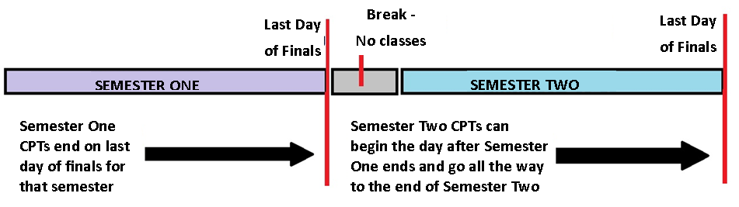
Length of CPT Authorization
Because CPT is curricular and tied to a specific internship credit, CPT authorization will only be granted for one semester at a time. INTERNSHIP MUST END BY LAST DAY Of FINALS.
If a student wishes to continue their internship for the following semester, they must submit a new CPT application, even if it will be with the same employer.
CPT authorization cannot overlap two semesters.
  The internship can begin the day following the end of the previous semester.

Slide 8
CPT in the Last Semester
CPT can be approved during a student’s final semester
The internship/CPT must end by the end of the semester (or the defense date for graduate students)
Care should be taken to show that the last semester internship is curricular in nature and was not intentionally being used to begin OPT early
A student cannot delay their graduation for the purpose of participating in an internship that is not required for graduation/completion

Slide 9

Can I enroll in just a CPT internship in my final semester?

Slide 10
Undergraduate Students:
  Yes, on a case-by-case basis
    If the internship credit(s) are required for the completion of your degree
    If you can graduate without the internship then you must graduate and apply for OPT.
Graduate Students:
  Yes, on a case-by-case basis
    If the credits will complete your program of study, OR
    If the internship is required for the completion of your thesis or dissertation

Slide 11
Course Requirement
Student must receive academic credit for the internship.
The internship course must be a minimum of 1 credit hour.
Student must register for the internship course before the CPT will be approved.
Student must remain in the course for the whole semester and receive a grade.
Graduate students can register for thesis/dissertation research credit if the internship is required to complete the thesis or dissertation. Otherwise, must enroll in an internship/other credit.

Slide 12
Students enrolled, but NOT on campus
Students who are enrolled but not on campus (ex. graduate students conducting research outside of Laramie) may not be eligible for the international student medical insurance, depending on the start date of your CPT.
If you will NOT be in Laramie during your CPT then you should contact the Student Insurance Advocate, stuins@uwyo.edu, during the FIRST WEEK of classes to see if you must/may have the insurance. If you are not eligible for the UW student medical insurance, ISS can provide a non-inclusive list of independent companies that provide international medical insurance to help you get started in selecting a company.

Slide 13
Working Part-Time vs. Full-Time
Part-time CPT allows no more than 20 hours of training per week with your internship employer.
Full-time CPT allows more than 20 hours of training per week with your internship employer.
  Full-time CPT will not be approved for fall or spring semesters for undergraduate students. Can be approved for graduate students in very specific, rare, circumstances.
  12-months (365 days) of authorized full-time CPT voids your eligibility for post-completion OPT after graduation. Part-time CPT has no affect on OPT eligibility.
    Example: A student authorized for 6 months of full-time CPT and 6 months of part-time CPT is eligible for OPT.

Slide 14

If I am volunteering for a company without pay, that means I don’t have to apply for CPT. Right?

Slide 15
Unpaid Does NOT Mean Volunteering
CPT is required for both paid and unpaid internship experiences!
Participating in activities that are considered unpaid employment, without CPT approval, can be a violation of your status
Volunteering
  Only short-term, altruistic types of volunteer work (soup kitchens, homeless shelters) often do not require work authorization, but it also depends on the types of jobs you are performing for the charity. Please check with ISS staff BEFORE “volunteering”.

Slide 16

Will CPT affect my student job or assistantship position on campus?

Slide 17
Campus Employment & CPT
Because CPT is curricular TRAINING, it does not negatively impact your on-campus employment benefit
  Example: A student can work 20 hours on-campus, as well as 20 hours on part-time CPT for their internship. (Subject to change)
  In the summer, a student can work as much as they want on-campus (UW limits apply), and are allowed to choose either part-time or full-time CPT for their internship.

Slide 18

What if my internship is located on-campus at UW?

Slide 19
Internships on the UW Campus
Internship on the UW camps that is NOT paid by UW
  Internships with an “on-campus” location, but paid by someone other than UW, usually require CPT approval and are not considered on-campus employment.
Internship on the UW campus that IS paid by UW
  Can be considered on-campus employment and does not require CPT approval.
  Student who also have an on-campus job (no more than 20 hours per week) can receive CPT approval for on-campus internships and are then allowed to do both the on-campus job and internship during the semester.

Slide 20

How to Apply

Slide 21
Applying for CPT
Step 1: Attend a CPT workshop and ask an ISS adviser to discuss CPT eligibility if you have any questions.
Step 2: Complete the CPT Application.
  Download the application from the ISS webpage:
    uwyo.edu/iss -> Current Students -> Employment
Email the completed forms to ISS (uwglobal@uwyo.edu) at least two weeks before the requested start date of the internship.

Slide 22
Applications must be submitted no later than TWO WEEKS prior to requested CPT start date.
The ISS staff will review CPT applications as quickly as possible and in consideration of other projects and student requests.
Check your email daily in case ISS has additional questions about your paperwork.
ISS staff will email the CPT approval I-20 to you as soon as CPT is approved. The CPT I-20 must be presented to your employer BEFORE you can begin your internship!
DO NOT WAIT UNTIL THE DAY BEFORE WORKING TO REQUEST CPT!

Slide 23
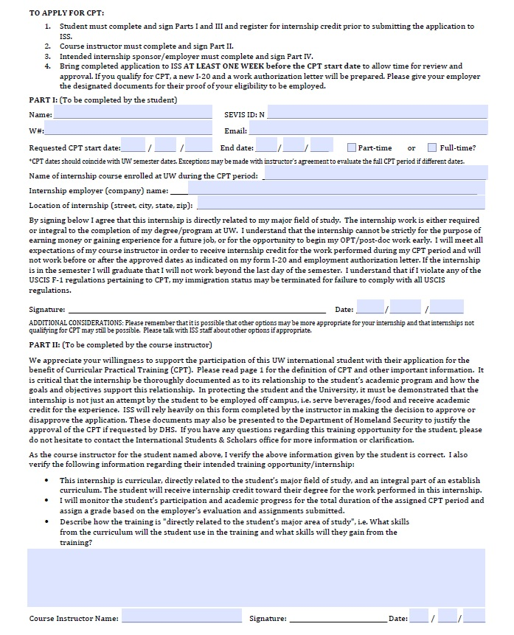
Instructor Recommendation
Part I: To be completed by student
Part II: To be completed by student’s academic advisor.
  Verify that the internship is related to the major and integral to the completion of the program.
  Verify that they will monitor the student’s participation and will assign a grade.
  Must describe how the internship is either required or curricular and related to the student’s major.
    Field must be completed!
    Box may not appear if document is not downloaded first.

Slide 24
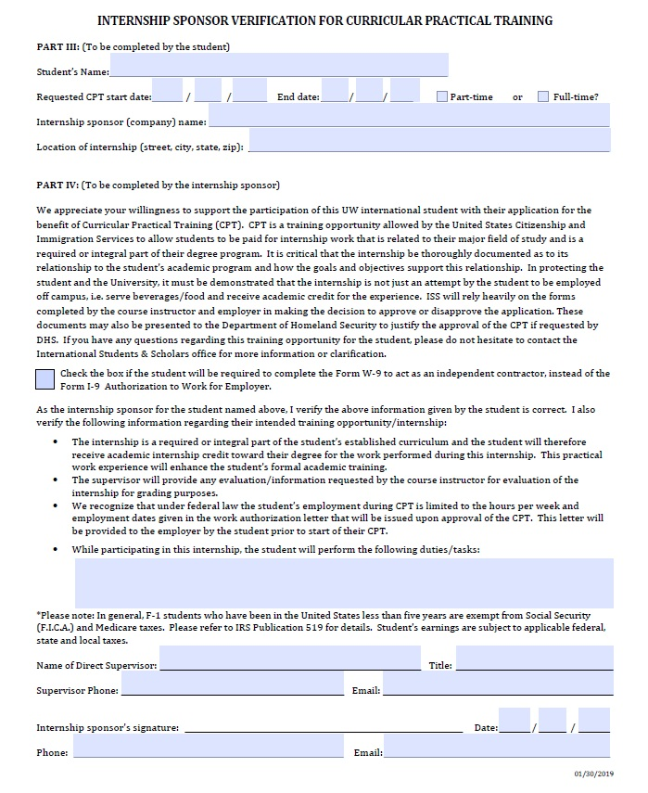
Employer Recommendation
Part III: To be completed by student
  Internship Sponsor is the company name, not your supervisor.
  This section will auto-complete if you fill in Section I.
Part IV: To be completed by employer
  Agree to provide evaluation/information requested by the academic advisor.
  Understand that student’s CPT is limited to hours and dates provided on the I-20.
  Describe tasks to be completed by student.
  Both fields must be signed. The person with authority to approve your internship may be your direct supervisor (have them sign both lines) OR someone else from HR/legal office or another office.

Slide 25
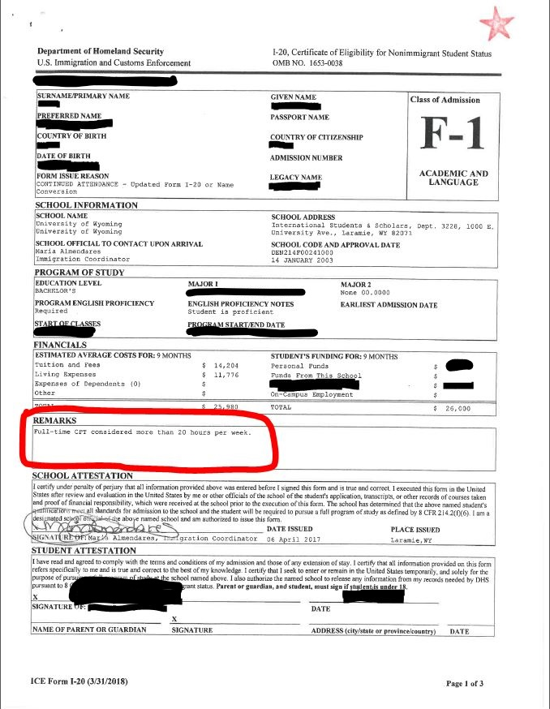
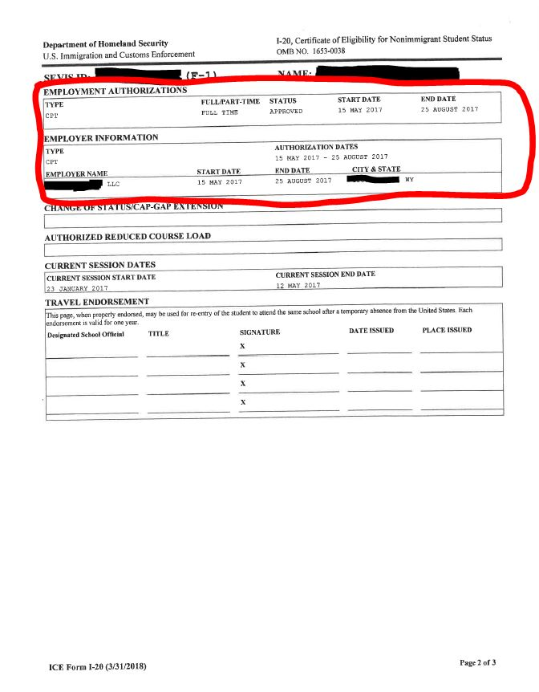
I-20 is Your Work Authorization
I-20 Page 1 shows if your CPT authorization Dates of employment are listed on the I-20 page 2. is part-time or full-time. Authorization is specific to the employer as shown on the I-20 page 2.

Slide 26
Changing CPT Employment
“Can I add a second internship?” Yes, but you must submit a separate CPT application and as well as register for a second internship credit. You will receive a revised I-20 showing both authorizations.
  If you want internships for two offices with the same employer, such as two different offices at UW or another university, these require two separate CPT applications. Approval for one UW internship does NOT automatically grant additional CPT internships on-campus for that semester.
“Can I change my employer? Yes, but it will require canceling your current authorization and submitting a new CPT request. You cannot work for the new employer until the new CPT request is approved by ISS.

Slide 27


Questions?

