Slide 1
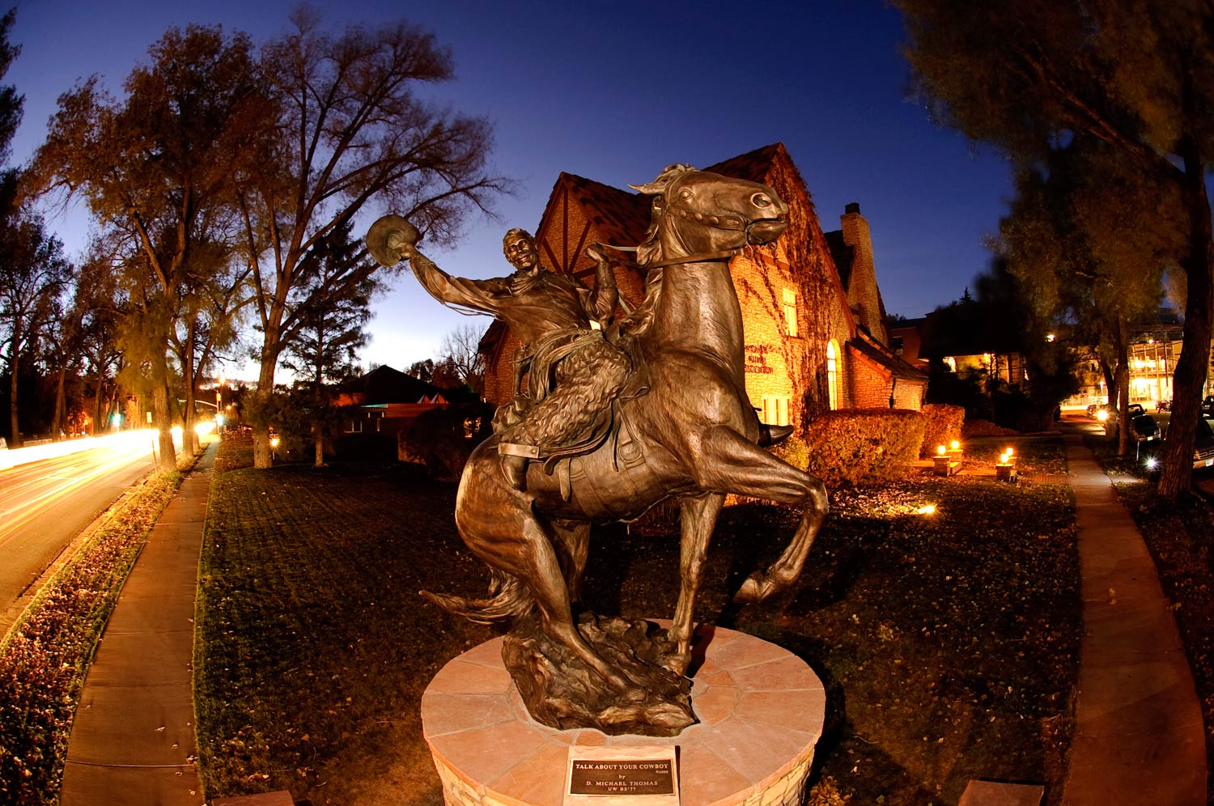
Transforming Physical and Health Education to Meet the Needs of 21st Century Learners (part 1)
Tami Benham Deal, PED
Division of Kinesiology and Health
University of Wyoming
Laramie, WY
307-766-4284
benham@uwyo.edu

Slide 2
Photo source:
http://joshfults.files.wordpress.com/2012/06/three-big-questions.jpg
What will health and physical education look like in a transformed education system?
What are the essential skills students will need in order to navigate the health challenges they will face in the 21st century?
Why should health and physical educators understand the Common Core Standards (CCS) in English Language Arts and Math
How can the CCS strengthen health and physical education standards and assessment in your state?

Slide 3
Transformational Education
Education Reform
Transforming Education

Slide 4
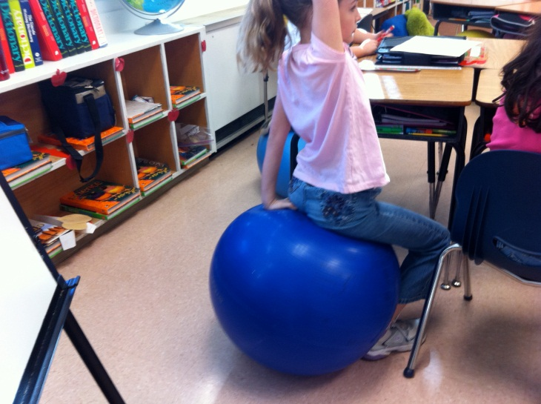
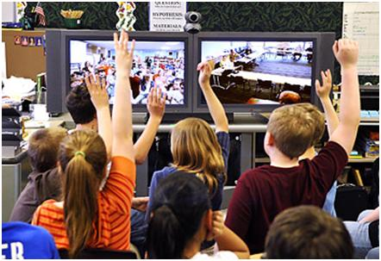
21st Century Schools

Slide 5
Will 21st Century PE Classrooms look like this?

Slide 6
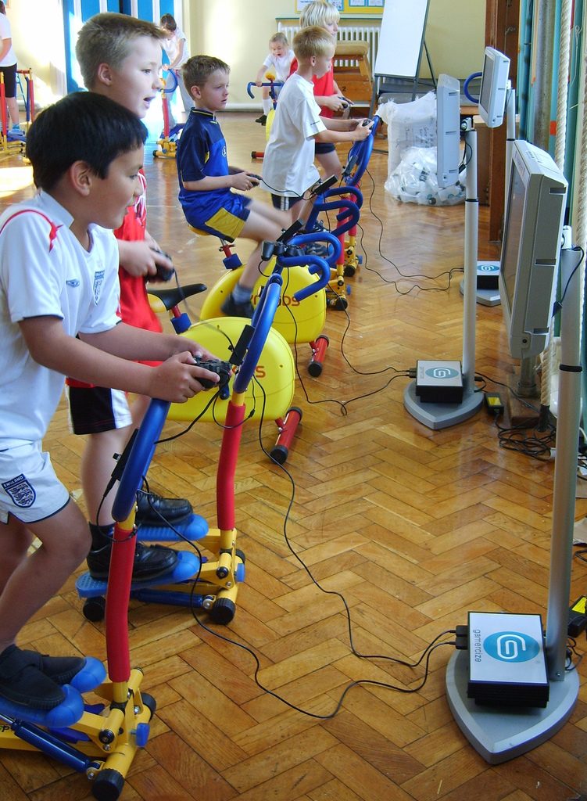
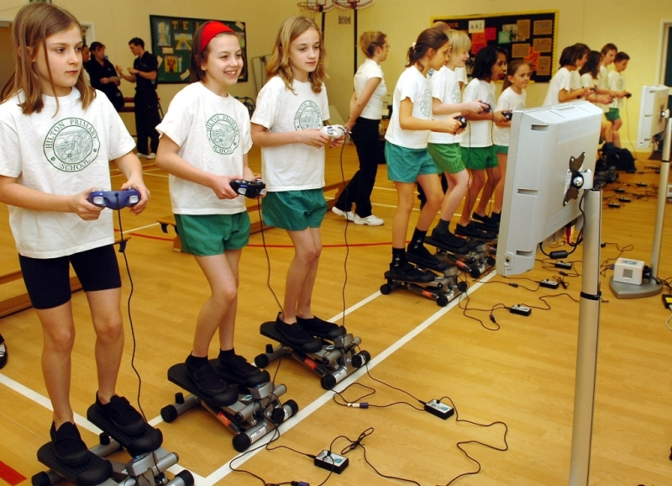
Or this?
Photo Sources
http://www.uruguayeduca.edu.uy/UserFiles/P0001/Image/EducacinFsica/GamerSize.jpg
http://blog.rmhheartandvascular.com/wp-content/uploads/2011/04/exergaming.jpg

Slide 7
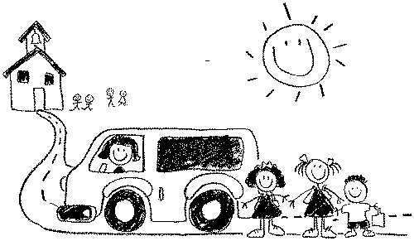
Mission of Schools
To ensure that every student graduates, having met a higher set of expectations that prepare them for lifelong learning, meaningful work, and citizenship.
Gene Wilhoit

Slide 8
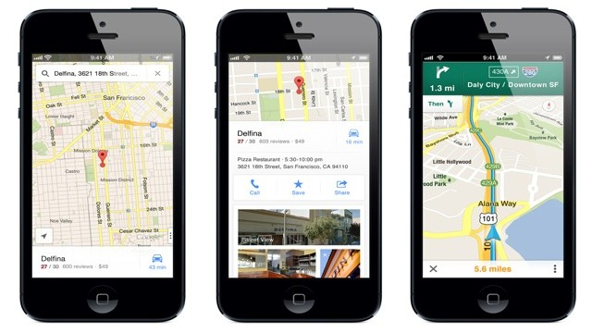
Transforming Education for 21st Century Learners
What are the essential skills students will need in order to navigate the health challenges they will face in the 21st century?

Slide 9
Health Education Standards for
21st Century Learners
Health Information, Products and Resources
Problem Solving and Decision Making
Effective Communication
Personal and Social Responsibility
Students access, analyze, and evaluate health information, products, and resources.
Students use critical thinking and systematic processes to examine health related problems and make decisions that enhance health and reduce, or avoid health risks
Students demonstrate the ability to use interpersonal communication skills to enhance health and reduce or avoid health risks .
Students demonstrate the ability to use personal and social skills that are associated with taking responsible action for enhancing health and reducing or avoiding health risks.

