Slide 1


Transforming Physical and Health Education
to Meet the Needs of 21st Century Learners (Part 2)
Making Connections

Slide 2
Grade Level Standards in ELA
English Language Arts
Reading
Writing
Speaking and Listening
Language
K-8, grade-by-grade
9-10 and 11-12 bands

Slide 3

Reading
Key Ideas and Details
Craft and Structure
Integration of Knowledge and Ideas
Range of Reading and Level of Text Complexity
Foundational Skills (K-5)
Literacy in History/Social Studies
Informational Text
(K-5, 6-12)
Literacy in Science/ Technical Subjects
Literature
(K-5, 6-12)

Slide 4


Reading: Informational Text
Grade 2 Determine the meaning of words and phrases in a text relevant to a grade 2 topic or subject area. | Health Education
Use, Misuse, Abuse

Slide 5


Reading: Informational Text
Grade 4 Determine the meaning of general academic and domain-specific words or phrases in a text relevant to a grade 4 topic or subject area. | Health Education
Medicine, Alcohol

Slide 6
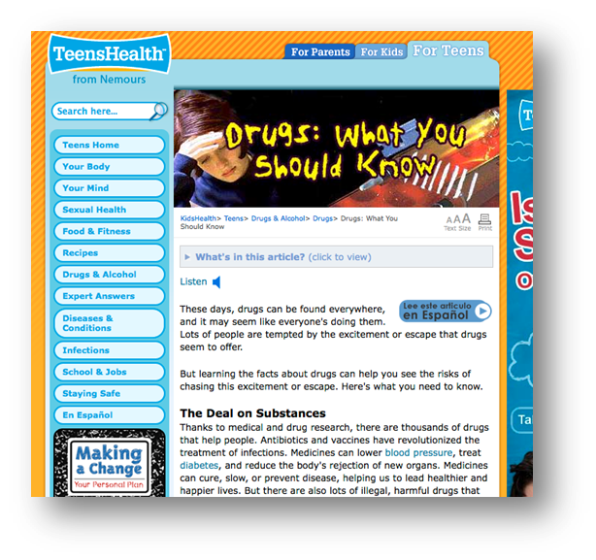
Reading: Informational Text
Grade 6 Determine the meaning of words and phrases as they are used in a text, including figurative, connotative, and technical meanings. | Health Education
“Use only as prescribed”
“Recommended dose”
http://kidshealth.org/teen/drug_alcohol/drugs/know_about_drugs.html#

Slide 7
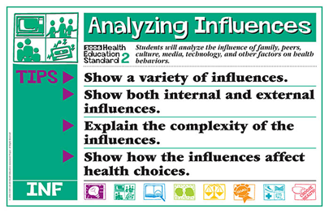
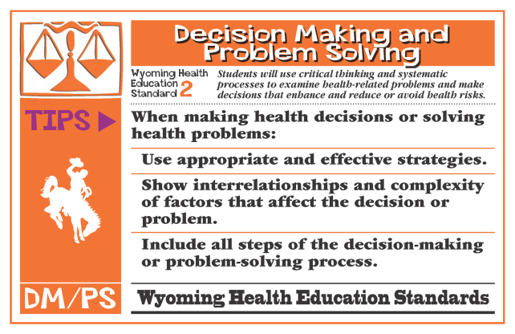



Reading: Informational Text
Grade 8 Determine the meaning of words and phrases as they are used in a text, including figurative, connotative, and technical meanings; analyze the impact of specific word choices on meaning and tone, including analogies or allusions to other texts. | Health Education

Slide 8
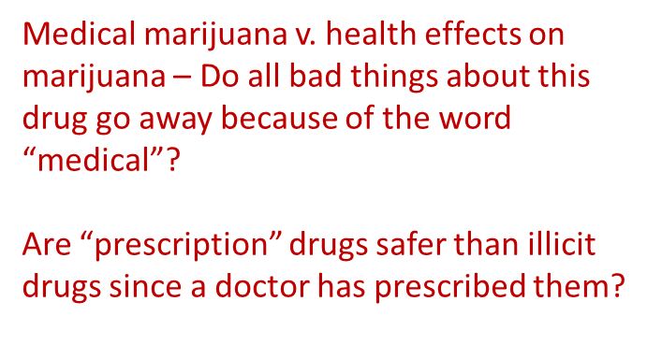


Reading: Informational Text
Grades 9-10 Determine the meaning of words and phrases as they are used in a text, including figurative, connotative, and technical meanings; analyze the cumulative impact of specific word choices on meaning and tone (e.g., how the language of a court opinion differs from that of a newspaper). | Health Education

Slide 9
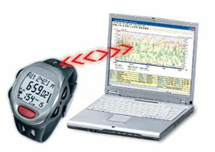


Making Connections
To transform health and physical education
Reading Standards for Literacy in Science and Technical Subjects
Grades 9-10 | How could you implement these standards in your physical education classroom?
Translate quantitative or technical information expressed in words in a text into visual form (e.g., a table or chart) and translate information expressed visually or mathematically (e.g., in an equation) into words.
Assess the extent to which the reasoning and evidence in a text support the author’s claim or a recommendation for solving a scientific or technical problem.
Compare and contrast findings presented in a text to those from other sources (including their own experiments), noting when the findings support or contradict previous explanations or accounts.
Translate health benefits of exercise from a heart rate graph depicting percentage of time workout falls above, below, and within target
Read an article on using steroids to enhance athletic performance to assess reasoning and evidence, like: Max Roosevelt. (2010, January 14). When the Gym Isn't Enough:[Style Desk]. New York Times)
Investigate if students accommodate for non-PE days by being more physically active after school on non-PE days than on PE days. Compare research to findings student collects with school pedometers.

Slide 10
Writing
Text type and purposes
Production and distribution of writing
Research to build and present knowledge
Range of writing
Writing Standards
(K-5, 6-12)
Writing Standards for Literacy in History/Social Studies
Writing Standards for Literacy in Science/ Technical Subjects

Slide 11

Writing Standards for Literacy
History/Social Studies, Science, and Technical Subjects
Text Types and Purposes
Production and Distribution of Writing
Research to Build and Present Knowledge
Range of Writing
Gather relevant information from authoritative print and digital sources, using advanced searches effectively
Assess strengths and limitations of each source in terms of the task, purpose, and audience
Integrate information into the text selectively to maintain the flow of ideas, avoiding plagiarism and overreliance on any one source and following a standard format for citation

Slide 12
Making Connections
To transform health and physical education
Gather relevant information from authoritative print and digital sources, using advanced searches effectively
Assess strengths and limitations of each source in terms of the task, purpose, and audience (and validity)
WY Health Education Standard #1
HE.12.1.1
Locate and evaluate appropriate resources at school, in the community and beyond that help to enhance health (e.g., human resources, printed and electronic resources, equipment and facilities).
HE.12.1.2
Locate and evaluate appropriate resources at school, in the community and beyond that help to reduce health risks (e.g., human resources, printed and electronic resources, equipment and facilities).
HE.12.1.3
Use criteria to evaluate the validity of health information from a variety of sources (e.g., written, verbal, visual, electronic, etc.)

Slide 13



Making Connections
To transform health and physical education
W 9-10 Text Type and Purposes
Write arguments focused on discipline-specific content
Introduce precise claim(s), distinguish the claim(s) from alternate or opposing claims, and create an organization that establishes clear relationships among the claim(s), counterclaims, reasons, and evidence.
Develop claim(s) & counterclaims fairly, supplying data and evidence for each while pointing out the strengths and limitations of both claim(s) & counterclaims in a discipline-appropriate form…
WY HE 2 – PROBLEM SOLVING AND DECISION MAKING
HE12.2.5: Apply a systematic process to evaluate the evidence, claims, beliefs and/or points of view about non-familiar health related issues or problems. ATOD, NUT, PA

Slide 14

Making Connections
To transform health and physical education
FTC Alleges Claims Are Not Backed by Adequate Scientific Evidence
In a settlement reached with the Federal Trade Commission, mouthguard marketer Brain-Pad, Inc. and its President Joseph Manzo are barred from making unsupported claims that their mouthguards reduce the risk of concussions from lower jaw impacts, reduce the risk of concussions generally, or have been clinically proven to do either.
As part of the FTC’s ongoing efforts to protect consumers from over-hyped health claims, the settlement also prohibits Brain-Pad and Manzo from misrepresenting the health benefits of any mouthguard or other athletic equipment designed to protect the brain from injury.
http://www.ftc.gov/opa/2012/08/brainpad.shtm
http://www.brainpads.com/
PE 11.2.3: Students will be knowledgeable consumers of fitness products and services.
HE12.2.5: Apply a systematic process to evaluate the evidence, claims, beliefs and/or points of view about non-familiar health related issues or problems. ATOD, NUT, PA

Slide 15
Writing Standards for Literacy
6. Production and Distribution of Writing (gr 6)
Use technology, including the Internet, to produce and publish writing and present the relationships between information and ideas clearly and efficiently.
PE8.3.2 | Students demonstrate sportsmanship, cooperation, and teamwork in physical activity settings.
http://www.yourcomicstrip.com/
6. Production and Distribution of Writing (gr 3)
With guidance and support from adults, use technology to produce and publish writing (using keyboard skills) as well as interact and collaborate with others.
PE4.2.2 | Students demonstrate an understanding of the health benefits of being physically active.
http://launchpadtoys.com/toontastic/#in-action

Slide 16
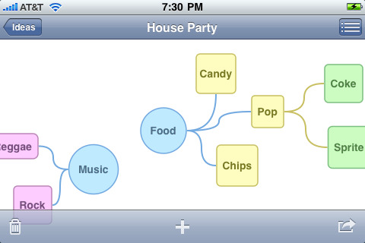
Making Connections
To transform health and physical education
PE11.1.3 | Students demonstrate an understanding of rules and strategies in: rhythms or dance, regulation or form team activities, regulation or form individual or dual activities, and lifetime activities.
itunes - Idea Sketch
https://itunes.apple.com/us/app/idea-sketch/id367246522?mt=8
6. Production and Distribution of Writing (gr 11-12)
Use technology, including the Internet, to produce and publish, and update individual or shared writing products in response to feedback, including new arguments or information.

