Slide 1
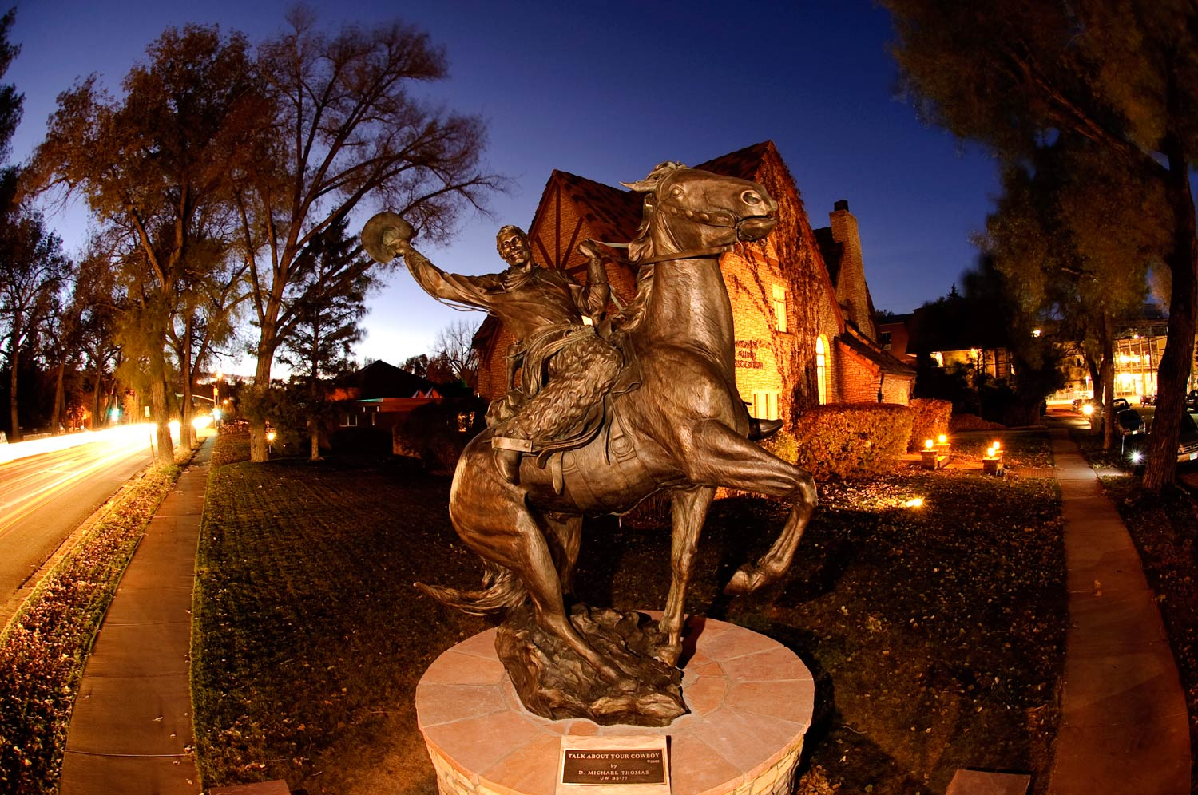

Transforming Physical and Health Education to Meet the Needs of 21st Century Learners
Tami Benham Deal, PED
Division of Kinesiology and Health
University of Wyoming
Laramie, WY

Slide 2


Photo source:
http://joshfults.files.wordpress.com/2012/06/three-big-questions.jpg
What will health and physical education look like in a transformed education system?
What are the essential skills students will need in order to navigate the health challenges they will face in the 21st century?
Why should health and physical educators understand the Common Core Standards (CCS) in English Language Arts and Math
  How can the CCS strengthen health and physical education standards and assessment in your state?

Slide 3
Transformational Education
Education Reform
Transforming Education

Slide 4


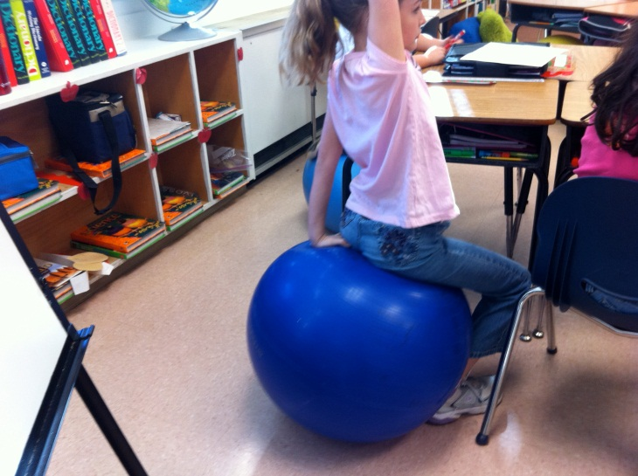
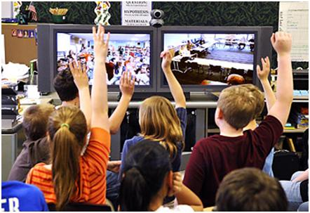
21st Century Schools

Slide 5
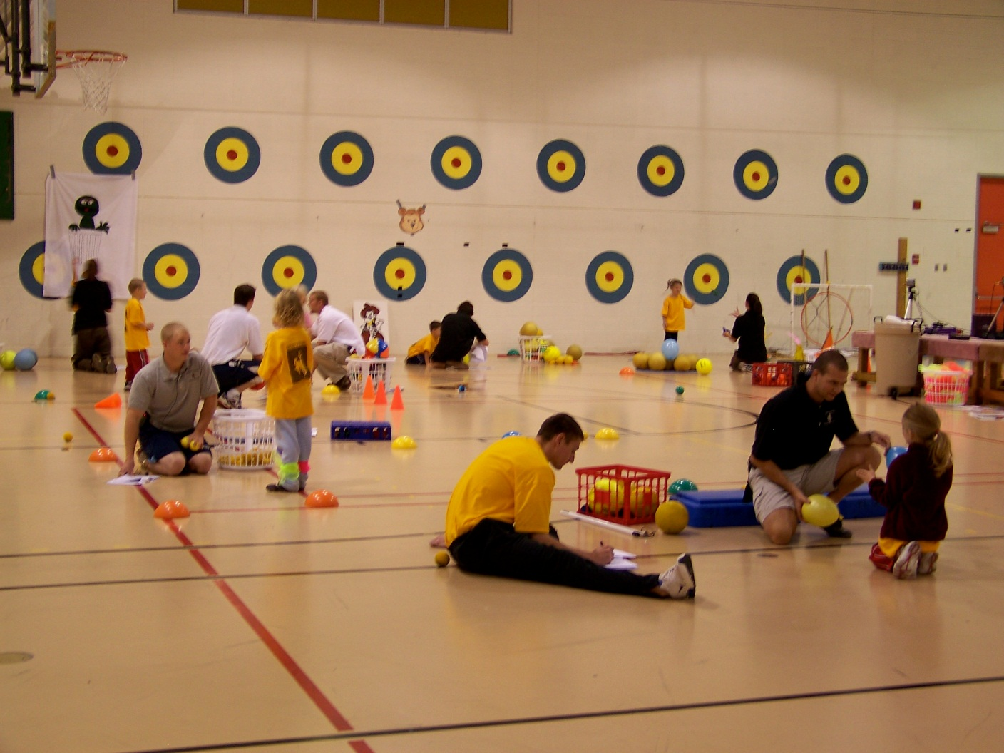
Will 21st Century PE Classrooms look like this?

Slide 6
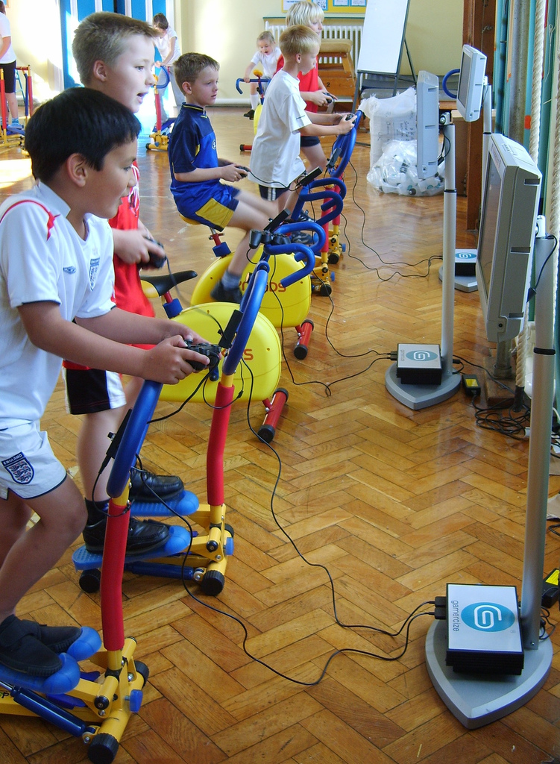
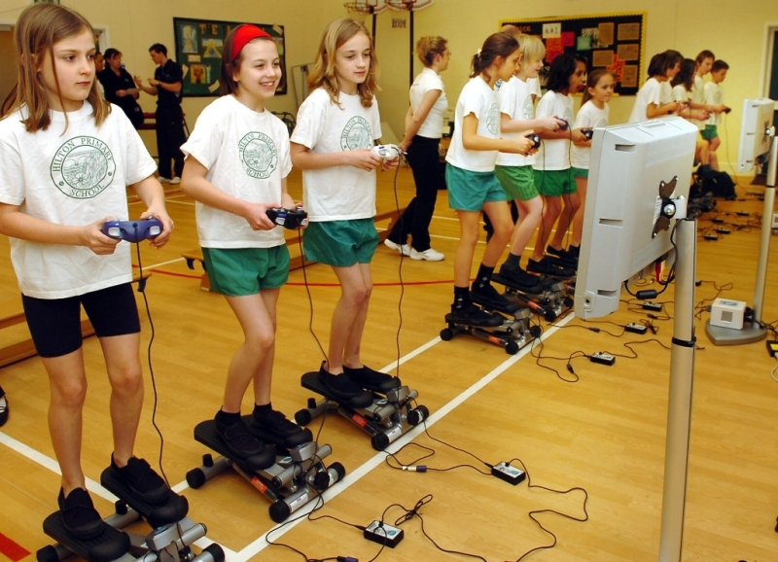
Or this?
Photo Sources
http://www.uruguayeduca.edu.uy/UserFiles/P0001/Image/EducacinFsica/GamerSize.jpg
http://blog.rmhheartandvascular.com/wp-content/uploads/2011/04/exergaming.jpg

Slide 7
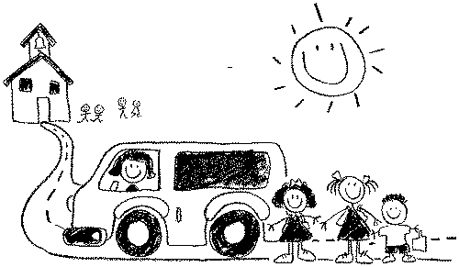
Mission of Schools
To ensure that every student graduates, having met a higher set of expectations that prepare them for lifelong learning, meaningful work, and citizenship.
Gene Wilhoit

Slide 8

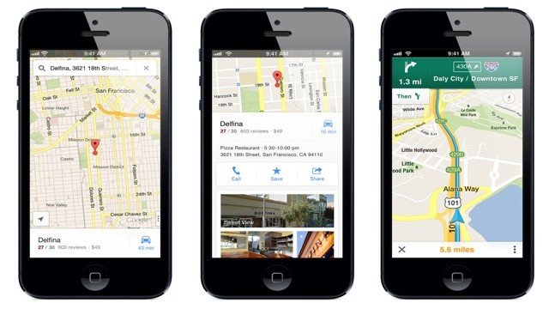
Transforming Education for 21st Century Learners
What are the essential skills students will need in order to navigate the health challenges they will face in the 21st century?

Slide 9

21st Century Learner
Self-Directed Learner
Critical Thinker
Effective Communicator
Responsible Productive Citizen

Slide 10
Self-Directed Learner
Self-directed learners engage in a continual process of:
Self-management
  establish clear goals about their health
  thoroughly gather valid information about their health
  use a systematic approach to solving health related problems and making decisions about their health
  use articulate, thoughtful communication
Self-monitoring
  consciously reflect on their health-related plans, decisions, and actions
  consider and evaluate the ramifications of their health-related thoughts, plans, decisions, and actions
Self-modification
  revise decisions and strategies when needed to maintain or improve health and reduce health risk
  strive to maximize health based on feedback (from self and others)
What National or State Standards in health education reflect these skills?
What National or State Standards in physical education reflect these skills?
Where could these skills be applied in physical education?

Slide 11
Critical Thinker
Reasons Effectively
Use various types of reasoning (inductive, deductive, etc.) to solve health related problems as appropriate to the situation
Use Systems Thinking
Analyze how factors work together and interact to make a person healthy or unhealthy
Make Judgments and Decisions
Effectively analyze and evaluate evidence, arguments, claims and beliefs about health
Analyze and evaluate major alternative points of view about health issues
Synthesize and make connections between health information and arguments
Interpret health information and draw conclusions and solutions based relevant criteria and standards
Reflect critically on health related information, decisions and actions
Solve Problems
Solve different kinds of non-familiar health related problems in both conventional and innovative ways
Identify and ask significant questions that clarify various points of view and lead to better solutions
Communicates effectively with others in figuring out solutions to complex health problems
What National or State Standards in health education reflect these skills?
What National or State Standards in physical education reflect these skills?
Where could these skills be applied in physical education?
Source: http://www.p21.org/
Notes:
in the context of relationships with each other and with other systems
people, structures, and processes that work together to make an organization healthy or unhealthy.

Slide 12
Effective Communicator
Clearly articulates thoughts and ideas about health
using oral, written and nonverbal communication skills
in a variety of forms and contexts
Listen effectively to decipher meaning
including health knowledge, values, attitudes and intentions
Use communication for a range of purposes
to inform, instruct, motivate and persuade
Utilize multiple media and technologies
to communicate and work collaboratively on health related issues
know how to evaluate their effectiveness a priori as well as assess their impact
Communicate effectively in diverse environments (including multi-lingual)
What National or State Standards in health education reflect these skills?
What National or State Standards in physical education reflect these skills?
Where could these skills be applied in physical education?
Source: http://www.p21.org/
Notes:
in the context of relationships with each other and with other systems
people, structures, and processes that work together to make an organization healthy or unhealthy.

Slide 13
Responsible Productive Citizen
Contributes to health of the community/nation
by taking action to prevent disease and injury to self and others
by taking action to reduce the risk of disease and injury to self and others
Advocates for community and environmental health
What National or State Standards in health education reflect these skills?
What National or State Standards in physical education reflect these skills?
Where could these skills be applied in physical education?
Notes:
in the context of relationships with each other and with other systems
people, structures, and processes that work together to make an organization healthy or unhealthy.

Slide 14
Health Education Standards for
21st Century Learners
Health Information, Products and Resources
Problem Solving and Decision Making
Effective Communication
Personal and Social Responsibility
Students access, analyze, and evaluate health information, products, and resources.
Students use critical thinking and systematic processes to examine health related problems and make decisions that enhance health and reduce, or avoid health risks
Students demonstrate the ability to use interpersonal communication skills to enhance health and reduce or avoid health risks .
Students demonstrate the ability to use personal and social skills that are associated with taking responsible action for enhancing health and reducing or avoiding health risks.

Slide 15


Slide 16
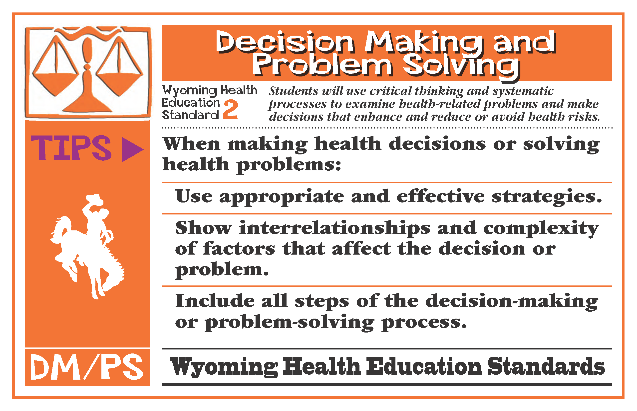

Slide 17
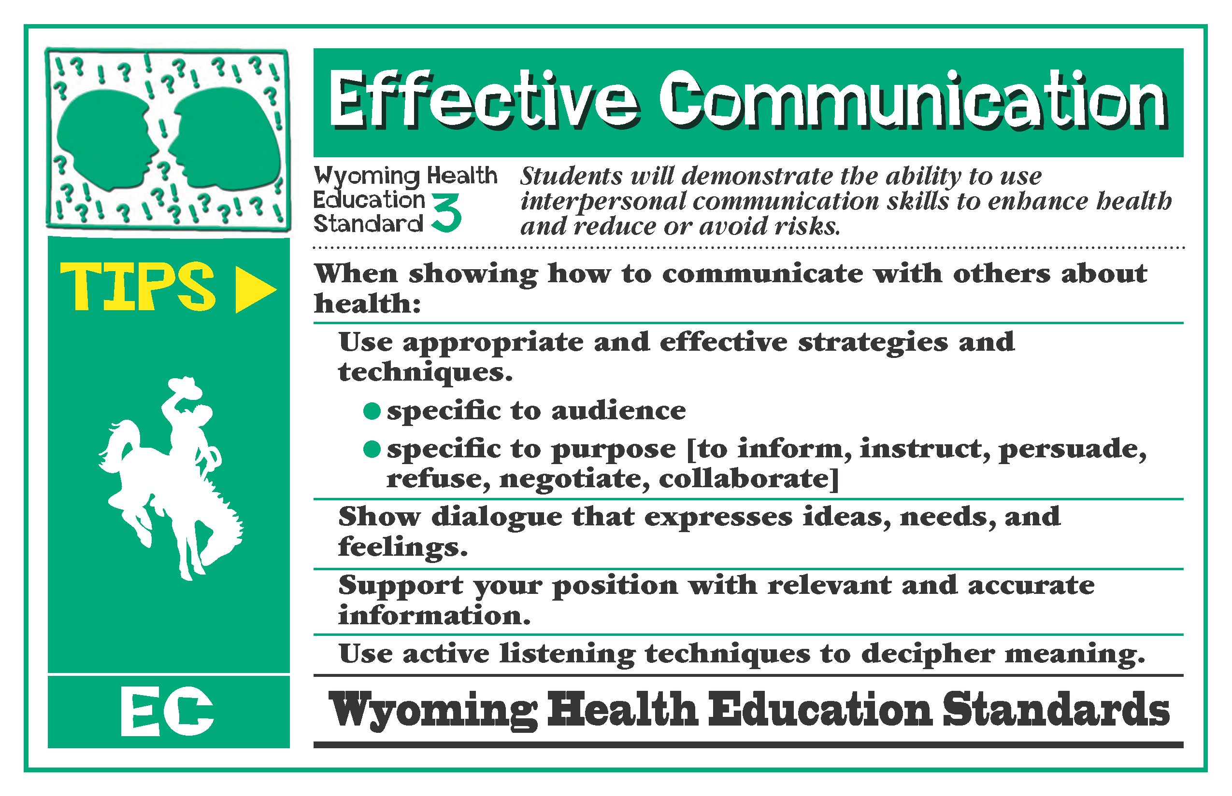

Slide 18
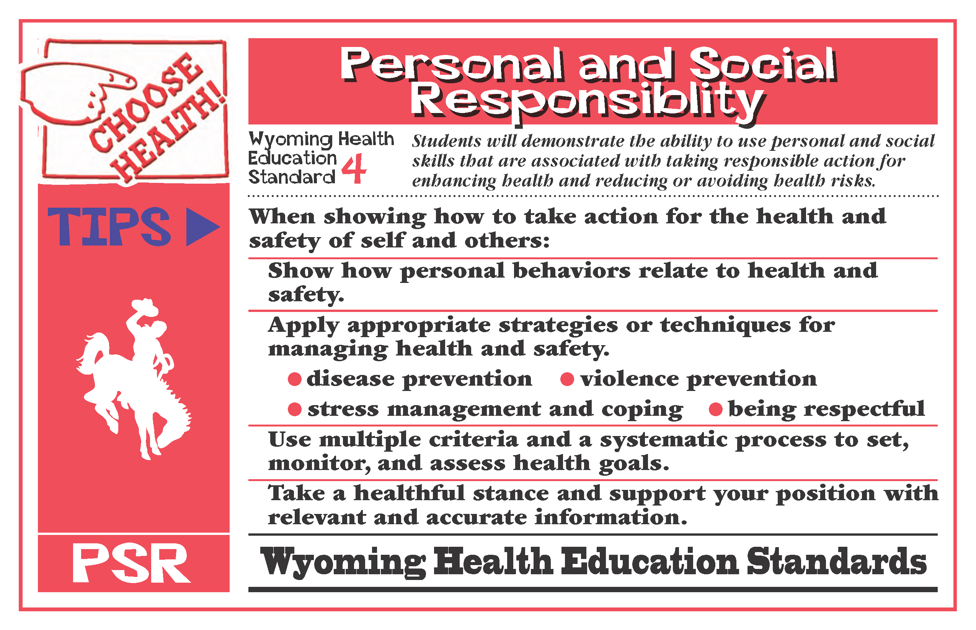

Slide 19


Slide 20

Transforming Physical and Health Education
to Meet the Needs of 21st Century Learners (Part 2)
Transforming
Instruction and Assessment

Slide 21
Grade Level Standards in ELA
English Language Arts
Reading
Writing
Speaking and Listening
Language
K-8, grade-by-grade
9-10 and 11-12 bands

Slide 22

Reading
Key Ideas and Details
Craft and Structure
Integration of Knowledge and Ideas
Range of Reading and Level of Text Complexity
Foundational Skills (K-5)
Literacy in History/Social Studies
Informational Text
(K-5, 6-12)
Literacy in Science/ Technical Subjects
Literature
(K-5, 6-12)

Slide 23


Reading: Informational Text
Grade 2 Determine the meaning of words and phrases in a text relevant to a grade 2 topic or subject area. | Health Education
Use, Misuse, Abuse

Slide 24


Reading: Informational Text
Grade 4 Determine the meaning of general academic and domain-specific words or phrases in a text relevant to a grade 4 topic or subject area. | Health Education
Medicine, Alcohol

Slide 25
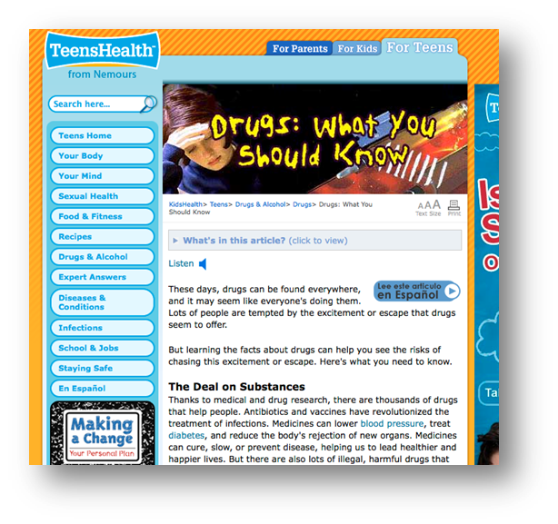
Reading: Informational Text
Grade 6 Determine the meaning of words and phrases as they are used in a text, including figurative, connotative, and technical meanings. | Health Education
“Use only as prescribed”
“Recommended dose”
http://kidshealth.org/teen/drug_alcohol/drugs/know_about_drugs.html#

Slide 26
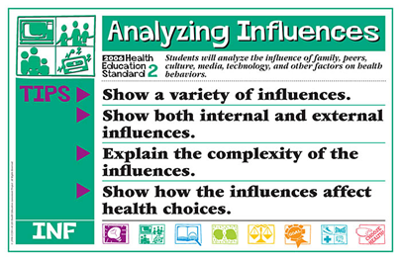




Reading: Informational Text
Grade 8 Determine the meaning of words and phrases as they are used in a text, including figurative, connotative, and technical meanings; analyze the impact of specific word choices on meaning and tone, including analogies or allusions to other texts. | Health Education

Slide 27
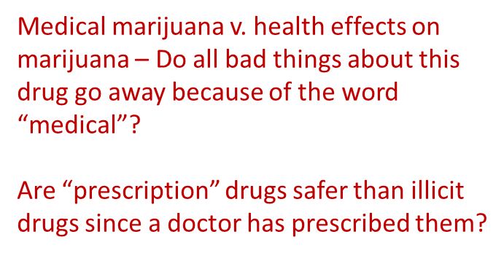


Reading: Informational Text
Grades 9-10 Determine the meaning of words and phrases as they are used in a text, including figurative, connotative, and technical meanings; analyze the cumulative impact of specific word choices on meaning and tone (e.g., how the language of a court opinion differs from that of a newspaper). | Health Education

Slide 28
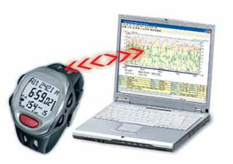


Making Connections
To transform health and physical education
Reading Standards for Literacy in Science and Technical Subjects
Grades 9-10 | How could you implement these standards in your physical education classroom?
Translate quantitative or technical information expressed in words in a text into visual form (e.g., a table or chart) and translate information expressed visually or mathematically (e.g., in an equation) into words.
Assess the extent to which the reasoning and evidence in a text support the author’s claim or a recommendation for solving a scientific or technical problem.
Compare and contrast findings presented in a text to those from other sources (including their own experiments), noting when the findings support or contradict previous explanations or accounts.
Translate health benefits of exercise from a heart rate graph depicting percentage of time workout falls above, below, and within target
Read an article on using steroids to enhance athletic performance to assess reasoning and evidence, like: Max Roosevelt. (2010, January 14). When the Gym Isn't Enough:[Style Desk]. New York Times)
Investigate if students accommodate for non-PE days by being more physically active after school on non-PE days than on PE days. Compare research to findings student collects with school pedometers.

Slide 29
Writing
Text type and purposes
Production and distribution of writing
Research to build and present knowledge
Range of writing
Writing Standards
(K-5, 6-12)
Writing Standards for Literacy in History/Social Studies
Writing Standards for Literacy in Science/ Technical Subjects

Slide 30

Writing Standards for Literacy
History/Social Studies, Science, and Technical Subjects
Text Types and Purposes
Production and Distribution of Writing
Research to Build and Present Knowledge
Range of Writing
Gather relevant information from authoritative print and digital sources, using advanced searches effectively
Assess strengths and limitations of each source in terms of the task, purpose, and audience
Integrate information into the text selectively to maintain the flow of ideas, avoiding plagiarism and overreliance on any one source and following a standard format for citation

Slide 31
Making Connections
To transform health and physical education
Gather relevant information from authoritative print and digital sources, using advanced searches effectively
Assess strengths and limitations of each source in terms of the task, purpose, and audience (and validity)
WY Health Education Standard #1
HE.12.1.1
Locate and evaluate appropriate resources at school, in the community and beyond that help to enhance health (e.g., human resources, printed and electronic resources, equipment and facilities).
HE.12.1.2
Locate and evaluate appropriate resources at school, in the community and beyond that help to reduce health risks (e.g., human resources, printed and electronic resources, equipment and facilities).
HE.12.1.3
Use criteria to evaluate the validity of health information from a variety of sources (e.g., written, verbal, visual, electronic, etc.)

Slide 32



Making Connections
To transform health and physical education
W 9-10 Text Type and Purposes
Write arguments focused on discipline-specific content
Introduce precise claim(s), distinguish the claim(s) from alternate or opposing claims, and create an organization that establishes clear relationships among the claim(s), counterclaims, reasons, and evidence.
Develop claim(s) & counterclaims fairly, supplying data and evidence for each while pointing out the strengths and limitations of both claim(s) & counterclaims in a discipline-appropriate form…
WY HE 2 – PROBLEM SOLVING AND DECISION MAKING
HE12.2.5: Apply a systematic process to evaluate the evidence, claims, beliefs and/or points of view about non-familiar health related issues or problems. ATOD, NUT, PA

Slide 33
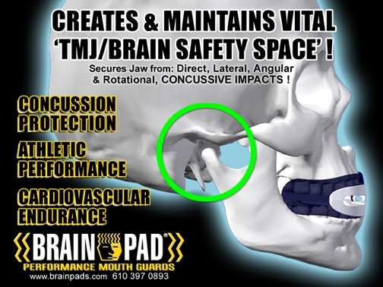
Making Connections
To transform health and physical education
FTC Alleges Claims Are Not Backed by Adequate Scientific Evidence
In a settlement reached with the Federal Trade Commission, mouthguard marketer Brain-Pad, Inc. and its President Joseph Manzo are barred from making unsupported claims that their mouthguards reduce the risk of concussions from lower jaw impacts, reduce the risk of concussions generally, or have been clinically proven to do either.
As part of the FTC’s ongoing efforts to protect consumers from over-hyped health claims, the settlement also prohibits Brain-Pad and Manzo from misrepresenting the health benefits of any mouthguard or other athletic equipment designed to protect the brain from injury.
http://www.ftc.gov/opa/2012/08/brainpad.shtm
http://www.brainpads.com/
PE 11.2.3: Students will be knowledgeable consumers of fitness products and services.
HE12.2.5: Apply a systematic process to evaluate the evidence, claims, beliefs and/or points of view about non-familiar health related issues or problems. ATOD, NUT, PA

Slide 34
Writing Standards for Literacy
6. Production and Distribution of Writing (gr 6)
Use technology, including the Internet, to produce and publish writing and present the relationships between information and ideas clearly and efficiently.
PE8.3.2 | Students demonstrate sportsmanship, cooperation, and teamwork in physical activity settings.
http://www.yourcomicstrip.com/
6. Production and Distribution of Writing (gr 3)
With guidance and support from adults, use technology to produce and publish writing (using keyboard skills) as well as interact and collaborate with others.
PE4.2.2 | Students demonstrate an understanding of the health benefits of being physically active.
http://launchpadtoys.com/toontastic/#in-action

Slide 35
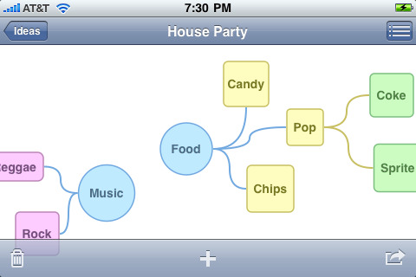
Making Connections
To transform health and physical education
PE11.1.3 | Students demonstrate an understanding of rules and strategies in: rhythms or dance, regulation or form team activities, regulation or form individual or dual activities, and lifetime activities.
itunes - Idea Sketch
https://itunes.apple.com/us/app/idea-sketch/id367246522?mt=8
6. Production and Distribution of Writing (gr 11-12)
Use technology, including the Internet, to produce and publish, and update individual or shared writing products in response to feedback, including new arguments or information.

Slide 36


Speaking and Listening
Presentation of Knowledge and Ideas 11-12 Present information, findings, and supporting evidence clearly, concisely, and logically such that listeners can follow the line of reasoning and the organization, development, substance, and style are appropriate to purpose, audience, and task.
Presentation of Knowledge and Ideas 11-12 Evaluate a speaker’s point of view, reasoning, and use of evidence and rhetoric, identifying any fallacious reasoning or exaggerated or distorted evidence.
WY HE 12.3.7 Delineate a speaker’s health argument and specific claims, distinguishing health claims that are supported by reasons and evidence from health claims that are not supported by reasons and evidence.

Slide 37

http://www.ted.com
Speaking and Listening

Slide 38
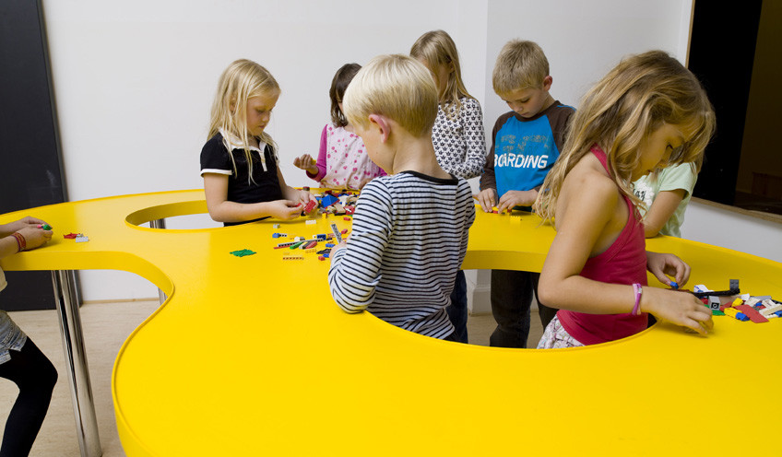
Transforming Physical and Health Education to Meet the Needs of 21st Century Learners

Slide 39
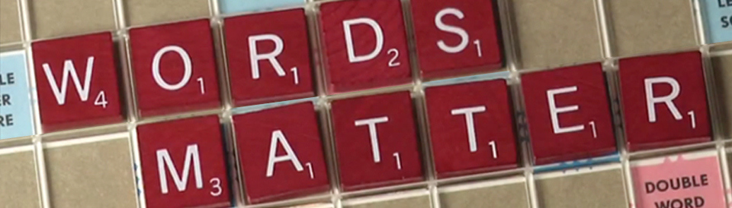

Aligning Standards and Assessment
Regional Workshops on Aligning 2012 WY Health Education Standards and Assessment to Common Core Standards in ELA and Literacy in History/Social Students, Science and Technical Subjects
Contact Tami Benham Deal (benham@uwyo.edu) for more details.

Slide 40
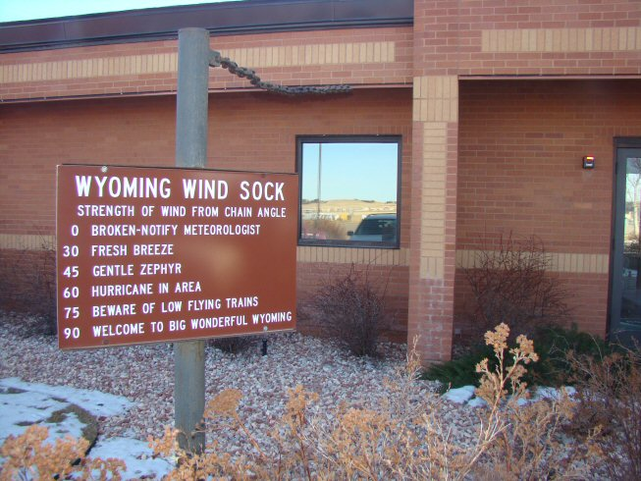

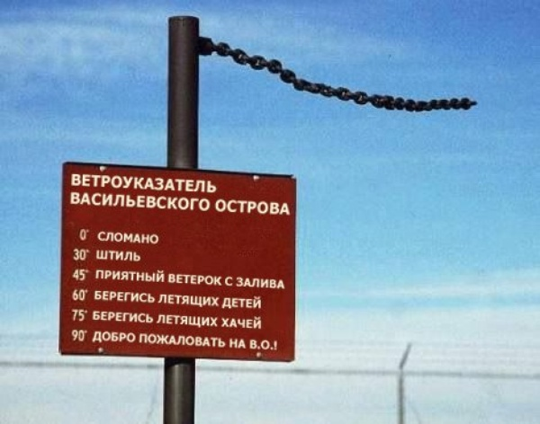
Changes in the Wind!
http://www.scassheap.org/

Slide 41

Tami Benham Deal, PED
Division of Kinesiology and Health
University of Wyoming
Laramie, WY
307-766-4284
benham@uwyo.edu

