Slide 1
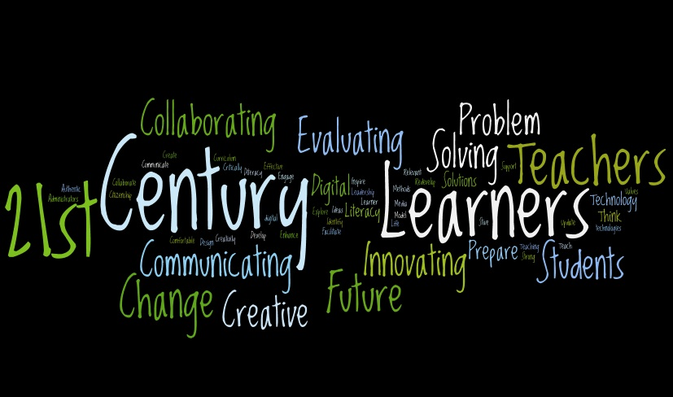

21st Century Learner
Self-Directed Learner
Critical Thinker
Effective Communicator
Responsible Productive Citizen

Slide 2
Self-Directed Learner
Self-directed learners engage in a continual process of:
Self-management
establish clear goals about their health
thoroughly gather valid information about their health
use a systematic approach to solving health related problems and making decisions about their health
use articulate, thoughtful communication
Self-monitoring
consciously reflect on their health-related plans, decisions, and actions
consider and evaluate the ramifications of their health-related thoughts, plans, decisions, and actions
Self-modification
revise decisions and strategies when needed to maintain or improve health and reduce health risk
strive to maximize health based on feedback (from self and others)
What National or State Standards in health education reflect these skills?
What National or State Standards in physical education reflect these skills?
Where could these skills be applied in physical education?

Slide 3
Critical Thinker
Reasons Effectively
Use various types of reasoning (inductive, deductive, etc.) to solve health related problems as appropriate to the situation
Use Systems Thinking
Analyze how factors work together and interact to make a person healthy or unhealthy
Make Judgments and Decisions
Effectively analyze and evaluate evidence, arguments, claims and beliefs about health
Analyze and evaluate major alternative points of view about health issues
Synthesize and make connections between health information and arguments
Interpret health information and draw conclusions and solutions based relevant criteria and standards
Reflect critically on health related information, decisions and actions
Solve Problems
Solve different kinds of non-familiar health related problems in both conventional and innovative ways
Identify and ask significant questions that clarify various points of view and lead to better solutions
Communicates effectively with others in figuring out solutions to complex health problems
What National or State Standards in health education reflect these skills?
What National or State Standards in physical education reflect these skills?
Where could these skills be applied in physical education?
Source: http://www.p21.org/
Notes:
in the context of relationships with each other and with other systems
people, structures, and processes that work together to make an organization healthy or unhealthy.

Slide 4
Effective Communicator
Clearly articulates thoughts and ideas about health
using oral, written and nonverbal communication skills
in a variety of forms and contexts
Listen effectively to decipher meaning
including health knowledge, values, attitudes and intentions
Use communication for a range of purposes
to inform, instruct, motivate and persuade
Utilize multiple media and technologies
to communicate and work collaboratively on health related issues
know how to evaluate their effectiveness a priori as well as assess their impact
Communicate effectively in diverse environments (including multi-lingual)
What National or State Standards in health education reflect these skills?
What National or State Standards in physical education reflect these skills?
Where could these skills be applied in physical education?
Source: http://www.p21.org/
Notes:
in the context of relationships with each other and with other systems
people, structures, and processes that work together to make an organization healthy or unhealthy.

Slide 5
Responsible Productive Citizen
Contributes to health of the community/nation
by taking action to prevent disease and injury to self and others
by taking action to reduce the risk of disease and injury to self and others
Advocates for community and environmental health
What National or State Standards in health education reflect these skills?
What National or State Standards in physical education reflect these skills?
Where could these skills be applied in physical education?
Notes:
in the context of relationships with each other and with other systems
people, structures, and processes that work together to make an organization healthy or unhealthy.

