Slide 1
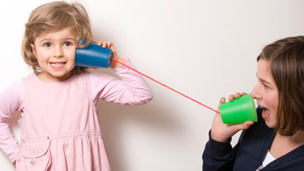
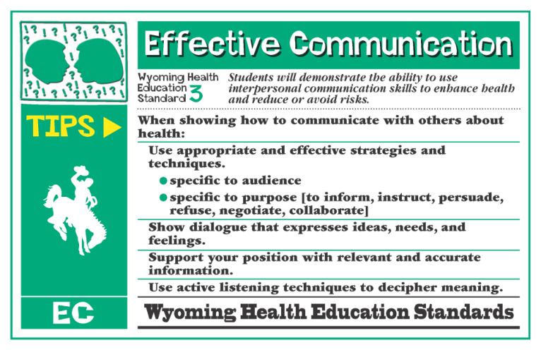

Speaking and Listening
Presentation of Knowledge and Ideas 11-12 Present information, findings, and supporting evidence clearly, concisely, and logically such that listeners can follow the line of reasoning and the organization, development, substance, and style are appropriate to purpose, audience, and task.
Presentation of Knowledge and Ideas 11-12 Evaluate a speaker’s point of view, reasoning, and use of evidence and rhetoric, identifying any fallacious reasoning or exaggerated or distorted evidence.
WY HE 12.3.7 Delineate a speaker’s health argument and specific claims, distinguishing health claims that are supported by reasons and evidence from health claims that are not supported by reasons and evidence.

Slide 2

http://www.ted.com
Speaking and Listening

Slide 3
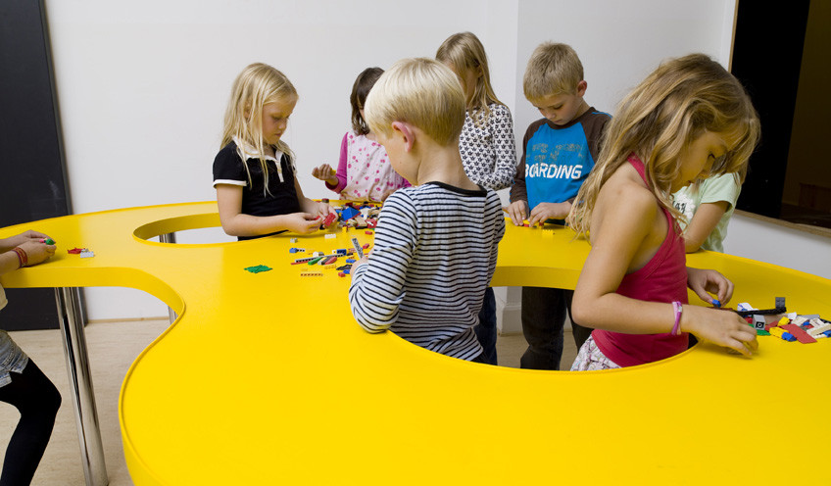
Transforming Physical and Health Education to Meet the Needs of 21st Century Learners

Slide 4
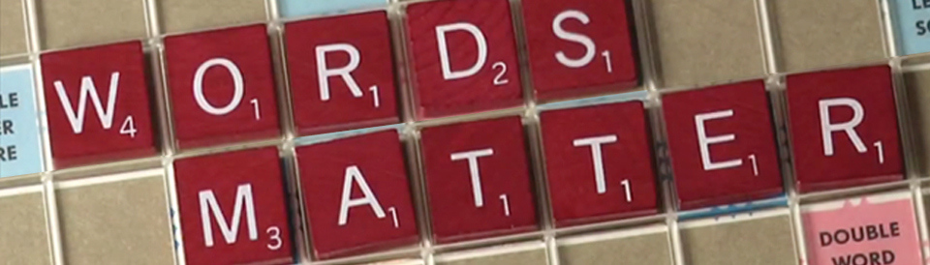

Aligning Standards and Assessment
Regional Workshops on Aligning 2012 WY Health Education Standards and Assessment to Common Core Standards in ELA and Literacy in History/Social Students, Science and Technical Subjects
Contact Tami Benham Deal (benham@uwyo.edu) for more details.

Slide 5
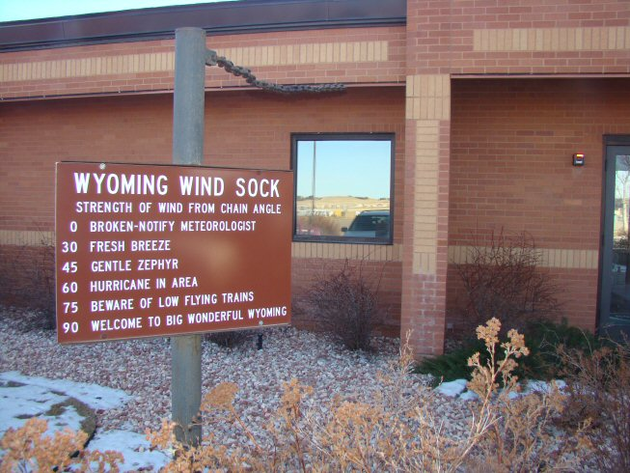

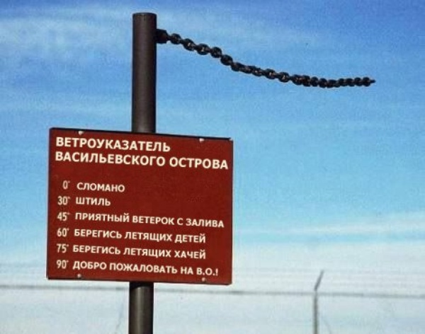
Changes in the Wind!
http://www.scassheap.org/

Slide 6

Tami Benham Deal, PED
Division of Kinesiology and Health
University of Wyoming
Laramie, WY
307-766-4284
benham@uwyo.edu

