Slide 1
Identifying and Managing Asperger’s
In and Out of the Classroom

Slide 2
Dr. Brian Van Brunt serves as the Director of Counseling at Western Kentucky State University. He is the president of the American College Counseling Association (ACCA) for the 2010-2011 term. He has worked in higher education for over twelve years.
Brian consults and presents nationally on a variety of counseling in higher education topics. He has spoken to faculty and staff on the topics of forensic threat assessment, suicide prevention, compassion fatigue, classroom disruption, and identifying and managing aggression.
Brian recently completed a series of 25 mental health case studies with Paper-Clip Communications to encourage discussion and awareness of these mental health issues on campus.
Brian’s resident advisor training course through Magna Publications is used by over 50 colleges and universities to augment their resident advisor education programs. He has been quoted in the LA Times, Miami Herald, CNN, NPR, USA Today and Newsweek.
www.brianvanbrunt.com

Slide 3
Introduction
Identifying and Understanding Asperger’s
Managing Asperger’s
Referral and Accommodations
Sample Programs
Case Studies
Notes:
(with focus on non-traditional students)
(with attention on bullying)

Slide 4
Introduction
Many professors and staff have come in contact with students who have been diagnosed with Asperger’s disorder.
These students struggle with interpersonal connections, odd fixations and social awkwardness.
We try to find ways to reach these students while keeping classroom order and focusing on the academics.
Staff may encounter Asperger students who have trouble following the rules, social cues, and developing relationships with floor mates and roommates.

Slide 5
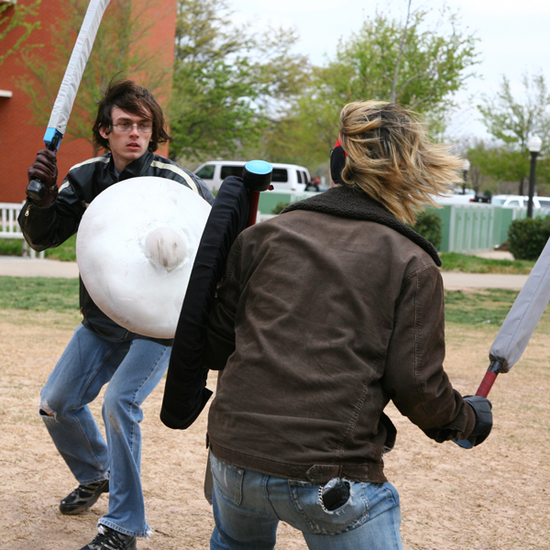
Introduction
Faculty may have had a student who:
Asks odd or repetitive questions which derail the lecture and distract the class.
May be teased or laughed at by other students who pick on them or talk quietly behind their back.
Has manners or strange speech patterns.
http://ou.media.clients.ellingtoncms.com/img/photos/2009/04/05/LARPing-ise.jpg

Slide 6
Introduction
Faculty may have had a student who:
Wears odd gothic clothing in class (such as a cape, elaborate jewelry, scarves or embroidery).
Talks in strange language (odd inflections, Latin, Klingon, Victorian English) or refuses to talk at all.
Writes on his/her arms with strange symbols.
http://www.kli.org/pics/piqdemo.gif

Slide 7
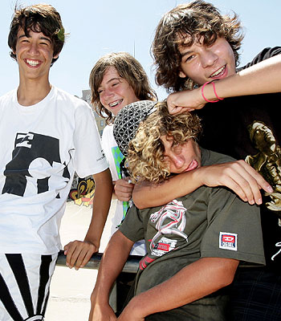
Introduction
Staff may have had a student who:
Gets into arguments with roommate about staying up late or going to bed early, frustrating habits or repetitive disagreement.
Gets picked on by other students in the halls.
Has poor hygiene or personal grooming.
Is sensitive to loud noises or bright lights.
http://resources0.news.com.au/images/2009/01/06/1111118/494824-teasing-banter-can-build-leaders.jpg

Slide 8
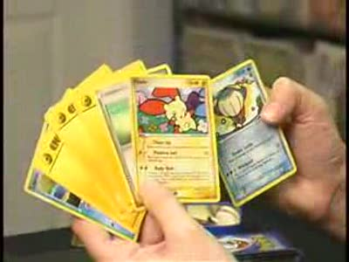
Introduction
Faculty may have had a student who:
Gets teased for odd appearance.
Has younger, developmental young speech or interests different from those she lives with.
Has trouble understanding social interactions and the speed of communication and new rules.
http://tipdeck.com/how-to-play-pokemon-cards

Slide 9
Introduction
A friend…
“I was diagnosed as a kid but my mom never told me so I didn't know I had it when I was actually in college, I thought I was just weird and bad at understanding people.
Mostly I had people issues and it led to poor personal relationships (I have a hard time understanding someone I trust might be lying to me...this led to a string of manipulative boyfriends), but I never really noticed its effects on my academic life.
I was sensitive to loud music so I didn't like the party scene other people thought was so important for the college experience.”

Slide 10
Identifying and Understanding Asperger’s
We are challenged to find ways to work with these students while staying focused on the academics and creating a successful learning environment in the residence halls.
This program will offer some practical approaches to working with these students.
Faculty and Staff who ignore or respond to these students with anger will have difficulty with their classrooms and be less effective in establishing healthy communities.

Slide 11
Identifying and Understanding Asperger’s
These approaches are designed to help you develop a response to the odd, strange or socially awkward behavior.
Regardless of the presence of an official diagnosis, these approaches are useful in both understanding these behaviors and finding ways to redirect and teach the student to create an improved learning environment and help the student feel more connected in a residence hall community.

Slide 12
Identifying and Understanding Asperger’s
Students with Asperger’s struggle with non-verbal behavior and social nuance.
Asperger’s is a development disorder.
No two people with Asperger’s have the same behaviors or symptoms. Asperger’s syndrome represents a broad spectrum of students.
They are all unique individuals.

Slide 13
Identifying and Understanding Asperger’s
Asperger’s Disorder is a milder variant of the autism spectrum disorder. You may observe:
Impairments in two-sided social interaction
Speech peculiarities (repetition, odd inflection)
Interests that interfere with age-appropriate interests (car motors, history, door knobs…)
Eccentric behavior, sensory issues
Difficulty reading social cues (standing to leave, subtle messages to stop talking, non-verbal signals)
Difficulty making small talk, find it hard to understand what others are thinking or feeling

Slide 14
Identifying and Understanding Asperger’s
Students with Asperger’s may also have strange, odd or less socially acceptable interests that draw teasing and isolation from other students. These may include:
Dungeons and Dragons, Live Action Role Play (LARP), World of Warcraft video games
Japanese Anime movies or cartoons
Specific movie or music interests that seem obsessive (punk, gothic, twilight/vampire)
Obsession with odd items (French windows, turn of the century soda cans)

Slide 15
Identifying and Understanding Asperger’s
Students who are socially awkward may or may not have Asperger’s disorder. They may be odd, developmentally less mature or simply “marching to the beat of a different drummer.”
It can be challenging to separate or differentiate these symptoms. Some non-Asperger behaviors are:
Having overly-dependent or “clingy” behavior
Creating chaotic and overly-dramatic interactions
Being angry, anti-social or aggressive

Slide 16
Identifying and Understanding Asperger’s
Social Problems
Social problems cover a wide range of behaviors and perceptual difficulties.
They may include personality disorders or severe adjustment problems to the college atmosphere.
You make the same suggestions over and over again and see little change in the student’s behavior or understanding.
These students are overly clingy or socially isolated. They may seem extremely shy, childish or odd. Often, they are picked on by other students.

Slide 17
Identifying and Understanding Asperger’s
Borderline Personality
Students often have inappropriate, short-term relationships, cannot maintain friendships and become very defensive and often aggressive on confrontation.
Their lives are often very chaotic and best described as unstable. They lack consistency and thrive on drama.
They are resistant to seeking help and often frustrate staff and faculty who make attempts to assist them.

Slide 18
Identifying and Understanding Asperger’s
Dependant Personality
Students form overly close attachments and want someone to take care of them.
These attachments often drain the person they are attached to, which may end that relationship.
They have difficulty functioning on their own and seek connection with others at the sacrifice of their own independence and growth.

Slide 19
Identifying and Understanding Asperger’s
Antisocial Personality
The main characteristics are selfishness, an unwillingness to take responsibility for their actions, little regard for rules or laws, lack of guilt, and failure to learn from mistakes.
May be hostile/aggressive towards others. Have trouble seeing things from other people’s perspective and are often overly narcissistic and aggressive.
Rarely aware of a problem and resistant to change.

Slide 20
Managing Asperger’s
Approach the behavior the same, whether the etiology is a personality disorder, developmental delays or socially odd behavior. Training faculty and staff to differentiate the cause of these behaviors would yield little improvement in their classroom management or getting compliance and reducing conflict in the residence halls.
Faculty should realize there are ADA protections extended to Asperger’s that may not exist for the others. The onus for completing the ADA application does fall to the student. We will talk in a moment about how faculty can assist with this referral.

Slide 21
Managing Asperger’s
These students are often distracting to others in the classroom. Sometimes they are teased.
We should address these behaviors with a consistent approach:
Seek to minimize the classroom and residence hall disruptions
Reduce teasing and
Increase positive communication
between all students
http://blog.orgsync.com/wp-content/uploads/2009/06/student-group-couch-300x220.jpg

Slide 22
Managing Asperger’s
Be clear, concise, consistent
When working with these students, it is essential to offer clear messages. Avoid trying to address multiple issues at one time.
CLEAR: “Please save any questions until after class or during my office hours.”
UNCLEAR: “When you ask questions before class it sometimes can take up time that I need to prepare for class. If you have a short question, you can ask it---but try to save big questions for during my office hours.”

Slide 23
Managing Asperger’s
Be clear, concise, consistent
When working with these students, it is essential to offer clear messages. Avoid trying to address multiple issues at one time.
CLEAR: “Please don’t play your techno music that loud.”
UNCLEAR: “Listen, quiet hours are in effect now and since it is close to finals, we really have to be aware of the noise level on the floor. Normally, this wouldn’t be a problem, but since it isn’t the weekend, you really need to turn it down a bit.”

Slide 24
Managing Asperger’s
Be clear, concise, consistent
Messages should be concise. They should be short and focused on the desirable action.
CONCISE: “Please don’t touch other students in class.”
LENGTHY: “I know you think you were just joking around when you flipped Megan’s hair up like that but she might have seen it as something else. And whether you like her or not, by touching her hair you can cause a problem that can end in assault charges. No one wants that, so try to avoid this in the future.”

Slide 25
Managing Asperger’s
Be clear, concise, consistent
Messages should be concise. They should be short and focused on the desirable action.
CONCISE: “Please don’t use your snooze alarm.”
LENGTHY: “Everyone can have some trouble waking up in the morning, but it is important not to hit the snooze alarm so many times. If you can learn to just use it once or twice, that would be one thing…but you hit it like twelve times…and that’s too many. So let’s try to cut back some, ok?”

Slide 26
Managing Asperger’s
Be clear, concise, consistent
Messages should be consistent. Messages that repeat the same information through repetition are more likely to sink in.
CONSISTENT: “I’d like you to limit yourself to 3 questions per class.”
INCONSISTENT: “Well, since your last 3 questions were good ones we’ll let you ask some more if you like. But make sure the question is relevant to the discussion at hand.”

Slide 27
Managing Asperger’s
Be clear, concise, consistent
Messages should be consistent. Messages that repeat the same information through repetition are more likely to sink in.
CONSISTENT: “Please shower every day.”
INCONSISTENT: “It’s up to you to choose how much you need to shower, but ultimately you should shower every few days, maybe more if you are working out or doing something physical. It depends, but either way you have to shower more because you smell.”

Slide 28
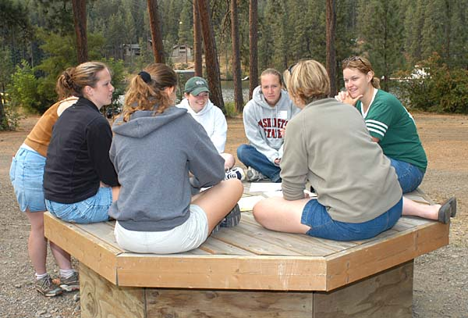
Managing Asperger’s
Inclusion and social management
It is important to include students in classroom discussions and group work (despite the awkwardness and frustration this may involve). This mainstreaming approach will use the student’s peers to help shape appropriate behavior.
http://www.vetmed.wsu.edu/announcements/camp03/images/DSC_0258A.jpg

Slide 29
Managing Asperger’s
Inclusion and social management
We need to be aware of students in the classroom who are helpful and unhelpful with the student in question. We should be alert to teasing behavior and positive behavior. The goal is to decrease exposure to the negative students and increase exposure to the positive ones.
http://www.untoldentertainment.com/blog/img/2009_04_07/revengeOfTheNerds.jpg

Slide 30
Managing Asperger’s
For example:
You may have had a student who is being teased by other students in the class for asking odd or repetitive questions. You have identified several supportive students and several others who lead the teasing.
Encourage the positive students through discussion and discourage the negative students by talking to them directly after class.
Find ways to better limit questions to “question time” or collect written questions at the end of class for extra credit.

Slide 31
Managing Asperger’s
Inclusion and social management
It is important to include students in floor activities and outings (despite the awkwardness and frustration this may involve). This will help students feel more comfortable and learn new habits when relating to others.
http://hikingtrip.org/wp-content/uploads/2010/05/Forest-Alexandria-Hiking-Trail.jpg

Slide 32
Managing Asperger’s
Inclusion and social management
We need to be aware of those who are supportive and those who are not. We should be alert to teasing behavior and positive behavior. The goal is to decrease exposure to the negative students and increase exposure to the positive ones.
http://www.everythingaction.com/2010/05/19/80s-bullying-a-tribute/

Slide 33
Managing Asperger’s
For example:
You may have had a student who is being teased by other students because they are obsessed with Pokémon cards. You have identified several supportive students and several others who lead the teasing.
Encourage the positive students through discussion and discourage the negative students by talking to them away from the Asperger’s student.
Find ways keep the Pokémon talk limited to others who are open to the experience. Help the student learn to understand when it is ok and when it is not to discuss their passion.

Slide 34
Managing Asperger’s
Take a journey
Take the time to understand Asperger’s students. This interest can build rapport and increase your success in working with them. For example:
Learn a bit about WOW or LARP from Wikipedia. It takes about 5-10 minutes and shows your willingness to connect. Understand how these groups are ways to increase social connection.
Understand something about Anime and Japanese culture. Consider using some graphics in your PowerPoint lecture (provided the student won’t be embarrassed or worked up by the reference).

Slide 35
Managing Asperger’s
Take a journey-- but not too far
Be aware that this is a delicate balance. There are times where increased questions can “activate” more negative behavior in the classroom. Examples may be:
A quick question about “What is your character’s name on World of Warcraft?” may turn into a ten minute discussion of how the character was created and why elves use silver weapons.
A comment about a Japanese Anime t-shirt might lead to a detailed discussion of the movie and an awkward invitation to the next comic-con.

Slide 36
Managing Asperger’s
Summary: How to Help
Set clear boundaries and expectations. Be aware they will not always keep them and have a plan of “what to do next.”
Try to encourage positive social interactions for them with others in the class or group.
Separate emotions from your interactions; be clear and focused in what you are trying to communicate.
Seek specific help on how best to interact with students who frustrate you. Often students with these kind of social problems (1) are very difficult to change or (2) aren’t aware of their behaviors.

Slide 37
Managing Asperger’s
Summary: How to Help
Asperger’s students have a literal understanding of language. Don’t use sarcasm.
Find safe havens on campus were a student can feel safe and they can explore their interests (like the library).
Develop a peer support group. Advice from someone who is struggling with Asperger’s can often be heard better than from a professional.

Slide 38
Referral and Accommodations
Referral
Understand when a referral to counseling or academic support is in order. It is our job to ensure the student is referred to services if the situation continues to worsen in the classroom setting.
When referring a student to counseling:
Do it during a time when you are alone with the student.
Focus on positive goals. Make interaction clear and direct.
Don’t make it seem accusatory.

Slide 39
Referral and Accommodations
When referring a student to ADA:
Do it during a time when you are alone with the student.
Focus on positive goals. Make interaction clear and concise.
Understand the legal requirements of the ADA. (Accommodations must be approved through that office, if you offer an accommodation then you become required to offer it in the future.)
If accommodations are needed, consider them early in the semester.

Slide 40
Sample Programs
http://www.youtube.com/watch?v=233-3jtEZck

Slide 41
Sample Programs
http://www.insidecollege.com/reno/Colleges-for-Students-with-Aspergers-The-Very-Friendly-Ones/421/list.do
http://mucollegesupport.blogspot.com/2008/05/understanding-aspergers-syndrome.html

Slide 42
Case Study A
Dave is often picked on by other students in the halls. He came to school in a relationship with Sarah, whom he met at his alternative high school. They both choose your college for their school.
Sarah breaks up with Dave during orientation. Dave has a hard time with this and becomes convinced he needs to win back her love. He follows her around and buys her flowers and writes her lengthy poetry.
Dave dresses up in his LARP costume and comes to her table at dinner to profess his love for her.
Notes:
Brian:

Slide 43
Case Study B
Carol loves history and spends every waking moment studying, reading and learning about the past. She takes the course Western Civilizations and often interrupts the professor during his lecture.
“Um, that isn’t quite correct. The Amorite kings ruled the Mesopotamian city states…”
While Carol is often correct, the professor is annoyed by her constant interruptions. He has asked her several times to be silent in class and she has not.
Other students call her the “Fertile Crescent” because she won’t stop talking.
Notes:
Brian:

Slide 44
Case Study C
Alex became upset at the teasing by other students on his floor. They often left items like dirty socks, used condoms and food garbage by his door in the morning. Alex would always scream and yell at the discovery and everyone would laugh in their rooms.
This happened for most of the semester and in an adjustment and personal growth class, two of his hall mates were laughing about what happened that morning. Dog poop was left outside the door.
Alex shouts at them and throws a handful of the dog feces he had carried to class at them.
Notes:
Brian:

Slide 45
Thank you
Dr. Brian Van Brunt
www.brianvanbrunt.com
Thank you for your participation!

