Slide 1
On bad genes and how to detect them (Game from Univ. Utah)
Siguna Mueller
PhD student in BMS, Univ. Wyoming
Notes:
Will ask you to be detective to find bad gene. First, some basics.

Slide 2
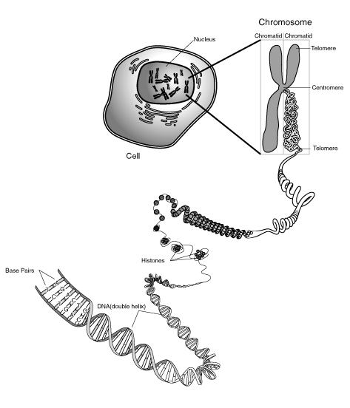
What is DNA?
Each cell needs instructions for its role in the body
What do these instructions look like?

Slide 3
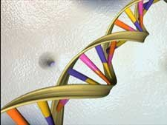
The instructions come in the form of a molecule called DNA.
DNA encodes a detailed set of plans, like a blueprint for building different parts of the cell
Notes:
Have you seen blueprints before? For what? Instructions are often broken up into parts. E.g. to build a house: electricity, roofing, windows…

Slide 4
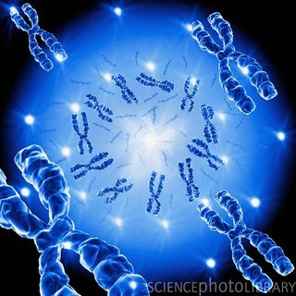
What is a Gene?
Genes are instruction
manuals for our body.
They are the directions
for building all the
proteins.
Proteins make our
bodies function.
Notes:
Each gene is responsible for its own protein product. How would that relate to our house?

Slide 5
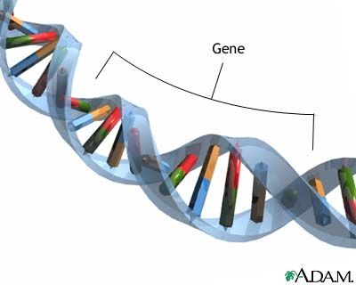
What do genes look like?
Genes are made of DNA.
One strand of DNA
contains many genes.
Each cell in our body contains a lot of DNA!
How much?
Notes:
The DNA from a single human cell, if stretched out, would be 3 meters long! How long is that?

Slide 6
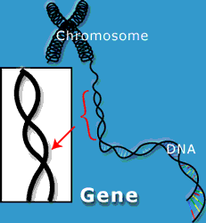
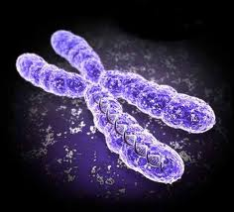
How does all of that DNA fit into a cell?
The DNA is packaged into compact units called chromosomes.
Chromosomes are efficient
storage units for DNA.

Slide 7
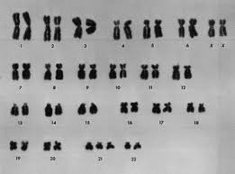
How many chromosomes does each cell have?
Each HUMAN cell has 46 chromosomes.
All the DNA is organized into
two sets of 23
chromosomes
(2x23=46 total).
We get genes from both our parents
That’s why children look both like their mom and dad

Slide 8
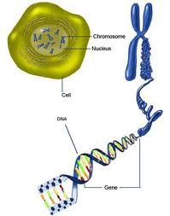
Remember
Every human has the same set of genes.
chromosomes
Genes reside on chromosomes.
Every human has the same set of genes.
Notes:
Basic instruction as to how to build a house is the same. But houses are different. How?

Slide 9
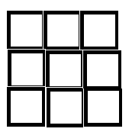
If we all have the same genes, what makes us different?
The information carried on genes differ slightly from person to person.
Different forms of genes (alleles)
result in unique traits
Examples?
9 chromosomes
Simplify:
Assume only 1 gene
per chromosome

Slide 10
Bad Genes
Medical Disorders

Slide 11
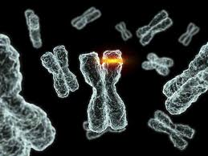
Mutations
A mutation is a permanent change to in the genetic material (seen in the DNA sequence).
What are the consequences of a such a change?
Notes:
What would that mean for our house?

Slide 12
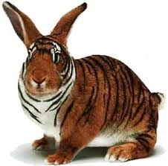
(How) can a gene be responsible for a disease?
Mutations may cause genes to malfunction.
This is known as a genetic disorder.
How?
A gene is mutated when it causes its protein product to malfunction.
Do you know an example of a genetic D/O?
Neurofibromatosis I (NF1)
Notes:
NF1 affects 1 in 3,000 individuals. D/O of nervous system, causes tumor growth. The gene encodes a protein that is responsible for cell division. Too much cell division leads cancer.

Slide 13
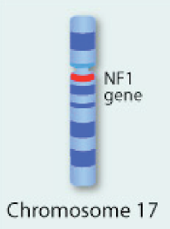
Genetic disorders
A medical conditions only arises
when the DNA sequence of a
gene is mutated.
Not all changes in DNA sequences lead to faulty genes.
So, how do scientists discover the faulty gene that is responsible for a medical condition?
For NF 1: the faulty gene is on chromosome 17

Slide 14
How to detect faulty genes
Can we find out, on which chromosome?
Once we know which chromosome, scientists can locate the faulty gene on this chromosome.
Example: Bad apples
Have a distinctive color

Slide 15
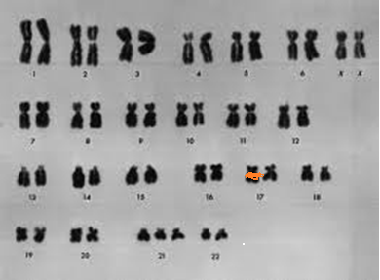
Key for Discovery
Every person with the D/O has this particular faulty gene
NO healthy individual has this faulty gene

Slide 16
Suppose we only have 9 chromosomes.
Each chromosome carries different information for different people.
Indicated by different colors
One of the four individual has a faulty gene.
Which of the chromosomes is faulty?
What and where is the ‘bad color’?

Slide 17
Genetic disorders run in families
What does this mean?
Does every child get the D/O?
How can we find out?
Construct a pedigree:
Diagram that describes family relationships
Shows which family member has the D/O

Slide 18
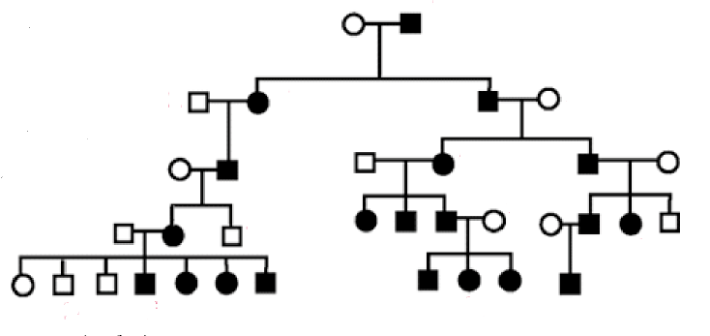
A Pedigree of NF 1
Black circles or squares indicate disease
Can ‘map’ gene to a specific location on the chromosome
Know which gene -> this helps for therapy

Slide 19
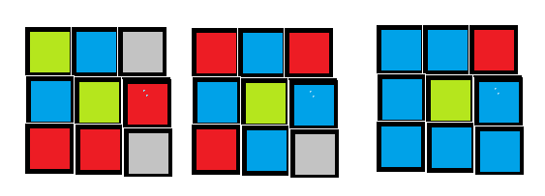
Affected
Unaffected Unaffected Unaffected
Other affected
The green colored piece in the center is present in
all affected individuals
The green is absent in individuals who do not have
the disorder

