Slide 1
WELCOME
New Safety Coordinators!
New Safety Coordinator
Spring Orientation
January 24, 2012
Notes:
Welcome. Thanks for registering and donating your valuable time to be here today. We will do our best to make it worth your while. It is good to see a wide variety of departments here. This is our first Safety Coordinator in-service or seminar. We hope to do something similar at least annually. We have put together some Thank You gifts, small tokens of our appreciation for your being a Safety Coordinator. When you leave at 11 please take one of those bags with you, mention items in bag and notebooks too. You also have packets with some information which we will discuss and refer to today through the course of the seminar. Mention emergency exits and bathroom locations. Food restroom breaks?

Slide 2
Introductions (Staff and Coordinators)
Name
Department
Primary work environment
(Facilities, Laboratory Research, Office/administration)
What does Safety mean to you?
Notes:
Nancy does slide.
Why safety is Important to UW: Have EHS staff record answers on tablet.
Accident, injury, illness prevention
Environmental Protection and sustainability
Grant requirements
Regulatory compliance
Risk reduction

Slide 3
EHS Mission
Promoting health, safety and environmental protection by providing exemplary programs in support of the University mission
Notes:
Exemplary: meaning programs others want to imitate. It is about programs that protect our biggest capital resource at the university is people: students, faculty performing teaching and research, support staff who provide needed services. So to provide a safe place to study and (for some students) to live, to teach to perform cutting edge research etc. This is a big job. There are a plethora of various regulations and regulating agencies that need to be addressed, OSHA, EPA, DEQ, NRC, NFPA, DOT. (Use names not acronyms). Newer in this arena are HLC and CDC.
UW is comprised of over 6000 employees ,about 15,000 students and about?? gross square feet of building space. We just exceeded 10 X 6 dollars in ???. In addition to the UW campus we have a variety of facilities, programs and activities talking pace in other parts of Wyoming, the US and the word. s and buildings UW EHS is you will see. Which is why support form administration, beginning with President Buchannan and filtering throughout the organization including and especially you all as departmental safety coordinators is essential.

Slide 4
Our Vision
A university culture where safety and health are core values, embraced and acted upon at all levels
Notes:
What does core value mean? Central or foundational. A basic, essential, enduring worth of someone or something. Embraced? Welcomed, or to take in or include as part, item, or element of a more inclusive whole. Use flip charts to capture ideas.

Slide 5
UW Regulation 4-2
(Office of General Counsel)
Employment Provisions-Applicable to All Personnel
Section L. Safety
Safety is the responsibility of every employee. Each employee shall conduct their activities in compliance with applicable governmental, university, and campus unit safety and health policies, procedures and regulations. This includes abiding by safety rules, participating in safety training as required and reporting hazards and potential violations. Any employee who believes there is a safety problem in his/her work environment or elsewhere in the University is obligated to bring the problem to the attention of the immediate supervisor, the Environmental Health and Safety Department or the Department of Risk Management and Insurance as appropriate.
Notes:
Jim, can you tell us a little bit about this regulation?

Slide 6
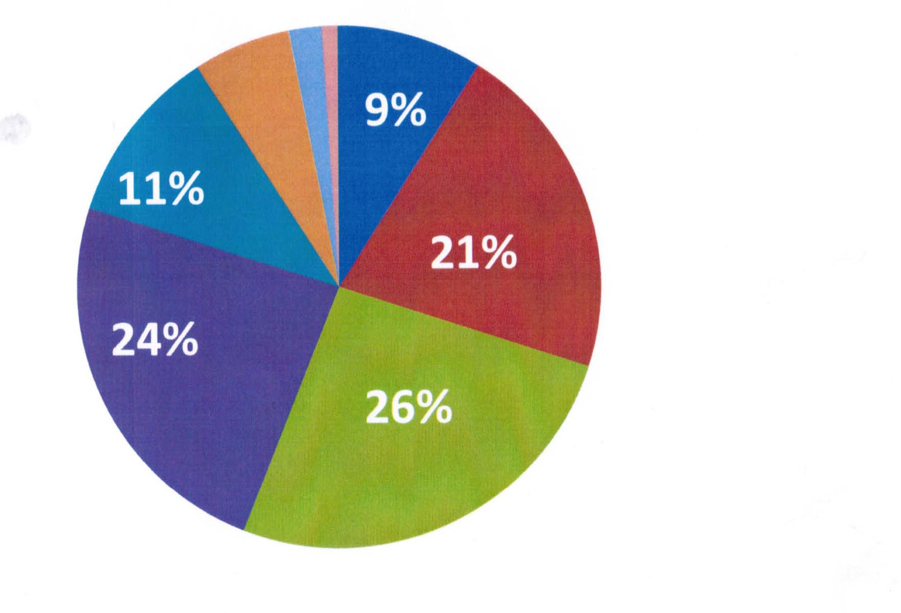
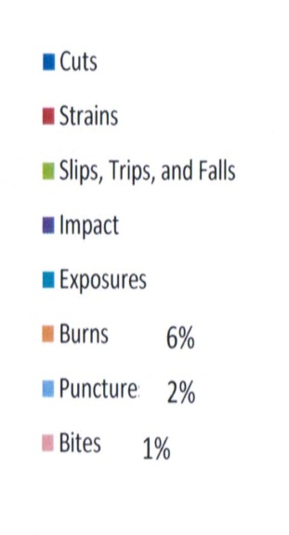
2011 Accident Types
% of Total Accidents
9%
21%
26%
24%
11%
9%
Notes:
Cuts decreased from 11 to 9%
Strains decreased from 25% to 21%
Slips Trips and Falls decreased from 28% to 26%
Impact increased from 18% to 24%
Exposure increased from 8% to 11%
Burns stayed the same
Puncture from 1% to 2%
Bites from 0.5% to 1%
No Shocks

Slide 7
UW EHS Overview
UW EHS Program Areas
EHS services
EHS Locations
EHS New Initiatives
Safety Roles and Responsibilities

Slide 8
EHS Program Areas
Biological Safety
Chemical Safety
Occupational Safety
Radiation Safety
Waste Management
Chemical Orders
Hazardous Materials Transportation
Notes:
Brief history EHS dept if time. Seven basic program areas :
Summary of each area and staff introductions. Have them stand up under their program areas are mentioned.
Biological Safety: Program provides guidance for minimizing health and environmental exposures to biological hazards, oversight for research with biological materials, and compliance with the OSHA Bloodborne Pathogen standard. The Institutional Biosafety Committee (IBC) is responsible for reviewing all University activities involving the use of biohazards, recombinant DNA, select agents, and bloodborne pathogens. The IBC evaluates risk and defines containment and practices for safe work with infectious agents and biologically derived infectious materials.
Chemical Safety: Offers a broad array of regulatory guidance and sound practical assistance concerning the safe use of hazardous chemicals in laboratory and non laboratory settings. This program encompasses the Chemical Hygiene Program for laboratories, the Hazard Communication program for non laboratory use of chemicals, chemical storage compatibility guidelines, chemical inventories, laboratory hood and emergency shower testing, inspections of chemical use areas, and fire extinguisher training.
Occupational Safety: Encompassing a wide range of safety and health subjects which are characteristically regulated by the Occupational Safety and Health Administration (OSHA), the emphases of this program includes respiratory protection, hearing conservation, electrical safety, accident/injury investigation, confined space entry, asbestos, lead, PPE, fall protection, air monitoring, and ergonomics. This program functions throughout all work environments.
Radiation Safety: With oversight from the University Radiation Safety Committee, this program controls the uses of radioactive materials and radiation producing equipment throughout the university and provides services necessary for compliance with applicable radiation safety and laser safety regulations. The mission of the Radiation Safety program is to assist university personnel and students in the safe acquisition, handling and disposal of radiation sources and to limit radiation exposures to the lowest level attainable.
Waste Management: The Regulated Materials Management Center (RMMC) handles discarded items that cannot go down the drain or to the landfill. This includes biological, radiological and chemical wastes, as well as e-waste and other universal wastes. Whenever possible, we seek to reduce, reuse or recycle these discarded materials in order to minimize disposal costs and the impact on the environment.
Chemical Orders: The Centralized Chemical Purchasing Program offers chemical ordering, comparison shopping, price negotiation, receipt inspection, and delivery service to any location on the extended campus. All permitted radioactive materials on campus are purchased through this program. We also sell ethanol for lab use in 5-gallon carboys and 55 gallon drums of 95% and pints, cases of pints and 5-gallon carboys of 100% ethanol.
Hazardous Materials Transportation: The Department of Transportation (DOT) regulates the transportation of biological, radioactive, and chemically hazardous materials. This section provides guidance to UW faculty, staff and students who transport hazardous materials in a motor vehicle on a public thoroughfare.

Slide 9
EHS Services
Consultation
Training
Hazard Assessments
Inspections
Emergency Response
Waste Management
Notes:
Explain as needed

Slide 10
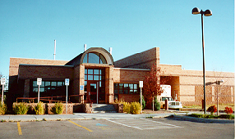
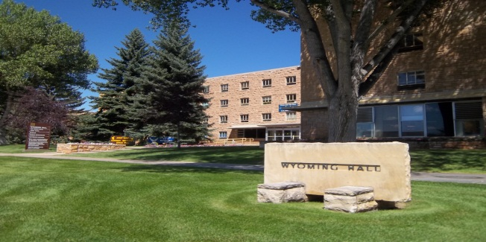
EHS Locations and Contact Information
Regulated Materials Management Center (RMMC) 751 North 19th Street
766-3698
Main EHS Office
Wyoming Hall, Room 102
766-3277
EHS web page: http//www.uwyo.edu/ehs
EHS email: uwehs@uwyo.edu

Slide 11
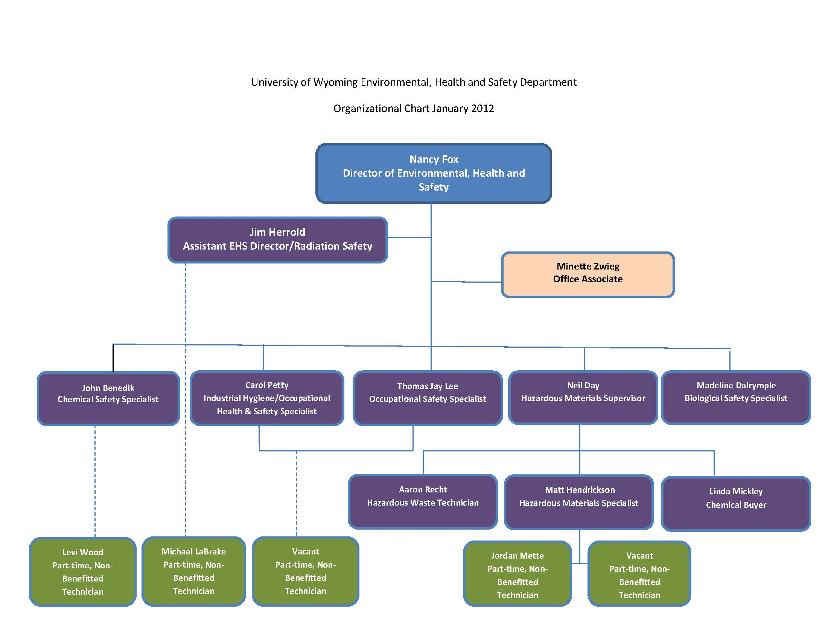

Slide 12
EHS Initiatives
Building Emergency Action Plan Template
HRMS-Online EHS Training, tracking and registration
Changes in hazardous and radioactive waste billing
Lab and General Workplace Hazard Assessment tool
Lab Coat program
MSDS Online
Online Chemical inventory
Development of OSHA required programs such as: Confined space, Hot Work, and Lockout/Tagout.
Notes:
Research Emphasis: IACUC, select agents, Radiation Safety, lab safety, grant compliance, etc

Slide 13
Safety Roles and Responsibilities
A university culture where safety and health are core values, embraced and acted upon at all levels
Administration
Supervisors/Principal Investigators
Staff
Students/Visitors
EHS Department/Safety Coordinators
Notes:
Includes and encompasses a variety of regulatory requirements.

Slide 14
Responsibilities
The University is required to provide:
A safe and healthful work environment
OSHA required programs
Training related to hazards on the job
Proper tools for those hazards
Employee medical records upon request
Notes:
Includes and encompasses a variety of regulatory requirements.

Slide 15
Responsibilities
The Employee
Attend safety training and apply training to job
Follow established safety rules/procedures
Request additional safety training as needed
Report hazards in the work area
Notes:
Includes and encompasses a variety of regulatory requirements.

Slide 16
Departmental Safety Coordinators
*Appointed by and serve under department head
Their role is to act as a liaison between their departments and EHS to actively promote safety at all levels.
Some activities they will be involved in (with training) include:
Distributing safety information
Completing hazard reports and assisting in resolution
Prevention of injuries and timely accident follow-up
Attending Safety Coordinator In-services provided by EHS for new information and tools
Coordinating hazard assessments

Slide 17
University of Wyoming
Environmental, Health and Safety Department
and
Departmental Safety Coordinators
Represent a partnership that is a valuable UW resource to help people stay healthy and safe!
Notes:
I hope you will join us in contributing to this mission. Your role as departmental safety coordinator is key. Having safety advocates and information liaisons through out the university is essential. Thanks.

