Slide 1
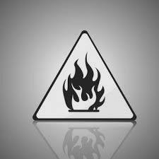
Flame Resistant / Chemical Protective FR/CP and Barrier/Fluid
Lab Coats

Slide 2
Overview
Industry Requirements
Protective Lab Coats
Why Alsco / VF Workwear ?

Slide 3
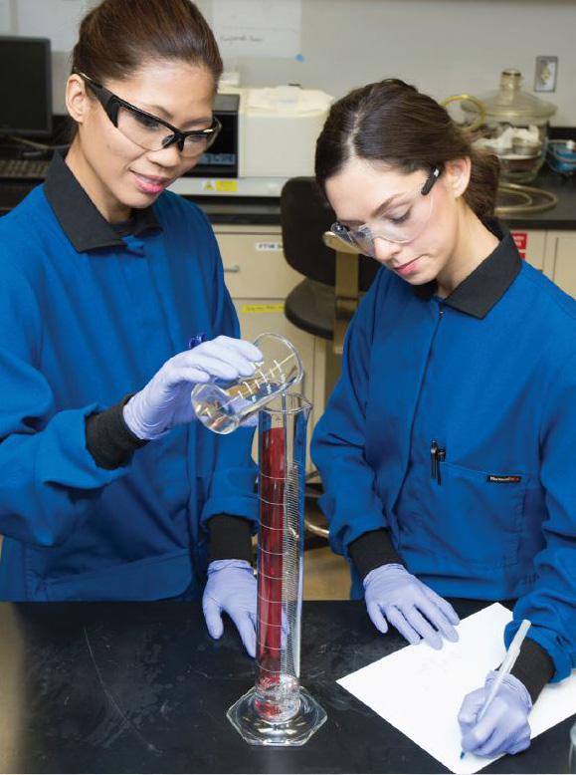
Safety
Expectations

Slide 4
Laboratory Safety Guidance
The Personal Protective Equipment (PPE) standard (29 CFR 1910.132) requires that employers provide and pay for PPE and ensure that it is used wherever “hazards of processes or environment, chemical hazards, radiological hazards, or mechanical irritants are encountered in a manner capable of causing injury or impairment in the function of any part of the body through absorption, inhalation or physical contact.” [29 CFR 1910.132(a) and 1910.132(h)]. In order to determine whether and what PPE is needed, the employer must “assess the workplace to determine if hazards are present, or are likely to be present, which necessitate the use of [PPE],” 29 CFR 1910.132(d)(1). Based on that assessment, the employer must select appropriate PPE (e.g., protection for eyes, face, head, extremities; protective clothing; respiratory protection; shields and barriers) that will protect the affected worker from the hazard, 29 CFR 1910.132 (d)(1)(i), communicate selection decisions to each affected worker, 29 CFR 1910.132 (d)(1)(ii), and select PPE that properly fits each affected employee, 29 CFR 1910.132(d)(1)(iii). Employers must provide training for workers who are required to use PPE that addresses when and what PPE is necessary, how to wear and care for PPE properly, and the limitations of PPE, 29 CFR 1910.132(f).
It is important that Personal Protective Equipment, PPE be selected based upon the hazard to the researcher;
• Properly fitted and in some cases periodically refitted (e.g., respirators);
• Properly worn;
• Regularly maintained and replaced in accordance with the manufacturer’s specifications;
• Properly removed and disposed of to avoid contamination of self, others or the environment; and
• If reusable, properly removed, cleaned, disinfected and stored.

Slide 5
FELONY CHARGES FILED
Against UC and a UCLA chemistry professor after fatal lab fire!
“Felony charges have been filed against the University of California and a UCLA chemistry professor in connection with a laboratory fire that killed a staff research assistant three years ago. On Tuesday, the Los Angeles County district attorney's office charged Harran and the UC regents with three counts each of willfully violating occupational health and safety standards, resulting in Sangji's death. Harran and UCLA are accused of failing to correct unsafe work conditions in a timely manner, to require clothing appropriate for the work being done and to provide proper chemical safety training. An arrest warrant was issued for Harran, 42, who faces up to 4 1/2 years in state prison, according to a district attorney's spokeswoman.
UC regents with three counts each of willfully violating occupational health and safety standards, resulting in Sangji's death. Harran and UCLA are accused of failing to correct unsafe work conditions in a timely manner, to require clothing appropriate for the work being done

Slide 6
July 28, 2012
UCLA Lab Prosecution Enforcement Agreement
The following Personal Protective Equipment (PPE) policy shall be considered the minimum standard to apply at all times while working or occupying any laboratory area:
Laboratory coats, or equivalent, are required to be worn while working on, or adjacent to, all hazardous chemicals, biological or unsealed radiological materials. These laboratory coats must be appropriately sized for the individual and be buttoned to their full length.

Slide 7
July 28, 2012
UCLA Lab Prosecution Enforcement Agreement
Flame resistant laboratory coats shall be worn when working with pyrophoric materials OR flammable liquids. Cotton (or other non-synthetic material) clothing must also be worn during these procedures to minimize injury in the case of a fire emergency.

Slide 8
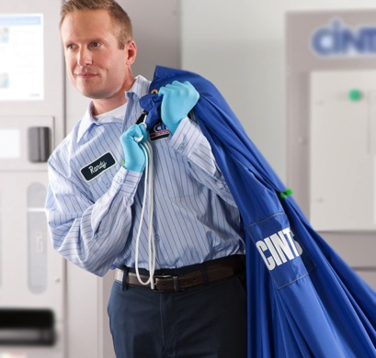
July 28, 2012
UCLA Lab Prosecution Enforcement Agreement
Each department or research unit shall be responsible for providing professional laundry services as needed to maintain the hygiene of laboratory coats. They may not be cleaned by staff members at private residences or public laundry facilities. Any clothing that becomes contaminated with hazardous materials must be decontaminated before it leaves the laboratory. Employees shall not bear the cost of any required PPE.

Slide 9
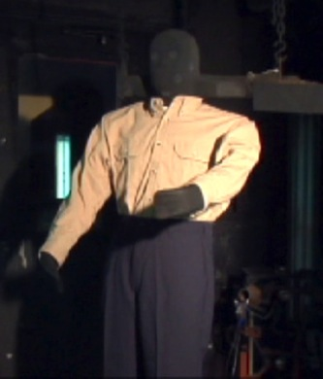
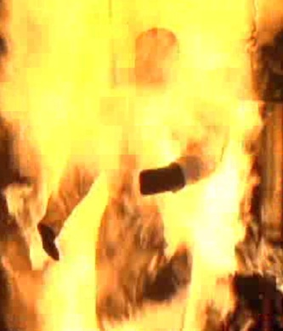
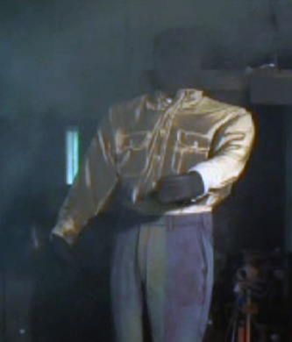
Flame Resistant Apparel in a Flash Fire
BEFORE
DURING
AFTER
Disclaimer: Garments are not designed for long term high heat exposure or for use around open flames and that no representation is made as to the garment’s ability to protect users from such injury or death.

Slide 10
Alsco / VF Workwear Protective
Lab Coats

Slide 11
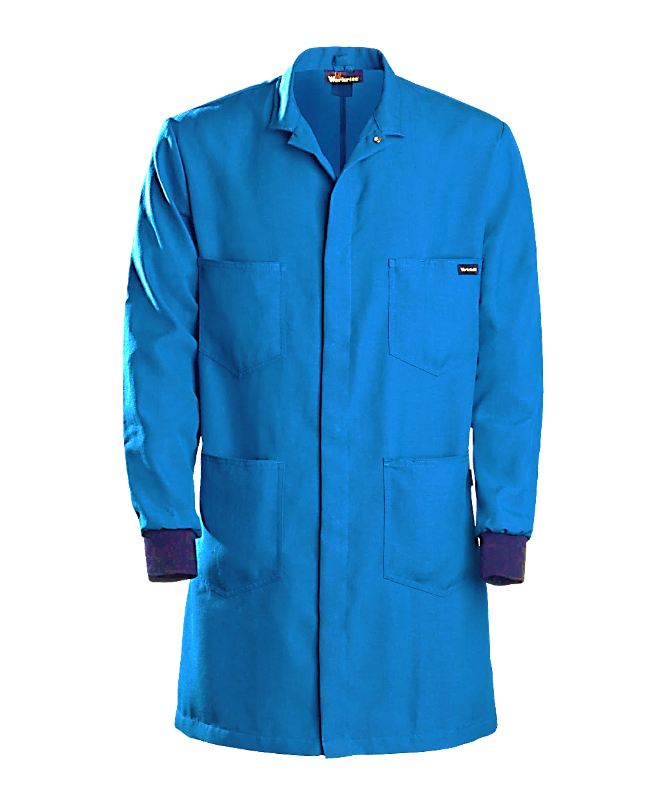
Flame/Chemical Resistant Lab Coat
SNAP CLOSURE
TOP
KNEE LENGTH 4.5oz NOMEX (worn directly over street clothes)
SIDE PASS THRU (access to inner clothing)
LARGE POCKETS (double-stitched)
KNIT CUFF (for comfort and safety)
SNAP CLOSURE (for quick release)

Slide 12
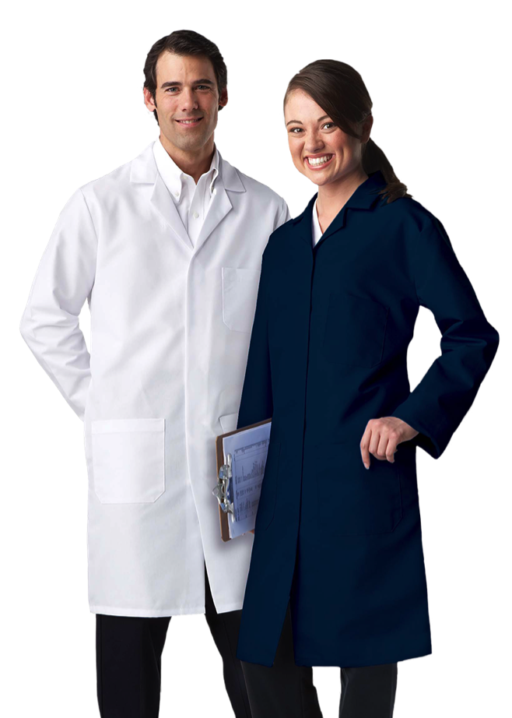
Standard and Barrier/Fluid Resistance Lab Coats
FIVE-BUTTON CLOSURE
OR SNAP CLOSURE
KNIT CUFF (for comfort and safety)
SIDE PASS THRU (access to inner clothing)
KNEE LENGTH (worn directly over street clothes)

Slide 13
Care & Maintenance Standards
ASTM 1449 States
“Effective cleaning and proper maintenance of the protective characteristics of flame, chemical and barrier/fluid resistant protective clothing should include consideration of the services a professional processor can supply.”
“It is important that the processes and materials used to launder flame/chemical resistant garments are compatible with the FR/CP materials to ensure that the FR/CP protection of the garment is not compromised during the laundering process.”

Slide 14
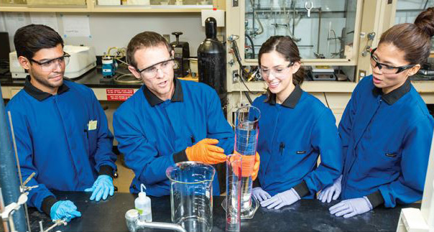
Why Alsco / VF Workwear

Slide 15
Tailored UW Lab Coat Program to Meet Your Needs
Choose RENTAL or Customer Owned Goods (COGs)
RESPONSIBILITIES RENT COGs
Bi-Weekly Laundering Alsco Alsco
Bi-Weekly Inspections Alsco Employee
Repairs Alsco Alsco
Delivery Alsco Alsco
Size Changes UW Safety UW Safety
New Orders/Replace UW Safety Dept
Program Management UW Safety UW Safety
Initial Outfitting UW Safety UW Safety

Slide 16
Complete Solution with UW Safety, Alsco & VF Workwear
1
Professional Fitting Event to ensure comfort and fit
Controlled distribution and inventory by UW Safety
Sourcing of lab coat and distribution
Lab Coats
redistributed to Lab
Soiled
Lab Coats
Collected
4
2
Wash, Dry,
Repair
Elimination of clutter; tracking of returns
Laundered and organized stock always available
3

Slide 17
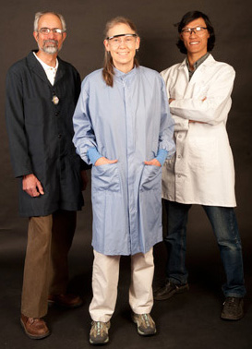
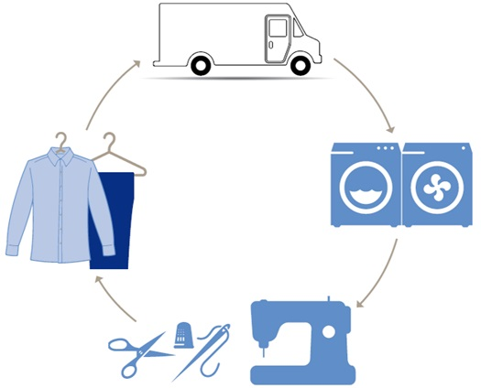
UW Safety Managing Your New Lab Coat Program

Slide 18
UW Partnering with Alsco & VF Workwear for your flame/chemical resistant clothing delivers you three key benefits: comfort, care, and convenience.
COMFORT
Alsco & VF offers a full line of retail inspired protective apparel from the best brands and fabrics. UW individually fit lab coats for each employee to ensure the right look and fit.

Slide 19
CARE
Alsco & VF complies with industry best practices regarding the proper laundering, repair and replacement of flame resistant clothing.
With the help of your employees, Alsco & VF will work with your university to ensure compliance with these industry best practices to protect your employees by:
Proper laundering - Using appropriate water temperatures, water softness and chemical formulas
Weekly inspection & repair - Searching garments for holes, missing buttons, broken zippers, and repairing with FR/CP or Barrier/Fluid resistant materials
Proactive replacement – Systematically retiring the garments from service

Slide 20
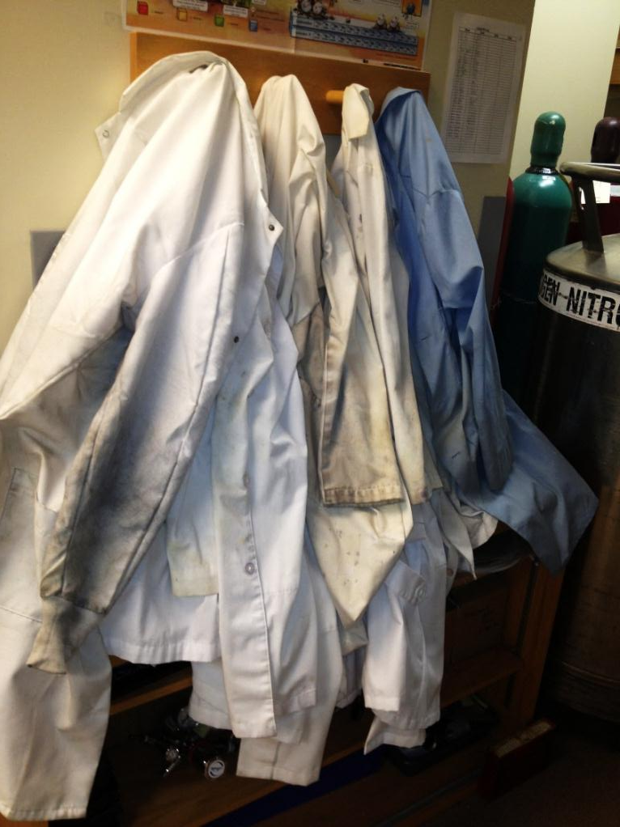
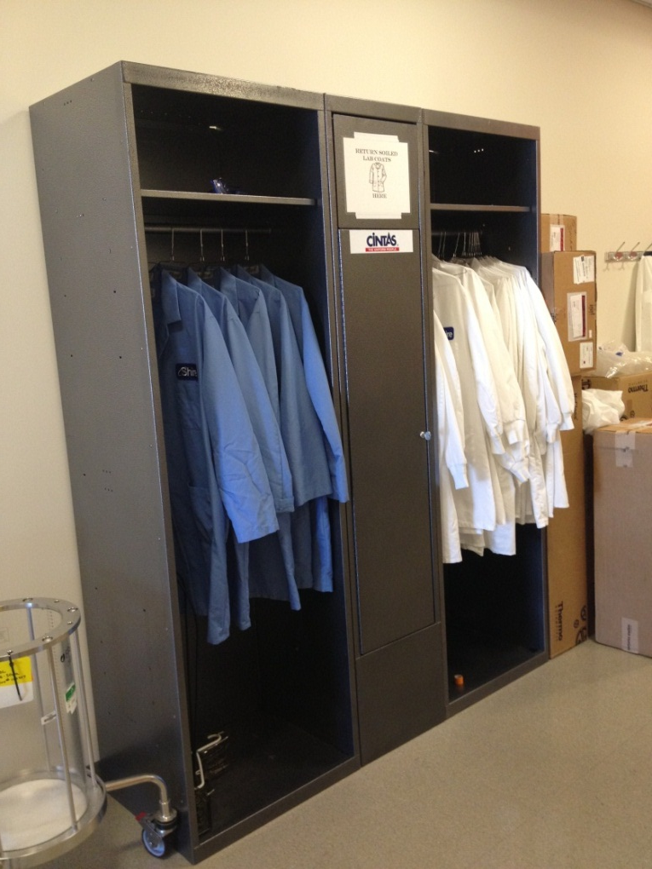
Clean, Safe, and Readily Available

Slide 21
Alsco Background & Capabilities
Alsco has over 128 years of experience with Linens and Uniforms
Over 350,000 customers and 170 locations worldwide
State of the art testing facility
Partner with industries largest manufacturer of FR garments
Locals representatives dedicated to training and service

Slide 22
VF Workwear/Workrite FRCP Background
VF Workwear is the largest manufacturer of FR apparel worldwide, including brands such as Bulwark FR, Wrangler FR, and Workrite FR
Complete safety control and tracking, from fiber-to-fabric-to finished garment for the highest level of compliance
Hazard training & FRCP garment wash/care/maintenance training available upon request; conducted by VF Workwear local representative
VF Workwear local representative dedicated to the success of this new PPE program at UW
Learn more: http://www.workrite.com/workritefr/frcp-lab-coats/

Slide 23
Care and Maintenance of UW PPE
Federal Register / Vol. 79, No. 70 / Friday, April 11, 2014 / Rules and Regulations (Page 184 - 187)
The OSH Act and the PPE standards at 1910.132 and 1926.95 make the employer, not the employee, responsible for the care and maintenance of PPE.
Wyoming OSHA stresses that 1910.132(a) and (b) and 1926.95(a) and (b) require employers to properly maintain FR and arc-rated clothing required by this final rule.
These provisions make PPE maintenance the responsibility of employers, not employees. WY-OSHA believes that it is the employer’s responsibility to ensure proper maintenance of PPE.
*Standards recommend the use of a professional laundry service

Slide 24
Care and Maintenance of UW PPE
Federal Register / Vol. 79, No. 70 / Friday, April 11, 2014 / Rules and Regulations (Page 184 - 187)
For example, employers should inspect this clothing before accepting it, and they can return it to the supplier if they find defects or contaminants on the clothing. In any event, the responsibility for maintaining PPE rests squarely with the employer under existing OSHA standards.
The Agency is not prohibiting home laundering of FR and arc-rated clothing. However, to comply with 1910.132 or 1926.95, employers cannot simply instruct employees to follow manufacturers’ instructions.
If employers rely on home laundering of the clothing, they must train their employees in proper laundering procedures and techniques, and employers must inspect the clothing on a regular basis to ensure that it is not in need of repair or replacement.
*Standards recommend the use of a professional laundry service

Slide 25
UW Safety, Alsco & VF Workwear are here to support you

