Slide 1
Wyoming State Science Fair
Display and Safety Regulations 2017
Notes:
Hello my name is Emma Griffin, I am the Graduate Assistant for the WSSF this year. I welcome you to the presentation on the Wyoming State Science Fair’s Display and Safety Regulations for 2017. The following regulations meet the current Intel ISFE Regulations and are used on the local, state, and international levels. This presentation can be used as a tool for participants to review the regulations prior to the Fair, as well as a training tool for volunteers, teachers, and parents.
On the day of the Science Fair, there will be volunteers checking to make sure that these regulations are met. Participants will have time and resources to fix any possible concerns, but to relieve any additional stress it is recommended to be familiar with these regulations and address those possible issues prior to the day of the Fair.
The regulations are spilt between Display and Safety. I will address the display regulations first.

Slide 2
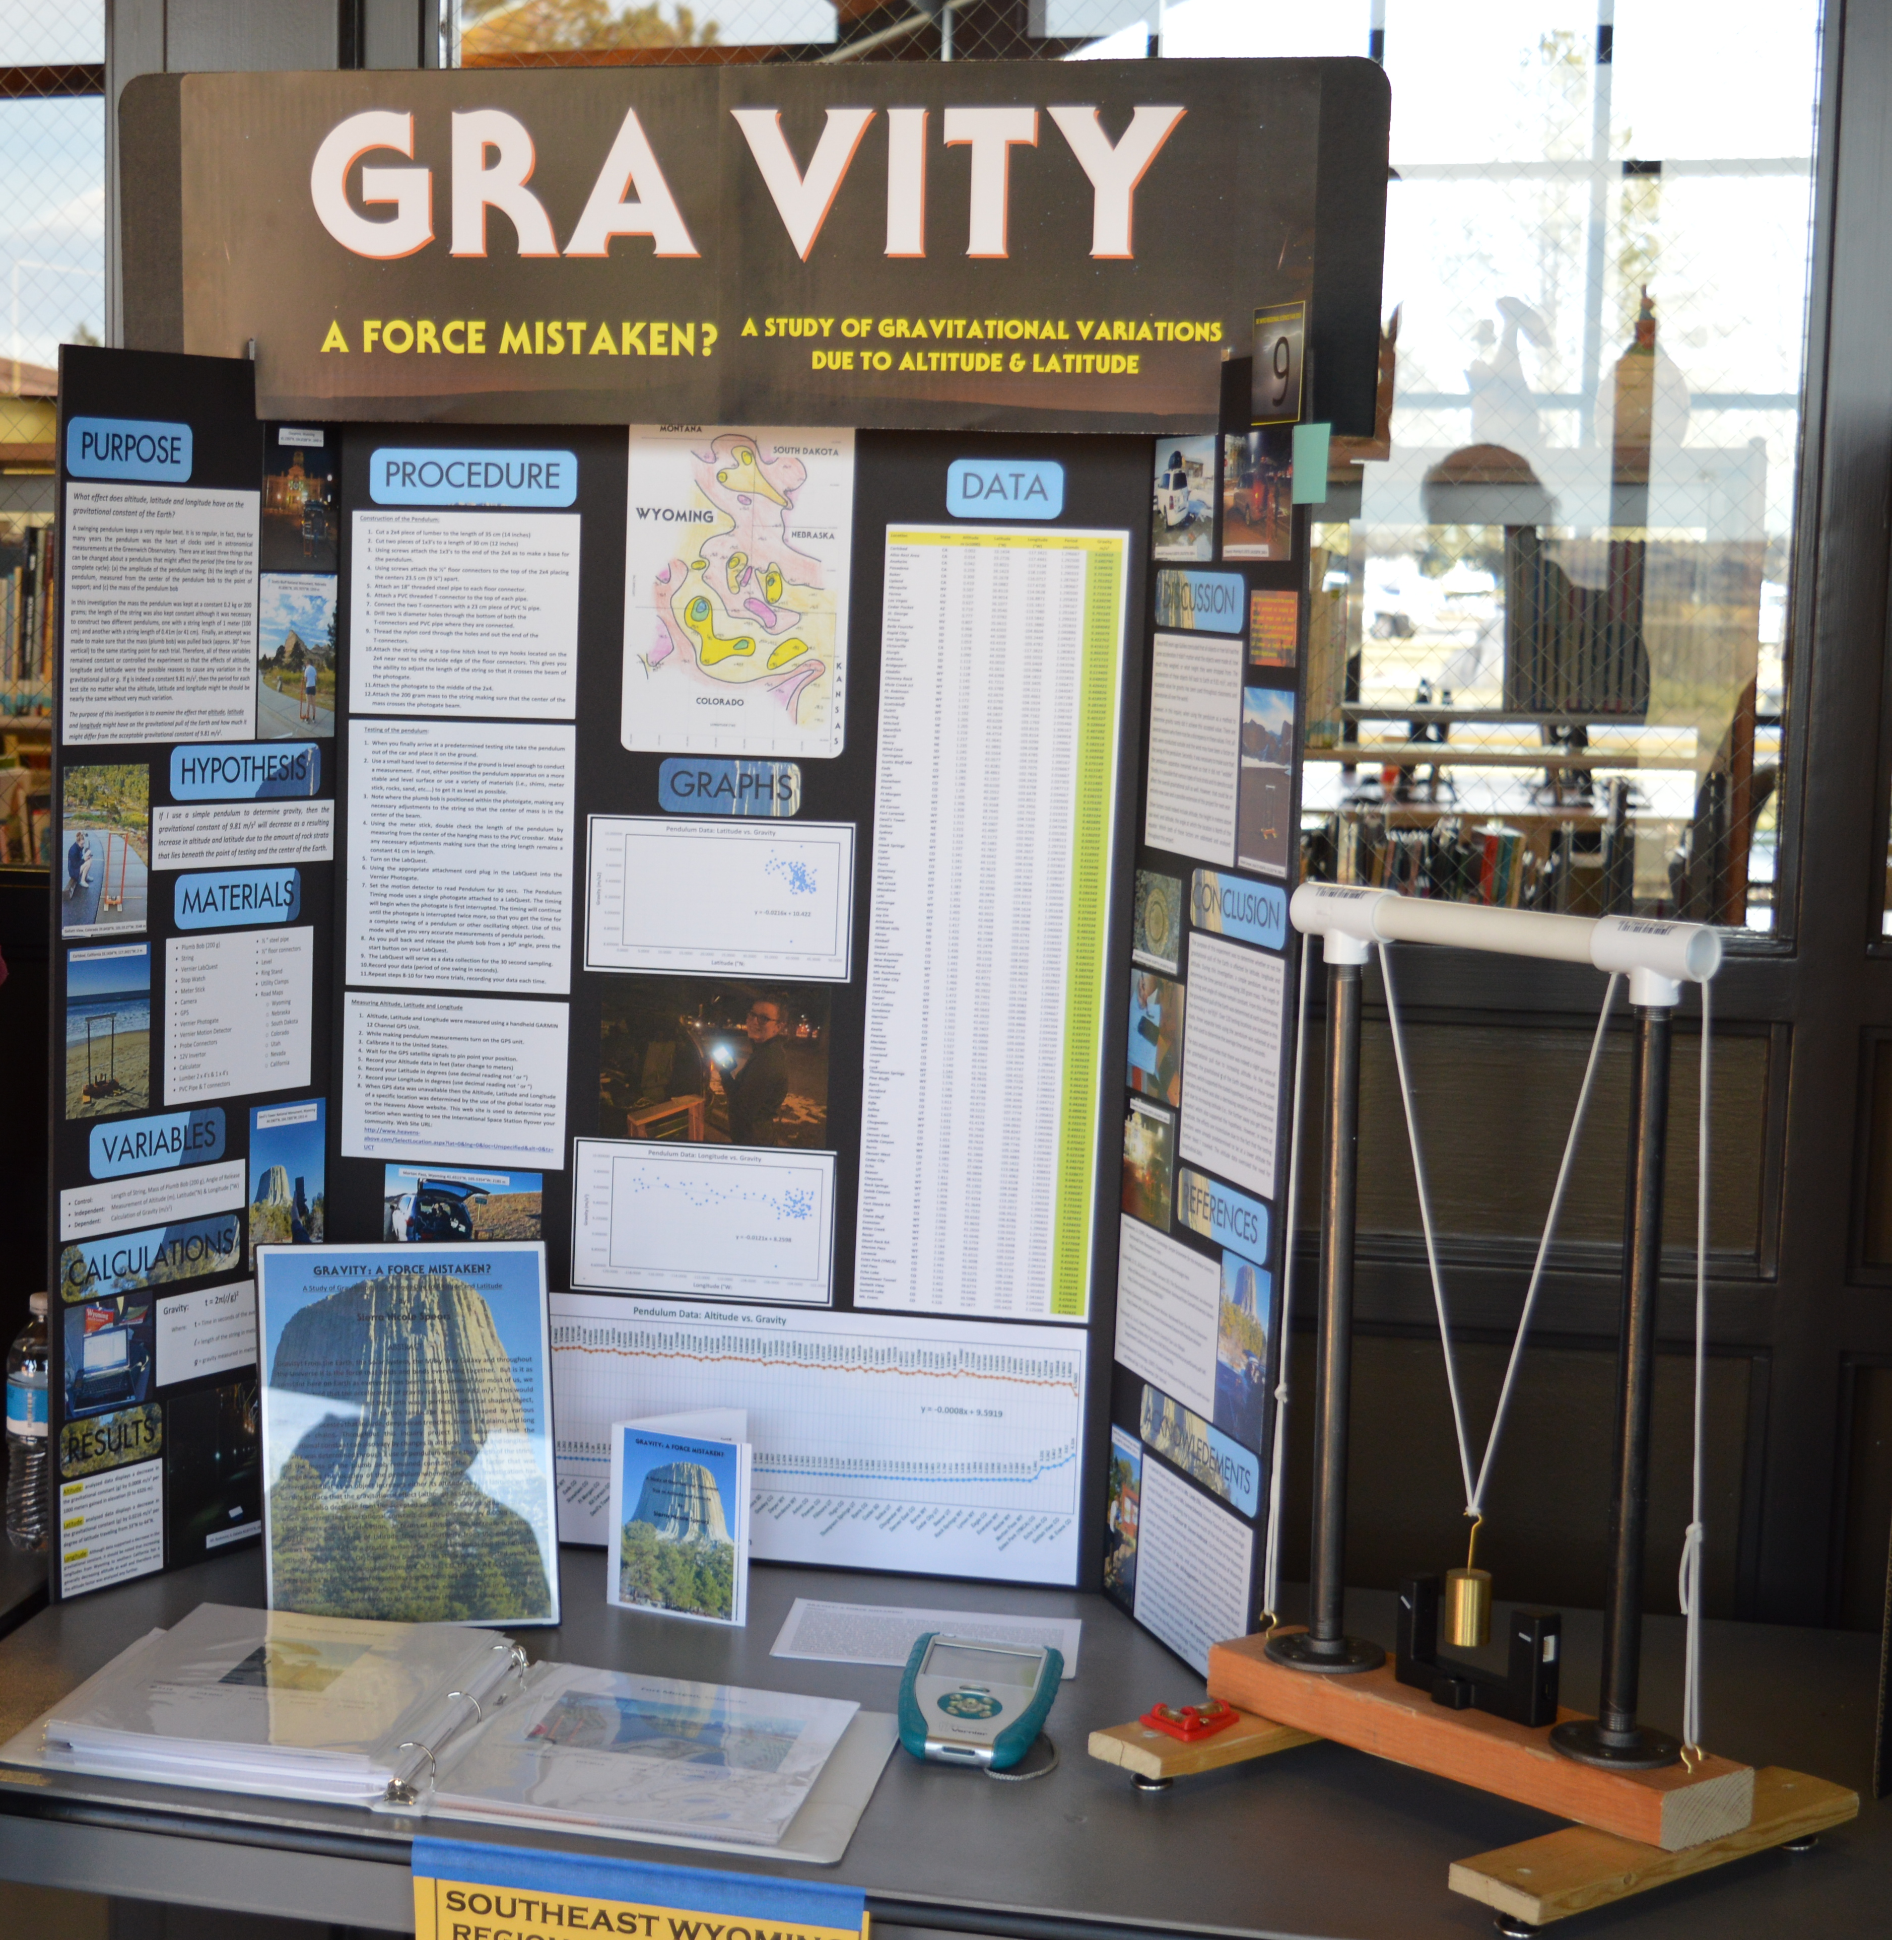
Display Regulations: Project Size
Maximum Size of Project
Depth (front to back): 30 inches or 76 centimeters
Width (side to side): 48 inches or 122 centimeters
Height (floor to top): 108 inches or 274 centimeters
Fair provided tables will not exceed a height of 36 inches (91 centimeters).
Notes:
One of the biggest display regulations is the size of your project since there is limited space and we need to make sure that all students have the opportunity to show case their work. The maximum size of the projects are listed above. It is important that all project materials and support mechanisms fit within these project dimensions. This includes the fair provided table. Since space is limited, it is important to make sure that you only put the appropriate and relevant information on your displays. A good rule of thumb is that Text on display boards should be readable by an older adult from a distance of ~4 ft away.

Slide 3
Display Regulations: Content
Regulated Research Institution Projects The display must reflect on the work conducted by the finalist.
Minimal reference to mentor’s or other researcher’s work must only reflect background information or be used to clarify differences between finalist’s and others’ work.
Continuation Projects The display board should summarize ONLY the CURRENT year’s work.
The Title may include the duration of the project (for example, “Year Two of an Ongoing Study”).
Minimum reference to conclusions of previous years’ work may be shown without any specific data being displayed.
Notes:
Whether your project is a regulated research institution project or a continuation project, there are regulations on the content of your project. For either type, Please make sure that you display YOUR work and not that of others. If your project has spanned over several years, it is important that you are summarize the current year’s work with minimal references to previous years research and conclusion.

Slide 4
Display Regulations: Forms to be displayed
An Abstract may be used as a handout
Abstracts should NOT be on the display board
OK!
Notes:
No forms should be displayed at the Wyoming State Science Fair; we will have them all on file instead so no need to worry about those.
Students may have an abstract to hand-out, but it cannot be displayed on the board. It can be set on the table or vertically displayed in a picture frame that sits on the table. This can be a nice touch for those visitors who want a quick overview of your project.

Slide 5
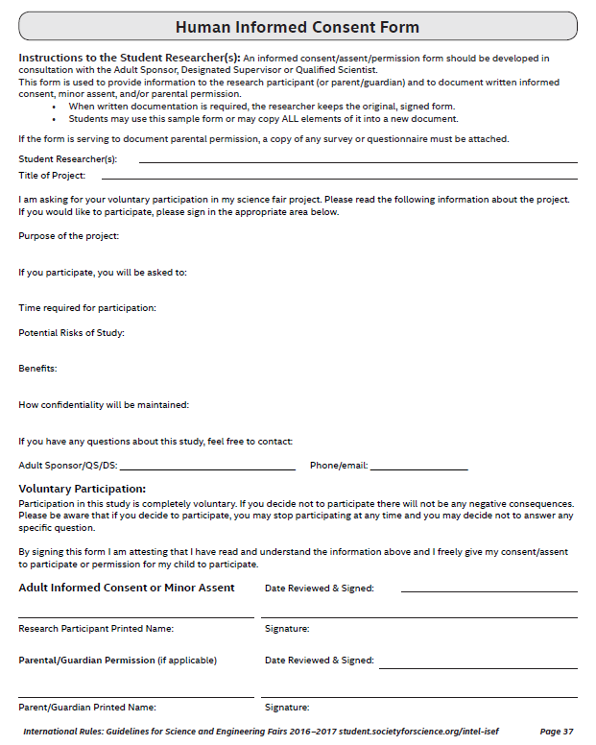
Display Regulations: Forms to NOT be displayed
Informed Consent Forms
Photo/video release forms
All of above forms do not have to be displayed, but should be available if requested.
Notes:
The following can not be displayed on your board, but they are still important to have completed. If these forms are not already on file, you might be asked to show them to the judges so it is always a good idea to have a copy of them with you.

Slide 6
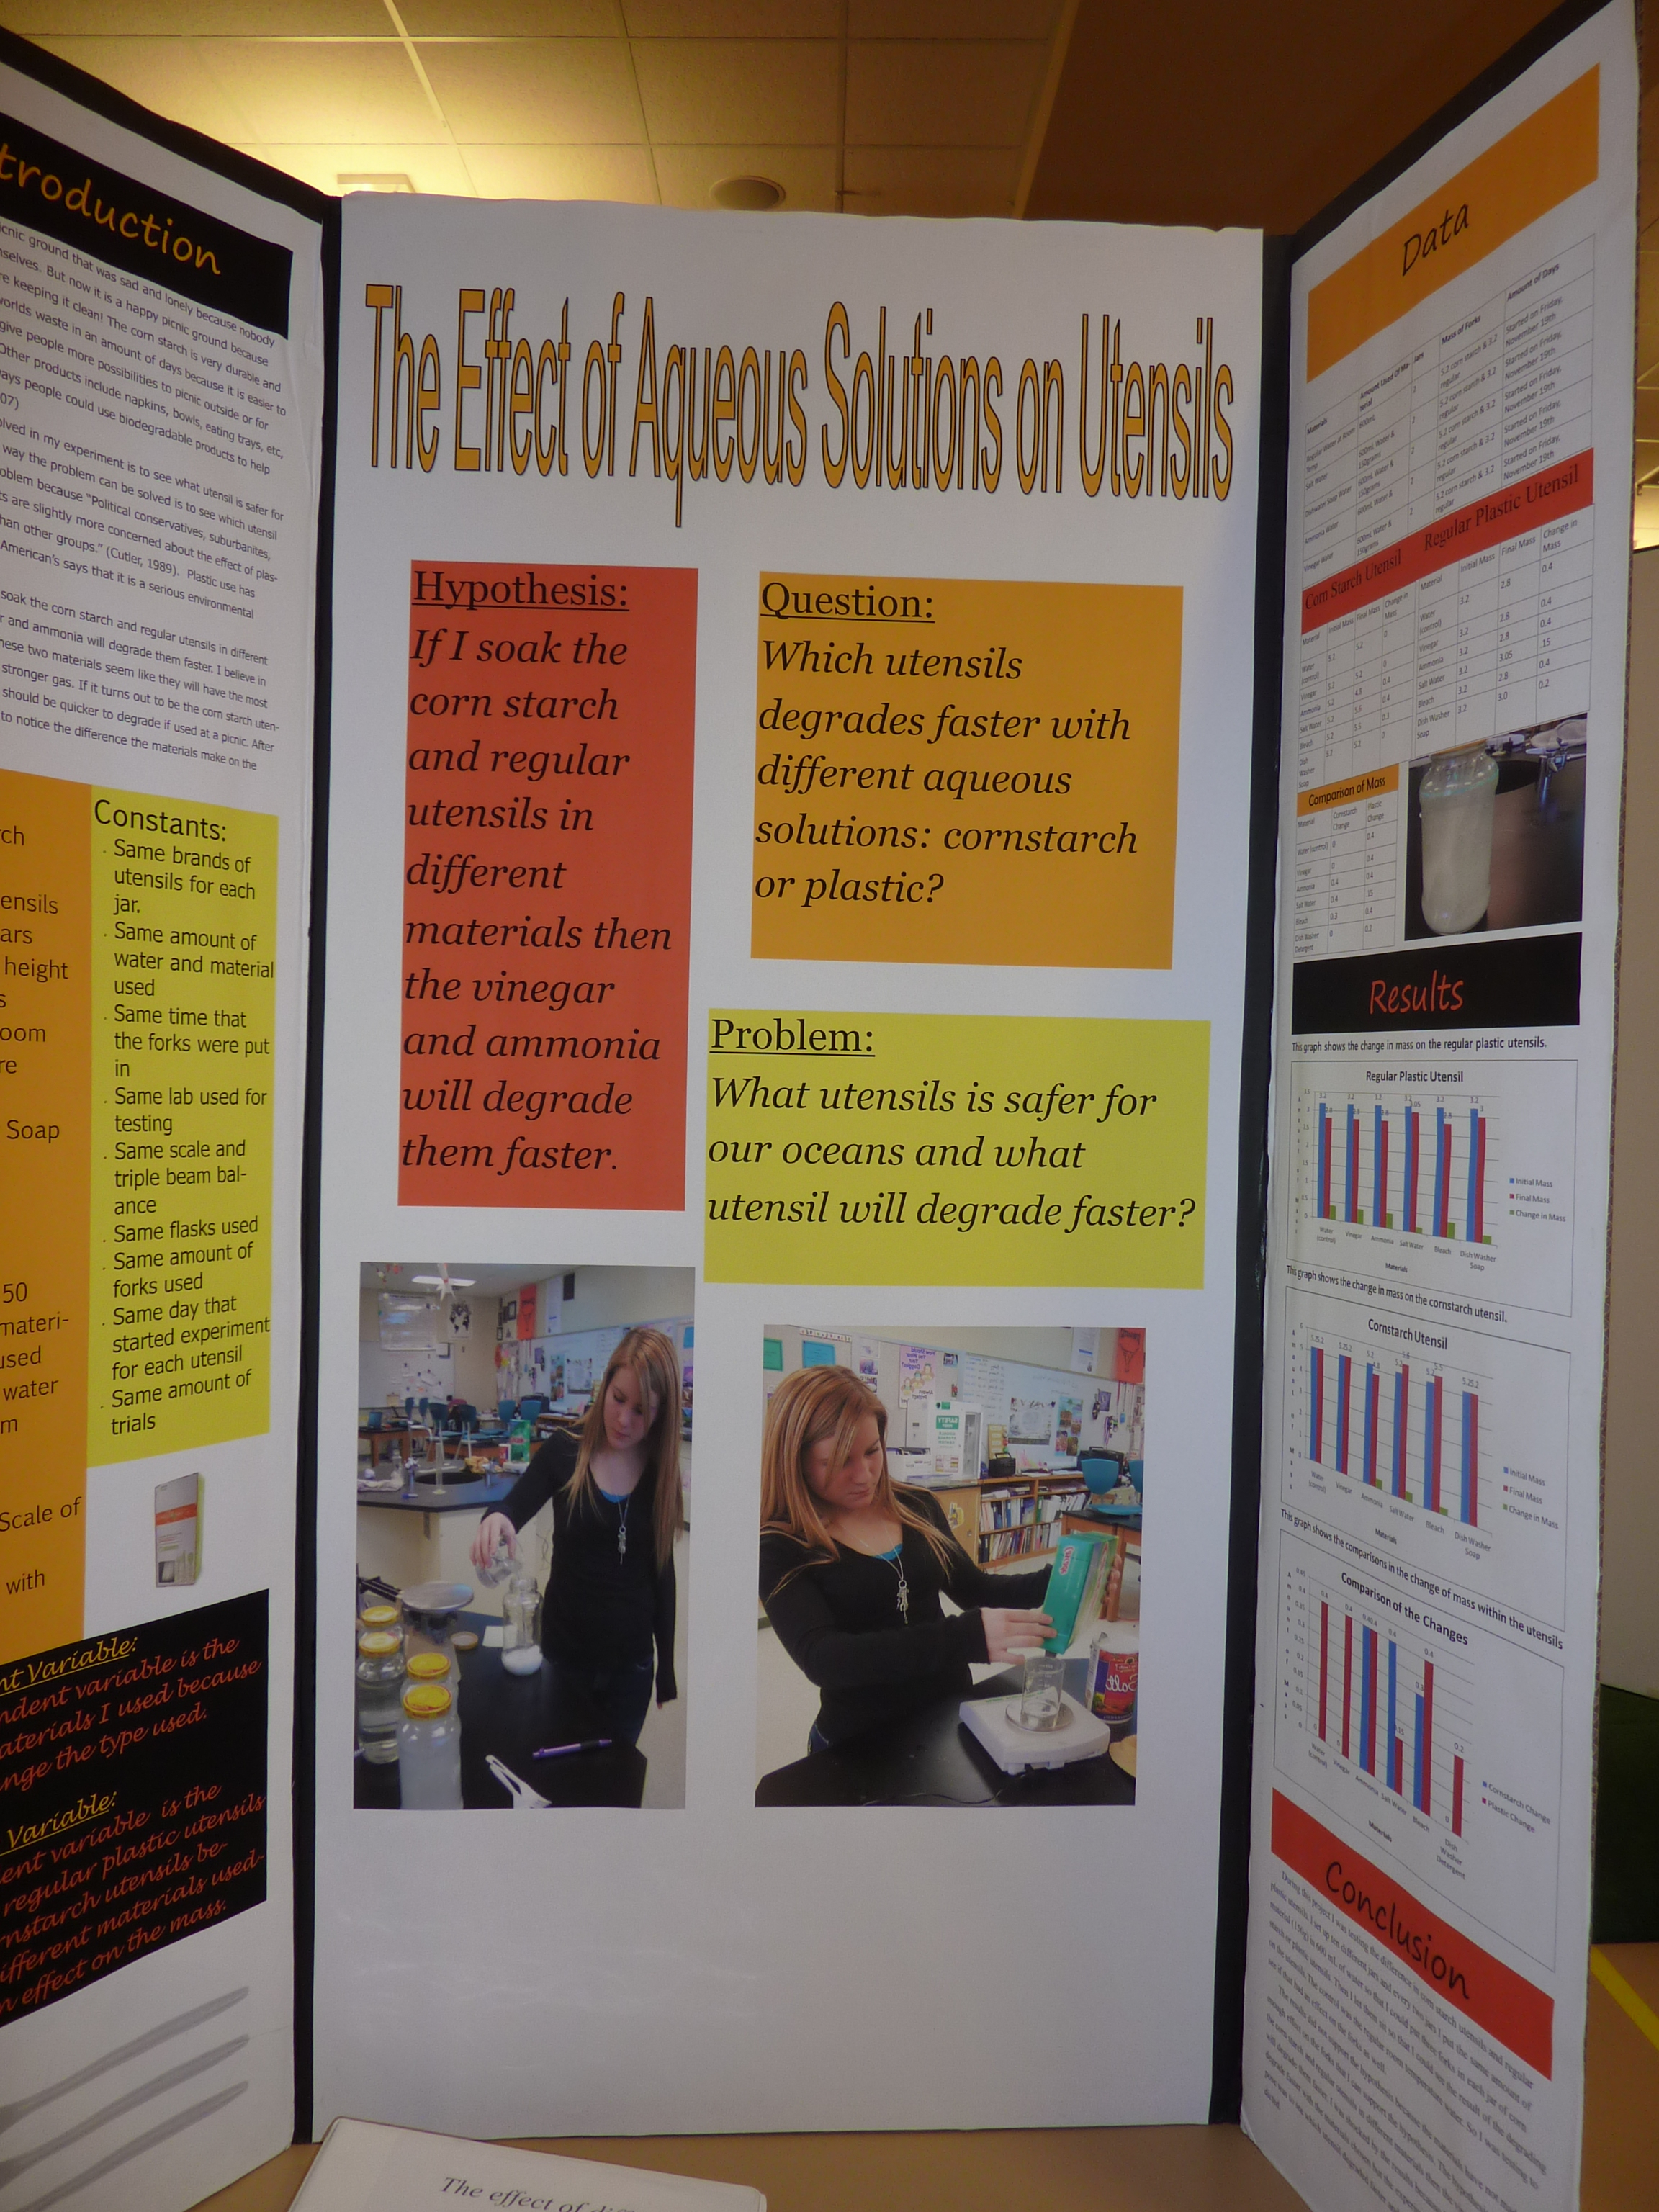
Display Regulations: Photos
All photos and video of someone other than the participant should have a signed consent form.
Any photograph/visual image/chart/table and/or graph is allowed if:
It is not deemed offensive or inappropriate (which includes images/photographs showing invertebrate or vertebrate animals/humans in surgical, necrotizing or dissection situations)
It has a credit line of origin (“Photograph taken by...”or “Image taken from...” or “Graph/Chart/Table taken from...”).
It is from the Internet, magazine, newspaper, journal, etc., and a credit line is attached.
It is a photograph or visual depiction of the researcher.
It is a photograph or visual depiction for which a signed consent form is at the project or in the booth.
Notes:
All photos and video of someone other than the participant should have a signed consent form.
All photos should be labeled and credited to the appropriate author or organization. If the photos are either from personal accounts or from the internet and from the same source is it sufficient to have one credit prominently and vertically displayed.
It is also important to make sure that the photos you use are appropriate. Inappropriate photos include… and you will be asked to cover or remove them from your display.

Slide 7
Display Regulations:
The following are NOT allowed on displays:
Any items that are acknowledgments, self-promotions or external endorsements (such as naming the research institution, mentor or patent pending statements) and/or are intended for distribution
Postal addresses, World Wide Web, email and/or social media addresses, QR codes, telephone and/or fax numbers of a project or finalist.
Active Internet or email connections as part of displaying or operating the project.
Prior year’s written material or visual depictions on the vertical display board (Exception: The project title displayed in the finalist’s booth may mention duration of the project).
Notes:
The following items should not be displayed. In this case, Self-promotions includes: any disks, CDs, business cards, printed materials (other than you abstract that is displayed on the table, not the board) flash drives, brochures, booklets, endorsements, and additional give-away items including, but not limited to, pins, key chains, food etc.

Slide 8
Final Display Regulations
No changes, modifications, or additions to projects may be made after approval by the Display and Safety Committee.
A project data book and research paper are not required but are highly recommended.
Notes:
After you have set up, you can have one of the safety and display committee volunteers come check your display before the final approval is made. During that time, you will have time and resources to fix any minor issues that might arise.

Slide 9
Safety Regulations: Items NOT allowed
Living organisms, including plants
Soil, sand, rock, cement and/or waste samples, even if permanently encased in a slab of acrylic
Taxidermy specimens or parts
Preserved vertebrate or invertebrate animals
Human or animal food as part of the exhibitor demonstration of the project.
Human/animal parts or body fluids (for example, blood, urine)
Plant materials (living, dead, or preserved) that are in their raw, unprocessed, or non-manufactured state (Exception: manufactured construction materials used in building the project or display)
All chemicals including water (projects may not use water in any form in a demonstration)
All hazardous substances or devices (Example: poisons, drugs, firearms, weapons, ammunition, reloading devices, and lasers)
Items that may have contained or been in contact with hazardous chemicals (Exception: Item may be permitted if professionally cleaned and document for such cleaning is available)
3-D Printers
Dry ice or other sublimating solids
Sharp items (for example, syringes, needles, pipettes, knives)
Flames or highly flammable materials (including magnified light sources) a. A Fresnel Lens cannot be used in conjunction with a light source – it becomes an open flame.
Batteries with open-top cells or wet cells
Glass or glass objects unless deemed by the Display and Safety Committee to be an integral and necessary part of the project
(for example, glass that is an integral
part of a commercial product such
as a computer screen is okay)
Any apparatus deemed unsafe by the Display and Safety Committee (Example: large vacuum tubes or dangerous ray-generating devices, empty tanks that previously contained combustible liquids or gases, pressurized tanks, 3D printers etc.)
OK!
Notes:
The following list of items not allowed is long, but remember that this is to insure that all participants and spectators are safe and comfortable while attending the Fair. Please make sure to read through this list and remove any of the above objects or materials from your display.

Slide 10
Safety Regulations: Electronics
Electrical power supplied to the project is 120 or 220 Volt, AC, single phase, 60 cycle. No multi-phase will be available or shall be used.
Electrical devices must be protectively enclosed. Any enclosure must be non-combustible. All external non-current carrying metal parts must be grounded.
Energized wiring, switches, and metal parts must have adequate insulation and over-current safety devices (such as fuses) and must be inaccessible to anyone other than the finalist. Exposed electrical equipment or metal that possibly may be energized must be shielded with a non-conducting material or with a grounded metal box to prevent accidental contact.
Decorative lighting or illumination is discouraged. If used, lighting must be as low a voltage as possible and must be LED lighting that does not generate heat. Light bulbs are prohibited. When student is not at the exhibit, all electrical power must be disconnected, or power bars must be switched off (Exception: during pre-judging audio visual displays may be available).
An insulating grommet is required at the point where any wire or cable enters any enclosure.
No exposed live circuits over 36 volts are allowed.
There must be an accessible, clearly visible on/off switch or other means of quickly disconnecting from the 120 or 220 Volt power source.
Notes:
The following electrons regulations are to keep you, fellow participants and visitors safe. If your display involves electronics of any kind, please read through the regulations. We do not want electronics or the accessories to create heat, become tripping hazards, or to injury anyone at the WSSF.

Slide 11
Safety Regulations: Lasers
Class 1 or Class 2 lasers, along with only Class 3A or 3R lasers, are allowed to be used in a safe and appropriate manner
Any laser must be labeled by the manufacturer so that power output can be inspected. Lasers without labels will NOT be “allowed.”
LED’s that consume over 1 watt, unless they are in a commercial light bulb/ fixture or otherwise shielded, will not be allowed.
Lasers will be confiscated if not used in a safe manner.
Notes:
If your display involved lasers, please become familiar with the following regulations. Lasers that aren’t used in a safe and appropriate will be confiscated.

Slide 12
Final Safety Regulations
Any inadequately insulated apparatus producing extreme temperatures that may cause physical burns is not allowed.
Any apparatus with unshielded belts, pulleys, chains, or moving parts with tension or pinch points must be for display only.
Project sounds, lights, odors, or any other display items must not be distracting. Exceptions to this rule may be permitted for judging demonstrations. Approval must be given prior to judging.
The Display and Safety Committee reserve the right to remove any project for safety reasons or to protect the integrity of the WSSF and its rules and regulations.
Failure to abide by these regulations could result in confiscation of objects and/or disqualification.
Notes:
Final regulations include the following. Please make sure you have no objects that generate heat, have moving parts, or could be become unsafe and/or distracting to you or other participants. Remember these regulations are to keep the WSSF safe and fun.

Slide 13
WSSF Contact Information
Wyoming State Science Fair
1000 E University Ave
Dept 3992
Laramie, WY 82071-2000
Phone: 307.766.9863
Fax: 307.766.3792
Email: wyostatefair@gmail.com
Notes:
I hope that you found this presentation to be informative and helpful in becoming familiar with the regulations. We look forward to see you at the WSSF! If you have any questions or concerns, please feel free to contact us.

