Slide 1
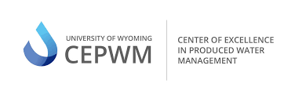
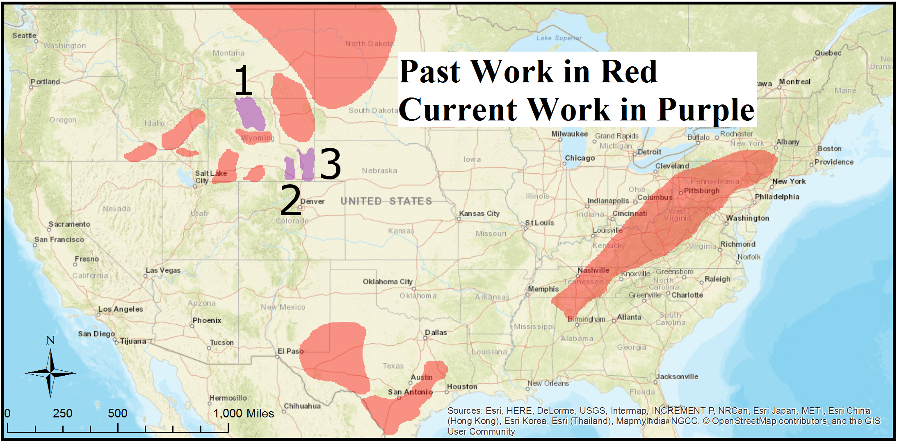
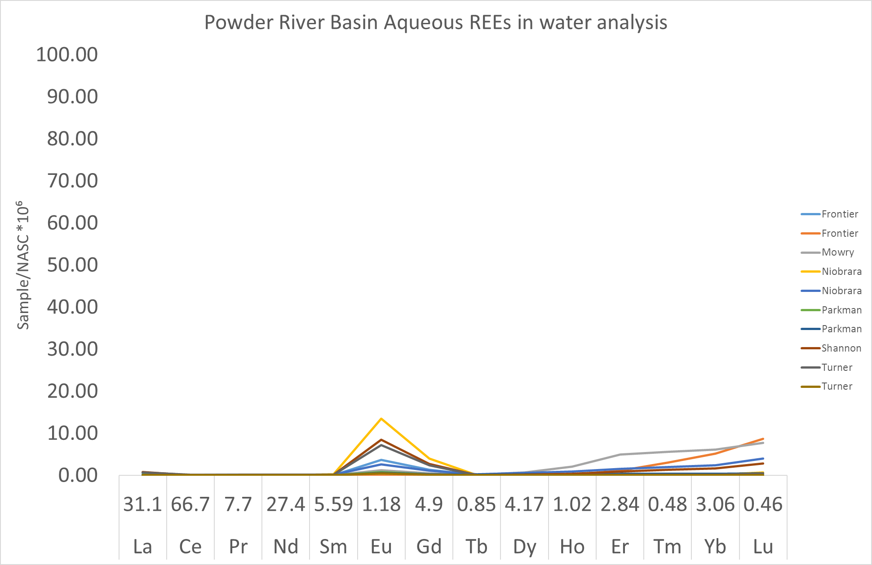
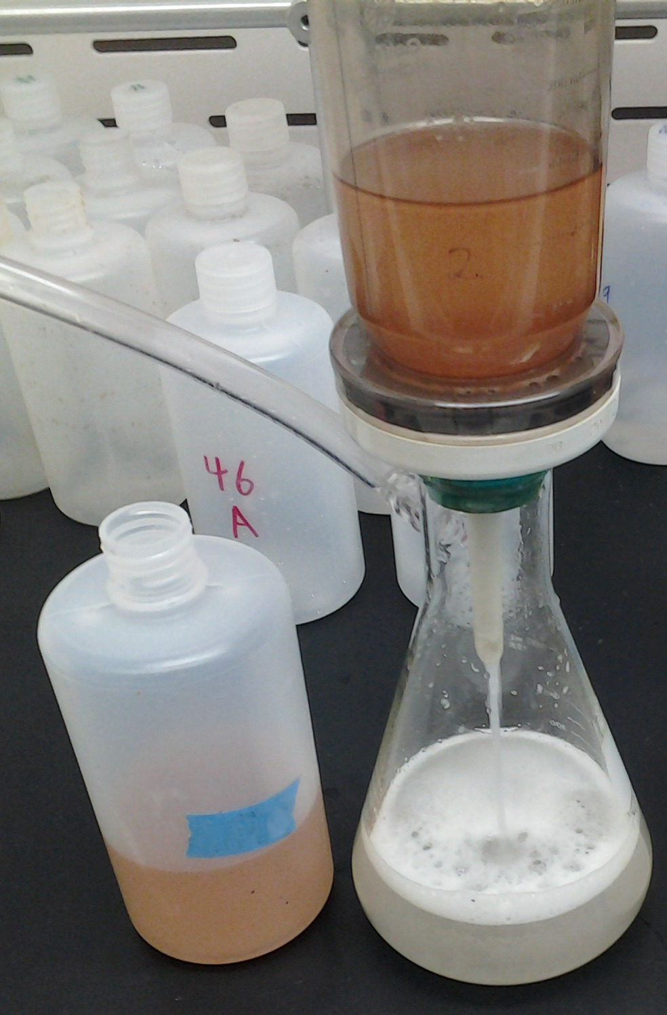
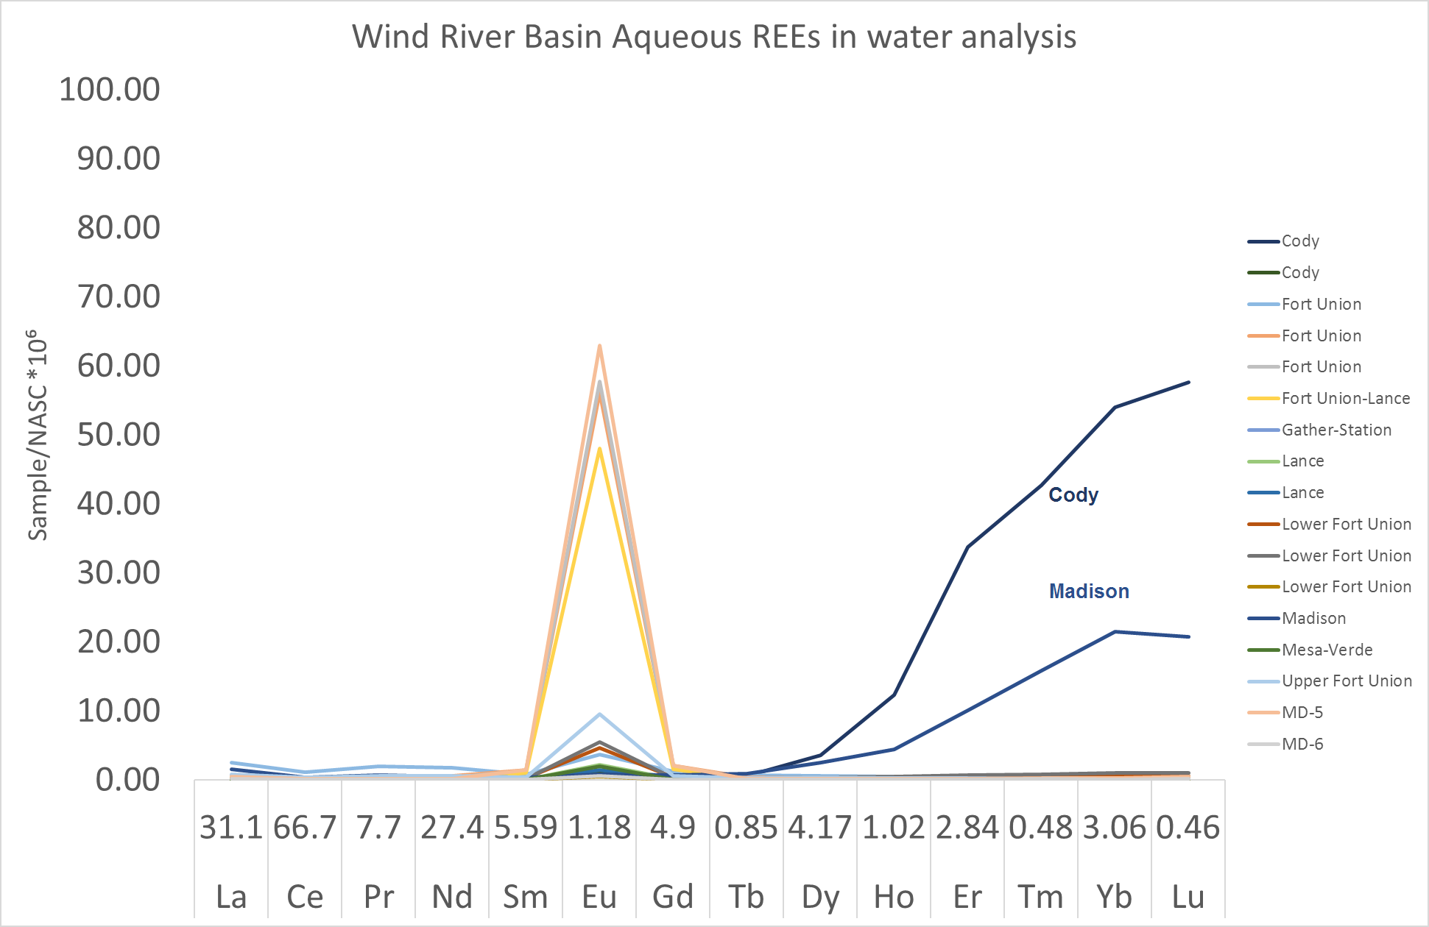
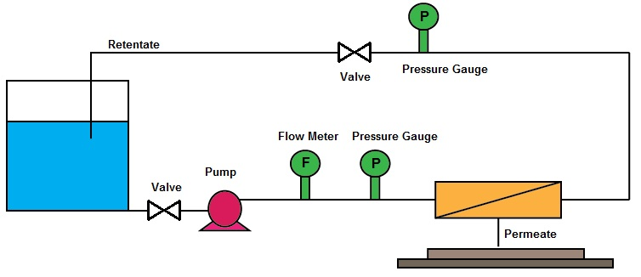
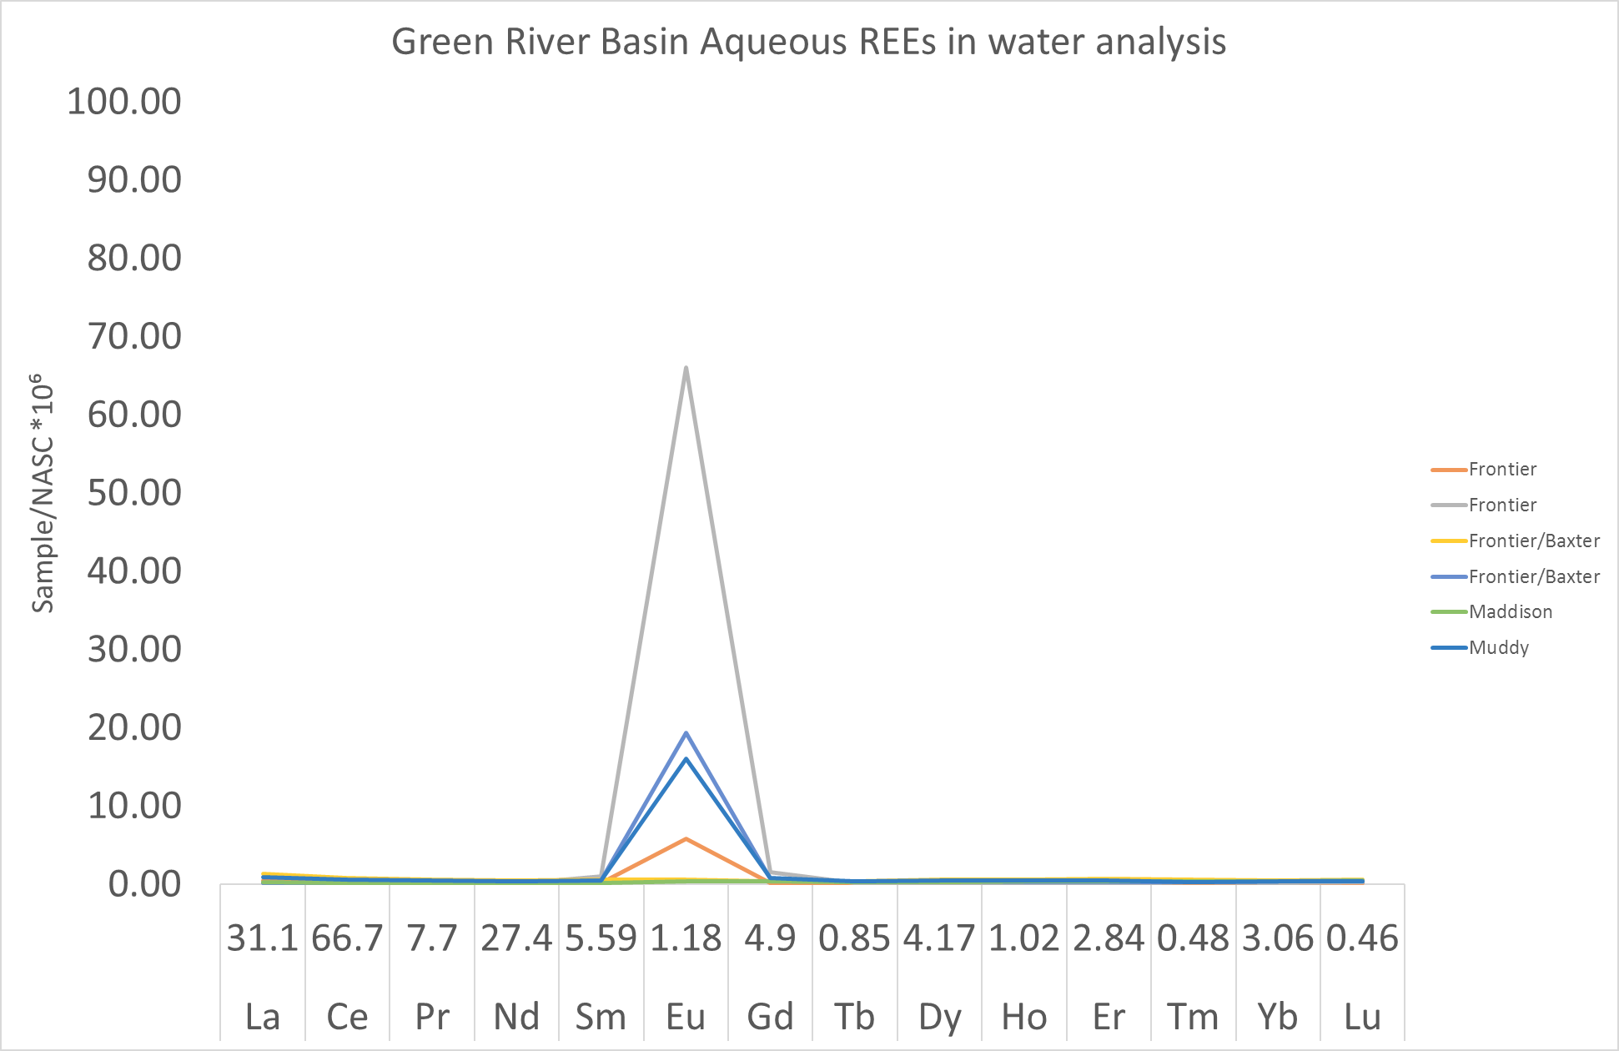
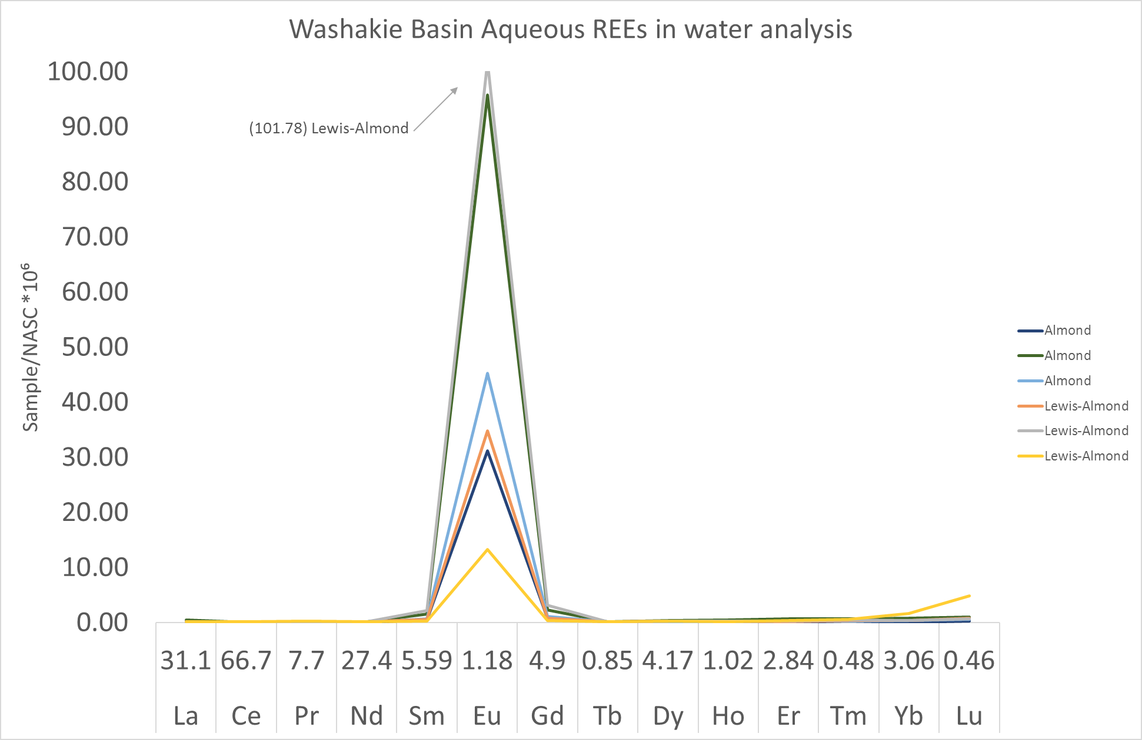
Nano-Filtration for Treatment of Produced Water and Rare Earth Elements Pre-Concentration
Mahdi Shahabadiª, Charles W. Nye^{b} and Jonathan A. Brantª
ª Department of Civil and Architectural Engineering, University of Wyoming
ª Center for Economic Geology Research, University of Wyoming
What Are Rare Earth Elements?
Rare earth elements (REEs) are the 15 lanthanides and in some definitions, yttrium, and scandium. The radius of the REEs is based on their atomic number and suggests they be divided into light REEs and heavy REEs. LREEs include lanthanum (La), cerium (Ce), praseodymium (Pr), neodymium (Nd), promethium (Pm), samarium (Sm), europium (Eu), and gadolinium (Gd). HREEs include terbium (Tb), dysprosium (Dy), holmium (Ho), erbium (Er), thulium (Tm) Ytterbium (Yb), lutetium (Lu), scandium (Sc) and yttrium (Y).
Study Areas and Rare Earth Elements Concentrations
Produced Water Pre-Treatment
Discussion: REEs Concentration
The size of the europium peak is variable and important; this may correlate to calcium 2+ content in rocks because europium 2+ can substitute for calcium 2+ in most crystal lattices.
Some samples have HREE enrichment; this may be caused by hydrothermal alteration of the granites under the Madison, which preferentially contribute HREEs to the overlying formations.
The samarium:gadolinium ratio shows Gd enrichment. Seawater has Gd enrichment. The Gd could be contributed by shales which formed under the Cannonball Arm of the Western Interior Seaway and other marine depositional units.
Membrane:
Mixed-Cellulose-Ether Micro-Filter
Mean Pore Size:
0.45 micron
Bottles:
500mL LDPE
Uses of Rare Earth Elements
The US Department of Energy calls them “technology metals”. Due to their unique magnetic, phosphorescent, and catalytic properties, REEs find application in computers, cell phones, lasers, rechargeable batteries, catalytic converters, magnets, fluorescent lighting and many modern electronics.
Discussion: Nano-Filtration
By reducing pH, the amount of positively charged functional groups increases, resulting in a positive zeta potential (surface charge).
Higher surface positive charge of the Nano-filtration membrane increases the retention of REEs.
Selected membranes should have stability to operate at low pH.
Applied pressure tends increase permeate flux, while increasing the transport of REEs (reducing rejection rate) and foulants to the membrane.
Cross-Flow Nano-Filtration
Extraction Challenges
REEs are present in almost all geothermal and produced waters. However, their concentration is very low, typically in the range of a few parts per trillion (ng/L). Such a low concentration not only hinders commercial production of REEs, it also makes measuring their concentration challenging.
Acknowledgment
The authors would like to thank Greg Kerr; University of Wyoming Office of Water Programs (WRP2018).
Past work was performed by: the authors, Scott Quillinan, Hari Neupane, and Travis McLing during the DOE GTO award "Assessing rare earth element concentrations in geothermal and oil and gas produced waters: A potential domestic source of strategic mineral commodities"
Measuring REE Concentration
Detecting the REEs in produced water is very difficult due to the low concentration of REEs along with the interferences by non-REE ions and hydrocarbons. In this study, the REE’s concentration was measure with a method developed by team members at Idaho National Lab (INL). Measurement was conducted in triplicate using an Agilent 7500a Inductively Coupled Plasma Mass Spectrometer (IPC-MS), with a Babington nebulizer, and an electron multiplier detector.
References
Nano-Filtration Parameters:
Applied Pressure (10-25 bar)
Feed Acidity (1.5-3.5)
Membrane Surface Charge
Effects on:
REEs Rejection (%)
Permeate Flux (LMH/bar)
C. W. Nye et al., Aqueous Rare Earth Element Patterns and Concentration in Thermal Brines Associated With Oil and Gas Production. PROCEEDINGS, 42nd Workshop on Geothermal Reservoir Engineering Stanford University, Stanford, California, February 13-15, 2017.
C. W. Nye et. al., A New Wyoming Basin Produced Waters REE Normalization and Its Application. PROCEEDINGS, 43nd Workshop on Geothermal Reservoir Engineering. Stanford University, Stanford, California, February 12-14, 2018.
B. K. Mutlu et. al., Application of nanofiltration for Rare Earth Elements recovery from coal fly ash leachate: Performance and cost evaluation. Chemical Engineering Journal 349:309–317, 2018.

