Slide 1
Stable Isotopes and Aqueous Geochemistry in Geothermal Brines Co-produced with Hydrocarbons
C. Nye, S. Quillinan
Carbon Management Institute
School of Energy Resources
University of Wyoming

Slide 2
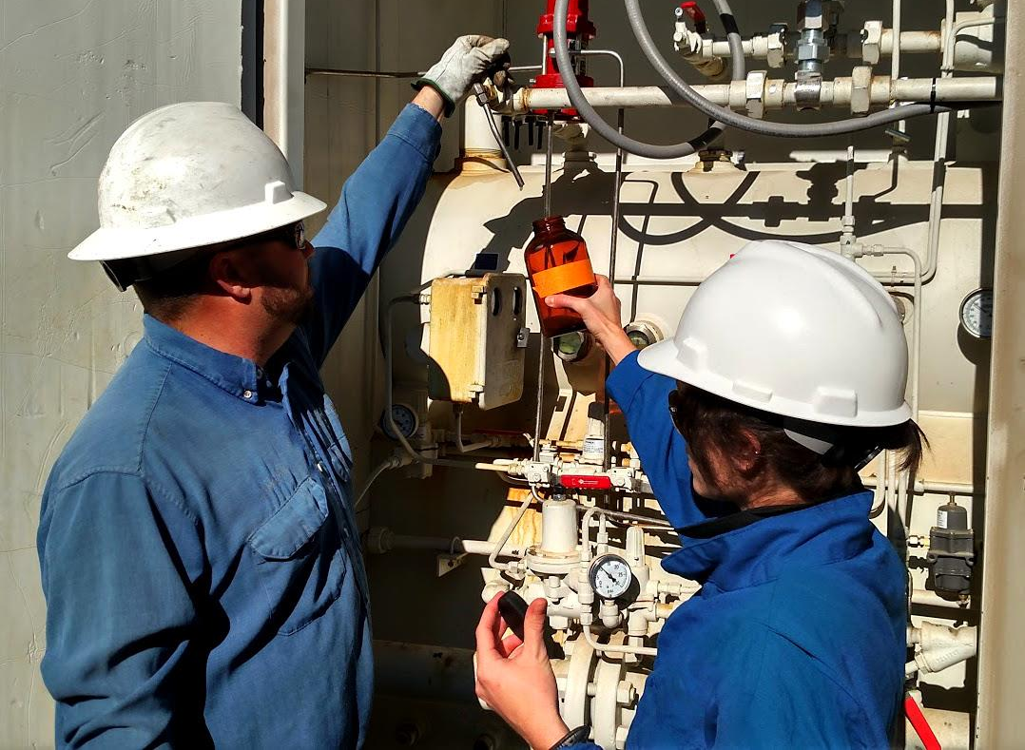
Water samples
Taken from Oil and Gas wells around the state.
Collected as near the well head as possible.
Frozen, split, and acidified appropriately.

Slide 3
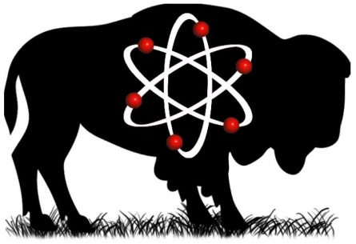
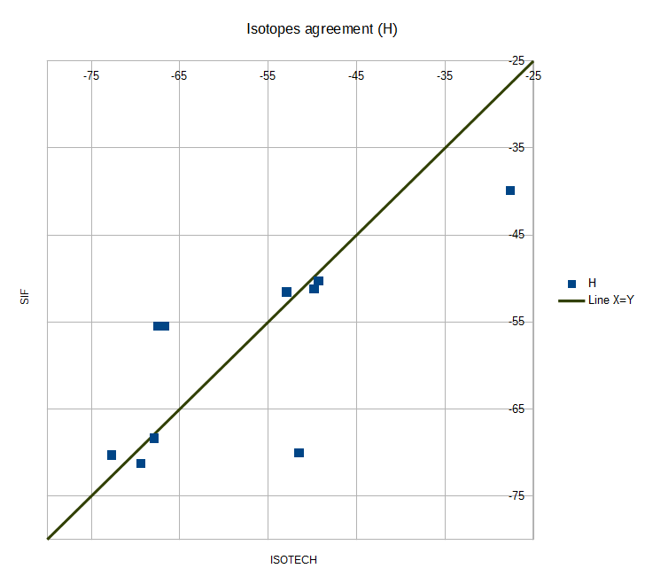
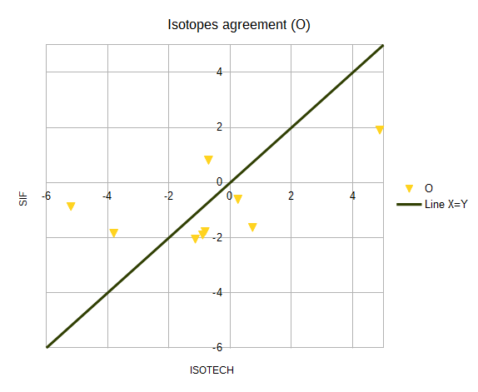
O-H Agreement Analysis
Standard Deviation of Disagreement (n=10): Deuterium = 6.56 Oxygen = 1.36

Slide 4
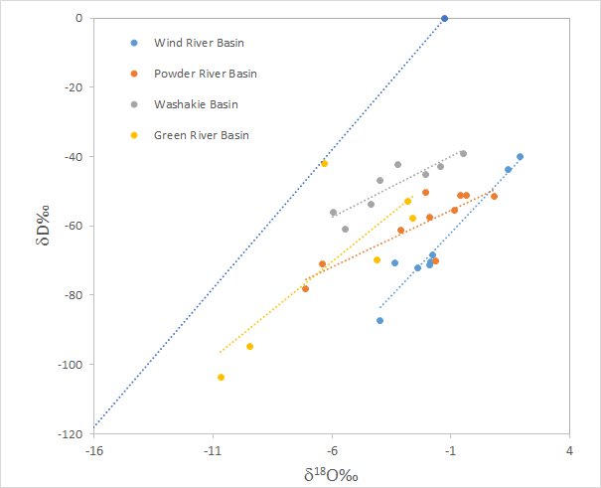
Same interpretation
O-H to right side agrees with 300°F water
Deuterium = 6.56
Oxygen = 1.36

Slide 5
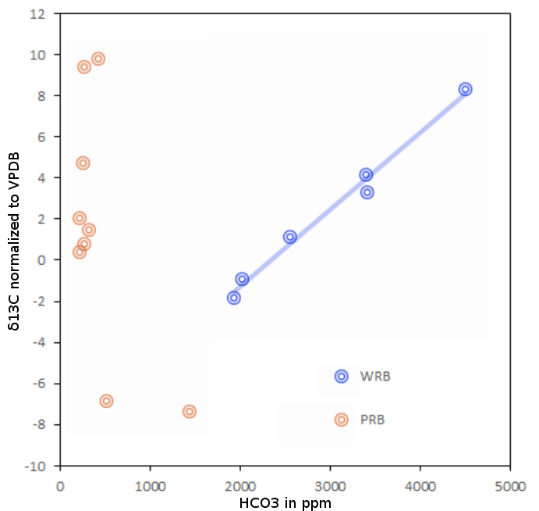
δC¹³ _{DIC} (SIF only)
None below -20
Many typical -15 to -5
Some microbial above +2
The linear relationship is evidence for biogenic methane production in the WRB samples.
Ambient
Groundwater
δC¹³
Microbial
Enrichment

Slide 6
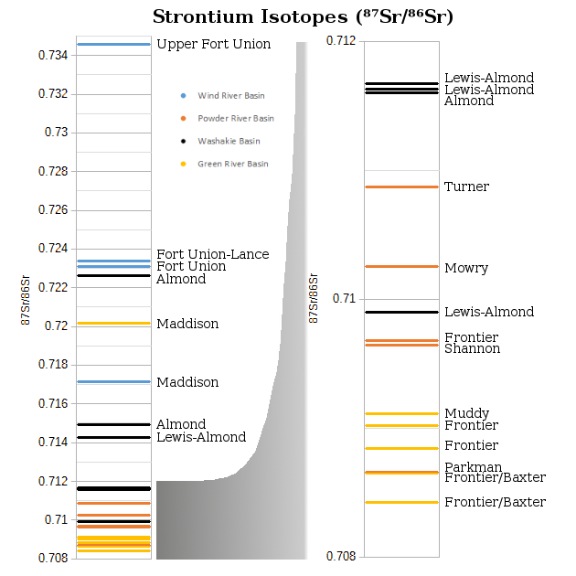
Sr (Isotech only)
Formations match even across the state

Slide 7
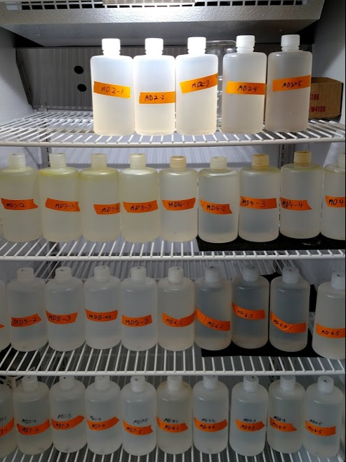
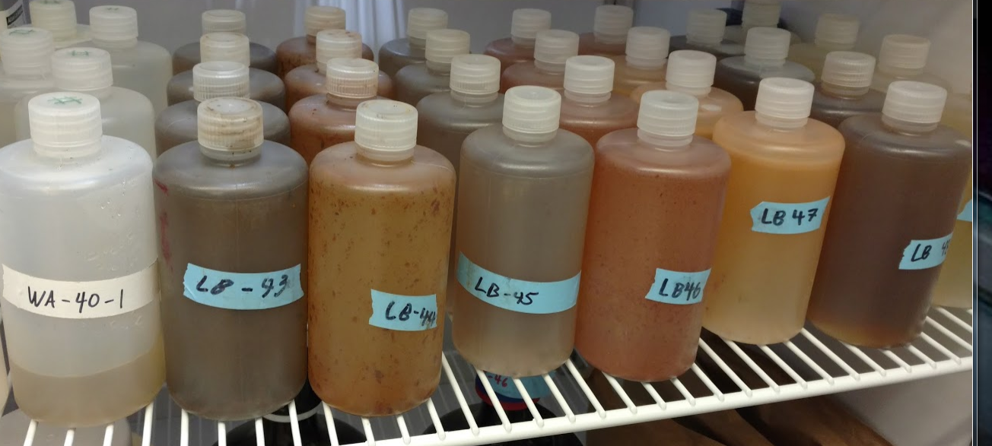
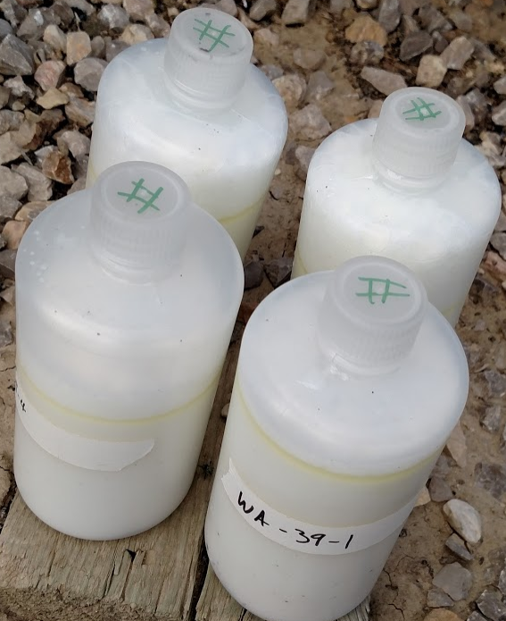
Questions?
Dissolved load Suspended load Soap

