Slide 1
AQUEOUS RARE EARTH ELEMENT PATTERNS AND CONCENTRATION IN CO-PRODUCED BRINES AND INDUSTRIAL PONDS, WYOMING
Charles Nye¹ Ghanashyam Neupane² Scott Quillinan¹
Travis McLing² Fred McLaughlin¹ Davin Bagdonas¹
¹Carbon Management Institute, University of Wyoming
²Idaho National Laboratory

Slide 2
Outline
Serious Title
The Parent Project
Isotope Data
General REE Theory
Measuring ng/L (ppt)
Data by Basin & Field
Conclusions
Cheap Novel Title
The Big Picture
Inspiration
Overlooked?
The Challenge
Found Fingerprints
Explanation

Slide 3
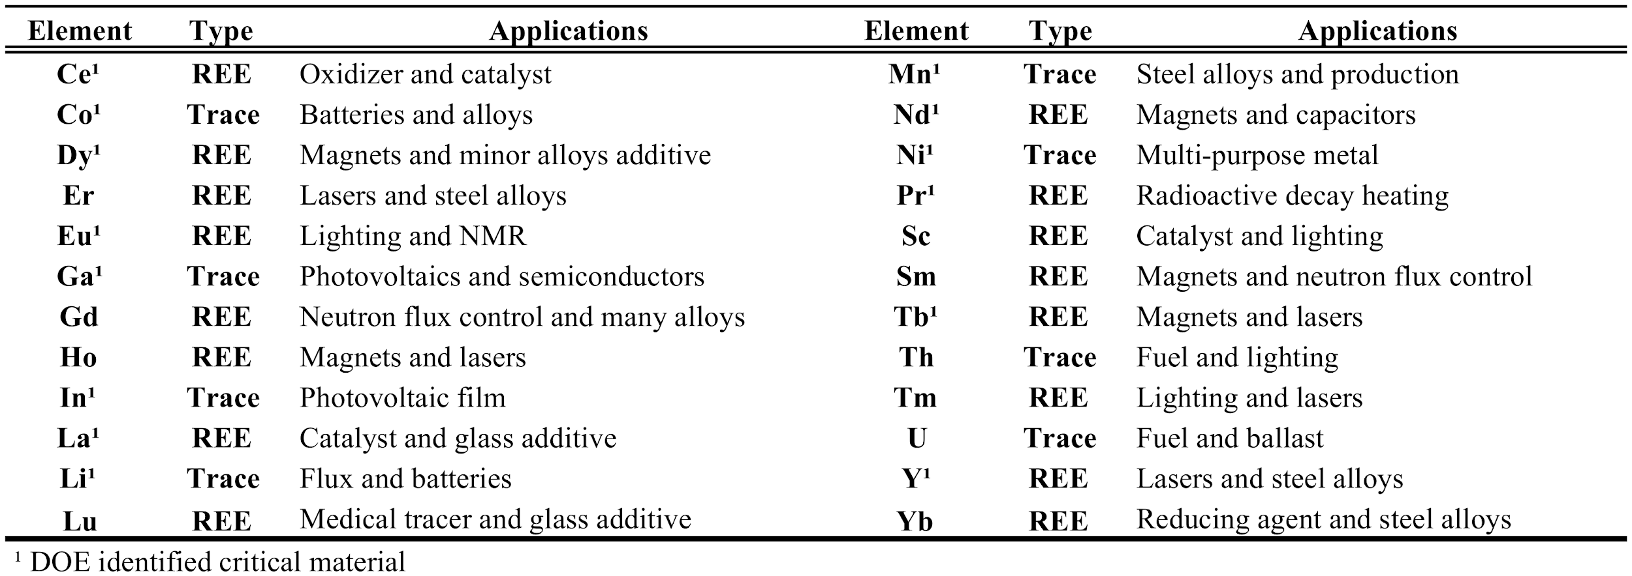
Project Objectives
National Database - O&G and Geothermal REEs
Refine Measuring Methods
Statistical Screening to predict occurrence
Techno-Economic Assessment

Slide 4
Project Objectives
National Database - O&G and Geothermal REEs
Refine Measuring Methods
Statistical Screening to predict occurrence
Techno-Economic Assessment

Slide 5
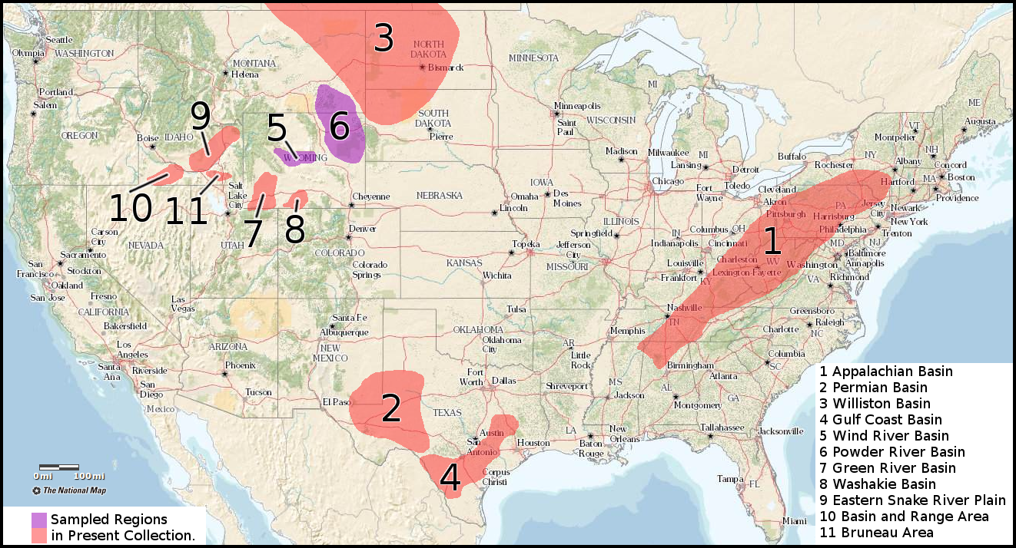
Ongoing REE Work
N ≈ 150

Slide 6
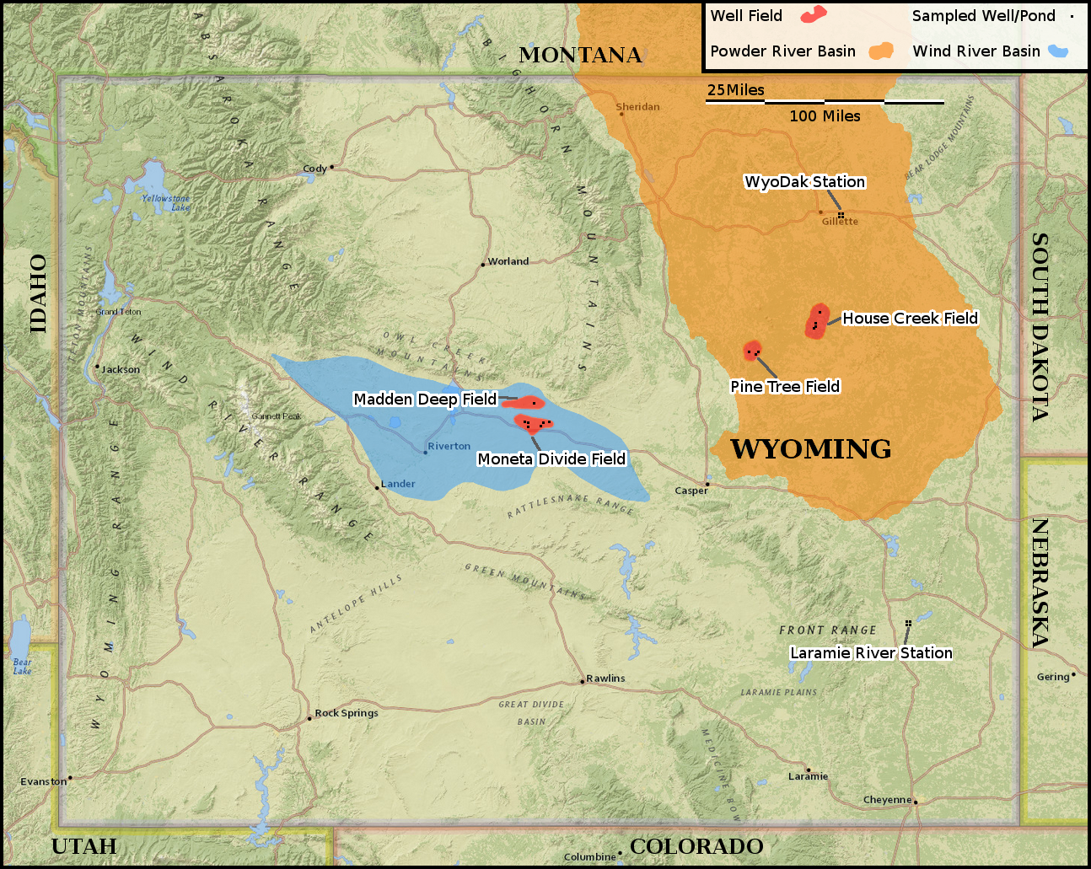
Study Area for this talk
N = 28
WRB
2 Fields
PRB
2 Fields
2 Power Stations

Slide 7
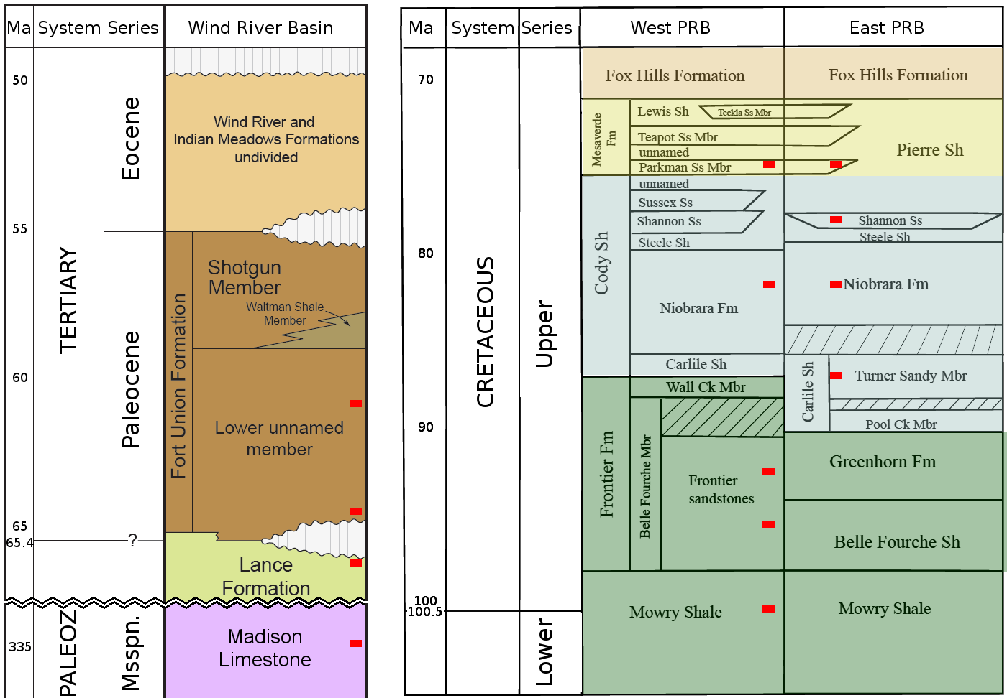
Strata
WRB:
Young-
Very Old
PRB:
East-
West

Slide 8
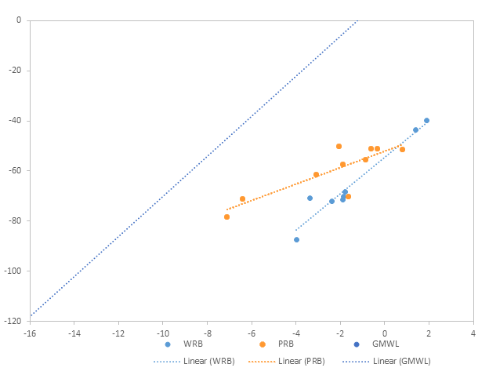
Isotopes: δD, δO¹⁸
Right of GMWL
Prolonged Rxn with Rock
Good place to see REEs from rock to water

Slide 9
REE Transfer
chondrite (ppm)
Mantle
mixing
Emplaced Magma
fract. crystallization
Igneous Metamorphs
weathering
Loose Sediment
diagenesis
Metasediment
chondrite
PAAS

Slide 10
Natural Water REE Transfer
Mantle
mixing
Emplaced Magma
fract. crystallization
Igneous Metamorphs
weathering
Loose Sediment
diagenesis
Metasediment
Note Ce anomaly
NPDW x 10⁷
dissolution
Water
Evaporation
Evaporites

Slide 11
Rock normalization inappropriate for Water
Solids - Rock, particulate, sediment:
NASC, PAAS, UCC, RSA, GLOSS, and Chondrite
Dissolved - 10⁻⁷ of solids:
NPDW, NADW, AIW, and various rivers.
Deep Basin Brine normalization remains to be developed.

Slide 12
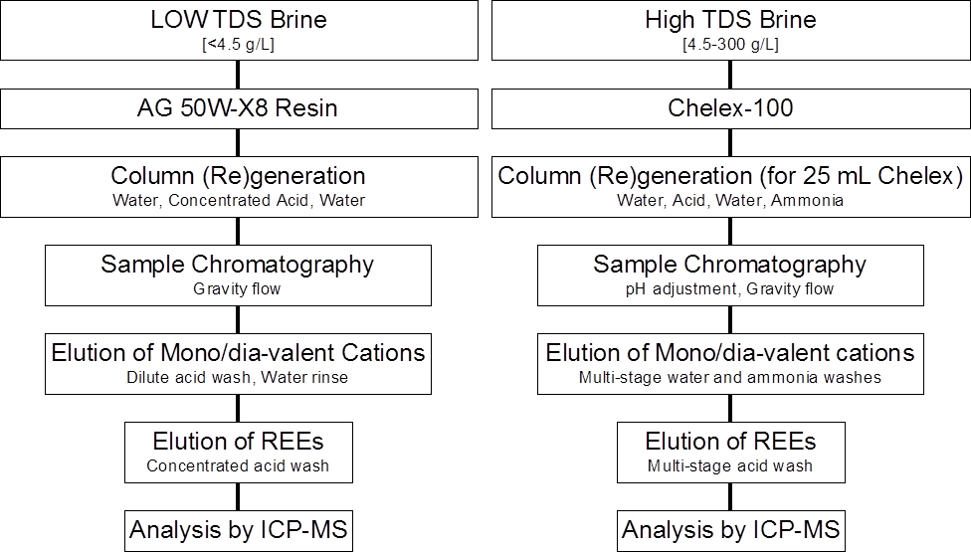

Slide 13
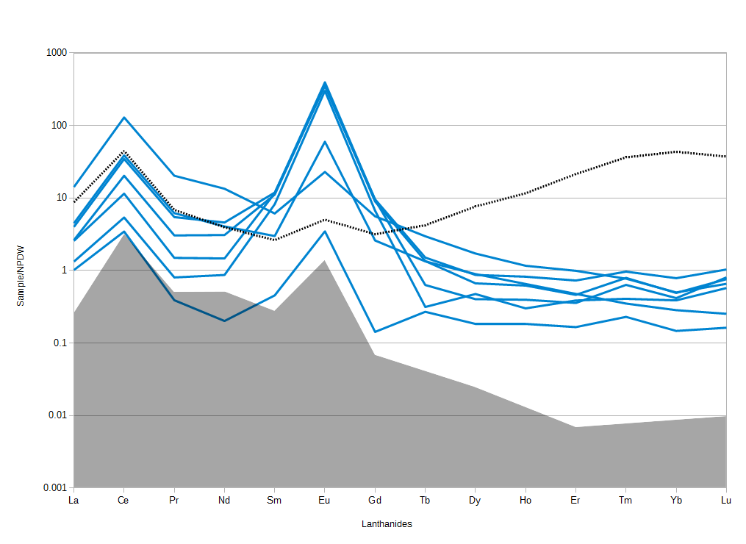
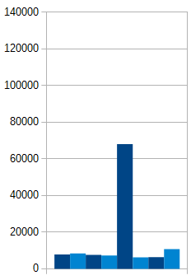
Basin REE
WRB:
Sm≈Gd<<Eu
TDS
ppm majors

Slide 14
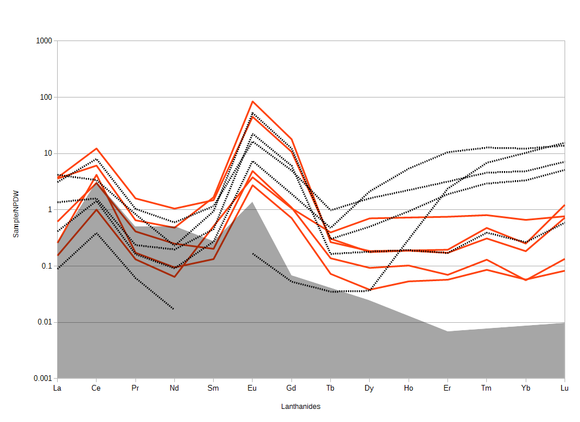
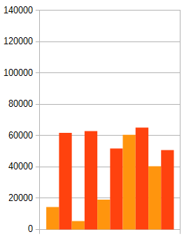
Basin REE
PRB:
Sm<Gd<Eu
TDS
ppm majors

Slide 15
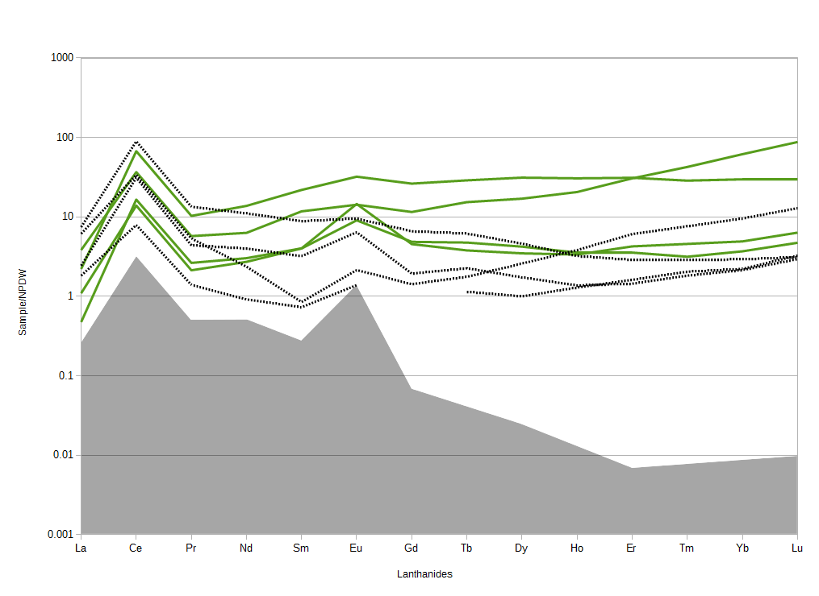
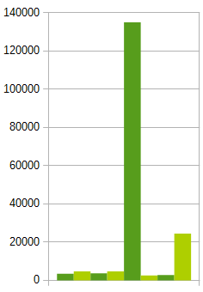
Basin REE
Industrial:
Sm≈Gd≈Eu
TDS
ppm majors

Slide 16
Signature for fields
Lost Cabin
Moneta Divide
Pine Tree (PRB-18)
House Creek (PRB-14)
Eu Gd Er
Eu Gd Er

Slide 17
Conclusions
REEs can be measured.
REEs may reflect Geologic Heterogeneity.
Terrestrial/Marine Frac-Sand/Biologics/Age
Many fields have higher concentration than Ocean Water. This does not necessarily imply a better mine. (oil droplets, TDS, disposal)
Future work will improve our ability to read these signatures and identify what they mean.

Slide 18
Acknowledgements
Carbon Management
Institute
Funding sources:
DOE: EERE
State of Wyoming
Team Members:
University of Wyoming
USGS

Slide 19
Guidance? Questions? Comments?
This REE project is just beginning.
We need more data. Collection continues.
We welcome any guidance from experts in the audience.

Slide 20
Ref
McLennan, S. M. (2001), Relationships between the trace element composition of sedimentary rocks and upper continental crust, Geochem. Geophys. Geosyst., 2, 1021, doi:10.1029/2000GC000109.
Clark, Ian, and Peter Fritz, 1997, Environmental isotopes in hydrogeology: Boca Raton, Fla., Lewis Publishers.
Hatje, Vanessa, Bruland K., and Flegal A. R.“Increases in Anthropogenic Gadolinium Anomalies and Rare Earth Element Concentrations in San Francisco Bay over a 20 Year Record” Environmental Science & Technology 2016 50 (8), 4159-4168 DOI: 10.1021/acs.est.5b04322
http://www.sciencedirect.com/science/article/pii/0016703785900900

