Slide 1
TYPICAL AQUEOUS RARE EARTH ELEMENT BEHAVIOR IN CO-PRODUCED BRINES, WYOMING
Charles Nye¹ Scott Quillinan¹ Travis McLing²
Ghanashyam Neupane² Yuri Ganshin¹
¹Carbon Management Institute, University of Wyoming
²Idaho National Laboratory

Slide 2
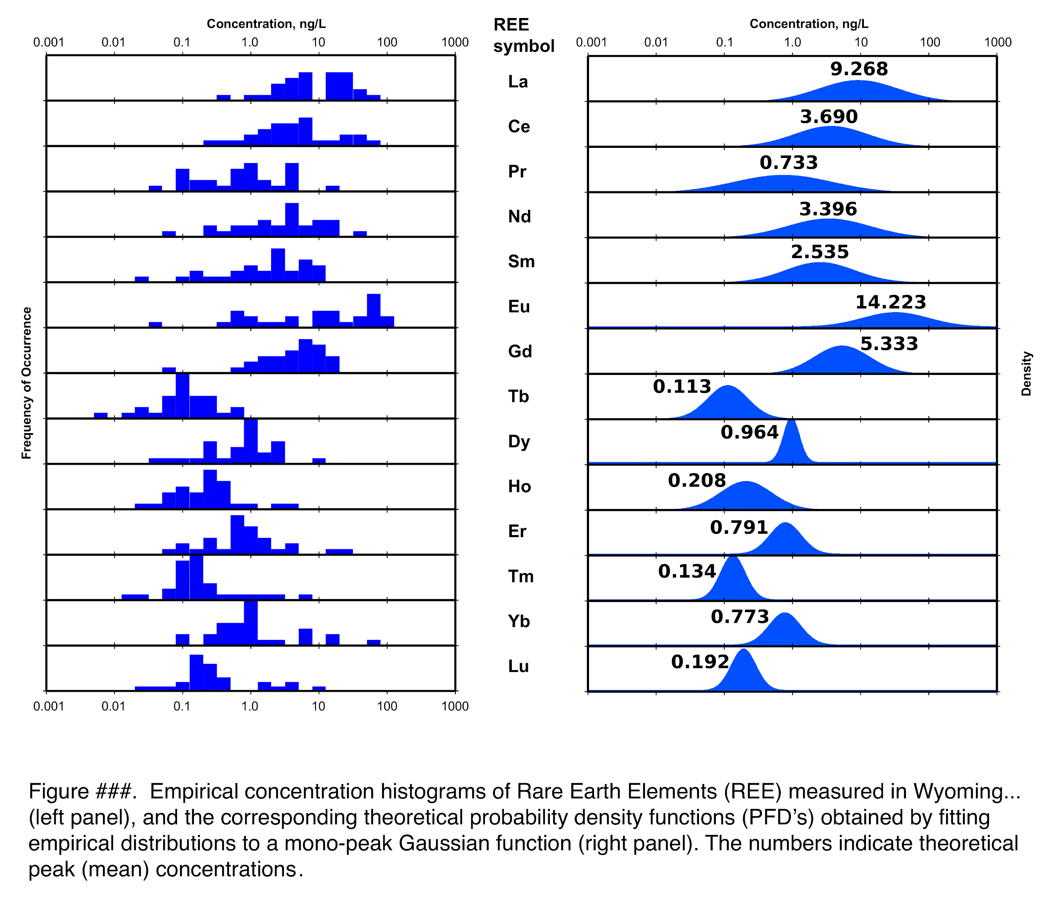
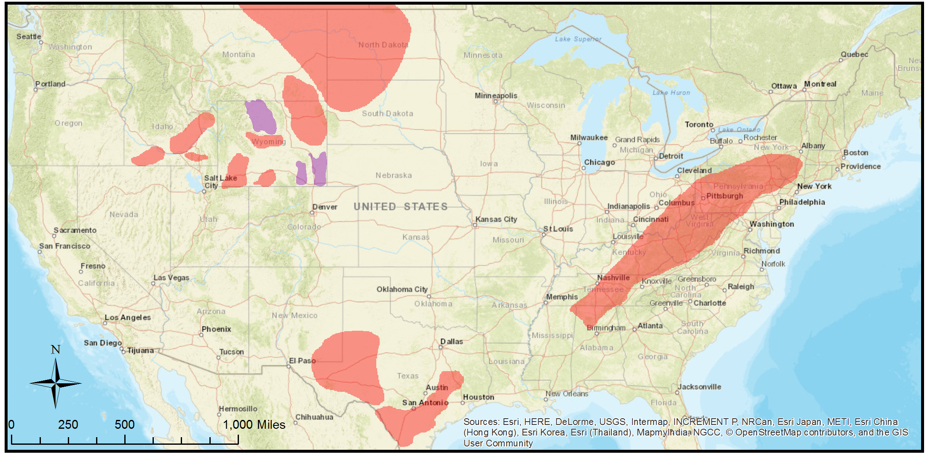
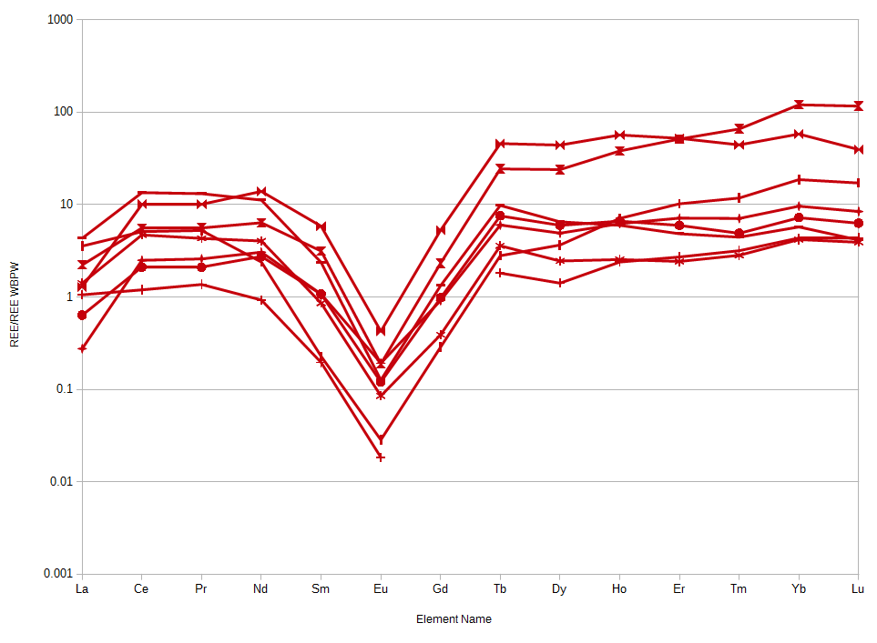
Outline
Study Area
Normalization
Data Comparison
Ligand model
Conclusions

Slide 4
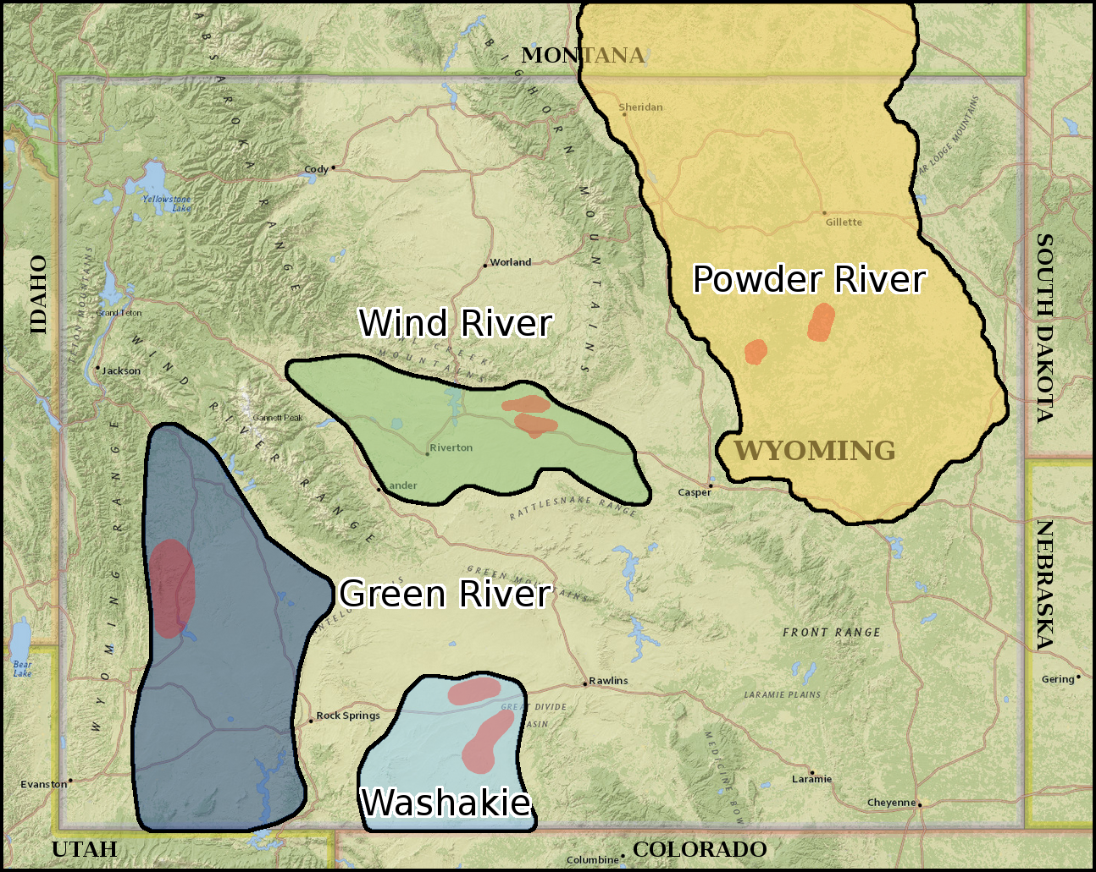
Study Area
N = 38+
Wind River Basin
Powder River Basin
Washakie Basin
Green River Basin
<31mS, pH 9.5-6.2, <65°C, -244/295mV Redox,
7,000/25,000 ft depth

Slide 5
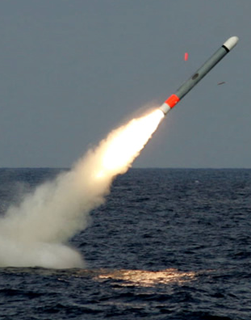
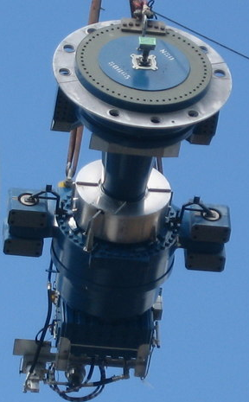
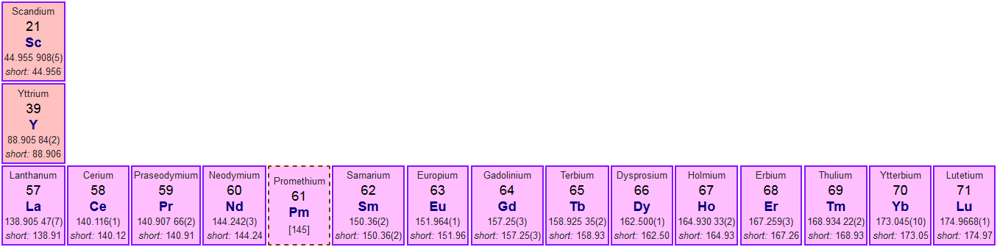
REEs
by Raytheon
by Paul Anderson
14 f-block elements
Y & Sc included makes “REEY”
Similar chemical behavior
Many difficult-to-substitute applications

Slide 6
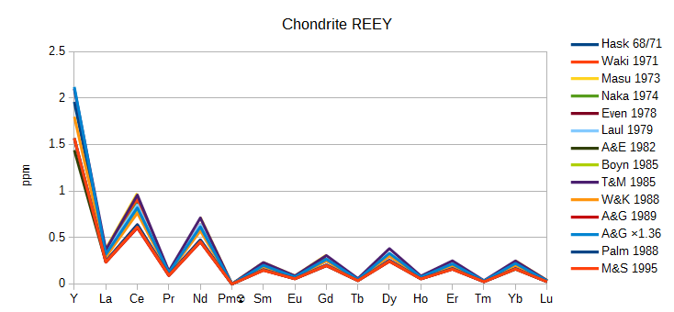
Normalization
Saw-tooth distracts
Small ratios/diff
Human eye
Yttrium
Promethium ☢

Slide 7
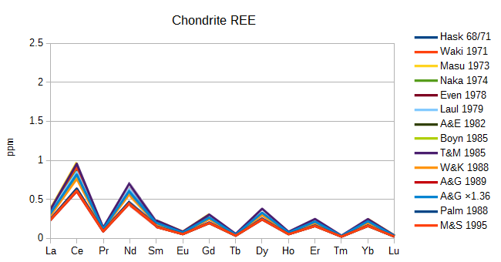
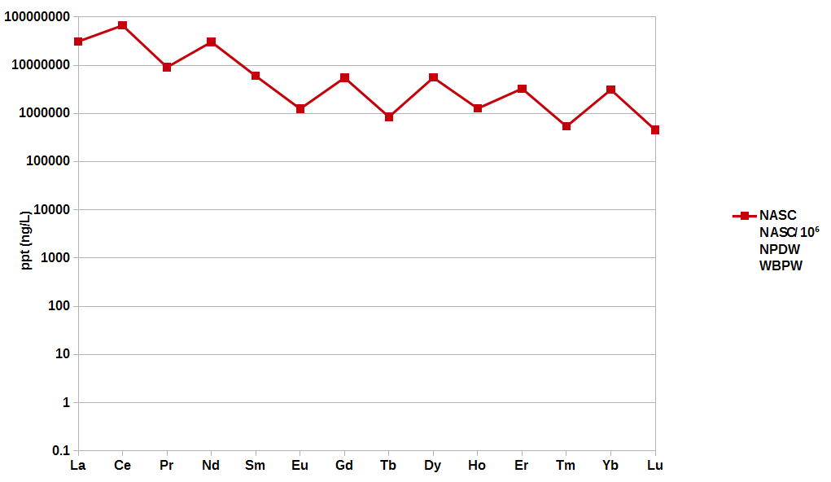
Normalization
Saw-tooth distracts
Small ratios/diff
Human eye
Yttrium
Promethium ☢

Slide 8
Normalization
NASC: good for rocks

Slide 9

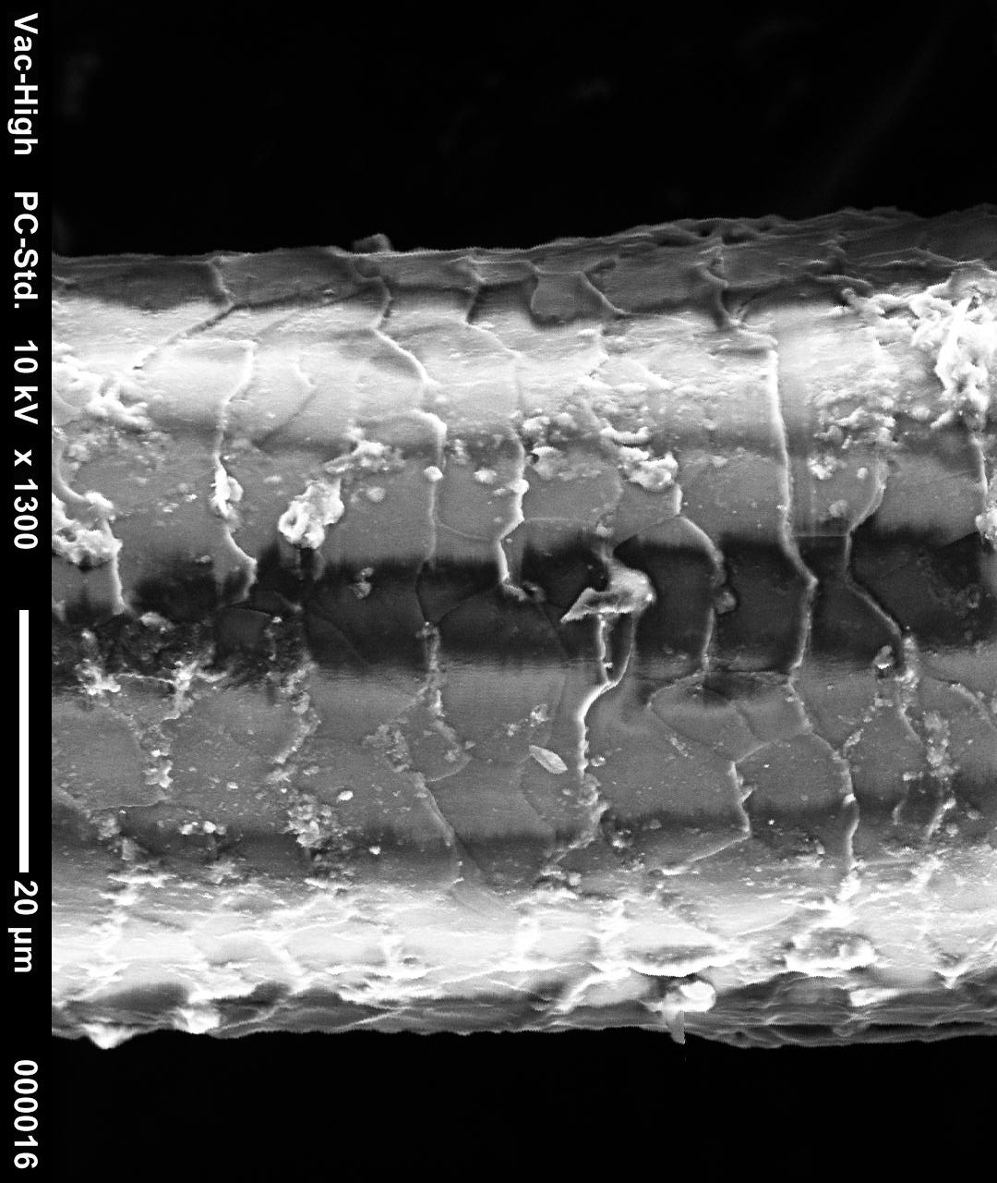
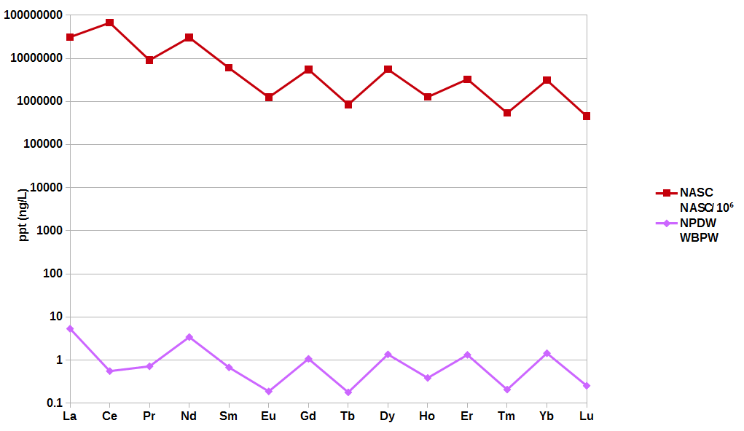
Normalization
NASC: good for rocks
NPDW: good for water
by Donald Tong
by Brian Ley

Slide 10
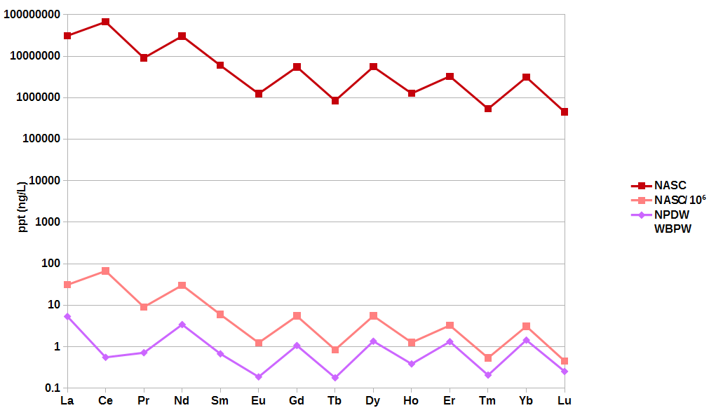
Normalization
NASC: good for rocks
NPDW: good for water
NASC*10⁻⁶: ?works?

Slide 11
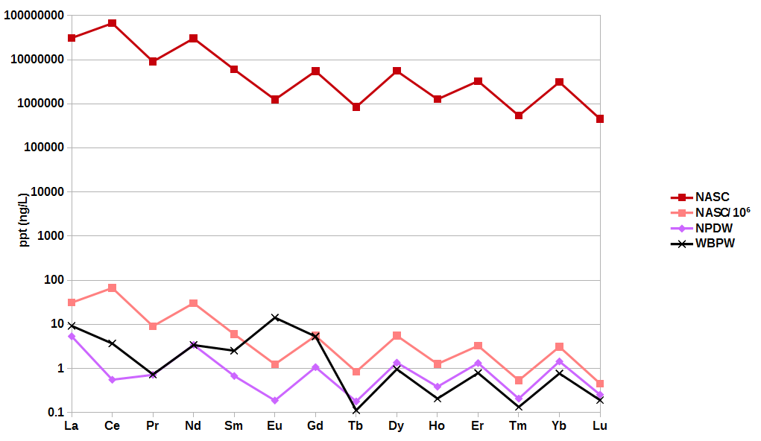
Normalization
NASC: good for rocks
NPDW: good for water
NASC*10⁻⁶: ?works?
WBPW: New structure

Slide 12
Normalization
#1
#2
#3
N = 38

Slide 13
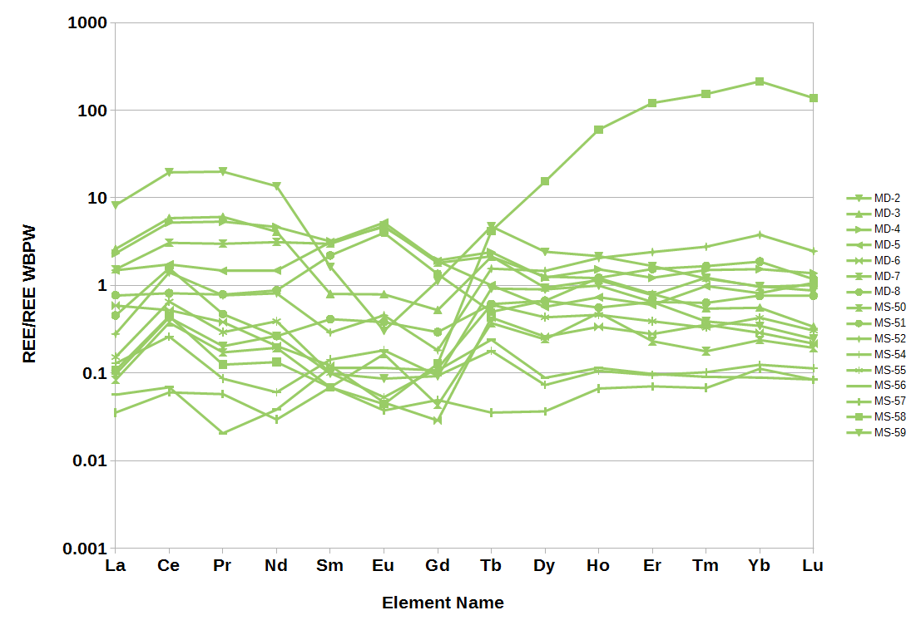
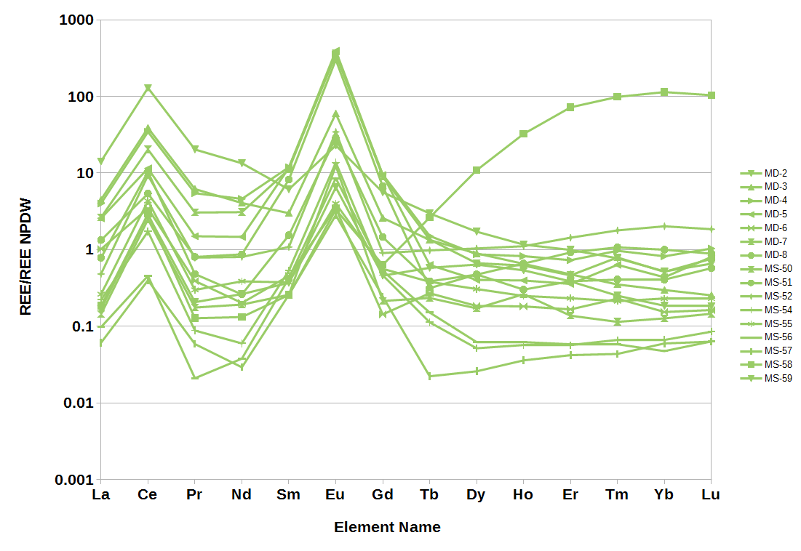
Data Comparison
Wind River

Slide 14
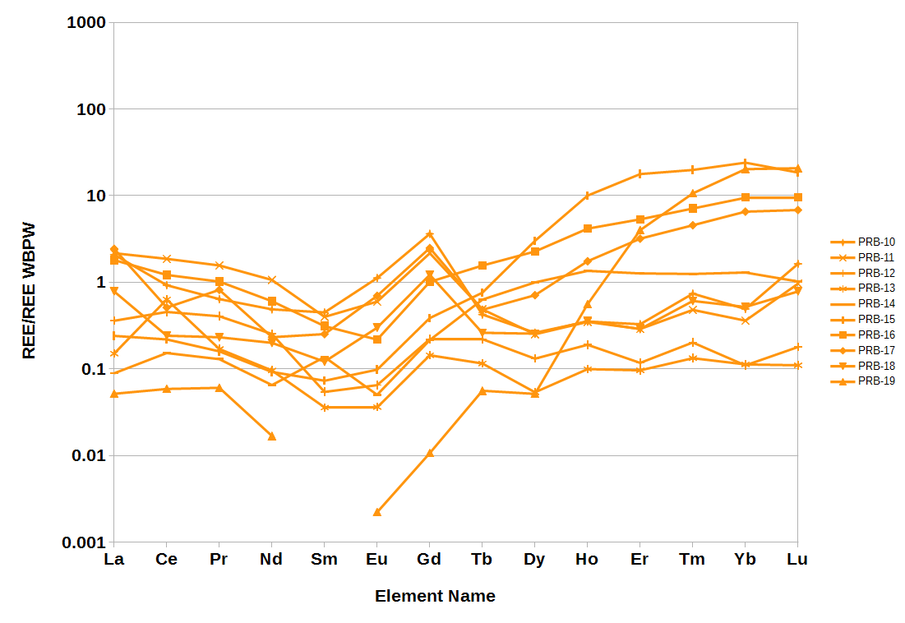
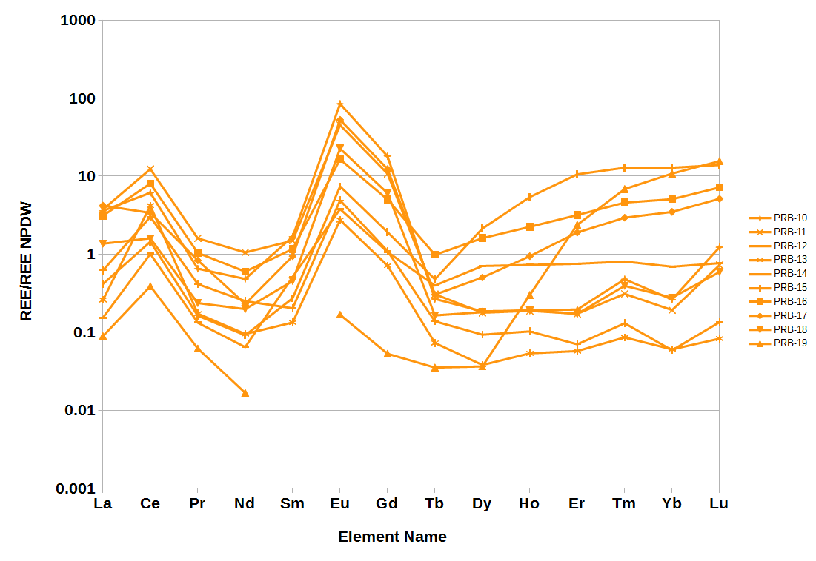
Data Comparison
Powder River

Slide 15
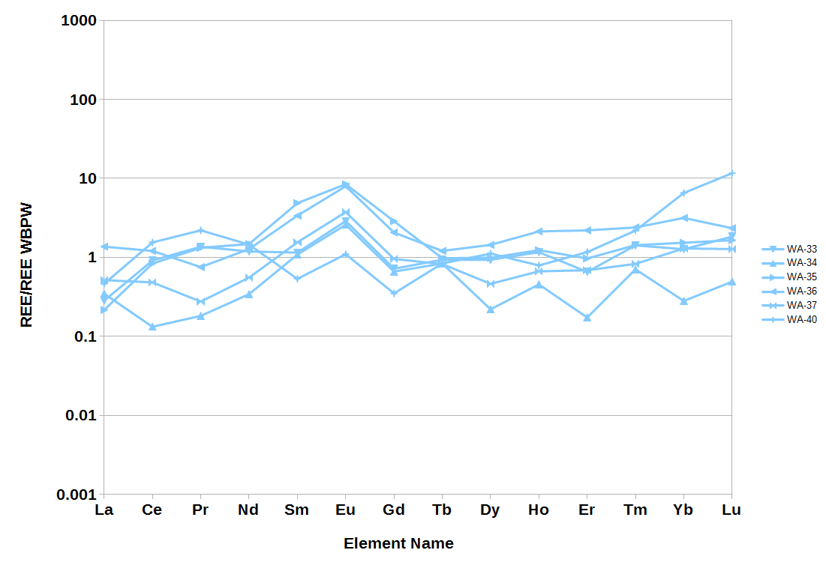
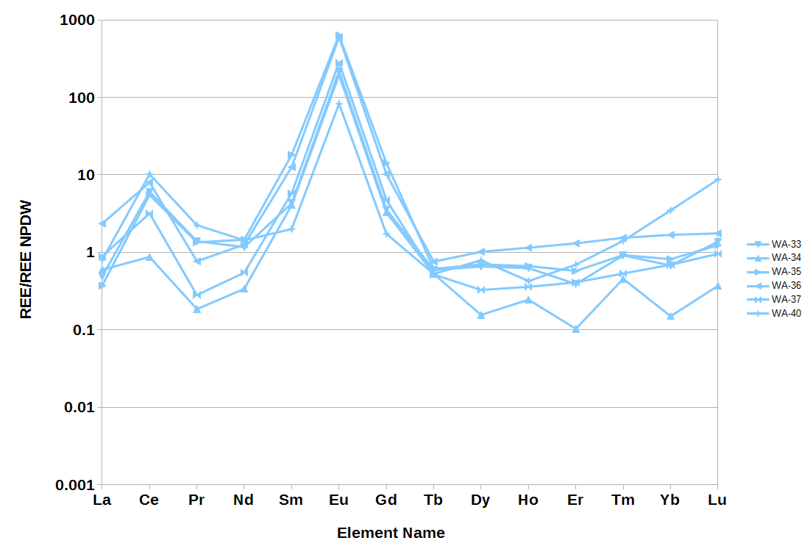
Data Comparison
Washakie

Slide 16
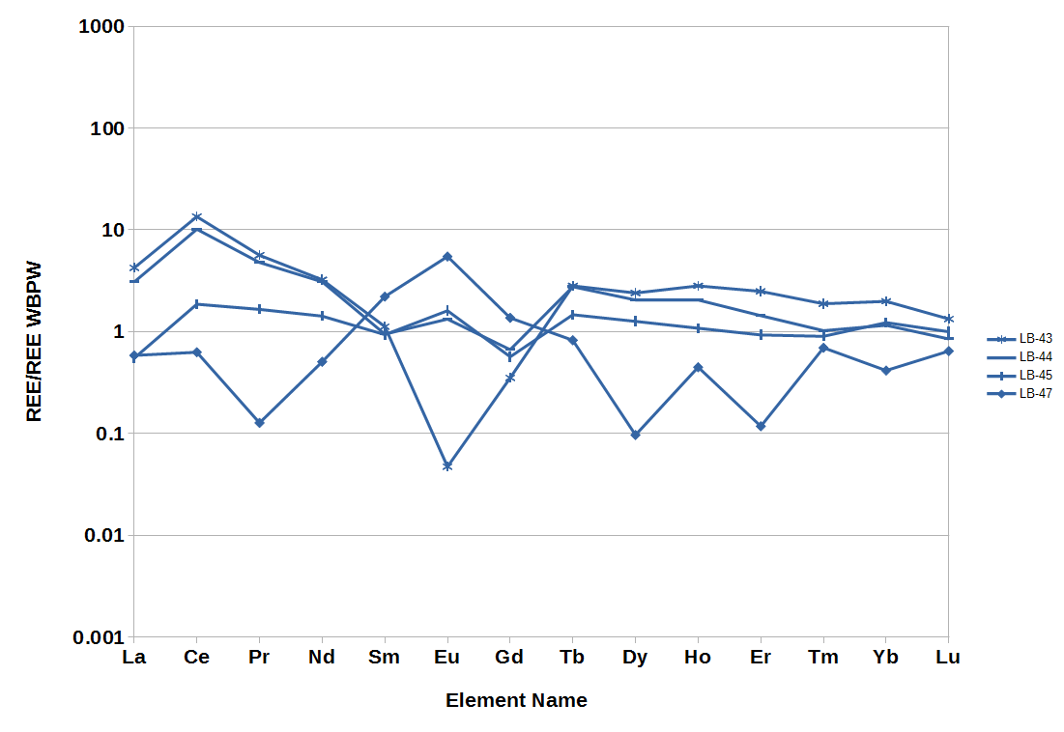
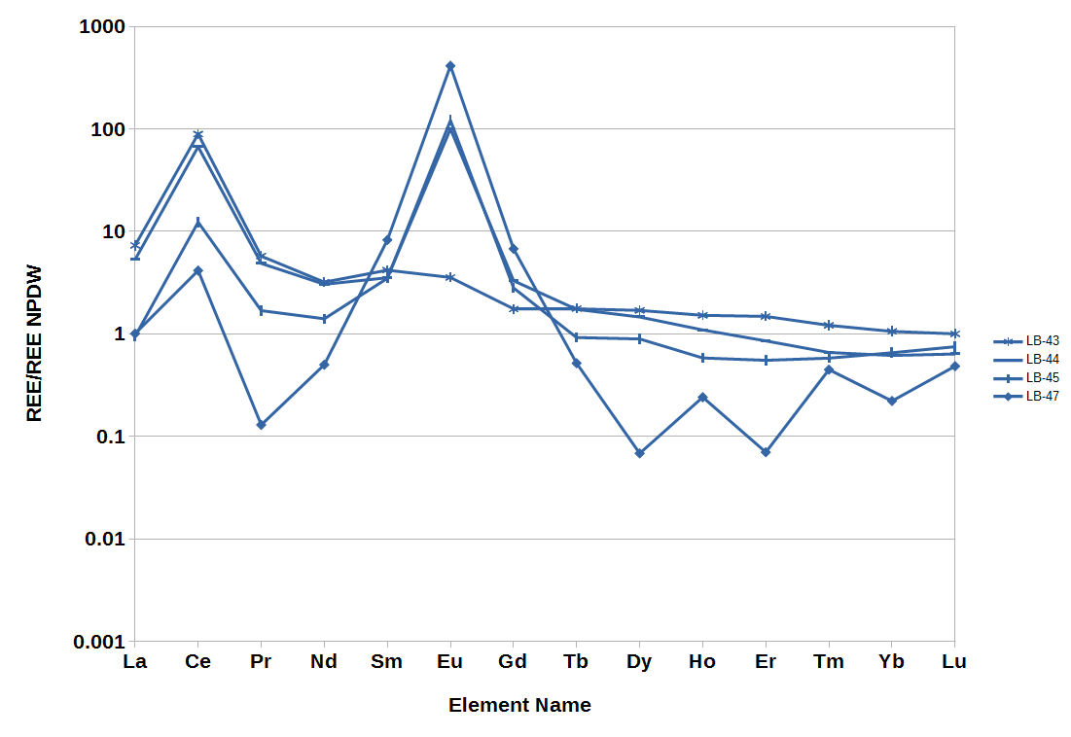
Data Comparison
Green River

Slide 17
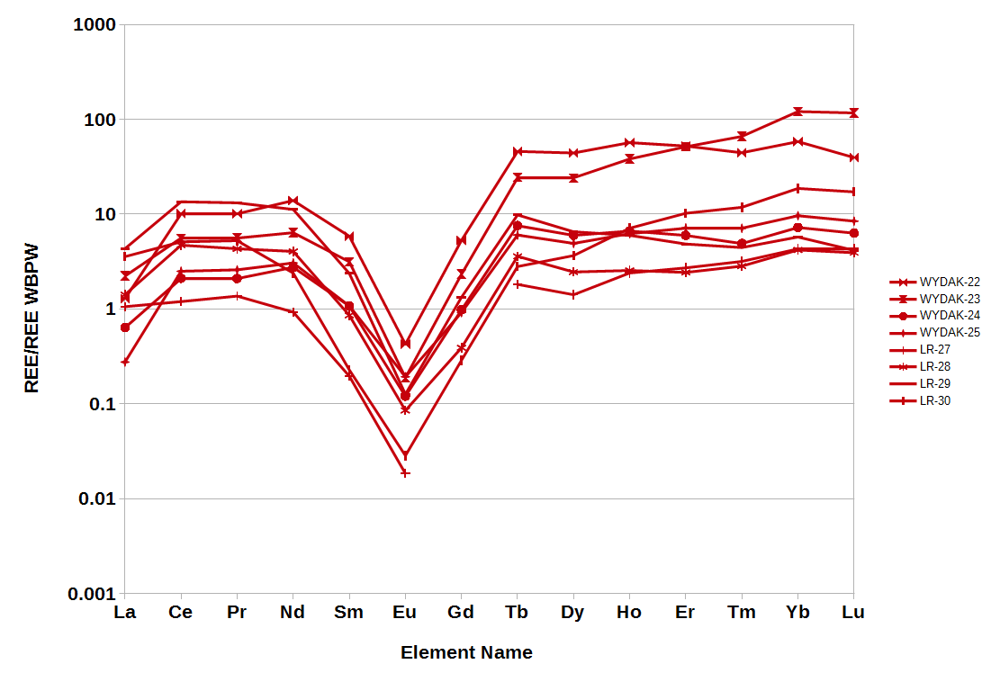
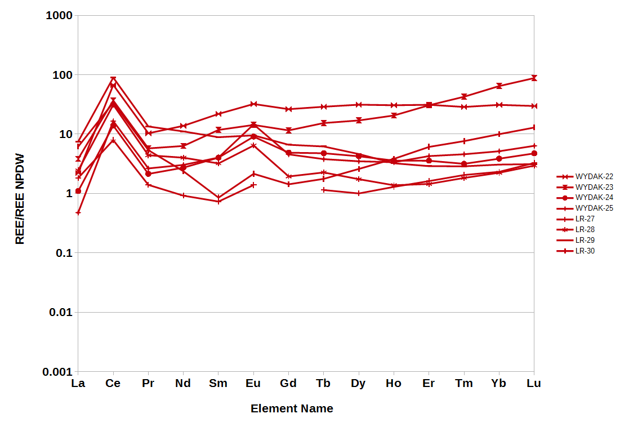
Data Comparison
Industrial

Slide 18
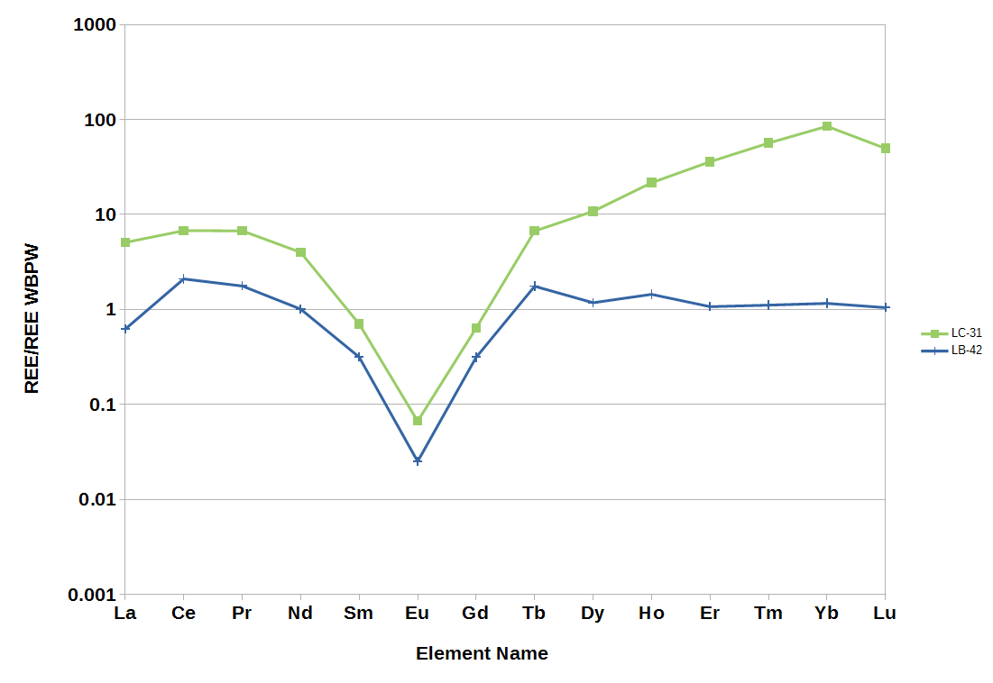
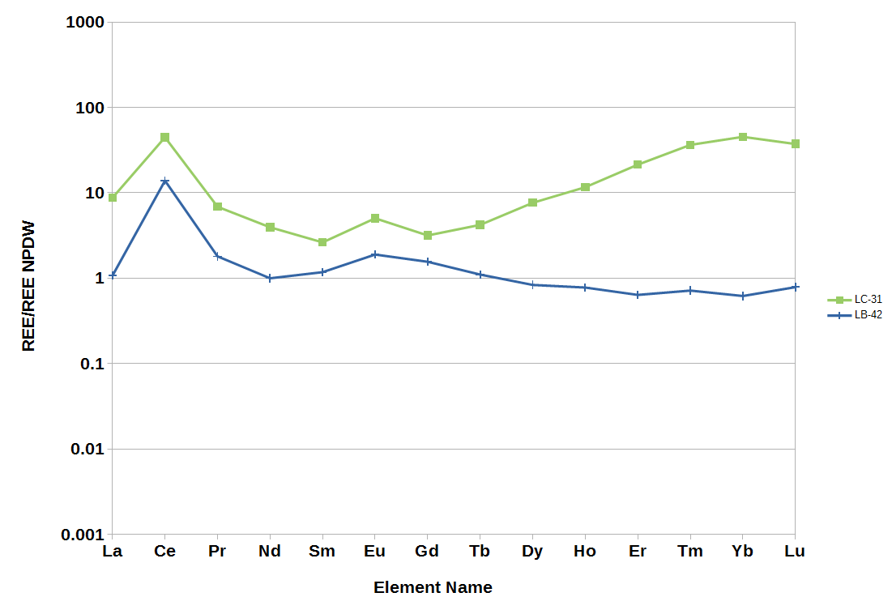
Data Comparison
Carbonates

Slide 19
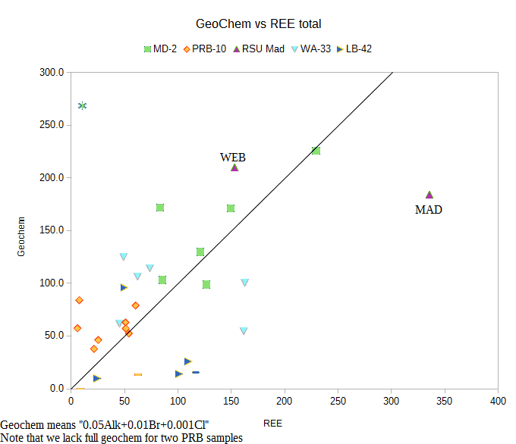
Ligands
Total REEs form a line given multipliers to carbonate, bromide, and chloride.
REE excess (left) indicates something else is contributing

Slide 20
Conclusions
REEs normalizations should match intended use.
Minimal distractions in WBPW allow comparison.
MREE are the most variable.
HREE tend to enrich as a block.
Carbonate, Bromide, and Chloride are ligands.
There may be other ligands, esp in carbonates.

Slide 21




Acknowledgements
Carbon Management
Institute
Funding sources:
DOE: EERE
State of Wyoming
Team Members:
University of Wyoming
USGS

