Slide 1
Aqueous Rare Earth Elements, Concentration, and Stable Isotopes in Deep Basin Brines, Wyoming
Charles Nye¹ Scott Quillinan¹ Ghanashyam Neupane²³ Travis McLing²³
¹Carbon Management Institute, University of Wyoming
²Idaho National Laboratory
³Center for Advanced Energy Studies

Slide 2
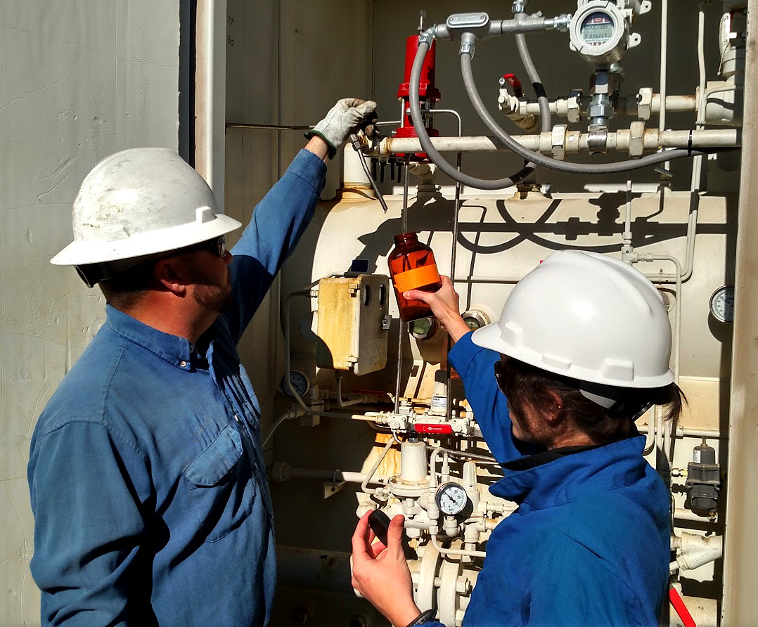
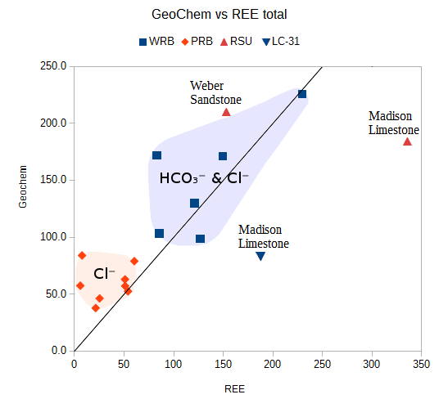
Outline
Why produced waters?
REE importance
Study areas: WRB, PRB, Ponds
Data by Basin & Field
Relationship to possible ligands

Slide 3
Produced waters are a solution
High Volume, Pre-developed, Hot, and Saline
West needs H₂O
Aqueous mining turns salinity into a resource

Slide 4
REE Importance
Needed for current technology economy
Past Water-Rock interactions
Offer tracing opportunity
Sources and authigenic tracking

Slide 5
REE Importance
Needed for current technology economy
Past Water-Rock interactions
Offer tracing opportunity
Sources and authigenic tracking

Slide 6
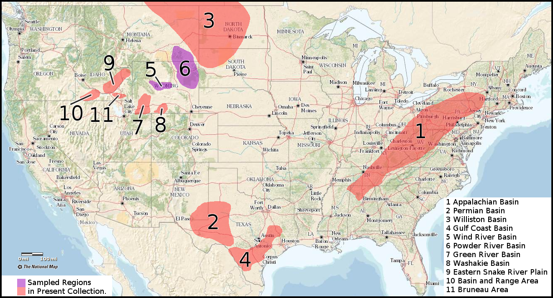
Ongoing REE Work
N ≈ 150

Slide 7
Study Area for this talk
N = 28
Wind River Basin
Powder River Basin
Power Stations

Slide 8
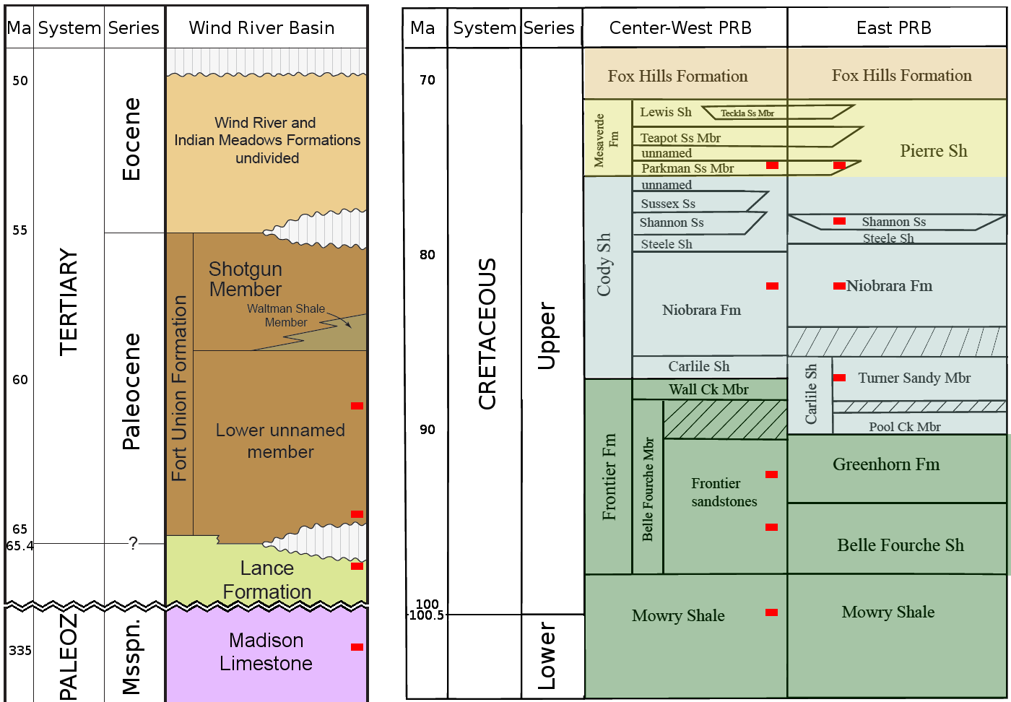
Strata
WRB:
Young-
Very Old
Shallow-
Deep
PRB:
East-
West

Slide 9
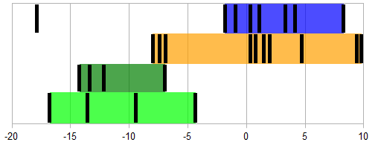
Isotopes: DIC δC¹³
None below -20
Many typical -15 to -5
Some microbial above +2
Ambient
Groundwater
δC¹³
Microbial
Enrichment

Slide 10
Isotopes: DIC δC¹³
WRB
Indistinct Madison vs Fort Union – Lance
Distinct Treatment
Fort Union - Lance
Madison
Treated Water
Ambient
Groundwater
δC¹³
Microbial
Enrichment

Slide 11
Isotopes: DIC δC¹³
PRB
Young Sandstones:P-S
Old Sandstones: T-F
Shales: N-M
Parkman
Shannon
Turner
Frontier
Niobrara
Mowry
Ambient
Groundwater
δC¹³
Microbial
Enrichment

Slide 12
Isotopes: DIC δC¹³
Power Stations
Same range
Northern Exit becomes more negative: organics?
Southern Exit becomes less negative: microbes?
Northern
Ambient
Groundwater
δC¹³
Microbial
Enrichment
Southern

Slide 13
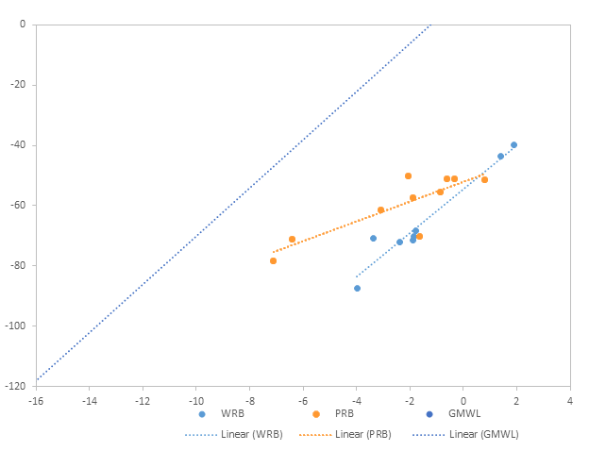
Isotopes: δD, δO¹⁸
Right of GMWL
δO¹⁸ isotopes heavy enriched
Prolonged Rxn with Rock
Non-Meteoric water

Slide 14
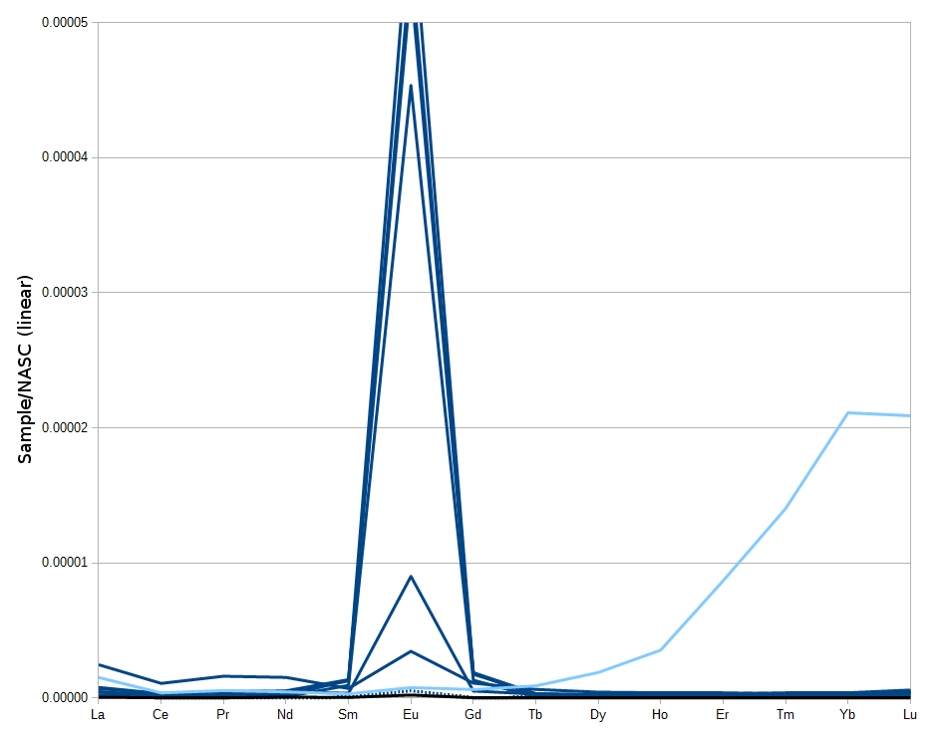
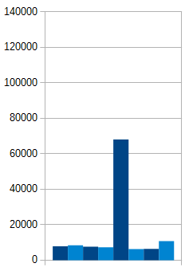
Basin REE
WRB:
175°C & 215°C
TDS
ppm majors
USDW

Slide 15
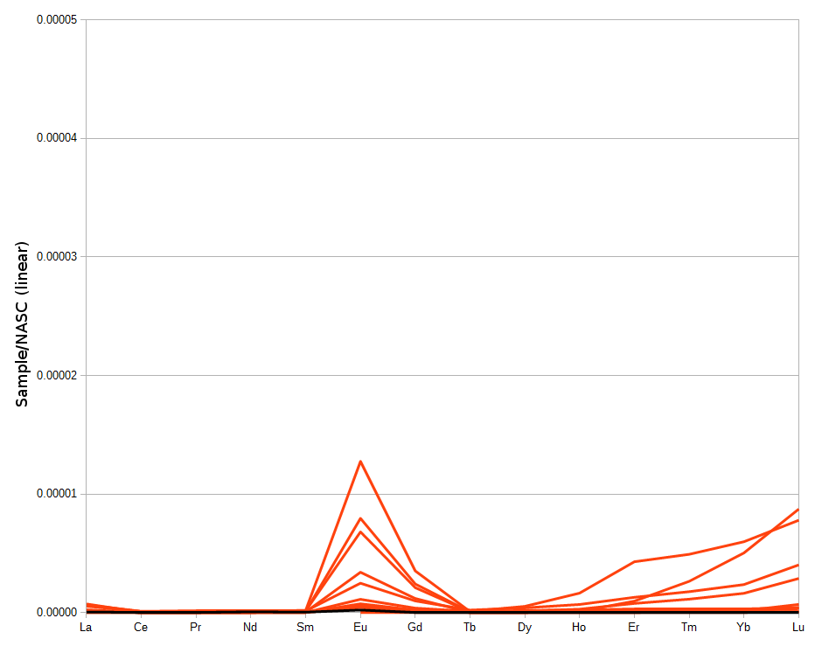
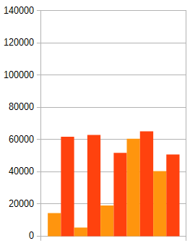
Basin REE
PRB:
115°C
TDS
ppm majors
USDW

Slide 16
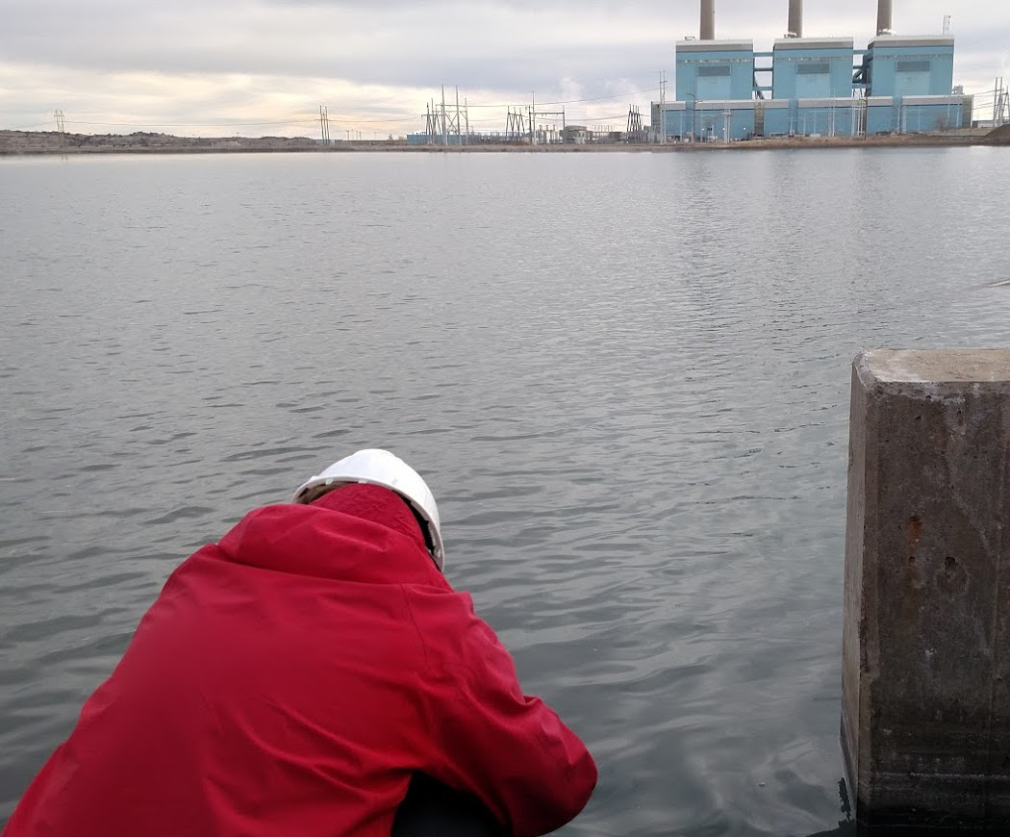
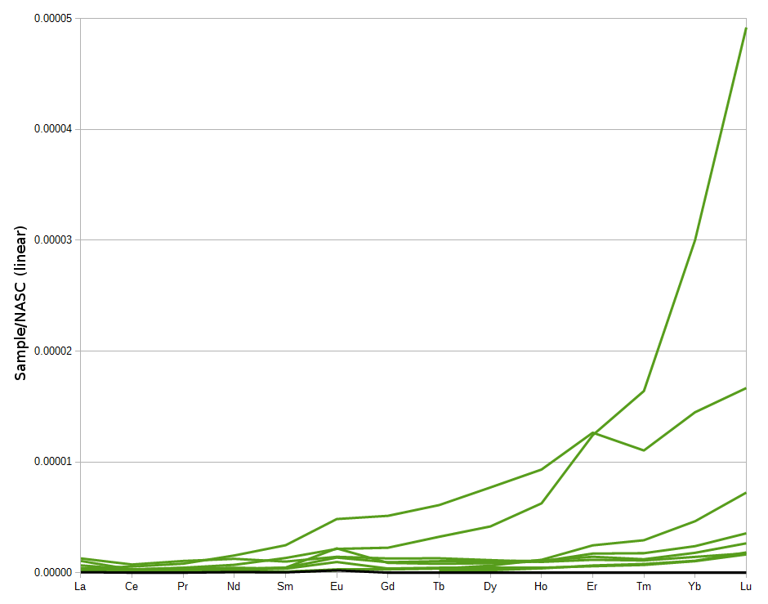
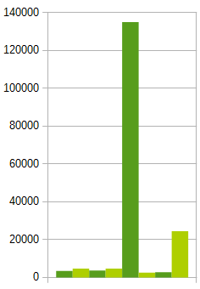
Basin REE
Ash-Ponds:
1270→300→20°C
TDS
ppm majors

Slide 17
Ligands
Migdisov et al 2016
ppm of:
Cl⁻ Br⁻ HCO₃⁻
ppt of:
total REE

Slide 18
Conclusions
REE exist in solution and can be measured
δO¹⁸ isotopes show prolonged rock interaction
Geothermal gradient may be high due to coal
Each study area has a unique signature:
Eu - WRB, Gd - PRB, HREE - Ash Ponds
Produced water have local HREE behavior
Total REE in wells may relate to ligands
Role of depositional environment

Slide 19
Acknowledgements
Funding sources:
DOE: EERE
State of Wyoming
Team Members:
Carbon Management
Institute

Slide 20
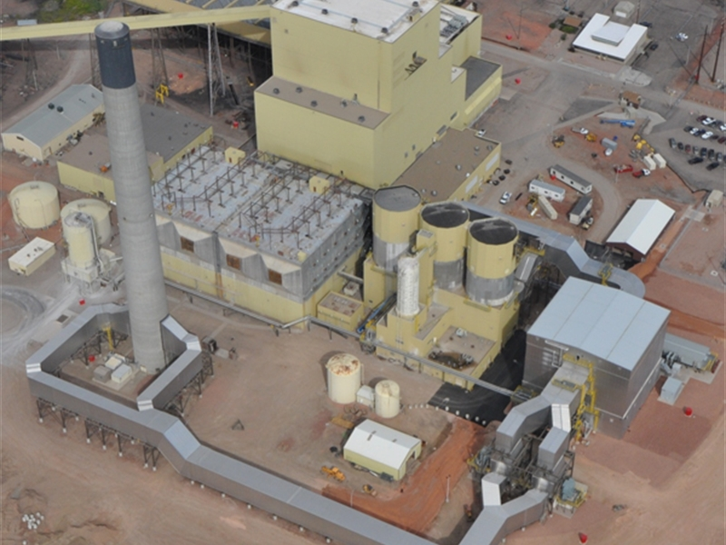
Questions? Comments?
New project
More data collection
Guidance?

Slide 21
Ref
Chu, Steven.: Critical Materials Strategy, Department of Energy, Office of International Affairs, Washington, DC (2011). Accessed from: https://energy.gov/sites/prod/files/DOE_CMS2011_FINAL_Full.pdf (December, 2016)
Clark, Ian, and Peter Fritz, 1997, Environmental isotopes in hydrogeology: Boca Raton, Fla., Lewis Publishers.
Hatje, Vanessa, Bruland K., and Flegal A. R.“Increases in Anthropogenic Gadolinium Anomalies and Rare Earth Element Concentrations in San Francisco Bay over a 20 Year Record” Environmental Science & Technology 2016 50 (8), 4159-4168 DOI: 10.1021/acs.est.5b04322
McLennan, S. M. (2001), Relationships between the trace element composition of sedimentary rocks and upper continental crust, Geochem. Geophys. Geosyst., 2, 1021, doi:10.1029/2000GC000109.
Migdisov A., A.E. Williams-Jones, J. Brugger, F.A. Caporuscio. (2016) Hydrothermal transport, deposition, and fractionation of the REE: experimental data and thermodynamic calculations. Chemical Geology, 439, pages 13–42. http://dx.doi.org/10.1016/j.chemgeo.2016.06.005

