Slide 1
Aqueous Rare Earth Element Patterns and Concentration in Thermal Brines Associated With Oil and Gas Production, Wyoming
Charles Nye¹ Ghanashyam Neupane²³ Scott Quillinan¹ Travis McLing²³
¹Carbon Management Institute, University of Wyoming
²Idaho National Laboratory
³Center for Advanced Energy Studies

Slide 2
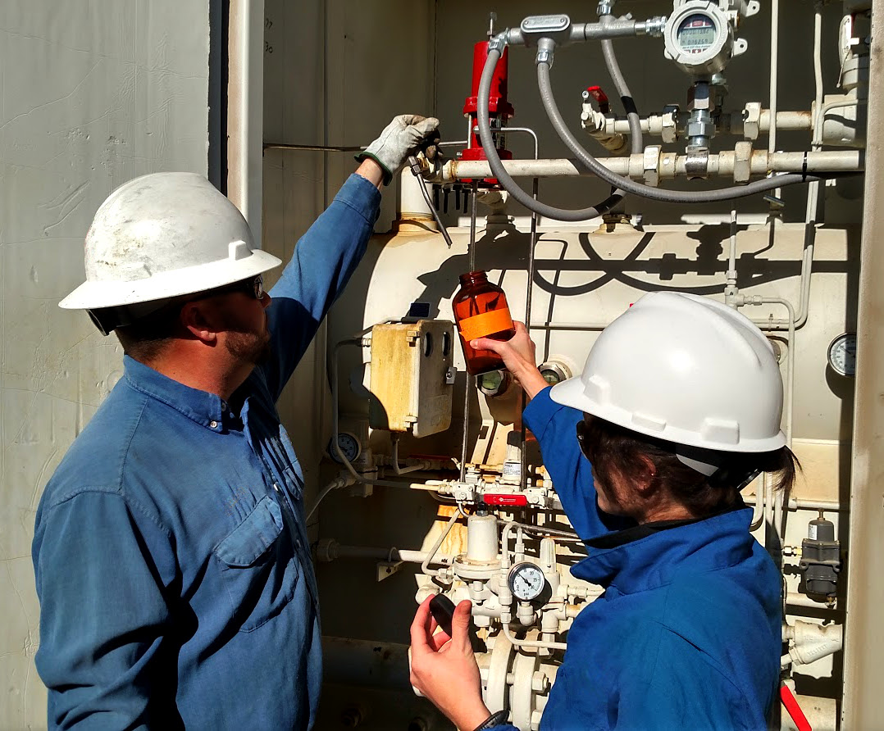
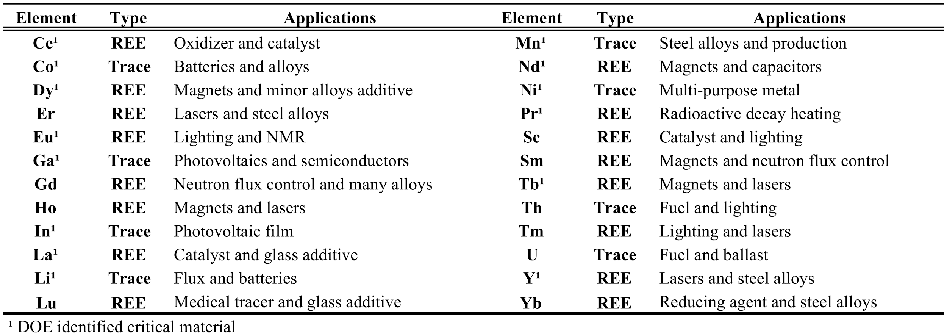
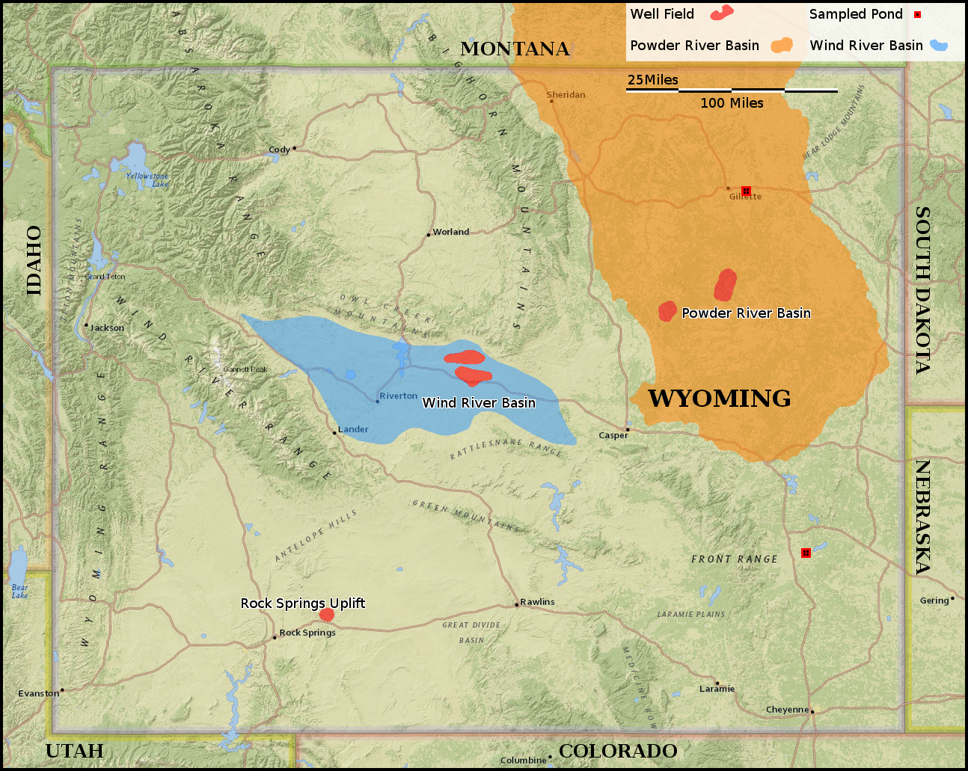
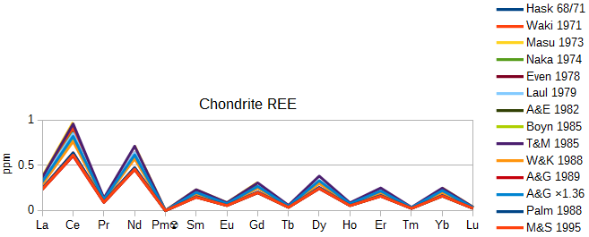
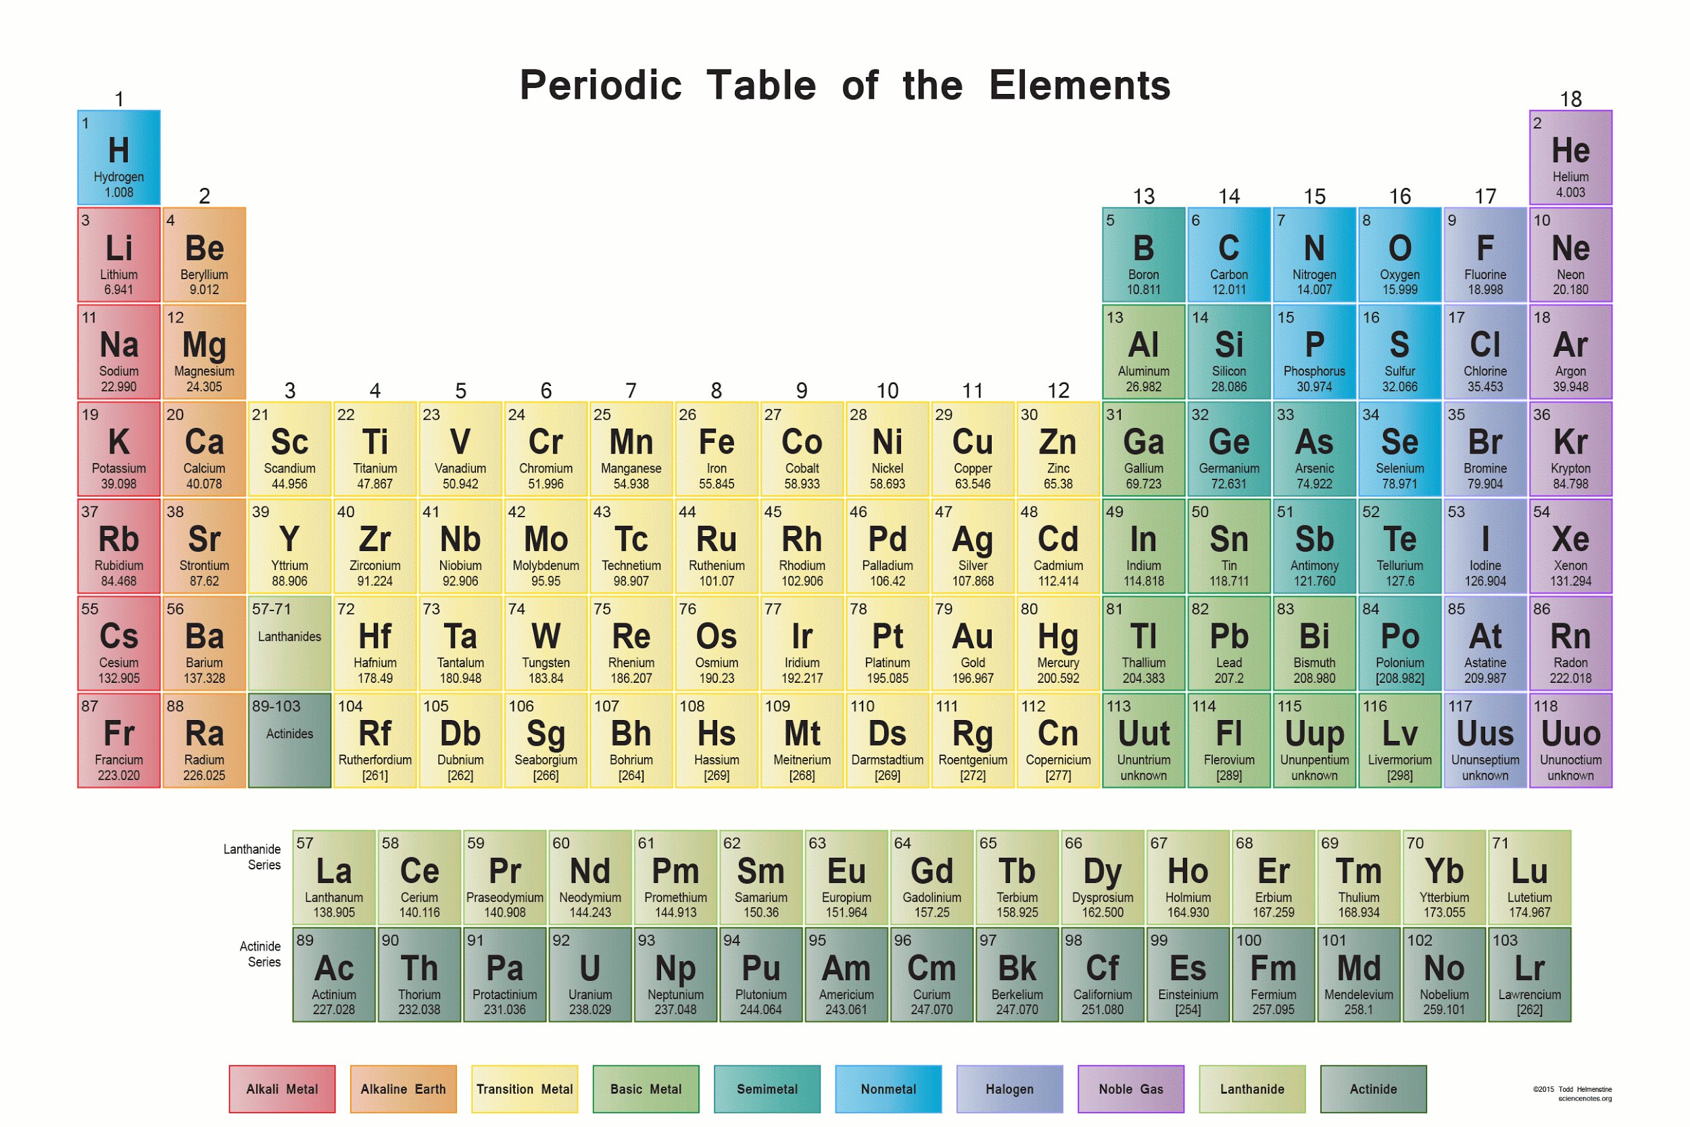
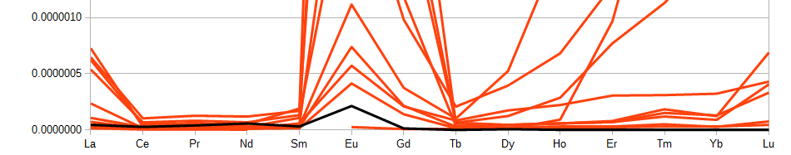
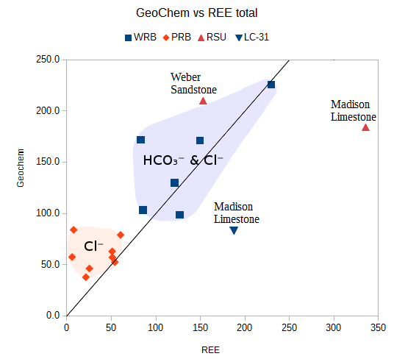
Outline
Why produced waters?
REE importance
Study areas: WRB, PRB, Ponds
How REEs are presented
Data by Basin & Field
Relationship to possible ligands

Slide 3
Produced waters are perfect
Oil and Gas wells
High Volume, Pre-developed, Hot, and Saline
Aqueous mining turns salinity into a resource

Slide 4
REE Importance
Needed for current technology economy
Past Water-Rock interactions
Offer tracing opportunity
Sources and authigenic tracking

Slide 5
REE Importance
Needed for current technology economy
Past Water-Rock interactions
Offer tracing opportunity
Sources and authigenic tracking

Slide 6
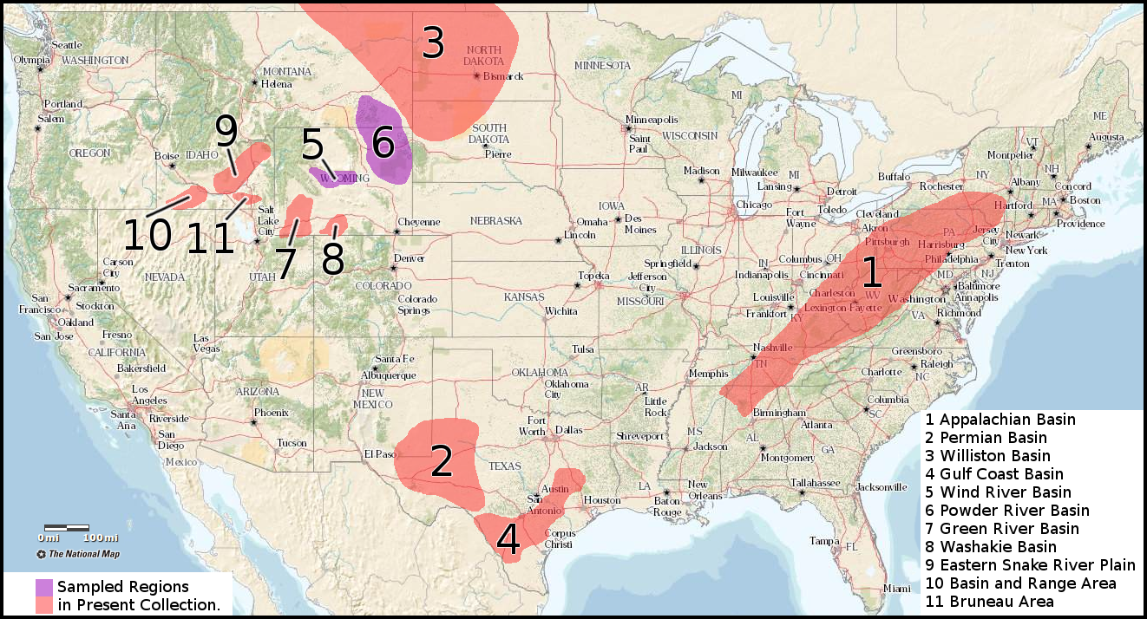
Ongoing REE Work
N ≈ 150

Slide 7
Study Area for this talk
N = 28
Wind River Basin
Powder River Basin
Power Stations

Slide 8
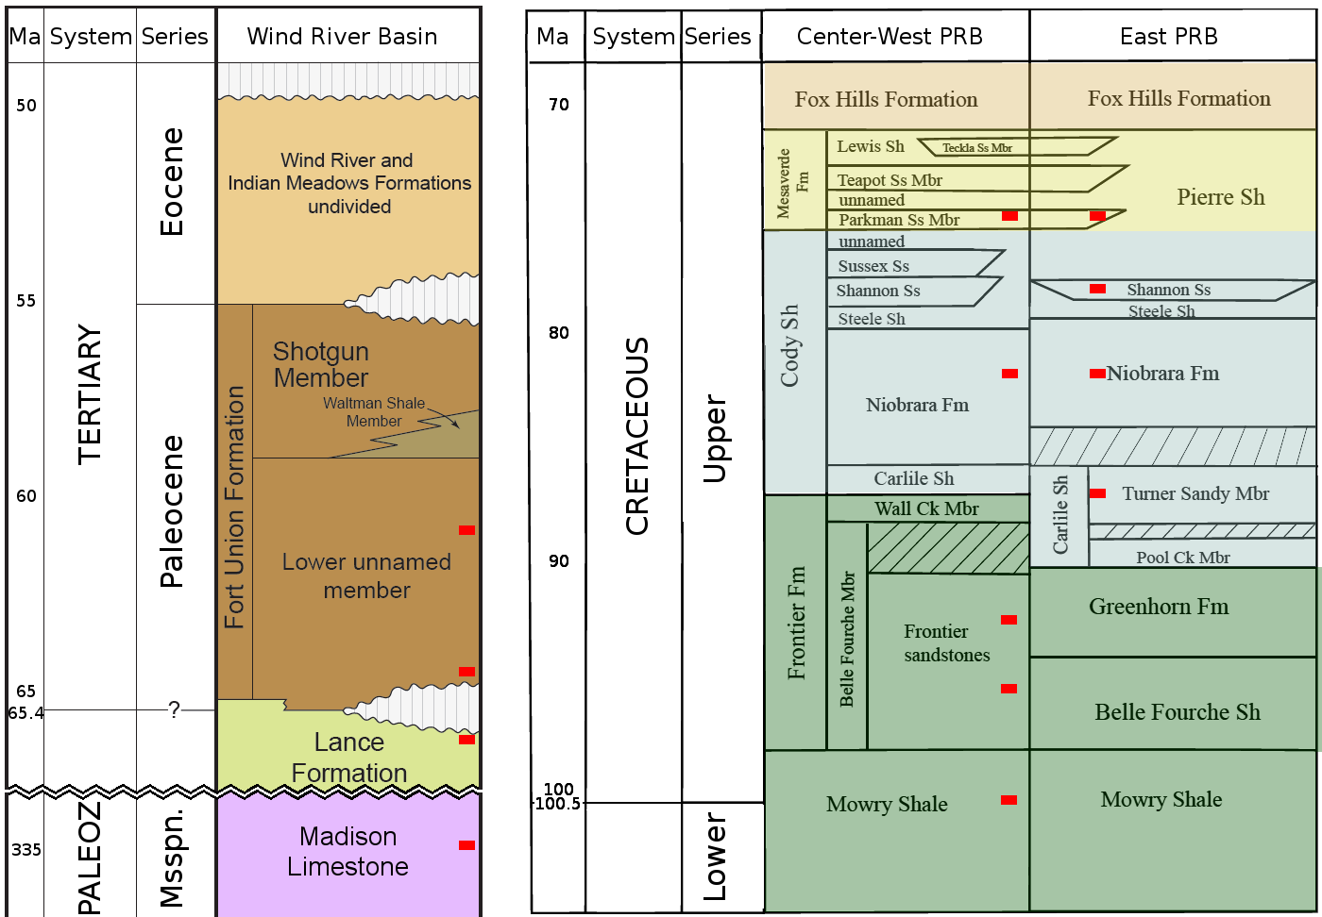
Strata
WRB:
Young-
Very Old
Shallow-
Deep
PRB:
East-
West

Slide 9
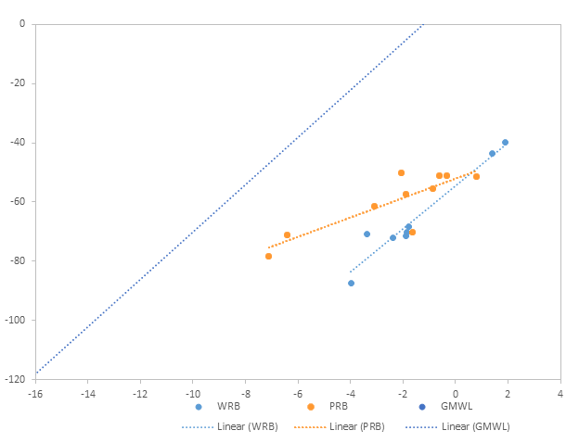
Isotopes: δD, δO¹⁸
Right of GMWL
δO¹⁸ isotopes heavy enriched
Prolonged Rxn with Rock
Non-Meteoric water

Slide 10
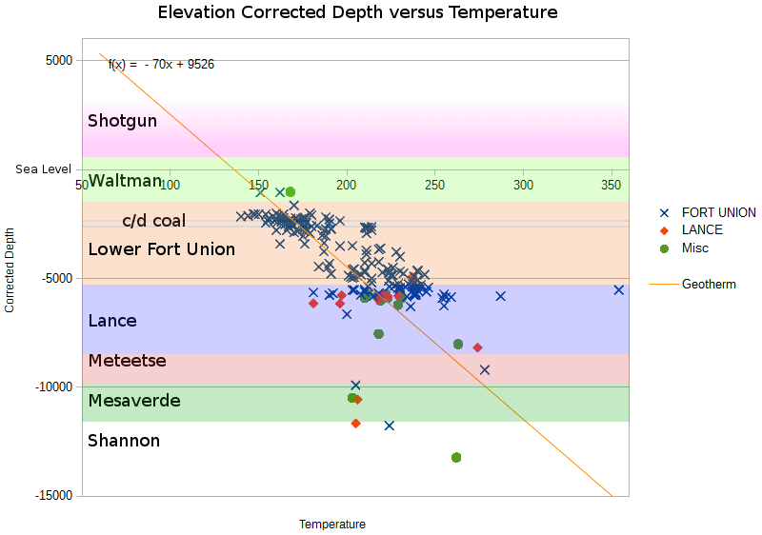
Heat in WRB
English BHT records
1°F/ 70ft
2 groups
Coal

Slide 11
How REE data are presented
Plot in F-block order
Saw-tooth
Normalize
Light REEs Middle REEs Heavy REEs

Slide 12
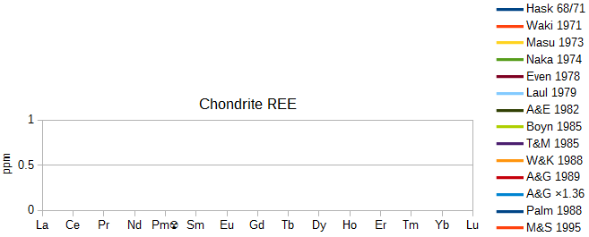
How REE data are presented
Plot in F-block order
Saw-tooth
Normalize

Slide 13
How REE data are presented
Plot in F-block order
Saw-tooth
Normalize

Slide 14
How REE data are presented
Plot in F-block order
Saw-tooth
Normalize
Sample/NASC
0 1 2

Slide 15
How REE data are presented
Plot in F-block order
Saw-tooth
Normalize
Sample/NASC
0 1 2

Slide 16
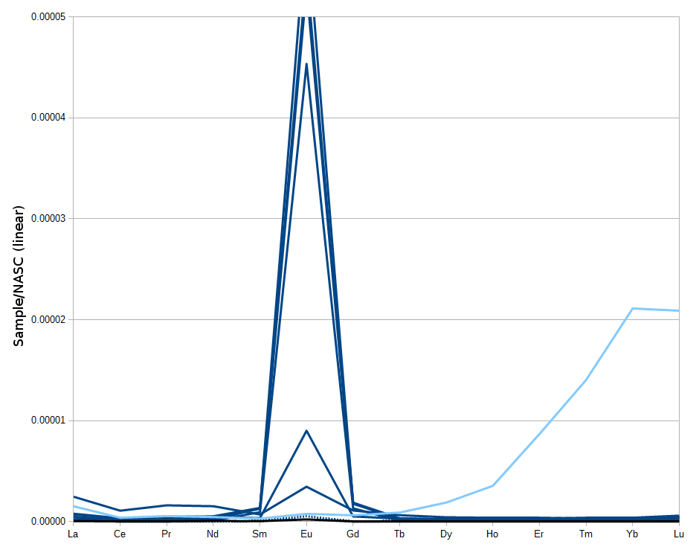
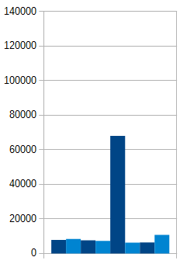
Basin REE
WRB:
175°C & 215°C
TDS
ppm majors
USDW

Slide 17
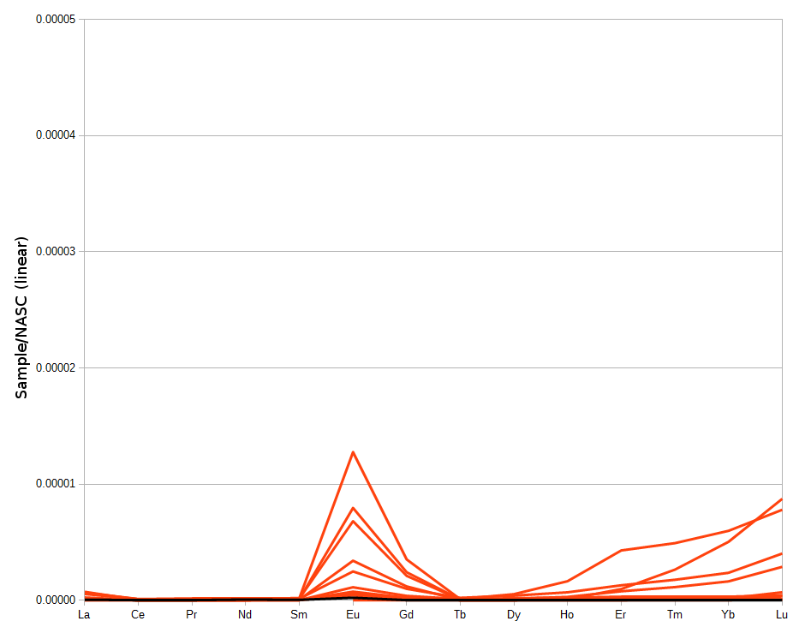
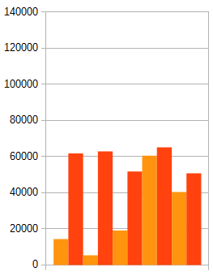
Basin REE
PRB:
115°C
TDS
ppm majors
USDW

Slide 18
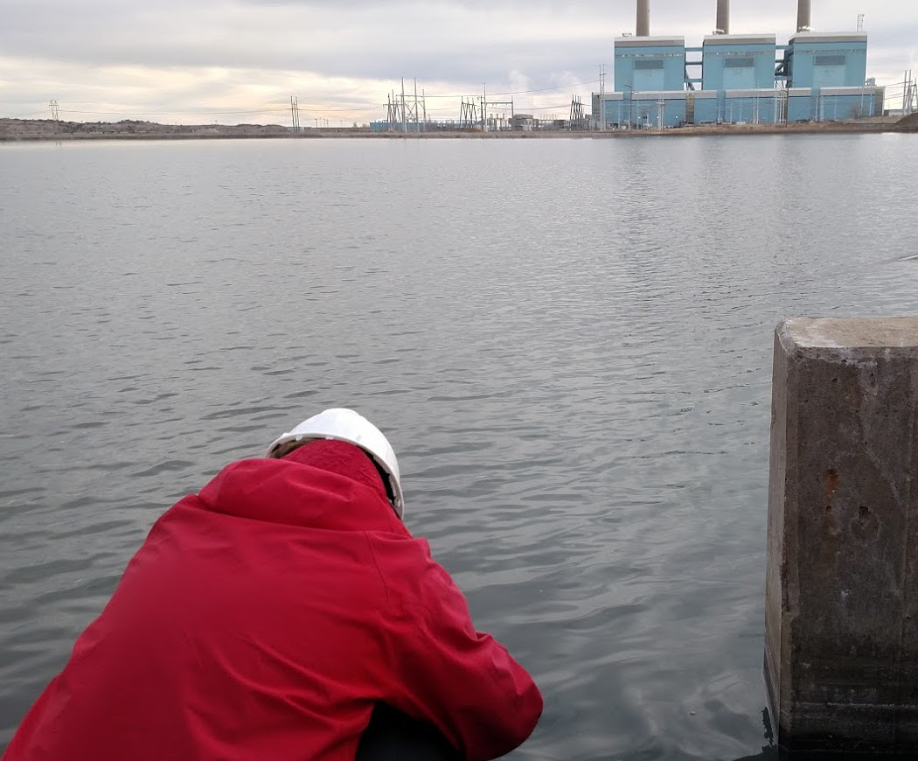
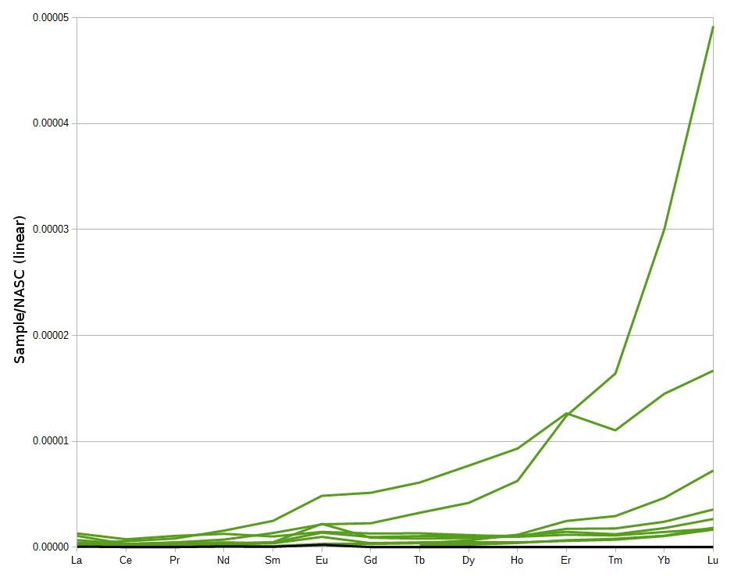
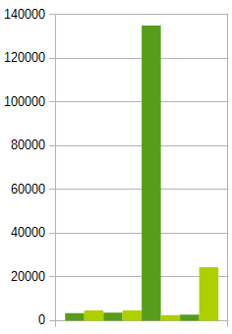
Basin REE
Ash-Ponds:
1270→300→20°C
TDS
ppm majors

Slide 19

Ligands
Migdisov et al 2016
ppm of:
Cl⁻ Br⁻ HCO₃⁻
ppt of:
total REE

Slide 20
Conclusions
REE exist in solution and can be measured
δO¹⁸ isotopes show prolonged rock interaction
Geothermal gradient may be high due to coal
Each study area has a unique signature:
Eu - WRB, Gd - PRB, HREE - Ash Ponds
Produced water have local HREE behavior
Total REE in wells may relate to ligands
Role of depositional environment

Slide 21




Acknowledgements
Funding sources:
DOE: EERE
State of Wyoming
Team Members:
Carbon Management
Institute

Slide 22
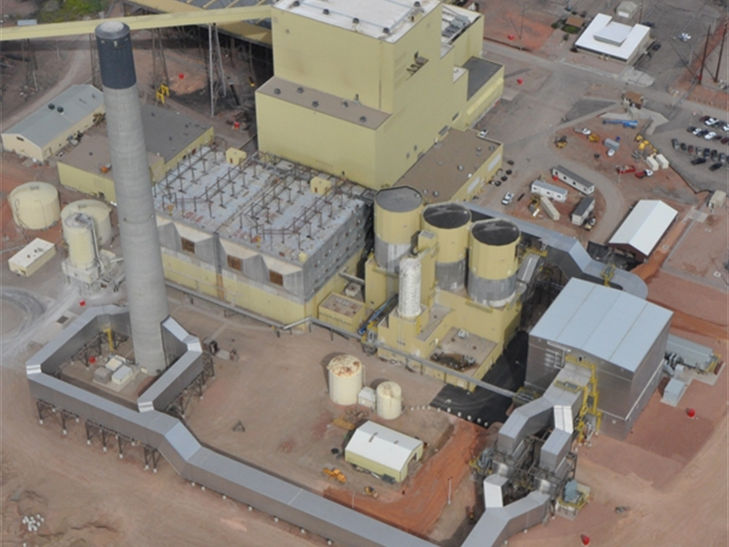
Questions? Comments?
New project
More data collection
Guidance?

Slide 23
Ref
Chu, Steven.: Critical Materials Strategy, Department of Energy, Office of International Affairs, Washington, DC (2011). Accessed from: https://energy.gov/sites/prod/files/DOE_CMS2011_FINAL_Full.pdf (December, 2016)
Clark, Ian, and Peter Fritz, 1997, Environmental isotopes in hydrogeology: Boca Raton, Fla., Lewis Publishers.
Hatje, Vanessa, Bruland K., and Flegal A. R.“Increases in Anthropogenic Gadolinium Anomalies and Rare Earth Element Concentrations in San Francisco Bay over a 20 Year Record” Environmental Science & Technology 2016 50 (8), 4159-4168 DOI: 10.1021/acs.est.5b04322
McLennan, S. M. (2001), Relationships between the trace element composition of sedimentary rocks and upper continental crust, Geochem. Geophys. Geosyst., 2, 1021, doi:10.1029/2000GC000109.
Migdisov A., A.E. Williams-Jones, J. Brugger, F.A. Caporuscio. (2016) Hydrothermal transport, deposition, and fractionation of the REE: experimental data and thermodynamic calculations. Chemical Geology, 439, pages 13–42. http://dx.doi.org/10.1016/j.chemgeo.2016.06.005

