Slide 1
A New Wyoming Basin Produced Waters REE Normalization and Its Application
Charles NYE, Davin BAGDONAS, Scott QUILLINAN
Carbon Management Institute, University of Wyoming
In collaboration with INL

Slide 2
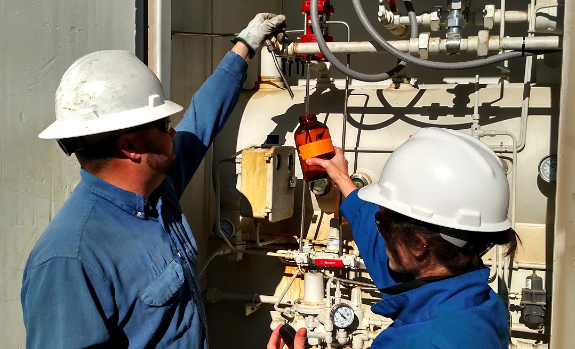
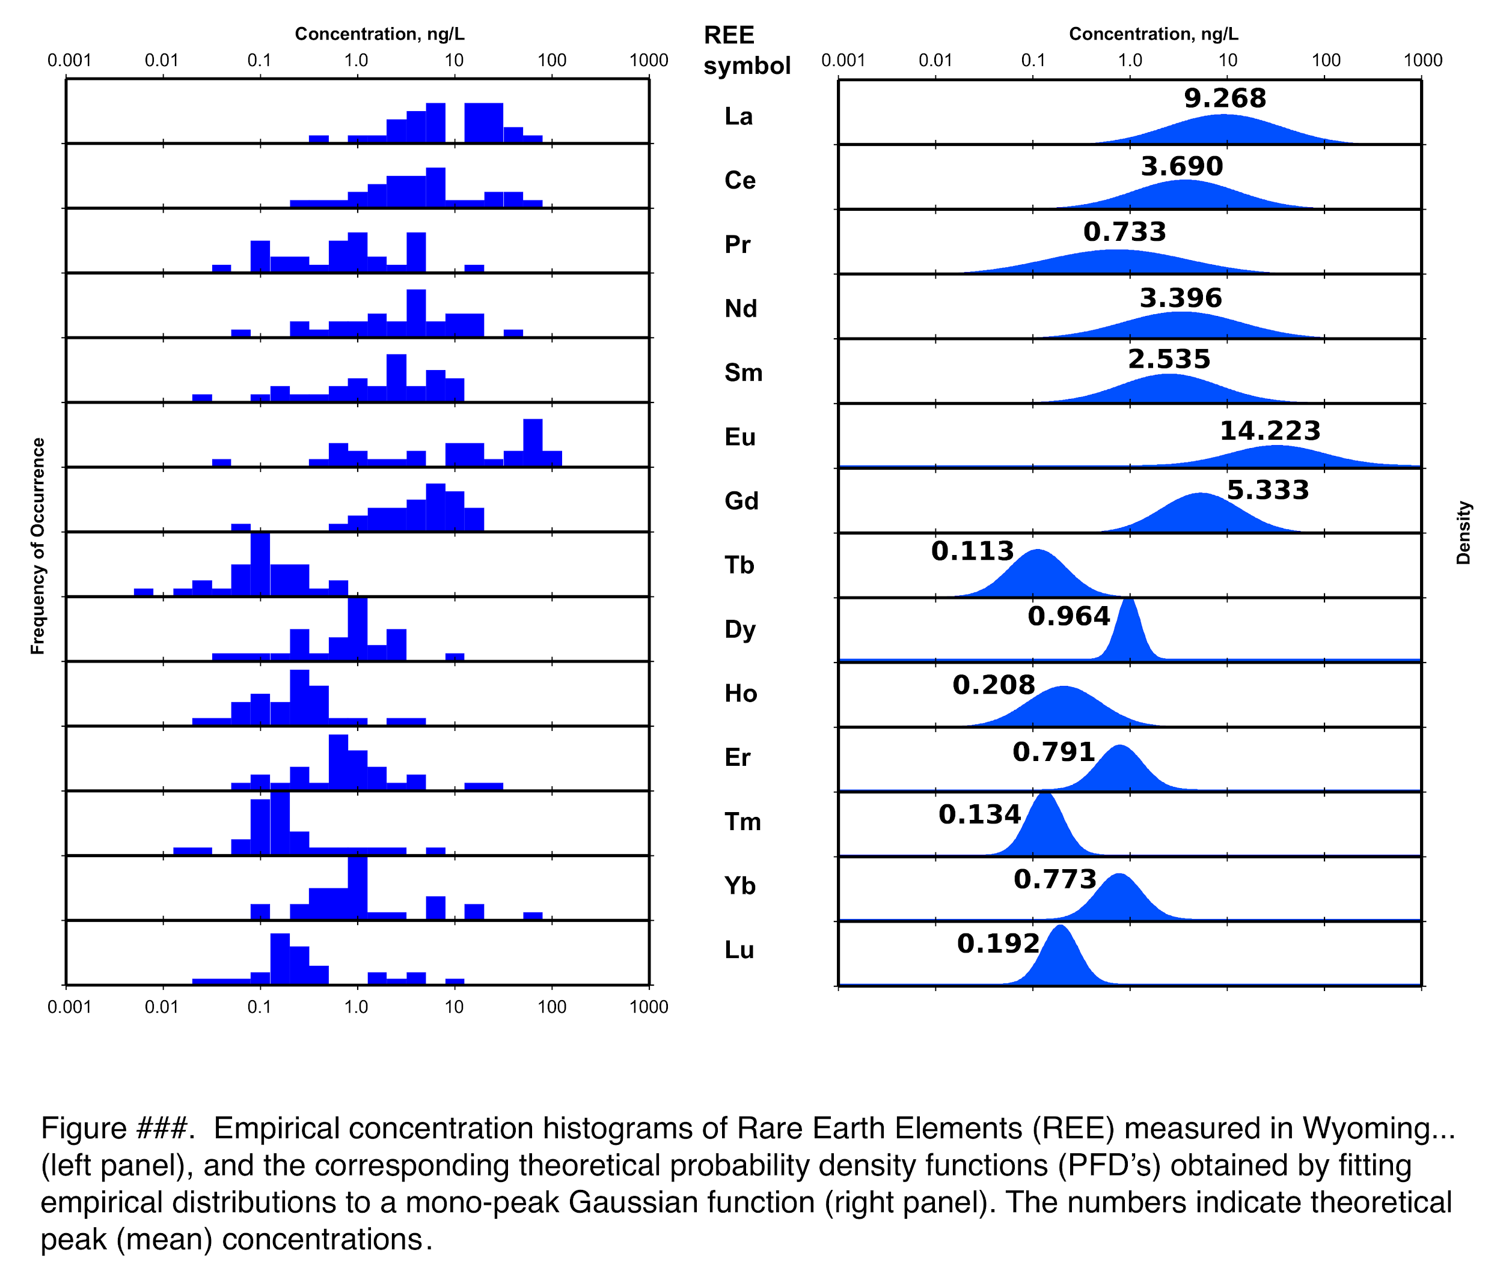
Outline
Project Areas: National and 4 Wyoming basins
How REEs are presented
The case for a new normalization (WBPW)
Using WBPW:

Slide 3
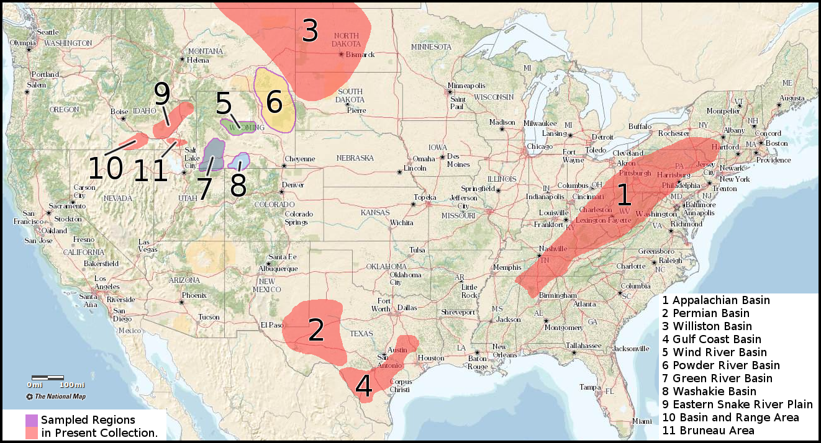
REE Work
N ≈ 150

Slide 4
Study Area
N = 38+
Wind River Basin
Powder River Basin
Washakie Basin
Green River Basin
<31mS, pH 9.5-6.2, <65°C, -244/295mV Redox,
7,000/25,000 ft depth

Slide 5
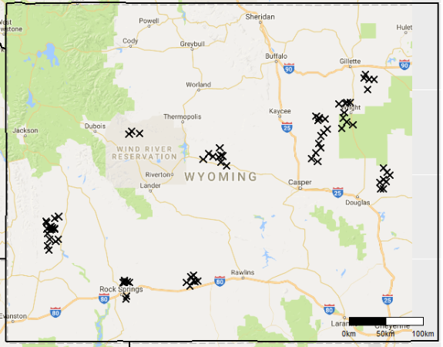
Study Area
N = 80+
Wind River Basin
Powder River Basin
Washakie Basin
Green River Basin
Mix of Core and Cuttings

Slide 6
REEs
by Raytheon
by Paul Anderson
14 f-block elements
Y & Sc included makes “REEY”
Similar chemical behavior
Many difficult-to-substitute applications

Slide 7
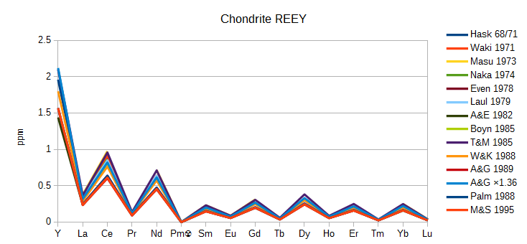
Normalization
Saw-tooth distracts
Small ratios/diff
Human eye
Yttrium
Promethium ☢

Slide 8
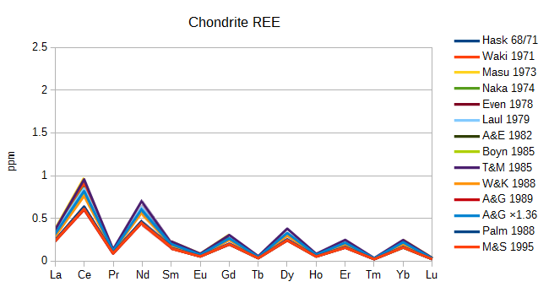
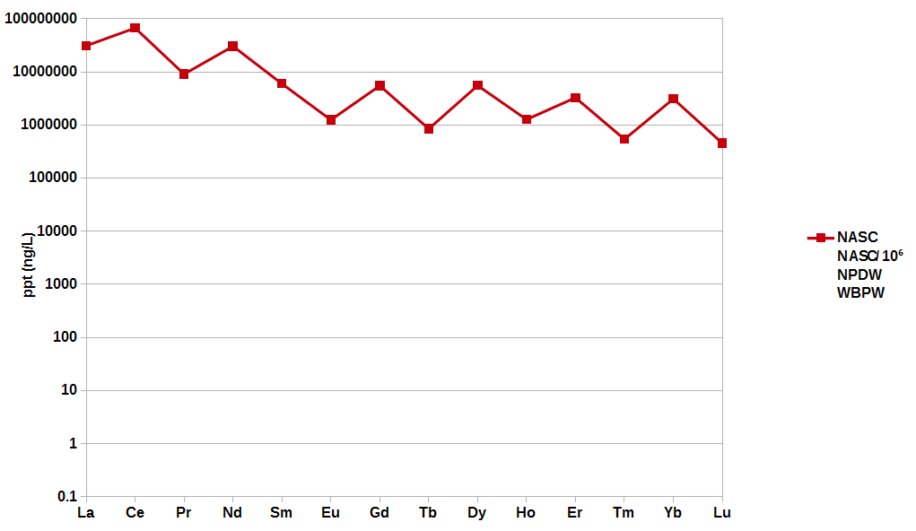
Normalization
Saw-tooth distracts
Small ratios/diff
Human eye
Yttrium
Promethium ☢

Slide 9
Normalization
NASC: good for rocks

Slide 10
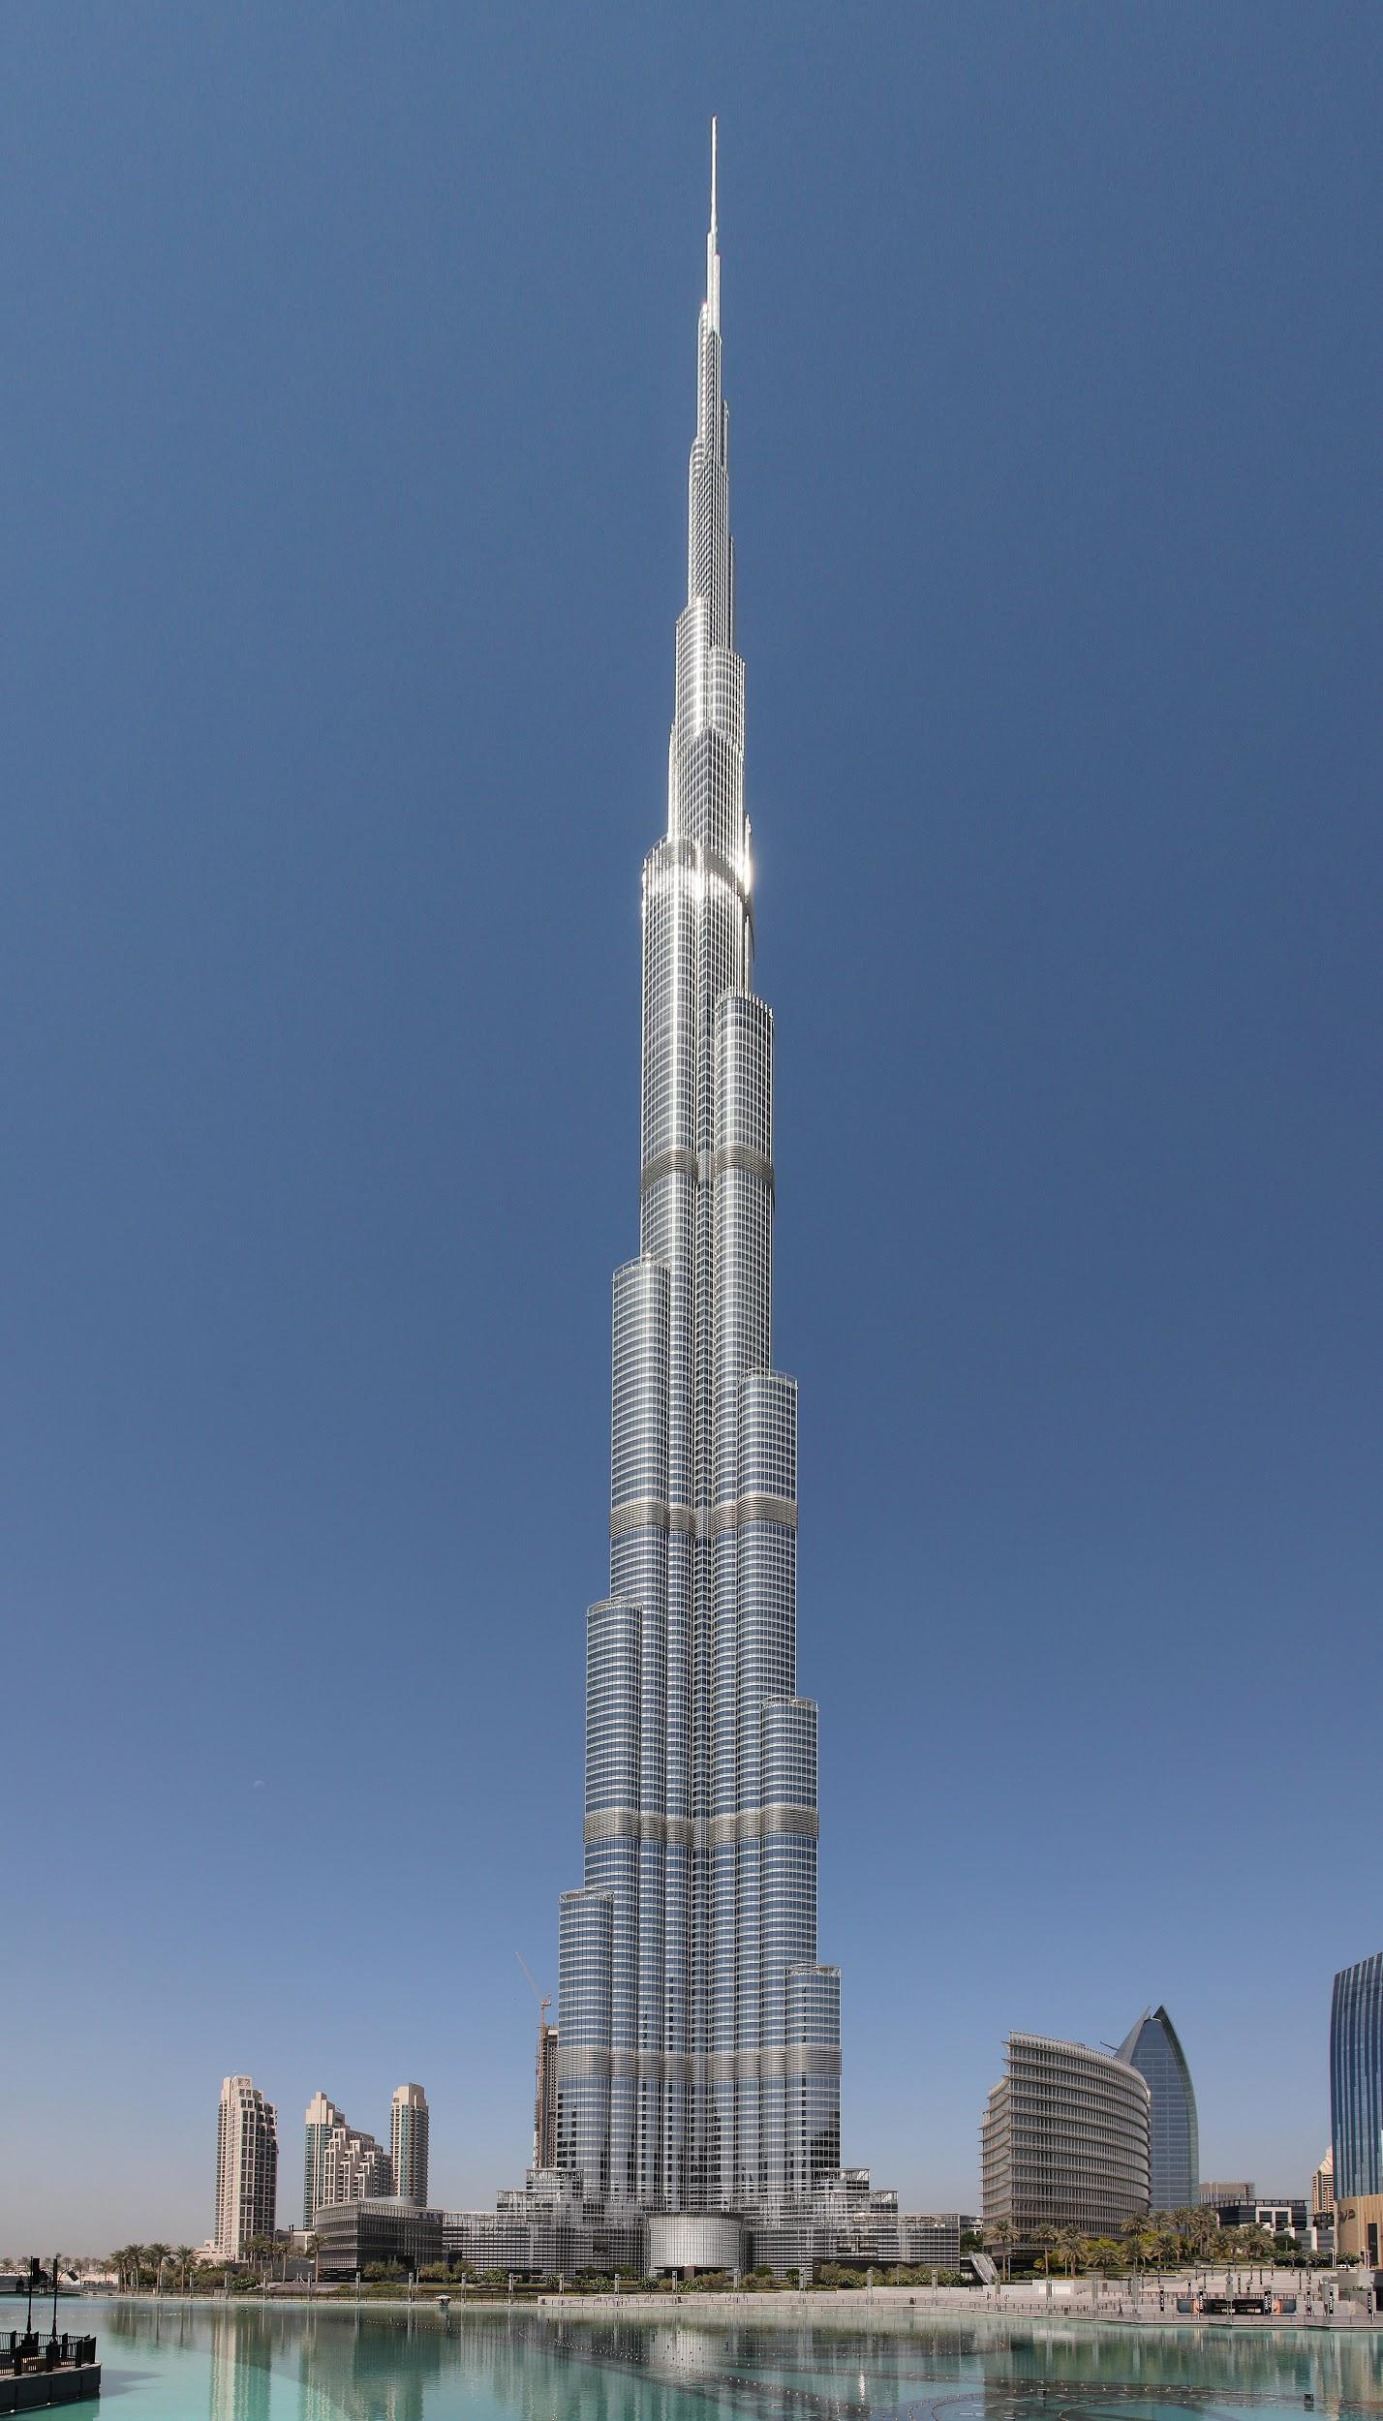
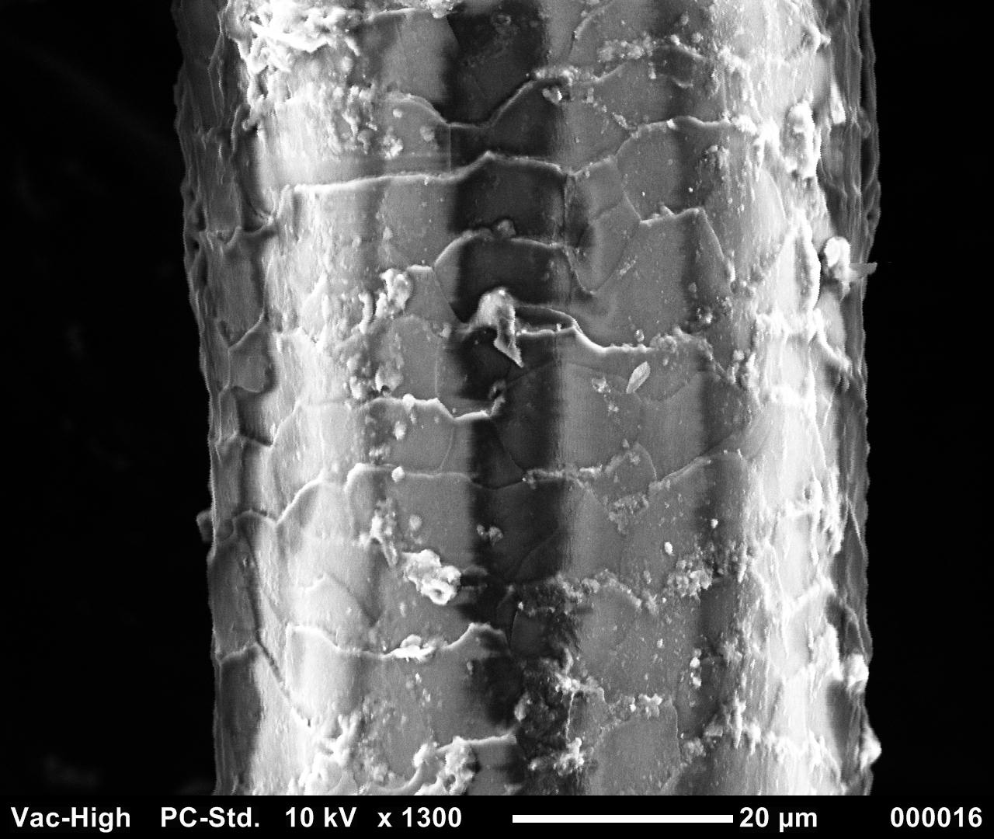
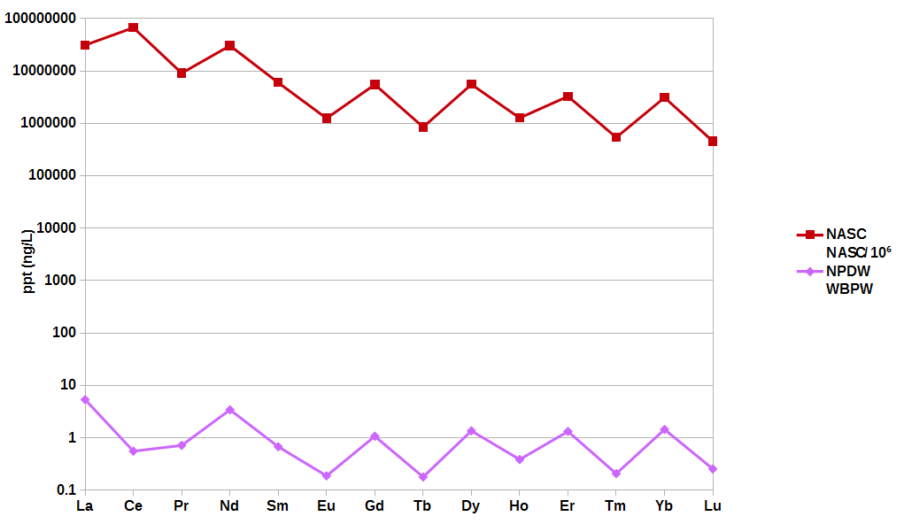
Normalization
NASC: good for rocks
NPDW: good for water
by Donald Tong
by Brian Ley

Slide 11
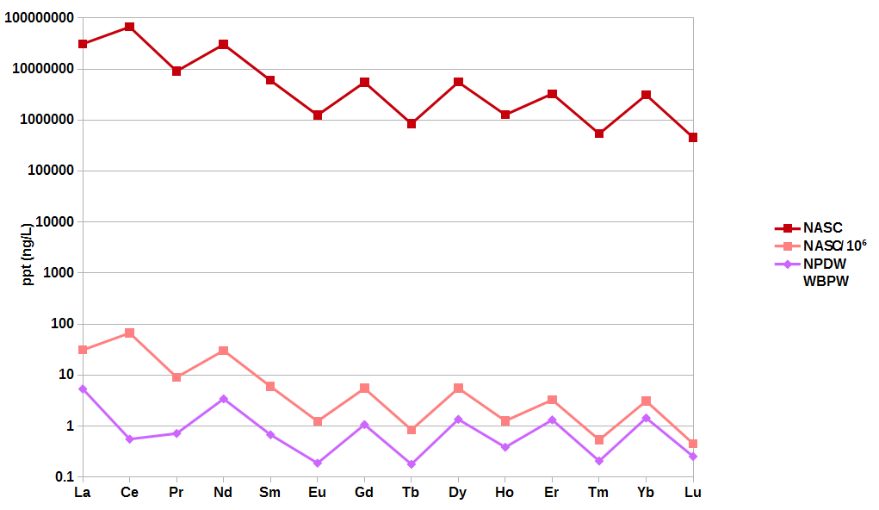
Normalization
NASC: good for rocks
NPDW: good for water
NASC*10⁻⁶: ?works?

Slide 12
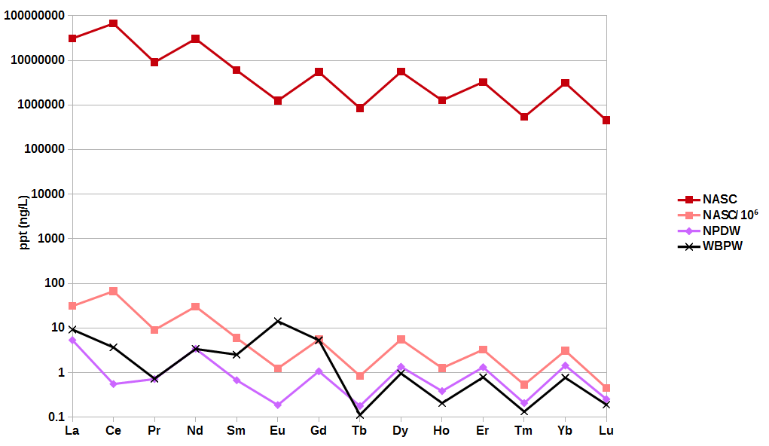
Normalization
NASC: good for rocks
NPDW: good for water
NASC*10⁻⁶: ?works?
WBPW: New structure

Slide 13
Normalization
#1
#2
#3
N = 38

Slide 14
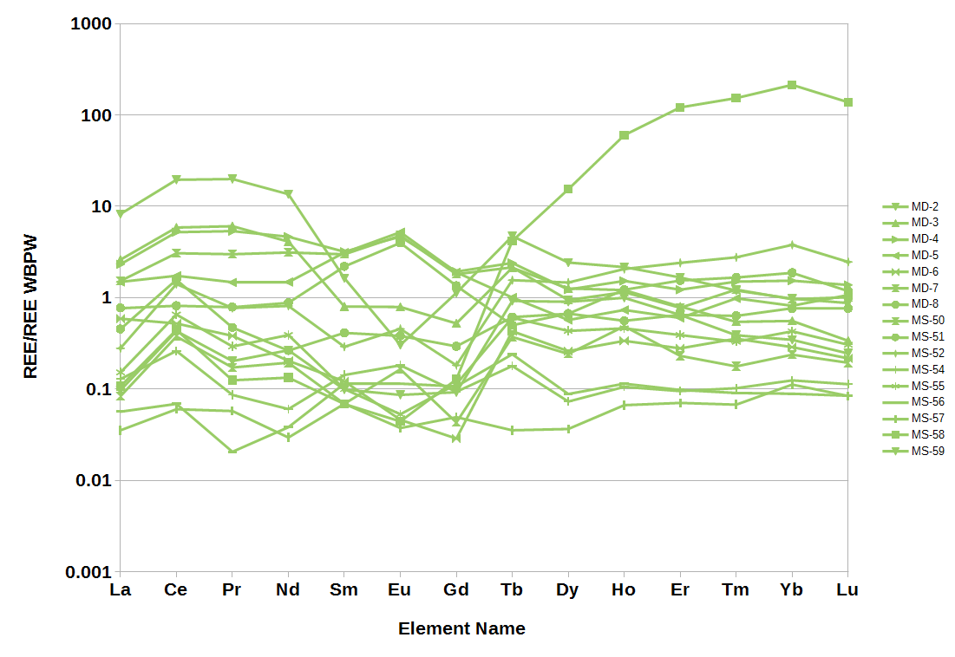
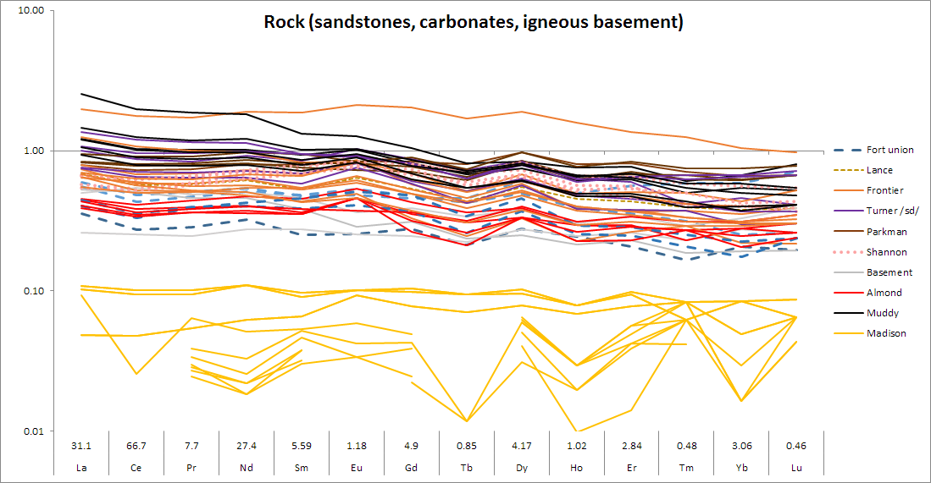
Data Comparison
Wind River
Fort Union, Lance, MesaVerde, Cody:
Clastic signature inherited from rock inherited from parent rock
Cody (58) has HREE contribution.

Slide 15
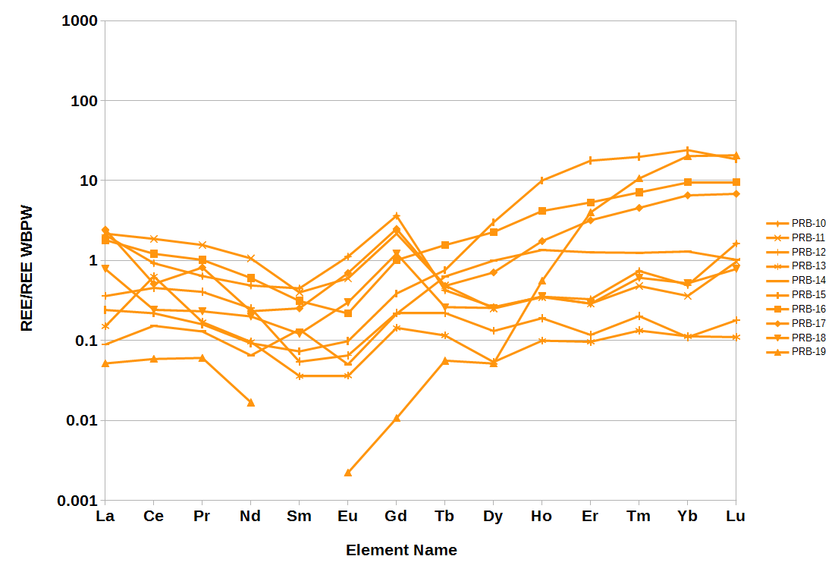
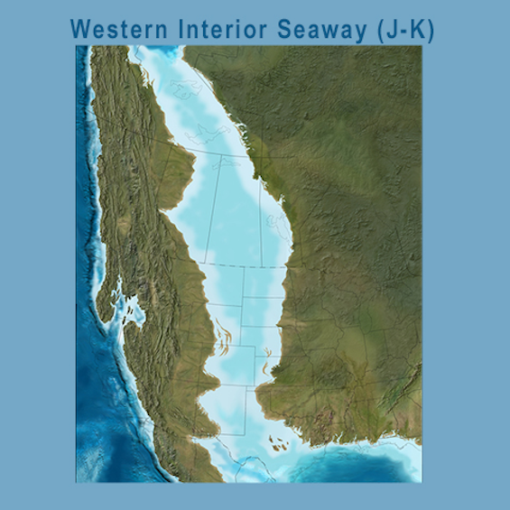
Data Comparison
Powder River
The four HREE enriched samples have a significant shale fraction.
Cannonball sea was persistent in this area.
Could also explain Gd
by Ron Blakey

Slide 16
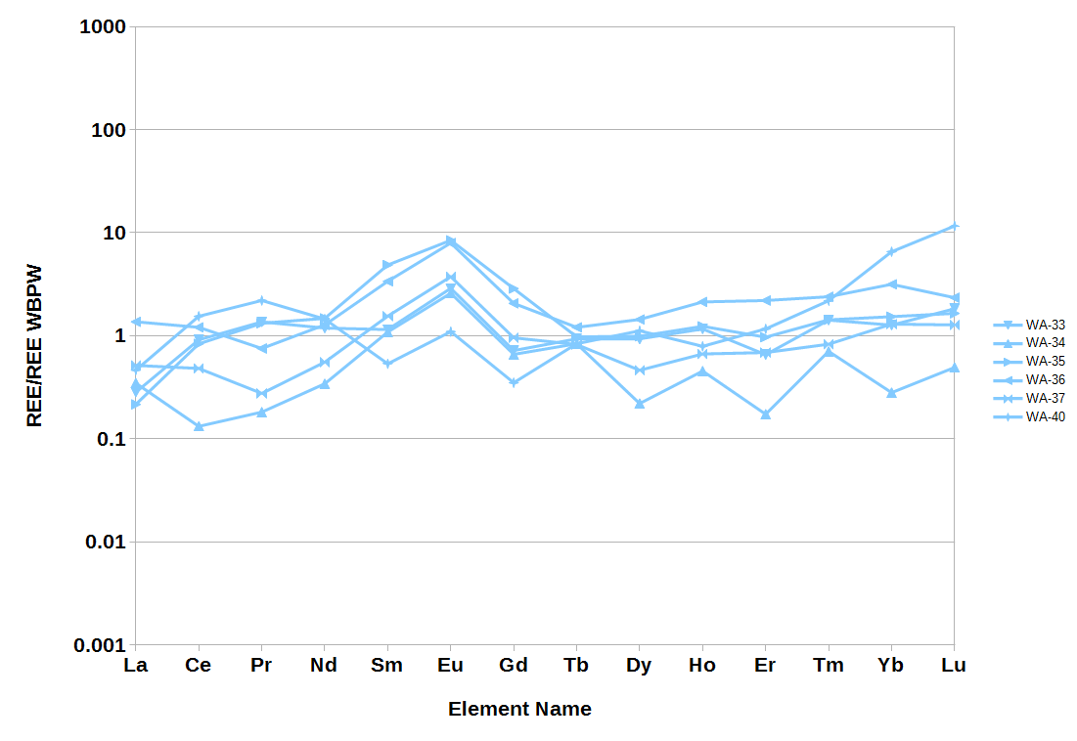
Data Comparison
Washakie
All from Lewis-Almond (regular)
Eu normally => Ca minerals but rock is low Ca
May be reducing conditions: Water ORP and Rock V enrichment

Slide 17
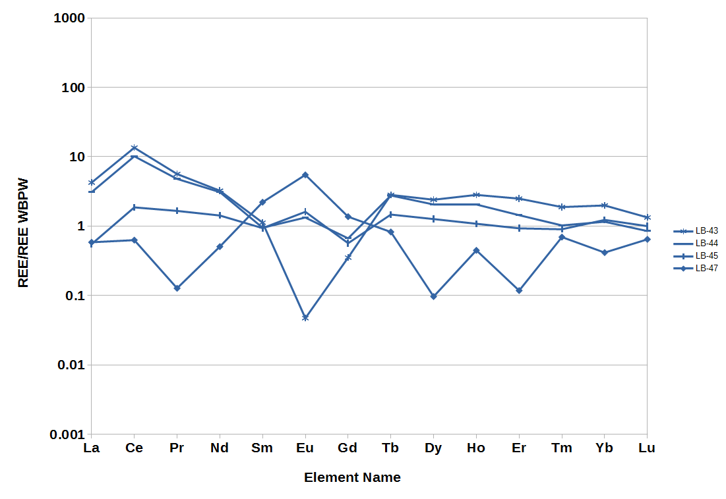
Data Comparison
Green River
Frontier-baxter & Muddy(44)
Poor conformance
Tank sampling, Iron co-precipitation?

Slide 18
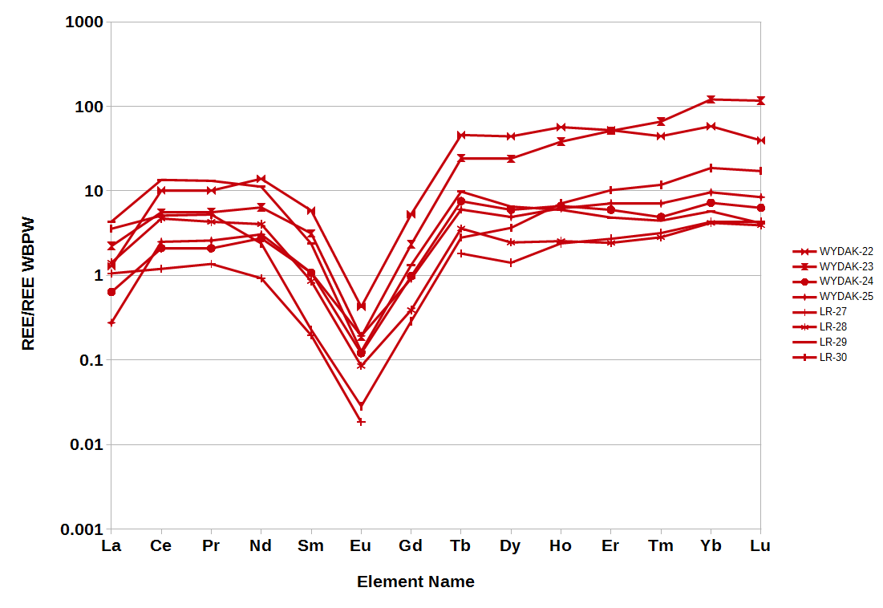
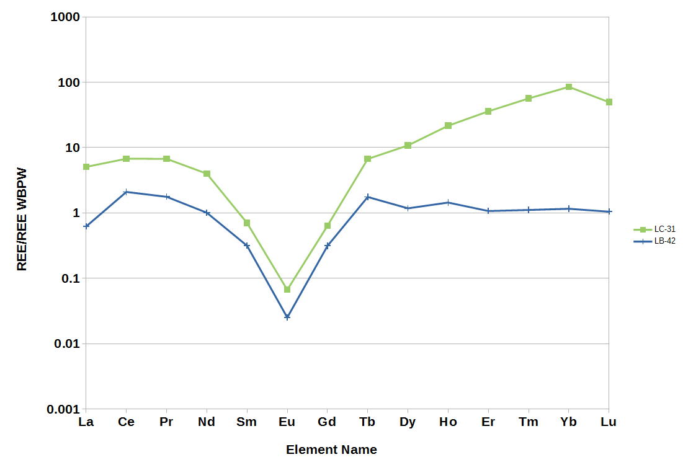
Data Comparison
Industrial
Scrubber adds lime, carbonate signature

Slide 19
Data Comparison
Carbonates
Low Rock REE, little Eu added to water.
WRB HREE could be a basement signature (hydrothermally altered cuttings)

Slide 20
Theoretical Model
We propose two 2-by-2 matrices:
An open system, and a closed system

Slide 21
Conclusions
REE exist in solution and can be measured (ppt)
Each study area has a unique signature.
Gd is unique to PRB, samples from ND needed
In produced waters HREE behavior may be local
Ligand relationship not yet described
Role of depositional environment (cannonball sea)

Slide 22
Acknowledgements
Funding sources:
DOE: EERE
State of Wyoming
Team Members:
Carbon Management
Institute

Slide 23
Ref
Chu, Steven.: Critical Materials Strategy, Department of Energy, Office of International Affairs, Washington, DC (2011). Accessed from: https://energy.gov/sites/prod/files/DOE_CMS2011_FINAL_Full.pdf (December, 2016)
Clark, Ian, and Peter Fritz, 1997, Environmental isotopes in hydrogeology: Boca Raton, Fla., Lewis Publishers.
Hatje, Vanessa, Bruland K., and Flegal A. R.“Increases in Anthropogenic Gadolinium Anomalies and Rare Earth Element Concentrations in San Francisco Bay over a 20 Year Record” Environmental Science & Technology 2016 50 (8), 4159-4168 DOI: 10.1021/acs.est.5b04322
McLennan, S. M. (2001), Relationships between the trace element composition of sedimentary rocks and upper continental crust, Geochem. Geophys. Geosyst., 2, 1021, doi:10.1029/2000GC000109.
Migdisov A., A.E. Williams-Jones, J. Brugger, F.A. Caporuscio. (2016) Hydrothermal transport, deposition, and fractionation of the REE: experimental data and thermodynamic calculations. Chemical Geology, 439, pages 13–42. http://dx.doi.org/10.1016/j.chemgeo.2016.06.005

