Slide 1
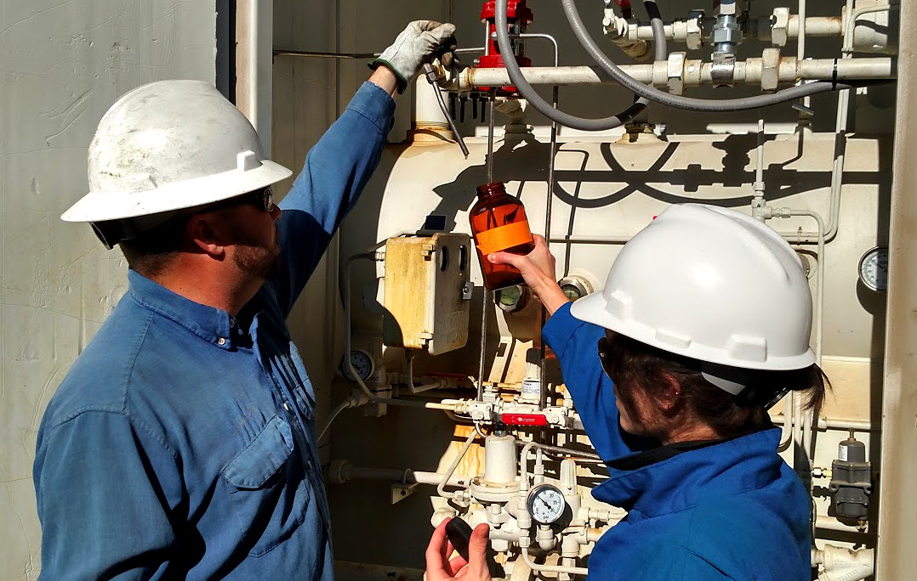
A Nationwide Study of REEs in
Geothermal and Produced Waters: Final Results
DOE Project Number: EE0007603
Charles Nye (UW), Ghanashyam Neupane (INL), Scott Quillinan (UW)
February 11, 2019
Image from Scott Quillinan

Slide 2
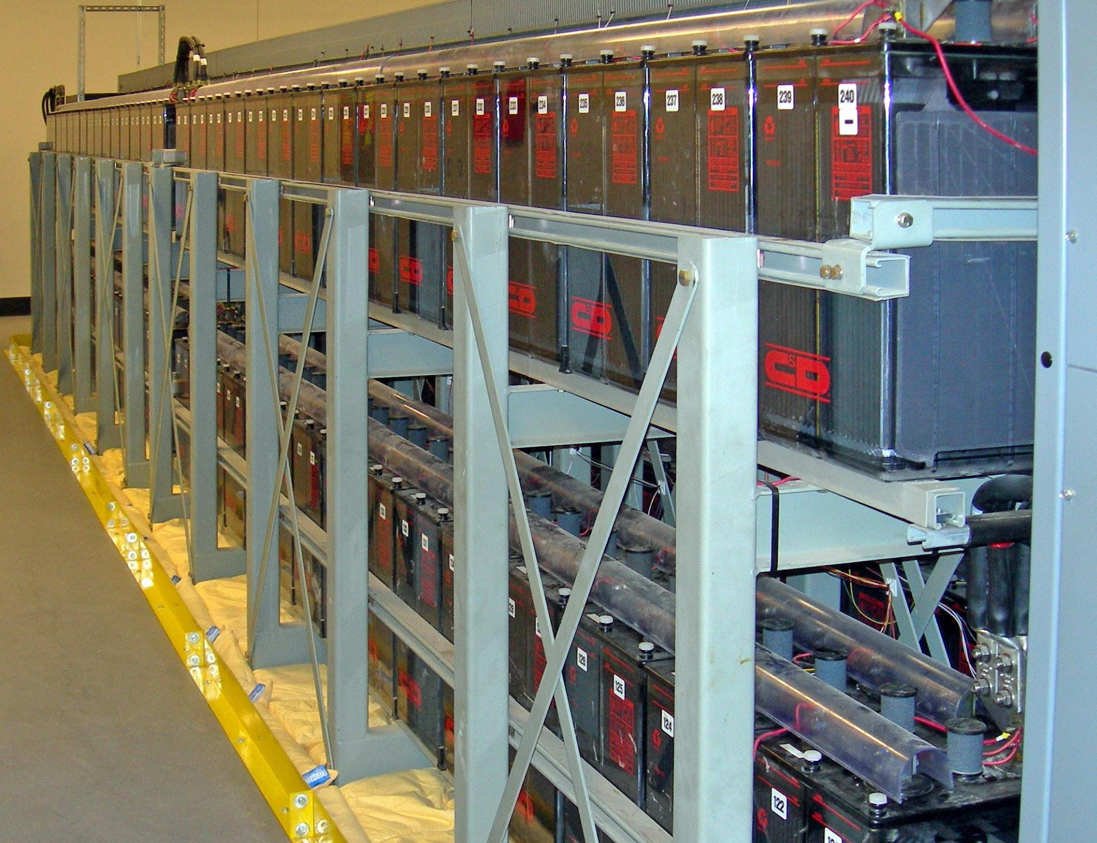
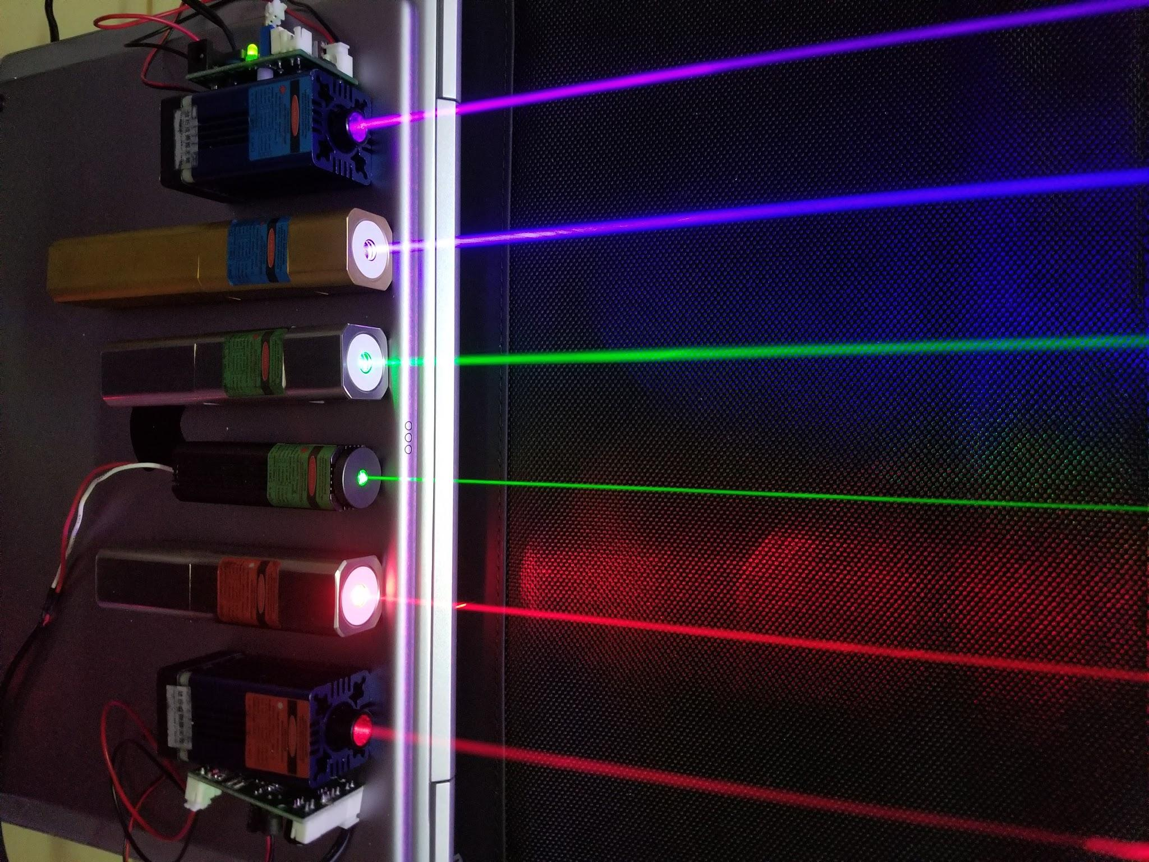

Project Motivation
Rare earth elements (REEs) play a critical role in the move towards 100% renewable energy portfolios.
While these elements have a growing strategic importance in our daily lives an economic domestic resource does not exist.
In addition to the lack of domestic resources, we recognize that another domestic challenge is the management and disposal of brines co-produced alongside oil and gas.
Images from Wikipedia [1] [2] [3]

Slide 3
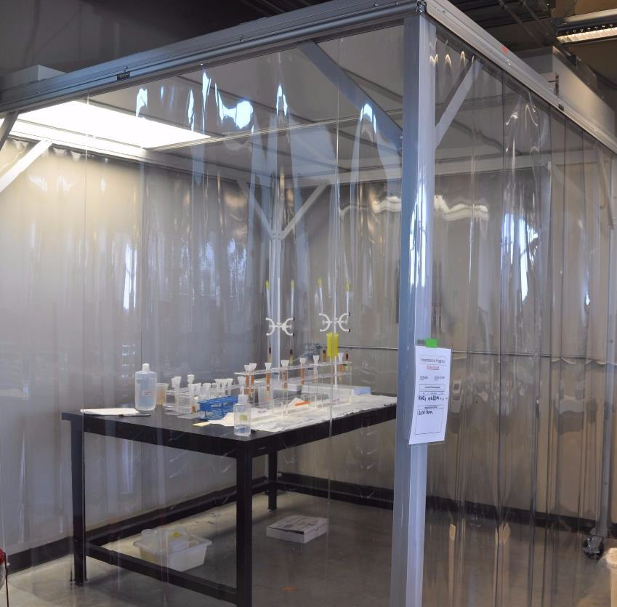
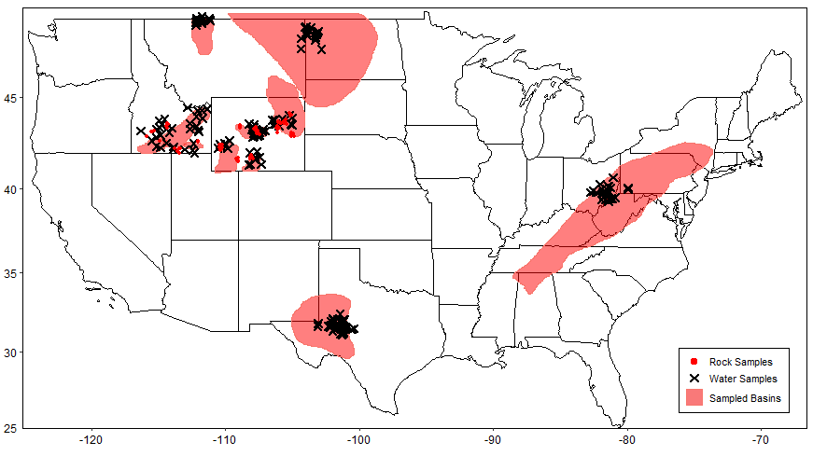
Project Goals
Contribute to a national database of rare earth element and high value materials in oil and gas produced waters and other geothermal waters
Refine methodologies for REE analysis in highly saline fluids
Develop a statistical screening tool for geologic prospecting
Techno-economic assessment
224=N_{water}
83=N_{rock}
Images from Hari Neupane
and Tom Moore

Slide 4
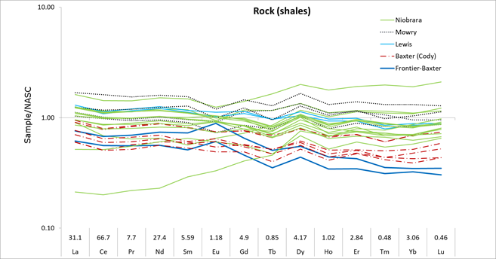
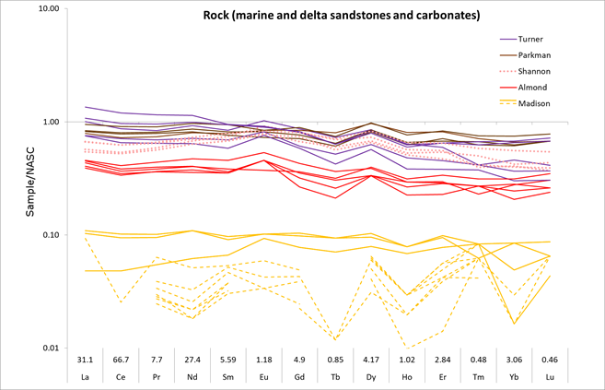
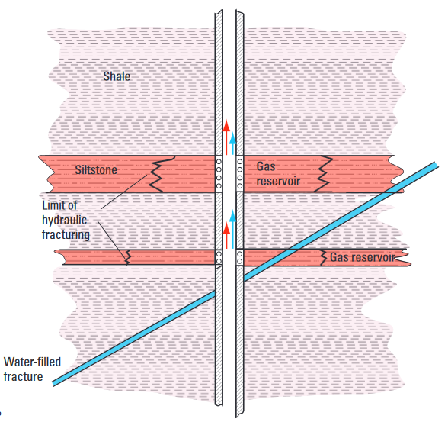
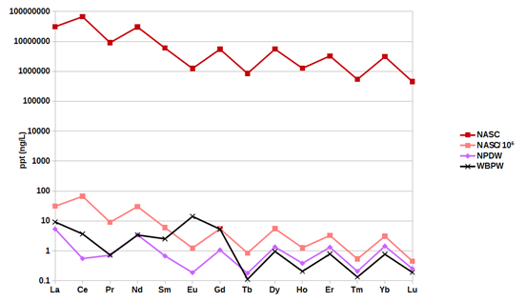
Ad Hoc Results
Carbonate Rocks contain little or no REEs
Serendipitous support for Nealson et al., (2009)
Continental REEs are unlike existing rock (NASC) and ocean (NPDW) normalizations
Images from Davin Bagdonas, Mark Engle, and Charles Nye

Slide 5
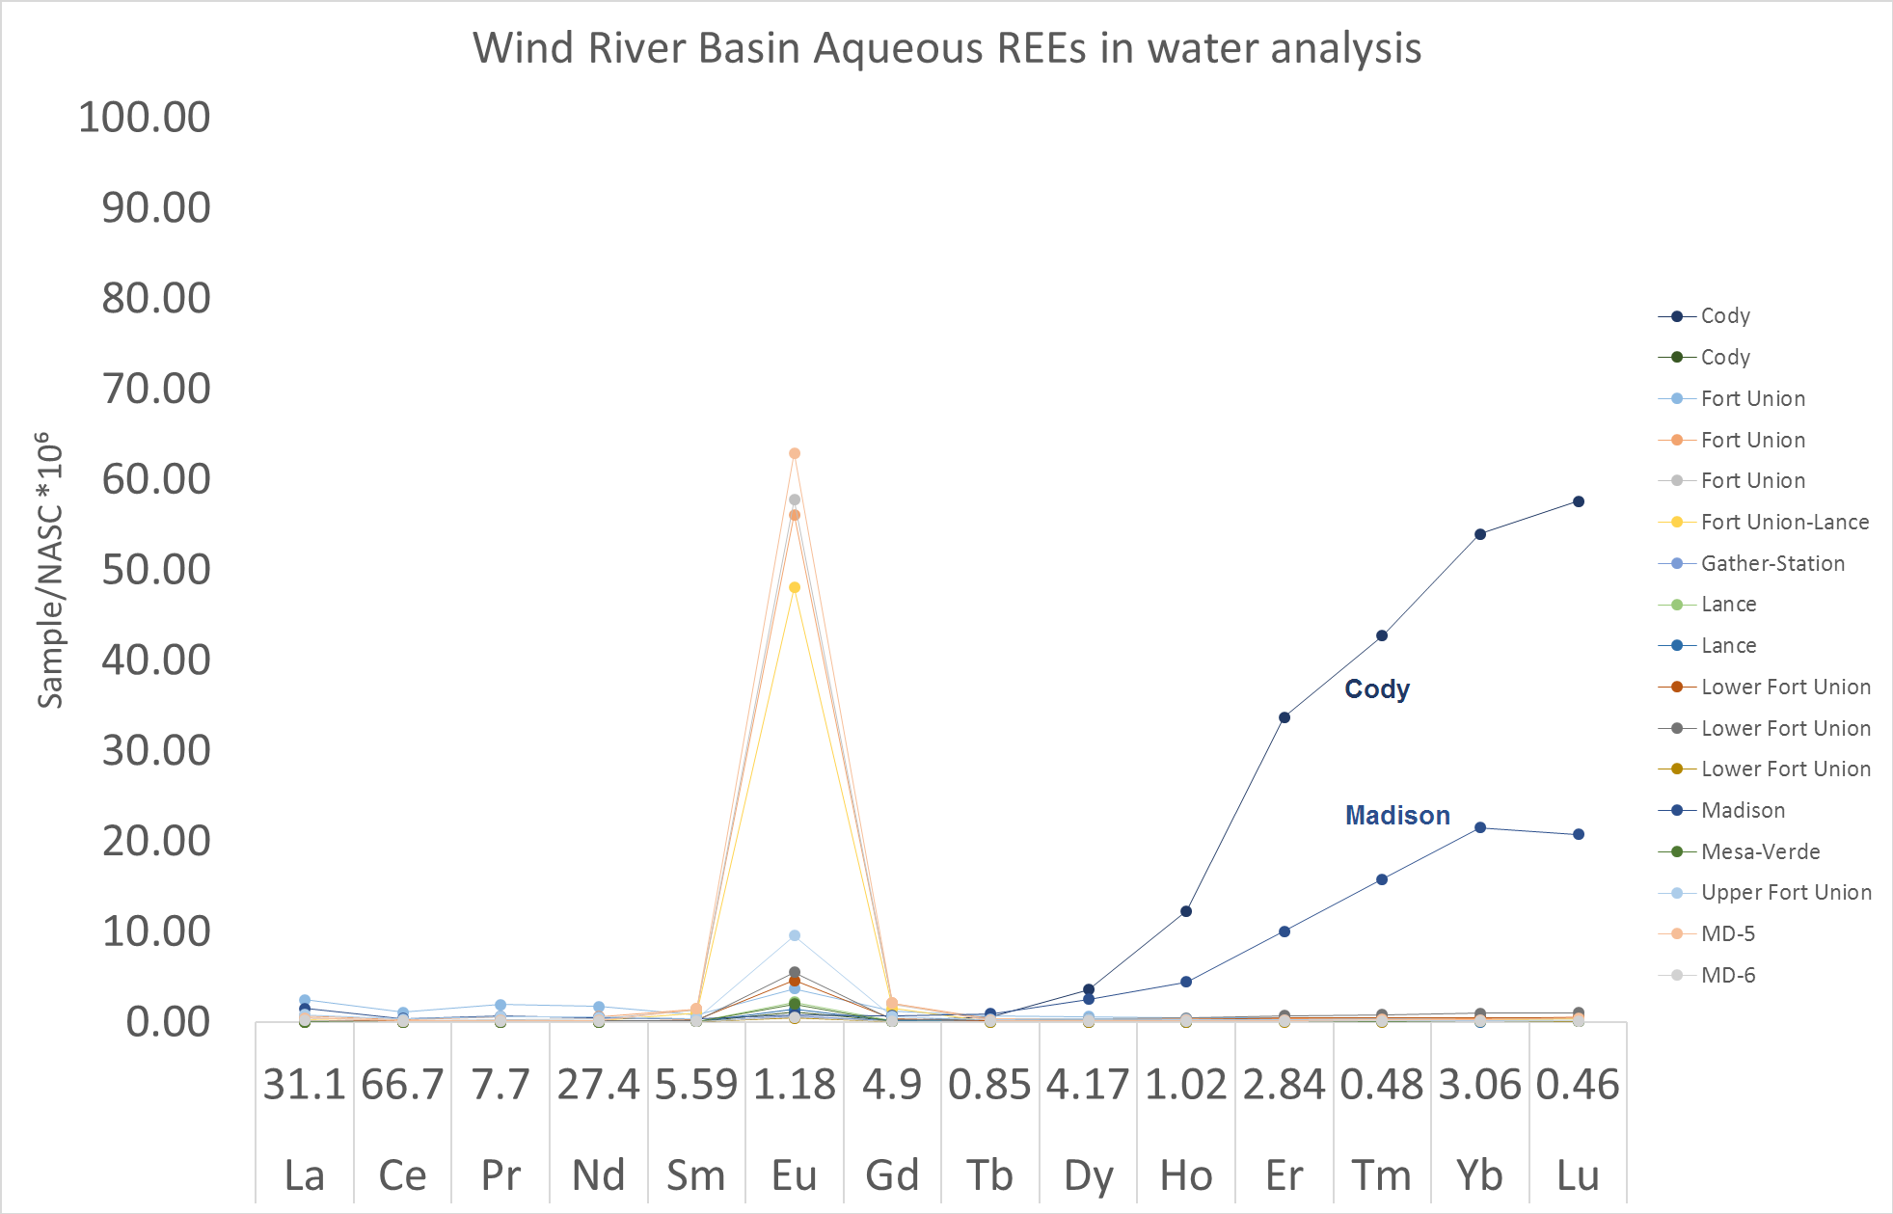
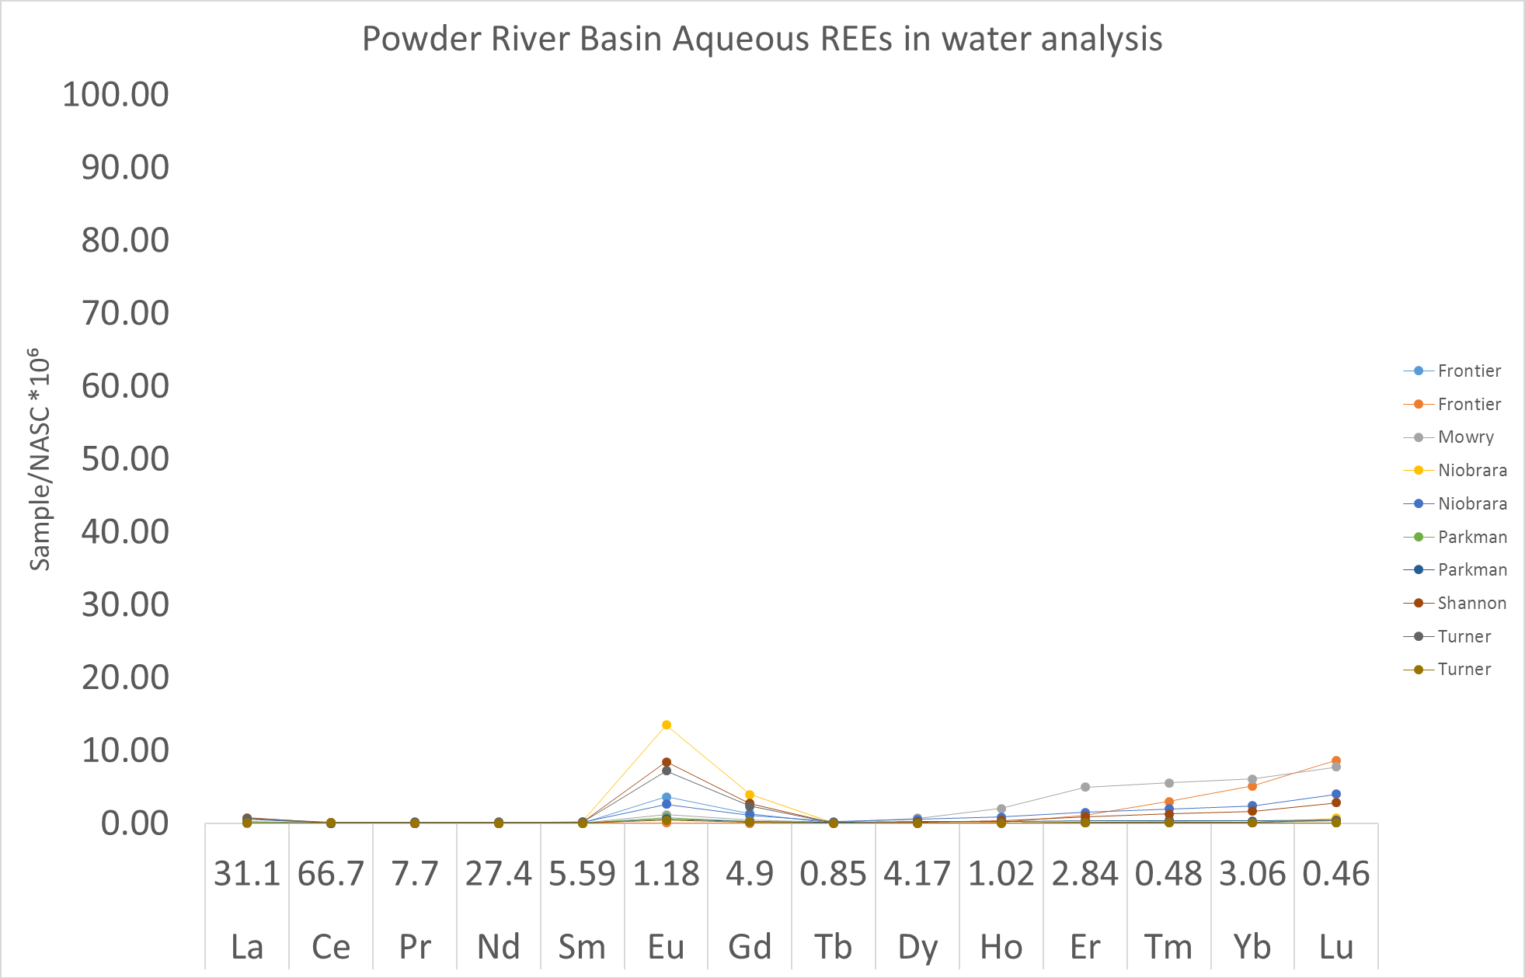
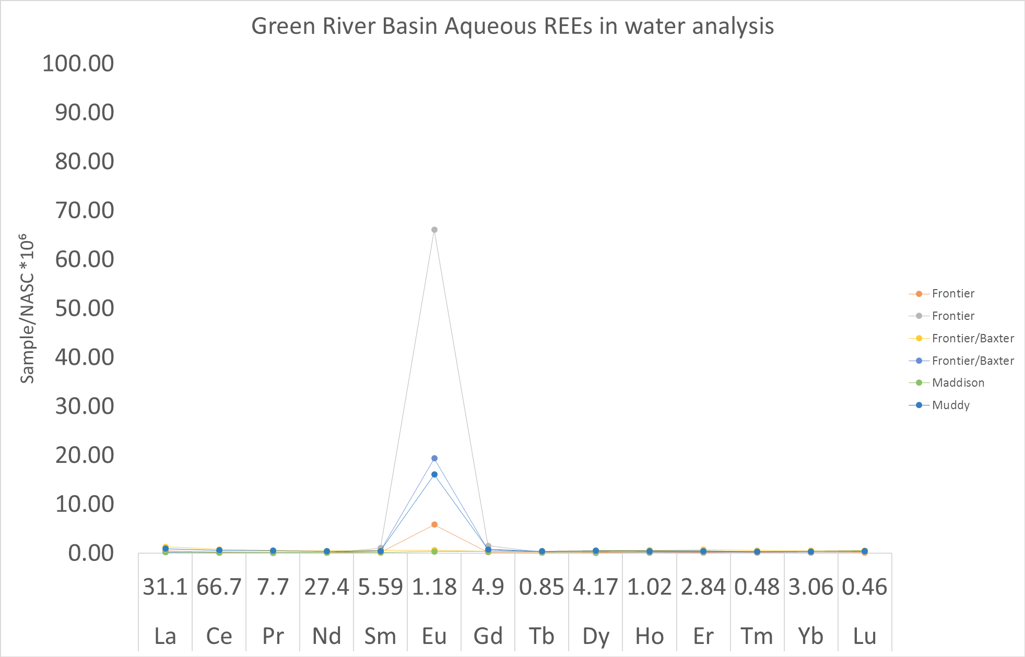
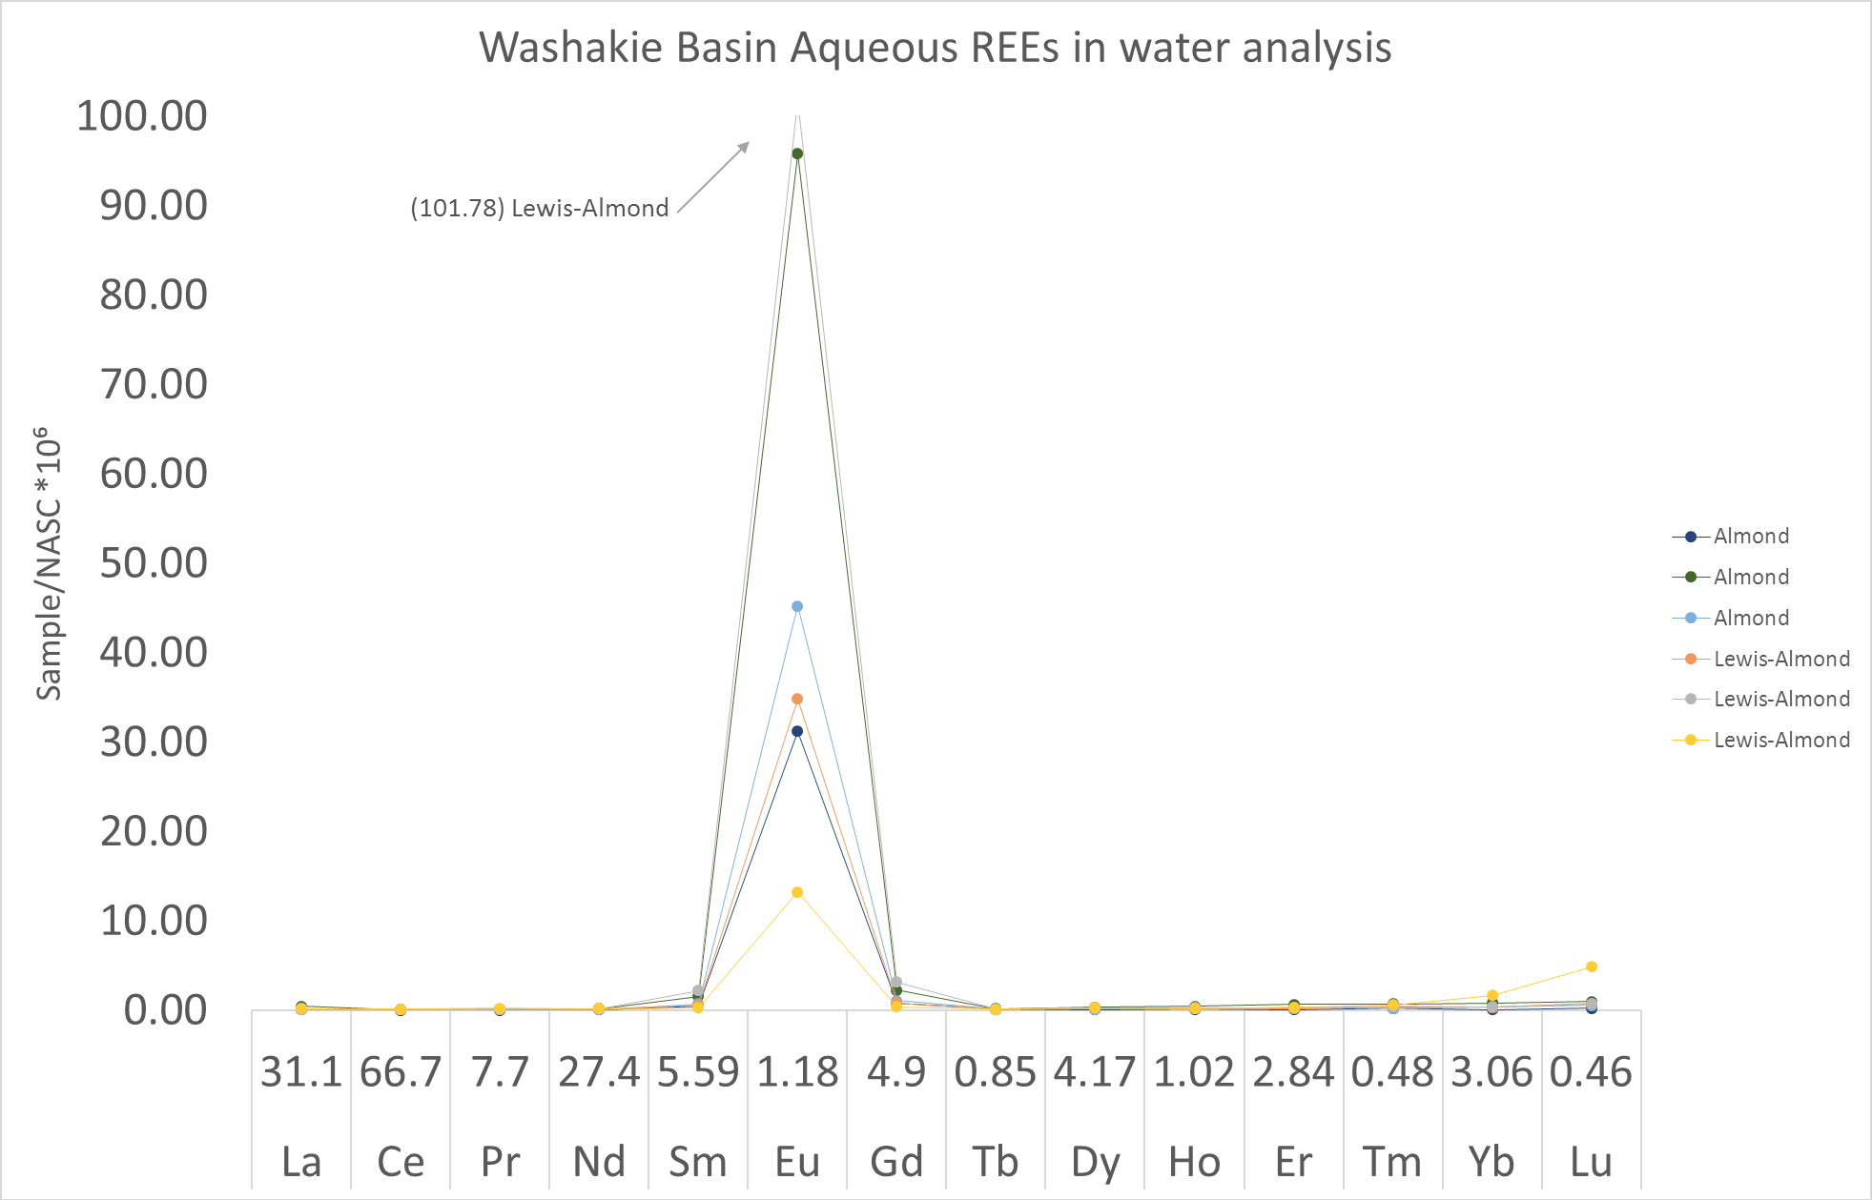
Images from Charles Nye

Slide 6
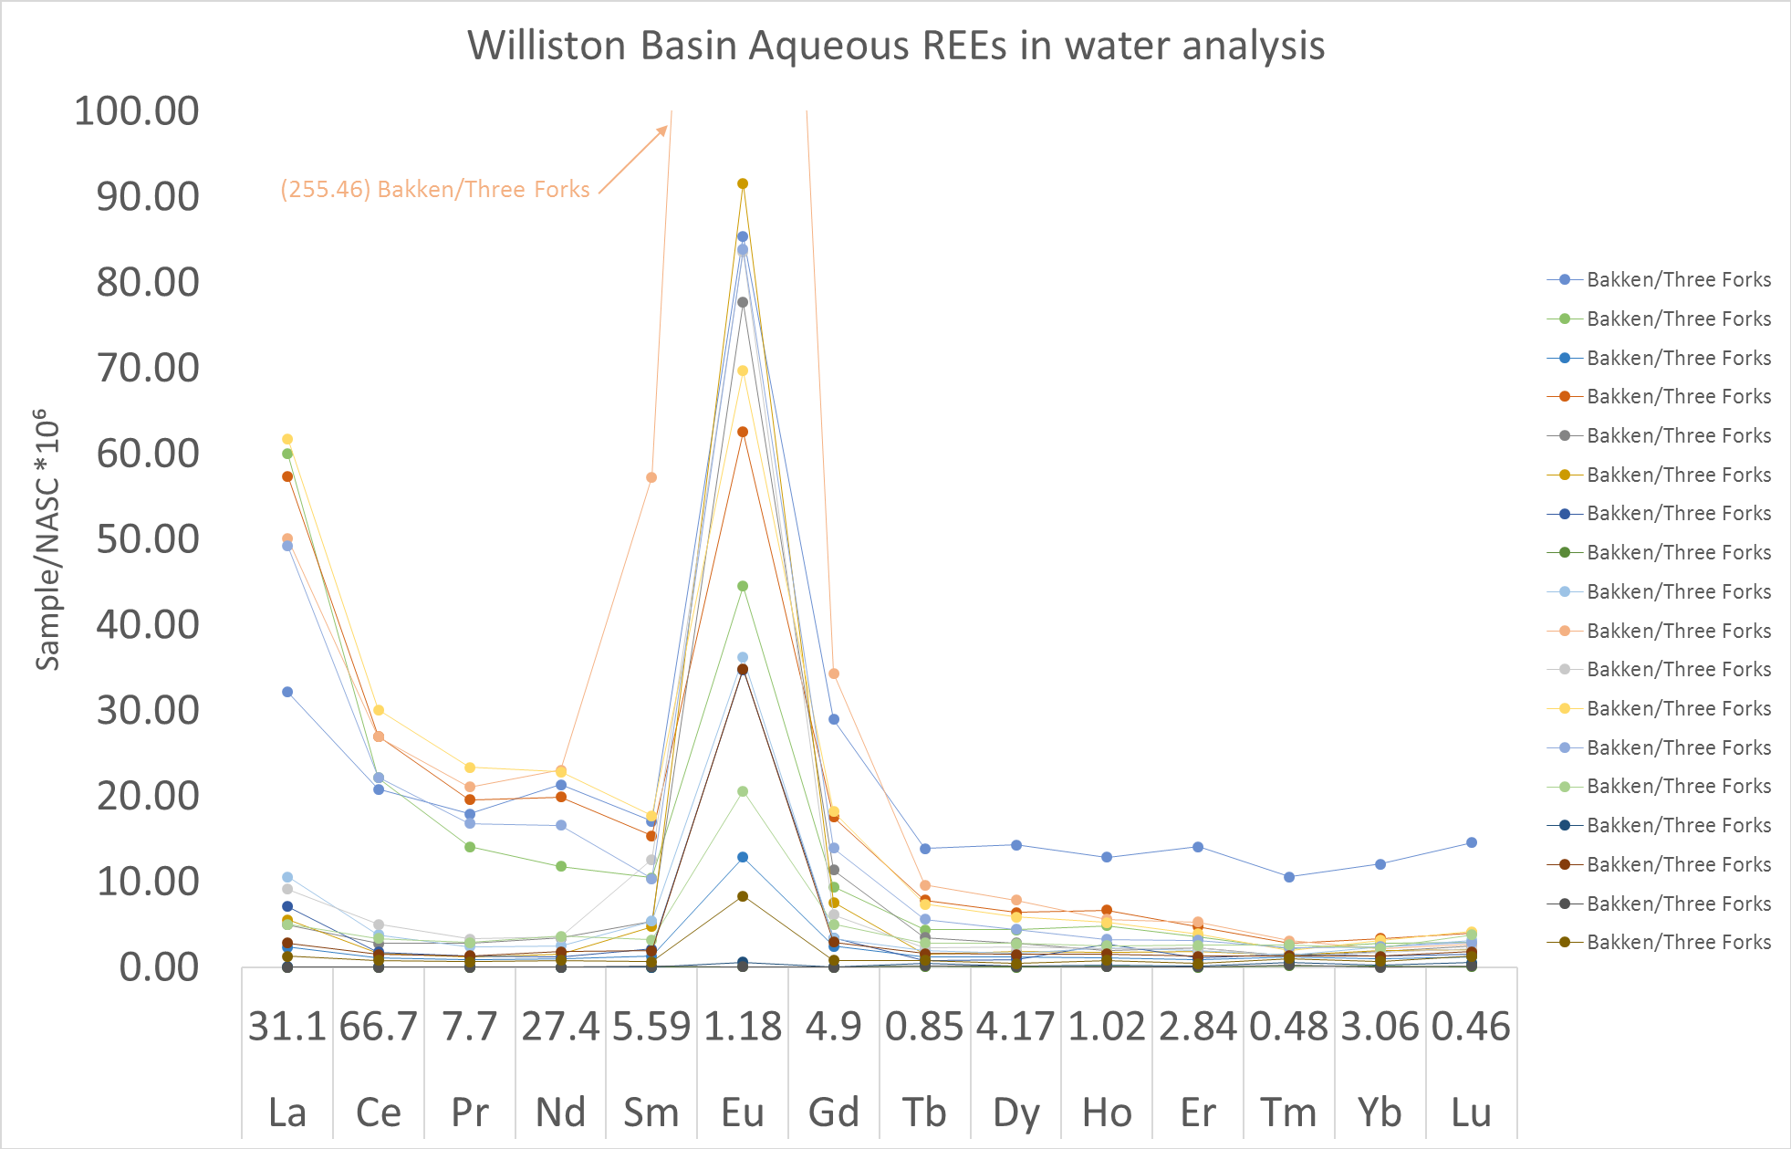
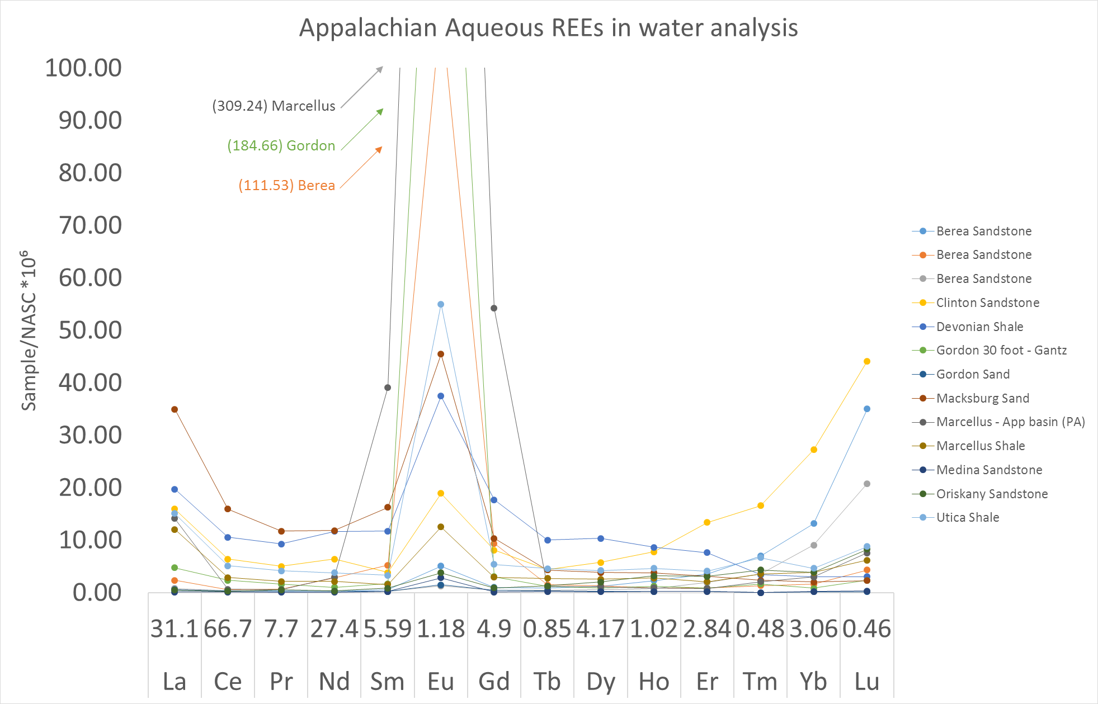
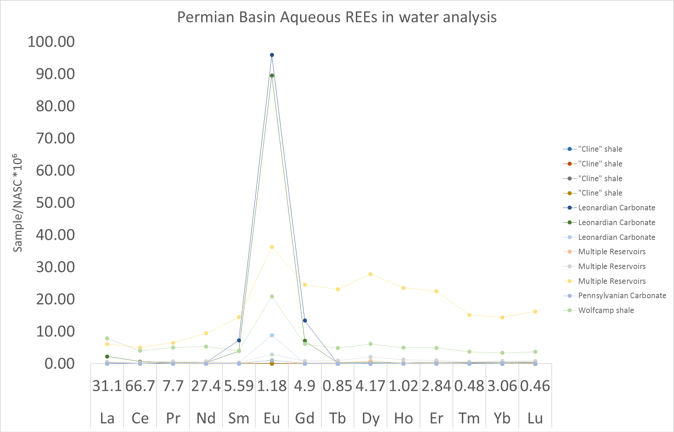
“A Machine Learning Approach to Predicting Rare Earth Element Potential in Produced and Geothermal Waters of the United States”
Mark A. Engle, Charles W. Nye, Ghanashyam Neupane, Scott A. Quillinan, J. Fred McLaughlin, Travis McLing, Josep A. Martín-Fernández
Natural Resources Research (In review) expected Q2 2019.
Images from Charles Nye

Slide 7
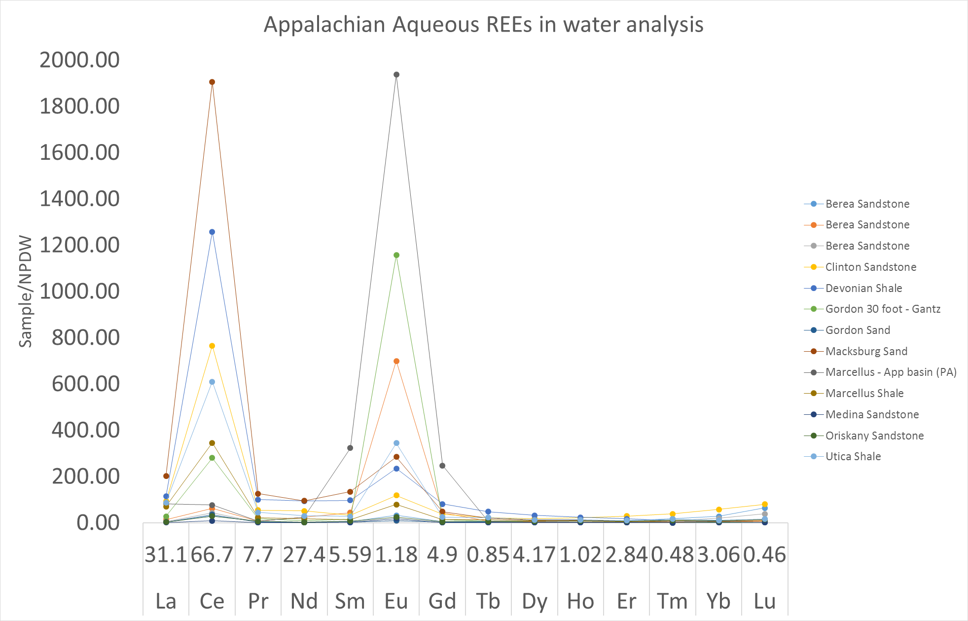
Results: 1/5
REEs sometimes occur in continental groundwater in excess of 1000-times their seawater concentrations.
Imperative to surpass Seawater
Europium: Blessing? Curse?
Site-Specific assessments to match market.
Image from Charles Nye
Sources: Nozaki 2001, Davies 1964, Matthai et al. 1957, Lieberman 2000

Slide 8
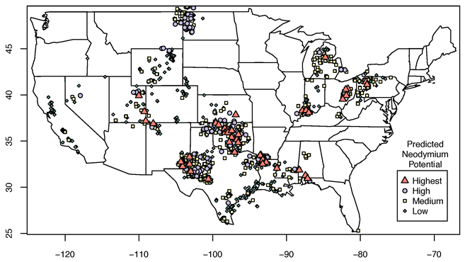
Results: 2/5
REEs occur in at least ng/L concentration in all continental groundwaters.
Some are barely over 1mg/L (ppt)
All are measurable with INL’s method
Extreme economics would allow anyone to supply REEs.
Image from Mark Engle

Slide 9
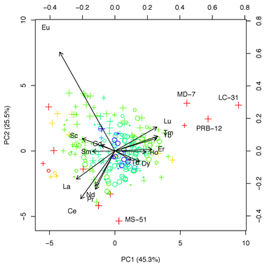
Results: 3/5
Natural Aqueous Behavior Suggests Distinctive Behavior between Light and Heavy REEs, matching Atomic Numbers 57-64 and 65-71.
Many principles for REE in rock should work for water.
Deviation from simple filling order: [Xe]6s²4f⁷5d¹
Total pairing ≈ orbital energy difference makes larger radius.
Image from Mark Engle

Slide 10
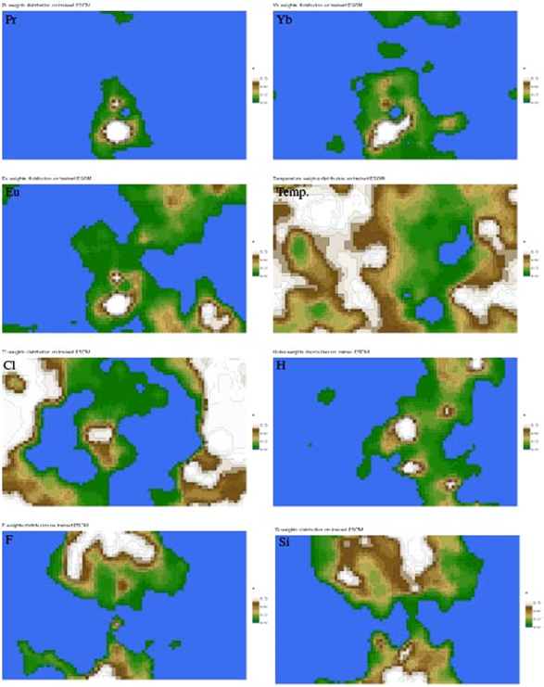
Results: 4/5
Lithology, temperature, and salinity do not have a significant relationship to REE concentration.
Rock type does not match, but individual rocks may match individual waters - challenging to construct in ESOM.
Location specific processes may explain REE enrichment.
Image from Mark Engle

Slide 11
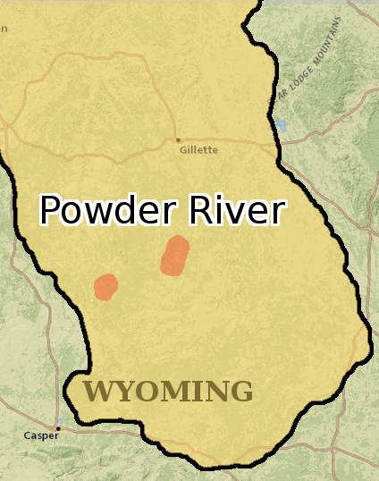
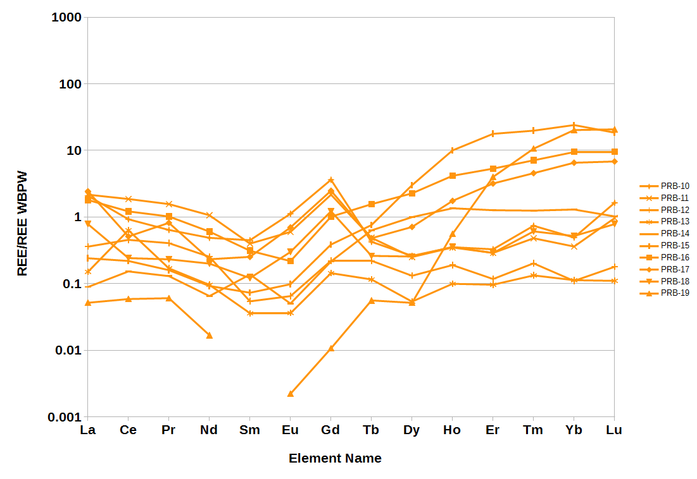
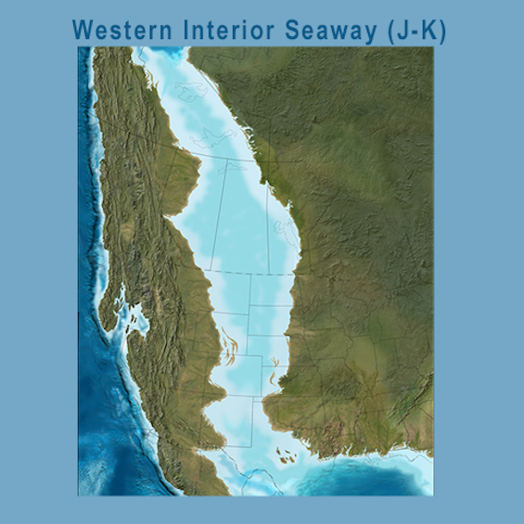
Results: 5/5
REE concentrations are often spatially co-associated.
The four HREE enriched samples have a significant shale fraction. Cannonball sea was persistent in this area.
Images from Charles Nye and Ron Blakey

Slide 12
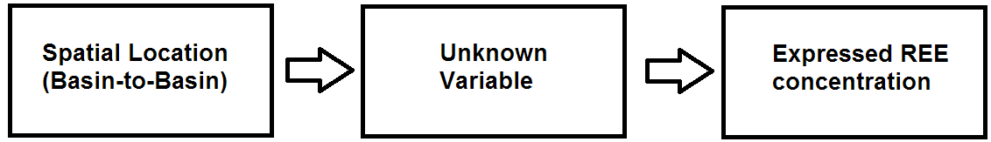
Future Work: 1/3
Hunt for the unknown variable that controls REE concentration.
Basin-by-basin behavior is not random.
Minor components of Lithology? Organic fraction? Clastics?
Depositional History? Coastal sands == deep ocean shale?
Flushing events limited by re-equilibration?
Image from Charles Nye

Slide 13
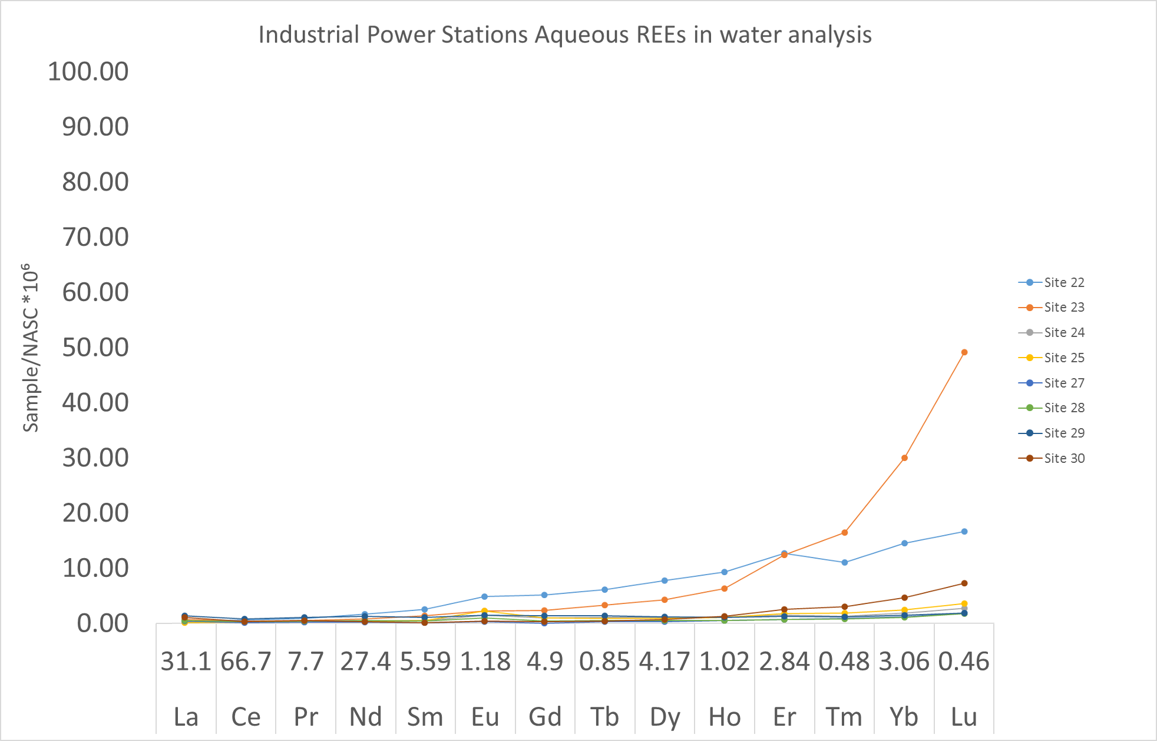
Future Work: 2/3
Collect a bigger sample set, maybe with new water types.
Oklahoma, N. Louisiana, S. Illinois, and Utah-Colorado border
Anomaly detection
Breakthrough on the unknown variable
“Used” water: cooling, solvay, purification, concentrate, coal power ash ponds?
Image from Charles Nye

Slide 14
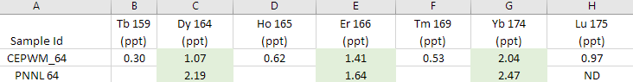
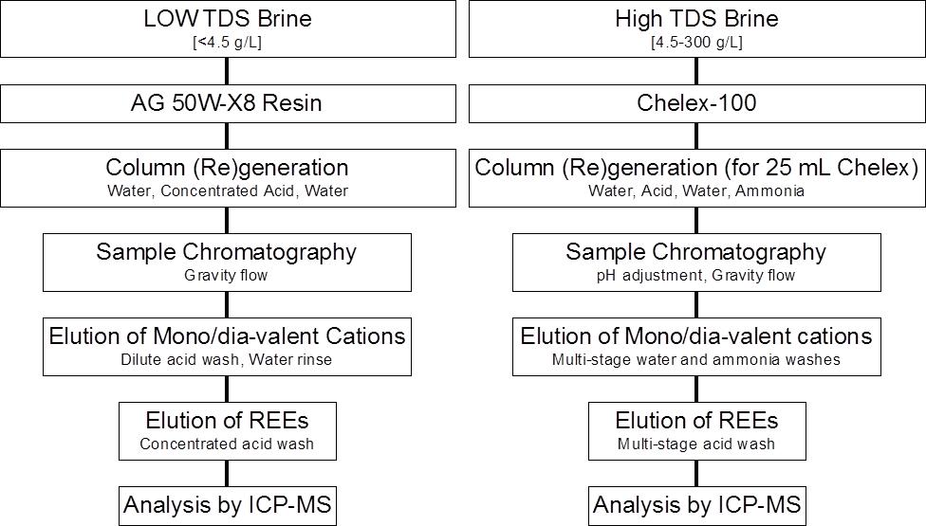
Future Work: 3/3
Comparison and validation of new analytical techniques.
Low-volume TIMS (Thermal ionization mass spectrometry)?
Naive analysis on an Agilent 8900 Triple Quadrapole?
Images from Charles Nye and Hari Neupane

Slide 15

Everything is on the GDR
Final report in review
Small number of non-material edits

Slide 16




Acknowledgements
Funding sources:
DOE: EERE
Team Members:
Carbon Management
Institute

Slide 17
Further Resources
Fernandez V. 2017 Rare-earth elements market: a historical and financial perspective Res. Policy, 53 (2017), pp. 26-45, 10.1016/j.resourpol.2017.05.010
Nozaki 2001 Rare Earth Elements and their Isotopes in the Ocean
doi:10.1006/rwos.2001.0284
Blakey, Ron C., 2104, Paleogeography and Paleotectonics of the Western Interior Seaway, AAPG Search and Discovery Article #30392
Quillinan S., Nye C., Engle M., Bartos T., Neupane G., Brant J., Bagdonas D., McLing T., McLaughlin J. F. (2019). Assessing rare earth element concentrations in geothermal and oil and gas produced waters: A potential domestic source of strategic mineral commodities. Final Report to U.S. Department of Energy, Geothermal Technologies Office, 184 pages. Award Number: DE-EE0007603, (In review)

Slide 18
Support Slides

Slide 19
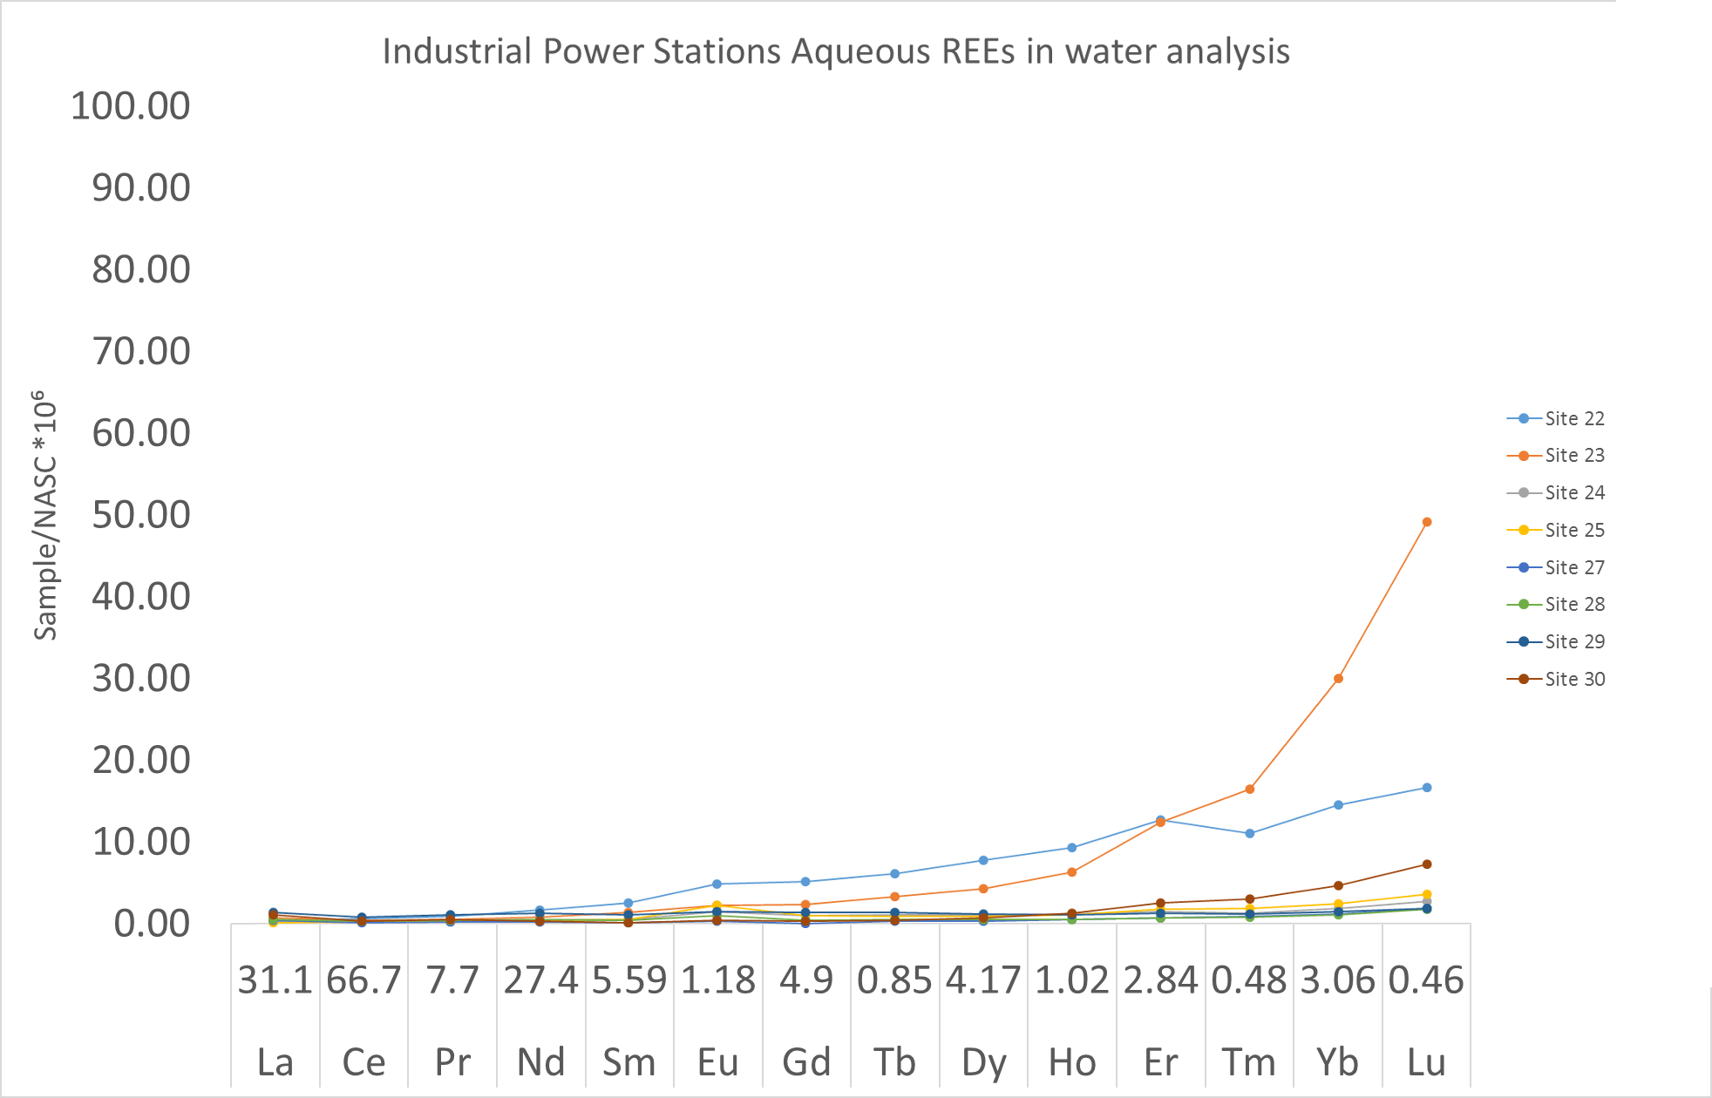
Industrial power station ash ponds and coal seams look promising!
These are very clean waters. That opens up clever processing options.
Coal seam pool
Ash pond
Ash pond

Slide 20
