Slide 1
Educational Attainment and Wyoming’s Economy: a Look at Recent Trends
Western Wyoming Community College
July 20, 2017

Slide 2
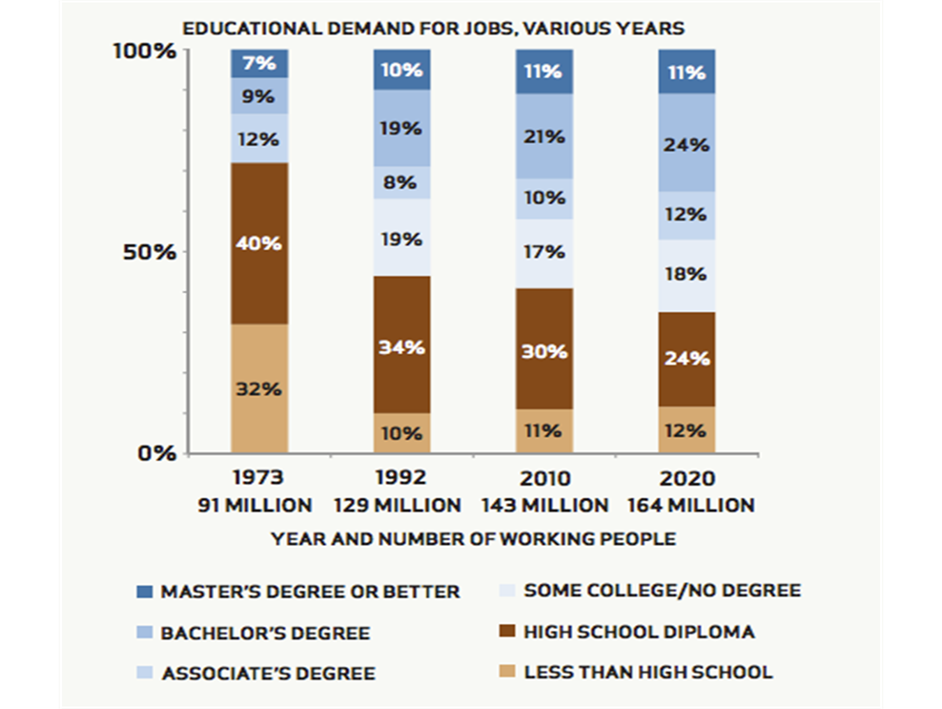
Demand for postsecondary education and training has been rising.
Source: CEW, Job Growth and Education Requirements through 2020
Notes:
As the economy has shifted, demand for postsecondary education and training has been on the rise.
In 1973 the majority of jobs (nearly ¾) required a high school diploma or less. This has dropped over time. By 2020 most jobs (more than 60%) will require some level of postsecondary education and training.
70 percent of the change is due to rising educational requirements within jobs that did not previously require pse; the remainder is due to the growth of new occupations

Slide 3
About two-thirds of Wyoming job openings will require some postsecondary education and training.
Source: CEW analysis from Recovery 2020: Projections of jobs and education requirements

Slide 4
Wyoming is right at the national average of 65 percent for the share of job openings that require some level of postsecondary education and training.
By 2020, 65 percent of jobs in the nation will require postsecondary education.

Slide 5
Wyoming has a larger share of people with some college, no degree and Associate’s degrees than the nation as a whole.
Source: CEW analysis of ACS 2015 25-64 population

Slide 6
Wyoming will experience modest growth in public high school graduates by 2025.
Source: Western Interstate Commission for Higher Education, Knocking at the College Door: Projections of High School Graduates, 2016.

Slide 7
Between 2004 and 2014, the share of White first-time students enrolled at Wyoming public postsecondary institutions declined, while the share of under-represented students climbed.
Source: CEW analysis of IPEDS change in first-time fall student enrollment between 2004 and 2014, based on data analysis performed for a forthcoming report

Slide 8
Award production, especially certificate and Associate’s degree output, has risen since 2010.
Source: CEW analysis of IPEDS award production 2010-2015: degrees and certificates awarded by year.

Slide 9
The Value of Setting a Goal
An attainment goal provides a unifying goal for the state’s strategies across different sectors.
While completion is a focus for college and community leaders, attainment can be a shared goal for statewide and cross-sector efforts.
Keep the end in mind. Postsecondary education (at some level) is now a pre-requisite for many jobs.

Slide 10
For More Information
Visit our website at cew.georgetown.edu
facebook.com/GeorgetownCEW
twitter.com/GeorgetownCEW

